Slide 1
Booking Platform Problem
https://lion.app.box.com/s/z0gh55q2qry5xytaka2hhct1v154w8ci

Slide 2
Implementation https://github.com/guneetbh/bookmyshow
Goals achieved-
Onboard new cities and theatres.
End customers are able to browse and access the movies across the cities, view theatres, auditorium and shows details, followed by booking the ticket.
Language - java,
Framework - SpringBoot, spring JPA
Database – mysql
Integration Technology – can use Kafka to serve high traffic
Editors – IntelliJ Idea (familiar with eclipse)
Cloud Technologies – can use AWS RDS instance and EC2 instance.
Presentation - Draw.io for class diagram and ER diagram

Slide 3
Code Artifacts
Spring boot application with intention to create RESTFul APIs. Microservices following 12 factor app principles.
Apis shall be invoked by front end applications – mobile/Web to avail the intended feature.
DB schema is created and shared to store the desired data in Mysql Database.
Implementation via commandLineRunner to test the scenario implementations.

Slide 4
Functional Features Implementation #1
Usecase: Browse theatres currently running the show with show timings
INPUT
City: New Delhi, Movie: Avatar
OUTPUT
#######Browse theatres currently running the movie in the given town#######
New Delhi- Payal, PVR Naraina
Show Name: Avatar
ShowStart Time:2023-04-14 13:44:46.919
Show End Time:2023-04-14 13:44:46.919
#######Browse theatres currently running the movie in the given town#######

Slide 5
Functional Features Implementation #2
Usecase #1: Book movie tickets by selecting a city, theatre, show and preferred seats for the day –
Usecase #2: Theatre can create the shows
Usecase #3: Theatre can allocate seat inventory and update them for the show
OUTPUT:-
#######Ready to book ticket#######
*****Ticket status******
SUCCESS
********Booking Info********
Booked by: Guneet
Booked on:Fri Apr 14 13:45:41 IST 2023
Booking Amount: 950.0
Theatre: Screen 1
Show: Avatar
Seats: 2L, 2M
********Booking Info********

Slide 6
Transactional Scenario-
Same seats shall not be booked by two user for the same movie show-
Solution Approach: Ticket booking is transactional and does not allow parallel processing. Therefore, booking happens in sequence by making the booking transactional and obtaining the lock as pessimistic.write on show seats.
OUTPUT:
Seats booked for userId: 1
| 58L | 59L | 60L
Booking for same seats cannot be done. Please choose another seat and try again

Slide 7
Integration with external Systems.
APIs based integrations via forward proxy.
Invocation via RESTTemplate and Spring Webflux ->WebClient calls

Slide 8

How to scale to multiple cities etc..
It goes from monolithic design on one single server to Service-oriented/microservices architecture.
Split services and databases
Split services into clusters
Add load balancers
Separate DB read and writes
DB horizontal and vertical partitioning
1. Vertical scaling. Adding more power (CPU, RAM, etc.) to the database server. It has a hard limit. 2. Horizontal scaling by adding more database servers. 3. Adding a caching layer to offload read requests.
we can modularize the functions into different services. The architecture becomes service-oriented / microservice.

Slide 9
OWASP security measures
Request & Response – TLS encryption
Data Tempering – enforce encryption via JWT tokens
Man-in the –middle-attack -> Use SSL and authentication certs
DDOS – Rate limiting and firewall
Store password with salt - a salt is a unique, randomly generated string that is added to each password as part of the hashing process.
Cross-site-scripting – there are several ways ex: using HTTPOnly cookie, encode url..
Use components tested for vulnerabilities
Ensure proper access controls
Security hardening & platform hardening
Logging & monitoring
Injections –input validation & sanitization, escape all user supplied inputs.

Slide 10
Release management/Software Release process
“it is the process of managing, planning, scheduling and controlling a software build through different stages and environments”
For Agile development – it is a cycle which performs a cycle for developing, testing, deploying, supporting new versions of software.
Requirement & Planning - Clear development and testing plan and schedule
Communication and coordination- effective communication among cross-functional teams, Dev team, QA team, Product owners
Documentation – helps in standardization
Automation – By bring in tools like Jenkins, Jira .. when a code committed, automatically run the unit tests and run regression tests on the related component
Decide, Measure & Improve- check for blockers, acceptance criteria & has software passed all environments
Risk analysis & mitigation plan- no checks should bypass in non-prod environments. Should come clean out of CI/CD pipeline. simple, tested detail-oriented rollback plan as a mitigation.

Slide 11
Monitoring & Tracing
Monitoring -> Prometheus & Grafana
Distributed tracing, log aggregation and visualization -> Logstash & Kibana

Slide 12
Software KPIs
Lead time for changes
Deployment frequency
Time to restore a service
Change failure rate
Operational performance

Slide 13
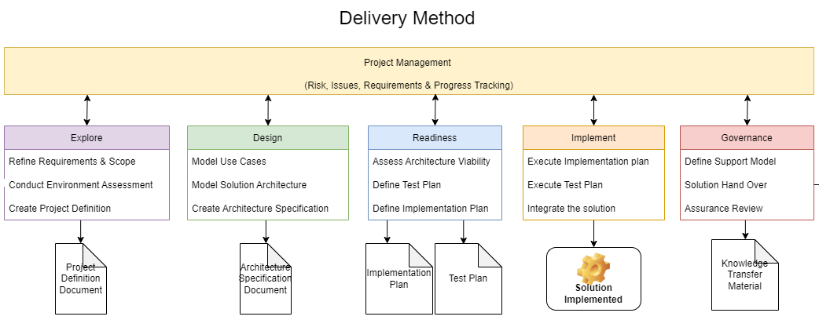
Estimations and project Plan
Requirement Gathering
Scoping
Estimations are based on resource requirement for the project and how many resources can work simultaneously. Finally, the resource availability is important factor to consider.

