Slide 1



DIGITAL ARCHITECT HACKATHON · SEASON 7 · MISSION 3
Service Blueprint & Agentic Ecosystem
One integrated agentic ecosystem — blueprinted end-to-end, sequenced across the customer journey, and given a commercial model.
Team 5 — Condor Galaxy
Guneet Bhatia
Ritu Verma
Mukesh Gupta
23 August 2026
Smart retail. Real value.
Notes:
Mission 2 — the core business process journeys of Neu.Tail. Where Mission 1 set the strategy, this mission goes operational: we take the two journeys that matter most, map them as they run today, reimagine them AI-first, quantify the outcomes, and lift the whole thing into a single architecture. Two journeys, thirteen agents, one platform. That's the story.

Slide 2
MISSION #3 · AGENDA
Service blueprint & agentic ecosystem design
OBJECTIVE 1
OBJECTIVE 2
Agentic ecosystem architecture & service blueprint
Business model
1
2
3
4
Agentic solution
Solution blueprint
Sequence diagrams
Commercial model
Specialised agents & their responsibilities — built on the Mission 2 estate, with new sub-agents where needed.
Full service blueprint — EA layers, triggers, orchestration, intent, routing, context, data universe, LLM platform & security.
Component & layer interaction for 3 of the 5 functionalities, end to end.
A PoV for a viable commercial model for the Digital Personalisation Assistant — customer-facing tiers plus platform monetisation (open API, white-label, usage-based pricing).
SCOPE · THE FIVE FUNCTIONALITIES THE SOLUTION DELIVERS
all five blueprinted · three sequenced
01 Customer Profiling & Segmentation
02 Personalised Discovery
03 Size & Fit
04 Service Upsell & Monetisation
05 Loyalty & Gamification
Mission #3 · Team 5 — Condor Galaxy
Smart retail. Real value.
Notes:
Mission 3 agenda, corrected to list deliverables rather than functionalities. Four deliverables under two objectives. Objective 1 produces three: the agentic solution (specialised agents and responsibilities), the full solution blueprint (EA layers, triggers, orchestration, intent, routing, context, data universe, LLM platform and security), and sequence diagrams for three of the five functionalities. Objective 2 produces the fourth: a commercial-model point of view for the Digital Personalisation Assistant, spanning customer-facing tiers and platform monetisation through open API, white-label and usage-based pricing. The five functionalities are not agenda items — they are the scope the deliverables operate on, shown as a foundation strip: all five appear in the blueprint, three are chosen for sequence diagrams. The through-line to Mission 2 is Size and Fit, which carries the returns target of 34 percent down to 10 to 15.

Slide 3
OBJECTIVE 1 · THE AGENTIC SOLUTION
Neu.Tail
All 17 agents — type, responsibility & how they relate
Analytical senses · classifies · predicts
Orchestration composes · arbitrates
Transactional commits money / contract
Execution acts in the world
Interaction converses · engages
Agent | Origin | Type | Responsibility | How it relates
PERSONA | NEW | Analytical | Builds the real-time profile; classifies segment; publishes it downstream | Sub-agent of ONEBASKET · feeds all four specialists
TAILOR | NEW | Analytical | Infers size, fit & preference; owns returns 34% → 10–15% | Sub-agent of MUSE · consumes GRADE + PERSONA
CONCIERGE | NEW | Orchestration + Transactional | Composes value-added offers; commits free → paid subscription | Hosted by CARE · SENTRY approves pay · → Obj 2
TALLY | NEW | Interaction | Accrues points; gamifies engagement; manages redemption & tiers | New lineage · consumes PERSONA
MUSE | DISCOVERY & PERSONALISATION | Orchestration | Composes the persona-driven feed — premium vs private-label | Consumes PERSONA + SCOUT · parent of TAILOR
ONEBASKET | SESSION & IDENTITY | Analytical | Resolves one identity across app, web & store | Parent of PERSONA
GRADE | RETURNS VISION | Analytical | Grades returns by image; infers condition & reason | Feeds TAILOR (fit) & RECLAIM (recovery)
CARE | AUTONOMOUS SERVICE | Interaction | Resolves routine contacts end to end conversationally | Hosts CONCIERGE
SENTRY | CHECKOUT RISK & APPROVAL | Transactional | Scores risk & approves the charge in real time | Approves CONCIERGE subscription payments
SCOUT | TREND & DEMAND SENSING | Analytical | Forecasts trend & demand from social, search & sell-through | Signal → MUSE · feeds OTB
PACE | DYNAMIC PRICE-PACING | Analytical + Transactional | Prices to demand; each price change is a commit (±5%) | Price context → CONCIERGE & MUSE · pairs with CLEAR
ROUTE | FULFILMENT ORCHESTRATION | Execution | Routes every order to its best source across the estate | Process #1 fulfilment
HANDOFF | CLICK & COLLECT | Execution | Executes the collect journey — reserve, pick, notify, hand over | Process #1 collect
OTB | OPEN-TO-BUY | Transactional | Commits buy spend inside the financial guardrail | Process #2 buy · consumes SCOUT
SPREAD | ALLOCATION & REPLENISHMENT | Execution | Allocates & replenishes stock by store cluster | Process #2 allocate
CLEAR | MARKDOWN OPTIMISATION | Transactional | Commits markdown timing & depth | Process #2 markdown · pairs with PACE
RECLAIM | VALUE RECOVERY | Execution | Routes end-of-life & returned stock to best recovery channel | Process #2 recover · consumes GRADE
New agents highlighted in red. Type = architectural behaviour (what the agent does); Origin = provenance (new sub-agent vs reused vs Mission 2-only). PERSONA & TAILOR are true sub-agents; CONCIERGE & TALLY are new agents with no parent. All governed by Lead Orchestrator, HITL & guardrails.
Notes:
The 17 agents classified two ways. Type is the architectural behaviour — analytical agents sense, classify and predict (PERSONA, TAILOR, ONEBASKET, GRADE, SCOUT); orchestration agents compose and arbitrate (MUSE, CONCIERGE); transactional agents commit money or contract (SENTRY, OTB, CLEAR, PACE on price commit, CONCIERGE at subscription); execution agents act in the world (ROUTE, HANDOFF, SPREAD, RECLAIM); interaction agents converse and engage (CARE, TALLY). Some span two — CONCIERGE both orchestrates an offer and commits the subscription; PACE prices analytically but each change is a transactional commit. Origin is provenance: the four new sub-agents are highlighted in red, the reused Mission 2 agents are neutral, the Mission 2-only agents are faded. The two classifications answer different questions — Type tells an architect what to worry about (transactional agents need approval rails, execution agents need rollback, analytical agents need model governance), while Origin tells the reuse story.

Slide 4
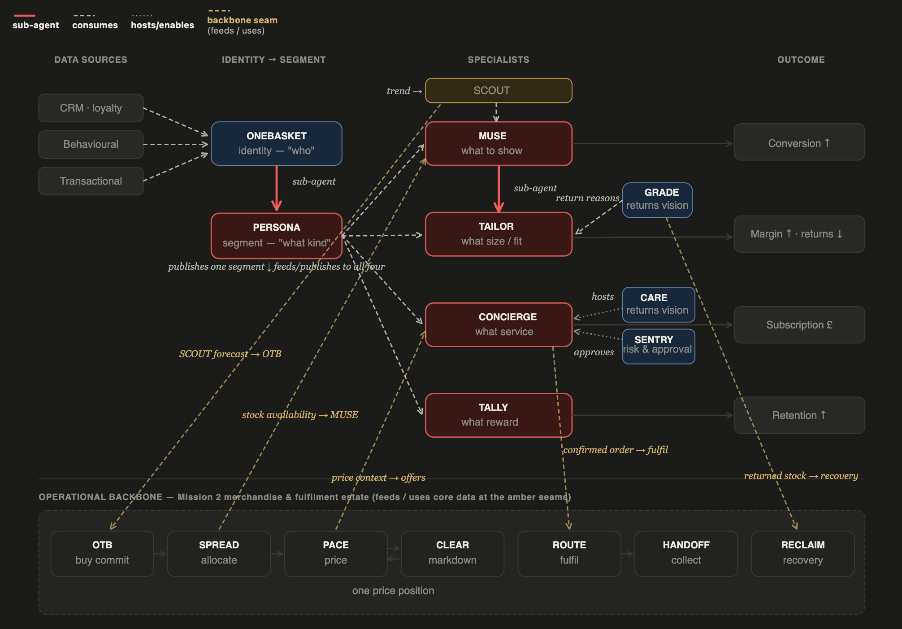
OBJECTIVE 1 · THE AGENTIC SOLUTION
Neu.Tail — how data flows between the agents
The Personalization core, plus the operational backbone that supplies, prices, fulfils and recovers around it.
Notes:
The 17 agents classified two ways. Type is the architectural behaviour — analytical agents sense, classify and predict (PERSONA, TAILOR, ONEBASKET, GRADE, SCOUT); orchestration agents compose and arbitrate (MUSE, CONCIERGE); transactional agents commit money or contract (SENTRY, OTB, CLEAR, PACE on price commit, CONCIERGE at subscription); execution agents act in the world (ROUTE, HANDOFF, SPREAD, RECLAIM); interaction agents converse and engage (CARE, TALLY). Some span two — CONCIERGE both orchestrates an offer and commits the subscription; PACE prices analytically but each change is a transactional commit. Origin is provenance: the four new sub-agents are highlighted in red, the reused Mission 2 agents are neutral, the Mission 2-only agents are faded. The two classifications answer different questions — Type tells an architect what to worry about (transactional agents need approval rails, execution agents need rollback, analytical agents need model governance), while Origin tells the reuse story.

Slide 5
HIGH-LEVEL ARCHITECTURE · ENTERPRISE LAYERS & COMPONENTS
Neu.Tail enterprise architecture — channels, experience services, agentic orchestration, integration, data, business domains and core systems
Channel Applications
Web Store
Mobile App
Store POS
Contact Centre
Social & Marketplace
Clienteling App
Email & Comms
Channel Services / Experience APIs
Search & Discovery
Catalogue & Browse
Cart & Checkout
Order & Fulfilment
Returns
Payments
Loyalty & Service
Agentic Orchestration Services — 17 agents · 4 new Personalisation sub-agents
LEAD ORCHESTRATOR decomposes multi-agent requests · arbitrates conflicting goals · holds journey context
LEAD ORCHESTRATOR senses intent · routes to the owning agent · holds context · arbitrates conflicts
HUMAN-IN-THE-LOOP
Discovery & Personalisation
Session & Identity
Risk & Approval
Demand, Buy & Allocate
Pricing & Markdown
Fulfil & Collect
Returns, Service & Recovery
UC1
UC2
UC3
UC4
UC5
MUSE
· TAILOR
ONEBASKET
PERSONA
SENTRY
SCOUT · OTB · SPREAD
PACE · CLEAR
ROUTE · HANDOFF
GRADE · CARE · RECLAIM
CONCIERGE · TALLY
SECURITY & COMPLIANCE
Profiling &
Segmentation
Personalised
Discovery
Size & Fit
Personalisation
Service Upsell
& Monetisation
Loyalty &
Gamification
IAM · encryption · audit · data protection · threat monitoring
two-way: dispatch ↓ · results ↑ | latency-critical single-domain calls may go direct (A2A)
AI & Agent Platform model serving · agent runtime (MCP / A2A) · feature serving & retrieval · MLOps & evals · guardrails & governance
PERSONA
MUSE
TAILOR
CONCIERGE
TALLY
Integration
Data & Analytics
profiling
discovery lead
fit · returns 34→10-15%
upsell → Obj 2
points · gamify
SECURITY & POLICY
HUMAN-IN-THE-LOOP
API Gateway
Event Streaming
iPaaS / Middleware
Real-time CDP
Data Lakehouse
Vector DB
Data Warehouse
Analytics Workbench
AI / ML Models
BI & Reports
SUPPORTED BY
SUPPORTED BY
SUPPORTED BY
SUPPORTED BY
SUPPORTED BY
ONEBASKET identity base
SCOUT trend signal
GRADE return reasons
CARE hosts session
consumes PERSONA segment
PACE price context
the AI & Agent Platform serves features & retrieval from these stores — data lives once, here
SENTRY approves pay
Business Services / Enterprise Domains
Product
Assortment
Pricing
Promotion
Inventory
Order
Fulfilment
Customer
Loyalty
Returns
Payment
Supplier
WIDER ESTATE — agents kept in the ecosystem; drawn on by the use cases but not use-case owners (merchandise & fulfilment lifecycle)
Core Business Systems
PLM
PIM
Assortment Plng
Demand Plng
Merch Fin. Plng (OTB)
Pricing Engine
Promotion Engine
Markdown Optimisation
OTB
SPREAD
CLEAR
ROUTE
HANDOFF
RECLAIM
buy commit
allocate
markdown
fulfil
collect
recovery
eCommerce Platform
Search & Merch
CMS / DAM
OMS
Inventory Mgmt
WMS
TMS / Last-mile
Store POS
Click & Collect
Returns / Reverse Log.
CDP
CRM
Loyalty Mgmt
Campaign / Marketing
Contact Centre / CSM
Payment Gateway
Fraud Mgmt
ERP (system of record)
Supplier Mgmt (SRM)
Financial Ledger
Space & Visual Merch
Store Operations
Workforce Mgmt (WFM)
Master Data Mgmt (MDM)
Tax Engine
Gift Card & Vouchers
Voice of Customer (VoC)
Digital Product Passport
In place
Partial / fragmented
Gap
To be validated
System of record: ERP · master data across product, customer, order, inventory
Third Party / External Systems
Payments & Financial
Logistics & Fulfilment
AI & Model Providers
Commerce & Demand
Supply & Compliance
Data & Identity
PSPs · card schemes · BNPL · tax
carriers · last-mile · 3PL · returns network
foundation models — via platform gateway
marketplaces · retail media · social · affiliates
suppliers · DPP registry · ethical audit
fraud/identity · competitor feeds · trend · weather
External calls are made from several layers — payments at checkout, carriers at fulfil, model providers via the platform gateway — not routed down through core systems.
Notes:
The whole enterprise on one page, derived from both journeys. Seven layers, top to bottom: channels, experience APIs, then agentic orchestration where thirteen agents live — coordinated by the Lead Orchestrator, which decomposes multi-agent requests and arbitrates conflicts; when SPREAD, PACE and CLEAR disagree on one product, it decides for EBITDA. Two cross-cutting control rails bracket the stack: Security and Compliance on the left — IAM, encryption, audit, data protection, threat monitoring — and Human-in-the-Loop on the right, the escalation path that makes autonomy approvable. Below sit the shared AI platform, integration, data, business domains, and the full 36-system estate with ERP as system of record. Two points to hold: unification is logical, not physical — we abstract above four ERPs, not consolidate them. And the status dots are inferred, not audited — the reds (no CDP, no MDM, no live pricing) are the investment case; the greys need CIO validation.

Slide 6
OBJECTIVE 1 · SERVICE BLUEPRINT (1 of 2)
The agentic solution blueprint — how a request flows through the estate
CHANNELS
1
Web / Mobile
Store POS · Clienteling
Contact Centre
Email & Comms
Social & Marketplace
INTENT SENSING & TRIGGERS
2
Intent detection
Event triggers
Context assembly
classify the ask — browse · fit · service · loyalty
cart · return · tier change · session start
load identity, segment & session state
ORCHESTRATION
LEAD ORCHESTRATOR
Route
Decompose
Arbitrate
Hold context
to the right agent(s)
multi-agent requests
conflicting goals
across the journey
REQUEST ↓
3
RESPONSE ↑
AGENT MESH — the Personalisation Assistant
PERSONA
MUSE
TAILOR
CONCIERGE
TALLY
event trigger
profiling
discovery
size & fit
upsell
loyalty
SECURITY & POLICY-AS-CODE
guardrails · PII & consent · segment-access policy · rate limits · audit
ONEBASKET
GRADE
CARE
SENTRY
SCOUT·PACE
identity
returns
service
approval
signals
5
processing: each agent reasons over its prompt + retrieved context, calls tools, returns a result to the orchestrator
holds context
(session memory)
reason
result
4
ENTERPRISE LLM & AGENT PLATFORM
Model gateway
Prompt management
Memory & context
Agent runtime
interoperability · routing · fallback
templates · versioning · guard prompts
short + long-term · session state
MCP · A2A · tool calling · evals
retrieve
Feature / RAG
DATA UNIVERSE
accessed via feature serving · RAG / vector retrieval · events · APIs
CRM
Loyalty
Catalogue / PIM
Inventory
Returns
Behavioural
Transactional
customer
points · tiers
product
stock · availability
GRADE reasons
clicks · sessions
orders · payments
served through: Real-time CDP · Vector DB · Data Lakehouse · Feature Store — data lives once, agents retrieve, never copy
1
TRIGGERS channel request or system event starts the flow
4
PROCESSING agent reasons on the LLM platform, retrieves from data
2
INTENT DETECTION classify what the ask is, to route it
5
CONTEXT MGMT results assembled, session state held, threaded back up
3
ROUTING orchestrator fans out to the owning agent(s)
Note: the LLM platform and the data universe are separate layers — the agent reasons on the platform, which serves retrieval from the data estate. Data lives once; agents retrieve, never copy.
Notes:
Slide 2a — the agentic solution blueprint, read top to bottom as a request lifecycle. A request enters from any channel. The intent-sensing and trigger layer classifies the ask (browse, fit, service, loyalty), fires on events (cart, return, tier change), and assembles context — identity, segment, session. The Lead Orchestrator routes to the right agent or agents, decomposes multi-agent requests, arbitrates conflicting goals and holds journey context. The agent mesh is the Personalisation Assistant: the four new sub-agents in red (PERSONA, TAILOR, CONCIERGE, TALLY) plus MUSE, with the reused enablers beneath (ONEBASKET, GRADE, CARE, SENTRY, and the SCOUT/PACE signals). Each agent processes by reasoning over its prompt plus retrieved context, calling tools, and returning to the orchestrator. Beneath sits the enterprise LLM and agent platform — the model gateway for interoperability and fallback, prompt management, memory and context management, and the agent runtime with MCP, A2A and evals. At the base is the data universe — CRM, loyalty, catalogue, inventory, returns, behavioural, transactional — accessed through feature serving, RAG and vector retrieval, events and APIs, served from the real-time CDP, vector DB, lakehouse and feature store, so data lives once and agents retrieve rather than copy. And spanning every layer on the left is the security and policy-as-code rail: guardrails, PII and consent, segment-access policy, rate limits and audit. The one-line story: sense, orchestrate, process, retrieve — all inside the security rail.

Slide 7
OBJECTIVE 1 · SERVICE BLUEPRINT (2 of 2)
The data universe — which agent touches which data, and by what means
Each cell shows access (R / W / R·W) + method. The same domain is reached different ways by different agents — semantic vs exact, real-time vs event.
Agent ▽ Data ▷
CRM
Loyalty
Catalogue
Inventory
Returns
Behavioural
Transactional
PERSONA ●
R FS
R FS
R FS
R FS
R FS
MUSE
R FS
R RAG
R FS
R FS
TAILOR ●
R RAG
R FS
R FS
CONCIERGE ●
R FS
R FS
R API
R FS
R API
TALLY ●
R·W API
R EVT
R API
ONEBASKET
R API
R FS
R FS
R FS
R API
GRADE
R API
W API
W EVT
CARE
R API
R API
R API
R API
R API
R API
SENTRY
R API
R FS
R·W API
ACCESS R read W write R·W both
METHOD API direct lookup RAG vector / semantic FS feature serving EVT event stream
Same domain, different means
Real-time features dominate reads
Writes are API or event, and gated
MUSE reads the catalogue by RAG (semantic find-similar); CARE reads it by API (exact SKU lookup). The method follows the job, not just the domain.
CRM, loyalty & behavioural are served through the feature store (FS) — low-latency, pre-computed — so personalisation stays real-time without hitting source systems.
GRADE writes return reasons as events (EVT); SENTRY & TALLY write transactional via API behind the approval rail. Every write is policy-checked.
Notes:
Data universe access matrix, upgraded so every cell shows access plus method. Access: read, write, read-write. Method: API for exact lookups, RAG for vector/semantic retrieval, FS for feature serving, EVT for event streams. The key point this version makes: the same domain is reached differently by different agents. MUSE reads the catalogue by RAG because discovery is semantic find-similar; CARE reads the same catalogue by API for exact SKU lookup — method follows the job, not the domain. Reads are dominated by the feature store (CRM, loyalty, behavioural) keeping personalisation real-time. Writes are API or event and all sit behind the approval and policy rail. Reasoned design, not an audited access list — validate with the data team before build.

Slide 8
OBJECTIVE 1 · ENTERPRISE LLM & AGENT PLATFORM
Neu.Tail
The platform every agent runs on — interoperable, governed, with memory
No agent is hard-wired to one model or its own prompt. Four shared capabilities make the mesh interoperable, safe and stateful.
MODEL INTEROPERABILITY
PROMPT MANAGEMENT
Model gateway
Governed prompts
▪
Right model per job big reasoner · fast classifier · vision — routed per call
▪
Versioned templates one registry, per-agent · not hard-coded in the app
▪
Vendor-neutral no agent hard-wired to one provider · swap without rework
▪
Guard prompts policy & safety injected at run time
▪
Fallback & cost control degrade gracefully · route to cheapest that meets SLA
▪
Test & roll back evaluate a prompt change before it ships
IN PRACTICE MUSE → reasoning model · PERSONA → fast classifier · GRADE → vision
IN PRACTICE every agent's prompt is a governed, versioned artefact
SECURITY & POLICY-AS-CODE
MEMORY & CONTEXT
AGENT RUNTIME
Two-tier memory
Execution & assurance
▪
Short-term (working) this session / journey — held by the orchestrator
▪
MCP standard tool / data access for every agent
▪
Long-term (durable) customer preferences & history — persists across visits
▪
A2A agent-to-agent calls (SCOUT→MUSE, GRADE→TAILOR)
▪
Threaded between agents one context object passed agent-to-agent
▪
Evals & observability quality, drift & safety monitored continuously
IN PRACTICE the Assistant remembers you within a session and across visits
IN PRACTICE the harness that makes autonomous agents safe to run
Why it matters: these four are shared services, not per-agent code. Interoperability avoids vendor lock-in, prompt & memory management make behaviour governable and stateful, and the runtime makes autonomy safe — the platform the whole 17-agent mesh depends on.
Notes:
The enterprise LLM and agent platform, explained as four shared capabilities rather than a single band. One, model interoperability: a gateway routes each agent's call to the right model — a big reasoning model for MUSE's composition, a fast cheap classifier for PERSONA's segmentation, a vision model for GRADE's returns grading — vendor-neutral, so no agent is hard-wired to one provider and we can swap models without reworking agents, with fallback and cost control. Two, prompt management: every agent's prompt is a versioned template in one registry, not hard-coded in the app; guard prompts inject policy and safety at run time; and prompt changes are evaluated and roll-back-able before they ship — this is where policy-as-code meets the prompt layer. Three, memory and context: two tiers — short-term working memory for the current session or journey, held by the orchestrator, and long-term durable memory for customer preferences and history that persists across visits — threaded between agents as one context object, so the Assistant remembers you both within a session and across visits. Four, the agent runtime: MCP for standard tool and data access, A2A for agent-to-agent calls like SCOUT to MUSE and GRADE to TAILOR, and an evals and observability harness that monitors quality, drift and safety continuously — the assurance that makes autonomous agents safe to run. All four are shared services touched by the security and policy-as-code rail, and all four are what the whole 17-agent mesh depends on.

Slide 9
OBJECTIVE 1 · LLM PLATFORM — TECHNICAL VIEW
Neu.Tail
LLM & Agent Platform — Security architecture, guardrails, policy as code for the agents
A call resolves down the centre (agent → runtime → gateway → model); prompt & memory serve it from the side; policy and evals are cross-cutting planes over everything.
Agent (mesh)
AGENT RUNTIME
MODEL POOL (interoperable)
PROMPT SERVICE
PERSONA · MUSE
TAILOR …
orchestrates tool + model calls
MCP client · A2A · retries
Reasoning LLM MUSE · CONCIERGE
frontier
registry · versioned templates per agent
guard-prompt injection · A/B + rollback
Fast / small LLM PERSONA · SENTRY
low-latency
MODEL GATEWAY
Vision model GRADE grading
multimodal
MEMORY & CONTEXT STORE
policy-based routing + fallback
cost / SLA / load routing
Embedding model RAG retrieval
vectors
short-term session state (Redis, TTL) + long-term customer memory (vector+KV)
context object threaded agent→agent
RETRIEVAL PLANE
feature store · vector DB · lakehouse · event bus — data lives once
▶ call ▶ model return ▶ side-service ┆ cross-cutting tap (policy · evals observe all)
POLICY & GUARDRAIL PLANE policy-as-code · PII / consent · model-access rules · prompt-injection & output filters · full audit — enforced on every call
EVALS & OBSERVABILITY PLANE quality · drift · safety · latency · cost — monitored continuously across the runtime, gateway, models, prompts & memory
Interoperability
Two cross-cutting planes
Memory tiers
Agents call capabilities, not vendors. The gateway maps a need (reason / classify / see) to a model; swapping a provider is a config change, zero agent rework.
Policy and evals are not steps in the call — they span it. Every call is policy-enforced and observed, exactly like the security rail across the wider architecture.
Short-term working memory (minutes, session-scoped) keeps a journey coherent; long-term customer memory (durable, vector+KV) personalises across visits.
Technical view · illustrative. Component names, model tiers & stores are reference choices to be confirmed in detailed design.
Notes:
The LLM and agent platform as a technical reference architecture. A call resolves down the centre: an agent issues a call to the agent runtime (MCP client, A2A, retries), which calls the model gateway, which does policy-based routing and fallback across an interoperable model pool — frontier reasoning model for MUSE and CONCIERGE, fast small model for PERSONA and SENTRY, vision for GRADE, embeddings for RAG. The model return path is shown separately. From the side, the prompt service (versioned templates, guard-prompt injection, rollback) and the two-tier memory store (short-term Redis session state, long-term vector-plus-KV customer memory, threaded as a context object) serve the call. Beneath sits the retrieval plane — feature store, vector DB, lakehouse, event bus. The important correction on this version: policy and evals are drawn as cross-cutting planes that span the whole architecture, with tap connections up into every core component, not as orphan boxes. The policy and guardrail plane enforces policy-as-code, PII and consent, model-access rules, prompt-injection and output filters, and audit on every call. The evals and observability plane monitors quality, drift, safety, latency and cost continuously across the runtime, gateway, models, prompts and memory. This mirrors how the security rail works across the wider enterprise architecture: cross-cutting concerns span everything rather than sitting in the flow. All component names and tiers are illustrative reference choices for detailed design.

Slide 10
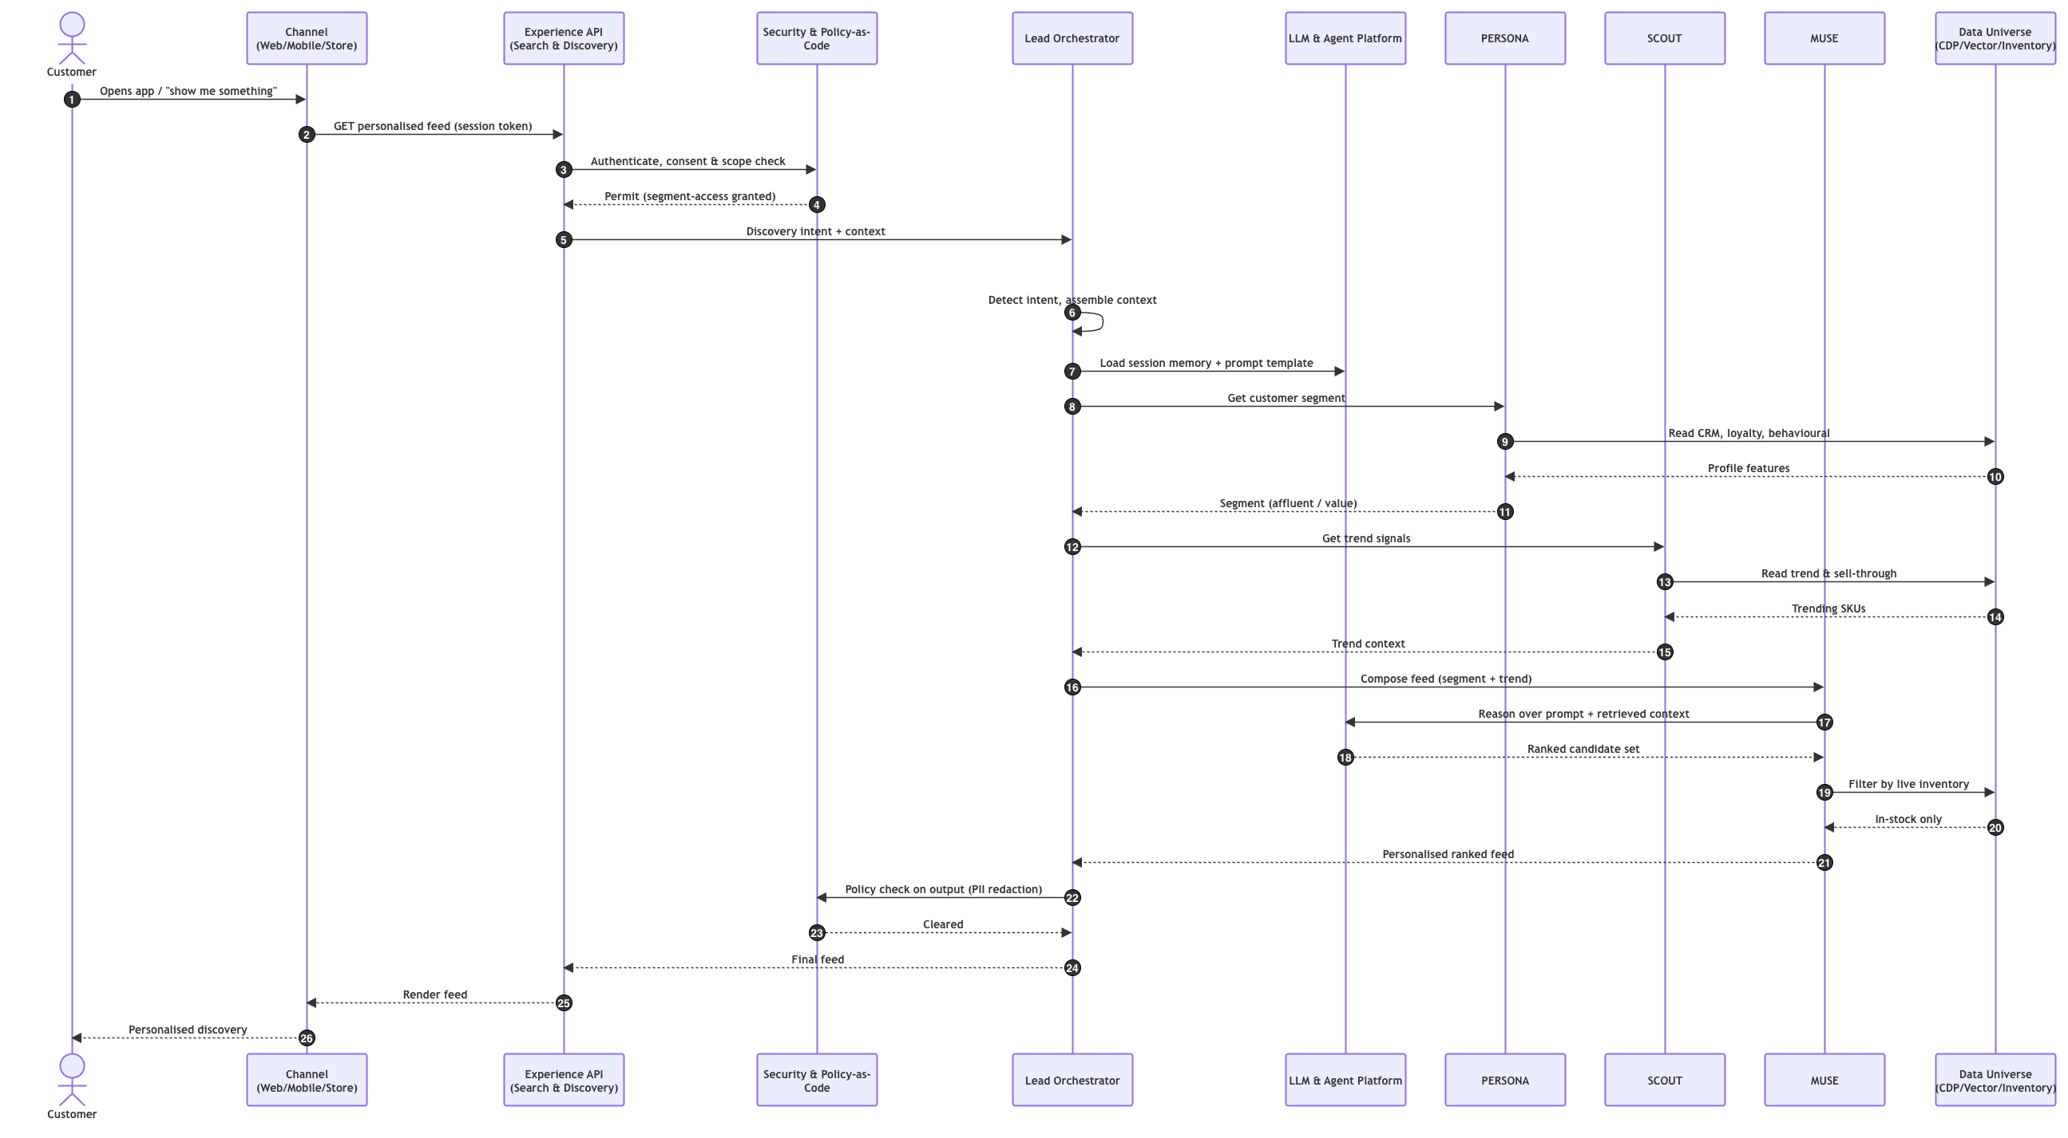
OBJECTIVE 1 · SEQUENCE DAIGRAM 1-3
DISCOVERY
Mission #3 · Team 5 — Condor Galaxy
Smart retail. Real value.
Notes:
Mission 3 agenda, corrected to list deliverables rather than functionalities. Four deliverables under two objectives. Objective 1 produces three: the agentic solution (specialised agents and responsibilities), the full solution blueprint (EA layers, triggers, orchestration, intent, routing, context, data universe, LLM platform and security), and sequence diagrams for three of the five functionalities. Objective 2 produces the fourth: a commercial-model point of view for the Digital Personalisation Assistant, spanning customer-facing tiers and platform monetisation through open API, white-label and usage-based pricing. The five functionalities are not agenda items — they are the scope the deliverables operate on, shown as a foundation strip: all five appear in the blueprint, three are chosen for sequence diagrams. The through-line to Mission 2 is Size and Fit, which carries the returns target of 34 percent down to 10 to 15.

Slide 11
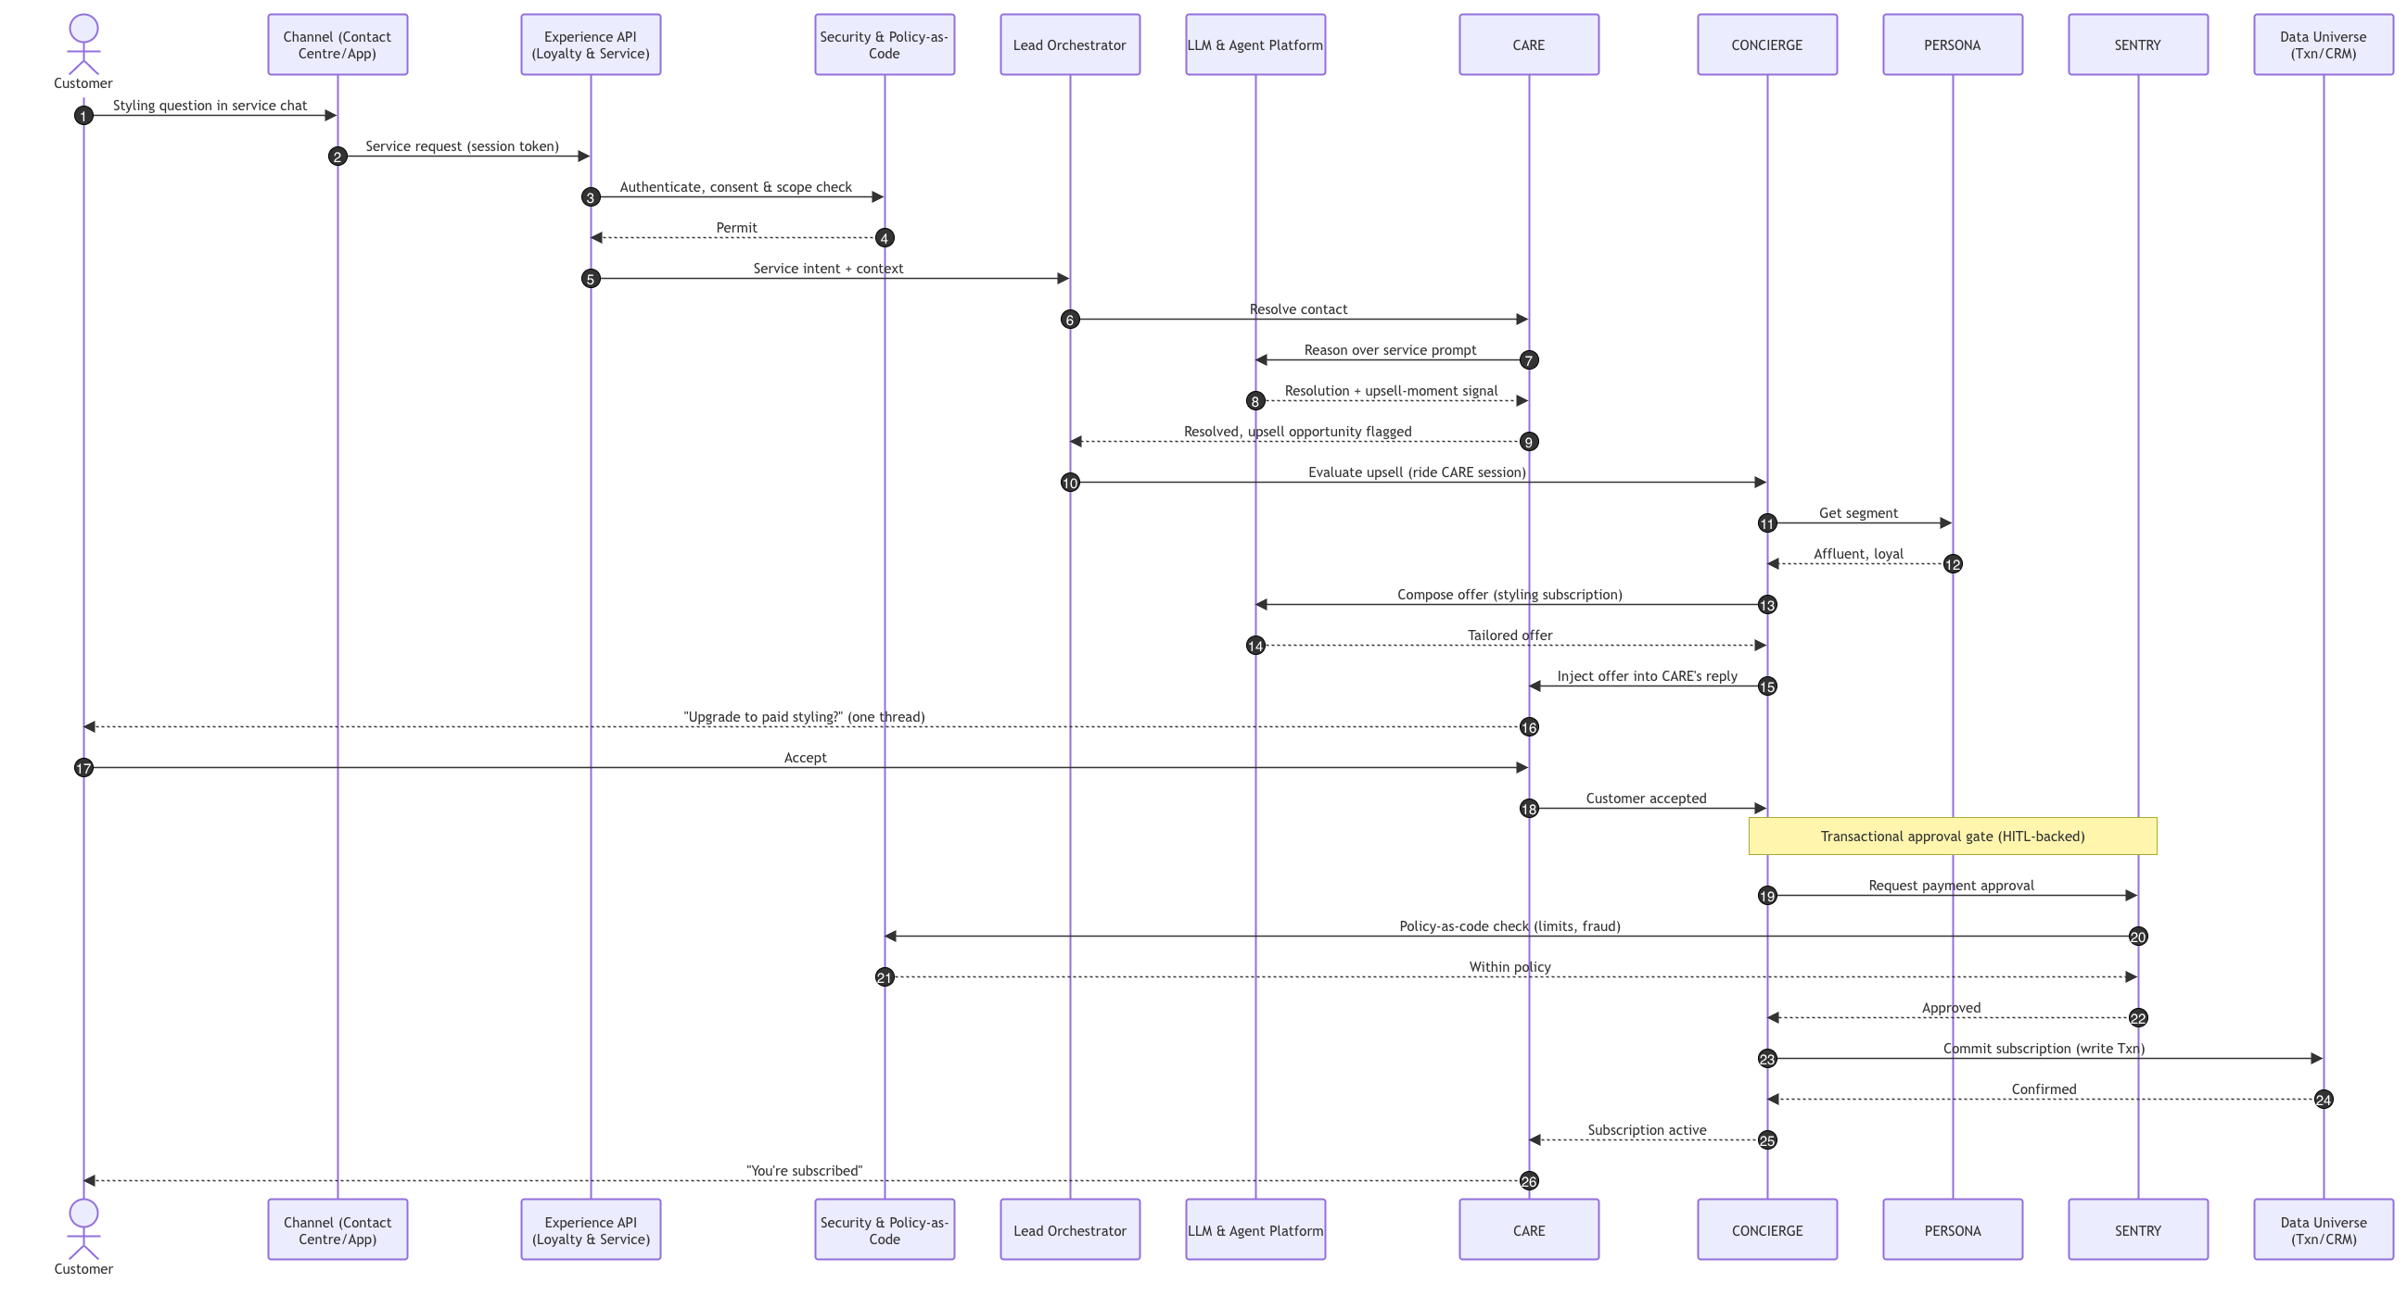
OBJECTIVE 1 · SEQUENCE DAIGRAM 2-3
UPSELL
Mission #3 · Team 5 — Condor Galaxy
Smart retail. Real value.
Notes:
Mission 3 agenda, corrected to list deliverables rather than functionalities. Four deliverables under two objectives. Objective 1 produces three: the agentic solution (specialised agents and responsibilities), the full solution blueprint (EA layers, triggers, orchestration, intent, routing, context, data universe, LLM platform and security), and sequence diagrams for three of the five functionalities. Objective 2 produces the fourth: a commercial-model point of view for the Digital Personalisation Assistant, spanning customer-facing tiers and platform monetisation through open API, white-label and usage-based pricing. The five functionalities are not agenda items — they are the scope the deliverables operate on, shown as a foundation strip: all five appear in the blueprint, three are chosen for sequence diagrams. The through-line to Mission 2 is Size and Fit, which carries the returns target of 34 percent down to 10 to 15.

Slide 12
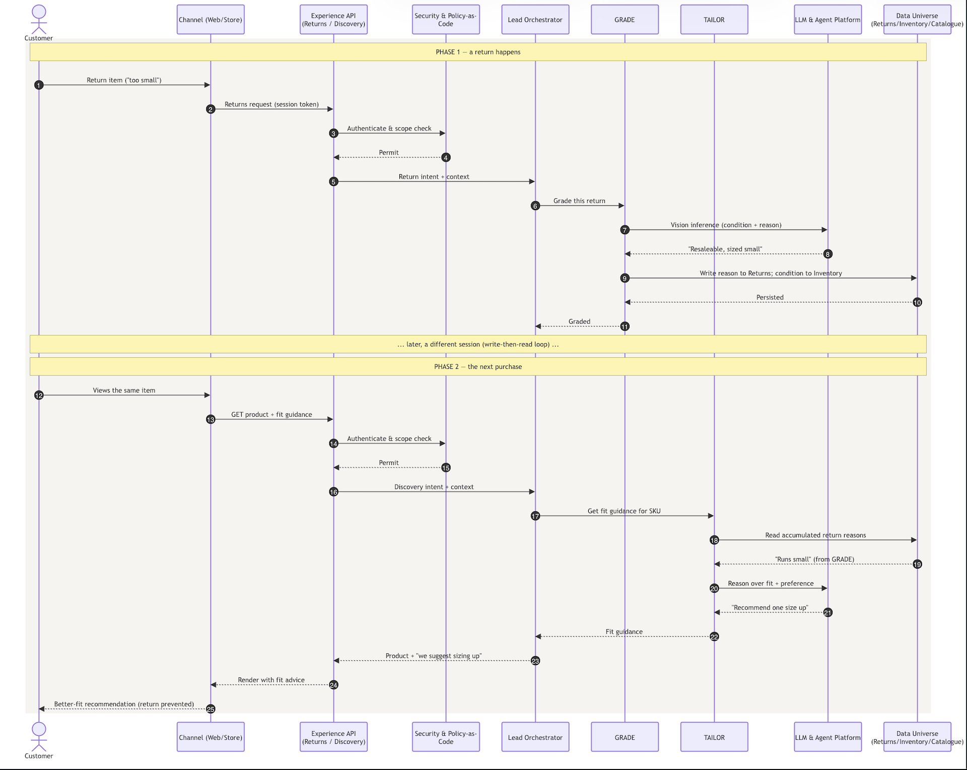
OBJECTIVE 1 · SEQUENCE DAIGRAM 3-3
Sequence Diagram #3 - Size & Fit
Mission #3 · Team 5 — Condor Galaxy
Smart retail. Real value.
Notes:
Mission 3 agenda, corrected to list deliverables rather than functionalities. Four deliverables under two objectives. Objective 1 produces three: the agentic solution (specialised agents and responsibilities), the full solution blueprint (EA layers, triggers, orchestration, intent, routing, context, data universe, LLM platform and security), and sequence diagrams for three of the five functionalities. Objective 2 produces the fourth: a commercial-model point of view for the Digital Personalisation Assistant, spanning customer-facing tiers and platform monetisation through open API, white-label and usage-based pricing. The five functionalities are not agenda items — they are the scope the deliverables operate on, shown as a foundation strip: all five appear in the blueprint, three are chosen for sequence diagrams. The through-line to Mission 2 is Size and Fit, which carries the returns target of 34 percent down to 10 to 15.

Slide 13
MISSION #3 · AGENDA
Business Model & Ecosystem Proposition. - POV
Mission: 1 Physical retailer with a website — or a platform with stores?
A digital platform with stores
OUR CHOICE
One customer, one platform, intelligent by default — with 38 stores as fulfilment, experience and trust nodes inside the platform.
"Neu.Tail's Personalisation Assistant is one capability, built once on 17 agents and a unified data spine, that monetises in concentric rings — starting with our own customers and widening to the whole retail market — with an outcome-based moat no pure-software competitor can copy."
Mission #3 · Team 5 — Condor Galaxy
Smart retail. Real value.
Notes:
Mission 3 agenda, corrected to list deliverables rather than functionalities. Four deliverables under two objectives. Objective 1 produces three: the agentic solution (specialised agents and responsibilities), the full solution blueprint (EA layers, triggers, orchestration, intent, routing, context, data universe, LLM platform and security), and sequence diagrams for three of the five functionalities. Objective 2 produces the fourth: a commercial-model point of view for the Digital Personalisation Assistant, spanning customer-facing tiers and platform monetisation through open API, white-label and usage-based pricing. The five functionalities are not agenda items — they are the scope the deliverables operate on, shown as a foundation strip: all five appear in the blueprint, three are chosen for sequence diagrams. The through-line to Mission 2 is Size and Fit, which carries the returns target of 34 percent down to 10 to 15.

Slide 14
OBJECTIVE 2 · BUSINESS MODEL & ECOSYSTEM PROPOSITION
Monetising the Personalisation Assistant — three widening rings
The Mission 1 choice — “a digital platform with stores” — means the same Assistant is not just a feature for our shoppers; it is a capability we can sell. One build, monetised at three rings.
THE PoV: one capability, built once on 17 agents and a single data spine, monetised in three widening rings — with an outcome-based moat no software-only rival can copy. Not three business models — one, zoomed in.
RING 1 · B2C
RING 2 · B2B
RING 3 · B2B2C
Customer-facing
Platform — Open API
White-label
WHO Our own 820K loyalty members
WHO Other retailers & brands
WHO A retailer's whole estate
MODEL Freemium + premium subscription
MODEL Usage-based / tiered + value-share
MODEL Platform licence + run
Free
Agents as APIs
The full Assistant
core personalisation — funded by the retail margin it creates (conversion ↑, returns ↓)
“Size & Fit as a Service” (TAILOR) · “Segmentation as a Service” (PERSONA)
rebranded, run on their catalogue, stores & data — our platform, their brand
Premium (paid)
Priced on use or outcome
Highest value
styling advisory, fit guarantee, early access, concierge service
per-call tiers, or value-share on the returns we cut
licence + revenue-share; the platform play in full
POWERED BY CONCIERGE · TALLY
POWERED BY TAILOR · PERSONA · MUSE
POWERED BY the whole 17-agent estate
Why the rings widen — and why only Neu.Tail can
Ring 1 proves it works on our own estate (and pays for the build). Ring 2 sells the proven agents as APIs. Ring 3 licences the whole platform. The moat: only Neu.Tail can offer outcome-based pricing on returns, because only we have the GRADE→TAILOR loop that turns a return into prevention. “We get paid when we save you returns” is a pitch no pure-software vendor can make.
Directional PoV. Pricing models shown, not committed figures — to be validated with commercial & finance.
Mission #3 · Team 5 — Condor Galaxy
Smart retail. Real value.
Notes:
Objective 2, the commercial model, opening slide. The strategic anchor is the Mission 1 choice: a digital platform with stores. That word platform is what makes Objective 2 possible — it means the Personalisation Assistant is not merely a feature for our own shoppers, it is a capability we can sell. So the same single build is monetised at three widening rings. Ring 1 is customer-facing, B2C: our own 820,000 loyalty members, on a freemium-plus-premium-subscription model. The core personalisation is free — it has to be, because it is what lifts conversion and cuts returns, which is the core retail business case, so it is funded by the margin it creates. The premium paid tier adds the high-value services: styling advisory, fit guarantee, early access, concierge. Ring 1 is powered by CONCIERGE and TALLY. Ring 2 is the platform play, B2B: other retailers call our agents through an open API, priced on usage or on outcome. Size and Fit as a Service is TAILOR; Segmentation as a Service is PERSONA. Ring 3 is white-label, B2B2C: the whole Assistant rebranded and run on another retailer's estate — our platform, their brand — licence plus revenue share, the highest-value and highest-touch option, powered by the whole 17-agent estate. The rings widen deliberately: Ring 1 proves it works and pays for the build, Ring 2 sells the proven agents, Ring 3 licences the platform. And the moat: only Neu.Tail can offer outcome-based pricing on returns, because only we have the GRADE-to-TAILOR loop that turns a return into prevention. We get paid when we save you returns is a pitch no pure-software vendor can make. Everything here is directional — pricing models, not committed figures, to be validated with commercial and finance.

Slide 15
OBJECTIVE 2 · RING 1 · CUSTOMER-FACING
The customer-facing model — free by default, premium by choice
ONE PoV · RING 1 of 3 — zoom-in
Personalisation itself is free — it funds itself through conversion and returns. We charge for services on top, not for being understood.
MOST STRATEGIC
TIER 0
TIER 1 · PREMIUM
TIER 2
Free
Neu.Tail+
Neu.Tail Elite
£0 every loyalty member
~£value/mo illustrative
value / ££ high-value segment
✓
1:1 personalised discovery
✓
Personal styling advisory
✓
Human + agent styling
MUSE curates to your persona
CONCIERGE — free-tier entry → paid depth
CONCIERGE escalates to a stylist
✓
Right-size fit guidance
✓
Fit guarantee
✓
Wardrobe management
TAILOR's basic fit advice
TAILOR-backed: free returns on any miss
proactive, cross-season
✓
Loyalty points & rewards
✓
Early & exclusive access
✓
White-glove logistics
TALLY accrual + redemption
drops, sales & reservations first
try-at-home, collection
✓
Autonomous service
✓
Priority everything
✓
VIP events & tiers
CARE resolves your queries
service, collect, fulfilment
TALLY's top tier
Free because it lifts conversion & cuts returns — the margin pays for it.
The paid layer sits on the same agents — services, not access.
For the affluent segment PERSONA identifies — highest ARPU.
The freemium logic: we never charge for the personalisation that makes us money anyway. Free tier drives the conversion and returns gains that fund the platform; the paid tiers monetise services — styling, guarantees, access — that the same agents already deliver. Upgrade is one tap inside the experience, surfaced by CONCIERGE at the right moment.
Mission #3 · Team 5 — Condor Galaxy
Smart retail. Real value.
Notes:
Ring 1 in detail — the customer-facing model. The core principle: personalisation itself is free, because it funds itself through conversion and returns; we charge for services on top, not for being understood. Three tiers. Tier 0, Free, for every loyalty member: 1:1 personalised discovery from MUSE, basic right-size fit guidance from TAILOR, loyalty points and rewards from TALLY, autonomous service from CARE. It is free because it lifts conversion and cuts returns — the retail margin pays for it. Tier 1, premium, call it Neu.Tail+, illustratively around 4.99 a month: personal styling advisory from CONCIERGE (the free-tier entry that converts to paid depth), a TAILOR-backed fit guarantee with free returns on any miss, early and exclusive access, and priority service and fulfilment. The key point: the paid layer sits on the very same agents — we are selling services, not access. Tier 2, Concierge, value-priced for the high-value segment PERSONA identifies: human-plus-agent styling, wardrobe management, white-glove logistics, VIP tiers — the highest ARPU. The freemium logic in one line: we never charge for the personalisation that makes us money anyway; the free tier drives the gains that fund the platform, and the paid tiers monetise services the same agents already deliver. Upgrade is one tap, surfaced by CONCIERGE at the right moment inside the experience. The 4.99 figure is illustrative and to be validated.

Slide 16
OBJECTIVE 2 · RINGS 2 & 3 · PLATFORM & ECOSYSTEM
The platform model — selling the agents beyond our own estate
ONE PoV · RINGS 2 & 3 of 3 — zoom-in
Three ways to buy the capability, from a single API call to the whole platform run for you — priced on use, on outcome, or on licence.
THE DIFFERENTIATOR
OPEN API
OUTCOME-BASED
WHITE-LABEL
Usage-based / tiered
Value-share
Licence + run
Pay-as-you-go
We share the saving
Platform licence
per 1,000 API calls — try before you scale
% of the returns value TAILOR removes
annual + revenue-share
Tiered plans
Aligned incentive
Fully run for them
Starter / Growth / Enterprise volume bands
we only win when the client wins
their brand, catalogue, stores & data
Agent endpoints
Our moat
The whole estate
TAILOR fit · PERSONA segment · MUSE reco
only we have the GRADE→TAILOR loop
all 17 agents, our runtime & guardrails
Lowest friction · land-and-expand
The pitch no software vendor can match
Highest value · highest touch
The land-and-expand ladder
1
Try one API
2
Scale on usage
3
Share the outcome
4
Go white-label
a retailer trials TAILOR fit on one category
rolls out across catalogue — tiered pricing
moves to value-share as returns fall
adopts the whole platform, our brand behind theirs
Directional PoV. Pricing structures shown, not committed rates — API tiers, value-share % and licence terms to be modelled with commercial & finance.
Mission #3 · Team 5 — Condor Galaxy
Smart retail. Real value.
Notes:
Rings 2 and 3 — the platform and ecosystem model, three ways to buy the capability beyond our own estate. First, the open API on usage-based or tiered pricing: pay-as-you-go per thousand calls so a buyer can try before they scale, tiered Starter/Growth/Enterprise bands, exposing agent endpoints — TAILOR for fit, PERSONA for segmentation, MUSE for recommendation. This is the lowest-friction, land-and-expand entry. Second, and the differentiator: outcome-based value-share. We take a percentage of the returns value TAILOR removes, so we only win when the client wins — a perfectly aligned incentive, and one only we can offer because only we have the GRADE-to-TAILOR loop that turns returns into prevention. It is the pitch no pure-software vendor can match. Third, white-label: a full platform licence plus revenue-share, the whole Assistant run for another retailer under their brand, on their catalogue, stores and data — all 17 agents, our runtime and guardrails. Highest value, highest touch. The land-and-expand ladder ties it together: a retailer tries one API, scales on usage, moves to value-share as returns fall, and ultimately goes white-label. Each rung deepens the relationship and the revenue. Everything is directional — pricing structures, not committed rates, to be modelled with commercial and finance.

Slide 17

MISSION 3 · TEAM 5 — CONDOR GALAXY
Thank you.
Five functionalities, seventeen agents, one platform — mapped, reimagined, and ready to build.
WEBSITE
www.neutail.co.uk
Smart retail. Real value.
Notes:
"To close: two journeys, thirteen agents, one platform — mapped, reimagined, and ready to build. Everything today rests on one idea: Neu.Tail becomes an AI-native platform that happens to own stores, running both the customer journey and the merchandise lifecycle on a single intelligent spine. Thank you."

Slide 18
OBJECTIVE 1 · THE AGENTIC SOLUTION
The full agent ecosystem — 17 agents, 11 in the Mission 3 use cases
Four new sub-agents built on the Mission 2 estate. UC1–5 = the five Personalisation Assistant use cases.
New (M3)
Reused in M3
Signal to M3
Mission 2 only
NEW — Mission 3 sub-agents
PERSONA
UC1
TAILOR
UC3
CONCIERGE
UC4
TALLY
UC5
PROFILING & SEGMENTATION
SIZE & FIT
UPSELL & MONETISATION
LOYALTY & GAMIFICATION
Real-time profile; classifies segment; publishes downstream
Size, fit & preference; owns returns 34%→10–15%
Value-added services; free → paid subscription
Points, gamification, redemption, tier upgrades
Extends ONEBASKET · feeds MUSE,
TAILOR, CONCIERGE, TALLY
Consumes GRADE return reasons + PERSONA prefs
Operates through CARE -> · SENTRY approves payments ·
New · consumes PERSONA · writes Loyalty Mgmt
REUSED — carried from Mission 2 into the use cases
MUSE
UC2
ONEBASKET
UC1
GRADE
UC3
CARE
UC4
SENTRY
UC4
DISCOVERY & PERSONALISATION
SESSION & IDENTITY
RETURNS VISION
AUTONOMOUS SERVICE
CHECKOUT RISK & APPROVAL
Persona-driven curation; premium vs private-label
One basket, one identity across channels
Grades returns at intake; captures reasons
Resolves routine contacts end to end
Real-time risk scoring & approval
consumes PERSONA + SCOUT
parent of PERSONA
feeds TAILOR + RECLAIM
hosts CONCIERGE
approves CONCIERGE pay
SIGNAL — cross-domain agents feeding the Assistant
SCOUT
UC2
PACE
UC2/4
TREND & DEMAND
DYNAMIC PRICING
Senses trend & demand signals
Live price-pacing within ±5% guardrail
feeds MUSE
price context for offers
MISSION 2 ONLY — in the estate, outside the M3 use cases
ROUTE
HANDOFF
OTB
SPREAD
CLEAR
RECLAIM
FULFILMENT ROUTING
CLICK & COLLECT
OPEN-TO-BUY
ALLOCATION
MARKDOWN
VALUE RECOVERY
Best source per order across estate
Reserve · pick · notify · collect
Buy commitments within guardrail
Cluster-level allocation on demand
Markdown timing & depth
Routes end-of-life stock
Process #1
Process #1
Process #2
Process #2
Process #2
Process #2 · consumes GRADE
17 agents · 11 in Mission 3. A capability cluster — 4 new sub-agents on 5 reused agents + 2 signals — governed by the Lead Orchestrator, HITL and guardrails carried from Mission 2.
Notes:
The full agent ecosystem on one slide — all 17 agents, colour-coded by their relationship to Mission 3. Four new sub-agents in red: PERSONA for profiling, TAILOR for fit, CONCIERGE for upsell, TALLY for loyalty. Five reused agents in blue carried straight from Mission 2 — MUSE, ONEBASKET, GRADE, CARE and SENTRY. Two cross-domain signal agents in amber — SCOUT feeding trend to MUSE, PACE giving price context. And six Mission 2-only agents in grey that remain in the estate but sit outside the Personalisation Assistant use cases. Each card carries its UC tag showing which of the five use cases it serves, plus its dependency line. The message: eleven of seventeen agents participate, but only four are new — the Assistant is overwhelmingly built from the existing estate, governed by the same orchestrator, human-in-the-loop and guardrails from Mission 2.

Slide 19
APPENDIX
Neu.Tail · Mission 2 — 13 Agents mapped to Architecture Orchestration Blocks
Seven orchestration boxes on the architecture slide contain thirteen agents. Journey: 1 = Discover to Fulfil · 2 = Plan to Shelf to Recover · 1·2 = both.
# | Agent | Codename | What it does | Fixes (mapped pain) | Journey | Architecture box (orchestration)
1 | Personalisation Agent | MUSE | Reads live behaviour and profile from the CDP to assemble a 1:1 feed, complete-the-look and fit guidance per shopper. | Generic feed · 18% declining app opens | 1 | Discovery & Personalisation
2 | Session & Identity Agent | ONEBASKET | Holds one basket and one identity across app, web and store; resolves the shopper wherever they reappear. | Basket resets between channels | 1 | Session & Identity
3 | Checkout Risk Agent | SENTRY | Scores each transaction and return request in real time; approves instantly, challenges only where risk is real. | Manual fraud checks · false declines | 1 | Risk & Approval
4 | Trend & Demand Agent | SCOUT | Senses trend and demand from social, search, competitor and sell-through to forecast at SKU and store level. | 4-week trend-to-shelf lag | 2 | Demand, Buy & Allocate
5 | Open-to-Buy Agent | OTB | Converts the forecast into buy commitments inside the financial guardrail — what to buy, how much, when to commit. | Spreadsheet-driven buying | 2 | Demand, Buy & Allocate
6 | Allocation Agent | SPREAD | Allocates and replenishes by store cluster and channel on live demand, not an averaged national split. | One-size allocation across 38 stores | 2 | Demand, Buy & Allocate
7 | Dynamic Pricing Agent | PACE | Paces price continuously against demand, competitor moves and stock cover — within the ±5% daily guardrail. | -1.2% deflation · no live re-pricing | 2 | Pricing & Markdown
8 | Markdown Agent | CLEAR | Decides when and how deep to cut, by product and channel, to clear at the best achievable residual value. | 11% markdown losses · knee-jerk clearance | 2 | Pricing & Markdown
9 | Fulfilment Routing Agent | ROUTE | Picks the best source for every order across 38 stores and the DC, balancing speed, cost-to-serve and stock health. | Estate not one stock pool | 1 | Fulfil & Collect
10 | Click & Collect Agent | HANDOFF | Runs the collect journey — reserve, pick in store, notify, verify, hand over — with live status to the customer. | 28% C&C · handoff gaps | 1 | Fulfil & Collect
11 | Returns Grading Agent | GRADE | Grades returns by image at intake; decides refund, restock or recovery; feeds reasons back to buying and content. | 34% returns · no grading at intake | 1·2 | Returns, Service & Recovery
12 | Service Agent | CARE | Resolves routine contacts end to end — where-is-my-order, returns, amendments — escalating only genuine exceptions. | 71% routine tickets manual | 1 | Returns, Service & Recovery
13 | Value Recovery Agent | RECLAIM | Routes end-of-life and returned stock to the best outlet — resale, outlet, marketplace or liquidation. | No recovery engine today | 2 | Returns, Service & Recovery
Roll-up: 7 orchestration boxes → 13 agents
Architecture box | Agents | Agents | Count | Count | Journey
Discovery & Personalisation | MUSE | MUSE | 1 | 1 | 1
Session & Identity | ONEBASKET | ONEBASKET | 1 | 1 | 1
Risk & Approval | SENTRY | SENTRY | 1 | 1 | 1
Demand, Buy & Allocate | SCOUT · OTB · SPREAD | SCOUT · OTB · SPREAD | 3 | 3 | 2
Pricing & Markdown | PACE · CLEAR | PACE · CLEAR | 2 | 2 | 2
Fulfil & Collect | ROUTE · HANDOFF | ROUTE · HANDOFF | 2 | 2 | 1
Returns, Service & Recovery | GRADE · CARE · RECLAIM | GRADE · CARE · RECLAIM | 3 | 3 | 1·2
Total |  |  | 13 | 13
Notes:
This slide closes the gap between the agents and the money. Three things sit beneath both journeys and belong to neither alone: the AI and agent platform — build once, not thirteen times, which is what makes nineteen initiatives affordable in 36 months; agent evaluation and assurance — how we prove decision quality before release, which is what lets a CTO sign off autonomous pricing; and the governance embedded in both. The headline: the two journeys share one spine, so returns grading simultaneously cuts customer friction and corrects buying. That's why the EBITDA path is credible on the clock.

