Slide 1
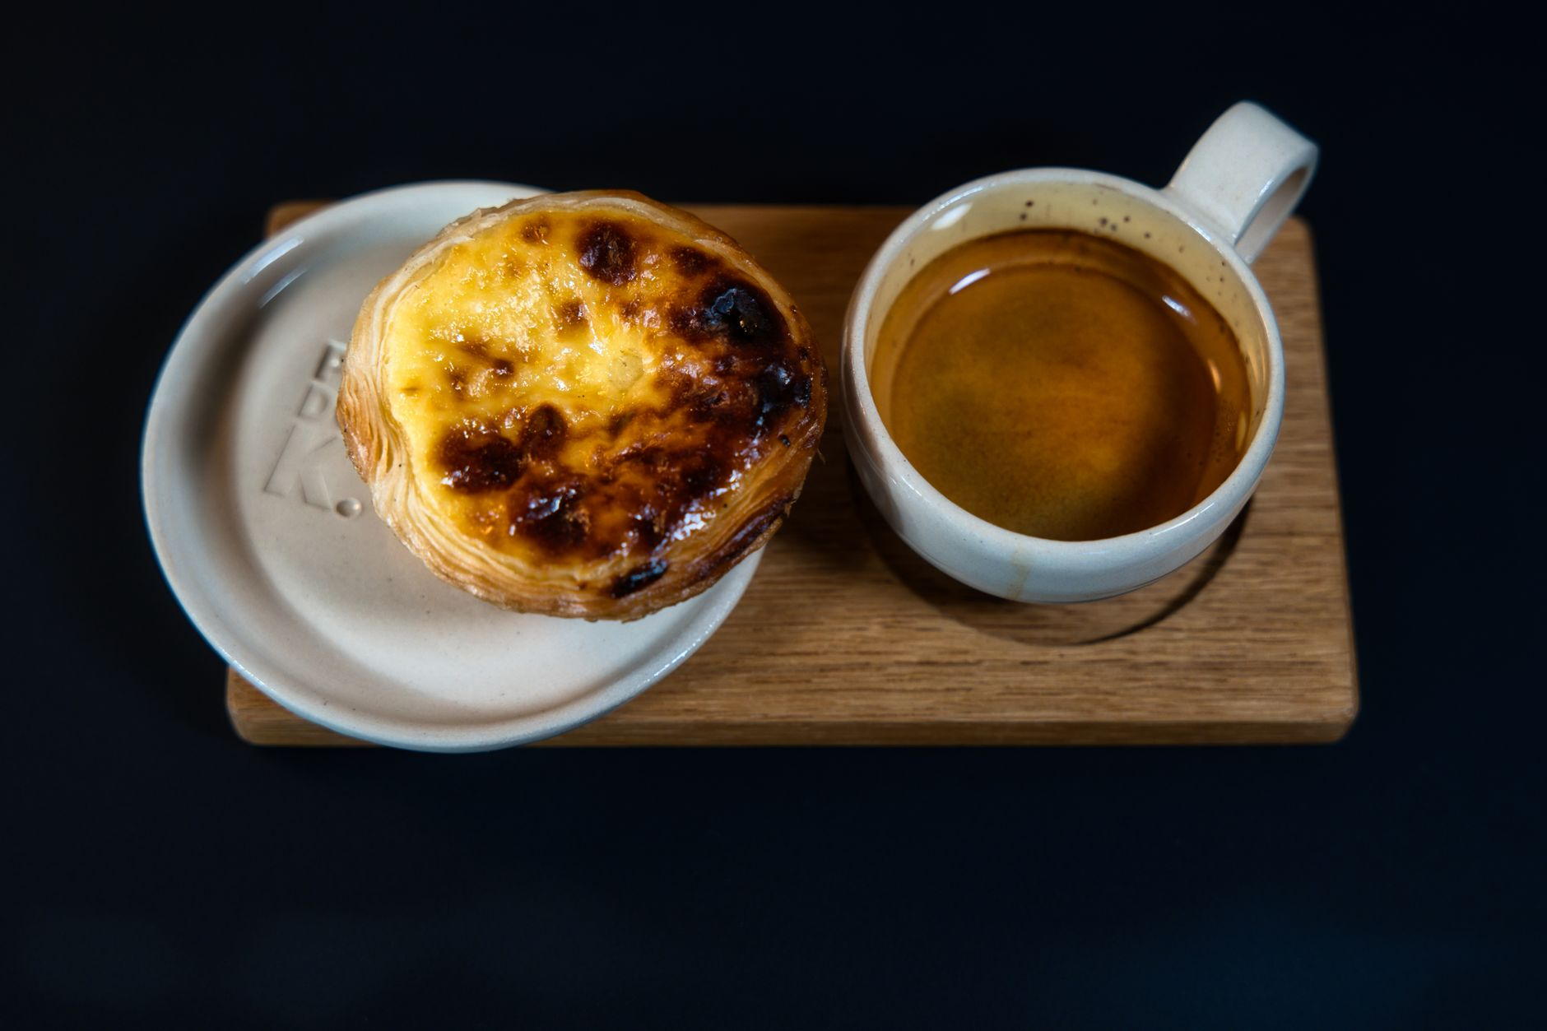
the pastel de nata agenda
may 2027 / not a spreadsheet / thank god
🥐
Notes:
dev dont look at the price

Slide 2
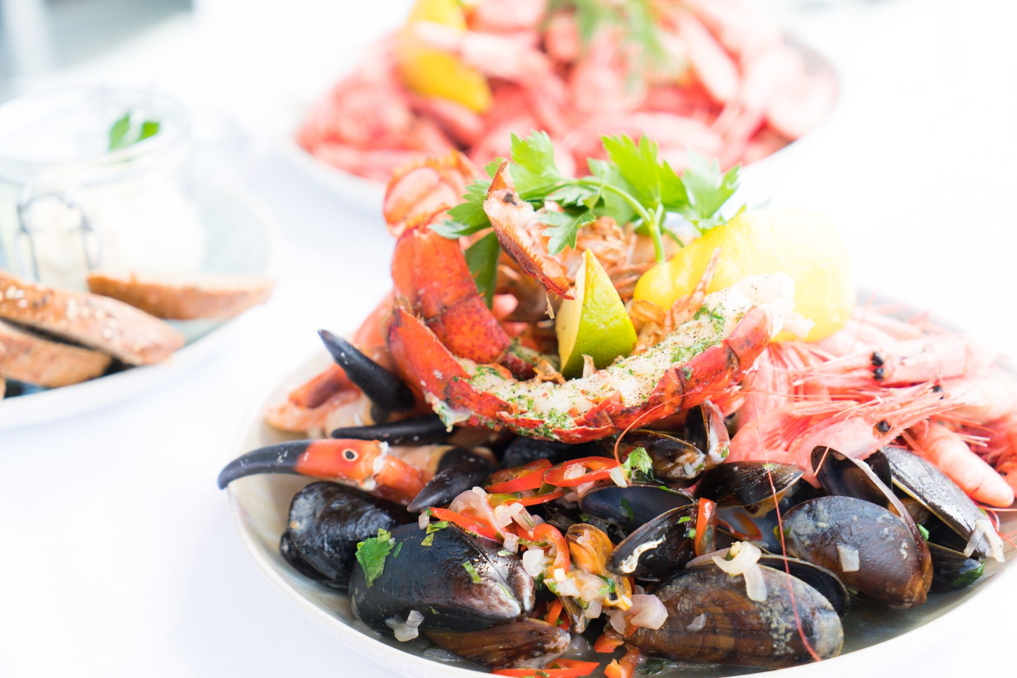
maré baixa is the first-night answer
cais do sodré
seafood plates
€€€
8:30 is the plan i have
arroz de marisco. i rest my case.
Notes:
if people say no, show them this one again

Slide 3
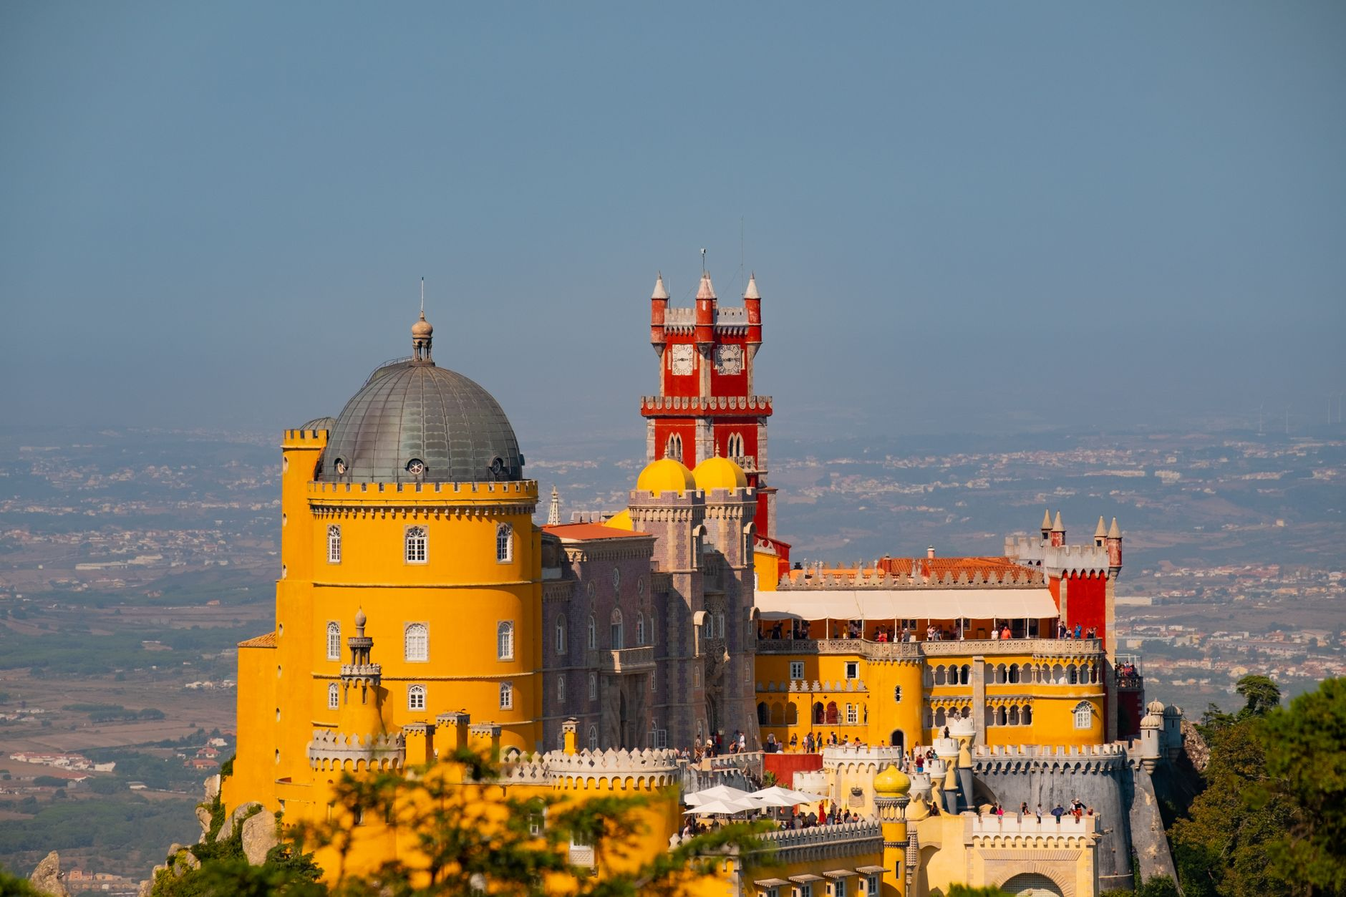
why sam is wrong about surfing
Rota Curta
Sintra Palaces
08:02
€79 each
we are already booked.
Notes:
sam will say surf. ignore.

Slide 4
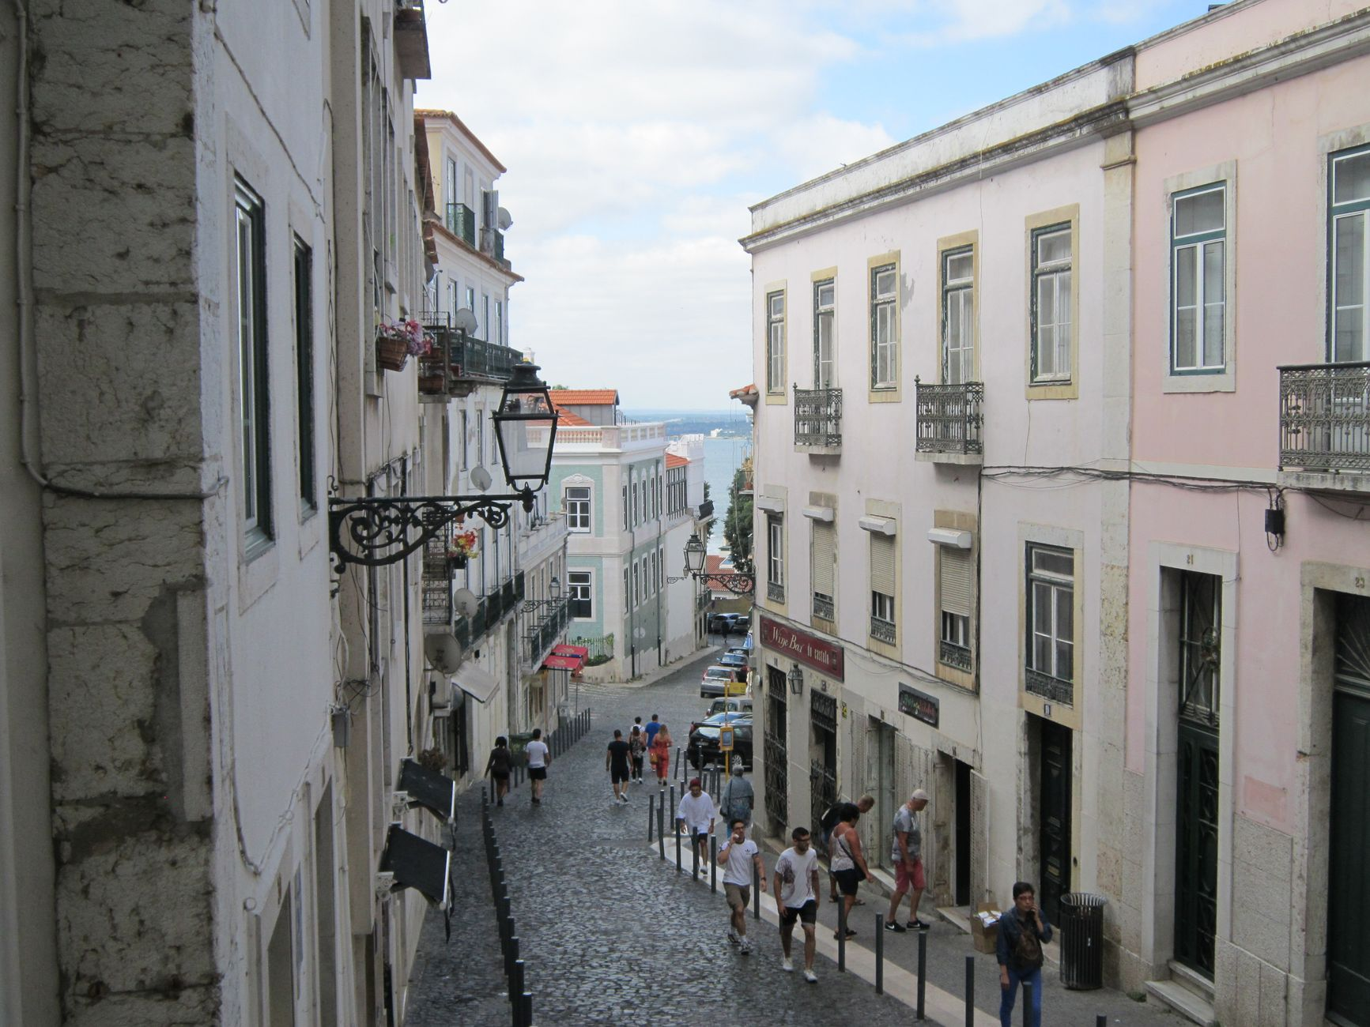

photo grid i need us to respect
alfama stairs
pastel + coffee
sintra fog

Slide 5
fine. maybe surf day.
only if people answer the group chat like adults

Slide 6
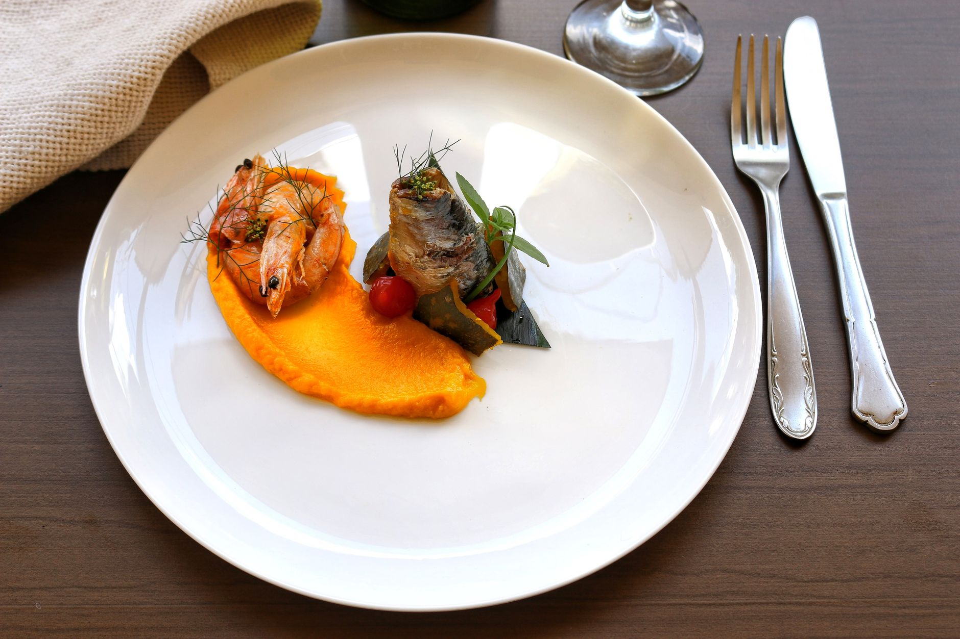
the extremely serious food math
maré baixa
first night. book it.
pastel situation
non-negotiable.
last dinner
TBD because dev wants an “actual budget”
THIS
Notes:
for the menu slide: this is not a request, it is a warning

Slide 7
vote in the gc

