Slide 1

Go-Around
Classification
Using ADS-B and METAR Data
BBL514E Pattern Recognition — Term Project
Furkan Güney (704241023) · Alper Berkin Yazıcı (704241020)
Notes:
Good morning/afternoon. Our project is about predicting go-arounds — aborted landing attempts — using open aviation and weather data. I'm [name], and this is [partner name].

Slide 2
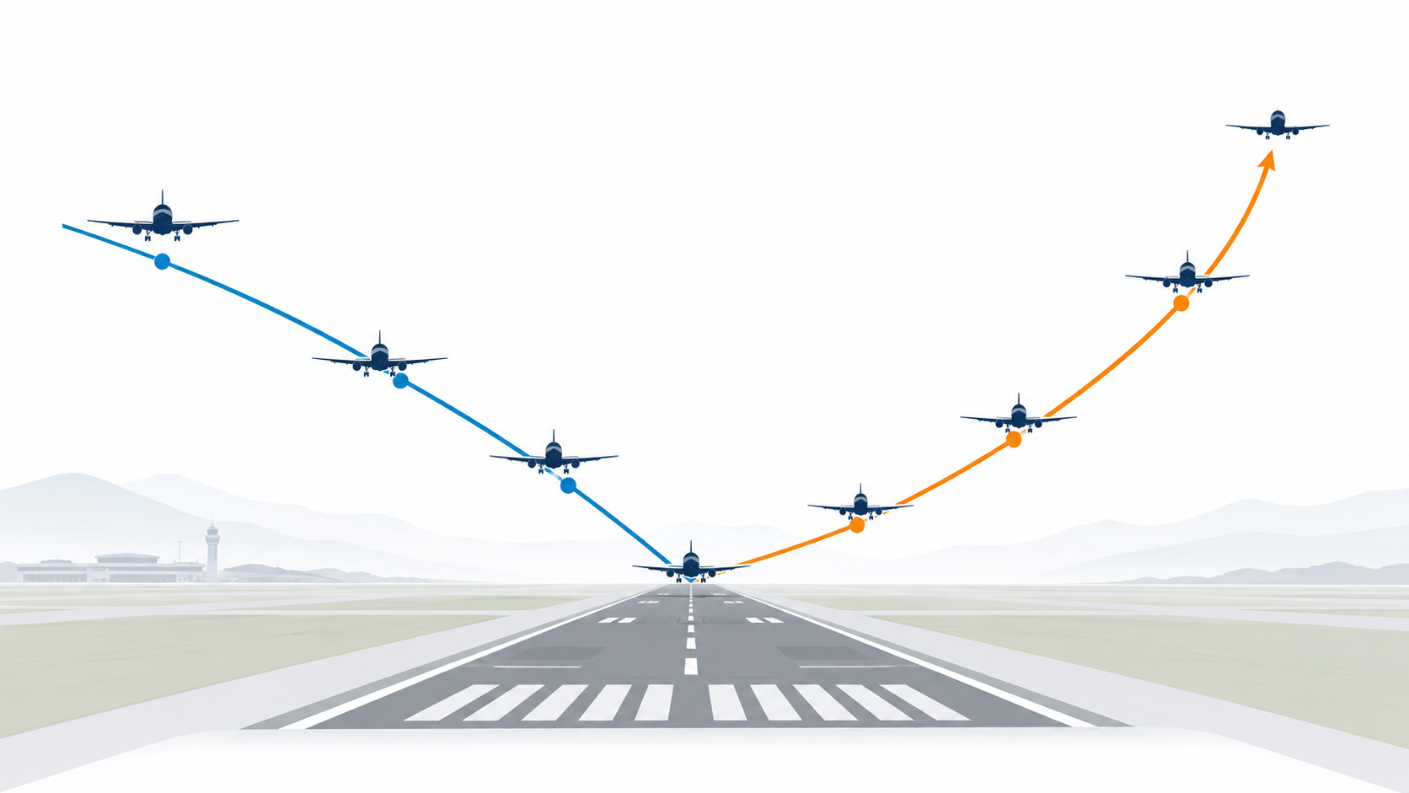
PROBLEM
What is a Go-Around?
Pilot aborts landing on final approach
Aircraft climbs away and re-attempts
Safety-preserving — but increases workload
Typical rate: 0.1–2% of landings
Dataset prevalence
0.37%
positive class
Severe class imbalance makes accuracy misleading.
Can we predict go-around risk from public data before touchdown?
BBL514E Pattern Recognition | Go-Around Classification | 2/10
Notes:
A go-around is when a pilot decides the landing isn't safe and climbs away to try again. It's the correct thing to do, but it disrupts traffic and increases controller workload. The challenge is that they are very rare — under 0.4% of all landings — which makes this a difficult imbalanced classification problem.

Slide 3
DATA
Dataset
~9M
~33K
176
44
2019
landings
go-arounds
airports
countries
full year
Source: Monstein et al. (2022) — Large Landing Trajectory Dataset for Go-Around Analysis
File: go_arounds_augmented.csv.gz
Jan–Aug 2019
TRAINING
5.66M rows
Sep–Oct 2019
VALIDATION
1.65M rows
Nov–Dec 2019
TEST
1.65M rows
Strict temporal split prevents future information leaking into training.
BBL514E Pattern Recognition | Go-Around Classification | 3/10
Notes:
We used a large public dataset from Zenodo covering all 2019 landings at 176 airports. We split it strictly by time — train on January through August, validate on September-October, and test on November-December. This prevents any future data leaking into training.

Slide 4
METHOD
Feature Engineering — Two Feature Sets
Context Only
15 features
Context + METAR
27 features
Airport, runway, aircraft type
Wake turbulence category
Glide slope angle, runway length
Month, day of week, hour (UTC)
Context features + weather
Wind speed, direction, gusts
Visibility, temperature, pressure
Weather codes: fog, rain, snow…
Leakage removed: n_approaches excluded because it counts total approaches per flight and post-hoc reveals the go-around.
Ablation question: how much does weather improve prediction beyond operational context?
BBL514E Pattern Recognition | Go-Around Classification | 4/10
Notes:
We defined two feature sets to run an ablation study. The context-only set uses airport, aircraft, runway, and time information. The full set adds METAR weather observations. One important step was removing n_approaches from features — it counted how many approaches a flight made total, which directly leaks the answer.

Slide 5
METHOD
Five Classifiers Compared
LDA
Logistic
Regression
Random
Forest
LightGBM
MLP
linear baselines
tree ensembles
neural model
Generative linear
Gaussian assumption
Weighted
cross-entropy
100-tree ensemble
bootstrap splits
Gradient boosting
histogram splits
64→32 hidden units
ReLU + early stop
All models used imbalance-aware training. Final threshold was tuned on validation set to maximize F1, not fixed at 0.5.
BBL514E Pattern Recognition | Go-Around Classification | 5/10
Notes:
We compared five classifiers — from the classical LDA baseline to neural and boosting models. All were trained with class weighting to handle the imbalance. After training, we tuned the decision threshold on the validation set to maximize F1 rather than using the default 0.5.

Slide 6
RESULTS
Results — Test Set Performance
Model
Feature Set
ROC-AUC
PR-AUC
F1
No-skill baseline PR-AUC ≈ 0.0035
Best model: 4.6× above baseline
MLP
context+METAR
0.685
0.0160
0.043
LightGBM
context+METAR
0.679
0.0134
0.030
Random Forest
context+METAR
0.690
0.0115
0.037
Primary selection metric: PR-AUC
because go-arounds are rare.
Logistic Reg.
context+METAR
0.691
0.0102
0.033
LDA
context+METAR
0.681
0.0100
0.034
MLP
context only
0.609
0.0123
0.037
Others
context only
~0.63
~0.008
~0.025
ROC-AUC can look acceptable even when false alarms dominate. PR-AUC exposes rare-event retrieval quality.
BBL514E Pattern Recognition | Go-Around Classification | 6/10
Notes:
Here are the test set results. We rank by PR-AUC because it is the right metric for rare events — ROC-AUC can look good even on imbalanced problems. The MLP with full weather features came first by PR-AUC at 0.016, about 4.6 times above the no-skill baseline.

Slide 7
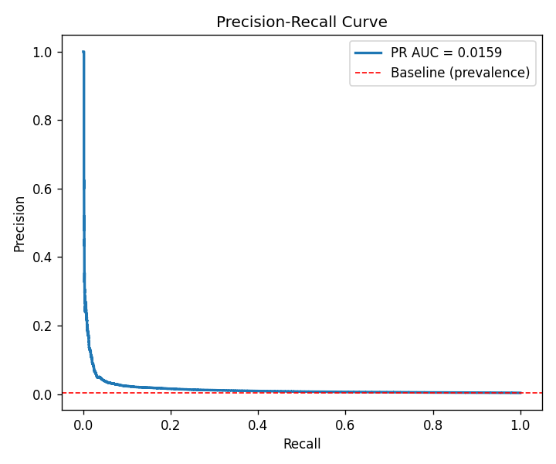
RESULTS
Key Finding — METAR Weather Features Help
PR-AUC relative gain from adding weather variables
MLP
+30%
LightGBM
+38%
Logistic Reg.
+46%
LDA
+33%
Weather adds independent signal: wind, visibility, pressure, and coded conditions help all model families.
BBL514E Pattern Recognition | Go-Around Classification | 7/10
Notes:
Adding weather features improved every single model by 30 to 46 percent in PR-AUC among the main methods shown here. This confirms that visibility, wind, and weather codes carry real predictive signal that context features alone cannot capture.

Slide 8
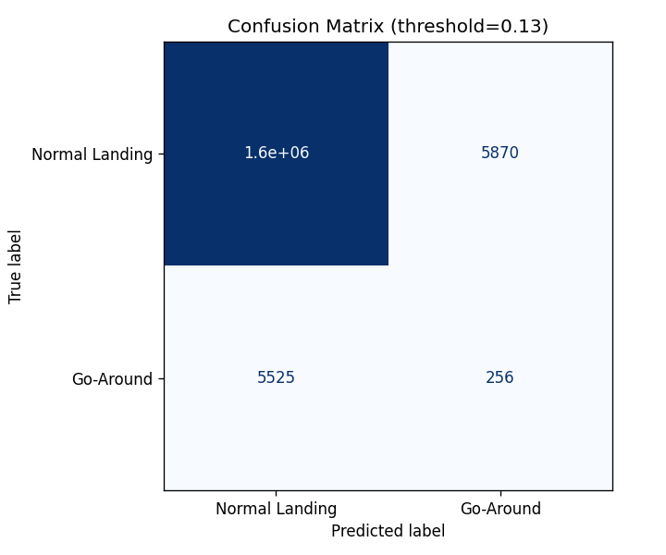
RESULTS
Best Model — Confusion Matrix
MLP · context + METAR
Threshold
τ* = 0.131
True Positives
256 go-arounds detected
False Negatives
5,525 missed
False Positives
5,870 false alarms
Precision: 4.2% · Recall: 4.4% · Accuracy: 99.3%
Accuracy is misleading under extreme imbalance.
BBL514E Pattern Recognition | Go-Around Classification | 8/10
Notes:
The confusion matrix shows the inherent difficulty of the problem. Even the best model detects only about 4% of go-arounds. This is expected — go-arounds share almost identical observable conditions with the vast majority of normal landings.

Slide 9
SYSTEM
Deployed System
HTTP POST /predict
User
Browser
HTML
Interface
FastAPI
Backend
MLP Model
.joblib
Docker
Container
Single docker compose up to run
/predict — JSON API endpoint
/ — HTML form interface
/health — health check
Backend and frontend run from the same container for the live demo.
BBL514E Pattern Recognition | Go-Around Classification | 9/10
Notes:
The system runs in a single Docker container. The FastAPI backend loads the trained model at startup and exposes both a JSON API and an HTML interface. Everything runs with one docker compose up command.

Slide 10
Conclusion
Go-around classification from public ADS-B + METAR data is feasible
METAR weather features improve all models in PR-AUC
Best model: MLP + context+METAR — ROC-AUC 0.685, PR-AUC 0.016
Temporal train/validation/test split reduces leakage risk
Limitations
• Landing-level aggregate features
• Low absolute precision/recall due to extreme imbalance
Future work
• Sequence models on per-second ADS-B trajectories
• Airport-specific fine-tuning and calibration
Now we will run the live demo.
Notes:
To summarize: go-around classification is feasible but difficult. Weather features consistently improve performance. The final system is a single Docker container with a trained MLP model, FastAPI backend, and HTML interface. Now we will run the live demo.

