Slide 1

Fault detection of electrical machines with Machine learning Approach
İbrahim Güngen
Msc- Electrical Machinery and Power Electronics

Slide 2
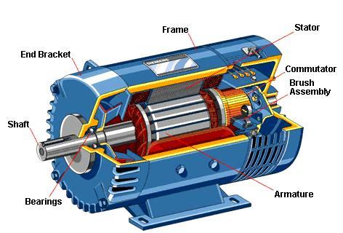
Electrical Machines
%45 of electrical energy is consuming by EM at the world
EMs have critical roles at the industry
Stopping some of them can lead to important financial losses
Faults should be fixed
immediately

Slide 3
Faults of Electrical Machines
Fixing process can take so long times
Needs to experience and theoretical knowledge
Some of them are below,
Insulation breakdown
Bearing failure
Unbalance input voltage
Shaft misalignment
Broken motor, magnet bar
Rotor and stator winding failure
Static airgap eccentricity
Interturn short circuit
Mass unbalance
And so on
In general, current, vibration, voltage signal analysis are used for fault detection by transforming signal method with Fourier, Wavelet transform

Slide 4
Machine Learning Methods
Convolutional Neural Network
Multilayer Neural Network

Slide 5
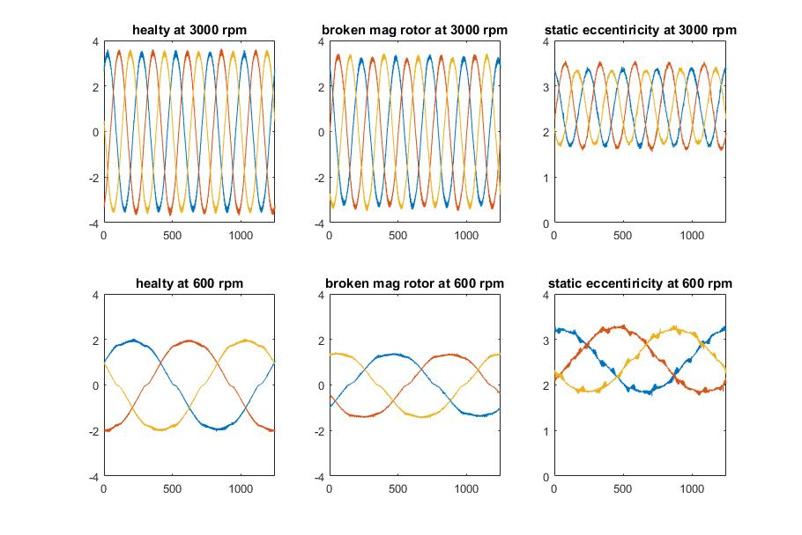
Database
Data are taken from authors of paper at Reference[1]
Includes 3 phase currents of 3 type operation(1 healthy 2 fault), these are healthy, broken rotor magnet fault and static airgap eccentricity fault conditions with 3 different load and 5 different speed (600, 1200, 1800, 2400, 3000 rpm).
Current signal of 3 phase divided 6750 train, 450 test data by using MATLAB

Slide 6
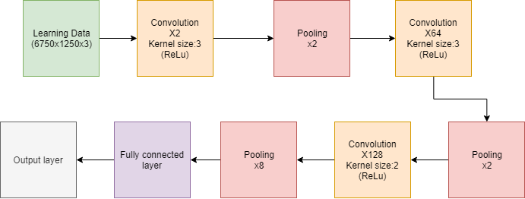
Convolutional Neural Network
3 convolution, 3 pooling, 1 fully connected classify and output layers are used. Adam optimizer and categorical cross entropy loss function are chosen.
I tried to arrange layers by taking harmonics into consideration

Slide 7
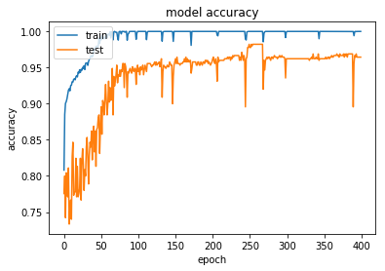
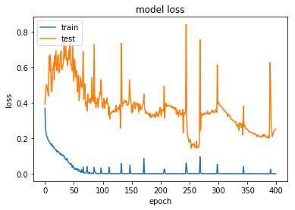
%100 accuracy for train data
%96,4 accuracy for test data
Converges 0 loss for train data
Converges 0,2 loss for test data

Slide 8
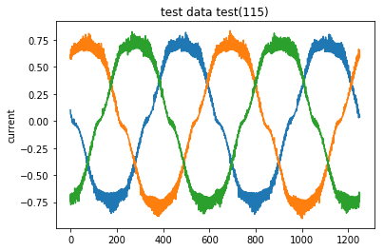
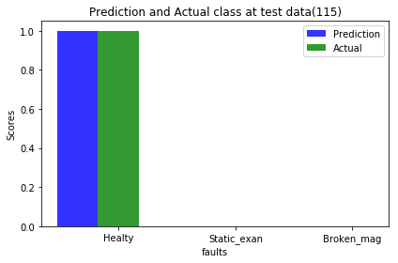
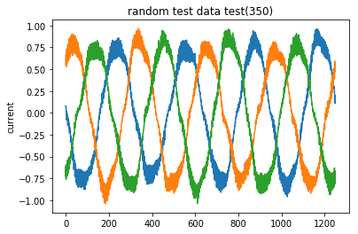
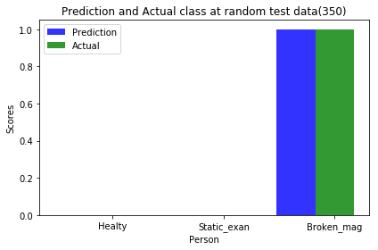
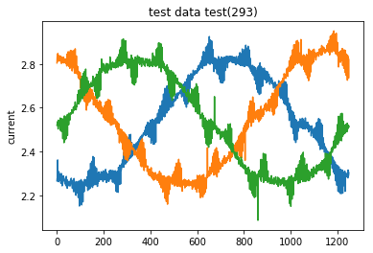
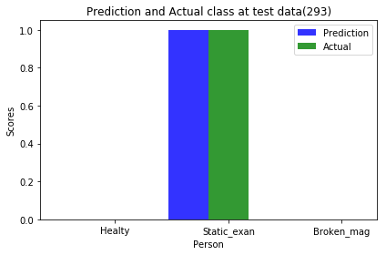

Slide 9
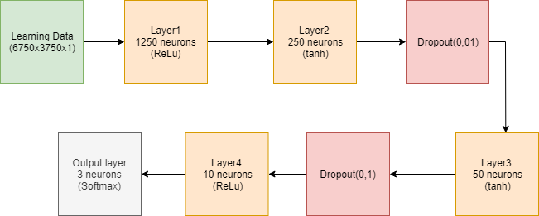
Multilayer Neural Network
4 layers and 2 dropouts are used. Gradient descent optimizer and square root hinges loss function are chosen
Tried to eliminate unnecessary connections

Slide 10
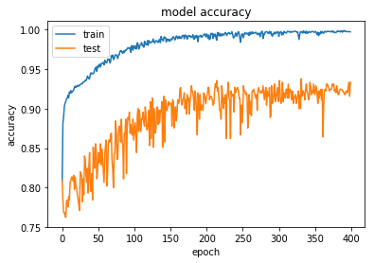
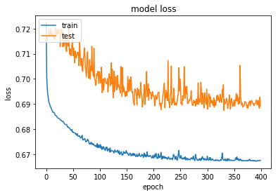
%99 accuracy for train data
%93,3 accuracy for test data
Converges 0,67 loss for train data
Converges 0,2 loss for test data

Slide 11
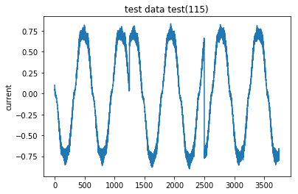
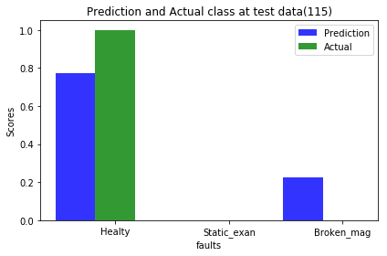
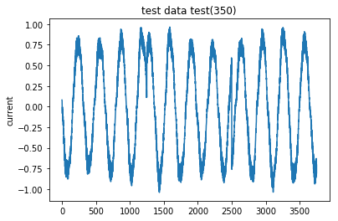

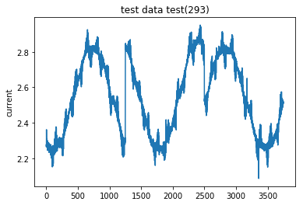


Slide 12
Comparison
 | CNN | MLP
Train Accuracy | 1.0 | 0.99
Train Loss | ~0 | 0.67
Test Accuracy | 0.964(max 0.98) | 0.93
Test Loss | 0.23(min 0.2) | 0.69
Step processing time | - | %21 faster

Slide 13
Conclusion
This work inspired us to usage of Machine learning at Electrical machines.
Future works
Increase fault types and data quantity
Optimize algorithm
Train with simulation results to estimate experimental results

Slide 14
Reference
[1] Heydarzadeh, M., Zafarani, M., Akin, B., & Nourani, M. (2018). A Wavelet-Based Fault Diagnosis Approach for Permanent Magnet Synchronous Motors. IEEE Transactions on Energy Conversion, 1-1. doi:10.1109/tec.2018.2864570

