Slide 1

Fault detection of electrical machines with Machine learning Approach
İbrahim Güngen
Msc- Electrical Machinery and Power Electronics

Slide 2
Faults of Electrical Machines
Some of them are below,
Insulation breakdown
Bearing failure
Unbalance input voltage
Shaft misalignment
Broken motor, magnet bar
Rotor and stator winding failure
Static airgap eccentricity
Interturn short circuit
Mass unbalance
And so on
In general, current, vibration, voltage signal anaysises are used for fault detection by transforming method like fourier, Wavelet transform

Slide 3
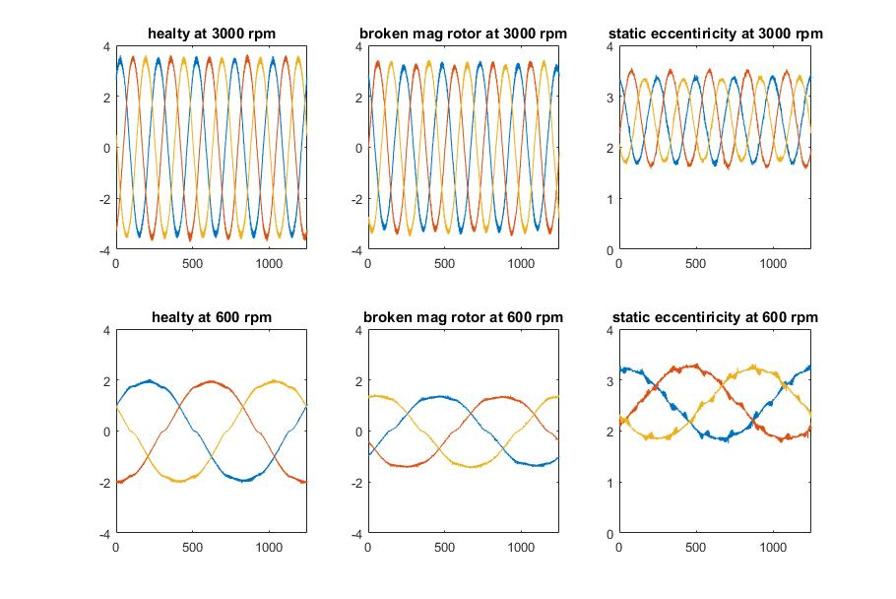
Database
Includes 3 type operation as healthy, broken rotor magnet and static airgap eccentricity with 3 different load and 5 different speed (600, 1200, 1800, 2400, 3000 rpm).

Slide 4
Machine Lerning Methods
Convolutional Neural Network
Multilayer Neural Network

Slide 5
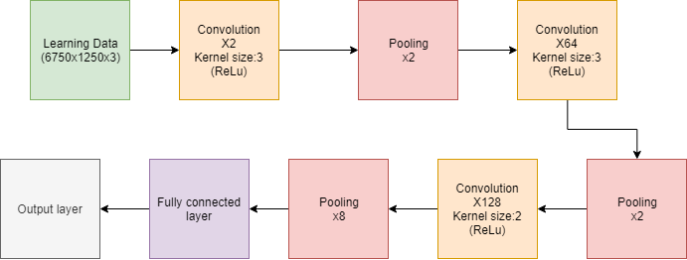
Convolutional Neural Network
3 convolution, 3 pooling, 1 fully connected classify and output layers are used. Adam optimizer and categorical cross entropy loss function is chosen.

Slide 6
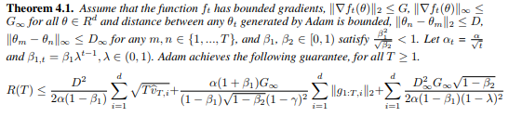
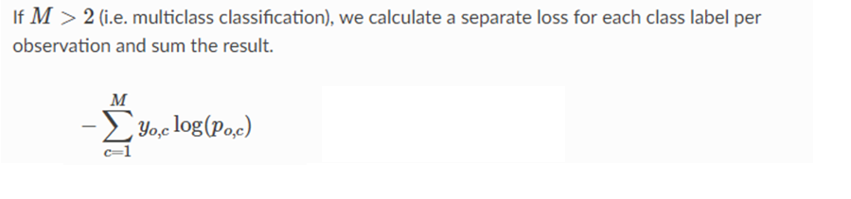
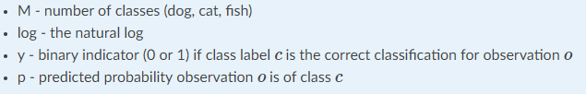
Adam optimizer formula
Cross entropy formula

Slide 7
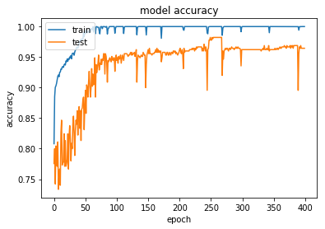
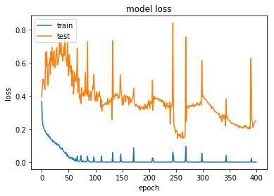

Slide 8
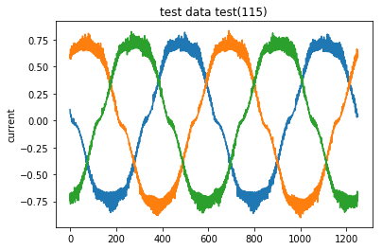
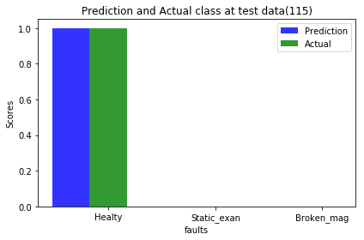
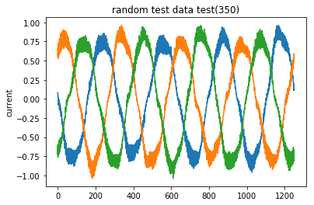
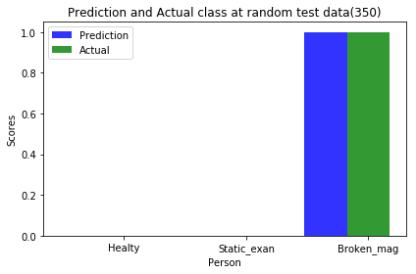
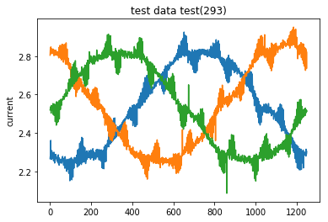
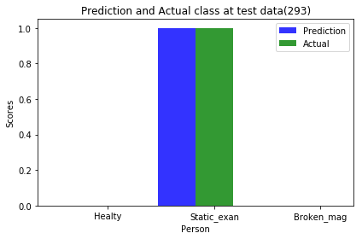

Slide 9
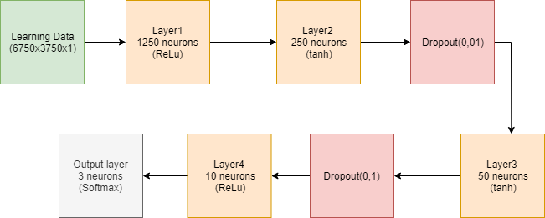
Multilayer Neural Network
4 layers and 2 dropouts are used. Gradient descent optimizier and square root hinges loss function is chosen

Slide 10
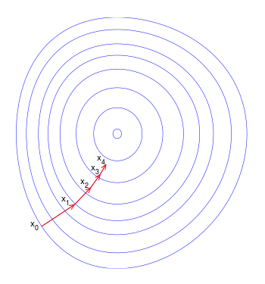


Gradient Descent optimizer formula
Hinge loss formula

Slide 11
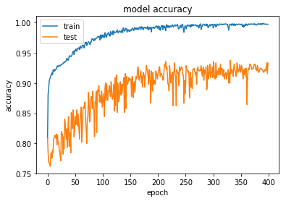
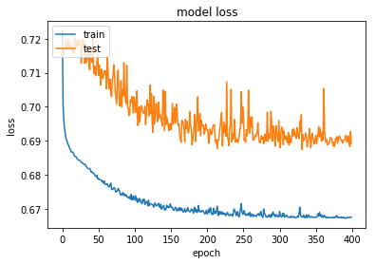

Slide 12
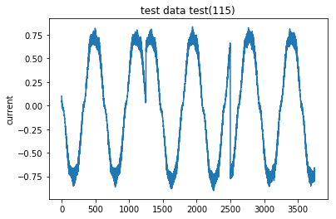
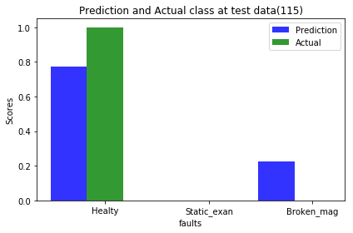
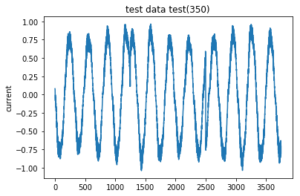

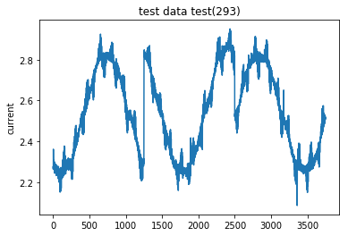


Slide 13
Comparison
 | CNN | MLP
Train Accuracy | 1.0 | 0.99
Train Loss | ~0 | 0.67
Test Accuracy | 0.964(max 0.98) | 0.93
Test Loss | 0.23(min 0.2) | 0.69
Step processing time | - | %21 faster

Slide 14
References
[1]

