Slide 1
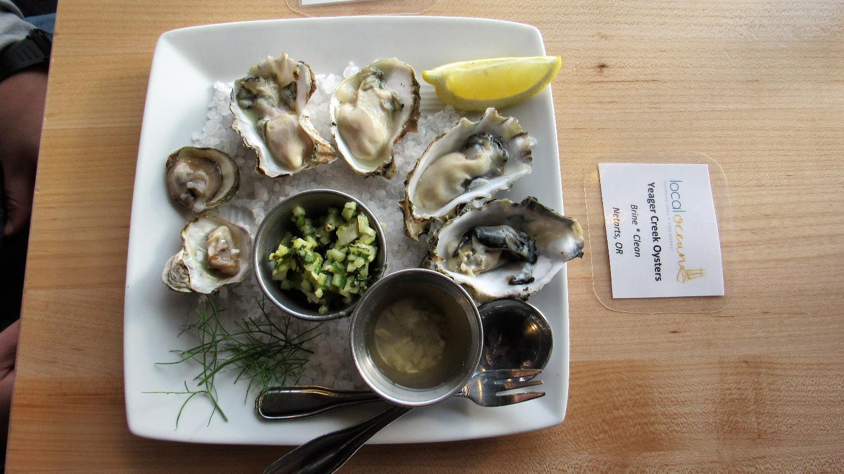
Company vision
At Oyster Technologies, we use deep data insights to empower the world’s oyster farmers – enabling them to create a sustainable, healthy protein source for us humans
Mobile app product vision
Using a smartphone application, we empower the world’s farmers to track oyster growth onsite, with accuracy, simplicity, and insight.
Company objectives
>30% of the world’s farmed oysters managed through our solutions
#1 provider of farm management solutions for oyster growers worldwide
Revenue growth of >25% annually
Product objectives
Add 3 objectives here…
© Todd Birzer

Slide 2
Company vision
At Oyster Technologies, we use deep data insights to empower the world’s oyster farmers – enabling them to create a sustainable, healthy protein source for us humans
Mobile app product vision
Using a smartphone application, we empower the world’s farmers to track oyster growth onsite, with accuracy, simplicity, and insight.
Company objectives
>30% of the world’s farmed oysters managed through our solutions
#1 provider of farm management solutions for oyster growers worldwide
Revenue growth of >25% annually
Product objectives
Add 3 objectives here…
Guidance
Product objectives are specific, measurable goals which track progress to meet your vision. These should support corporate objectives. Pick 2 or 3.
Key areas: Customer value, competitive advantage, and revenue/profit (Examples: Growth, market share, number of customers/users, retention, customer lifetime value, net promoter score, average revenue per user/unit, annual recurring revenue, monthly recurring revenue, etc.)
© Todd Birzer

Slide 3
Instructor’s answer

Slide 4
Company vision
At Oyster Technologies, we use deep data insights to empower the world’s oyster farmers – enabling them to create a sustainable, healthy protein source for us humans
Mobile app product vision
Using a smartphone application, we empower the world’s farmers to track oyster growth onsite, with accuracy, simplicity, and insight.
Product objectives
Customer value
Highest net promoter score (NPS) among all competing products
>90% of farm workers can use the application correctly after a 5-minute self-training
>4.2-star rating on Google Play store
Leadership and competitive advantage
Most popular oyster sizing application worldwide
Most valuable insight as judged by a panel of oyster farmers testing multiple solutions side-by-side
Growth and revenue
Double the number of users in the next one year
>88% of subscribers renew each year
Make >$XM revenue (or profit) from our mobile application subscriptions
Company objectives
>30% of the world’s farmed oysters managed through our solutions
#1 provider of farm management solutions for oyster growers worldwide
Revenue growth of >25% annually
Instructor answers
These are all potential objectives. Note that they all complement the company vision and objectives. Also, they are all measurable. If we were doing this for real, we would pick 2-3 key objectives.
Did you craft something similar??
© Todd Birzer

