Slide 1
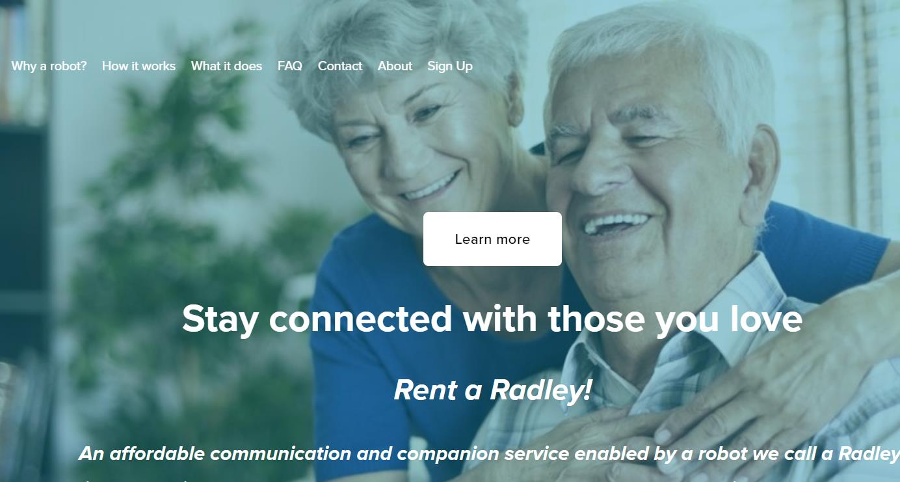
Practice activity:
Development buckets
You are a new product manager at an
elder care robotics startup
Example only, not real data!

Slide 2
You are working with your engineering team and product designer…
…deciding what development efforts to prioritize over the next eight weeks

Slide 3
You have many opportunities:
Generative AI-powered voice chatbot for helpful and engaging conversations
Custom links for a major elderly care company to connect their billing systems
Fix contact lists not displaying correctly
Fix inaccurate battery charge levels
Redesign the robot ID (industrial design) to make it friendlier and more appealing
Rearchitect our database
Create a prototype for fall detection alerts
Remote body temperature detection trial
Migrate cloud platform to AWS
Example only, not real data!

Slide 4
The prioritization debates have been confusing
Should we focus on…
Generative AI-powered voice chatbot
Our strategy, roadmap, and OKRs have set this a high priority
Custom links for a major elderly care company
Sales wants this badly
Fix inaccurate battery charge levels
A top customer support issue
Rearchitect our database
Engineering is worried about code-red crashes if we don’t solve this
Example only, not real data!

Slide 5
Your challenge
How can you set the right priorities for the next eight weeks?
Guidance
Use the development bucket template to help guide your thought process
Put the 9 opportunities in the right categories

Slide 6
Development buckets
Development categories >> | Big impact items | Near-term client enhancement requests | Support & bug fixes | Platform, technical debt, and stability
Percentage of development time | 60% | 15% | 10% | 15%
Items | Item 1 Item 2 Item 3 | Item 1 Item 2 Item 3 | Item 1 Item 2 Item 3 | Item 1 Item 2 Item 3
Generative AI-powered voice chatbot
Custom links
Fix contact list
Fix inaccurate battery charge
Redesign the robot ID
Rearchitect our database
Prototype for fall detection
Remote body temperature detection
Place each blue item into the right development category
Place each blue item into the right development category
Place each blue item into the right development category
Place each blue item into the right development category
Migrate cloud platform

Slide 7
Development buckets
Development categories >> | Big impact items | Near-term client enhancement requests | Support & bug fixes | Platform, technical debt, and stability
Percentage of development time | 60% | 15% | 10% | 15%
Items | I
item
item
item
item
item
item
item
item
item
Your answer will look something like this

Slide 8
Todd’s answer

Slide 9
Development buckets
Instructor answer
Development categories >> | Big impact items | Near-term client enhancement requests | Support & bug fixes | Platform, technical debt, and stability
Percentage of development time | 60% | 15% | 10% | 15%
Items
Generative AI-powered voice chatbot
Custom links
Fix contact list
Rearchitect our database
Redesign the robot ID
Fix inaccurate battery charge
Migrate cloud platform
Prototype for fall detection
Remote body temperature detection

