Slide 1
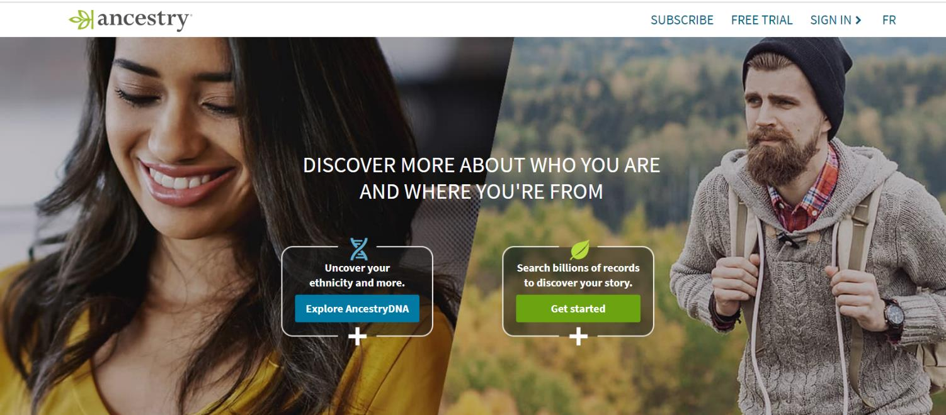
Practice Activity: Write an OKR for Ancestry

Slide 2
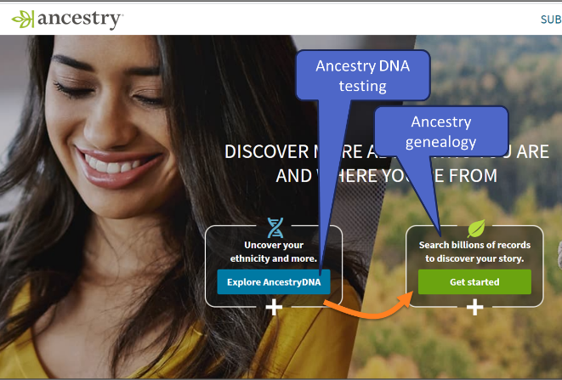
Background
We are product managers at Ancestry
To generate growth, we would like more of our DNA testing customers to subscribe to our genealogy service
Ancestry DNA testing: one time ($99)
Ancestry Genealogy: subscription ($225/year)
Your challenge
Write an OKR for Ancestry’s product team, with one objective and one key result.
Focus this OKR on our DNA-to-genealogy growth goal
Example only, not real data!

Slide 3

OKRs for Q2
Objective 1: Increase the number of new active users
Key results | >60% of first-time users submit a second bird checklist
Objective 2: Increase the usage of eBird’s data by university researchers
Key results | >1000 CSV data downloads
 | >30 academic articles published
Objective 3: Expand user base in countries with high bird diversity but low eBird usage (Columbia Peru, Ecuador, Brazil)
Key results | >100 “friend” referrals in target countries
Example OKRs from eBird
Example only, not real data!

Slide 4
OKR
Objective 1: <Write your objective here>
Key results | <Write your key result here>
You can use this template

Slide 5
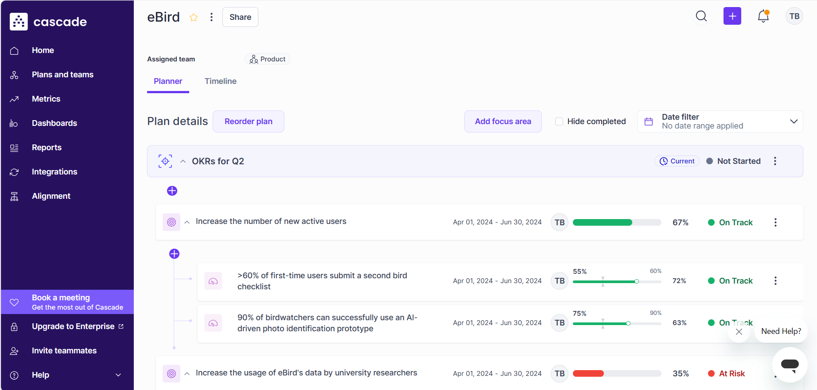
OKR tools
Cascade (cascade.app)
WorkBoard (workboard.com)
Jira (atlassian.com)
Perdoo (perdoo.com)
Weekdone (weekdone.com)
Peoplelogic (peoplelogic.ai)
Others…
You can also use a free/trial version of one of these tools
Example only, not real data!

Slide 6
Todd’s answer

Slide 7
OKR
Objective 1: Increase the number of DNA testing customers who subscribe to our genealogy service
Key results | For DNA testing customers, increase the 14-day trial signup rates from the current 25% to 35% For DNA testing customers, increase the percentage of people who access their relatives’ records (birth certificates, immigration records, marriage records, census data, etc.) from the current 17% to 28% For DNA testing customers, increase the percentage who subscribe to our genealogy services from the current 5% to 8%
Possible OKRs for Ancestry
Did you come up with something similar?
Example only, not real data!

