Slide 1

Roadmap styles…
Product area
Technology / product / market
Now, next, later
Theme-based
Photo by airfocus on Unsplash

Slide 2
Products | Product area 3
 | Product area 2
 | Product area 1
1H 202X | 2H 202X | 202Y
Data visualization tools
CSV data exports
Birdsong recording tools
Computer vision / AI-driven photo ID (prototype)
Field ID tools
Rare bird alerts
Profile enhancements
Roadmap by product area

Slide 3
Markets
Products/services
Technology platform
1H 202X | 2H 202X | 202Y
1st time birdwatchers
Field ID tool
Photo ID tool
Field identification engine
Computer vision / AI-driven photo ID (prototype)
Technology to products to markets roadmap

Slide 4
This year (Apr-June) | This year (July-Dec) | Next year
AI-driven photo identification (North America, Europe, Asia, Australia) AI-driven photo identification (South America) | Population trend data access for scientists Local bird names for South America | Guided walkthrough for first time users Photo, video, and audio library access for scientists
Now, next, later roadmap
Example only, not real data!

Slide 5
 | This year (July-Dec) Help first-time users | Next year (Jan-June) Make eBird more useful to scientists | Next year (July-Dec) Expand eBird usage in countries with high bird diversity
Description | Help our first-time users have a great experience, returning for their second and third checklist | Make it easy for scientists to use our data for their research | Make eBird more attractive to birdwatchers in countries with high bird diversity, but low eBird usage (Columbia, Peru, Ecuador, and Brazil)
New features, products, or services | Guided walkthrough for first time users AI-driven photo identification (North America, Europe, Asia, Australia) | Photo, video, and audio library access for scientists Population trend data access for scientists | AI-driven photo identification (South America) Local bird names for South America
Roadmap with major strategic themes
Major launch opportunity

Slide 6
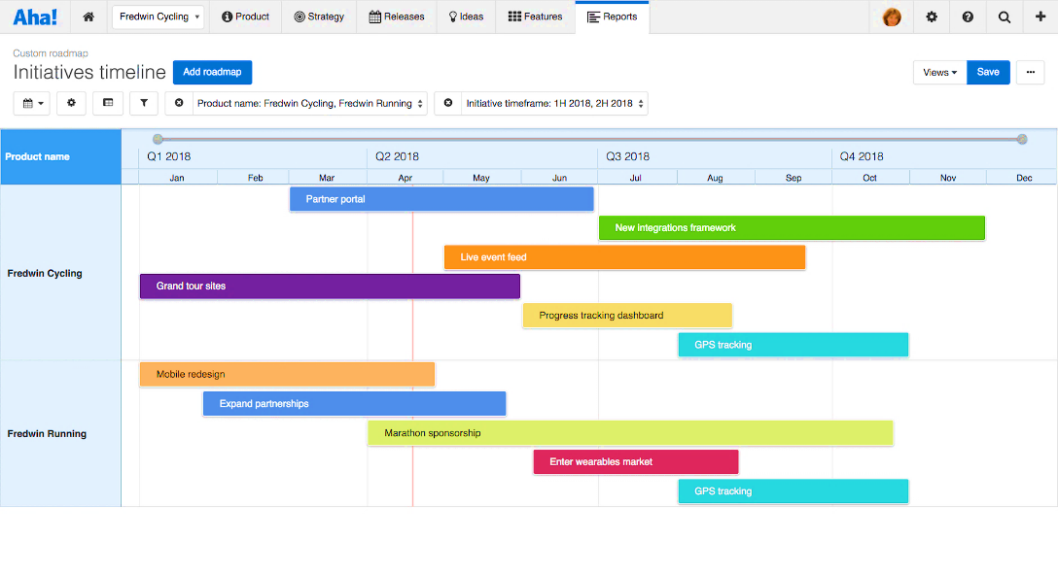
Aha!

Slide 7
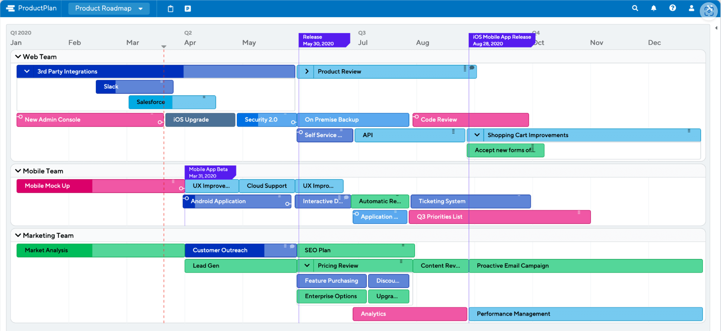
Using ProductPlan
ProductPlan

Slide 8
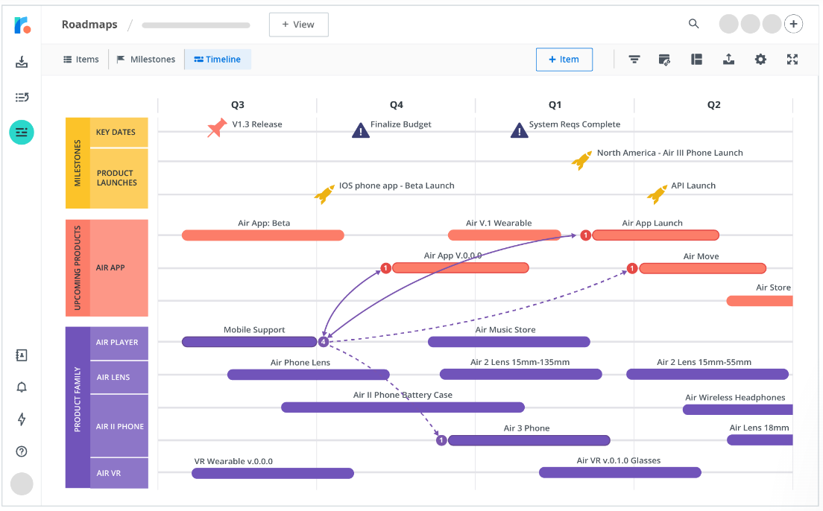
Tempo Strategic Roadmaps

Slide 9
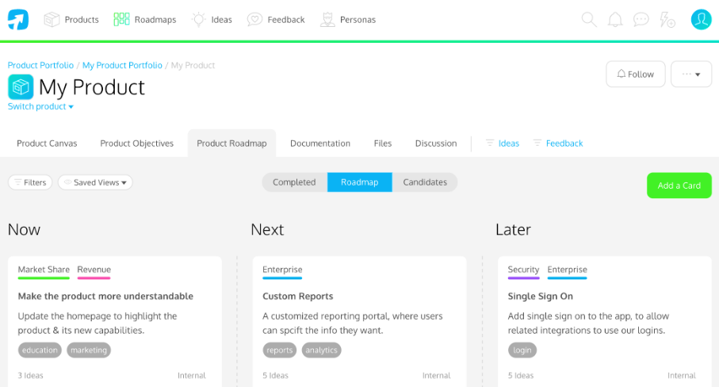
ProdPad

Slide 10
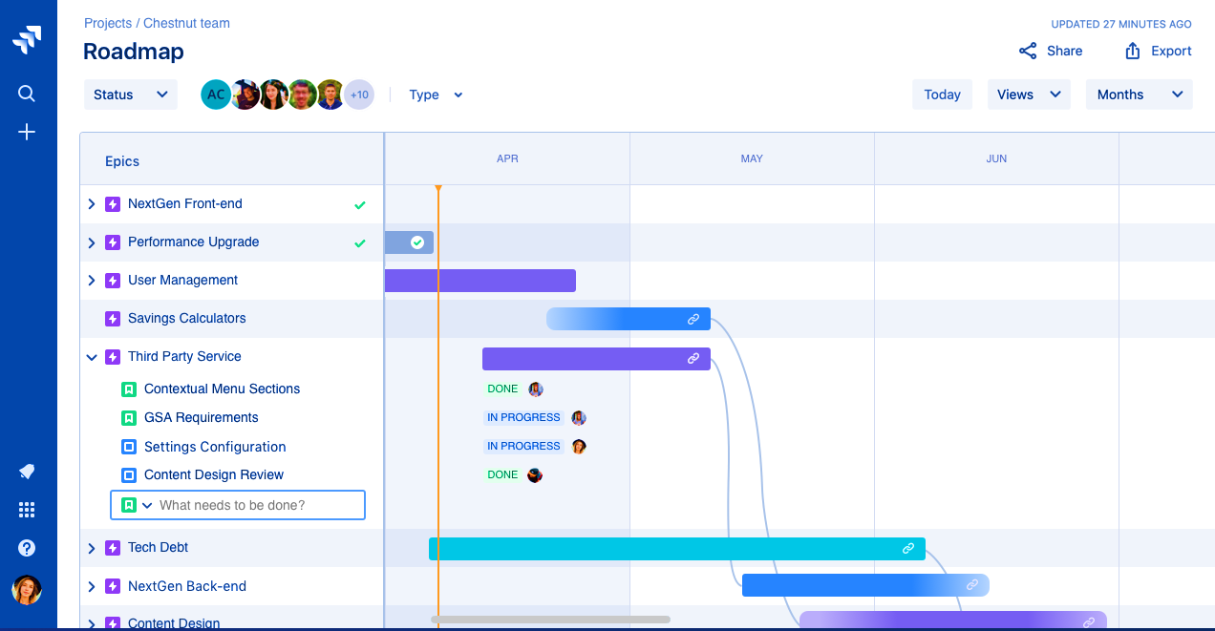
Jira

