Slide 1
Practice Activity!
Finding growth for established products in the market today
Think about a product you are familiar with
Pick an established product that has been on the market for a while (not an early-stage startup product)
Look at the attached product tool on the following pages
Think about the lifecycle stage of your product, then look at growth opportunities for this stage
Use the table to generate about 5-7 growth ideas for your own product
The table is just meant to be a starting point. Get creative!
Circle 1 or 2 ideas that look most promising

Slide 2

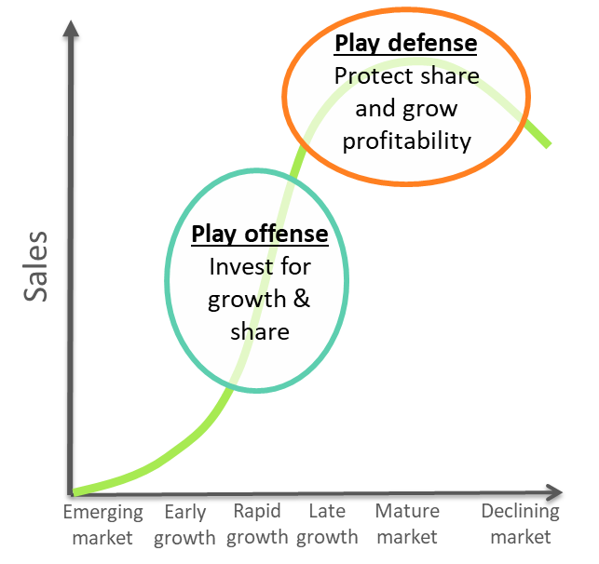
Product tool Finding Growth for established products in the market today
Most successful products go through a predictable product lifecycle, from emerging markets, to growth, to maturity, to decline. As product people, we can often find growth at every stage, but our growth strategy will vary depending on where we are in the product lifecycle.
In the early, rapid, and late growth phases, we typically want to play offense—investing for growth and share.
In mature and declining markets, we can still find growth, and—if we are one of the market leaders—we typically want to play defense, protecting our share and growing our profitability.
The bottom-line truth is that we can often find growth at every point along the product lifecycle, but with many companies these opportunities are overlooked and underinvested.
How do we find these opportunities? We can start by using the table on the following pages to spark ideas.
How to use this tool:
Think about the lifecycle stage of your product, then look at growth opportunities for this stage.
Use the table to generate at least 5-7 ideas for your own product. The table is just meant to be a starting point. Get creative!
Pick your top 1-2 ideas and consider how you could run an experiment with these. Start simply, start small, and see if these ideas will actually generate growth. Modify and refine your approach as you learn more.
When you are confident you have growth ideas that work in the market, hit the accelerator.

Slide 3
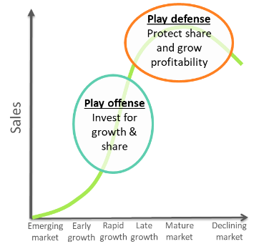
 | Category | Actions | Examples | Add ideas for your product here i
Play offense | Grow share (a bigger slice of the pie) | Raise awareness | Search engine optimization (SEO), content marketing (blogs, whitepapers, etc.), ads, influencers, build virality, build enthusiasm
 |  | Increase trial & conversion | Free trial period or free forever, demos, samples, promotions, tradeshows, sales outreach, fast onboarding
 |  | Add differentiating features, close feature gaps | Add compelling new functionality, or match competitor features
 |  | Optimize pricing | Limited time offers, usage-based pricing, subscription pricing, special pricing for key customers
 |  | Develop new sales channels | New sales distribution channels, partner with complementary companies
 |  | Directly attack competitors | Sales programs directly targeting competitive accounts

Slide 4
 | Category | Actions | Examples | Add ideas for your product here i
Play offense | Grow the market (a bigger pie) | Expand overall market demand | Viral marketing, evangelize at conferences, work with key opinion leaders / influencers
 |  | Move into new countries | Expand into India or Brazil
 |  | Increase revenue per customer | Identify light or disengaged users for potential greater use of product, upsell to new services, expand product usage within existing clients
 |  | Target closely related segments | Office chair company adding an executive chair line
 |  | Develop the “ecosystem” | Linked applications and partnerships with complementary companies
 |  | Promote new uses of product | Learn new uses from innovative current users, and evangelize
 | Enter new markets (a new pie) | Target adjacent or under-served markets (existing or new) | Ancestry.com adding a health DNA testing service, in addition to their ancestry DNA analysis Using product analytics, IOT, or AI to craft new services

Slide 5
 | Category | Actions | Examples | Add ideas for your product here i
Play defense | Protect share | Create loyalty programs | Incentives for renewal and repurchase
 |  | Enhance purchase convenience | Favorable financing terms, more convenient ways to buy
 |  | New sales channels | Expand and optimize distribution
 |  | Channel sales incentives | Cash rewards for sales
 | Maximize profits | Intelligently lower marketing and sales investment. Focus on retention of customers rather than new acquisition. | Reduce or eliminate awareness-building for new customers (esp. expensive outbound marketing, like ads). Ramp up customer loyalty and retention efforts.
 | Harvest & exit | Raise prices or reduce marketing investment, and eventually exit | Raise prices to shed price-sensitive customers, retaining only the most profitable ones. Sell the business.

