Slide 1
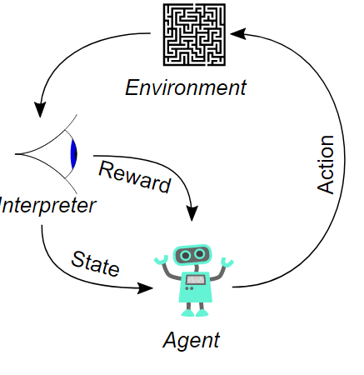
Q learning for Tic Tac Toe

Slide 2
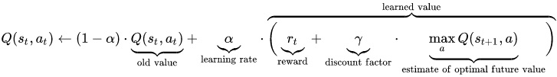
Q-learning is a model-free reinforcemen learning technique. Specifically, Q-learning can be used to find an optimal action-selection policy for any given (finite) Markov decision process(MDP). It works by learning an action-value function, often denoted by Q(s,a), which ultimately gives the expected utility of taking a given action in a given state , and following an optimal policy thereafter

Slide 3
Step 1: From now state, find action to maximum Q(state,action)
Step 2: Excute action.
if match win, reward =1
if match loss, reward=-1
if match draw, reward=0
Update Q(state,action)
Step 3: Update state after every action
Loop while match.done==False

Slide 4
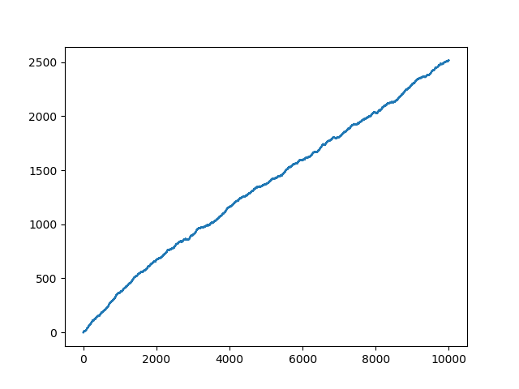
Result after 10000 match.

