Slide 1
SOCIAL MEDIA AGENT
“Exploring the World of Sociality”

Slide 2
Project Tile – [SOCIAL MEDIA AGENT]
Domain of Project – [ AI/Machine learning ]
Student Name | Recent Passport Photo | Email ID | Mobile number [WhatsApp]
Gungun Joshi |  | jgungun90@gmail.com | 7852017505

Slide 3
Problem Statement -
Problem Statement : Social Media Agent
The Challenge:-
Social media is essential for brand growth, but businesses and content creators struggle with consistent content generation, multi-platform post scheduling, and timely audience interaction. Information on trend analysis and audience engagement metrics is scattered across disconnected platforms. Without personalized, real-time automation and strategy optimization, many accounts fail to maintain active presence, grow reach, or optimize marketing ROI.
The Objective:-
Build an AI-powered Social Media Agent that delivers autonomous social media management and actionable insights for brands, businesses, and creators. The solution should:
* Personalized Content Strategies – Generate tailor-made post captions, graphics, and schedules based on brand voice, target audience, and current market trends.
* Social Data & Trend RAG Retrieval – Fetch and analyze real-time market trends, hashtag metrics, and competitor strategies from verified social media APIs and databases.
* Multi-Platform Management & Feedback – Allow users to draft and schedule posts across platforms (e.g., via text, image prompts, or direct input) and provide instant engagement analysis.
* Targeted Campaign Focus – Recommend optimized posting times and campaign structures for maximum reach and conversion.
* Multi-Agent System –
* Social Trend Knowledge Agent (fetches viral trends, hashtags, and competitive intelligence)
* Content Generation Agent (creates personalized captions, hashtags, and media suggestions)
* Engagement Advisory Agent (suggests community management strategies and optimal post timing)
* Analytics & Scheduling Agent (schedules posts and tracks real-time performance)
* Visualization Dashboard – Show performance metrics, reach growth, and ROI progress toward marketing goals.
.

Slide 4
PROPOSED SOLUTION:- AI-Powered Social Media Agent
The proposed solution is a multi-agent AI-powered Social Media Agent built using IBM Bob, IBM watsonx.ai, and Granite models to provide personalized, real-time social media management and strategy guidance. The system addresses challenges in content generation, campaign scheduling, audience engagement, and performance analytics through an intelligent, modular architecture.
At its core, the solution uses a Retrieval-Augmented Generation (RAG) pipeline to fetch accurate market trends, platform algorithms, and audience behavioral insights from trusted sources such as social media APIs and trend databases. This data is embedded and stored in a vector database, enabling the system to retrieve and summarize actionable engagement metrics and viral strategies using Granite models.
The system consists of four key agents:
Social Trend Knowledge Agent retrieves and summarizes viral trends, hashtag performance, and competitor intelligence using RAG.
Content Generation Agent creates personalized post captions, image/video prompts, hashtags, and tailored campaign copy aligned with brand voice and marketing goals.
Engagement Advisory Agent provides actionable audience management suggestions, optimal posting schedules, and automated response strategies for community building.
Analytics & Scheduling Agent tracks multi-platform campaign performance, automates post scheduling, and analyzes post-level engagement metrics.
The solution includes a user-friendly dashboard (built with Streamlit or React) that visualizes daily and weekly performance metrics, tracks audience reach, and highlights engagement trends toward digital marketing goals.
IBM Bob is used to orchestrate agent workflows, while watsonx.ai ensures scalable model deployment, embeddings, and governance. Granite models power reasoning, content generation, and strategy personalization.
Overall, this solution delivers an end-to-end intelligent social media assistant that promotes audience growth and brand awareness through automated content generation, real-time engagement insights, and data-driven marketing strategy recommendations.

Slide 5
Technology Used
#Content Creation & Strategy: Drafting high-converting captions, hooks, calls to action (CTAs), carousel outlines, and video scripts (Reels/TikTok/Shorts).
#Campaign & Content Calendars: Structuring weekly or monthly posting schedules tailored to specific platforms (Instagram, LinkedIn, X, TikTok, YouTube).
#Analytics & Performance Optimization: Analyzing post engagement, audience reach, conversion metrics, and suggesting data-driven improvements.
#Community Engagement: Drafting standard response frameworks, FAQ replies, or strategies for managing online community interactions.

Slide 6
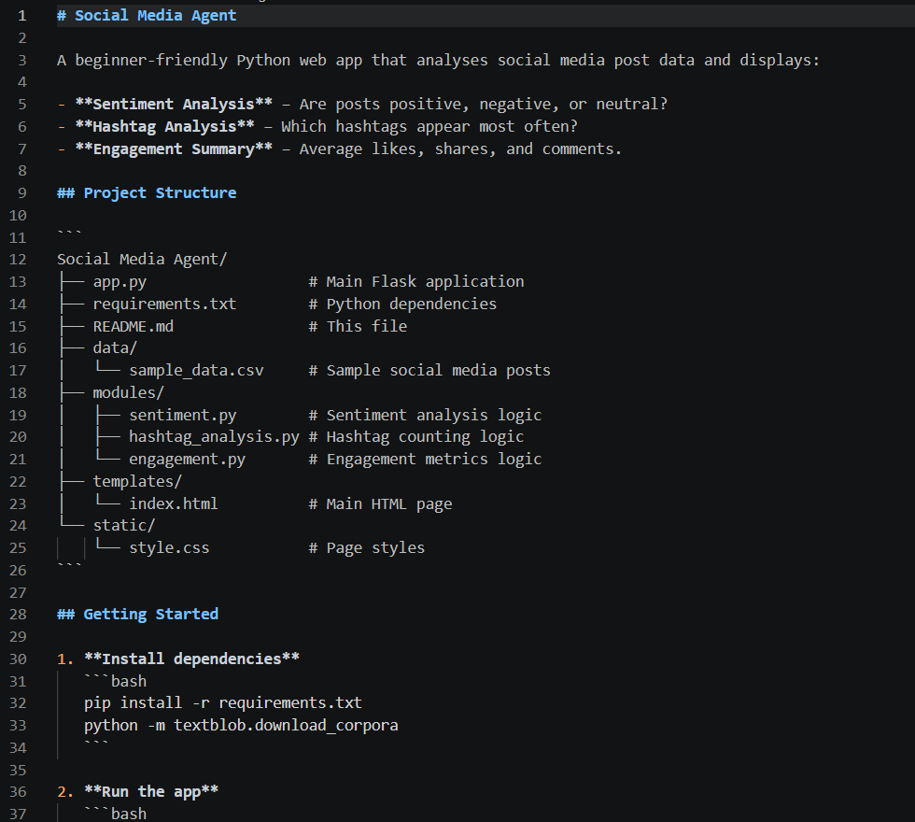
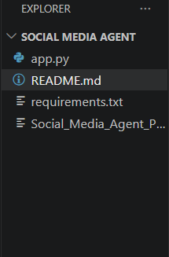
Required Files created using IBM bob -

Slide 7
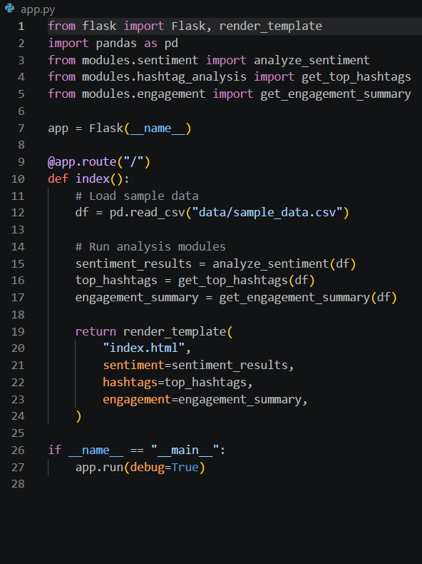
IBM Bob Screenshots:

Slide 8
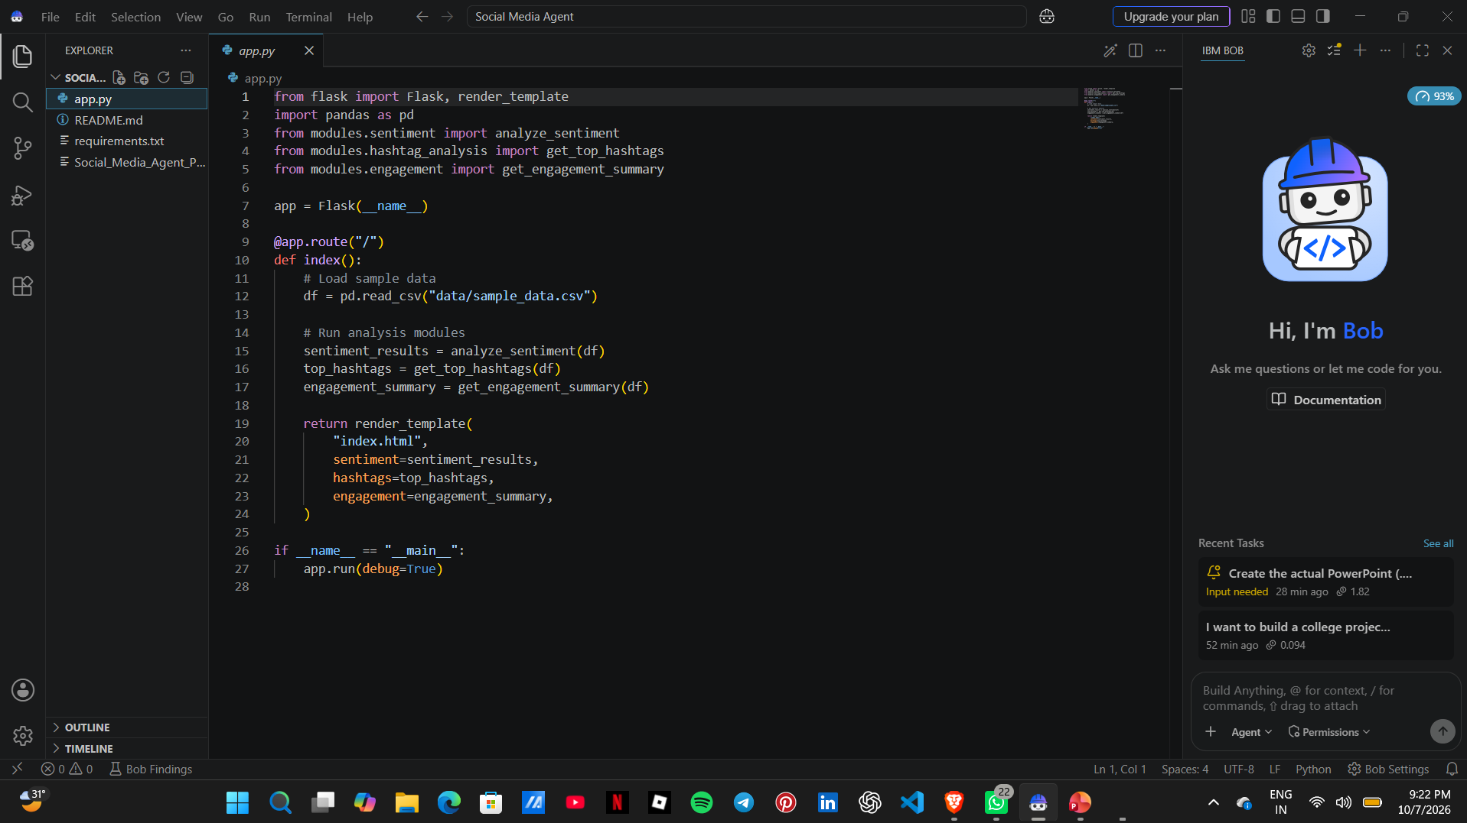

Slide 9
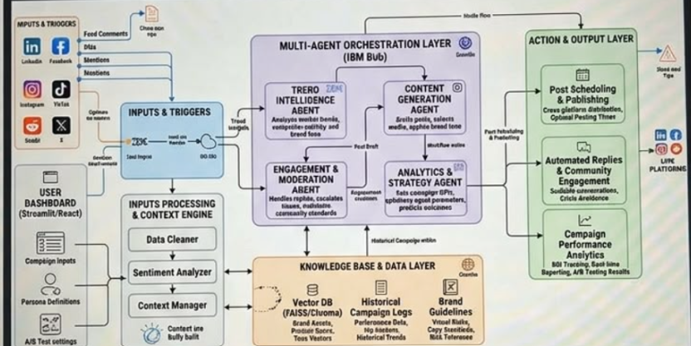
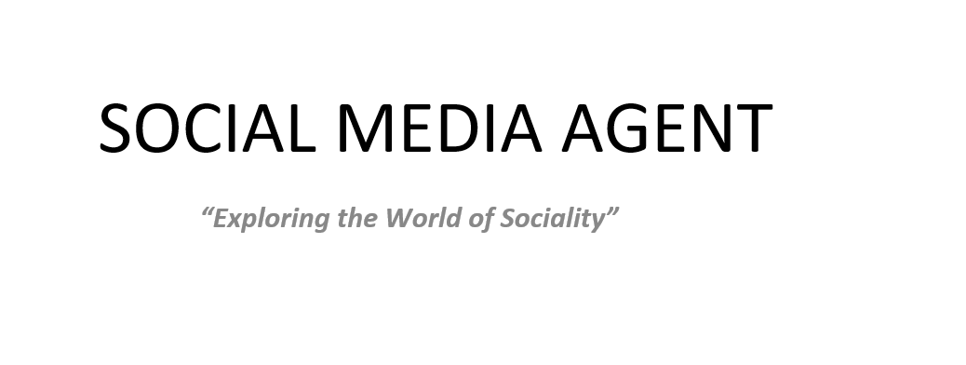
Project Output Screenshot
Please put IBM Bob output screenshots with 2-3 prompts.
You can take 2-3 more slides for each screenshot
·
·
·

Slide 10
Git Hub Link
· Please create public github repository (Enable Add README button while creating repository) with format –
Please test and Paste the working Github URL –
https://github.com/gungunjoshi/Social-media-agent
Make sure you have Uploaded following three files into your github repository
1) All Agent relevant files of IBM Cloud , 2) yourproblemstatement.pdf file 3) your projectpresntation.pptx file 4)any other files
·
·
·

Slide 11
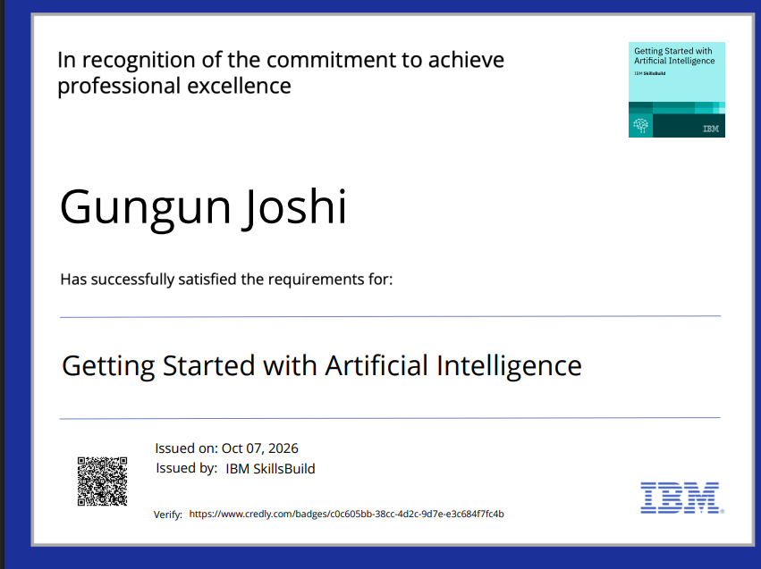
Certificates Earned:
Please add your credly certificate

Slide 12
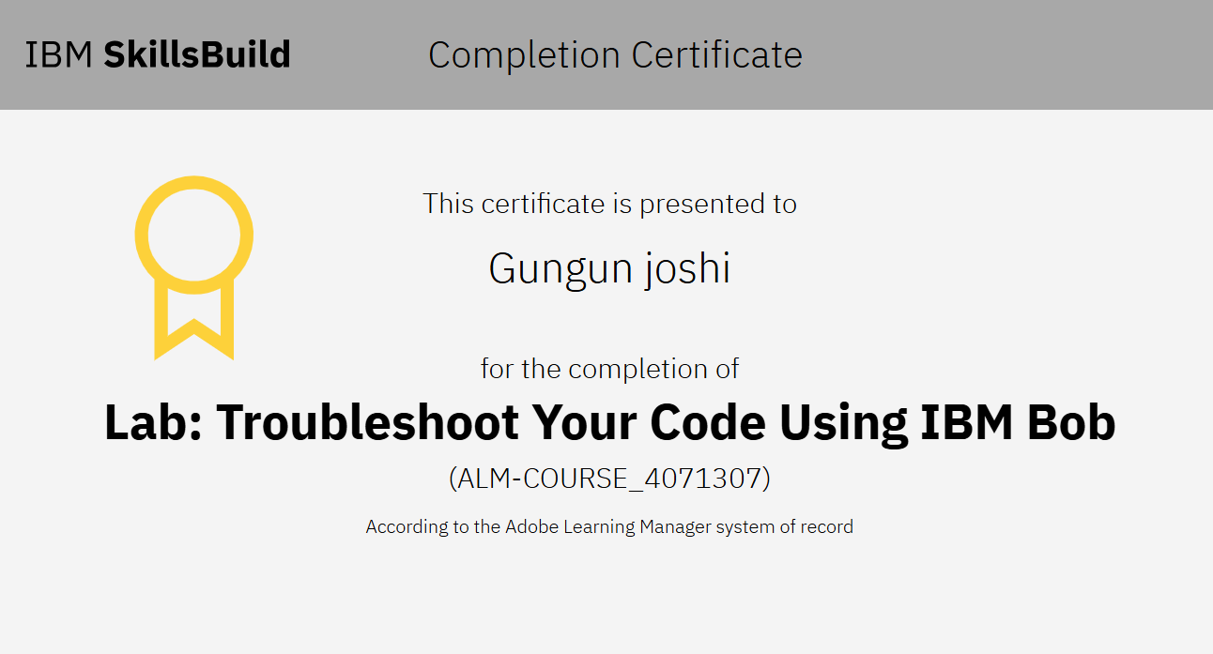
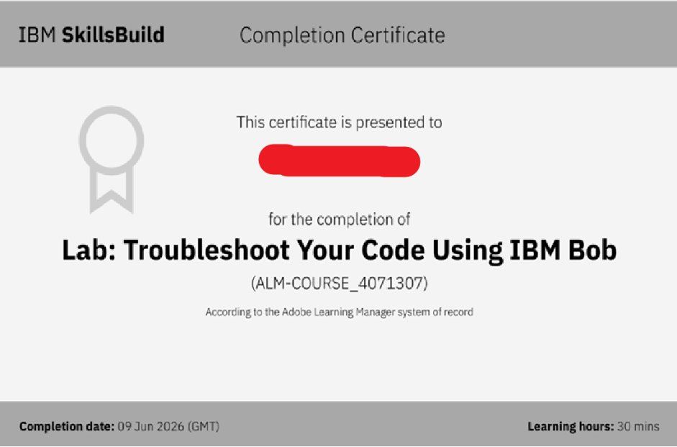
Certificates Earned:​
Add your IBM BOB Certificate

Slide 13


