Slide 1
DART: Directed Automated Random Testing
김효림

Slide 2
Contents
Abstract
Introduction
DART Overview
An Introduction to DART
Execution Model
Test Driver and Instrumented Program
Example
Advantages of the DART approach
Question

Slide 3
Abstract
DART: Directed Automated Random Testing
Main Techniques
Automated Extraction of the interface of a program with its external environment using static source-code parsing
Automatic generation of a test driver for this interface that performs random testing to simulate the most general environment the program can operate in
Dynamic analysis of how the program behaves under random testing and automatic generation of new test inputs to direct systematically the execution along alternative program paths

Slide 4
Abstract
Main Strength
Performed completely automatically on any program that compiles
No need: test driver, harness code
Detects standard errors
Program crashes
Assertion violations
Non-termination

Slide 5
1. Introduction
Testing
The primary way to check the correctness of software
Cost: Software failure > Software Test
Unit Testing
Detect errors in the component’s logic
Check all corner cases
Provide 100% code coverage
But,
Hard and expensive to perform
Need to write test driver/harness code to simulate the environment of the component
Often either performed very poorly or skipped
Subsequent phases of testing(feature, integration and system testing)
Not to check the corner cases where bugs causing reliability issues are typically hidden

Slide 6
1. Introduction - cont.
DART: Directed Automated Random Testing
Automate unit testing of software
Main Techniques
Automated Extraction of the interface of a program with its external environment using static source-code parsing
Automatic generation of a test driver for this interface that performs random testing to simulate the most general environment the program can operate in
Dynamic analysis of how the program behaves under random testing and automatic generation of new test inputs to direct systematically the execution along alternative program paths

Slide 7
1. Introduction - cont.
Main Strength
Performed completely automatically on any program that compiles
No need: test driver, harness code
Detects standard errors
Program crashes
Assertion violations
Non-termination
Preliminary experiments to unit test examples
Needham-Schroeder’s security protocol
oSIP library

Slide 8
1. Introduction - cont.
The idea of extracting automatically interfaces of software components via static analysis
Model-checking purposes
Reverse engineering
Compositional verification
Combine automatic interface extraction with random testing and dynamic test generation
DART
Test management tools

Slide 9
1. Introduction - cont.
Random testing
Simple and well-known technique
Can be remarkably effective at finding software bugs
Usually provide low code coverage
If (x ~)-then branch of the conditional statement
Has only one chance to be exercised out of 2^32 if x is a 32bit integer(randomly initialized input)
DART
Makes random testing automatic by combining it with automatic interface extraction
Makes it much More effective in finding errors thanks to the use of dynamic test generation to drive the program along alternative conditional branches

Slide 10
1. Introduction - cont.
Code Inspection
The way to check correctness during the software development cycle
Static source-code analysis for building automatic code-inspection tools
Prefix/Prefast
MC
Klocwork
Polyspace
lint (static checker)
Generate an overly large number of warnings and false alarms
Rarely used by programmers on a regular basis

Slide 11
1. Introduction - cont.
Main challenge faced by the new generation of static analyzers
To do a better job in dealing with false alarms, which arise from the inherent imprecision of static analysis
Report only high-confidence warnings(at the risk of missing some actual bugs)
Report all of them(at the risk of overwhelming the user)
Static analysis still need significant human intervention
DART
Based on dynamic analysis and fully automated

Slide 12
2. DART Overview
Integration of random testing and dynamic test generation
Using Symbolic reasoning

Slide 13
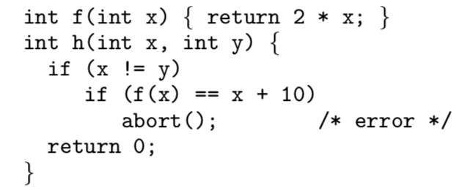
2.1 An Introduction to DART
Function h: defective
Abort statement for some value of its input vector(parameter x or y or both)
Typical of random testing
Difficult to generate input values that will drive the program through all its different execution path
DART
Dynamically gather knowledge about the execution of the program
Directed search
Start with random input
Calculate during each execution an input vector for the next execution
This vector contains values that are the solution of symbolic constraints gathered from predicates in branch statements during the previous execution
The new input vector attempts to force the execution of the program through a new path
Repeating this process, a directed search attempts to force the program to sweep through all its feasible execution paths
<code> Function h

Slide 14
2.1 An Introduction to DART - cont.
Repeat & Find all its feasible execution paths
Random input | → | Calculate an input vector for the next execution (go to new Path Constraint) | → | Attempts to force the execution through a new path
(Termination)
(Abort)
Path Constraint: an equivalence class of input vectors, all input vectors that drive the program through the path that was just executed
To force the program through a different equivalence class (with Equivalence Partitioning)
Negating the last predicate of the current path constraint

Slide 15
2.2 Execution Model
Under test(concretely, executing the actual program P)
Random input / Path constraints
Symbolically(on values at memory locations expressed in terms of input parameters)
ℳ: memory (domain)(mapping from memory addresses m)
m: memory address (codomain(range))
+: update
ℳ ‘ = ℳ + [m → v] == ℳ ‘(m) = v
e : set of addresses m
P: program
Defines
M⃗₀: a sequence of input addresses
the addresses of the input parameters of P
I⃗ : input vector
the initial value of M⃗₀ and hence ℳ
associates a value to each input parameter

Slide 16
2.2 Execution Model - cont.
l: statement of address(other than abort or halt)
Initial address l0
S : mapped memory address
c: constance
*(e’, e’’): a dyadic term denoting multiplication
≤(e’, e’’): a term denoting comparison
¬(e’) : a monadic term denoting negation
*e’ : a monadic term denoting pointer dereference
evaluate_concrete(e, ℳ): evaluates expression e in context ℳ and return a 32-bit value for e
statement_at(l, ℳ): the next statement to be executed

Slide 17
2.2 Execution Model - cont.
Program execution w
C: the set of conditional statements
A: the set of assignment statements in P
finite sequence in Execs := (A∪C)*(abort | halt)
α₁c₁α₂c₂ … c_{k}α_{k+1}s, where α_{i} ∈ A∗ (for 1≤i≤k+1), c_{i} ∈ C (for1≤i≤k) , and s ∈ { abort, halt}.
Execs( P ): the set of such executions generated by all possible I⃗
Node: each statement
Form: Execution tree
Assignment nodes have one successor
Conditional nodes have one or two successors
Leaves are labeled abort or halt

Slide 18
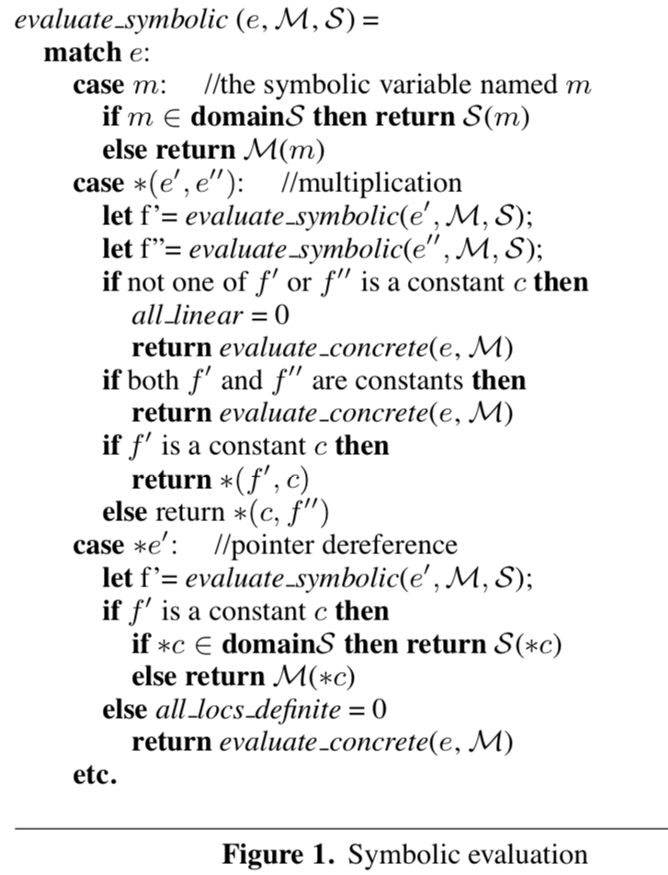
2.3 Test Driver and Instrumented Program
The goal of DART
To explore all paths in the execution tree Execs(P)
Assume
The theory of integer linear constraints
How we handle the transition from constraints within the theory to those that are outside
Symbolic evaluation
a symbolic memory S that maps memory addresses to expressions
S: mapping that maps each m ∈ M⃗₀ to itself
When an expression falls outside the theory, DART simply falls back on the concrete value of the expression
Flag for track completeness
all_linear
all_locs_definite
Initial value: 1
Falls back on the concrete value: 0

Slide 19
2.3 Test Driver and Instrumented Program - cont.
Execution Tree
Run repeatedly
Each run(except the first) is executed with the help of a record of the conditional statements executed in the previous run
Each conditional
Record a branch value
1: the then branch is taken
0: the else branch is taken
Record done value
0: only one branch of the conditional has executed in prior runs
With the same history up to the branch point
1: otherwise
Stack: Store information associated with each conditional statement of the last execution path
List variable
kept in a file between executions
i+1th conditional execution
For i, 0 ≤ i < |stack|, stack[i] = (stack[i].branch, stack[i].done)

Slide 20
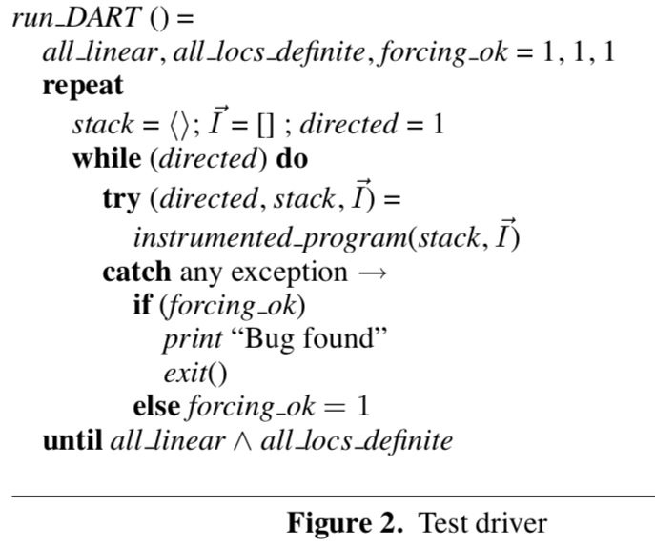
2.3 Test Driver and Instrumented Program - cont.
Test_Driver
Combines random testing(the repeat loop) with directed search(the while loop)
If the instrumented_program throws an exception, then a bug has been found
completeness flags
all_linear
all_locs_definite
Each holds unless a “bad” situation
If completeness flags are still hold, then program terminated
Found all paths
If just one of the completeness flags have been turned off, then the outer loop continues forever

Slide 21
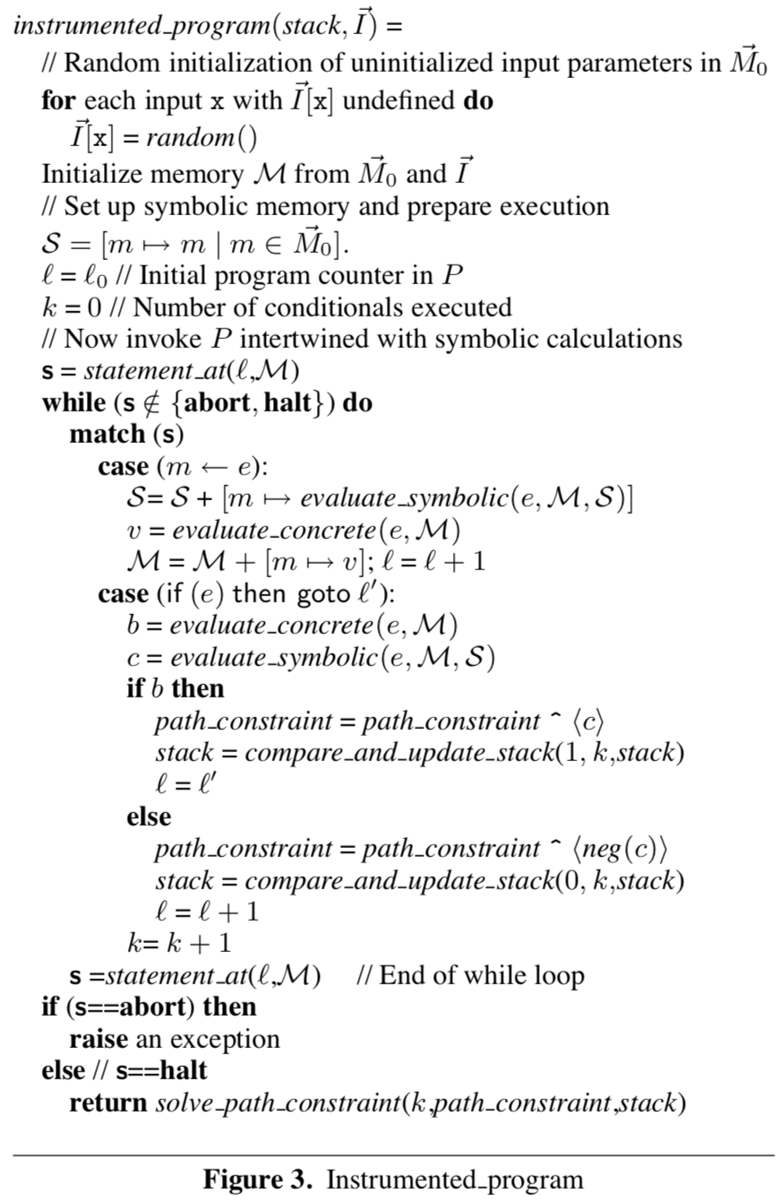
2.3 Test Driver and Instrumented Program - cont.
Instrument_program
Executes as the original program
With interleaved gathering of symbolic constraints
s = statement_at(l, ℳ)
Each conditional statement
Checks by calling compare_and_update_stack
^: list concatenation
then: path_constraint^⟨c⟩
else: path_constraint^⟨neg(c)⟩
loop invariant
stack[|stack|-1].done = 0(initial)
1: If the execution proceeds according to all the branches in stack as checked by compare_and_update_stack

Slide 22
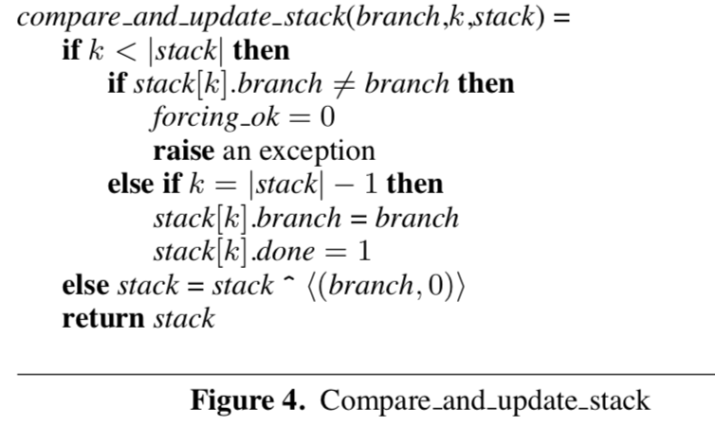
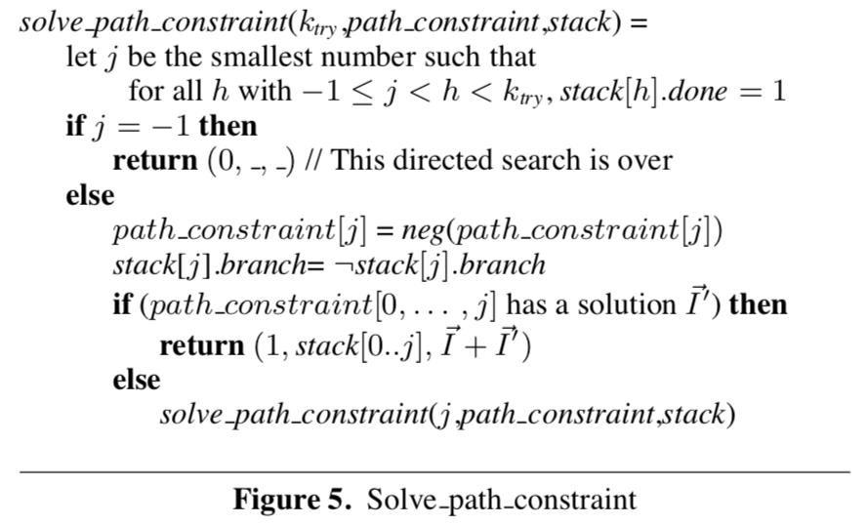
2.3 Test Driver and Instrumented Program - cont.
Compare_and_update_stack
Checks whether the current execution path matches the one predicted at the end of the previous execution and represented in stack passed between runs
flag forcing_ok == 1(initial)
0
If prediction of the outcome of a conditional is not fulfilled
Restart run_DART with a new random input vector
all_linear ⋀ all_locs_definite ⇒ forcing_ok
Solve_path_constraint
When the original program halts, new input values are generated
To attempt to force the next run to execute the last unexplored branch of a conditional along the stack
I^{⃗ +} I⃗’ : If such a branch exists and if the path constraint that may lead to its execution has a solution I⃗’, this solution is used to update the mapping I^{⃗ to be used for the next run}

Slide 23
2.3 Test Driver and Instrumented Program - cont.
THEOREM 1
If run_DART prints out “Bug found” for P, then there is some input to P that leads to an abort
If run_DART terminates without printing “Bug found,” then there is no input that leads to an abort statement in P, and all paths in Execs(P) have been exercised
Otherwise, run_DART will run forever
Proofs
(a) and (c) are immediate
(b)
Any potential incompleteness in DART’s directed search detected and recorded by setting at least one of the two flags to 0.
all_linear
all_locs_definite
Difference between DART and static_analysis_based approaches
DART is guaranteed to be sound even when using an incomplete or wrong theory

Slide 24
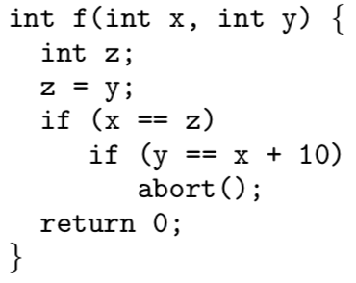
2.4 Example
First Run
Initial concrete memory: ℳ = [m_{x} → 123456, m_{y} → 654321]
Initial symbolic memory: S = [m_{x} → m_{x} , m_{y} → m_{y}]
Path constraint: ⟨m_{x} = m_{y}⟩
halt: ⟨¬(m_{x} = m_{y})⟩
k = 1, stack = ⟨(0, 0)⟩, S = [m_{x} → m_{x}, m_{y} → m_{y}, m_{z} → m_{y}], ℳ = [m_{x} → 123456, m_{y} → 654321, m_{z} → 654321]
Solve ⟨m_{x} = m_{y}⟩
⟨m_{x} → 0, m_{y} → 0⟩
Update input vector I⃗ + I⃗′ is then ⟨0, 0⟩
The branch bit in stack has been flipped
<code> Function f

Slide 25
2.4 Example - cont.
Second Run
run_DART
(directed, stack, I⃗)=(1, ⟨(1, 0)⟩, ⟨0, 0⟩)
compare_and_update_stack
Check that the actually executed branch of the outer if statement is now then branch
The else branch of the inner if statement is executed
Path constraint
⟨m_{x} =m_{y}, m_{y} =m_{x} +10⟩
run_DART driver calls solve_path_constraint
(k_{try}, path_constraint, stack)=(2,⟨m_{x} =m_{y}, m_{y} =m_{x}+10⟩,⟨(1,1),(0,0)⟩)
This path constraint has no solution and the first conditional has already been covered (stack[0].done = 1)
solve_path_constraint returns (0, _, _)
All completeness flags are still set
run_DART terminates
<code> Function f

Slide 26
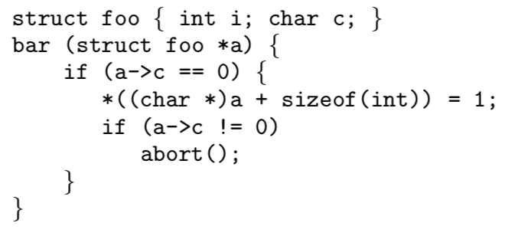
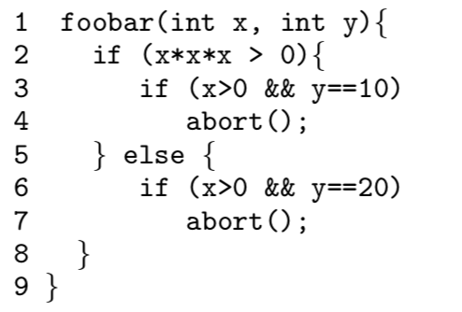
2.5 Advantages of the DART approach
Dynamic analysis often has an advantage over static analysis when reasoning about dynamic data
Ex. If two pointers point to the same memory location (<code> struct foo)
DART simply checks whether their values are equal and does not require alias analysis
Static analysis will typically not be able to report with high certainty that abort() is reachable
Standard alias analysis is not able to guarantee that a—>c has been overwritten
DART finds a precise execution leading to the abort very easily by simply generating an input satisfying the linear constraint a —> c == 0
DART
Concrete + symbolic execution
Concolic
First, any execution leading to an error detected by DART is trivially sound
Second, it allows us to alleviate the limitations of the constraint solver/theorem prover
Find the only reachable abort statement in the above example(<code> foobar) with high probability.
<code> struct foo
<code> foobar

Slide 27
Question
Static
Dynamic
WhiteBox
BlackBox
BlackBox
What is DART's testing technique?
White box(symbolic execution, branch coverage) — input a branch to the stack
Black box(Random Testing(concrete execution), Equivalence Partitioning)
If so, does it include Boundary Value Analysis?
Test drive: dynamic test
Directed search
Figure 3, Why there is no forcing_ok flag after ‘if(s==abort)then’?
Bug log

