Slide 1
Introduction to Software Testing
김효림

Slide 2
Contents
Part 1 Foundations
Why Do We Test Software?
Model-Driven Test Design
Test Automation
Criteria-Based Test Design
Question

Slide 3
1. Why Do We Test Software?
Testing
Design of test cases
Success of software products
Background
Software quality is increasingly becoming essential to all businesses
Knowledge of software testing is becoming necessary for all software engineer
Software industry has become much bigger, is more competitive, and has more users
Software is an essential component of exotic embedded applications and as well as mundane appliances
Optimistic consumers assume that software will never fail

Slide 4
1. Why Do We Test Software? - cont.
This book’s goal
Clarifying obscures underlying similarities among techniques
Show How testing is more efficient and effective by using a classical engineering approach
How to develop abstraction models, design tests at the abstract level, and then implement actual tests at the concrete level by satisfying the abstract designs
Recognizing that all test criteria can be defined with a very short list of abstract models
Input domain characterizations
Graphs
Logical expressions
Syntactic descriptions

Slide 5
1. Why Do We Test Software? - cont.
Fault
When Software Goes Bad
Software Fault
A static defect in the software
Design mistakes
Do not appear spontaneously, but exist as a result of a decision by a human
Can never eliminate all faults from software
Software Error
An incorrect internal state that is the manifestation of some fault
Software Failure
External, incorrect behavior with respect to the requirements or another description of the expected behavior
Error
Cause
Failure
Error
Discover

Slide 6
1. Why Do We Test Software? - cont.
Bug
Refer to all three of fault, error, and failure
Public Failure
Mars lander of September 1999
Crashed due to a misunderstanding in the units of measure used by two modules created by separate software groups
Therac-25 radiation therapy machine
First Ariane 5 rocket
exploded 37 seconds after liftoff in 1996
Unhandled floating point conversion exception in an inertial guidance system function
Arian 4 —> Arian 5

Slide 7
1. Why Do We Test Software? - cont.
Pentium microprocessor bug in 1994
The great northeast blackout of 2003
Power line in Ohio brushed against overgrown trees and shut down
Fault in the power industry
Software alarm system failed in the local power company
Centralized students data management system in Korea miscalculated he academic grades of over 29,000 middle and high school student in 2011
Symantec security threat report in 2007, 61% of all vulnerabilities disclosed were due to faulty software

Slide 8
1. Why Do We Test Software? - cont.
Goals Of Testing Software
Useful standards
IEEE Standard Glossary of Software Engineering Terminology
DOD-STD-2167A
MIL-STD-498 from the US Department of Defense
British Computer Society’s Standard for Software Component Testing Software Error
Verification
The process of determining whether the products of a phase of the software development process fulfill the requirements established during the previous phase
Technical activity that uses knowledge about the individual software artifacts, requirements, and specifications
Validation
The process of evaluating software at the end of software development to ensure compliance with intended usage
Depends on domain knowledge
Knowledge of the application for which the software is written

Slide 9
1. Why Do We Test Software? - cont.
Test process maturity levels
Level 0
there is no difference between testing and debugging
Level 1
The purpose of testing is to show correctness
Level 2
The purpose of testing is to show that the software does not work
Level 3
The purpose of testing is not to prove anything specific, but to reduce the risk of using the software
Spell checker
Level 5
Testing is a mental discipline that helps all IT professionals develop higher- quality software

Slide 10
2. Model-Driven Test Design
Every Software has problems
Wise software engineers try to evaluate software’s “behavior” to decide if the behavior is acceptable within consideration of a large number of factors including reliability, safety, maintainability, security, and efficiency
Overwhelming complexity
Raise our level of abstraction
Model-Driven Test Design(MDTD)
Breaks testing into a series of small tasks that simplify test generation
Test designers isolate their task and work at a higher level of abstraction
Using mathematical engineering structures
Designing test values independently of the details of software or design artifacts, test automation, and test execution

Slide 11
2. Model-Driven Test Design - cont.
Key intellectual step
Test case design
be the primary determining factor in whether tests successfully find failures in software
Approach
Human-Based
test engineer uses domain knowledge of the software’s purpose and his or her experience
to design tests that will be effective at finding faults
Criteria-based
Use coverage criteria

Slide 12
2. Model-Driven Test Design - cont.
Software Testing Foundations
Testing can show only the presence of failures, not their absence
Level 2: test successful == it finds an error
Testing
Evaluating software by observing its execution
Test Failure
Execution of a test that results in a software failure
Debugging
The process of finding a fault given a failure
Not all inputs will “trigger” the fault into creating incorrect output(a failure)
Difficult to relate a failure to the associated fault

Slide 13
2. Model-Driven Test Design - cont.
Test
Final Program State and Outputs
Reaches
Incorrect Portion of the Final State
Observed Portion of the Program State
Faulty Location
Infects
Incorrect Program State
Propagates
Reveals
Figure 2.1. Reachability, Infection, Propagation, Reveal-ability(RIPR) model(fault/failure model)
Test must reach the location or locations in the program that contain the fault (Reachability)
The state of the program must be incorrect (Infection)
The infected state must propagate through the rest of the execution and cause some output or final state of the program to be incorrect (Propagation)
The tester must observe part of the incorrect portion of the final program state (Reveal-ability)
If the tester only observes parts of the correct portion of the final program state, the failure is not revealed
The common way to deal with complexity in engineering
To use abstraction by abstracting out complicating details that can be safely ignored by modeling the problem with some mathematical structures

Slide 14
2. Model-Driven Test Design - cont.
Software Testing Activities
Test engineer
An Information Technology (IT) professional who is in charge of one or more technical test activities
designing test inputs
producing test case values
running test scripts
analyzing result
reporting results to developers and managers
Each software artifact produced over the course of a product’s development has, or should have, an associated set of test cases, and the person best positioned to define these test cases is often the designer of the artifact

Slide 15
2. Model-Driven Test Design - cont.
Test manager
In charge of one or more test engineers
Set test policies and processes
Interact with other managers on the project
Help the engineers test software effectively and efficiently
Must design tests by creating test requirements
Figure 2.2. Activities of test engineers
Test requirements
Transformed into actual values and scripts that are ready for execution
Executable tests
Run against the software
Results
Evaluated to determine if the test reveal a fault in the software

Slide 16
2. Model-Driven Test Design - cont.
Test Manager
Test Designs
instantiate
Executable Tests
Design
Test engineer
Test engineer
Test engineer
P
Computer
Execute
Output
Evaluate
This activities may be carried out by one person or by several
The process is monitored by a test manager
Test engineer’s powerful tools
Formal coverage criterion
Way to decide what test inputs to use during testing
making it more likely that the tester will find problems in the program
Providing greater assurance that the software is of high quality and reliability
Provide stopping rules for the test engineers

Slide 17
2. Model-Driven Test Design - cont.
Testing Levels Based On Software Activity
Acceptance Testing
assess software with respect to requirements or user’s needs
System Testing
Assess software with respect to architectural design and overall behavior
Integration Testing
Assess software with respect to subsystem design
Module Testing
Assess software with respect to detailed design
Unit Testing
Assess software with respect to implementation

Slide 18
2. Model-Driven Test Design - cont.
Requirements Analysis
Acceptance Test
Test
Architectural Design
Design
System Test
Information
Subsystem Design
Integration Test
Subsystem Design
Module Test
Implementation
Unit Test
Figure 2.3. Software development activities and testing levels - the “V Model”
Typical scenario for Testing levels
How they relate to software development activities by isolation each step
Not intended to imply a waterfall process
Mere process of designing tests can identify defects in design decisions that otherwise appear reasonable
Standard advice
to design the tests concurrently with each development activity, even though the software will not be in an executable form until the implementation phase

Slide 19
2. Model-Driven Test Design - cont.
Requirements Analysis
Captures the Customer’s needs
Acceptance testing
Designed to determine whether the completed software in fact meets these needs
Do what the users want
Users or other individuals who have strong domain knowledge
Architectural design
Choose components and connectors that together realize a system whose specification is intended to meet the previously identified requirements
System testing
Designed to determine whether the assembled system meets its specifications
Very expensive place to find lower-level faults and is usually not done by the programmers
Subsystem design
Specify the structure and behavior of subsystems
each of which is intended to satisfy some function in the overall architecture
Often, the subsystems are adaptation of previously developed software
Integration testing
Designed to assess whether the interfaces between modules in a subsystem have consistent assumptions and communicate correctly

Slide 20
2. Model-Driven Test Design - cont.
Detailed design
Determines the structure and behavior of individual modules
Module Testing(Developer testing)
Module
Collection of related units
Assembled in a file(C), package(Ada), or class(C++, Java)
Designed to assess individual modules in isolation, including how the component units interact with each other and their associated data structures
Implementation
Actually produces code
Unit Testing
Program unit( function(C or C++), procedure or function(Ada), method(Java), subroutines(Fortran))
One or more contiguous program statements
Designed to assess the units produced by the implementation phase
“lowest” level of testing
OO software
Many dependencies among methods in classes
To combine unit and module testing
Use the term unit testing or developer testing

Slide 21
2. Model-Driven Test Design - cont.
Regression testing
Done after changes are made to the software
To help ensure that the updated software still possesses the functionality it had before the updates
Intra-method testing
Unit and module testing
Evaluates individual methods
Evaluates pairs of methods within the same class
Evaluates a single entire class, usually as sequences of calls to method
Integration testing
Evaluates more than one class at the same time

Slide 22
2. Model-Driven Test Design - cont.
Coverage Criteria
Testing’s essential problem
Numbers
Input space
Infinite
Test designer’s goal
Summarized in a very high-level way as searching a huge input space
Hoping to find the fewest tests that will reveal the most problems
Source of key problems in testing
How do we search
When do we stop

Slide 23
2. Model-Driven Test Design - cont.
Coverage criteria
Structured, practical ways to search the input space
Can maximize the “bang for the buck,” with fewer tests that are effective at finding more faults
Will be comprehensive, yet factor out unwanted redundancy
Provide traceability from software artifacts such as source, design models, requirements, and input space descriptions
Provide stopping rule for testing
Four mathematical structures
Input domains
Graphs
Logic expressions
Syntax descriptions(grammars)

Slide 24
2. Model-Driven Test Design - cont.
covering pairs of edges in finite state machines
switch cover
two-trip
two-trip
node coverage == edge coverage
Black-Box Testing
Derive tests from external descriptions of the software
Including specifications, requirements, and design
White-Box Testing
Derive tests from the source code internals of the software
Specifically including branches, individual conditions, and statements
MDTD
Model-Based Testing

Slide 25
2. Model-Driven Test Design - cont.
Model-Driven Test Design
Each Task requires different skills, background knowledge, education, and training
Test Design
The process of creating input values that will effectively test software
Criteria-based test design
Design test values that satisfy engineering goals such as coverage criteria
The most mathematical and technically challenging part of testing
Human-based test design
Design test values based on domain knowledge of the program and human knowledge of testing
The testers must have knowledge of the software’s application domain, of testing, and of user interfaces
Stress testing
Not expect during typical behavior
Test Automation
The process of embedding test values into executable scripts
Require more knowledge and problem-solving skills
Need to add additional software to access the hardware, simulate conditions, or otherwise control the environment

Slide 26
2. Model-Driven Test Design - cont.
Test Execution
The process of running tests on the software and recording the results
Require basic computer skills and can often be assigned to interns or employees with little technical background
Test Evaluation
The process of evaluating the results of testing and reporting to developers
Require knowledge of the domain, testing, user interface, and psychology
Test Personnel and Abstraction

Slide 27
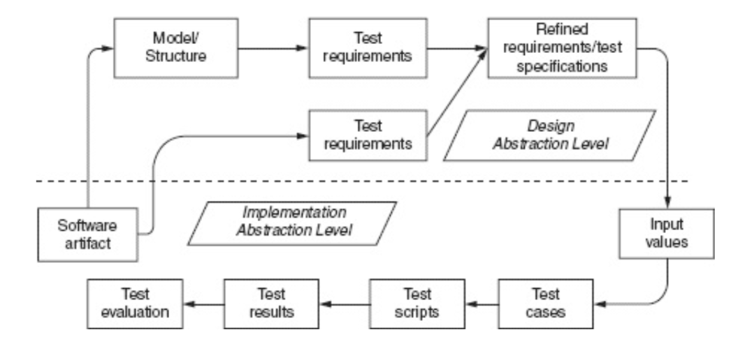
2. Model-Driven Test Design - cont.
Figure 2.4. Model-driven test design
Raise their level of abstraction
Small subset of testers can do the mathematical aspects of designing and developing tests

Slide 28
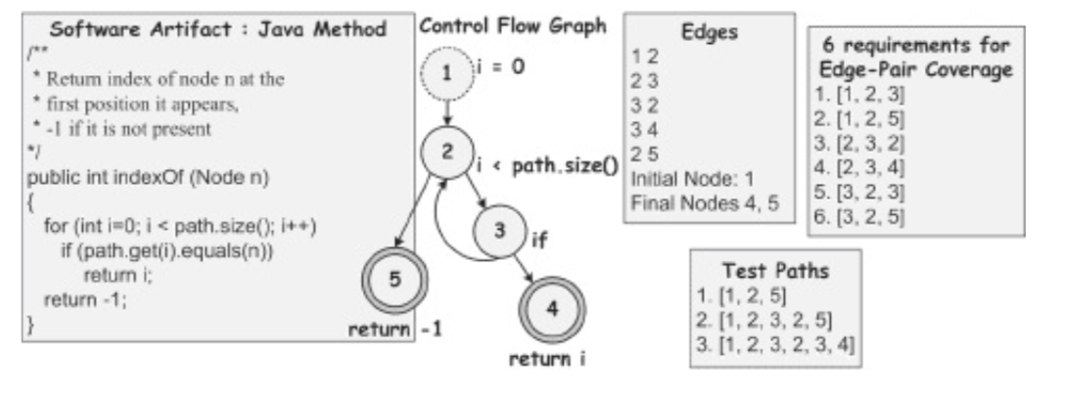
2. Model-Driven Test Design - cont.
Figure 2.5. Example method, CFG, test requirements and test paths
The process for unit testing of a small java method
code/control Flow Graph
Initial node: dotted circle
Final node: double circles

Slide 29
3. Test Automation
Prerequisite for unit testing and criteria-based testing
Test automation
The use of software to control the execution of tests, the comparison of actual outcomes to predicted outcomes, the setting up of test preconditions, and other test control and test reporting function
Not only reduces the cost of testing, also reduces human error and makes regression testing easier by allowing a test to be run repeatedly with the bush of a button
Distinguish revenue tasks
Excise tasks
Routinely use large amounts of test engineers’ time

Slide 30
3. Test Automation - cont.
Candidates for automation
Eliminating excise tasks eliminates drudgery
Making the test engineer’s job more satisfying
Automation frees up time to focus on the fun and challenging parts of testing
Test design
Revenue task
Automation allows the same test to be run thousands of times without extra effort in environments where tests are run daily or even hourly
Automation can help eliminate errors of omission
Failing to update all the relevant files with the new set of expected results
Automation eliminates some of the variance in test quality caused by differences in individual’s abilities
Maintaining test scripts
rerunning tests
Comparing expected result with actual results

Slide 31
3. Test Automation - cont.
Software Testability
Estimates how likely testing will reveal a fault if one exists
Testability
The degree to which a system or component facilitates the establishment of test criteria and the performance of tests to determine whether those criteria have been met
How to provide the test values to the software
How to observe results of test execution
Software observability
How easy it is to observe the behavior of a program in terms of its outputs, effects on the environment, and other hardware and software components
Software controllability
How easy it is to provide a program with the needed inputs. In terms of values, operations, and behaviors

Slide 32
3. Test Automation - cont.
Embed software
Input: hardware sensors
Difficult to control
Some inputs may be difficult, dangerous, or impossible to supply
Testing with simulation
Extra software built to “bypass” the hardware or software components that interfere with testing
Crucial to test automation
Test scripts need to control the execution of the component under test and to observe the results of the test

Slide 33
3. Test Automation - cont.
Components of a Test Case
Test Case Values
The input values necessary to complete an execution of the software under test
Determine the quality of the testing
Prefix Values
Input necessary to put the software into the appropriate state to receive the test case values
Postfix Values
Inputs that need to be sent to the software after the test case values are sent
Verification Values
Values necessary to see the results of the test case values
Exit Values
Values or commands needed to terminate the program or otherwise return it to a stable state
Test oracle
Decides whether a test passed or failed
test is valid or is as expected
Expected Results
The result that should be produced by the test case if the software behaves as expected

Slide 34
3. Test Automation - cont.
Test Case
composed of the test values, prefix values, postfix values, and expected results necessary for complete execution and evaluation of the software under test
Test Set
a set of test case
RIPR
R
the prefix values are included to achieve reachability
I
the test case values to achieve infection
P
the post fix values to achieve propagation
R
the expected results to reveal the failures
Executable Test Script
A test case that is prepared in a form to be executed automatically on the test software and produce a report

Slide 35
3. Test Automation - cont.
A Test Automation Framework
Test Framework
A set of assumptions, concepts, and tools that support test automation
Provides a standard design for test scripts
Include support for the test driver
Assertions to evaluate expected result
The ability to share common test data among tests
Test sets to easily organize and run tests
The ability to run tests from either a command line or a GUI

Slide 36
3. Test Automation - cont.
The JUnit Test Framework
Run as stand alone Java programs (from the command line) or within an integrated development environment (IDE)
Used to test an entire class, part of an object such as a method or some interaction methods, or interaction between several objects
Used for unit and integration testing
Not system testing
Embed each test into one test method
Test methods are collected into test classes
A collection of test methods
Methods to set up the program state before running each test (prefix values) and update the state after each test (postfix values)

Slide 37
3. Test Automation - cont.
Test classes are written using the method in the JUnit.famework.assert class
Each test method checks a condition (assertion)
Reports to the test runner whether the test failed or succeeded
assertions
How expected results and the test oracle are encoded into JUnit tests
The test runner reports the result to the user

Slide 38
3. Test Automation - cont.
Assert method
All assert method return void
assertTrue(boolean)
This is the simplest assertion, and, in principle, any assertion about program variables can ultimately be implemented using this assertion
assertTrue(String, boolean)
This assertion provides more information to the tester
If the assertion is true, the string is ignored
If the assertion is not true, the string is sent to the test engineer
It should provide a concise summary of the failure
fail(String)
This assertion puzzles many new test engineers, but it is extremely useful in situations where if a certain section of code is reached, that means the test has failed
As before, the string provides a summary to the test engineer
The fail method is often used to test exceptional behavior

Slide 39
3. Test Automation - cont.
Test fixture
The state of the test
defined by the current values of key variables in the software under test
Control the prefix values(initializations, @Before) and postfix values(reset values, @After)
@Before
Sets up
Called before every test method
@After
Tear down
Called after every test method
@Test
JUnit test
Test***

Slide 40
3. Test Automation - cont.
Data-Driven Tests
The same test methods to be run multiple times
Difference: input values, expected output
To write the test once and then supply the data values in a table
Parameterized
Overloaded in the context of unit testing with different, conflicting, definitions
@RunWith(Parameterized.class)
@Parameters
@Test

Slide 41
3. Test Automation - cont.
Adding Parameters to JUnit Tests
Theory mechanism
Defined test methods with parameters
@Theory
@DataPoints
JUnit from the Command Line
The format of the feedback is simply the normal stack trace that the Java runtime system supplies for any uncaught exception

Slide 42
5. Criteria-Based Test Design
The number of inputs is effectively infinite and cannot be explicitly enumerated
Coverage Criteria Defined
Test Requirement
A test requirement is a specific element of a software artifact that a test case must satisfy or cover
TR
Branch coverage
Cover all decisions in the program
Call coverage
Every method must be called at least once
Coverage Criterion
A coverage criterion is a rule or collection of rules that impose test requirements on a test set

Slide 43
5. Criteria-Based Test Design - cont.
Coverage
Given a set of test requirements TR for a coverage criterion C, a test set T satisfies C if and only if for every test requirement tr in TR, at least one test t in T exists such that t satisfies tr
Minimal Test Set
Given a set of test requirements TR and a test set T that satisfies all test requirements, T is minimal if removing any single test from T will cause T to no longer satisfy all test requirements
Minimum Test Set
Given a set of test requirements TR and a test set T that satisfies all test requirements, T is minimum if there is no smaller set of tests that also satisfies all test requirements
Why coverage is important?
Sometimes expensive to satisfy a coverage criterion
To compromise by trying to achieve a certain coverage level
Coverage Level
Given a set of test requirements TR and a test set T, the coverage level is the ratio of the number of test requirements satisfied by T to the size of TR
Some requirements cannot be satisfied

Slide 44
5. Criteria-Based Test Design - cont.
Infeasible
Test requirements that cannot be satisfied
No test case values exist
Dead code results
Used
To directly generate test case values to satisfy the criterion
Often assumed by the research community
The most direct way to use criteria
To generate test case values externally and then measure the tests against the criterion in terms of their coverage
Often favored by industry practitioners
Sometimes misleading

Slide 45
5. Criteria-Based Test Design - cont.
Coverage criteria are sometimes called metrics
Generator
Procedure that automatically generates values to satisfy a criterion
Corresponds to a tool that automatically creates test case values
Recognizer
Procedure that decides whether a set of test case values satisfies a criterion
Coverage analysis tool
Quite plentiful, both as commercial products and freeware
Criteria Subsumption
A coverage criterion C1 subsumes C2 if and only if every test set that satisfies criterion C1 also satisfies C2

Slide 46
5. Criteria-Based Test Design - cont.
Infeasibility and Subsumption
Sometimes a criterion C1 will subsume another criterion C2 if and only if all test requirements are feasible
If some test requirements in C1 are infeasible, however, C1 may not subsume C2
Sometimes a criterion C1 will subsume another criterion C2 if we assume that C1 has no infeasible test requirements
However, if C1 creates an infeasible test requirements for a program, a test set that satisfies C1 while skipping the infeasible test requirements might also “skip” some test requirements from C2 that could be satisfied

Slide 47
5. Criteria-Based Test Design - cont.
Advantages of Using Coverage Criteria
Used to decide which test inputs to use
Making it more likely that the testers will find problems
Can yield fewer tests than human-based approaches, yet be more effective at finding faults
Explicitly derived from specific software artifacts
Get built-in traceability
Provide “stopping rules” for testing
Be natural to automate the use of test criteria
Important issues
The difficulty of computing test requirements
The difficulty of generating tests
How well the tests reveal faults

Slide 48
Question
Bug log
Stack trace

