Slide 1
Generating Test Inputs By Symbolic Execution
Shin Hong
6 June 2018

Slide 2
Structural Coverage Testing Problem
Achieving high line/branch coverage is desirable in testing
many empirical evidences show that a test of a higher branch coverage tends to detect more bugs than one of a lower coverage
Finding a test input reaching a subtle branch is tedious
a condition of achieving a branch is heavily constrained by many branch/loop conditions in a long and complicated path from input (when input variables are not related with each other heavily)
A. S. Namin and J. H. Andrews: The Influence of Size and Coverage on Test Suite Effectiveness, ISSTA 2009

Slide 3
Test Generation Approaches
Black box testing
Random testing
White box testing
Search-based testing
model a path condition of a branch as a continuous function over input values
search input values toward fitting the function with a target
Symbolic execution-based testing
model a path condition of a branch as a logical formula over input values
solve the path condition to find inputs to cover the branch

Slide 4









Symbolic Execution
Run a program with inputs as symbols instead of concrete values
The value of a variable at a time is tracked as an expression over symbols
A branch condition is tracked an expression of symbols
A path condition is a conjunction of symbolic expressions
Example
Symbolic memory
int gcd(int K, int M) {
1 int x = K;
2 int y = M;
3 while (x != y) {
4 if (x > y)
5 x = x - y;
6 else
7 y = y - x; }
8 return x ; }
$$α$$
x
y
$$α−β$$
$$β$$
$$2β −α$$
Path condition
$$α≠β$$
$$∧ α>β$$
$$∧ α−β≠β$$
$$∧¬(α−β>β)$$
$$∧¬(α−β≠2β−α)$$

Slide 5
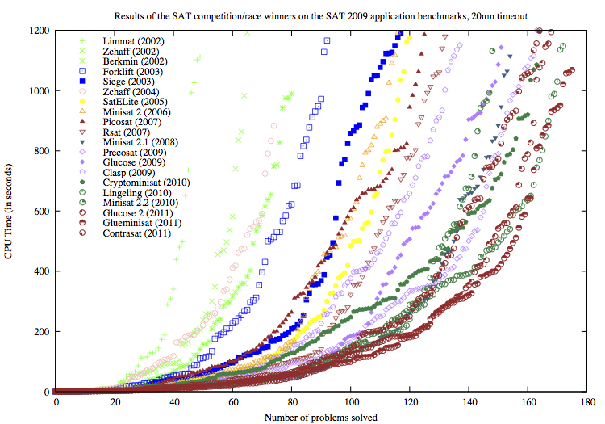
Symbolic Execution Based Test Generation
Symbolic path condition
a model of the condition of all input values that tour the path
Test input generation
construct a symbolic path condition reaching a new branch
solve the condition by a constraint solver
repeat from 1 until no branch remains
Constraint solver
SAT solver: propositional formula
SMT solver: LIA, etc.
dramatically improved in 2000's

Slide 6
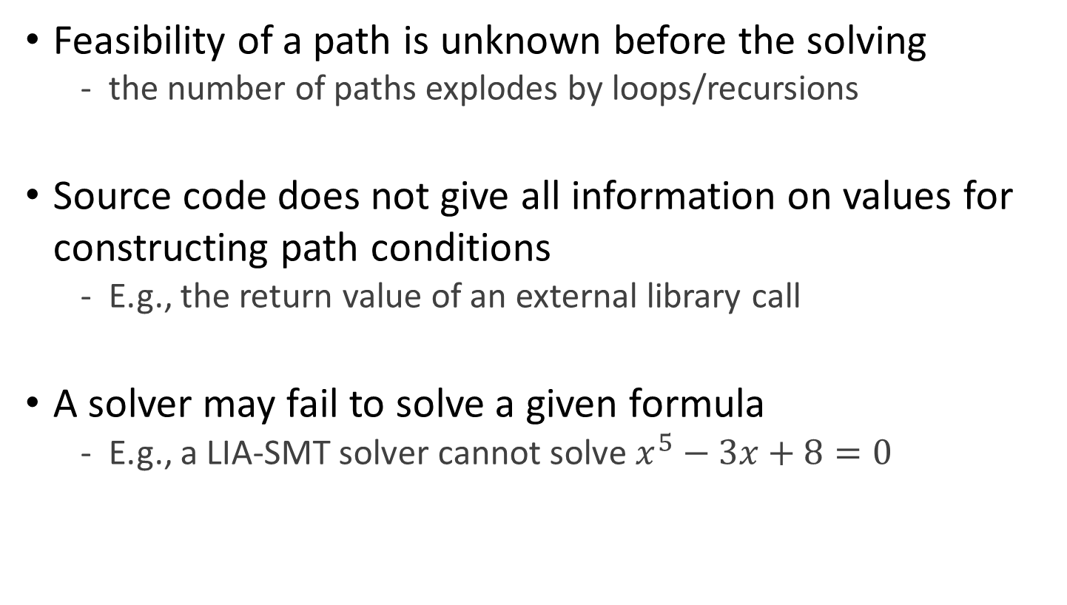
Challenges
Feasibility of a path is unknown before the solving
the number of paths explodes by loops/recursions
Source code does not give all information on values for constructing path conditions
E.g., the return value of an external library call
A solver may fail to solve a given formula
E.g., a LIA-SMT solver cannot solve $x^{5}−3x+8=0$

Slide 7
Dynamic Symbolic Execution
Run a program with actual input values while running symbolic executions in background
an actual execution tours only feasible paths
an actual execution gives an exact runtime value for any variable or expression
Construct an approximated path condition by combining symbolic values and runtime values
use a runtime value if there is no corresponding symbolic value
keep a path condition solvable by replacing an unsolvable expression with a runtime value

Slide 8
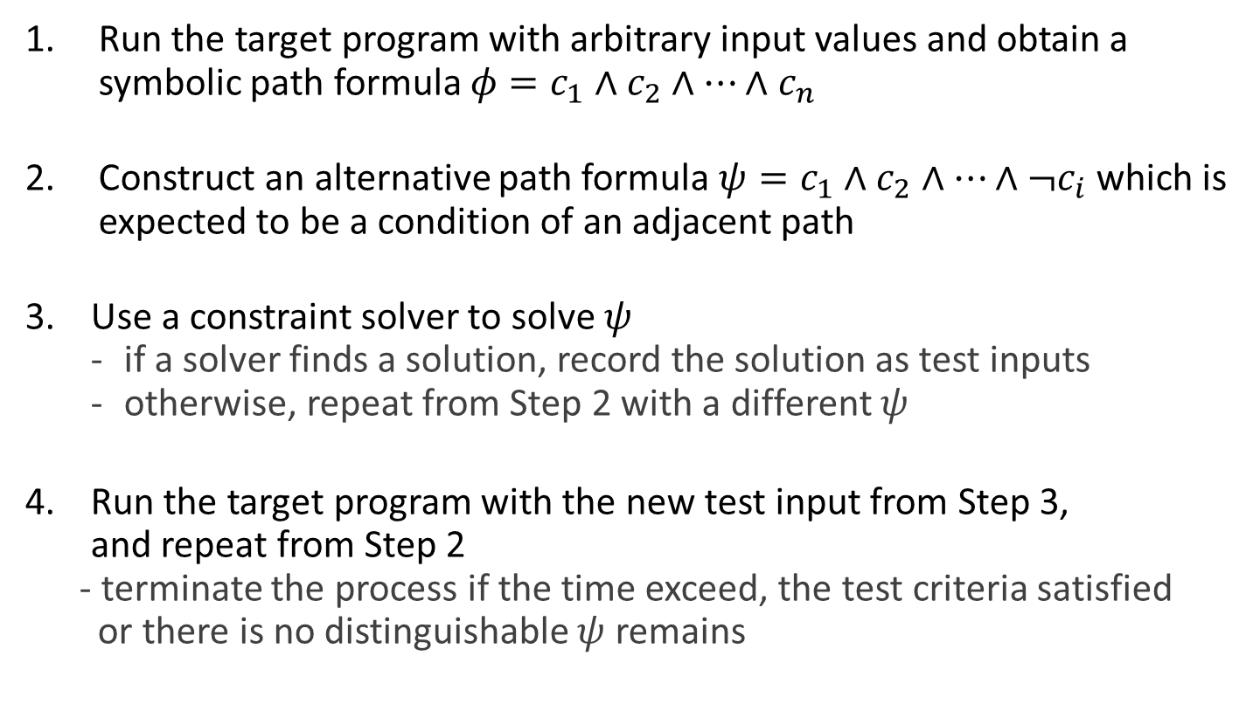
Test Generation Using Dynamic Symbolic Execution
Run the target program with arbitrary input values and obtain a symbolic path formula $φ=c_{1}∧c_{2}∧…∧c_{n}$
Construct an alternative path formula $ψ=c_{1}∧c_{2}∧…∧{¬c}_{i}$ which is expected to be a condition of an adjacent path
Use a constraint solver to solve $ψ$
if a solver finds a solution, record the solution as test inputs
otherwise, repeat from Step 2 with a different $ψ$
Run the target program with the new test input from Step 3, and repeat from Step 2
- terminate the process if the time exceed, the test criteria satisfied or there is no distinguishable $ψ$ remains

Slide 9
DART: Directed Automated Random Testing
Koushik Sen
University of Illinois Urbana-Champaign
Joint work with Patrice Godefroid and Nils Klarlund

Slide 10
DART Approach
main(){
int t1 = randomInt();
int t2 = randomInt();
test_me(t1,t2);
}
int double(int x) {return 2 * x; }
void test_me(int x, int y) {
int z = double(x);
if(z==y){
if(x != y+10){
printf(“I am fine here”);
} else {
printf(“I should not reach here”);
abort();
}
}

Slide 11
DART Approach
Concrete Execution
Symbolic Execution
main(){
int t1 = randomInt();
int t2 = randomInt();
test_me(t1,t2);
}
int double(int x) {return 2 * x; }
void test_me(int x, int y) {
int z = double(x);
if(z==y){
if(x != y+10){
printf(“I am fine here”);
} else {
printf(“I should not reach here”);
abort();
}
}
concrete state
symbolic state
constraints
t1=36
t1=m

Slide 12
DART Approach
Concrete Execution
Symbolic Execution
main(){
int t1 = randomInt();
int t2 = randomInt();
test_me(t1,t2);
}
int double(int x) {return 2 * x; }
void test_me(int x, int y) {
int z = double(x);
if(z==y){
if(x != y+10){
printf(“I am fine here”);
} else {
printf(“I should not reach here”);
abort();
}
}
concrete state
symbolic state
constraints
t1=36, t2=-7
t1=m, t2=n

Slide 13
DART Approach
Concrete Execution
Symbolic Execution
main(){
int t1 = randomInt();
int t2 = randomInt();
test_me(t1,t2);
}
int double(int x) {return 2 * x; }
void test_me(int x, int y) {
int z = double(x);
if(z==y){
if(x != y+10){
printf(“I am fine here”);
} else {
printf(“I should not reach here”);
abort();
}
}
concrete state
symbolic state
constraints
t1=36, t2=-7
t1=m, t2=n

Slide 14
DART Approach
Concrete Execution
Symbolic Execution
main(){
int t1 = randomInt();
int t2 = randomInt();
test_me(t1,t2);
}
int double(int x) {return 2 * x; }
void test_me(int x, int y) {
int z = double(x);
if(z==y){
if(x != y+10){
printf(“I am fine here”);
} else {
printf(“I should not reach here”);
abort();
}
}
concrete state
symbolic state
constraints
x=36, y=-7
x=m, y=n

Slide 15
DART Approach
Concrete Execution
Symbolic Execution
main(){
int t1 = randomInt();
int t2 = randomInt();
test_me(t1,t2);
}
int double(int x) {return 2 * x; }
void test_me(int x, int y) {
int z = double(x);
if(z==y){
if(x != y+10){
printf(“I am fine here”);
} else {
printf(“I should not reach here”);
abort();
}
}
concrete state
symbolic state
constraints
x=36, y=-7, z=72
x=m, y=n, z=2m

Slide 16
DART Approach
Concrete Execution
Symbolic Execution
main(){
int t1 = randomInt();
int t2 = randomInt();
test_me(t1,t2);
}
int double(int x) {return 2 * x; }
void test_me(int x, int y) {
int z = double(x);
if(z==y){
if(x != y+10){
printf(“I am fine here”);
} else {
printf(“I should not reach here”);
abort();
}
}
concrete state
symbolic state
constraints
x=36, y=-7, z=72
x=m, y=n, z=2m
2m != n

Slide 17
DART Approach
Concrete Execution
Symbolic Execution
main(){
int t1 = randomInt();
int t2 = randomInt();
test_me(t1,t2);
}
int double(int x) {return 2 * x; }
void test_me(int x, int y) {
int z = double(x);
if(z==y){
if(x != y+10){
printf(“I am fine here”);
} else {
printf(“I should not reach here”);
abort();
}
}
concrete state
symbolic state
constraints
2m != n
x=36, y=-7, z=72
x=m, y=n, z=2m

Slide 18
DART Approach
Concrete Execution
Symbolic Execution
main(){
int t1 = randomInt();
int t2 = randomInt();
test_me(t1,t2);
}
int double(int x) {return 2 * x; }
void test_me(int x, int y) {
int z = double(x);
if(z==y){
if(x != y+10){
printf(“I am fine here”);
} else {
printf(“I should not reach here”);
abort();
}
}
concrete state
symbolic state
constraints
solve: 2m = n
m=1, n=2
2m != n
x=36, y=-7, z=72
x=m, y=n, z=2m

Slide 19
DART Approach
Concrete Execution
Symbolic Execution
main(){
int t1 = randomInt();
int t2 = randomInt();
test_me(t1,t2);
}
int double(int x) {return 2 * x; }
void test_me(int x, int y) {
int z = double(x);
if(z==y){
if(x != y+10){
printf(“I am fine here”);
} else {
printf(“I should not reach here”);
abort();
}
}
concrete state
symbolic state
constraints
t1=1
t1=m

Slide 20
DART Approach
Concrete Execution
Symbolic Execution
main(){
int t1 = randomInt();
int t2 = randomInt();
test_me(t1,t2);
}
int double(int x) {return 2 * x; }
void test_me(int x, int y) {
int z = double(x);
if(z==y){
if(x != y+10){
printf(“I am fine here”);
} else {
printf(“I should not reach here”);
abort();
}
}
concrete state
symbolic state
constraints
t1=1, t2=2
t1=m, t2=n

Slide 21
DART Approach
Concrete Execution
Symbolic Execution
main(){
int t1 = randomInt();
int t2 = randomInt();
test_me(t1,t2);
}
int double(int x) {return 2 * x; }
void test_me(int x, int y) {
int z = double(x);
if(z==y){
if(x != y+10){
printf(“I am fine here”);
} else {
printf(“I should not reach here”);
abort();
}
}
concrete state
symbolic state
constraints
t1=1, t2=2
t1=m, t2=n

Slide 22
DART Approach
Concrete Execution
Symbolic Execution
main(){
int t1 = randomInt();
int t2 = randomInt();
test_me(t1,t2);
}
int double(int x) {return 2 * x; }
void test_me(int x, int y) {
int z = double(x);
if(z==y){
if(x != y+10){
printf(“I am fine here”);
} else {
printf(“I should not reach here”);
abort();
}
}
concrete state
symbolic state
constraints
x=1, y=2
x=m, y=n

Slide 23
DART Approach
Concrete Execution
Symbolic Execution
main(){
int t1 = randomInt();
int t2 = randomInt();
test_me(t1,t2);
}
int double(int x) {return 2 * x; }
void test_me(int x, int y) {
int z = double(x);
if(z==y){
if(x != y+10){
printf(“I am fine here”);
} else {
printf(“I should not reach here”);
abort();
}
}
concrete state
symbolic state
constraints
x=1, y=2, z=2
x=m, y=n, z=2m

Slide 24
DART Approach
Concrete Execution
Symbolic Execution
main(){
int t1 = randomInt();
int t2 = randomInt();
test_me(t1,t2);
}
int double(int x) {return 2 * x; }
void test_me(int x, int y) {
int z = double(x);
if(z==y){
if(x != y+10){
printf(“I am fine here”);
} else {
printf(“I should not reach here”);
abort();
}
}
concrete state
symbolic state
constraints
x=1, y=2, z=2
x=m, y=n, z=2m
2m = n

Slide 25
DART Approach
Concrete Execution
Symbolic Execution
main(){
int t1 = randomInt();
int t2 = randomInt();
test_me(t1,t2);
}
int double(int x) {return 2 * x; }
void test_me(int x, int y) {
int z = double(x);
if(z==y){
if(x != y+10){
printf(“I am fine here”);
} else {
printf(“I should not reach here”);
abort();
}
}
concrete state
symbolic state
constraints
2m = n
x=1, y=2, z=2
x=m, y=n, z=2m
m != n+10

Slide 26
DART Approach
Concrete Execution
Symbolic Execution
main(){
int t1 = randomInt();
int t2 = randomInt();
test_me(t1,t2);
}
int double(int x) {return 2 * x; }
void test_me(int x, int y) {
int z = double(x);
if(z==y){
if(x != y+10){
printf(“I am fine here”);
} else {
printf(“I should not reach here”);
abort();
}
}
concrete state
symbolic state
constraints
2m = n
m != n+10
x=1, y=2, z=2
x=m, y=n, z=2m

Slide 27
DART Approach
Concrete Execution
Symbolic Execution
main(){
int t1 = randomInt();
int t2 = randomInt();
test_me(t1,t2);
}
int double(int x) {return 2 * x; }
void test_me(int x, int y) {
int z = double(x);
if(z==y){
if(x != y+10){
printf(“I am fine here”);
} else {
printf(“I should not reach here”);
abort();
}
}
concrete state
symbolic state
constraints
2m = n
m != n+10
x=1, y=2, z=2
x=m, y=n, z=2m

Slide 28
DART Approach
Concrete Execution
Symbolic Execution
main(){
int t1 = randomInt();
int t2 = randomInt();
test_me(t1,t2);
}
int double(int x) {return 2 * x; }
void test_me(int x, int y) {
int z = double(x);
if(z==y){
if(x != y+10){
printf(“I am fine here”);
} else {
printf(“I should not reach here”);
abort();
}
}
concrete state
symbolic state
constraints
solve: 2m = n and m=n+10
m= -10, n= -20
2m = n
m != n+10
x=1, y=2, z=2
x=m, y=n, z=2m

Slide 29
DART Approach
Concrete Execution
Symbolic Execution
main(){
int t1 = randomInt();
int t2 = randomInt();
test_me(t1,t2);
}
int double(int x) {return 2 * x; }
void test_me(int x, int y) {
int z = double(x);
if(z==y){
if(x != y+10){
printf(“I am fine here”);
} else {
printf(“I should not reach here”);
abort();
}
}
concrete state
symbolic state
constraints
t1=-10
t1=m

Slide 30
DART Approach
Concrete Execution
Symbolic Execution
main(){
int t1 = randomInt();
int t2 = randomInt();
test_me(t1,t2);
}
int double(int x) {return 2 * x; }
void test_me(int x, int y) {
int z = double(x);
if(z==y){
if(x != y+10){
printf(“I am fine here”);
} else {
printf(“I should not reach here”);
abort();
}
}
concrete state
symbolic state
constraints
t1=-10, t2=-20
t1=m, t2=n

Slide 31
DART Approach
Concrete Execution
Symbolic Execution
main(){
int t1 = randomInt();
int t2 = randomInt();
test_me(t1,t2);
}
int double(int x) {return 2 * x; }
void test_me(int x, int y) {
int z = double(x);
if(z==y){
if(x != y+10){
printf(“I am fine here”);
} else {
printf(“I should not reach here”);
abort();
}
}
concrete state
symbolic state
constraints
t1=-10, t2=-20
t1=m, t2=n

Slide 32
DART Approach
Concrete Execution
Symbolic Execution
main(){
int t1 = randomInt();
int t2 = randomInt();
test_me(t1,t2);
}
int double(int x) {return 2 * x; }
void test_me(int x, int y) {
int z = double(x);
if(z==y){
if(x != y+10){
printf(“I am fine here”);
} else {
printf(“I should not reach here”);
abort();
}
}
concrete state
symbolic state
constraints
x=-10, y=-20
x=m, y=n

Slide 33
DART Approach
Concrete Execution
Symbolic Execution
main(){
int t1 = randomInt();
int t2 = randomInt();
test_me(t1,t2);
}
int double(int x) {return 2 * x; }
void test_me(int x, int y) {
int z = double(x);
if(z==y){
if(x != y+10){
printf(“I am fine here”);
} else {
printf(“I should not reach here”);
abort();
}
}
concrete state
symbolic state
constraints
x=-10, y=-20, z=-20
x=m, y=n, z=2m

Slide 34
DART Approach
Concrete Execution
Symbolic Execution
main(){
int t1 = randomInt();
int t2 = randomInt();
test_me(t1,t2);
}
int double(int x) {return 2 * x; }
void test_me(int x, int y) {
int z = double(x);
if(z==y){
if(x != y+10){
printf(“I am fine here”);
} else {
printf(“I should not reach here”);
abort();
}
}
concrete state
symbolic state
constraints
x=-10, y=-20, z=-20
x=m, y=n, z=2m
2m = n

Slide 35
DART Approach
Concrete Execution
Symbolic Execution
main(){
int t1 = randomInt();
int t2 = randomInt();
test_me(t1,t2);
}
int double(int x) {return 2 * x; }
void test_me(int x, int y) {
int z = double(x);
if(z==y){
if(x != y+10){
printf(“I am fine here”);
} else {
printf(“I should not reach here”);
abort();
}
}
concrete state
symbolic state
constraints
2m = n
x=-10, y=-20, z=-20
x=m, y=n, z=2m
m = n+10

Slide 36
DART Approach
Concrete Execution
Symbolic Execution
main(){
int t1 = randomInt();
int t2 = randomInt();
test_me(t1,t2);
}
int double(int x) {return 2 * x; }
void test_me(int x, int y) {
int z = double(x);
if(z==y){
if(x != y+10){
printf(“I am fine here”);
} else {
printf(“I should not reach here”);
abort();
}
}
concrete state
symbolic state
constraints
Program Error
2m = n
m = n+10
x=-10, y=-20, z=-20
x=m, y=n, z=2m

Slide 37
Advantage of Dynamic Analysis over Static Analysis
struct foo { int i; char c; }
bar (struct foo *a) {
if (a->c == 0) {
*((char *)a + sizeof(int)) = 1;
if (a->c != 0) {
abort();
}
}
}
Reasoning about dynamic data is easy
Due to limitation of alias analysis “static analyzers” cannot determine that “a->c” has been rewritten
BLAST would infer that the program is safe
DART finds the error
sound

Slide 38
Further advantages (1)
1 foobar(int x, int y){
2 if (x*x*x*x*x > x){
3 if (x>0 && y==10){
4 abort();
5 }
6 } else {
7 if (x>0 && y==20){
8 abort();
9 }
10 }
11 }
foobar(2,1)
(32 > 2)
!(2>0 && 1==10)
foobar(2,1)
(x*16 > x)
!(x>0 && y==10)
(x * 16 > x) && (x > 0 && y == 10)
is solvable

Slide 39
Further advantages (2)
#include <math.h>
1 foobar(int x, int y){
2 if (exp(x, 5) > x){
3 if (x>0 && y==10){
4 abort();
5 }
6 } else {
7 if (x>0 && y==20){
8 abort();
9 }
10 }
11 }
foobar(2,1)
(32 > 2)
!(2>0 && 1==10)
foobar(2,1)
(32 > x)
!(x>0 && y==10)
(32 > x) && (x > 0 && y == 10)
is solvable

Slide 40
Advances
Symbolic execution idea [CACM '76]
DART for C [PLDI'05]
CUTE for Java [FSE'05]
EXE for C [CCS'06]
Symbolic JPF [TACAS'07]
KLEE for C [OSDI'08]
CREST for C [ASE'08]
PEX for .NET CIL [TAP'08]
SAGE for x86 binary [NDSS'08]
BitBlaze for x86 binary [ISSTA'09]
Kudzu for JavaScript [S&P '10]
MultiSE [FSE'15]

Slide 41
CREST: Concolic Testing Tool for C Programs
Workflow
Static phase
Target program w/
sym. setting
CIL instrumentor
Target
program
probes
Linker
CREST
runtime library
Dynamic phase
Target
program w/
sym. setting
CREST
runtime library
SMT solver
Yices
Target
program w/
sym. setting
CREST
runtime library
Initial
input
input
Test driver

Slide 42
Target Program with Symbolic Setting
Declare a input variable as symbolic
Resolve non-deterministic factors
#include <stdio.h>
int main(void) {
int a, b, c, d, e;
scanf("%d", &a) ;
scanf("%d", &b) ;
scanf("%d", &c) ;
scanf("%d", &d) ;
e = a + 1 ;
if (e == 5)
if (b == 19)
if (c == 7)
if (d == 4)
fprintf(stderr, "GOAL!\n");
return 0;
}
#include <crest.h>
#include <stdio.h>
int main(void) {
int a, b, c, d, e;
CrestInt(a);
CrestInt(b);
CrestInt(c);
CrestInt(d);
e = a + 1 ;
if (e == 5)
if (b == 19)
if (c == 7)
if (d == 4)
fprintf(stderr, "GOAL!\n");
return 0;
}

Slide 43
Source Code Instrumentation (1/2)
CIL, C Intermediate Language, is a C parser framework
transform target source code as a canonical form
support construction of a program analyzer or transformer
https://github.com/cil-project/cil
written in OCaml
https://people.eecs.berkeley.edu/~necula/Papers/cil_cc02.pdf
E.g.,
int x, y;
for(int i = 0; i<5; i++) {
if(i == 5) continue;
if(i == 4) break;
i += 2;
}
while(x < 5) {
if(x == 3) continue;
x ++;
}
int main(void) {
int x ;
int i ;
{
i = 0;
while (i < 5) {
if (i == 5) {
goto __Cont;
}
if (i == 4) {
break;
}
i += 2;
__Cont:
i ++;
}
while (x < 5) {
if (x == 3) {
continue;
}
x ++;
}
return (0);
}
}

Slide 44
Source Code Instrumentation (2/2)
A CIL transformer inserts probes for background symbolic execution
insert a probe before every memory access and arithmetic operation to run a symbolic stack-machine along a program execution
insert a probe before every then/else block execution
#include <crest.h>
#include <stdio.h>
int main(void) {
int a, b, c, d, e;
CrestInt(a);
CrestInt(b);
CrestInt(c);
CrestInt(d);
e = a + 1 ;
if (e == 5)
if (b == 19)
if (c == 7)
if (d == 4)
fprintf(stderr, "GOAL!\n");
return 0;
}
#include <crest.h>
#include <stdio.h>
…
int a, b, c, d;
__CrestInt(&a);
…
__CrestLoad(&a, a) ;
__CrestLoad(0, 1) ;
__CrestApply(ADD, a+1) ;
__CrestStore(&e) ;
e = a + 1 ;
__CrestLoad(&e, e) ;
__CrestLoad(0, 5) ;
__CrestApply(CMP_EQ, (e == 5)) ;
if (e == 5) {
__CrestBranch(TRUE) ;
…

Slide 45
CREST Runtime Library
Probes (libcrest/crest.cc)
Update symbolic stack machines
Update symbolic memory (symbol tables)
Construct a symbolic path formula
Driver (src/run_crest.cc)
Feed test inputs to a target program and generate executions
Receive a extracted symbolic path formula
Generate an alternative path formula
Launch a solver to get a solution of the alternative path formula

Slide 46
Search Strategy
c₁
Which branch condition should be flipped for generating next test input?
Heuristics [Burnim, ASE'08]
Depth-First Search
Reverse Depth-First Search
Random Branch
CFG
select a branch closest to a unreached branch in CFG
c₂
c₃
c₄
c₅
c₆

Slide 47
Constraint Solver
A constraint solver is a program for automatically finding a solution (value instance) of a given formula
SAT solver
solves a propositional formula
E.g., zChaff, MiniSAT, Microsoft Z3
SMT solver
solves a satisfiability module theories (SMT) formula
E.g., Microsoft Z3, Yices, CVC3
$$\left(p∨q\right)∧\left(¬p∨¬r\right)∧(p∨¬q∨r)$$
$$2A>B+C ∧2B>C+D∧2C>3D∧3D>A+C$$
p cnf 3 3
1 2
-1 -2
1 -2 3
(benchmark formula
:logic QF_UFLIA
:extrafuns ((A Int) (B Int) (C Int) (D Int))
:formula (and
(> (* 2 A) (+ B C))
(> (* 2 B) (+ C D))
(> (* 2 C) (* 3 D))
(> (* 3 D) (+ A C)) ))

Slide 48
Demo
The latest version of CREST is installed at /usr/local/crest @ peace
Construct an instrumented target program
$ crestc <target file>
Execute concolic test generation
$ run_crest <instrumented object> <# test cases> -[dfs|cfg|random]

Slide 49






Challenge: Limitation of Search Strategy – DFS Example
int get_max(int a[], uint n) {
1: int max = 0, i = 0 ;
2: while (i < n) {
3: if (max < a[i])
4: max = a[i] ;
5: i++; }
6: if (max <= 0)
7: abort() ;
8: return max ;
}
<TC1>
n = 100
a = [1, 2, 3, 4, ..., 100]
$φ_{TC1}$(a, n) =
(0 < n) $∧$
(0 < a[0]) $∧$
(1 < n) $∧$
(a[0] < a[1]) $∧$
...
(a[98] < a[99]) $∧$
(100 $≮$ n) $∧$
(a[99] $>$ 0)
$ψ_{1}$(a, n) = (0 < n) $∧$
(0 < a[0]) $∧$
(1 < n) $∧$
(a[0] < a[1]) $∧$
...
(a[98] < a[99]) $∧$
(100 $≮$ n) $∧$
$¬$(a[99] $>$ 0)
$ψ_{1}$(a, n) = (0 < n) $∧$
(0 < a[0]) $∧$
(1 < n) $∧$
(a[0] < a[1]) $∧$
...
(a[98] < a[99]) $∧$
(100 $≮$ n) $∧$
$¬$(a[99] $>$ 0)
$ψ_{2}$(a, n) = (0 < n) $∧$
(0 < a[0]) $∧$
(1 < n) $∧$
(a[0] < a[1]) $∧$
...
(a[98] < a[99]) $∧$
¬(100 $≮$ n)
Unsatisfiable
Notes:
Directing test executions toward unreached lines of code is what everyone wants from automated test generation.
Symbolic execution supports directed test generation with a power of SMT solver.
However, symbolic executions often fail to cover certain lines, even they are reachable, because there’re an enormously large number of paths from the starting point to at a target line, and it is hard to figure out which one of the paths is feasible before solving them one by one.
So, practically, symbolic executions usually have blind-spots, or I say hard-to-cover lines, even for a simple program.

Slide 50
Challenge: Limitation of Search Strategy – DFS Example
int get_max(int a[], uint n) {
1: int max = 0, i = 0 ;
2: while (i < n) {
3: if (max < a[i])
4: max = a[i] ;
5: i++; }
6: if (max <= 0)
7: abort() ;
8: return max ;
}
<TC1>
n = 100
a = [1, 2, 3, 4, ..., 100]
<TC2>
n = 101
a = [1, 2, 3, 4, ..., 100, 0]
<TC3>
n = 102
a = [1, 2, 3, 4, ..., 100, 0, 0]
Notes:
There’re many works to resolve this problem by improving symbolic search strategies based on static and dynamic information of the target problem,
However, generally it remains as a difficult problem because it is hard to foresee which path is feasible or not, before solving the path condition with heavy computation.

