Slide 1

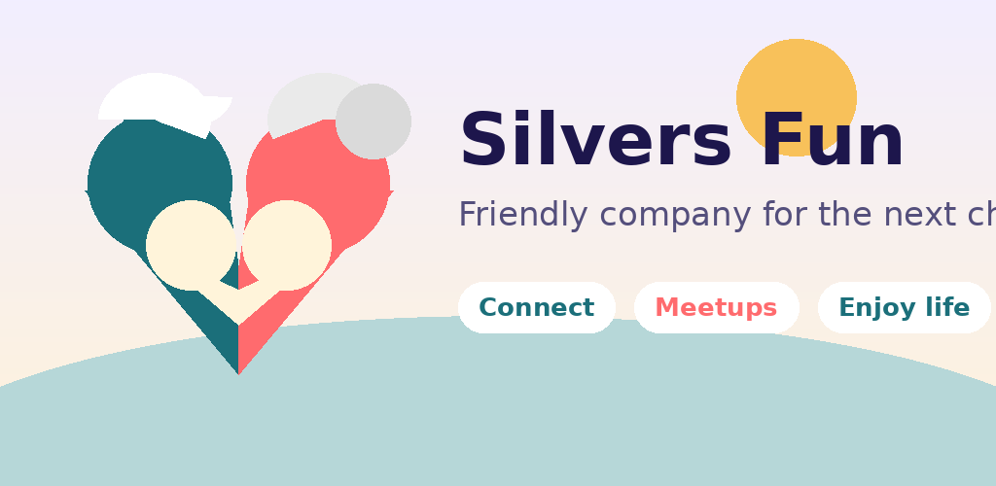
Silvers Fun
Helping seniors connect, meet, and enjoy life together.
A warm social companion app for the 65+ community
1 / 10

Slide 2
THE PROBLEM
Connection gets harder with age
• Many seniors want companionship, conversation, and shared activities.
• Existing apps feel built for younger users — confusing, fast, or unsafe.
• Moving, retiring, or losing a partner can shrink social circles.
• Families want a safe, comfortable way for older relatives to make friends.
2 / 10

Slide 3
WHO IT IS FOR
Built around the 65+ community
Seniors 65+
Families
Senior communities
Hobby & interest groups
Looking for friends, companions, and group activities.
Helping a parent or grandparent stay socially active.
Centers and residences that host meetups and events.
Walking, cooking, music, faith, language exchange.
3 / 10

Slide 4
WHAT IT DOES
Real connections, made simple
Silvers Fun helps seniors discover people with shared interests, join meetups, and build meaningful connections.
1
Profiles
2
Discover
3
Meetups
Photos and interests that show who you are.
Browse people who share your interests.
Create or join group activities nearby.
4
Likes
5
Chat
6
English & 한국어
Friendly mutual interest — no swiping.
Simple messaging once both sides like each other.
Full English and Korean support.
4 / 10

Slide 5
GETTING STARTED
Easy to start, easy to use
Sign in once and you're ready to meet people — no usernames or passwords to remember.
Add screenshot
Sign-in screen
Sign in with Google
1
One tap. No passwords or usernames to remember.
Set up your profile
2
Add a few photos and the interests that matter to you.
Discover and meet
3
Browse people, join meetups, start friendly conversations.
5 / 10
One-tap sign-in

Slide 6
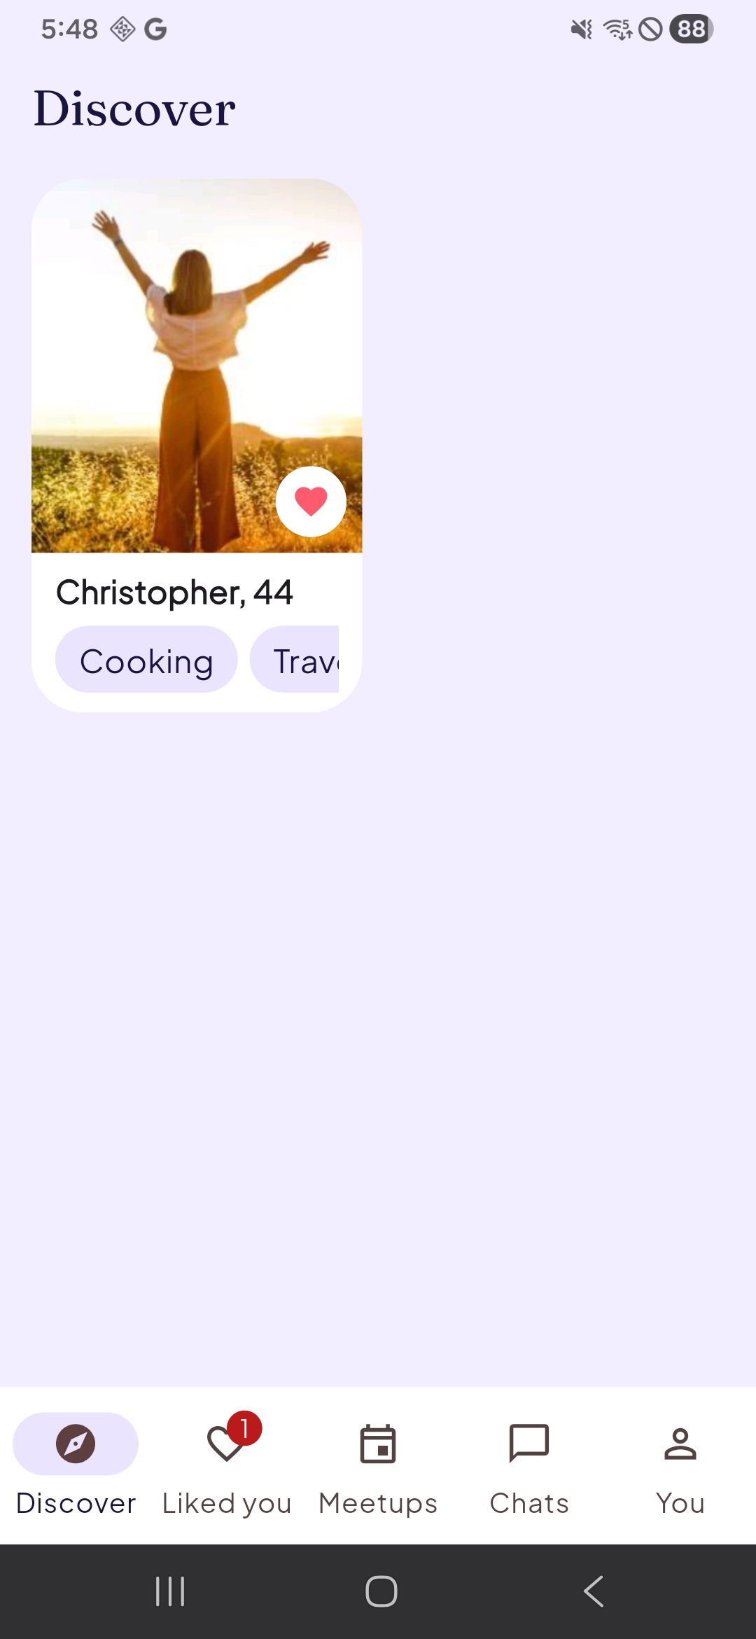
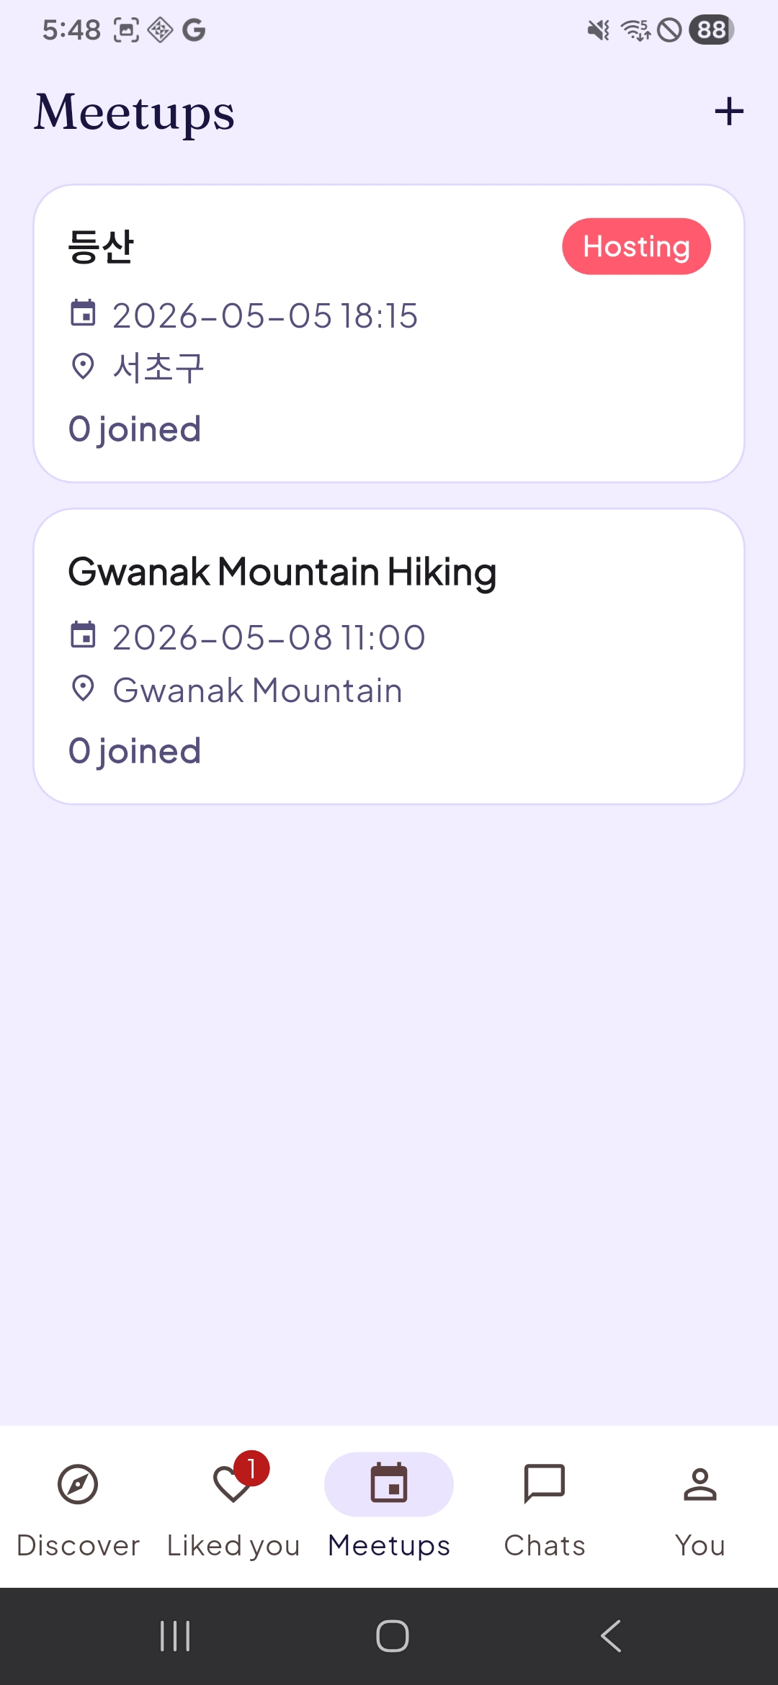
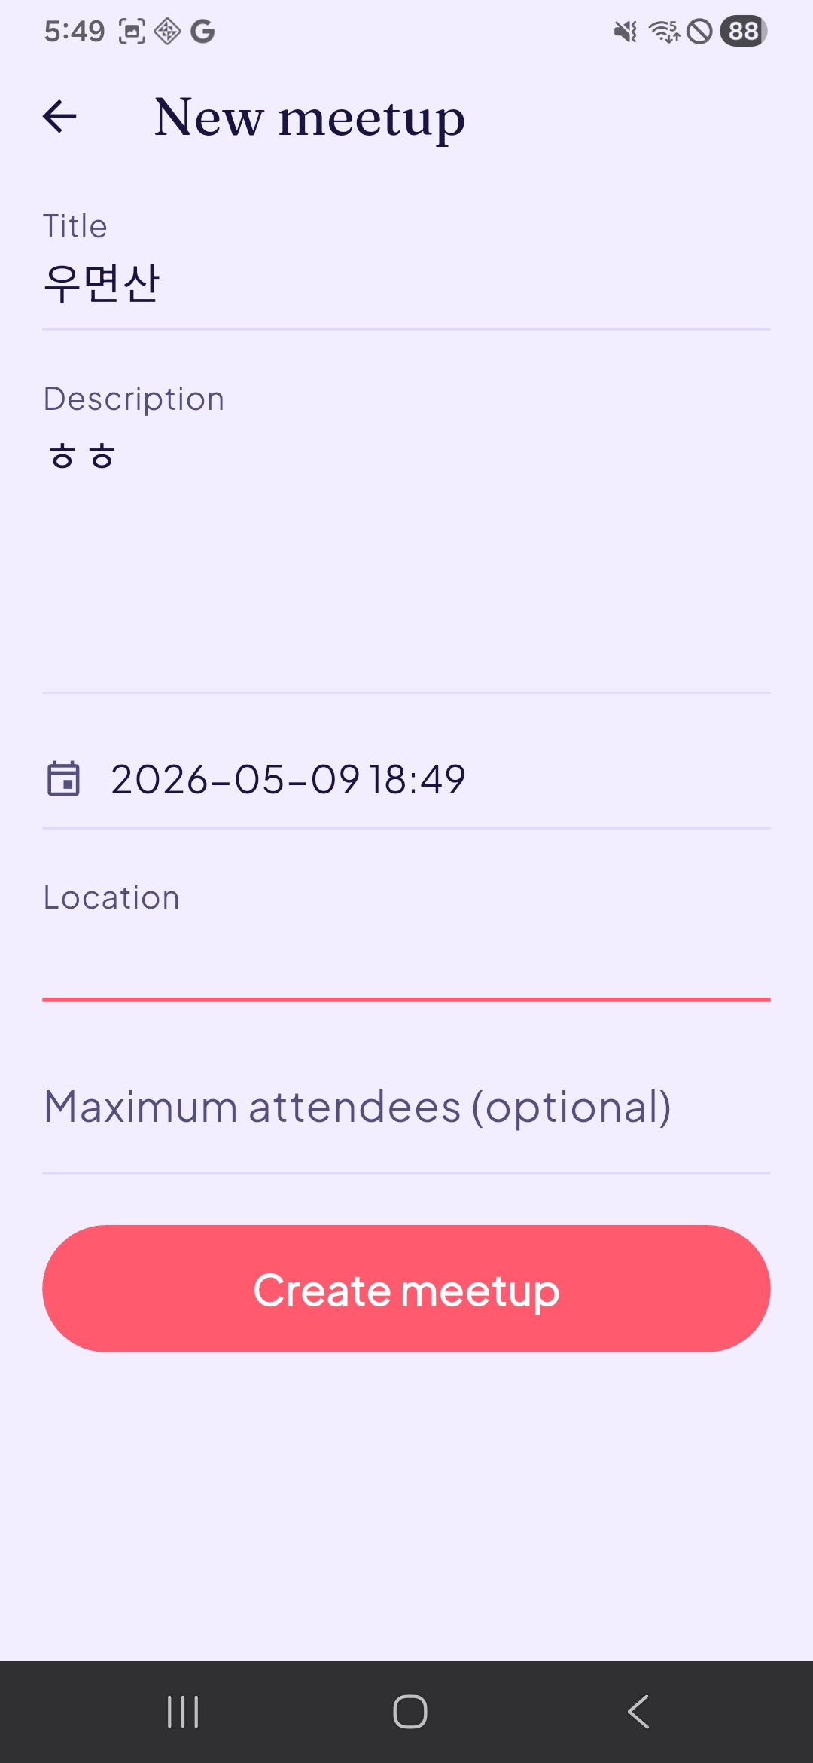
DISCOVER & MEETUPS
Explore people and activities
Discover people with shared interests, browse meetups, and create or join activities.
6 / 10
Discover
Meetups
Create meetup

Slide 7
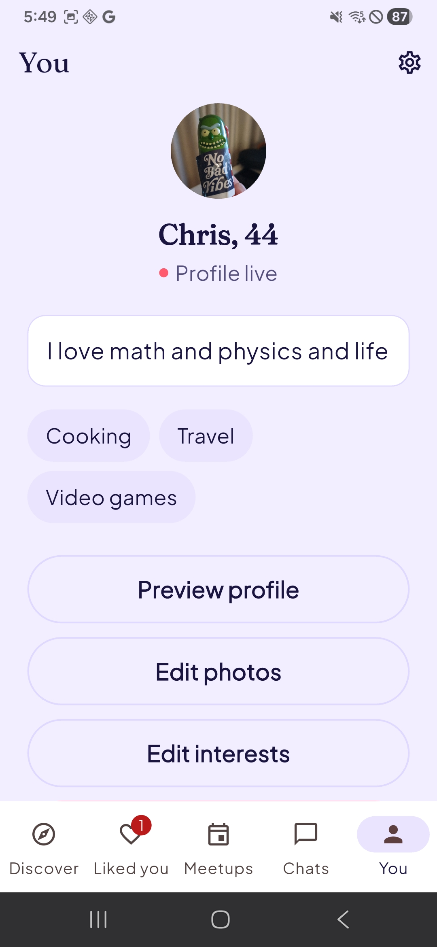
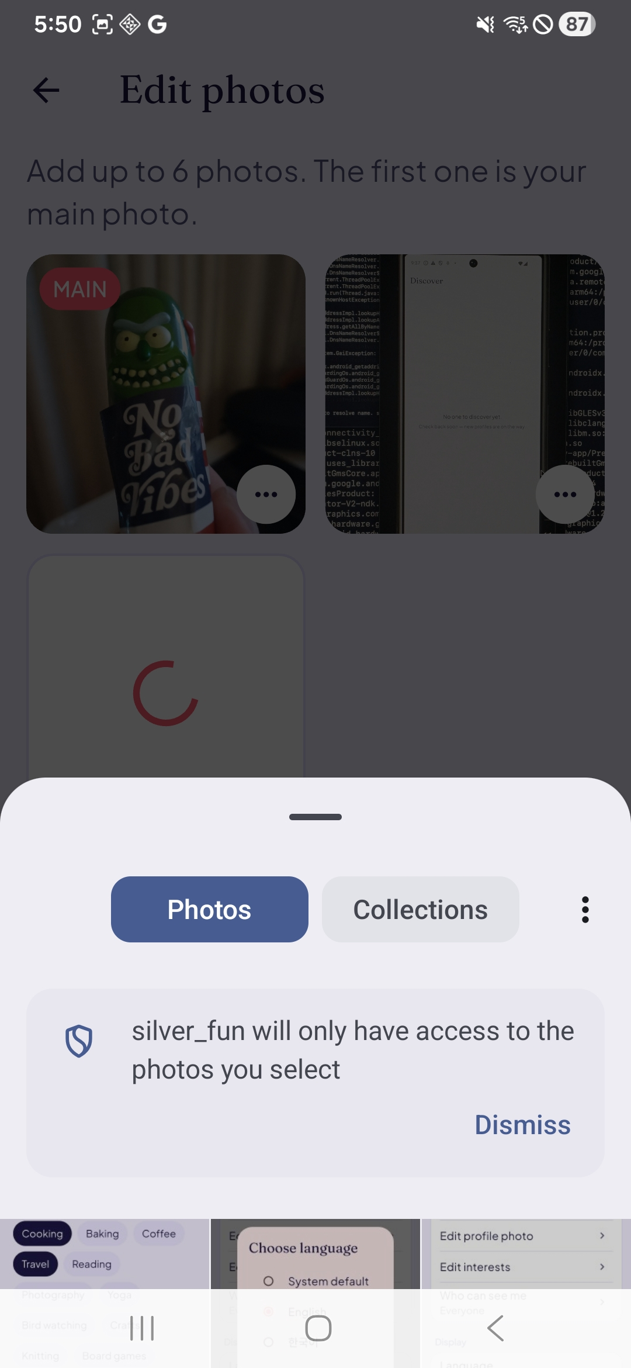
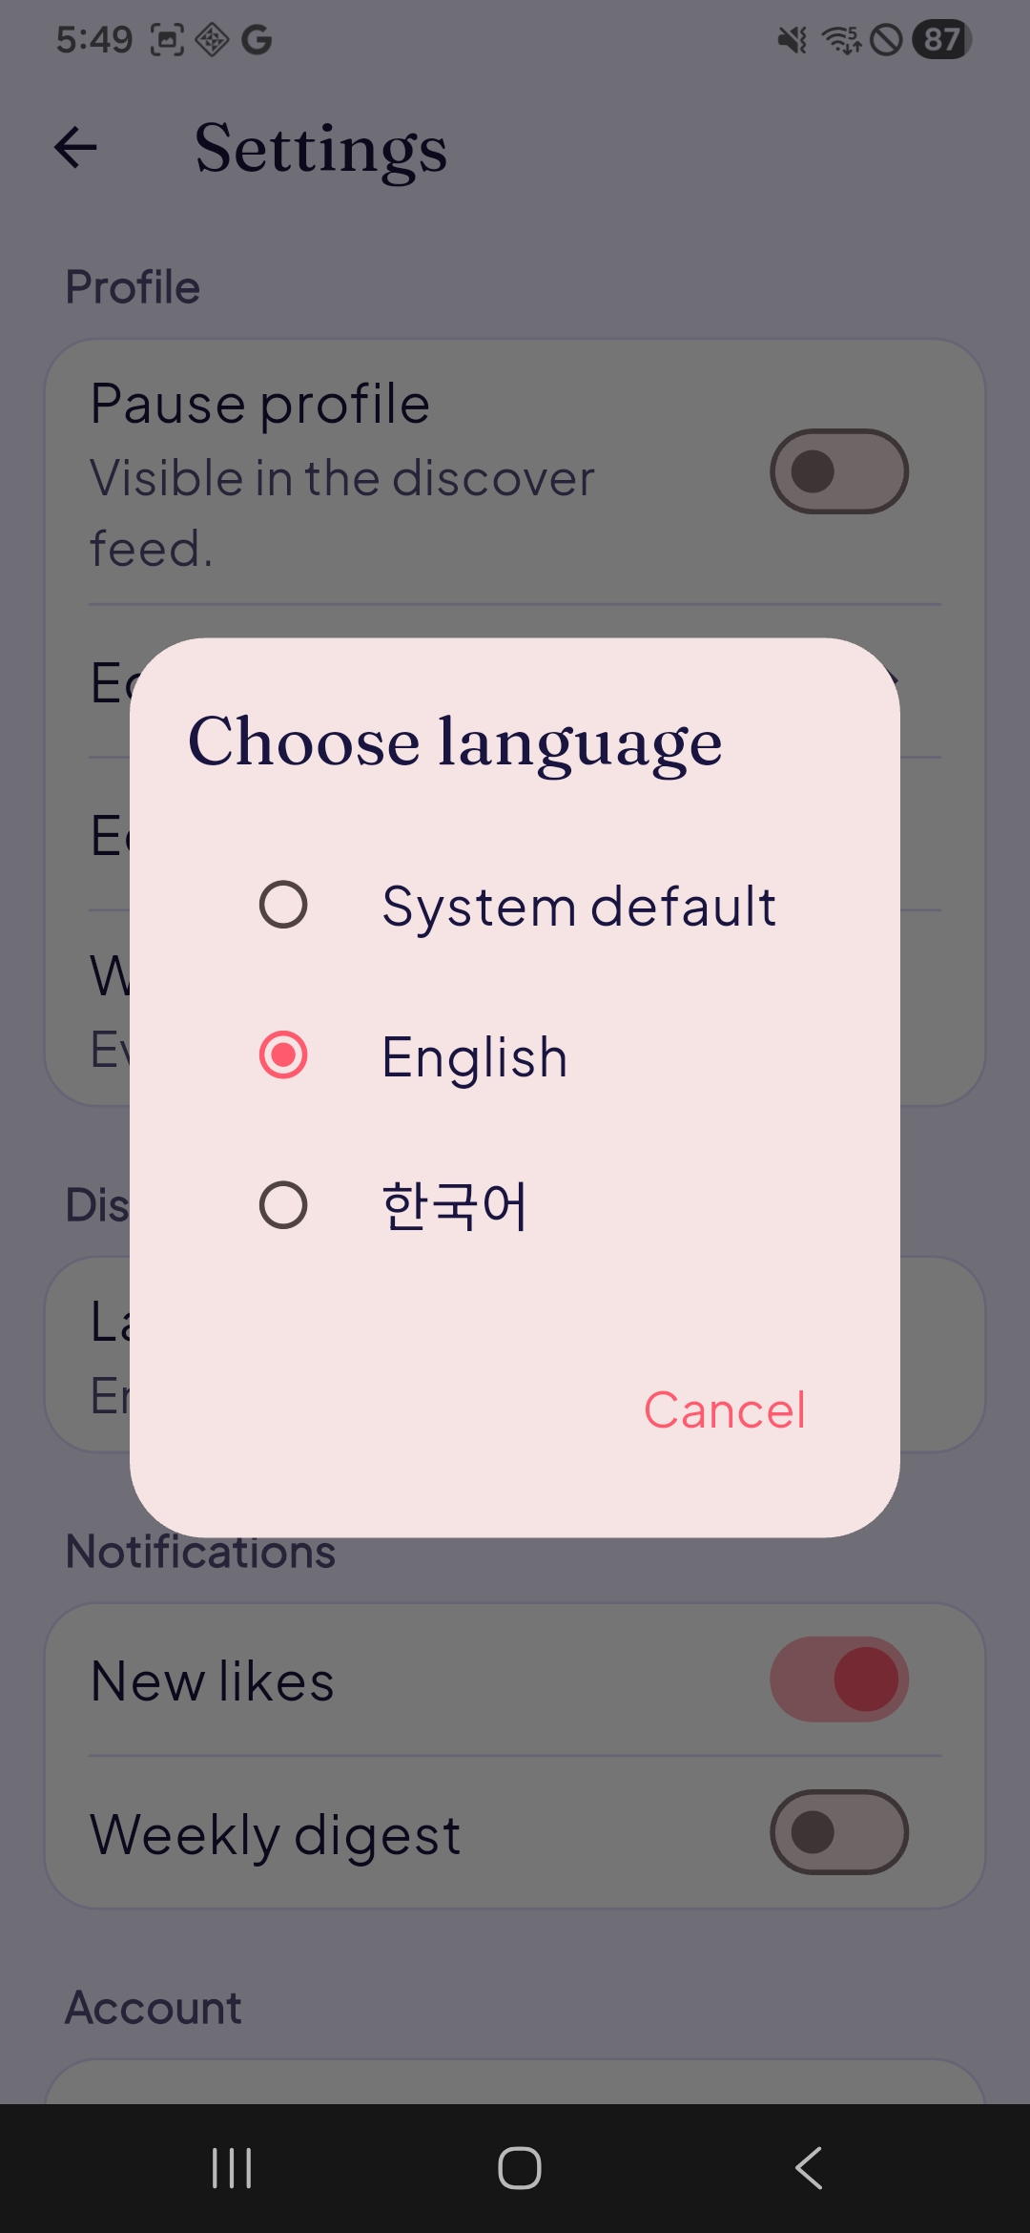
ACCOUNT & SETTINGS
Personalize your experience
Set up your profile, photos, language, and how connections start.
Add screenshot
Likes
Profile
Photos
Language
Likes
7 / 10

Slide 8
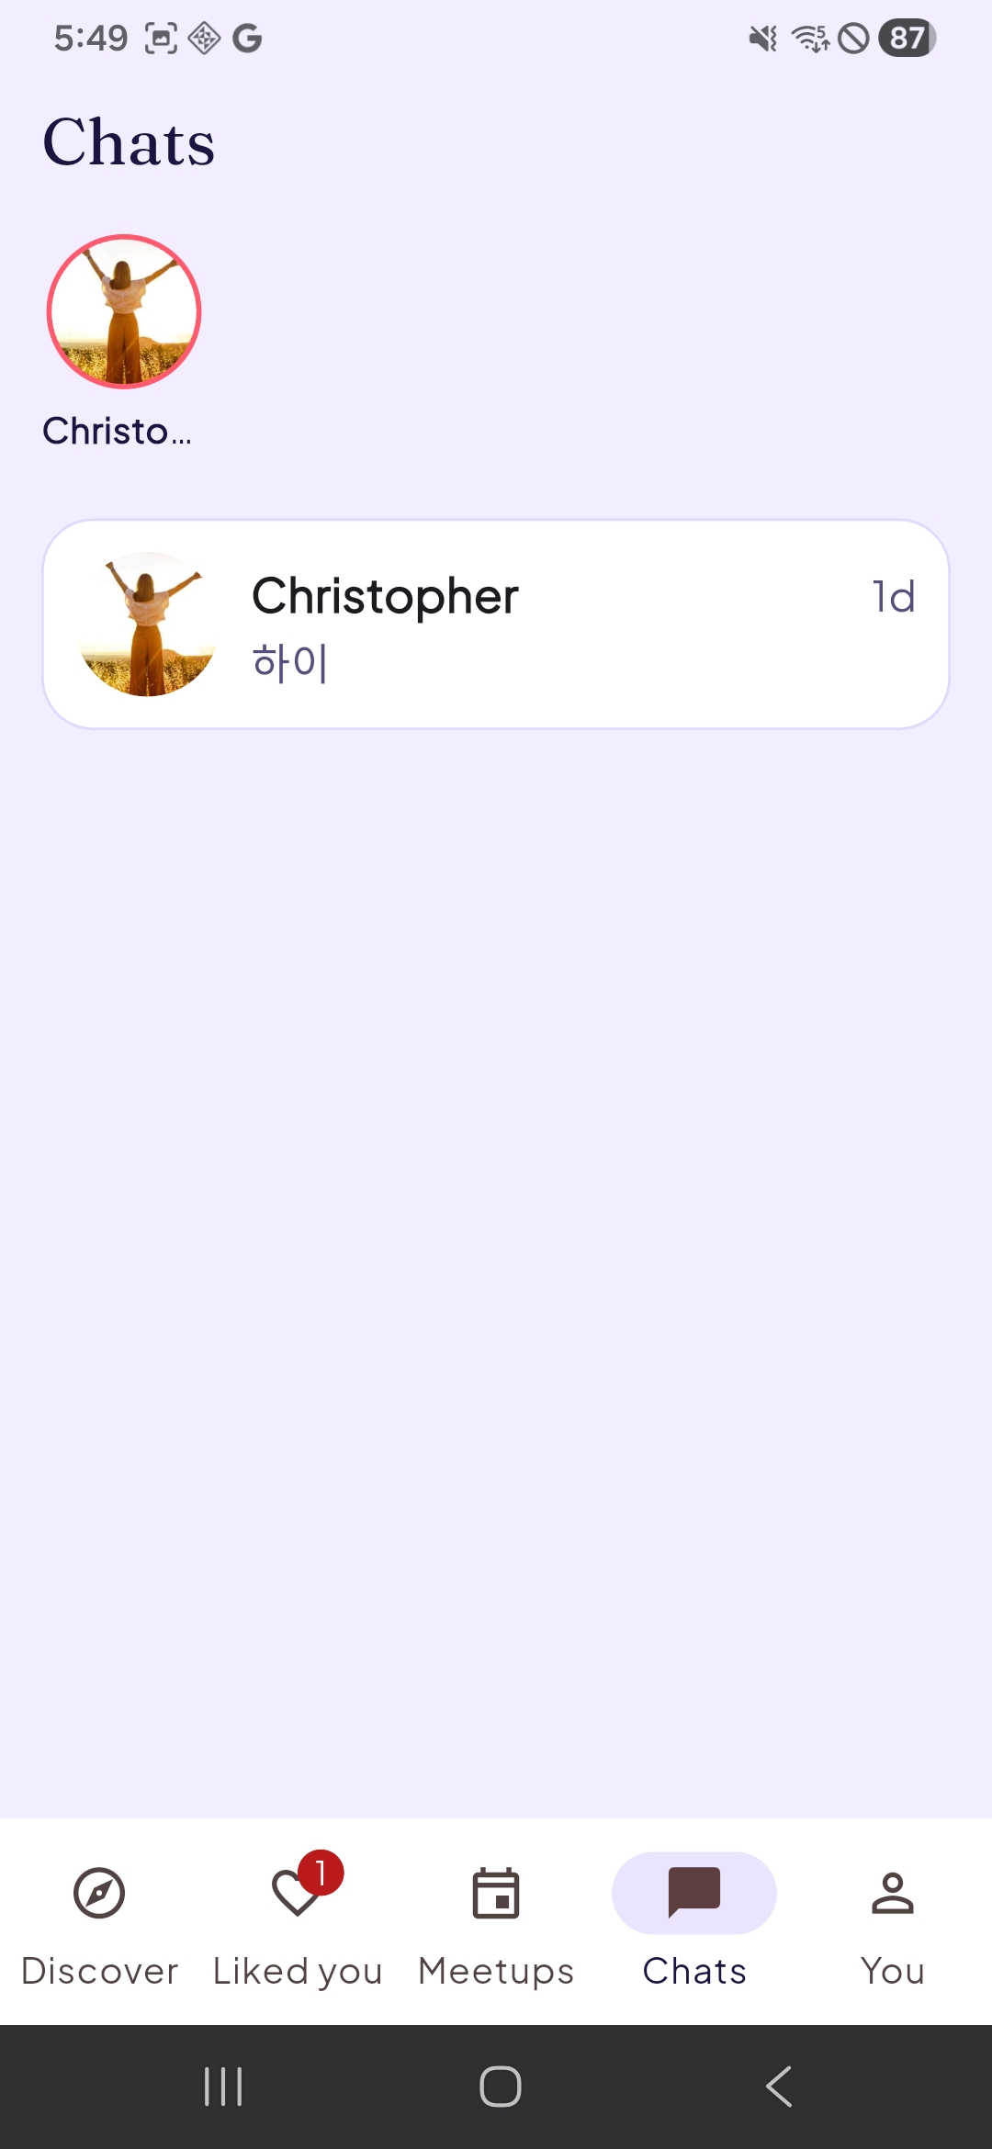
FRIENDLY CHAT
Connect comfortably and safely
Chat opens only after both people like each other — no unwanted messages.
1
Like
Tap the heart on a profile that interests you.
2
Mutual
If they like you back, you're connected.
3
Chat
Friendly, low-pressure messaging opens up.
Block and report tools available at any time.
8 / 10
Friendly chat

Slide 9
ACCESSIBILITY & TRUST
Comfort, control, and confidence
Companionship-first, not swipe-first dating — built around shared interests, meetups, and low-pressure connection.
Built for friendship
Low-pressure pace
Mutual connection
Comfortable to use
Shared interests and meetups, not dating swipes.
Connect at your own speed; no urgency, no judgments.
Chat opens only when both sides agree.
Large readable text, careful testing on real devices.
9 / 10

Slide 10
LAUNCH PLAN
Listening before scaling
1
Internal testing
2
Closed testing
3
Feedback loop
4
Community outreach
Team and trusted users on real devices.
Small groups of seniors and family members.
Iterate on usability, safety, and warmth.
Senior centers, residences, and partners.
Help us bring Silvers Fun to more seniors.
Partner with us, share with families, or join testing.
10 / 10

