Slide 1
Nikita Bairagi (013714454) Prachi Jani (013801359) Chi Tran (013834275) Hema Mutyala (013704392)
CMPE 285: SOFTWARE ENGINEERING PROCESS
Fall 2019 – Term Project STOCK PORTFOLIO SUGGESTION ENGINE
GUIDED BY – PROF RICHARD SINN

Slide 2
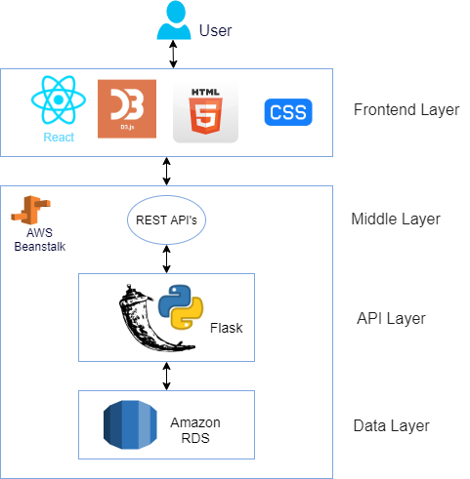
System Architecture

Slide 3
Features
Stock Suggestions based on investment strategy and investment amount.
The engine provides details of number of stocks, portfolio diversity ratio and holding value.
Input validations for investment amount and investment strategy.
Weekly trend of total portfolio and individual stocks.

Slide 4
Extra Features
Secure Signup and Sign-in functionality. We have implemented form validations for first-name, last-name, email and password.
Real Time Ticker with latest prices of various stocks.
Latest market trend widget with details of Active, Gainer and Loser Stocks for 1D, 1M, 3M, 1Y, 5Y and All time periods.
Intuitive material design frontend.

Slide 5
Challenges
Understanding stock market and various stock investment strategies.
Finding a good API for market data without any limits on usage.
Developing the algorithm to distribute the money in stocks based on the number of stocks.
Simplistic UI which is clean as well as serves the purpose.

Slide 6
Demo

Slide 7
Test Cases – 1/2
S.No. | Test Case | Expected
1 | Step1: In the Sign In page the user clicks on the “Don’t have an account? Signup” Step2: User provides first name as “first” and last name as “last” email id “abcd@test.com” and password “” and clicks on sign up | A validation message stating ”Password is not valid”
2 | Step1: In the Sign In page the user clicks on the “Don’t have an account? Signup” Step2: User provides first name as “first” and last name as “last” email id “abcd” and password “12345” and clicks on signup | A validation message stating ”Email is not valid”
3 | Step1: In the Sign In page the user clicks on the “Don’t have an account? Signup” Step2: User provides first name as “first” and last name as “last” email id “abcd@test.com” and password “12345” and click on sign up | A notification stating “User signed up successfully. Redirecting to dashboards.”. The welcome message with user-name should appear on left pane.
4 | Step1: signing up successfully. Step2: Log out. Step3: Sign in with same credentials | User should be able to sign in successfully. The welcome message should display user name. And widgets should display.
5 | Step1: Enter an invalid amount (< $5000). | Error message should be displayed saying "Minimum amount should be $5000". And submit button should be disabled.

Slide 8
Test Cases – 2/2
S.No. | Test Case | Expected
6 | Step1: Enter a valid amount (>= $5000) but not select any strategy | Submit button should be disabled.
7 | Step1: Enter a valid amount (>= $5000) and select any three strategies. | An error message “Maximum two strategies can be picked at a time.” should be displayed. And submit button should be disabled.
8 | Step1: Enter a valid amount (>= $5000) and select any one strategy Step2: Click submit | Dashboard updates with allocation details of 3 company stocks and holding ratios. The holding ratios must sum to 100%
9 | Step1: Enter a valid amount (>= $5000) and select any two strategies Step2: Click submit | Dashboard updates with allocation details of 6 company stocks and holding ratios. The holding ratios must sum to 100%
10 | Step1: Click on logout | The user session must be terminated and user must be redirected to login page.

Slide 9
Future Work
Extend the application to mobile app.
Add more live dashboards for user portfolio which would update real-time.
User could choose to sign-up for daily email alerts with portfolio value.
Save users investment strategies and suggest more stocks on next visit.

Slide 10
Thank You

