Slide 1
Supermarket Sales Dashboard Insights

Slide 2
Executive Summary
- Total Quantity Sold: 5,510
- Total Invoices: 1,000
- Average Rating: 6.97
- Total Tax Amount: 15.38K
- Total COGS: 307.59

Slide 3
Sales by Payment Type
- Cash is the most used method
- Followed by Credit Card and Ewallet
- Insight: Continue support for all types to ensure convenience

Slide 4
Sales by Gender
- Sales are nearly balanced between Male and Female
- Insight: Gender-neutral marketing strategy is effective

Slide 5
Sales by Product Line
- Top product lines:
• 1st: 175.92
• 2nd: 93.74
• 3rd: 87.23
- Insight: Focus on high-performing products

Slide 6
Sales by Day of Week
- Highest Sales: 216.85
- Lowest Sales: 87.23
- Insight: Promote more during low-sale days

Slide 7
Sales by City
- Sales are consistent across Naypyitaw, Yangon, Mandalay
- Insight: Regional promotions could boost local sales

Slide 8
Hourly Sales Trend
- Peak Hours: 13:00–14:00 and 19:00–20:00
- Insight: Focus staff and offers during peak times

Slide 9
Sales Over Time
- Fluctuating trend with some dips
- Insight: Monitor seasonal effects and promotions

Slide 10
Sales by Customer
- Sales from Normal customers: 0.16M
- Insight: Start loyalty programs for retention

Slide 11
Tax Amount vs Sales
- Higher taxes from Fashion and Electronics
- Insight: Use efficient sourcing and pricing strategies

Slide 12
Average Rating by Product Line
- Ratings Range: 4.2 to 6.6
- Insight: Improve lower-rated products using feedback

Slide 13
Business Recommendations
- Promote during low-sale days & off-peak hours
- Expand loyalty programs
- Optimize top-performing products
- Improve under-rated products

Slide 14
Data Storytelling & Key Insights
Dashboard Storytelling: Supermarket Sales Analysis
This dashboard helps business stakeholders monitor sales, profit, and customer patterns across branches, product lines, and time.
Key Insights:
Branch Performance
Branch C recorded the highest total sales and average rating, indicating strong customer satisfaction and revenue performance.
Best Performing Product Line
Food and Beverages consistently generated the highest revenue, suggesting it should remain a focus area for promotions and inventory.

Slide 15
Data Storytelling & Key Insights
Monthly Sales Trend
Peak sales occurred in the middle months (e.g., March), possibly due to seasonal or promotional campaigns.
Suggest planning future campaigns around similar timeframes.
Gender & Customer Type Insights
Both genders show almost equal spending, but Member customers tend to spend slightly more than Normal customers – indicating loyalty program effectiveness.
Time-Based Trends
Highest sales occur between 12 PM to 6 PM, suggesting prime shopping hours and scope for staff optimization during those hours.
Payment Preferences
Ewallet is the most preferred payment method, showing a shift toward digital transactions.

Slide 16
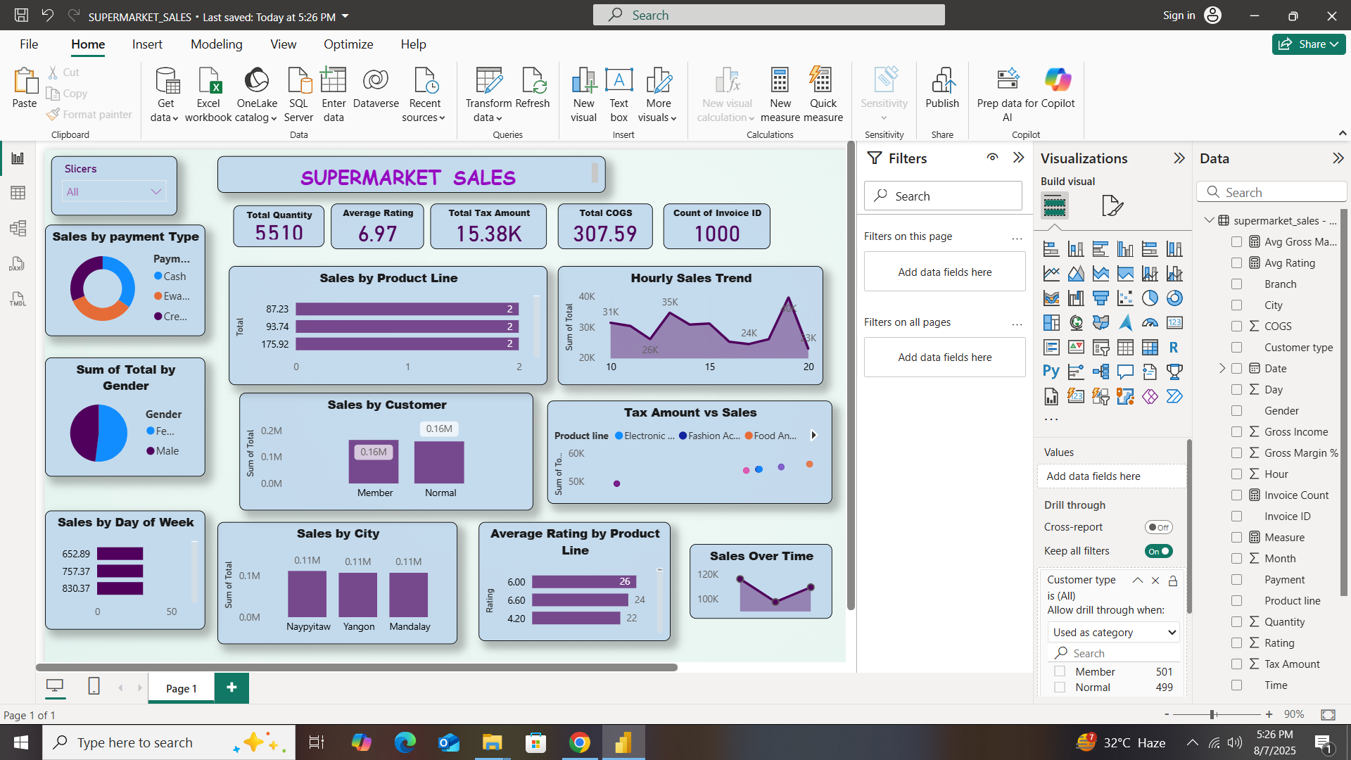

Slide 17
