Slide 1
Assembling a drone

Slide 2
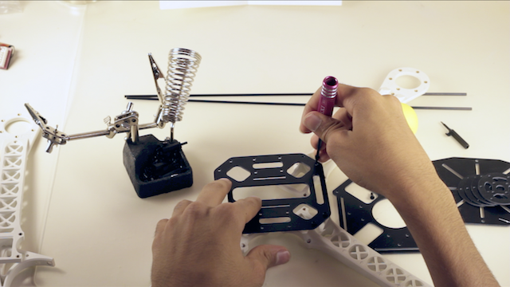
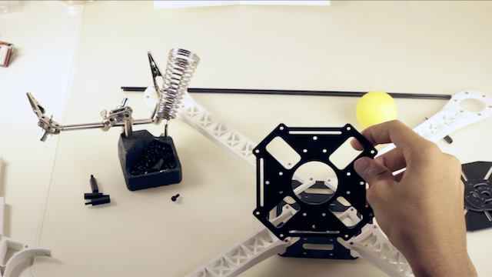
Building a frame(1/2)
Connecting the arms of a frame in drone.

Slide 3
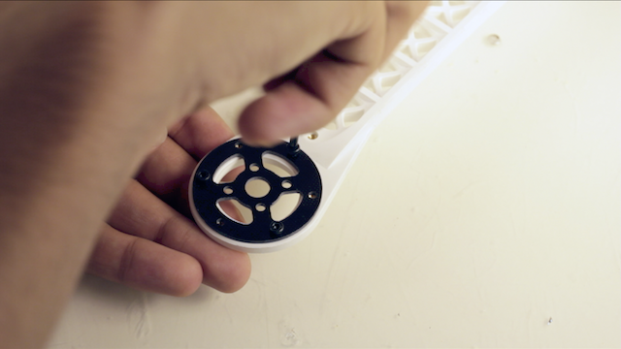
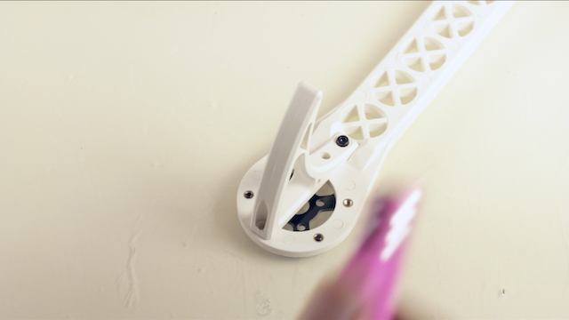
Building a frame(2/2)
Connecting the motors frame and landing gear to the arms of frame.

Slide 4
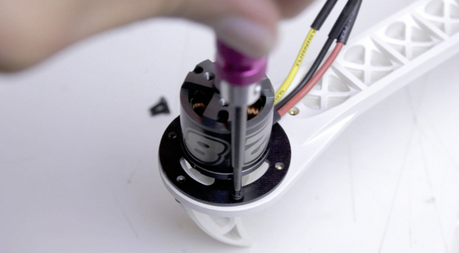
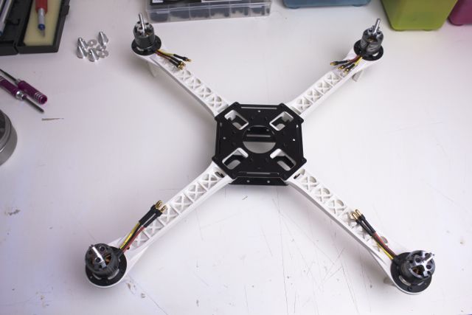
Connecting a motor to frame

Slide 5
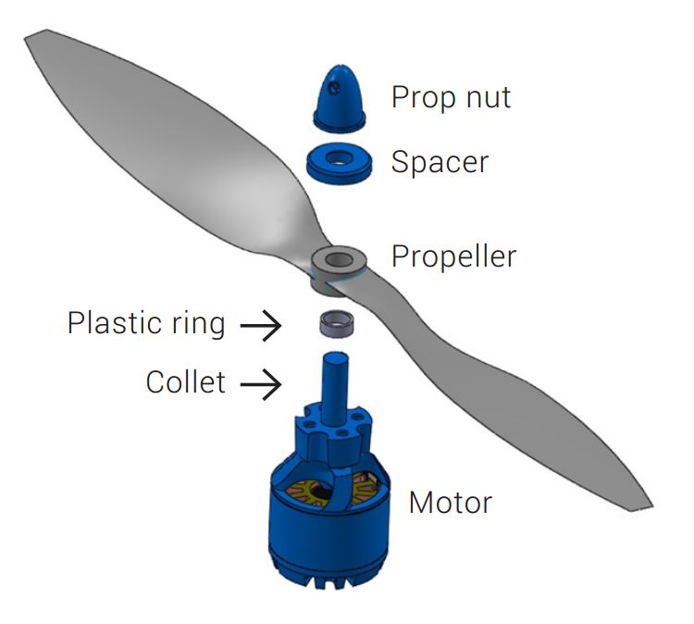
Connecting a propellers to motor
Now connect a propeller to the motor which is placed on the frame.

Slide 6
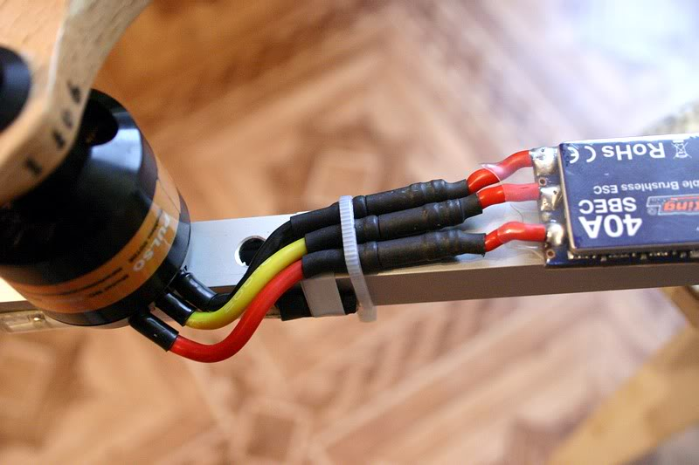
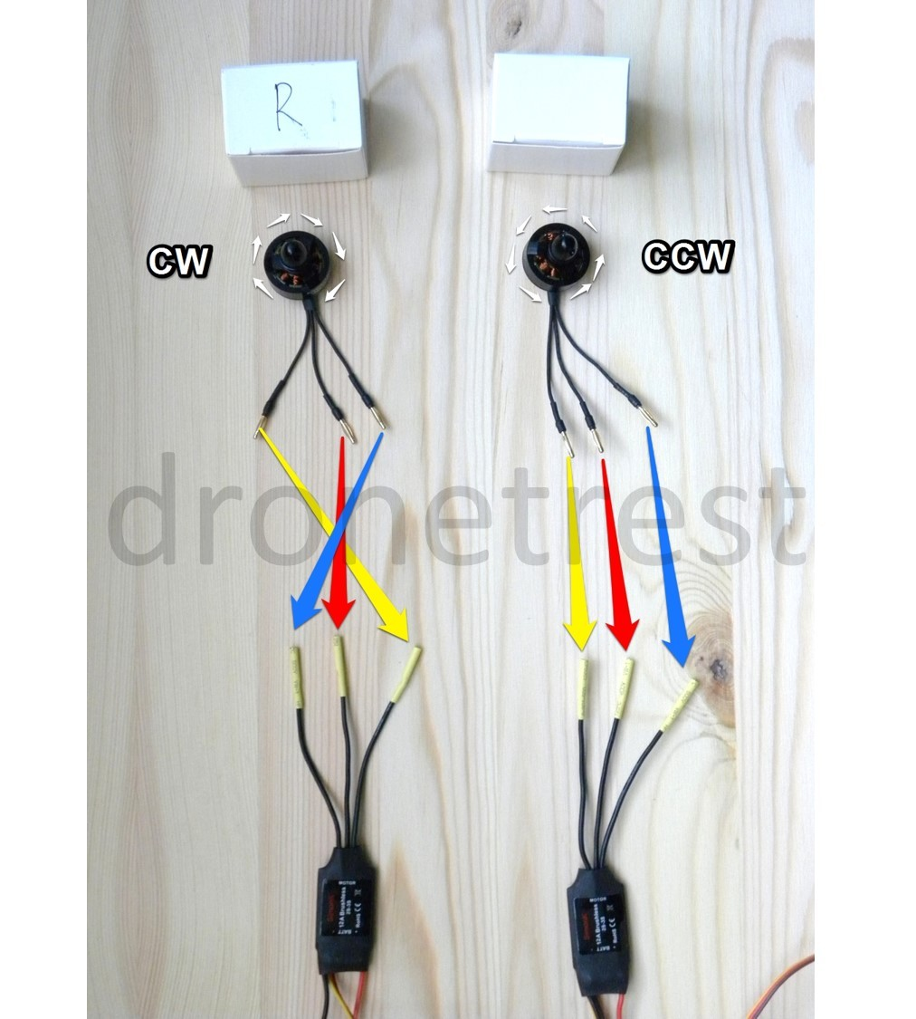
Connecting an esc to motor

Slide 7
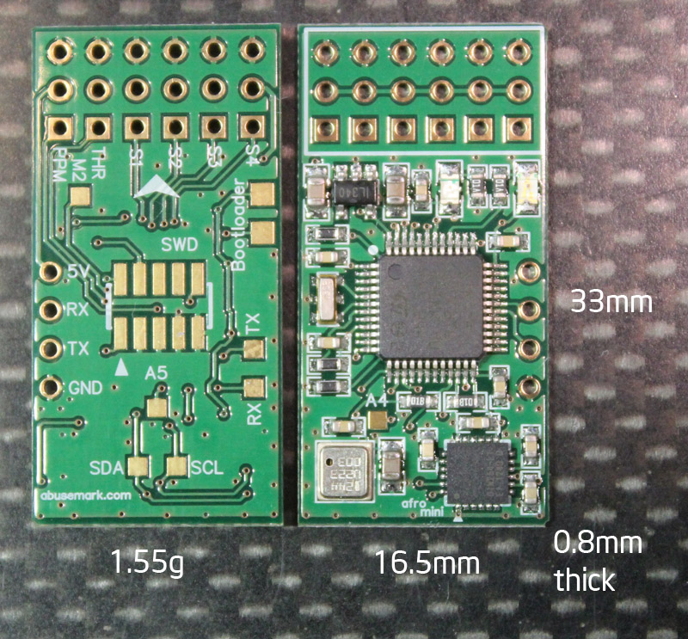
Connecting the components to autopilot

Slide 8
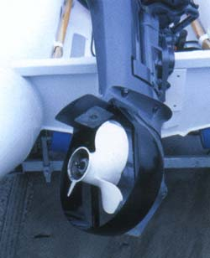
Propeller Guards

Slide 9
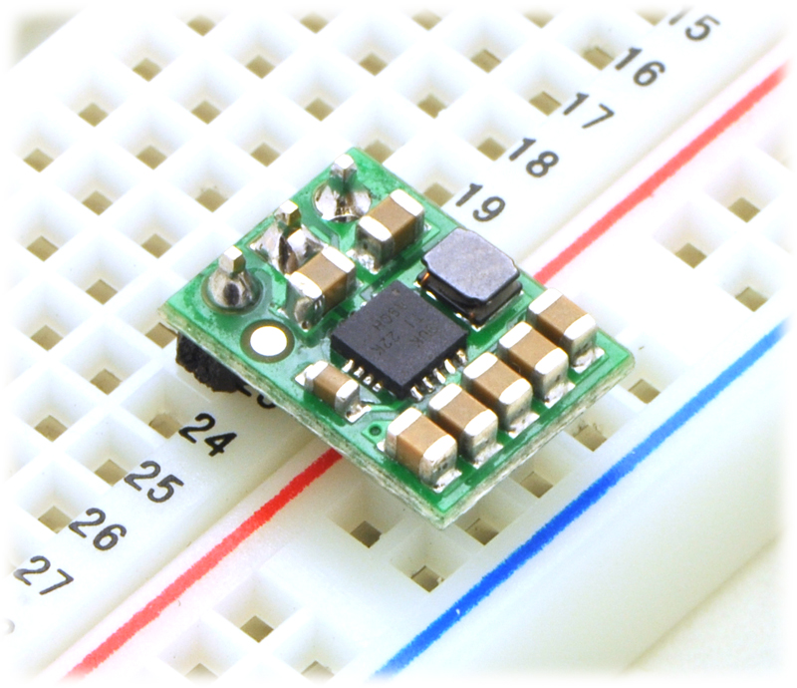
Regulator
The step-up/step-down regulator has just three connections
Input voltage (VIN),
Ground (GND), and
Output voltage (VOUT).

Slide 10
Thank you

