Slide 1
Y-6 Drone

Slide 2
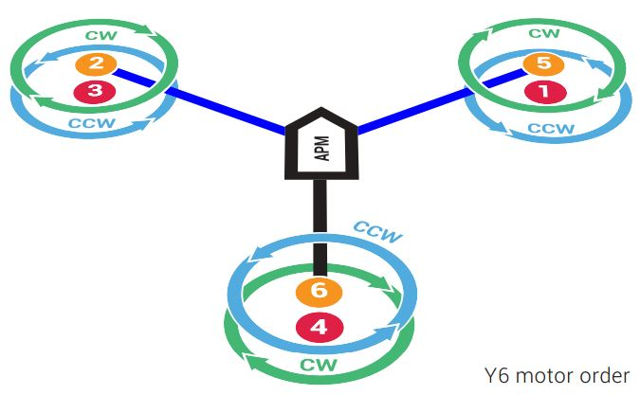
Y-6 drone
A Y6 design is a type of hexacopter but rather than six arms, it has three support arms, with a motor connected to either side of the arm.
Advantages:
Lightweight design
Can lift more payload compared to quadcopter
If a motor fails, the drone can still land safely
Disadvantages:
More expensive than a quadcopter
Higher capacity battery is required
Less efficient

Slide 3
Components Required
Frame
Motor
ESC(Electronic Speed Controller)
Propellers
Battery
Autopilot/FlightController
RC Transmitter
RC Receiver

Slide 4
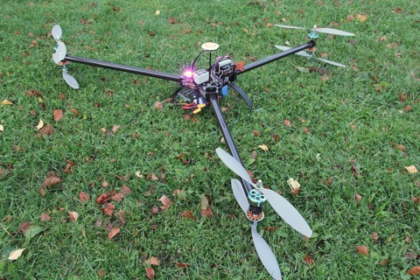
Frame
12*3.8 APC props mounted on the DT700’s

Slide 5
Material of The Frame
Carbon Fiber
Fiberglass
Aluminum

Slide 6
Why Carbon fiber?
Carbon fiber is lighter than fiberglass.
it’s 70% lighter than steel, 40% lighter than Aluminum.
Carbon fiber is more rigid.
Carbon fiber is about 3 times stiffer than steel and aluminum
for a given weight.

Slide 7
Motor (How?)
To choose a motor we first need to know how much is the weight of the drone.
General rule is that we need to provide twice as much thrust than the weight of the drone.
As we are building a Y-6 drone:
Required Thrust per motor = ( Weight x 2 ) / 6
Estimation of drone's total weight:
Suppose our drone weighs 2.4 kg including all components.
We need ~ 4.8kg of thrust.
So 4800/6 ~ 800g thrust/motor

Slide 8
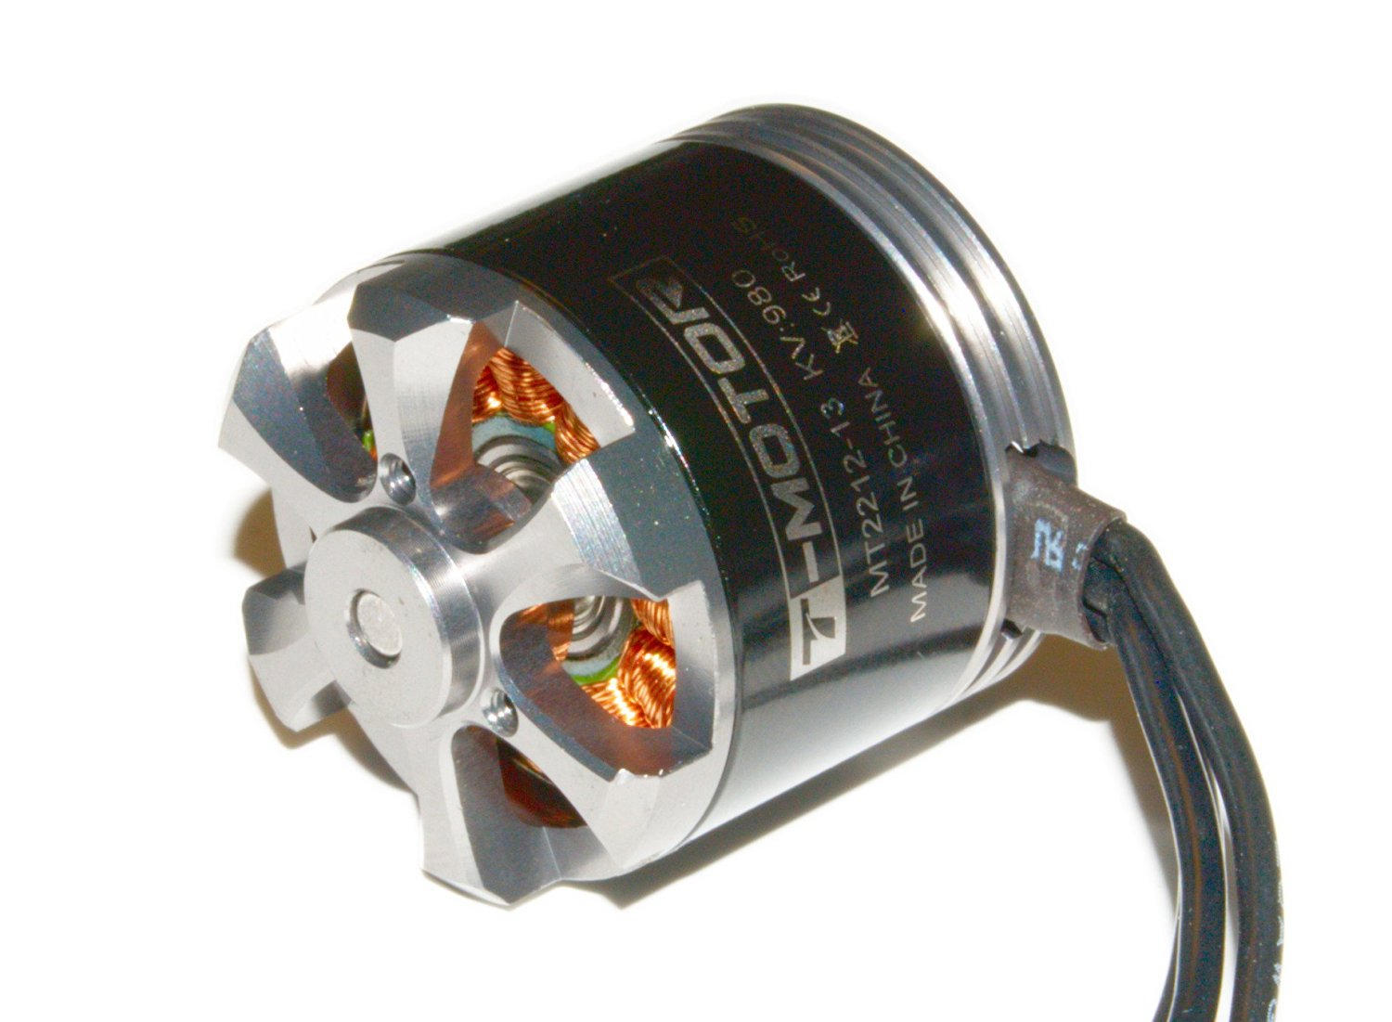
Motors(why?)
We need thrust of 800g so we can choose T-MOTOR MT2212 KV980 brushless motor.
Cost: $57*6=$342

Slide 9
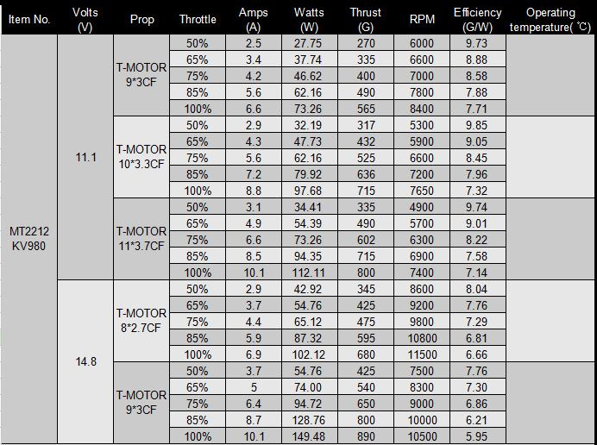
Thrust table of MT2212 KV980

Slide 10
ESC(How?)
Once we choose the motors, choosing an ESC is an easy task. For the ESC to work with the motor, it must be rated for voltage of the battery, and it must be able to handle the motor’s amp draw.
For example:
Since our motor require a max of 10 Amp continuous current, So it is always better to use an ESC that is rated slightly higher than the amps we want.

Slide 11
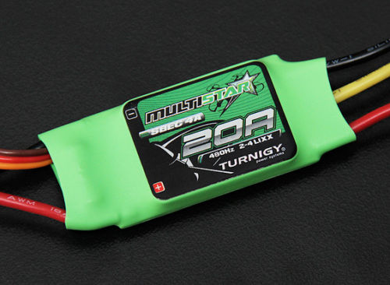
ESC(How?)
We have choosen Turnigy Multistar 20 Amp Multi-rotor Brushless ESC 2-4S
Specifications:
Output: 20A continuous; 25Amps for 10 seconds
Input: 30A continuous; 35Amps for 10 seconds
Weight: 25gms
Size: 47mm x 27mm x 12mm
Cost: $7*6=$42

Slide 12
Propellers(How?)
A Y-6 drone uses three clockwise(CW) and three counter-clockwise(CCW) propellers.
Propellers are classified by length and pitch. For example 9×3 propellers are 9 inch long and has a pitch of 3.
When deciding on length and pitch, we need to find a good balance. Generally a prop with low pitch numbers can generate more torque. The motors don’t need to work as hard so it pulls less current with this type of prop.
When it comes to the length, propeller efficiency is closely related to the contact area of a prop with air, so a small increase in prop length will increase the propeller efficiency.
There are a few different types of propellers, such as plastic, carbon fibre etc.

Slide 13
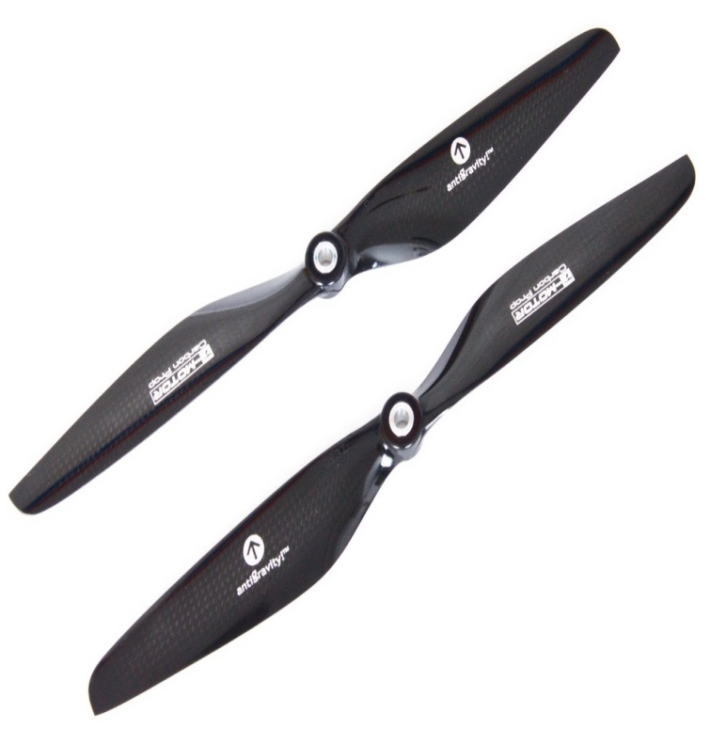
Propellers(Why?)
We need thrust of 800g, so we have choosen a propeller of 9*3CF to produce the required thrust with T-MOTOR MT2212 KV980 brushless motor.
We have choosen T-Motor Antigravity 9*3CF propellers.
Specifications:
higher efficiency & loaded ability
longer flight times
light weight & high strength
prolong hover time
weight:5.5g
Diameter:9inches
It has two pieces:1cw and 1ccw.
Working stable:100%balanced
Cost:$29 * 3=$87

Slide 14
Battery (How?)
Knowing what size battery you need
Battery Discharge Rate and Capacity
Battery Voltage (cell count)
Number of batteries
What is the best battery brand?

Slide 15
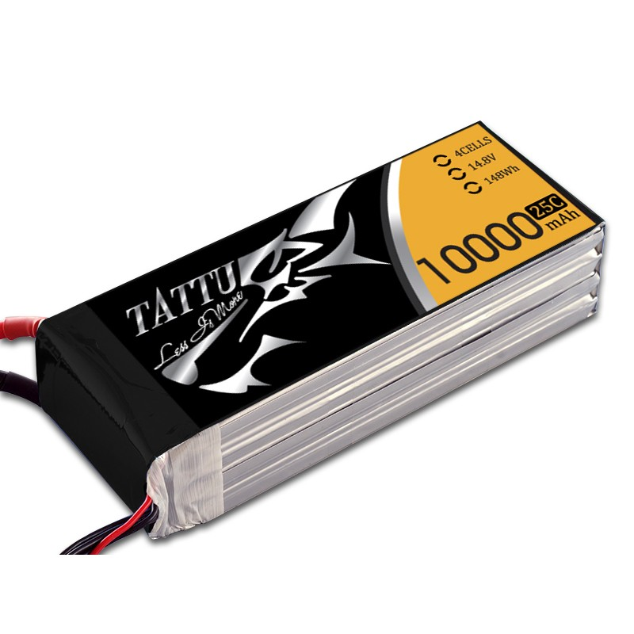
Battery(Why?)
All TATTU batteries have passed the UN 38.3 battery test which is the highest quality standard test for lithium polymer batteries.
We have choosen a Tattu 10000mAh 14.8V 25/50C 4S1P
Specification:
Capacity: 8000mAh
Voltage: 14.8V
Max Continuous Discharge: 15C (120A)
Max Burst Discharge: 50C (500A)
Weight: 941.9g
Dimensions: 166*64*41 mm
Cost: $150

Slide 16
Flight Controller(How?)
A flight controller for a multi-rotor is an integrated circuit normally made up of a microprocessor, sensors and input / output pins.
It is the brain of drone.
There are many FCs out now in the RC world. Some of them are KK, MultiWii, Ardupilot, Naza, Naze, Rabbit, WKM and many other.
But we have choosen PixHawk.

Slide 17
PixHawk(Why?)
Flight Controller | Processor | Size | Accuracy | Cost
APM 2.8 | 8Bit | Less(2.7 x 1.7 x 0.5)28g | Less accurate | $96.00
3DR Pixhawk | 32bit | More(3.2 x 1.9 x 0.6) 38 g | More accurate | $200

Slide 18
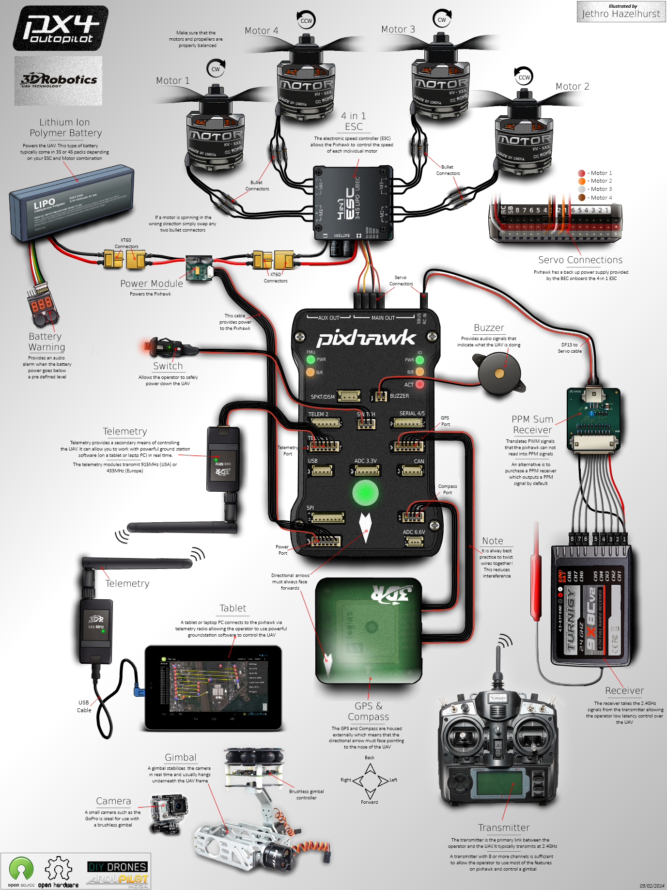
PixHawk
How all the components are connected to the autopilot.

Slide 19
RC Controller
To control the drone from ground we need a controller, to send signals to the drone.The controller is the transmitter.
There are several transmitters available in market and it’s a one time investment so we have choosen Frsky Tranis.

Slide 20
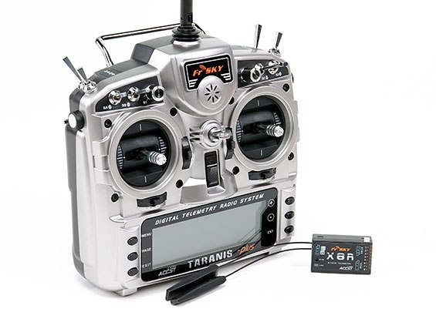
Transmitter
FrSky 2.4GHz ACCST TARANIS X9D PLUS
No. of channels =16
Frequency=2.4ghz
2000 mAH battery
64 mixers, 9 flight modes
60 Model memory
(expandable via a SD card)
Cost=$210

Slide 21
RC Receiver
Aas we are sending signals to the drone so there we need a device which can capture those signals so we need a receiver.
The receiver must work on the same frequency as of transmitter.
Aas we choose the FrSky transmitter, the Frsky receiver comes with the same pack.

Slide 22
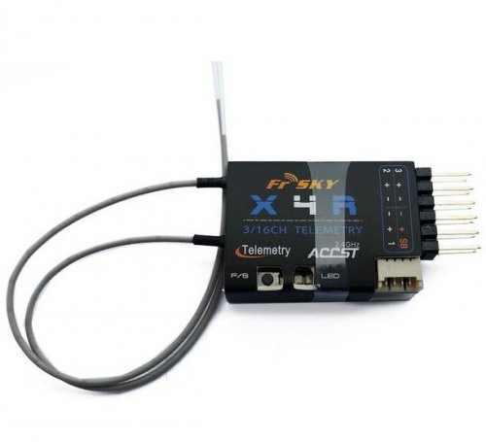
RC Receiver
FRSKY X4R-SB 2.4GHZ 16 CHANNEL ACCST RECEIVER W/ S-BUS
Cost : $27.35
Dimension: 40x22.5x6
Weight: 5.8g
Operating Voltage Range: 4V-10.0V
Operating Current: 100mA@5V
Operating Range: >1.5km (Full Range)
Firmware Upgradeable

Slide 23
Thank you

