Slide 1
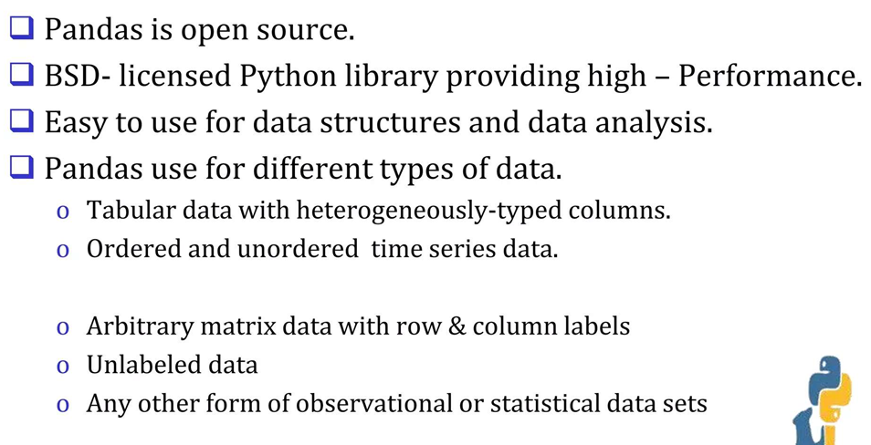
What is Pandas?

Slide 2
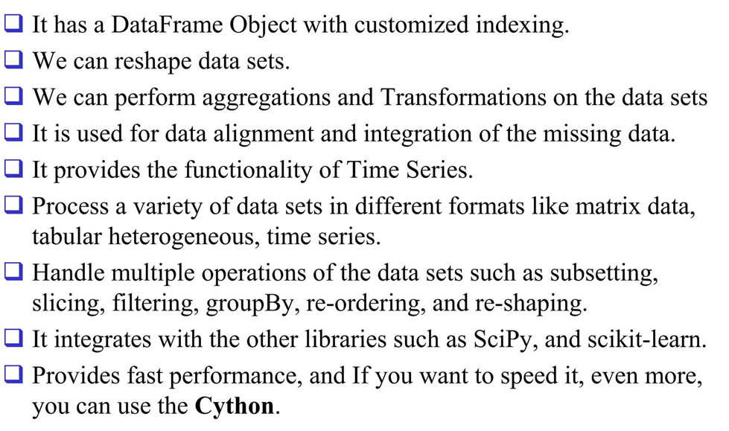
Features of Pandas

Slide 3
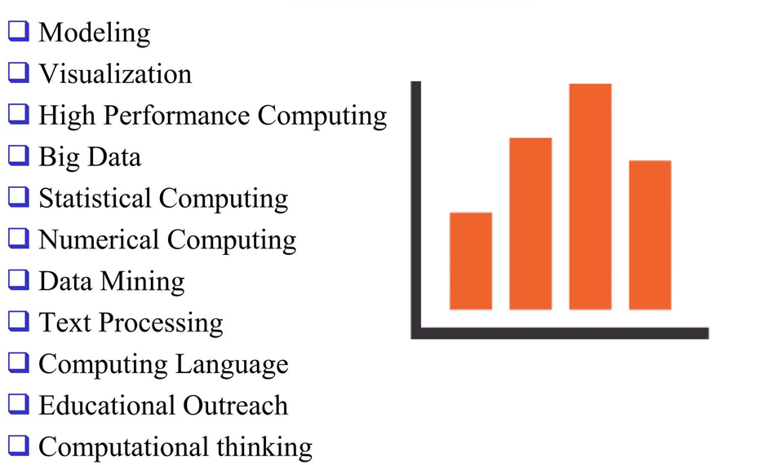
Usage of Pandas

Slide 4
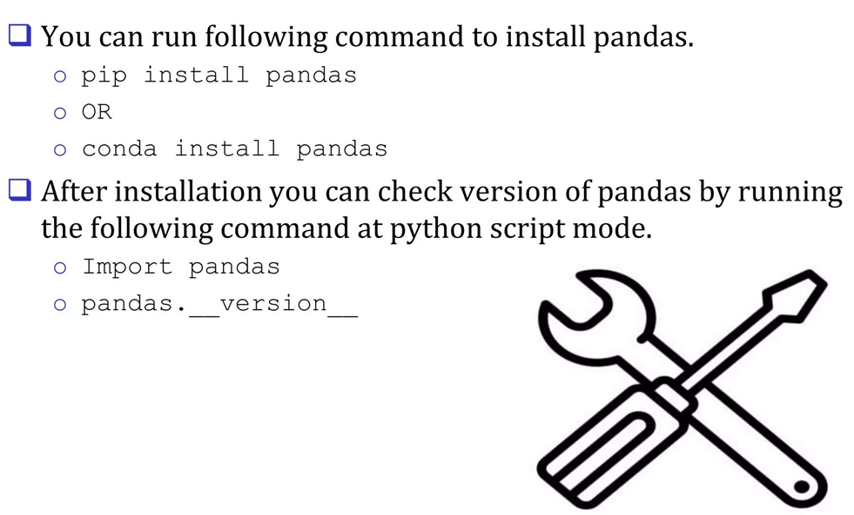
How to install Pandas

Slide 5
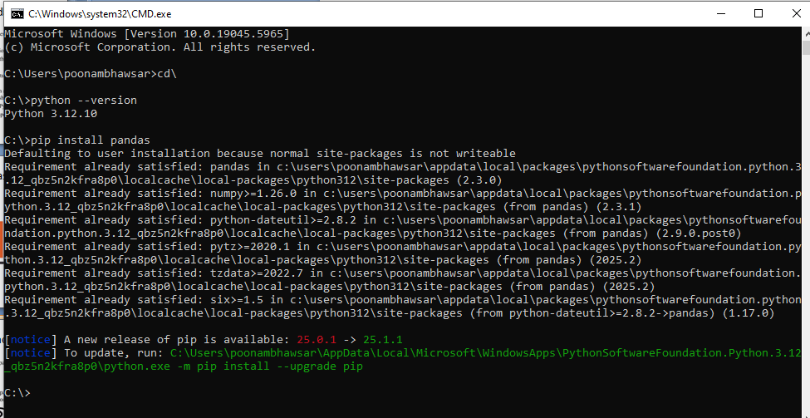

Slide 6
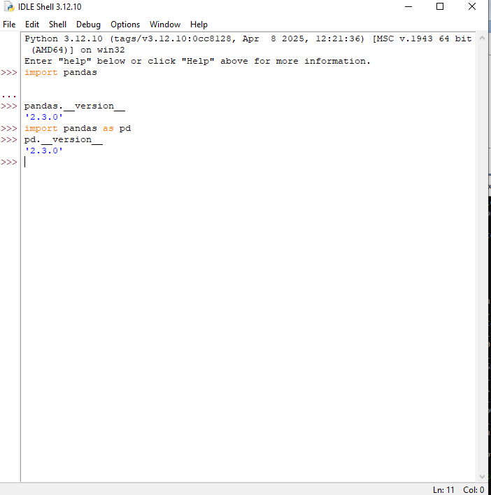

Slide 7
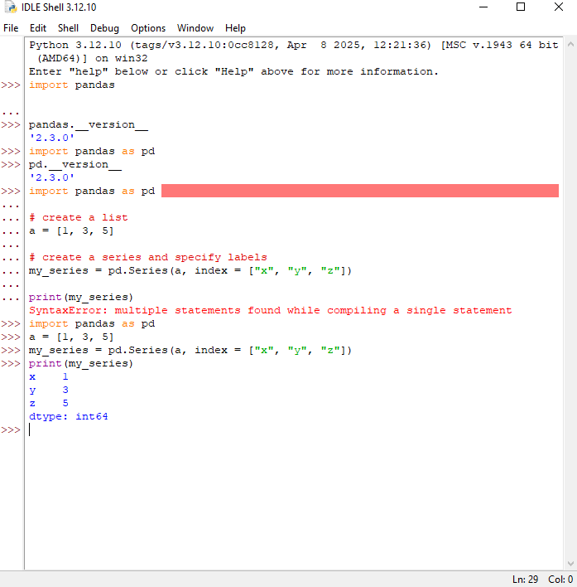

Slide 8
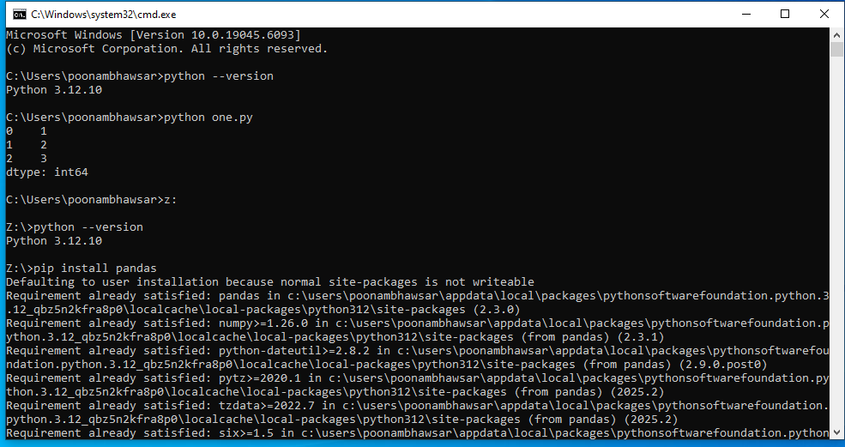

Slide 9
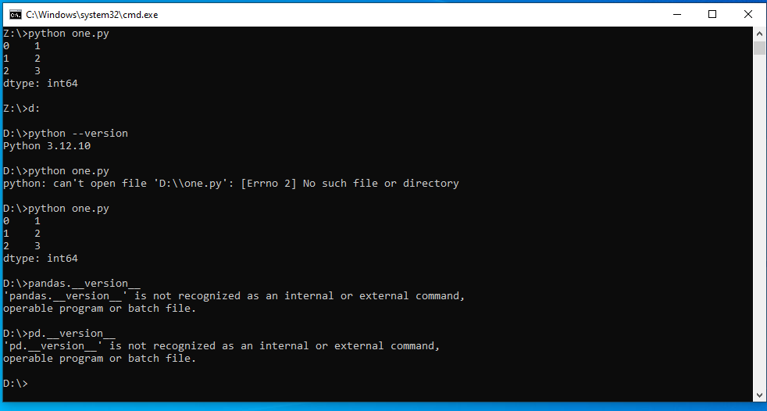

Slide 10
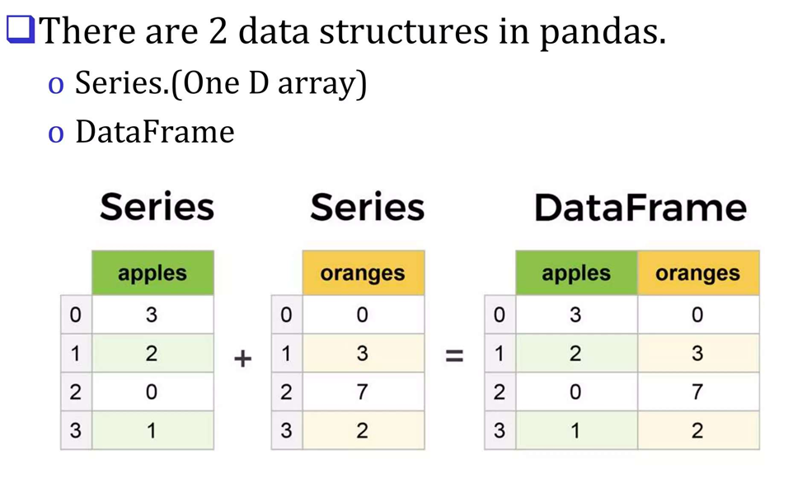
Data Structures

Slide 11
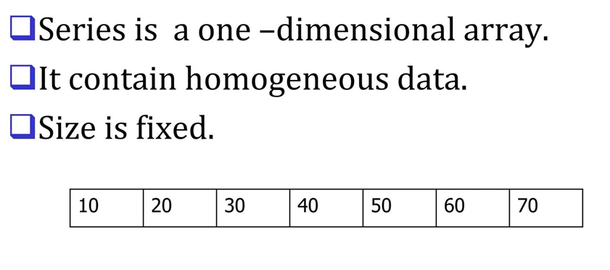
Series data structure

Slide 12
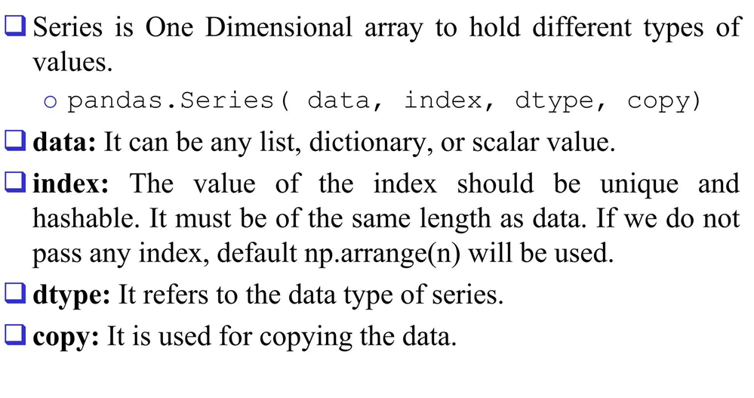
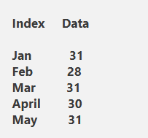
Series data structure

Slide 13
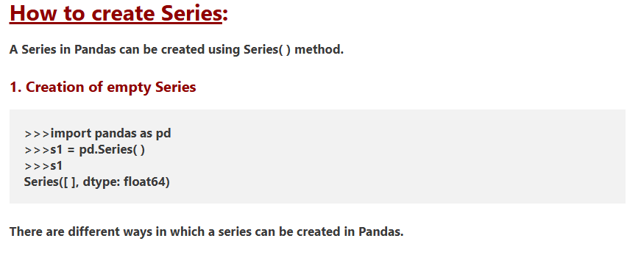

Slide 14
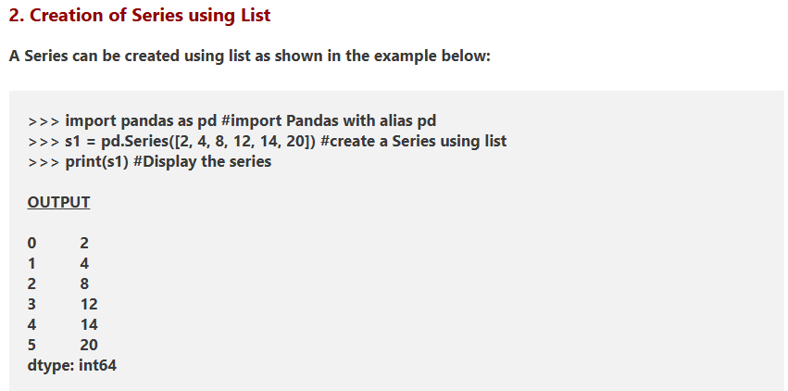

Slide 15
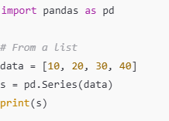
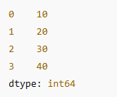
1. Creating a Pandas Series

Slide 16
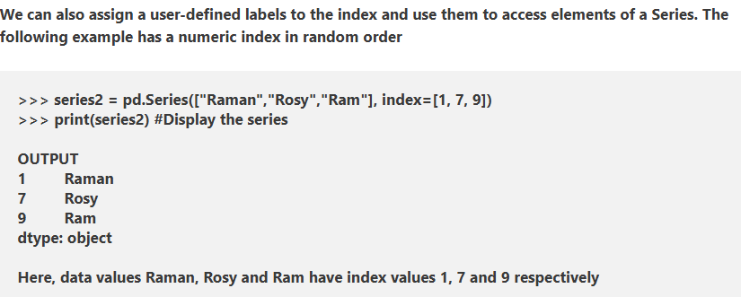

Slide 17
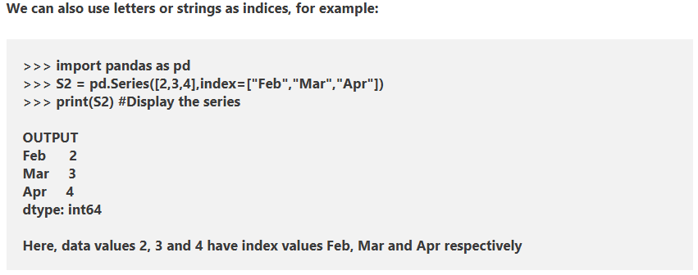

Slide 18
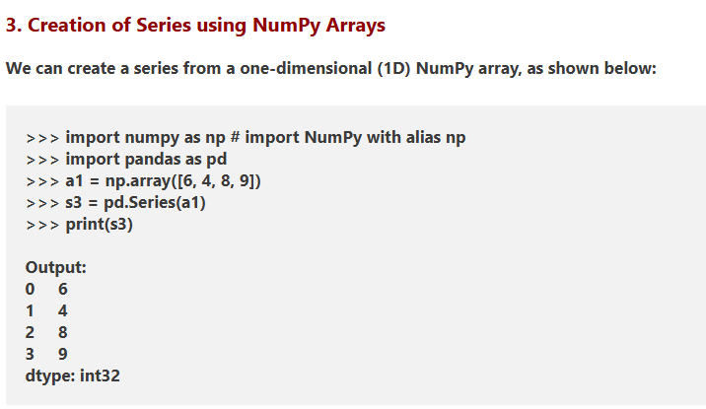

Slide 19
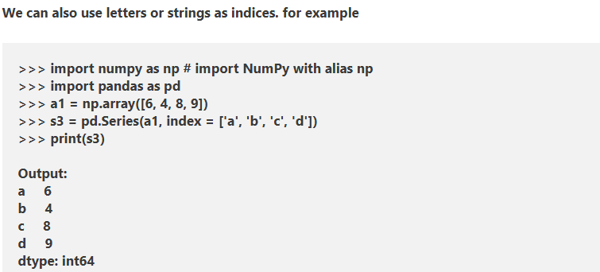

Slide 20
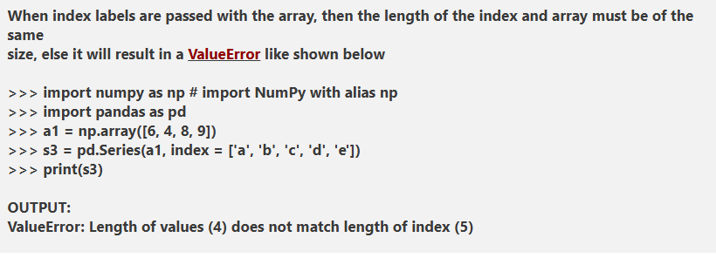

Slide 21
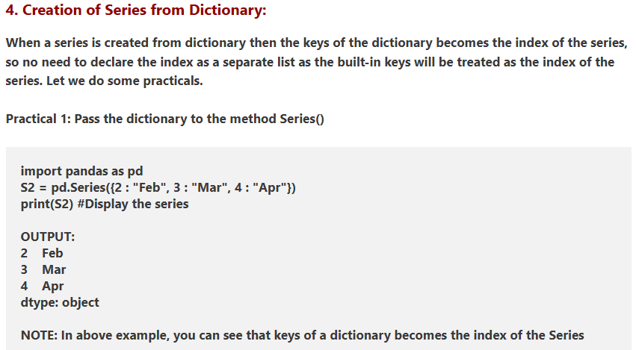

Slide 22
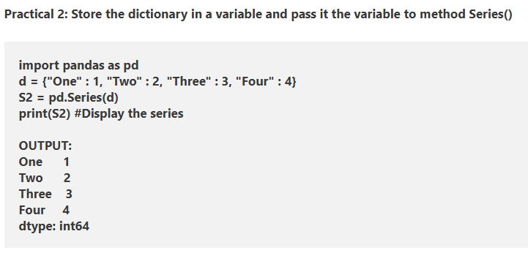

Slide 23
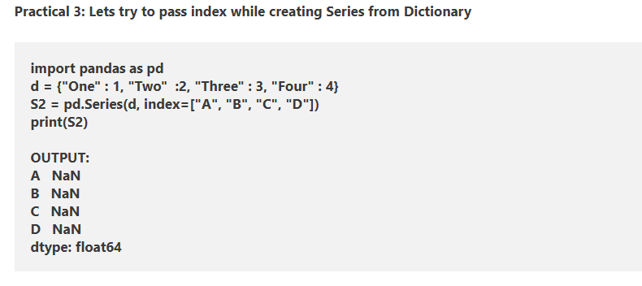

Slide 24
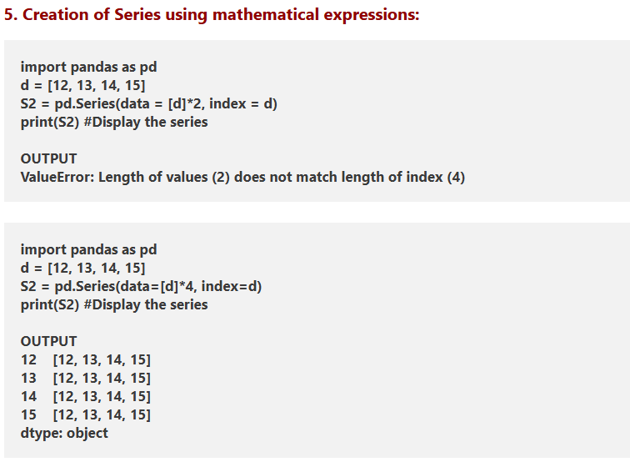

Slide 25
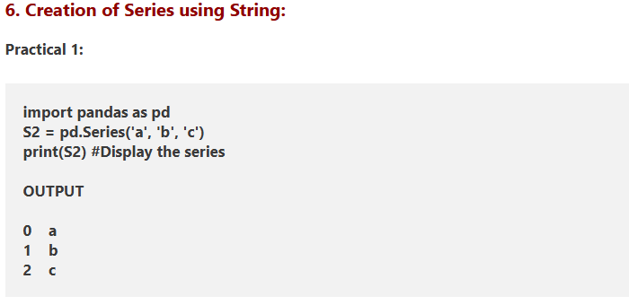

Slide 26
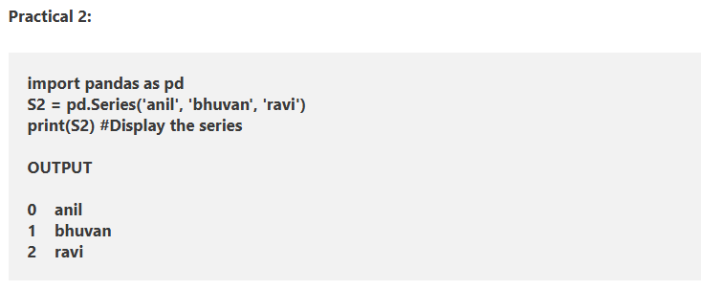

Slide 27
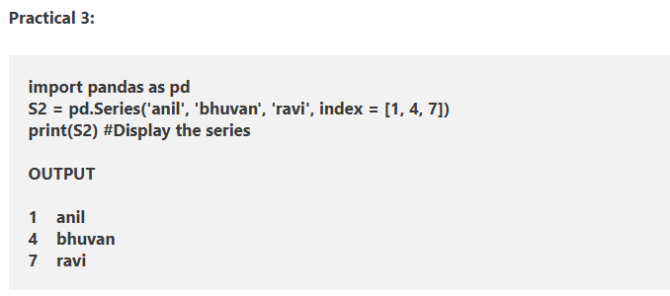

Slide 28
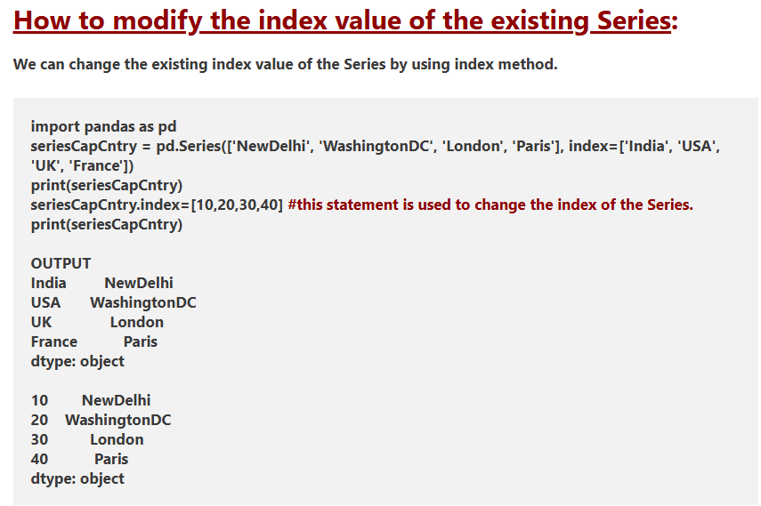

Slide 29
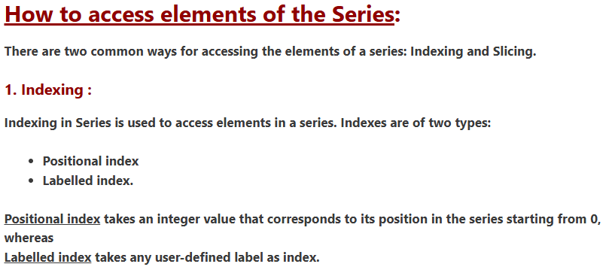

Slide 30
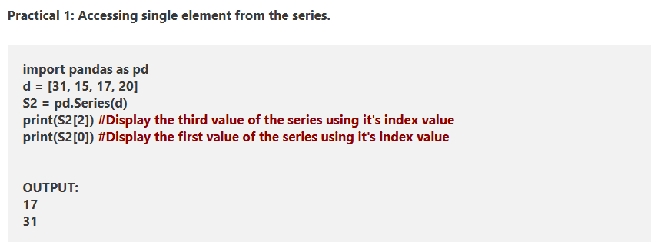

Slide 31
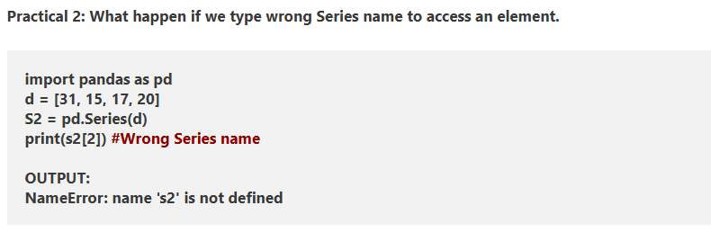

Slide 32
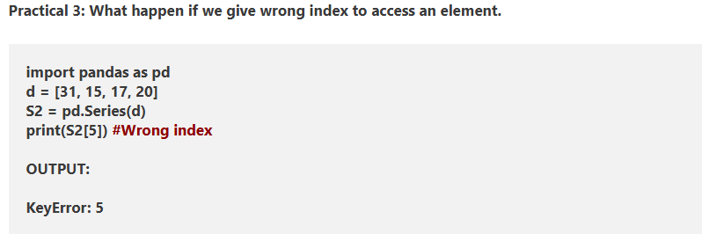

Slide 33
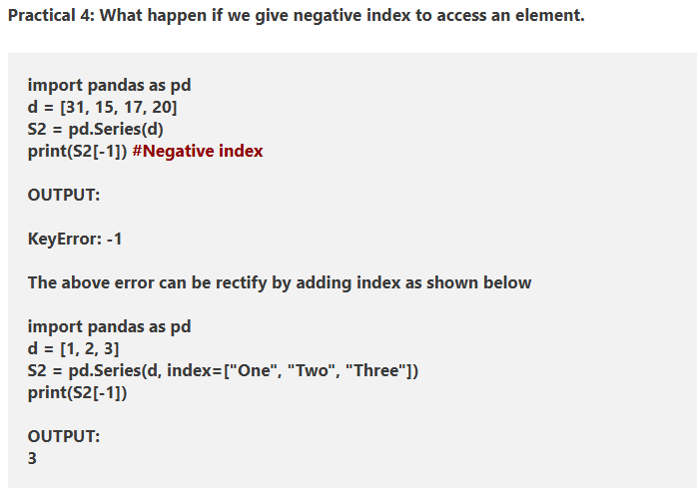

Slide 34
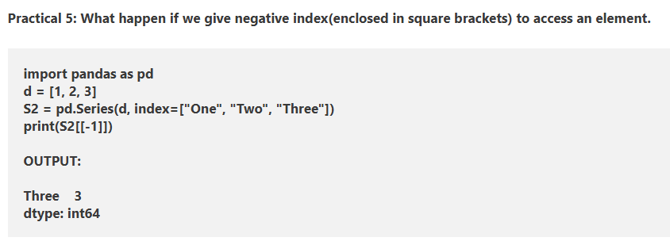

Slide 35
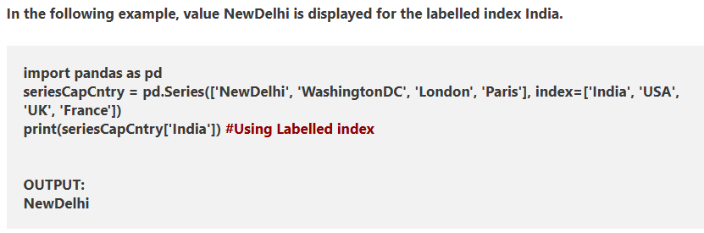

Slide 36
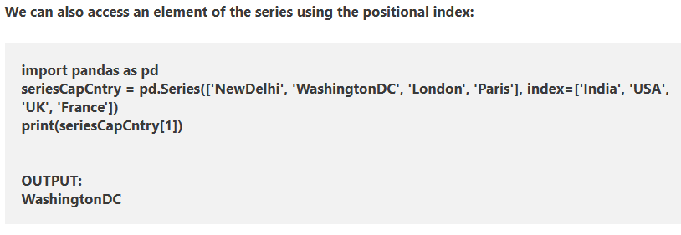

Slide 37
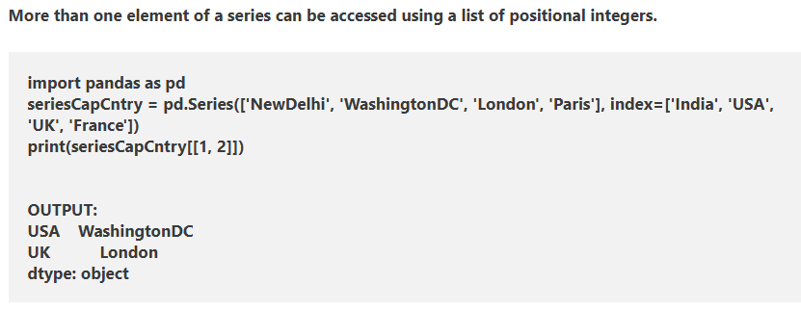

Slide 38
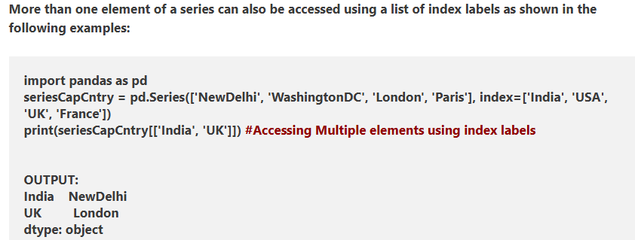

Slide 39
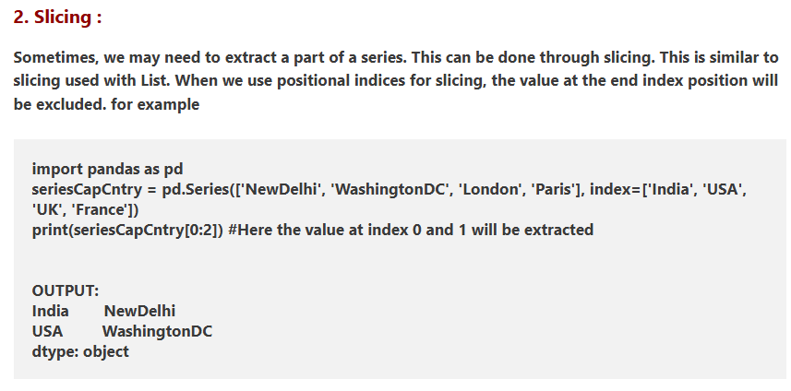

Slide 40
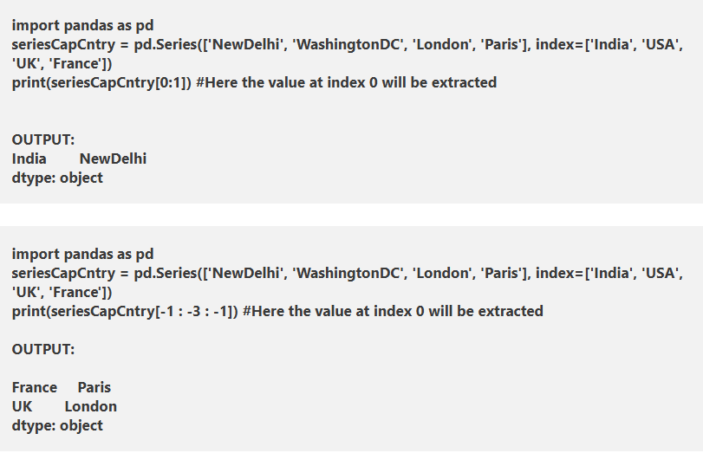

Slide 41
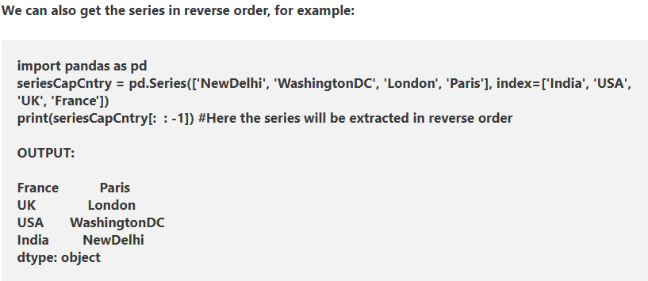

Slide 42
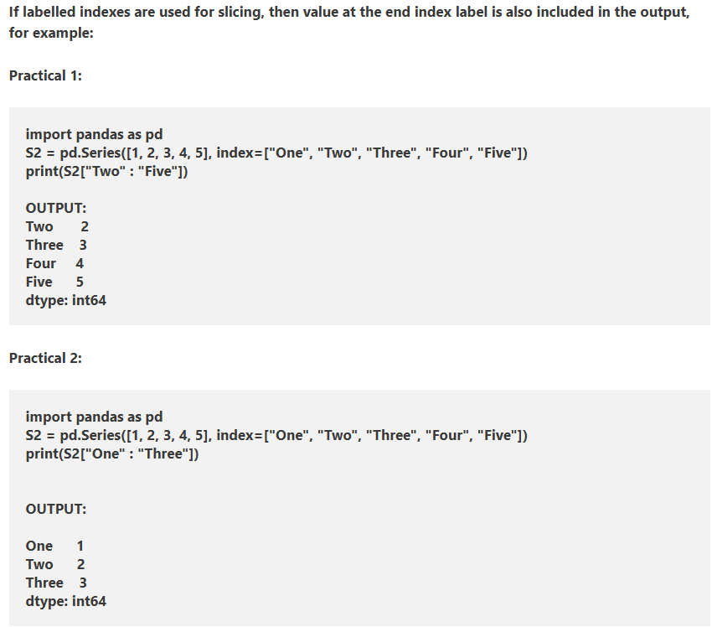

Slide 43
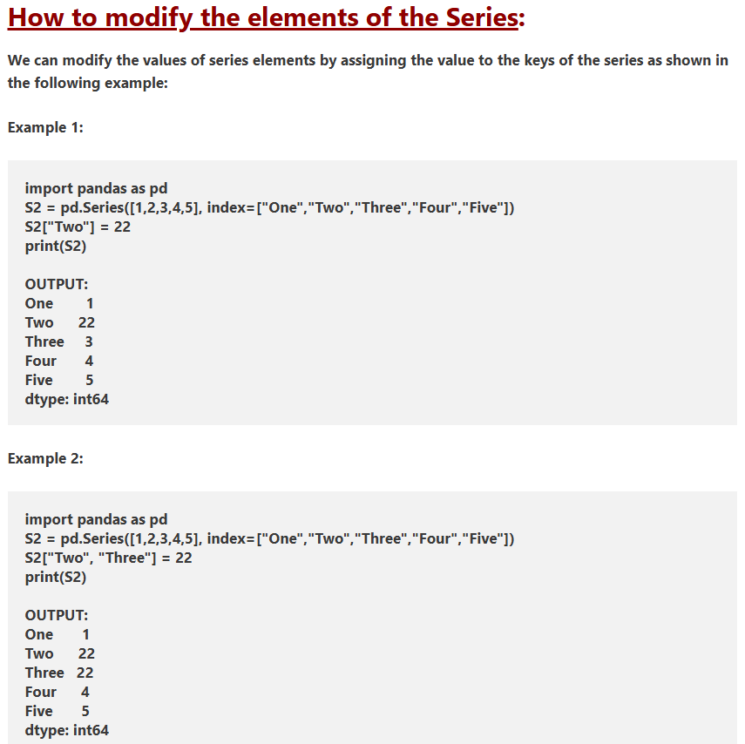

Slide 44
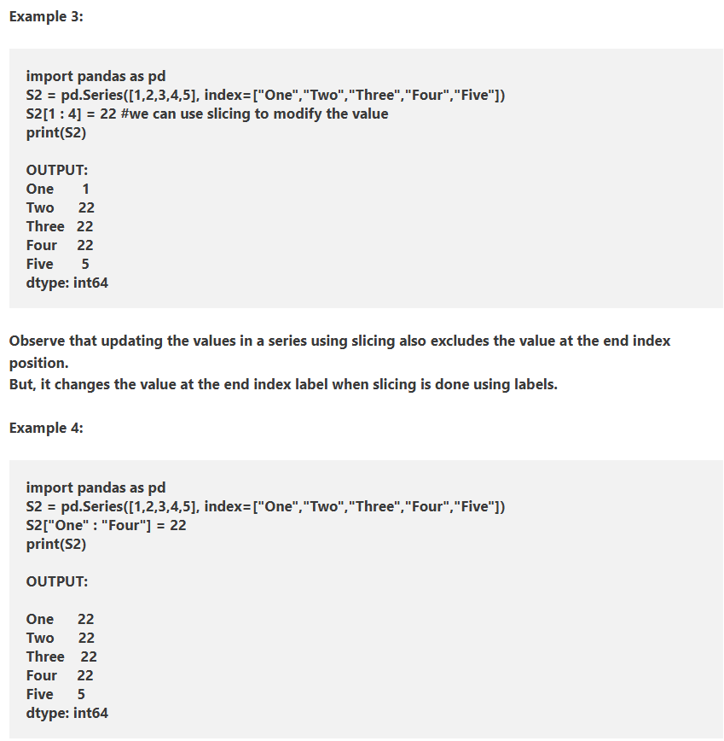

Slide 45
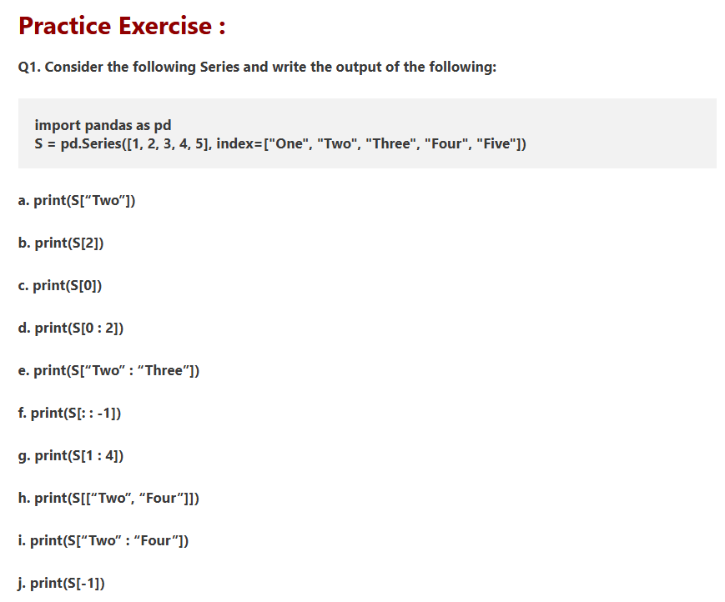

Slide 46
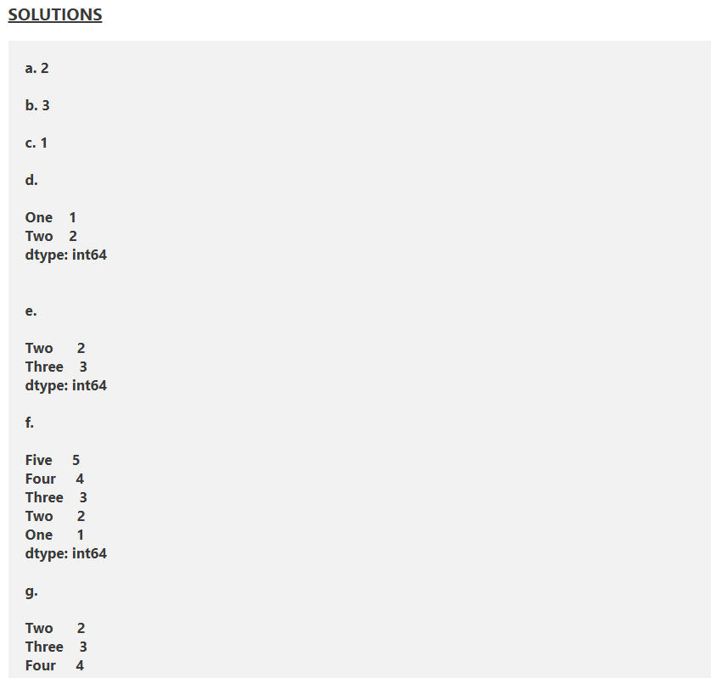
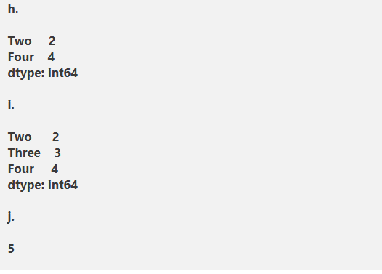

Slide 47
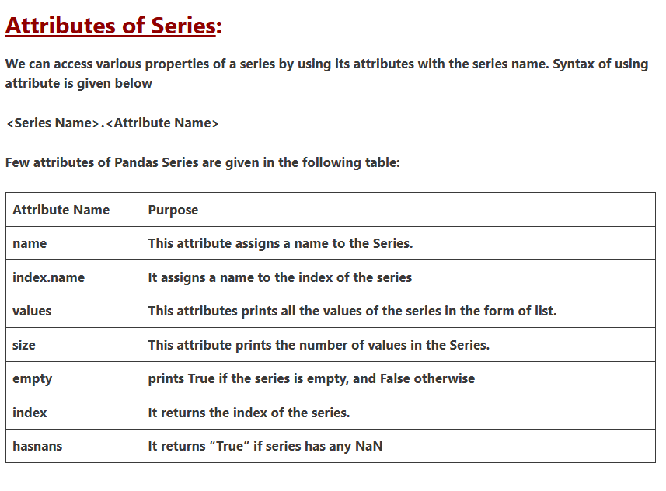

Slide 48


Slide 49


Slide 50


Slide 51


Slide 52


Slide 53


Slide 54


Slide 55


Slide 56


Slide 57


2. Creating Series with Custom Index

Slide 58


Slide 59


Slide 60


Slide 61


Slide 62


Slide 64

3. Accessing Elements in a Series

Slide 65

Performing Operations on Series

Slide 66


Filtering Elements in a Series

Slide 67

Using a Dictionary to Create Series

Slide 68


Mathematical Operations Between Series

Slide 69

Creating a Series

Slide 70

Using Array

Slide 71


Slide 72

Series Object Attribute

Slide 73

Series Object Attribute

Slide 74

Pandas Operations

Slide 75


Slide 76
between()
The between() method in Pandas is used to filter values within a specified range.
Example
import pandas as pd
# create a Series
data = pd.Series([1, 2, 3, 4, 5, 6, 7, 8, 9, 10])
# use between() to filter values between 3 and 7
filtered_data = data[data.between(3, 7)]
print(filtered_data)

Slide 77
between() Syntax
The syntax of the between() method in Pandas is:
Series.between(left, right, inclusive='both')
between() Arguments
The between() method takes following arguments:
left - the lower boundary of the range
right - the upper boundary of the range
inclusive (optional) - specifies whether the boundaries are inclusive
between() Return Value
The between() method returns a boolean Series of the same length as the input Series. This boolean Series indicates whether each element in the original Series falls within the specified range.

Slide 78
Example 1: Filter Values Within a Specified Range
import pandas as pd
# create Series with temperature data
temperatures = pd.Series([18, 22, 25, 30, 35, 19, 28])
# use between() to filter values between 20 and 30 degrees (inclusive)
in_range = temperatures.between(20, 30)
print("Boolean Series indicating values in range:\n", in_range)
# filter the original series
filtered_temperatures = temperatures[in_range] print("\nFiltered Temperatures:\n", filtered_temperatures)

