Slide 1
Insurance Price Prediction
Capstone Project - Final Presentation
Group << n >> - Batch << year >> - Mentor: << Name >>

Slide 2
Contents / Agenda
Executive Summary
Business Problem Overview & Solution Approach
Data Overview & Preprocessing
Exploratory Data Analysis (EDA) Outcomes
Model Selection & Metrics of Interest
Model Performance & Final Model
Explainability (Permutation + SHAP)
Business Insights & Recommendations
Deployment
Appendix

Slide 3
Executive Summary
Problem: estimate an applicant's insurance_cost from health, lifestyle, habit, and demographic data to support fair pricing and risk triage.
Final model: LightGBM - Test R2 = 0.958, MAE = 2,328, RMSE = 2,909 (beats the reference solution).
13 model families compared; tuned with RandomizedSearchCV & Optuna; XGBoost/CatBoost on GPU.
Key drivers: weight, admission history, other-insurer coverage, preventive checkups.
Deployed as a leak-free sklearn pipeline via FastAPI + a React UI + a Streamlit app.

Slide 4
Business Problem Overview & Solution Approach
Problem: healthcare costs are high; insurers must price policies to balance affordability against risk. Estimate the optimum insurance cost per individual (target: insurance_cost).
Solution approach:
Audit & clean the data; fix schema/category quality issues.
Treat missing values and outliers; engineer risk-oriented features.
Compare baseline, linear, tree, and boosting models with cross-validation.
Tune the best family; select on RMSE/MAE/R2 + stability + overfit gap.
Explain the model and deploy it for inference.

Slide 5
Data Overview
25,000 applicants x 24 columns; one row per applicant; no duplicate rows.
Target insurance_cost: mean ~ 27,147, mild right skew (~ 0.33).
Missing values in only two columns:
Year_last_admitted - 47.5% (meaningful: indicates no prior admission)
bmi - 4.0% (imputed by age-band x gender median)
Mixed types: continuous, discrete counts, binary flags, nominal & ordinal categoricals.
Fixed source typos in column names and the 'Salried' -> 'Salaried' category.

Slide 6
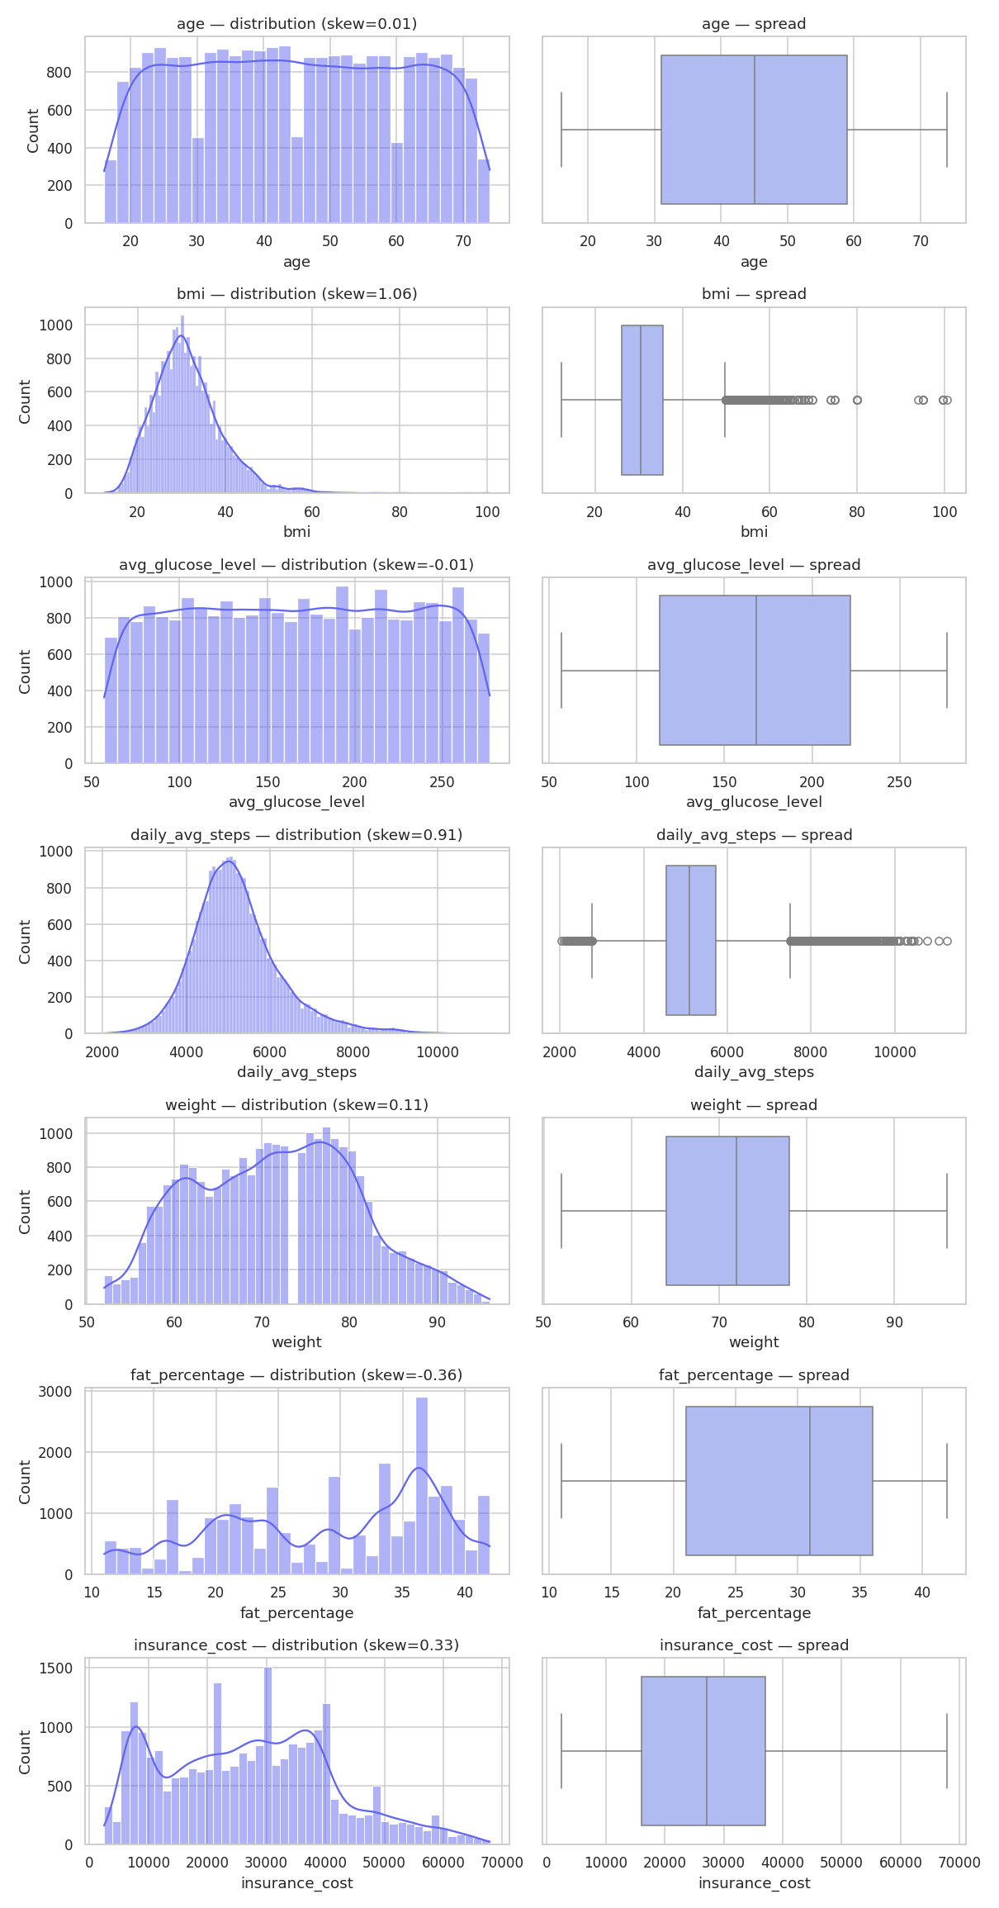
EDA - Distributions of Continuous Attributes
Target is mildly right-skewed; weight, BMI, glucose, and steps are roughly symmetric.

Slide 7
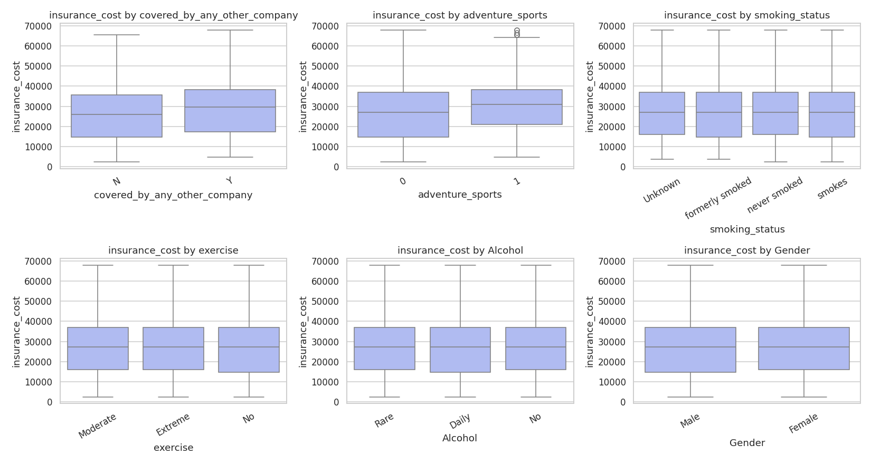
EDA - Key Relationships
- weight has an unusually strong positive link to cost - the dominant signal.
- Higher cost for applicants covered by another insurer and adventure-sports participants.
- Admission history adds useful risk information.
- Lifestyle effects act mainly through nonlinear interactions captured by boosting.
- Flagged: validate weight dominance for plausibility/leakage.

Slide 8
Data Preprocessing
Duplicate check: none; dropped applicant_id (non-predictive identifier).
Missing values: grouped-median BMI imputation; Year_last_admitted -> was_admitted_before + years_since_last_admitted.
Outliers: capped unrealistic BMI; retained valid high-premium targets.
Feature engineering: age_band, bmi_category, cholesterol_midpoint, any_major_disease_history, weight_bmi_interaction, steps_per_age.
Leak-free sklearn Pipeline: feature engineering -> impute + scale + one-hot -> model (fit on training data only).

Slide 9
Model Selection & Metrics of Interest
Baseline: DummyRegressor (mean) and LinearRegression.
Advanced: Ridge/Lasso/ElasticNet, DecisionTree/RandomForest/ExtraTrees, and boosting (GradientBoosting, HistGradientBoosting, XGBoost, LightGBM, CatBoost).
Metrics of interest:
MAE - average pricing error in cost units (primary, business-readable).
RMSE - penalises larger errors; R2 - variance explained.
MAPE/SMAPE - percentage errors; CV RMSE & train-test gap - stability/overfit.

Slide 10
Model Performance Summary (top models by test RMSE)
Model | Train R2 | Test R2 | Test RMSE | Test MAE
LightGBM | 0.964 | 0.958 | 2,909 | 2,328
HistGradientBoosting | 0.962 | 0.958 | 2,912 | 2,334
CatBoost | 0.962 | 0.958 | 2,929 | 2,345
GradientBoosting | 0.958 | 0.957 | 2,944 | 2,368
RandomForest | 0.994 | 0.956 | 3,006 | 2,381
XGBoost | 0.978 | 0.955 | 3,034 | 2,428
ExtraTrees | 1.000 | 0.951 | 3,153 | 2,489

Slide 11
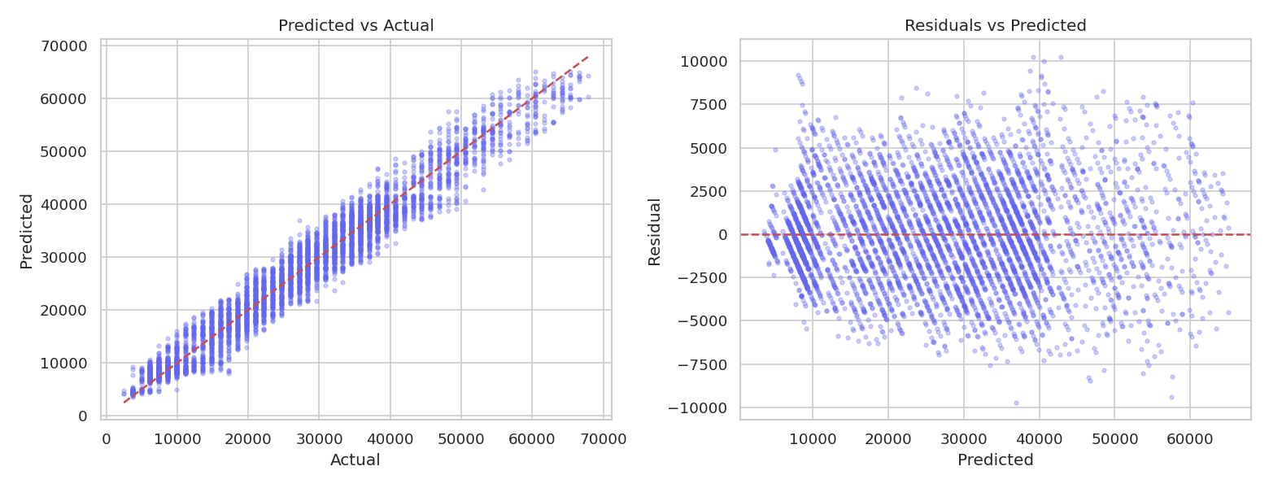
Final Model & Evaluation - LightGBM
- Selected for lowest test RMSE/MAE, strong R2, stable CV, small train/test gap.
- Test MAE: 2,328
- Test RMSE: 2,909
- Test R2: 0.9585
- Test MAPE: 11.3%
- Residuals centred & homoscedastic; predictions track actuals.

Slide 12
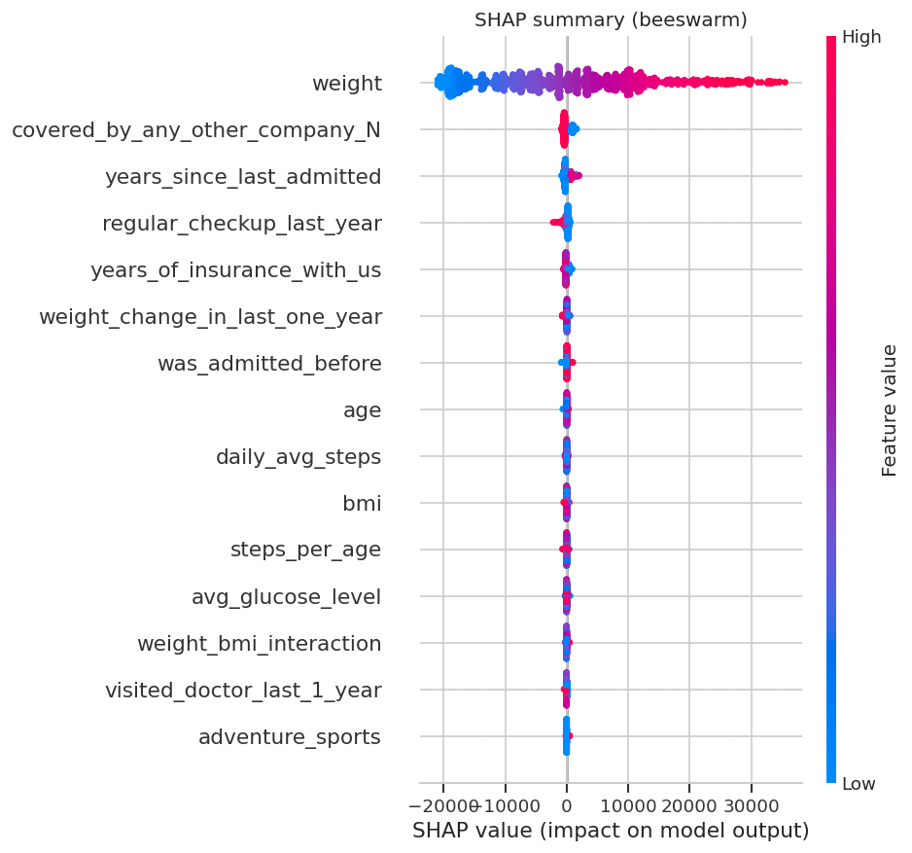
Explainability - Permutation + SHAP
- Two independent methods agree on the drivers:
- weight (dominant)
- admission recency / history
- other-insurer coverage
- preventive checkups, weight change
- SHAP shows effect direction (higher weight -> higher cost).

Slide 13
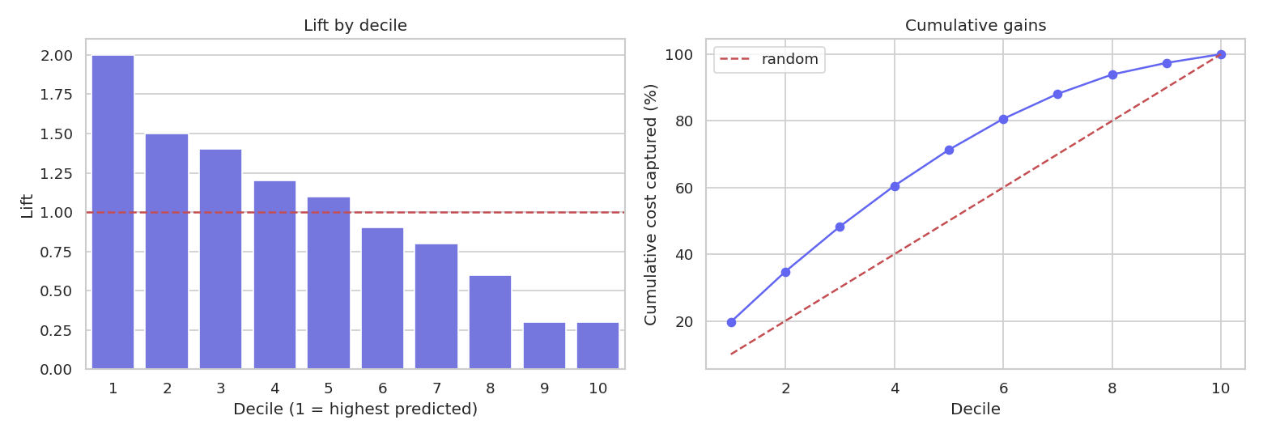
Business Insights - Lift / Gains
- Applicants sorted by predicted cost into deciles.
- Top deciles carry lift well above 1.0.
- Cumulative-gains curve sits above random.
- -> Effective ranking for underwriting triage and
- targeting high-cost segments.

Slide 14
Business Recommendations
Use as pricing decision-support, not automated underwriting (track override rate).
Route extreme predictions (top decile) to manual review (reduce mispriced policies).
Target wellness programmes at high-risk segments (weight, checkups, activity).
Governance: review Gender/Location for fairness; validate weight dominance for leakage.
Monitor drift, segment-level error, and override rates post-deployment.

Slide 15
Deployment
Production pipeline saved as one sklearn artifact (models/final_model.pkl).
FastAPI service: /health, /schema, /predict -> cost + Low/Medium/High risk + top drivers.
React + TypeScript + Tailwind UI, built dynamically from the API schema.
Streamlit app for a one-click demo of the same model.
GPU acceleration (XGBoost/CatBoost); reproducible via `uv run python -m insurance.train`.

Slide 16
Appendix

Slide 17
Appendix - Data Background
Source: Insurance Data.csv - 25,000 rows x 24 columns; target insurance_cost.
Predictors span profile (age, gender, occupation, location), health (bmi, glucose, cholesterol, disease history), habits (smoking, alcohol, exercise, steps), and policy fields.
Full data dictionary: reports/tables/data_dictionary.csv; model comparison & importance tables under reports/tables/.
Limitations: dataset provenance unknown; weight dominance needs plausibility/leakage review; predictors must be available at quote time; expand fairness testing before production.

Slide 18
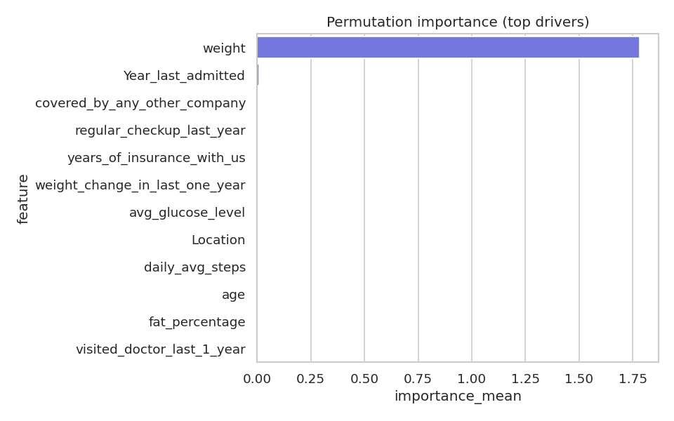
Appendix - Permutation Importance
Permutation importance of input features for the final LightGBM model.

Slide 19
Thank You

