Slide 1
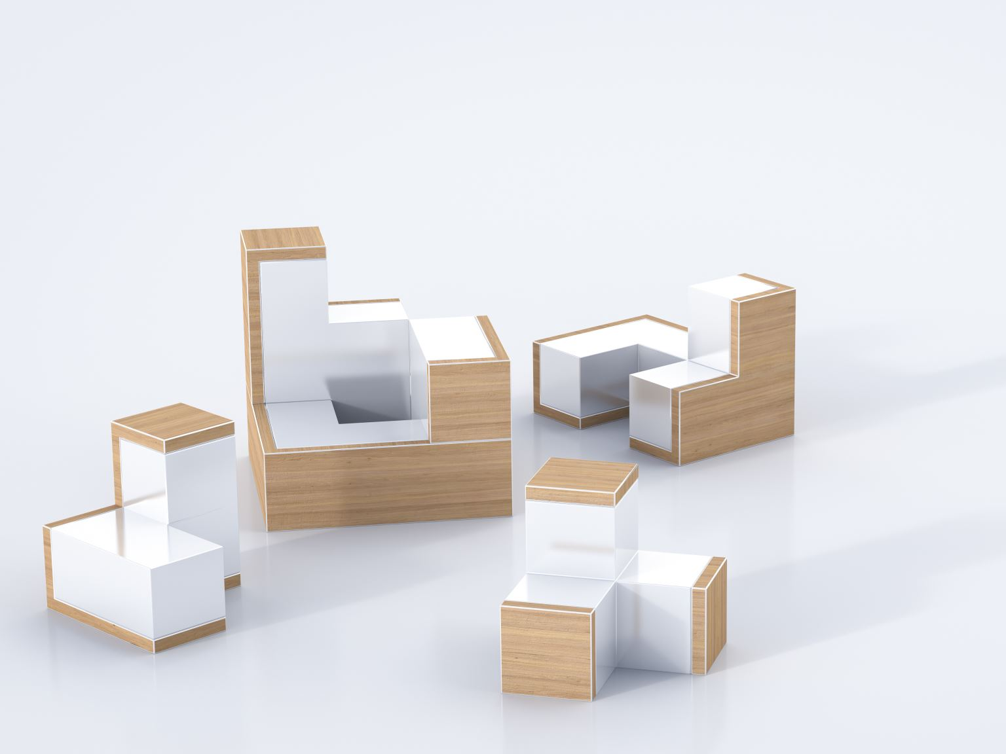
Furniture Sales Prediction Project
BY- GUNJAN AGRAWAL

Slide 2
Problem Statement
Predict the number of furniture items sold (sold) based on product attributes such as productTitle, originalPrice, price, and tagText.
Tech Stack: Python, pandas, scikit-learn, matplotlib, seaborn

Slide 3
Data Preprocessing
- Converted price/originalPrice to numeric
- Extracted discount and discount_percent features
- Handled missing values (imputation)
- Grouped categorical features (tagText, sold groups)

Slide 4
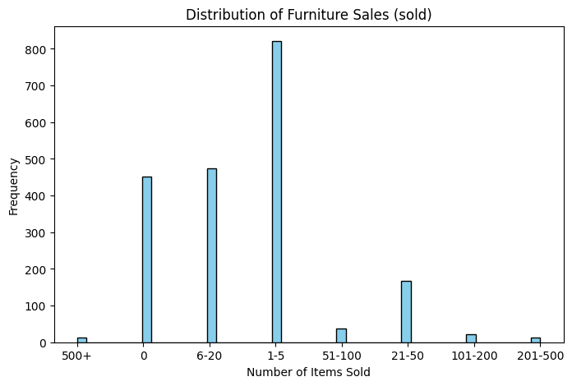
EDA Visual 1
This chart shows that most furniture products have very low sales (1–5 units), while a few items reach 500+ sales. The sales distribution is highly skewed, indicating only a small fraction of products are top sellers.

Slide 5
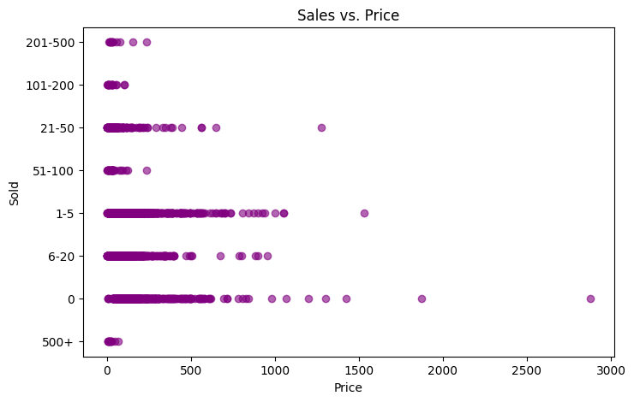
EDA Visual 2
This plot shows that most sales occur at lower price ranges, especially for 1–20 items sold. Higher-priced items generally see very few sales, highlighting a negative relationship between price and demand.

Slide 6
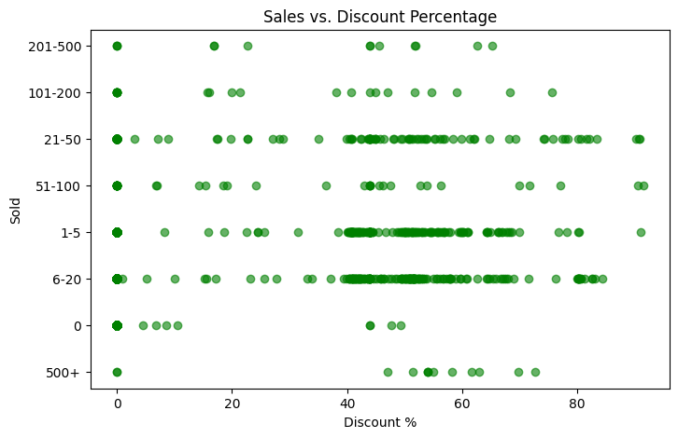
EDA Visual 3
This chart shows that moderate discounts (40–60%) are linked with higher sales volumes, especially in the 6–20 and 21–50 ranges.

Slide 7
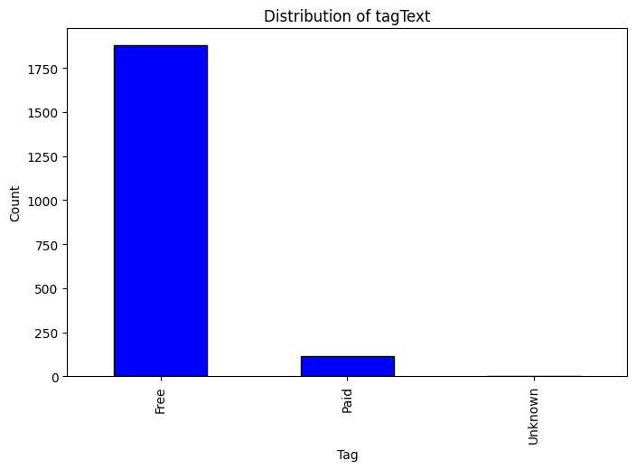
EDA Visual 4
The chart shows that most items are tagged as "Free", while very few are marked as "Paid" and almost none as "Unknown". This suggests that the dataset is highly imbalanced toward free offerings.

Slide 8
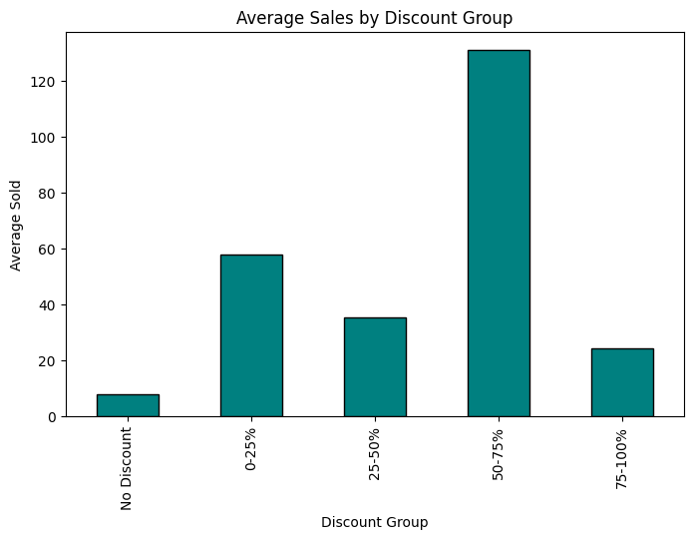
EDA Visual 5
The chart shows that sales peak in the 50–75% discount range, suggesting that moderate to high discounts drive the highest average sales.

Slide 9
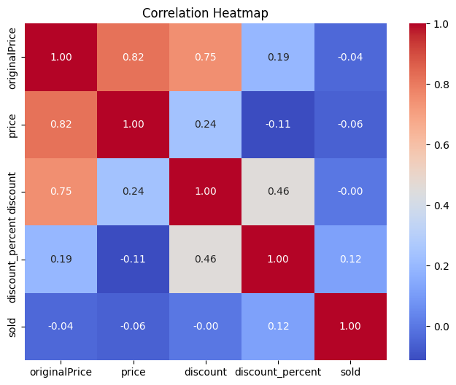
EDA Visual 6

Slide 10
Models Used
1. Linear Regression
2. Random Forest Regressor
3. XGBoost Regressor

Slide 11
Performance Metrics
Linear Regression:
- MAE: ~0.98
- RMSE: ~1.22
- R²: ~0.18
Random Forest:
- MAE: ~0.84
- RMSE: ~1.06
- R²: ~0.39
XGBoost:
- MAE: ~0.83
- RMSE: ~1.08
- R²: ~0.37

Slide 12
Best Model
Random Forest performed best:
- Lowest MAE and RMSE
- Highest R² (0.39)
- Robust to categorical features and nonlinear patterns

Slide 13
Conclusion & Future Work
Conclusion:
- Random Forest is most effective for predicting sales
- Discounts and pricing strongly impact sales
Future Work:
- Hyperparameter tuning
- Incorporating NLP features from productTitle
- Predictive dashboards for business decisions

Slide 14
Thank you

