Slide 1


GROUP-23
SENTENCE AUTO-COMPLETION
ADITYA DAIPURIA
ADITYA GHOSH
GUNJAN DABAS JYOTIRMAYA SINGH VIDUR GOEL

Slide 2
PROBLEM STATEMENT
Current challenge in natural language processing underscore the need for advancements in sentence auto-completion systems using classical machine learning techniques.
The difficulty lies in developing models that not only generate accurate and contextually relevant sentence endings but also comprehend and apply commonsense knowledge.
The project addresses these challenges, seeking to contribute solutions that improve accuracy in generating sentence suggestions, ultimately paving the way for more effective and nuanced communication between machines and humans.
For performance metrics, we will qualitatively analyse the accuracy of suggestions.

Slide 3
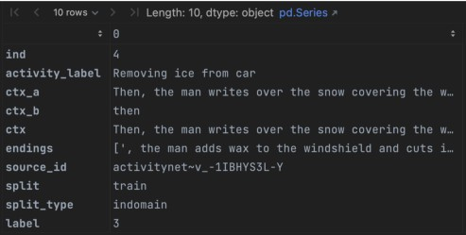
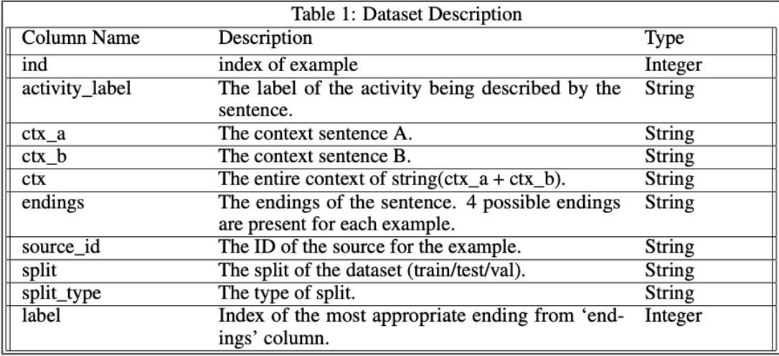
DATASET DESCRIPTION
The HellaSwag dataset comprises 10,000 examples, organized into 39,905 rows and 10 columns.
Columns include ctx_a and ctx_b, representing context sentences, along with ending_a and ending_b, which offer possible sentence completions.
The label column indicates the correct ending for each example.
The dataset categorizes the examples into 178
activity-based groups.
Adversarial Filtering is employed in the preparation of the dataset.

Slide 4

EXPLORATORY DATA ANALYSIS
CLASS IMBALANCE
SENTENCE LENGTH
Some classes had much higher length due to major imbalance in classes.
01 02
Major class imbalance found in Food and Entertaining , Health and Computer and electronics using a bar plot.
UNIGRAMS
Counting the most occuring words in the dataset but they may give false indications as they may not be of importance. Words like ‘Title’ , ‘Header’ and ‘Step dominated the list. These were then subsequently removed in our analysis due to loss of meaning.
BIGRAMS/TRIGRAMS
These can help identify the language patterns . In bigrams (title,header) were the most occuring , while (title,header,step) were most occuring in trigrams. These again, were subsequently removed in our analysis due to loss of meaning.
WORD CLOUD
Unsual words stood out which lead to futher analysis and also got to know patterns and trends which were helpful in deciding and choosing words that fit into sentences.
03
04
EVERYGRAM
Though unigrams still dominated the list but we got to know there were bigrams present as well which means some words occurred together while mostly the language preferred to have a single word.
05
06

Slide 5
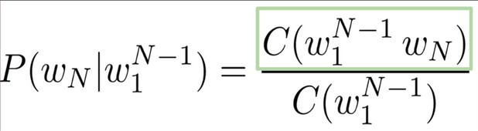
METHODOLOGY
A thorough literature survey found out that using an N-grams model along with PMI yielded the highest accuracy on the MSR dataset challenge. We tweak our model to be a generative model rather than a classification-based model.
An N-grams model is a type of probabilistic language model used in natural language processing (NLP) and computational linguistics. It is based on the Markov assumption which allows us to assume that the probability of a word in a text depends only on the previous n-1 words.
An N-gram is simply a sequence of N words. Therefore, a 1-gram (or unigram) is a single word. A 2-gram (or bigram) is a sequence of two words. A 3-gram (or trigram) consists of three words, and so on.
In general, the probability of an N-gram model can be estimated as:
where C(w1, w2): is how many times the sequence (w1,w2) occurs w1,N-1: is the sequence of words w1,w2,...,wn.
The joint probability of a word sequence can be decomposed into the product of conditional probabilities using the chain rule:

Slide 6
Pointwise Mutual Information: Pointwise Mutual Information (PMI) is a measure used in information theory and statistics to quantify the association between two events or variables. PMI between 2 event X and Y can be given as:
Calculation of PMI in Text Data: In NLP, PMI is used to calculate the association between two words. For two words w1 and w2, PMI is calculated as:

Slide 7
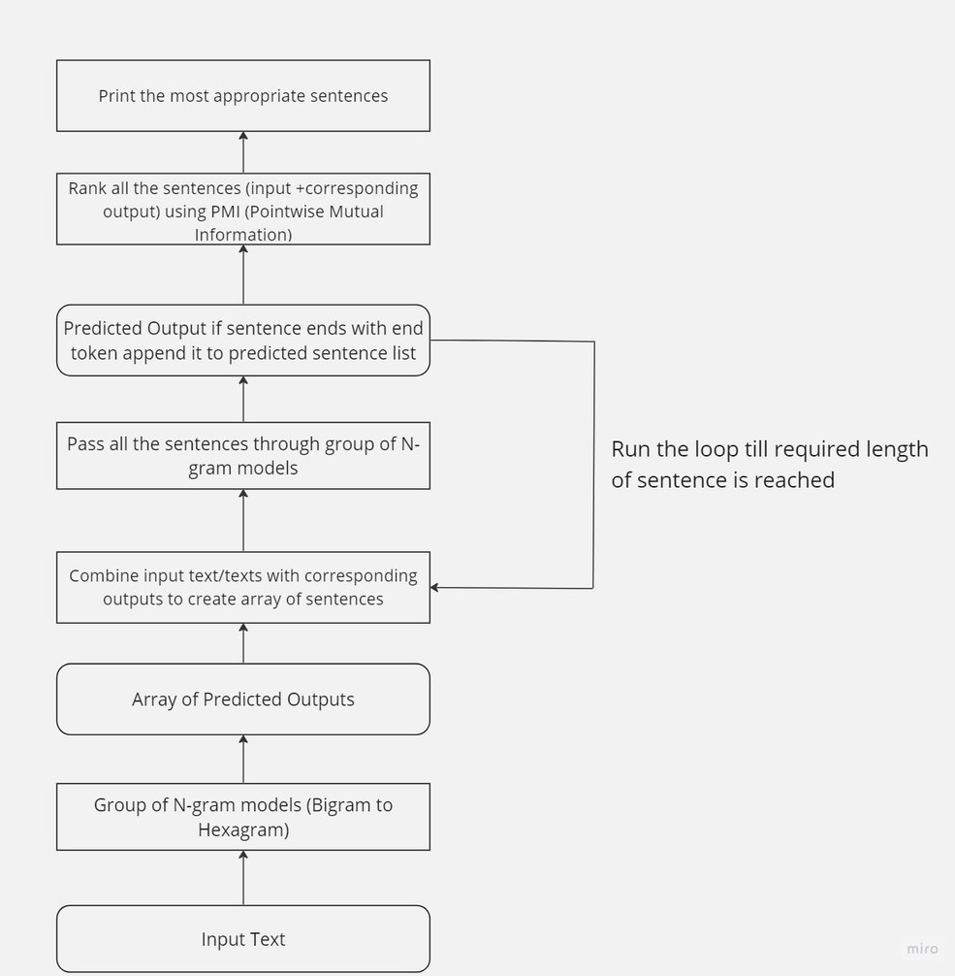
MODELS
We train the model on the “correct” endings provided by the
Hellaswag training dataset.
The words are lemmatised and different n-gram tokens are created and their respective frequencies are calculated.
Input text when passed to a group of N-gram models generate an array of predicted outputs. which gets passed as input text to generate a concatenated output for each of the input texts.
Repeat until length reached.
If a term is not in the model's vocabulary, we continue prediction by randomly inserting a word that does not modify the meaning of the sentence.
We distinguish sentences ending with a full stop ('<e>') from those still open for completion. Note that sentences without a full stop will eventually conclude as we permit sentence length to grow.
We finally rank the appropriateness of each sentence by calculating the PMI (Pointwise Mutual Index) of each sentence.

Slide 8
RESULTS
While there are no quantitative performance metrics for our task, we did conduct a small initial analysis of the performance of various n-gram models on the validation set of the Hellaswag dataset.
The bigram model achieved an accuracy of 26.07% while trigrams, quadgrams, pentagrams and hexagrams achieved an accuracy between 25.0%-25.2%. This is only slightly better than random guessing which is the baseline.
However, it is notable that the various deep learning models achieved only around 30% accuracy. This fact has been noted that while humans are able to perform the sentence completion task with relative ease, the then state-of-the-art-models struggled to do the same.
In fact, a model trained by University of South Florida and Oklahoma State University used GPT which achieved an accuracy of 25.8%. Our simple bigrams model outperformed the same. This can be evidence of the fact that a simple n-grams model may be able to perform reasonably well on the given task.
For our specific task, there is no quantitative metric for evaluating the generated outputs. We rely on the judgement of readers/evaluators to decide how well our model is able to generate text in this limited environment.

