Slide 1
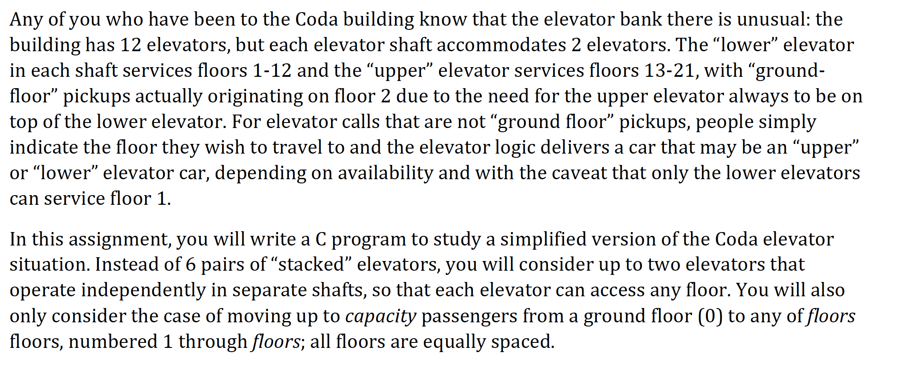
Project description

Slide 2
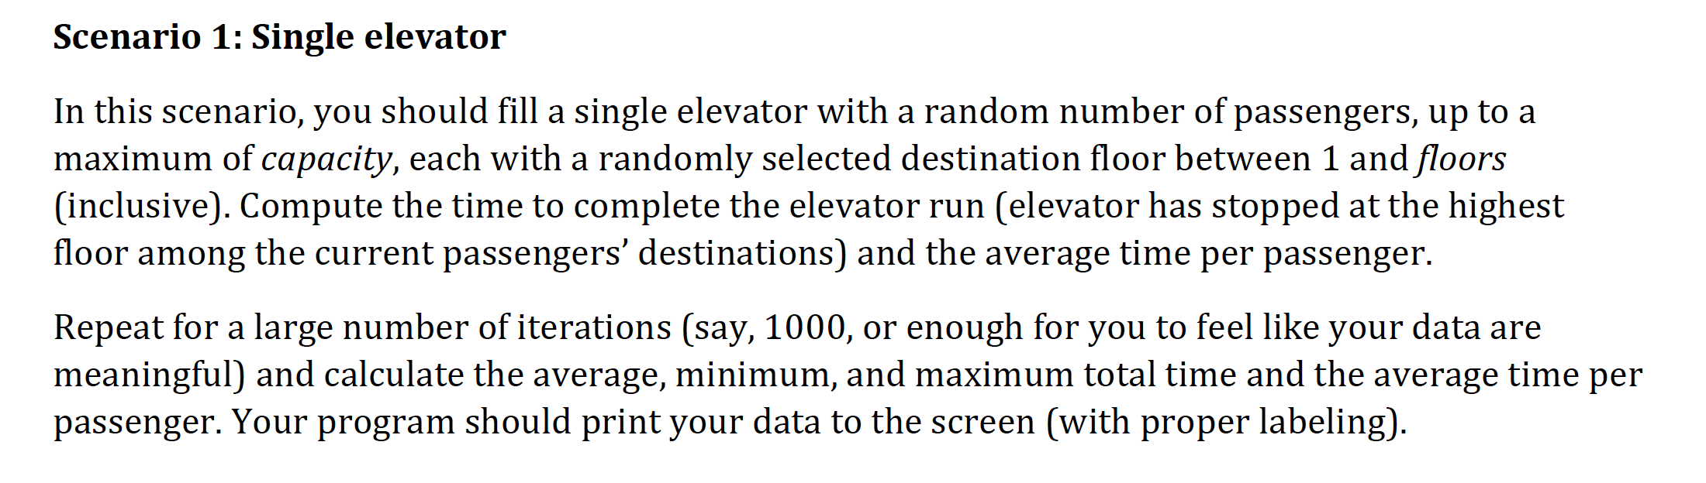
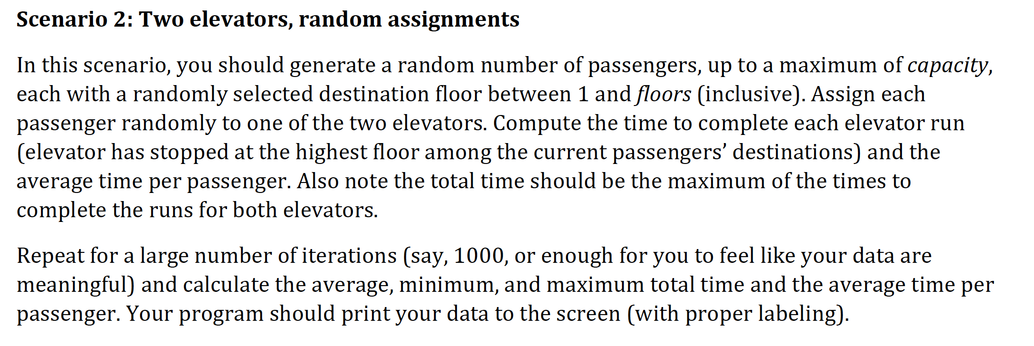
Project description (cont.)

Slide 3
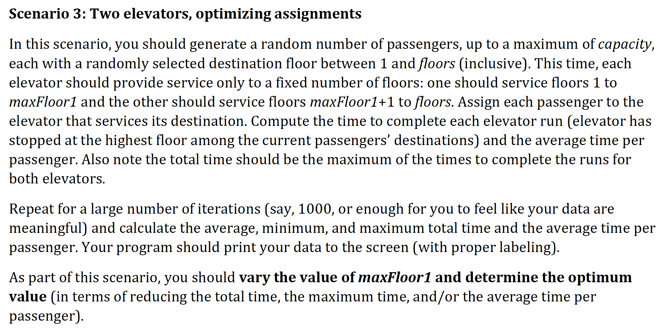
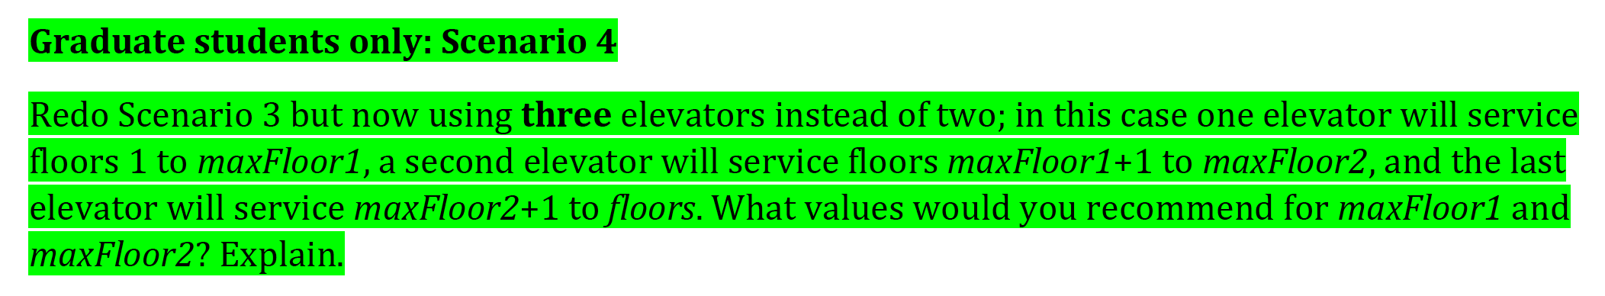
Project description (cont.)

Slide 4
6010 Partner Assignment 1
Brief Summary of the analysis
Our analysis show that, average time taken per passenger is :
Scenario 1 > Scenario 2 > Scenario 4 > Scenario 3
The time statistics we obtained are:
Measure | Scenario 1 | Scenario 2 | Scenario 3 | Scenario 4
 |  |  | lowest at (floor 10) | lowest at (7,14 floors)
Average total time | 145 | 101 | 88 | 79
Maximum total time | 285 | 285 | 180 | 150
Minimum total time | 3 | 3 | 3 | 3
Average time per passenger | 78.36 | 64.36 | 53.62 | 48.08

Slide 5
Development of Code
Data structure
Struct elevator – data for each elevator run.
Int total_time: Total run time of the elevator
Float average_time: Average wait time for each passenger
Struct people – data for each passenger
int person_no: Passenger ID number
int ExitFloor: The destination floor for each passenger.
int elevatorNumber: Elevator allotted to each passenger (for scenarios 2,3 and 4).
int travelTime: Travel time for each passenger
int waitTime: Wait time for each passenger
int waitFloor: Number of floors the passenger has to wait before getting off.

Slide 6
Development of Code
Time calculation
Scenario 1 – Generating passenger, Initializing passenger attributes (Exit_Floor, time_taken etc), Time statistics such as average time taken, min max time taken, avg time taken by each passenger.
Scenario 2 – We divided the total capacity into 2 elevators and generated passenger for each one of them and assigning them respective exit floors. This calculated the time separately for both elevators, and we dropped the lowest time elevator for time statistics.
Scenario 3 – This was bit tricky, we implemented it based on the logic that, the passenger will be separated based on elevator as well as their exit floor
Scenario 4 – Here we only followed logic of scenario 2 & 3 again to add an elevator and distribute the total capacity and calculate the time statistics.

Slide 7
Functions
Elevator_run() – Simulates 1000 elevator runs; accumulates the average elevator run time; calculates maximum and minimum elevator run times. For the case of multiple elevators, the total run time is the max of individual run times of the 2 elevators.
generate_people() – Generates an array of people objects of size total_count. In case of scenario 3,4 this function also separates the list of passengers into 2(or 3) different list for each elevator.
Sortarray()- Sorts arrays in ascending order of exit floors
Swap() – Swaps entries of passenger array based on a given condition
caltime() – calculates the number of floors that need to have passed until a passenger has to get down.

Slide 8
Calculating Time
In the passenger attributes, we first calculated the move time as well as stop time for each passenger.
But then we needed to calculate stop time for the floors where an actual passenger have its exit floor.
That’s why we calculated move time for each passenger in the passenger attribute and then calculate stop time later given the if else condition with an additional variable attribute waitFloor for each passenger.
Future improvements could be a way to integrate this time calculation directly with move time if we can implement a data structure for the passengers.

