Slide 1

MLFlow
Machine Learning based Flow Optimizer
Gunjan Patel
Romil Jain
Rosalind Lee
Yaping Gu

Slide 2
Traffic Pattern

Slide 3
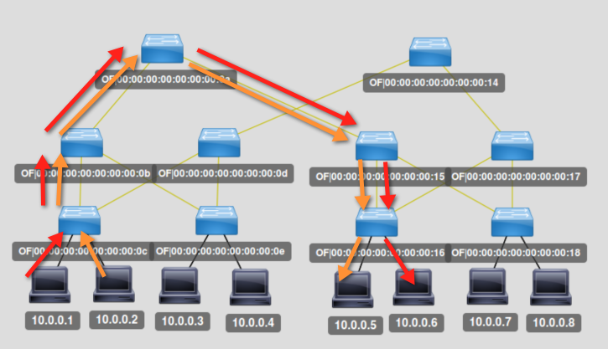
Before…

Slide 4
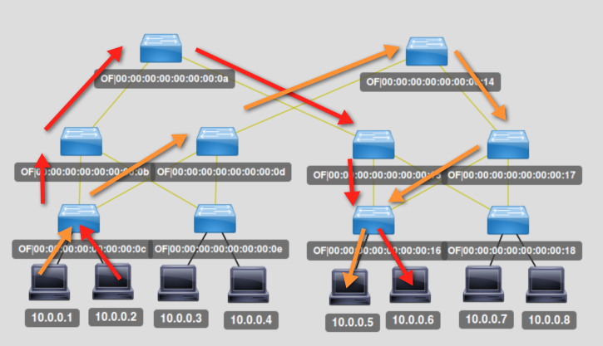
After…

Slide 5
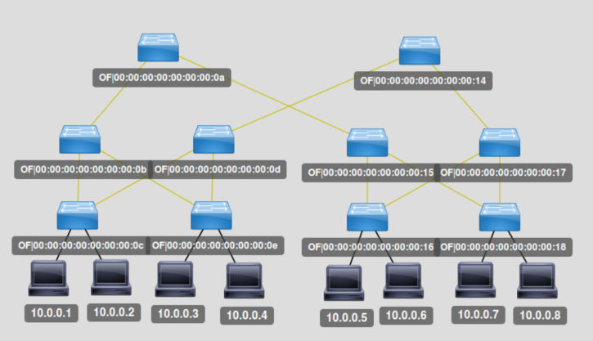
MLFlow in action…
App
Mininet

Slide 6
Summary
Machine Learning based traffic engineering with SDN can avoid congestion by proactively provisioning flows and providing dedicated path to the server(s) who’s traffic is going to peak before that happens.
MLFlow collects real-time stats and a Machine Learning algorithm learns the traffic pattern and will predict future traffic patterns so that Flow Programmer can proactively program the flows

