Slide 1

Experiential Learning
Project Assessment-I on
“Recruitment & HR Analytics Portal”
under the course
Python Programming Language (N-PCCCM304P)
Presented By
Gunjan R. Chimote
Under the Guidance of
Mrs. Mayuri Getme
Session:2026-27 (ODD )
Department of CSE(AI&ML)
S. B. JAIN INSTITUTE OF TECHNOLOGY MANAGEMENT AND
RESEARCH,NAGPUR
An Autonomous Institute, Affiliated to RTMNU, Nagpur
)

Slide 2
Contents
Problem statement
Objectives
Algorithm
Flowchart/pseudocode
Understanding of Python logic
GitHub account, repository creation, uploading code, meaningful commits, collaboration, individual contribution
S. B. Jain Institute of Technology Management and research

Slide 3

Problem Statement
Project Title
Recruitment & HR Analytics Portal
Project Description
A Python-based HR management system that manages job applications, candidate information, interview schedules, employee recruitment, and generates HR analytics reports to support effective hiring decisions.
S. B. Jain Institute of Technology Management and research

Slide 4
Objectives
🎯 Automate & Simplify
Automate and simplify end-to-end recruitment workflows, reducing manual effort and administrative overhead.
📊 Efficient Management
Manage jobs, candidates, applications, and interview schedules efficiently from a single portal.
📈 Data Analytics
Analyze recruitment data using advanced data-processing techniques and machine-learning models.
💡 Visual Insights
Provide rich visual HR insights via interactive charts to support smarter, data-driven hiring decisions.

Slide 5
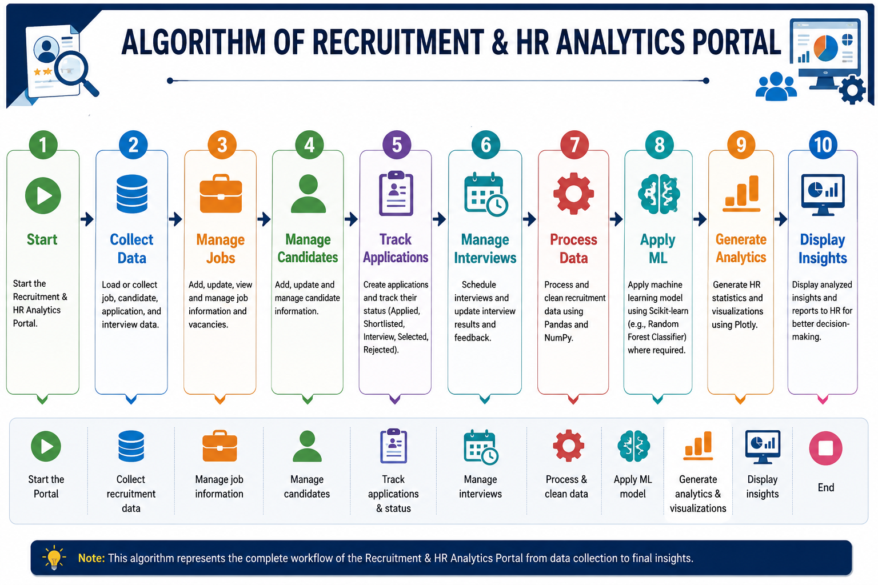
Algorithm

Slide 6
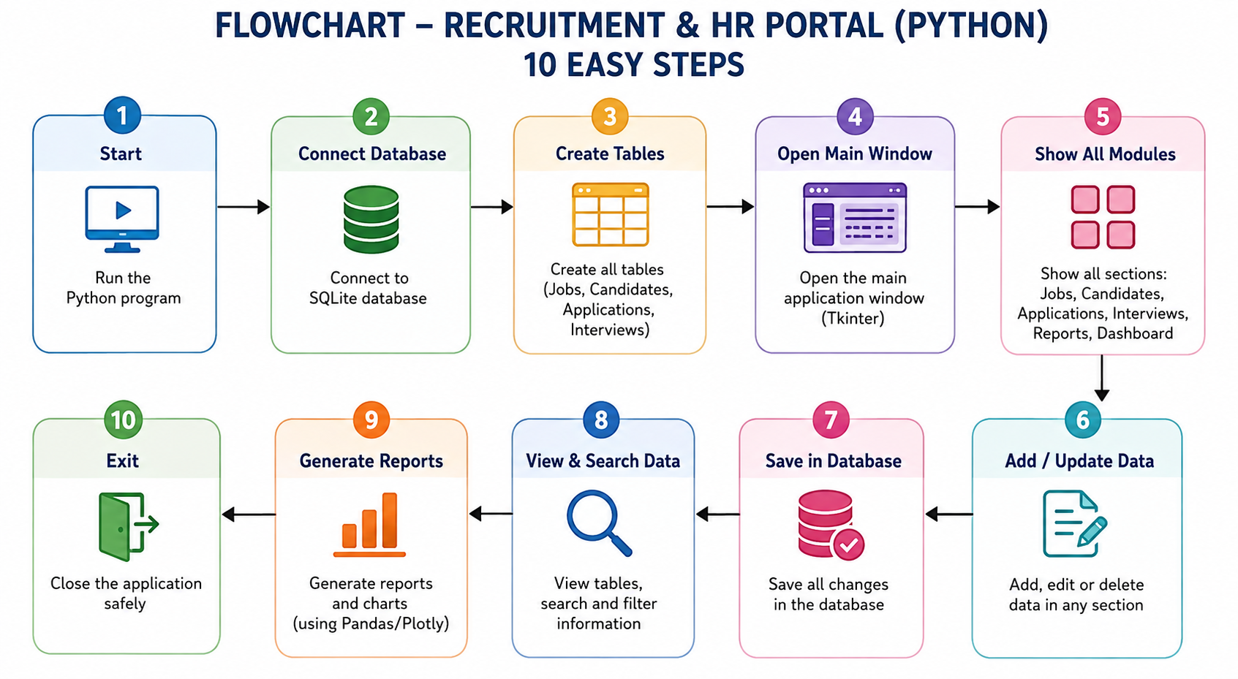
Flowchart

Slide 7
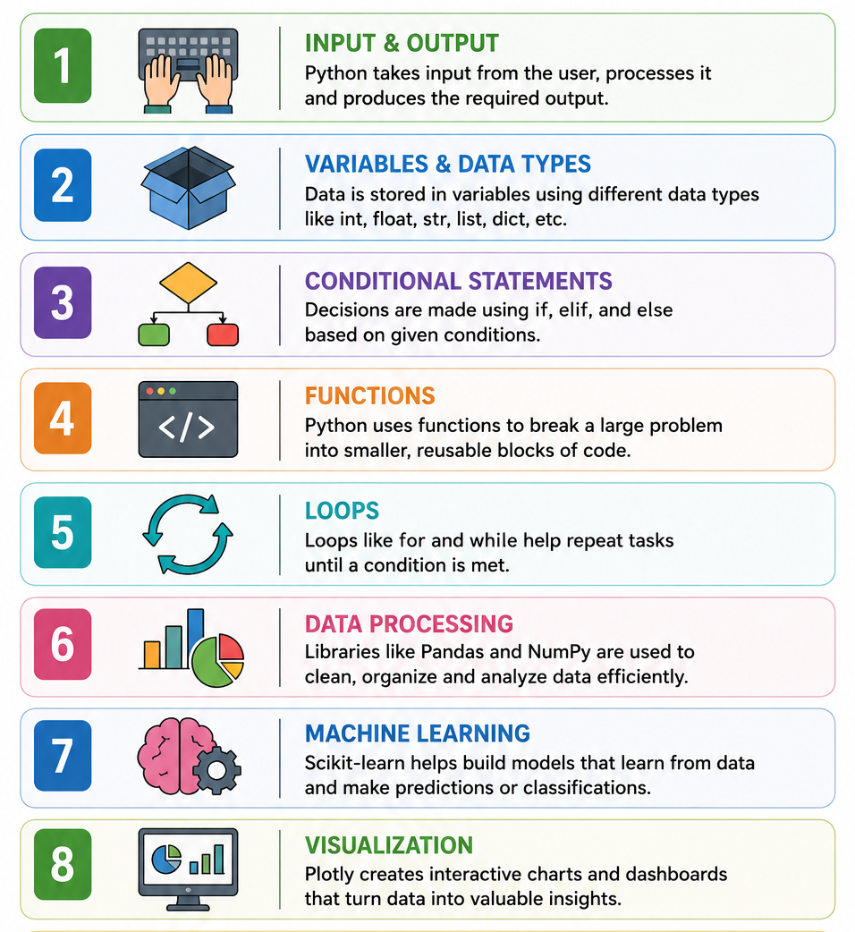
Understanding of Python Logic
Input Handling: Collects job, candidate, application, and interview details.
Variables & Data Types: Store and organize recruitment information.
Conditional Statements: Check application and interview status.
Functions: Perform tasks such as adding, updating, and managing records.
Loops: Process multiple candidates and applications.
Data Processing: Pandas and NumPy analyze recruitment data.
Machine Learning: Scikit-learn is used for classification/prediction.
Visualization: Plotly displays HR analytics through interactive charts.

Slide 8

GitHub
Created a dedicated GitHub repository for the Experiential Learning project.
The repository is used to upload and maintain the complete project code and related files.
Built data processing pipeline using Pandas & NumPy
Developed HR analytics visualizations with Plotly & dashboard in Streamlit

Slide 9
Thank You
S. B. Jain Institute of Technology Management and research

