Slide 1

Project Progress
Report
Presentation
Developed by:
Project ID :[14]
Gunjan Dhaduk [Roll no: 19 ]
Jisna Saji [Roll no: 32]
Class: TYBCA Sem 5
Project on
“Healthy Bite: Digital Menu & Food Ordering System”
Project Guide:
Ms. Pintukumari Bera
Submitted To:
Dept. of Computer Applications,
Christ College, Rajkot

Slide 2
Content
• Introduction
• Proposed Technology
• Preliminary Investigation
• Feasibility Study
• Requirement Analysis
• Data Dictionary
• Roles and Responsibilities
• E-R Diagram – Database Relationship Chart
• Use Case Diagram
• Activity Diagram
• DFD – Data Flow Diagram
• Database Tables
• Process Flow
• SDLC
• Conclusion / Thank You

Slide 3
Introduction
• Healthy Bite is a QR-based Digital Menu & Food Ordering System designed for restaurants.
• Customers scan a table QR code to access the digital menu without relying on printed menus.
• Food details include ingredients and nutritional information such as calories, protein, carbohydrates and fat.
• Customers can select food variants and customizations before placing an order.
• The system supports digital ordering, order status tracking, payment processing and reviews.
• Restaurant/admin users can manage restaurants, branches, tables, QR tokens, categories, food items, variants and customizations.

Slide 4
Proposed Technology
• Frontend: HTML5, CSS3, JavaScript, Bootstrap 5
• Backend: PHP
• Database: MySQL
• Local Server: XAMPP
• Code Editor: Visual Studio Code
• Web Browser: Google Chrome / Microsoft Edge
• QR Technology: QR-code based digital menu access

Slide 5
Preliminary Investigation
Definition
Healthy Bite is a digital restaurant menu and food ordering system that allows customers to access restaurant menus through QR codes, browse food items, customize dishes, view nutritional information, and place orders digitally.
Goal
To simplify and improve the restaurant ordering process by providing a centralized digital platform that connects customers, restaurant owners, kitchen staff, and administrators while reducing manual ordering and improving order management.

Slide 6
Need
The system reduces dependence on physical menus, manual order taking, phone calls, and paper-based processes by organizing the complete restaurant ordering process through one platform. “To manage the complete food ordering process at one place, allowing customers to browse, customize, and order food digitally while helping restaurants efficiently manage menus, tables, orders, and kitchen operations.”
Scope
The system supports customer QR-based menu access, food browsing and category filtering, dietary filtering, food customization, nutritional information, cart management, order placement, order tracking, restaurant owner management, kitchen order processing, table and QR-code management, and administrator management. Future enhancements may include online payment integration, real-time order notifications, GPS-based delivery tracking, customer loyalty programs, AI-based food recommendations, and a dedicated mobile application.

Slide 7
Feasibility Study
Technical Feasibility: The project is constructed on universally supported, open-source technologies (PHP 8, MySQL, Bootstrap 5, Apache). It runs on any standard web browser across Android, iOS, Windows, and macOS without requiring proprietary hardware or native mobile binaries.
Economic Feasibility: Zero commercial software license costs. Eliminates recurring paper menu printing and lamination expenses. Reduces waitstaff labor strain and order refund costs caused by communication errors. Highly cost-effective deployment on standard web servers.
Operational Feasibility: Zero customer barrier to entry—customers point their phone camera at the QR code and immediately order. The restaurant owner portal and kitchen display system feature intuitive graphical interfaces requiring less than 15 minutes of staff training.

Slide 8
Requirement Analysis
Hardware Requirements
• Processor: Intel Core i3 or above
• RAM: Minimum 4 GB
• Storage: Minimum 100 GB HDD/SSD
• Keyboard and Mouse
• Internet Connection
• Smartphone for QR scanning
• QR-code stands for restaurant tables
Software Requirements
• OS: Windows 10 / Windows 11
• Frontend: HTML5, CSS3, JavaScript, Bootstrap 5
• Backend: PHP
• Database: MySQL
• Local Server: XAMPP
• Code Editor: Visual Studio Code
• Browser: Google Chrome / Microsoft Edge

Slide 9
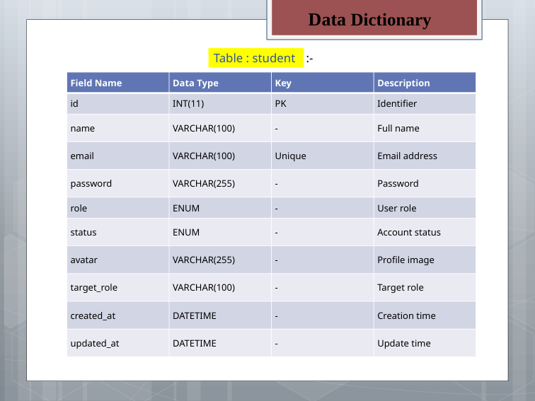
Data Dictionary
Table : admin
:-
Field Name | Data Type | Key | Description
id | bigint(20) unsigned | PK | Unique administrator record ID.
name | varchar(120) | — | Name of the administrator/auditing record.
created_at | timestamp | — | Date and time the record was created.
updated_at | timestamp | — | Date and time the record was last updated.

Slide 10
Data Dictionary
Table : branches
:-
Field Name | Data Type | Key | Description
id | bigint(20) unsigned | PK | Unique branch identifier.
restaurant_id | bigint(20) unsigned | FK | Links the branch to a restaurant.
name | varchar(150) | — | Physical branch name.
address | text | — | Branch street address.
city | varchar(100) | — | Branch city.
state | varchar(100) | — | Branch state.
phone | varchar(30) | — | Branch contact number.
status | enum('active','inactive') | IDX | Operational status of the branch.
created_at | timestamp | — | Date and time the record was created.
updated_at | timestamp | — | Date and time the record was last updated.

Slide 11
Data Dictionary
Table : categories
:-
Field Name | Data Type | Key | Description
id | bigint(20) unsigned | PK | Unique menu category ID.
restaurant_id | bigint(20) unsigned | FK/IDX | Links the category to a restaurant.
name | varchar(100) | — | Category name such as Bowls or Wraps.
slug | varchar(100) | IDX | URL-friendly category identifier.
description | text | — | Description of the menu category.
image | varchar(255) | — | Category image path.
sort_order | int(11) | — | Display order of the category.
status | enum('active','inactive') | — | Whether the category is active.

Slide 12
Data Dictionary
Table : customers
:-
Field Name | Data Type | Key | Description
id | bigint(20) unsigned | PK | Unique customer ID.
name | varchar(120) | — | Customer name.
mobile | varchar(30) | IDX | Customer mobile number.
email | varchar(191) | IDX | Customer email address.
created_at | timestamp | — | Date and time the customer was created.
updated_at | timestamp | — | Date and time the customer was last updated.

Slide 13
Data Dictionary
Table : food_customizations
:-
Field Name | Data Type | Key | Description
id | bigint(20) unsigned | PK | Unique customization ID.
food_item_id | bigint(20) unsigned | FK/IDX | Links the customization to a food item.
name | varchar(100) | — | Customization option name.
description | varchar(255) | — | Description of the customization.
group_name | varchar(100) | — | Customization group such as toppings or protein.
price_adjustment | decimal(10,2) | — | Price added or adjusted by the option.
calories_adjustment | int(11) | — | Calories added or adjusted.
protein_adjustment | decimal(6,2) | — | Protein adjustment in grams.
carbs_adjustment | decimal(6,2) | — | Carbohydrate adjustment in grams.
fat_adjustment | decimal(6,2) | — | Fat adjustment in grams.
fiber_adjustment | decimal(6,2) | — | Fiber adjustment in grams.
sugar_adjustment | decimal(6,2) | — | Sugar adjustment in grams.
sodium_adjustment | decimal(7,2) | — | Sodium adjustment in milligrams.
caffeine_adjustment | decimal(6,2) | — | Caffeine adjustment in grams.
is_required | tinyint(1) | — | Indicates whether the option is required.
min_quantity | int(10) unsigned | — | Minimum selectable quantity.
max_quantity | int(10) unsigned | — | Maximum selectable quantity.
is_available | tinyint(1) | IDX | Indicates whether the option is available.
sort_order | int(11) | — | Display order of the customization.
created_at | timestamp | — | Date and time the record was created.
updated_at | timestamp | — | Date and time the record was last updated.

Slide 14
Data Dictionary
Table : food_items
:-
Field Name | Data Type | Key | Description
id | bigint(20) unsigned | PK | Unique food item ID.
restaurant_id | bigint(20) unsigned | FK/IDX | Links the food item to a restaurant.
category_id | bigint(20) unsigned | FK/IDX | Links the food item to a menu category.
name | varchar(150) | — | Food item name.
slug | varchar(150) | IDX | URL-friendly food item identifier.
description | text | — | Description of the food item.
image | varchar(255) | — | Food image path.
ingredients | text | — | Ingredients used in the food item.
allergens | varchar(255) | — | Allergen information.
food_type | enum(...) | — | Dietary type such as vegetarian, vegan, Jain or other.
base_price | decimal(10,2) | — | Base selling price.
calories | int(10) unsigned | — | Calories per serving.
protein | decimal(6,2) | — | Protein amount in grams.
carbs | decimal(6,2) | — | Carbohydrate amount in grams.
fat | decimal(6,2) | — | Fat amount in grams.
fiber | decimal(6,2) | — | Fiber amount in grams.
sugar | decimal(6,2) | — | Sugar amount in grams.
sodium | decimal(7,2) | — | Sodium amount in milligrams.
caffeine | decimal(6,2) | — | Caffeine amount.
serving_size | varchar(100) | — | Serving size description.
is_featured | tinyint(1) | IDX | Indicates whether the item is featured.
is_popular | tinyint(1) | IDX | Indicates whether the item is popular.
is_available | tinyint(1) | IDX | Indicates whether the item is currently available.
created_at | timestamp | — | Date and time the record was created.
updated_at | timestamp | — | Date and time the record was last updated.

Slide 15
Data Dictionary
Table : food_variants
:-
Field Name | Data Type | Key | Description
id | bigint(20) unsigned | PK | Unique food variant ID.
food_item_id | bigint(20) unsigned | FK/IDX | Links the variant to a food item.
name | varchar(100) | — | Variant or portion name.
description | varchar(255) | — | Description of the variant.
price_adjustment | decimal(10,2) | — | Price adjustment for the variant.
calories_adjustment | int(11) | — | Calories adjustment.
protein_adjustment | decimal(6,2) | — | Protein adjustment in grams.
carbs_adjustment | decimal(6,2) | — | Carbohydrate adjustment in grams.
fat_adjustment | decimal(6,2) | — | Fat adjustment in grams.
fiber_adjustment | decimal(6,2) | — | Fiber adjustment in grams.
sugar_adjustment | decimal(6,2) | — | Sugar adjustment in grams.
sodium_adjustment | decimal(7,2) | — | Sodium adjustment in milligrams.
caffeine_adjustment | decimal(6,2) | — | Caffeine adjustment.
is_required | tinyint(1) | — | Indicates whether a variant is required.
is_available | tinyint(1) | IDX | Indicates whether the variant is available.
sort_order | int(11) | — | Display order of variants.
created_at | timestamp | — | Date and time the record was created.
updated_at | timestamp | — | Date and time the record was last updated.

Slide 16
Data Dictionary
Table : order_item_customizations
:-
Field Name | Data Type | Key | Description
id | bigint(20) unsigned | PK | Unique order customization ID.
order_item_id | bigint(20) unsigned | FK/IDX | Links the customization to an ordered item.
customization_id | bigint(20) unsigned | FK/IDX | Links to the original customization definition.
customization_name_snapshot | varchar(100) | — | Stores the customization name at order time.
quantity | int(10) unsigned | — | Quantity selected for the customization.
price_adjustment | decimal(10,2) | — | Price adjustment stored with the order.
calories_adjustment | int(11) | — | Calories adjustment stored in the order.
protein_adjustment | decimal(6,2) | — | Protein adjustment snapshot.
carbs_adjustment | decimal(6,2) | — | Carbohydrate adjustment snapshot.
fat_adjustment | decimal(6,2) | — | Fat adjustment snapshot.
fiber_adjustment | decimal(6,2) | — | Fiber adjustment snapshot.
sugar_adjustment | decimal(6,2) | — | Sugar adjustment snapshot.
sodium_adjustment | decimal(7,2) | — | Sodium adjustment snapshot.
caffeine_adjustment | decimal(6,2) | — | Caffeine adjustment snapshot.
created_at | timestamp | — | Date and time the record was created.

Slide 17
Data Dictionary
Table : order_items
:-
Field Name | Data Type | Key | Description
id | bigint(20) unsigned | PK | Unique ordered item ID.
order_id | bigint(20) unsigned | FK/IDX | Links the item to its order.
food_item_id | bigint(20) unsigned | FK/IDX | Links to the ordered food item.
food_name_snapshot | varchar(150) | — | Food name preserved at order time.
base_price_snapshot | decimal(10,2) | — | Base price preserved at order time.
variant_name_snapshot | varchar(100) | — | Variant name preserved at order time.
variant_price_snapshot | decimal(10,2) | — | Variant price preserved at order time.
quantity | int(10) unsigned | — | Number of units ordered.
unit_price | decimal(10,2) | — | Price per ordered unit.
total_price | decimal(10,2) | — | Total line price.
calories | int(11) | — | Calories snapshot for the item.
protein | decimal(6,2) | — | Protein snapshot in grams.
carbs | decimal(6,2) | — | Carbohydrate snapshot in grams.
fat | decimal(6,2) | — | Fat snapshot in grams.
fiber | decimal(6,2) | — | Fiber snapshot in grams.
sugar | decimal(6,2) | — | Sugar snapshot in grams.
sodium | decimal(7,2) | — | Sodium snapshot in milligrams.
caffeine | decimal(6,2) | — | Caffeine snapshot.
created_at | timestamp | — | Date and time the order item was created.

Slide 18
Data Dictionary
Table : orders
:-
Field Name | Data Type | Key | Description
id | bigint(20) unsigned | PK | Unique order ID.
order_number | varchar(64) | UNI | Unique customer-facing order number.
restaurant_id | bigint(20) unsigned | FK/IDX | Restaurant receiving the order.
branch_id | bigint(20) unsigned | FK/IDX | Branch receiving the order.
table_id | bigint(20) unsigned | FK/IDX | Dining table associated with the order.
customer_id | bigint(20) unsigned | FK/IDX | Customer who placed the order.
order_type | enum('dine_in','takeaway') | — | Type of order.
subtotal | decimal(10,2) | — | Order subtotal before tax and service charge.
tax | decimal(10,2) | — | Tax amount, including 5% GST.
service_charge | decimal(10,2) | — | Optional service charge.
total_amount | decimal(10,2) | — | Final payable order amount.
payment_status | enum(...) | IDX | Payment state of the order.
order_status | enum(...) | IDX | Order lifecycle status.
notes | text | — | Additional customer/order notes.
created_at | timestamp | IDX | Date and time the order was created.
updated_at | timestamp | — | Date and time the order was last updated.

Slide 19
Data Dictionary
Table : payments
:-
Field Name | Data Type | Key | Description
id | bigint(20) unsigned | PK | Unique payment record ID.
order_id | bigint(20) unsigned | UNI/FK | Unique order settlement reference.
payment_method | enum('cash','upi','card') | — | Payment method used.
transaction_reference | varchar(128) | — | External payment transaction reference.
amount | decimal(10,2) | — | Amount settled.
status | enum('pending','completed','failed') | IDX | Payment transaction status.
paid_at | timestamp | — | Date and time payment was completed.
created_at | timestamp | — | Date and time the payment record was created.

Slide 20
Data Dictionary
Table : qr_tokens
:-
Field Name | Data Type | Key | Description
id | bigint(20) unsigned | PK | Unique QR token record ID.
restaurant_id | bigint(20) unsigned | FK/IDX | Restaurant associated with the QR token.
branch_id | bigint(20) unsigned | FK/IDX | Branch associated with the QR token.
table_id | bigint(20) unsigned | FK/IDX | Table associated with the QR token.
token | varchar(128) | UNI | Unique QR ordering session token.
status | enum('active','inactive','expired') | IDX | Current token status.
expires_at | timestamp | — | Token expiration date and time.
created_at | timestamp | — | Date and time the token was created.

Slide 21
Data Dictionary
Table : restaurant_tables
:-
Field Name | Data Type | Key | Description
id | bigint(20) unsigned | PK | Unique restaurant table ID.
restaurant_id | bigint(20) unsigned | FK/IDX | Restaurant owning the table.
branch_id | bigint(20) unsigned | FK/IDX | Branch containing the table.
table_number | varchar(50) | UNI* | Table number; unique within a branch.
status | enum(...) | IDX | Current table availability/occupancy status.
created_at | timestamp | — | Date and time the table was created.
updated_at | timestamp | — | Date and time the table was last updated.

Slide 22
Data Dictionary
Table : restaurants
:-
Field Name | Data Type | Key | Description
id | bigint(20) unsigned | PK | Unique restaurant ID.
owner_user_id | bigint(20) unsigned | FK/IDX | Assigned restaurant owner user.
name | varchar(150) | — | Restaurant name.
slug | varchar(150) | UNI | Unique URL-friendly restaurant identifier.
logo | varchar(255) | — | Restaurant logo path.
cover_image | varchar(255) | — | Restaurant cover image path.
description | text | — | Restaurant description.
phone | varchar(30) | — | Restaurant phone number.
email | varchar(191) | — | Restaurant email address.
address | text | — | Restaurant address.
city | varchar(100) | — | Restaurant city.
state | varchar(100) | — | Restaurant state.
status | enum('pending','approved','suspended') | IDX | Restaurant approval status.
created_at | timestamp | — | Date and time the restaurant was created.
updated_at | timestamp | — | Date and time the restaurant was last updated.

Slide 23
Data Dictionary
Table : reviews
:-
Field Name | Data Type | Key | Description
id | bigint(20) unsigned | PK | Unique review ID.
restaurant_id | bigint(20) unsigned | FK/IDX | Restaurant being reviewed.
customer_id | bigint(20) unsigned | FK/IDX | Customer who submitted the review.
order_id | bigint(20) unsigned | FK/IDX | Optional order associated with the review.
rating | tinyint(3) unsigned | — | Customer rating.
comment | text | — | Customer review comment.
restaurant_reply | text | — | Restaurant owner's reply to the review.
replied_at | timestamp | — | Date and time the restaurant replied.
status | enum('pending','approved','hidden') | IDX | Review moderation status.
created_at | timestamp | — | Date and time the review was created.
updated_at | timestamp | — | Date and time the review was last updated.

Slide 24
Data Dictionary
Table : roles
:-
Field Name | Data Type | Key | Description
id | bigint(20) unsigned | PK | Unique role ID.
name | varchar(50) | — | Role name such as Super Admin or Restaurant Owner.
slug | varchar(50) | UNI | Unique role identifier.
description | varchar(255) | — | Description of role permissions.
created_at | timestamp | — | Date and time the role was created.
updated_at | timestamp | — | Date and time the role was last updated.

Slide 25
Table : users
Field Name | Data Type | Key | Description
id | bigint(20) unsigned | PK | Unique user account ID.
role_id | bigint(20) unsigned | FK/IDX | Links the user to an authorization role.
restaurant_id | bigint(20) unsigned | FK/IDX | Optional restaurant scope for the user.
name | varchar(120) | — | User's display name.
email | varchar(191) | UNI | Unique login email address.
password | varchar(255) | — | Encrypted password value.
status | enum('active','inactive','suspended') | IDX | User account status.
created_at | timestamp | — | Date and time the user was created.
updated_at | timestamp | — | Date and time the user was last updated.

Slide 26
Roles & Responsibilities
Parameter | Gunjan Dhaduk [Roll No: 19] | Jisna Saji [Roll No: 32]
Designation / Title | Lead Full-Stack Developer & Software Architect | System Analyst, Documentation Lead & QA Coordinator
Primary Domain | System Architecture, Coding, Logic & Database | Research, Project Documentation, Diagrams & QA Testing
Key Deliverables | Working Web App, MVC Engine, APIs, KDS Kanban | Final Project Report, IEEE Research Paper, UML/DFD, Test Suite
Core Technologies | PHP 8, MySQL/PDO, JavaScript ES6+, Bootstrap 5 | MS Word, MS Visio/Draw.io, MS PowerPoint, QA Manual Testing

Slide 27
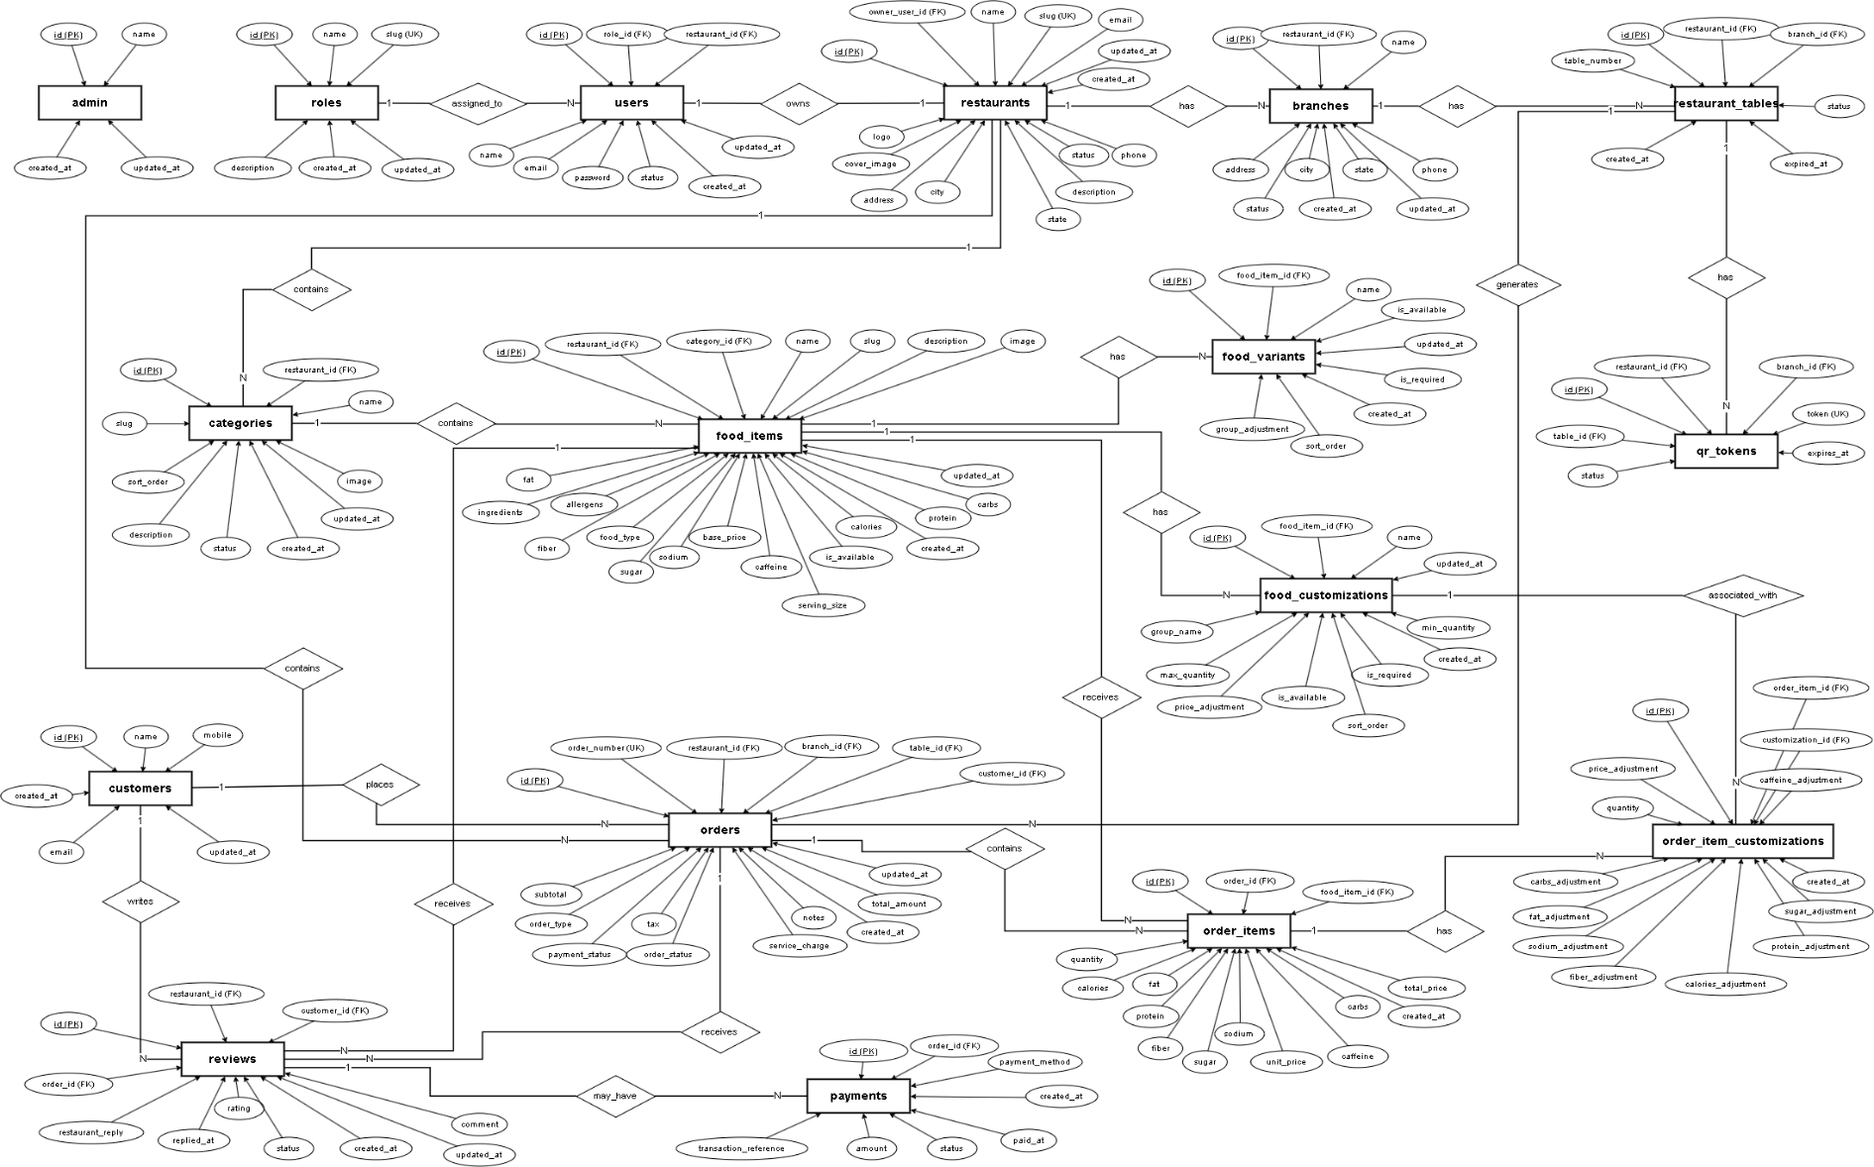
E-R Diagram – Database Relationship Chart

Slide 28
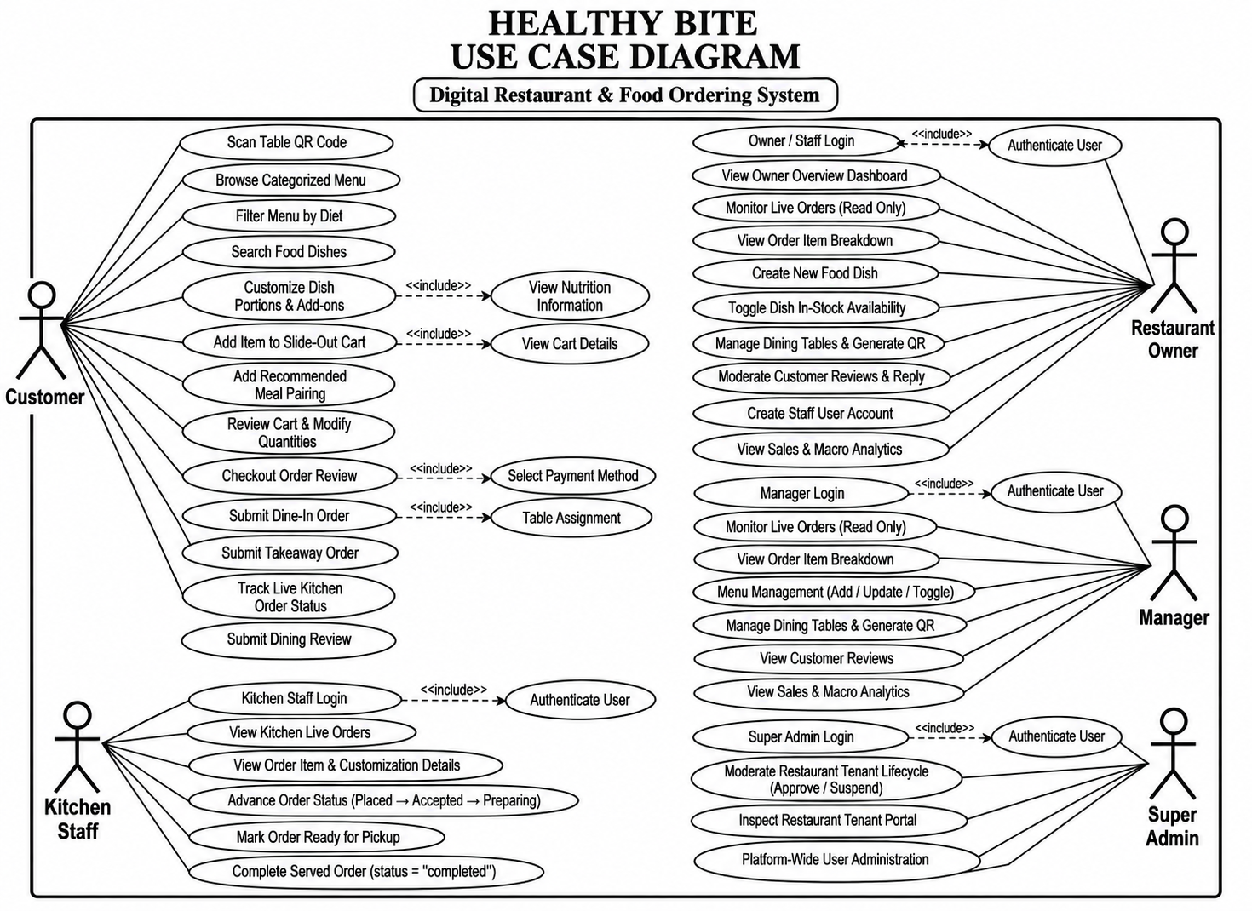

Slide 29
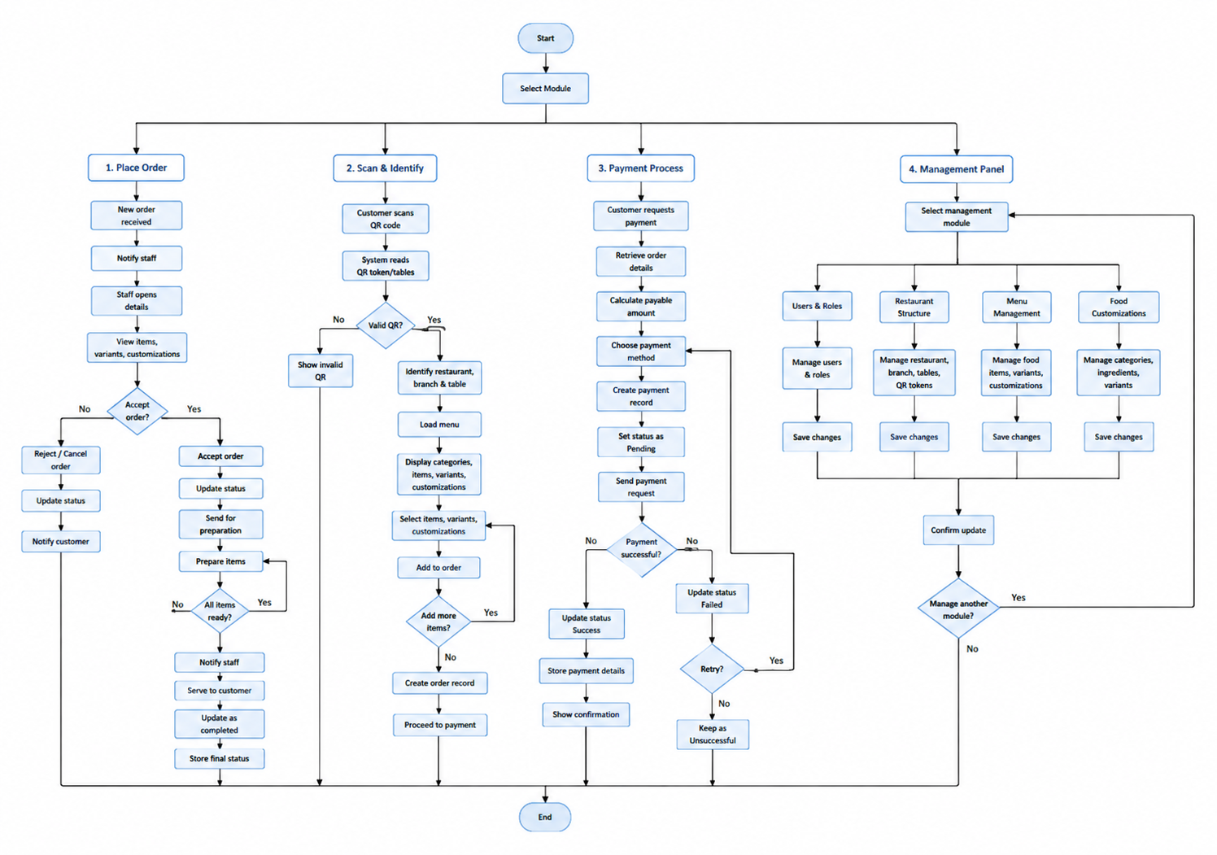
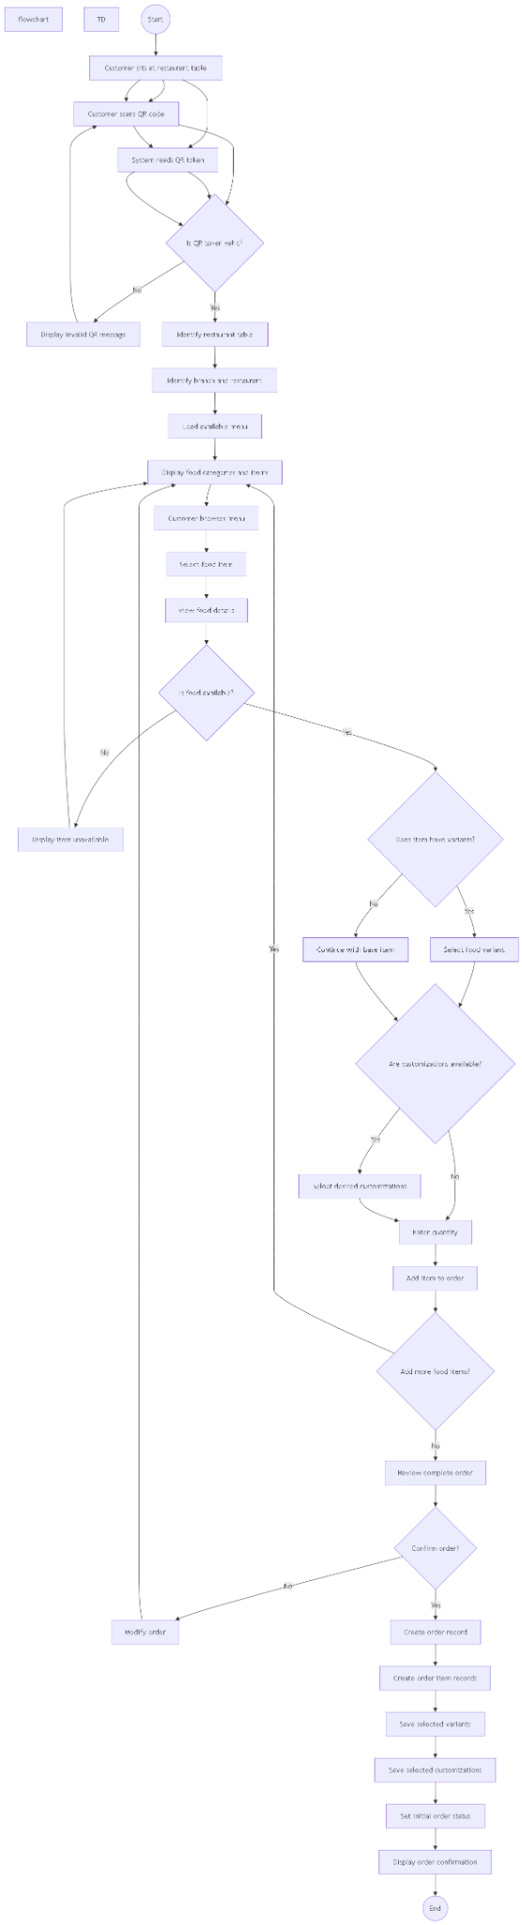
Activity Diagram

Slide 30
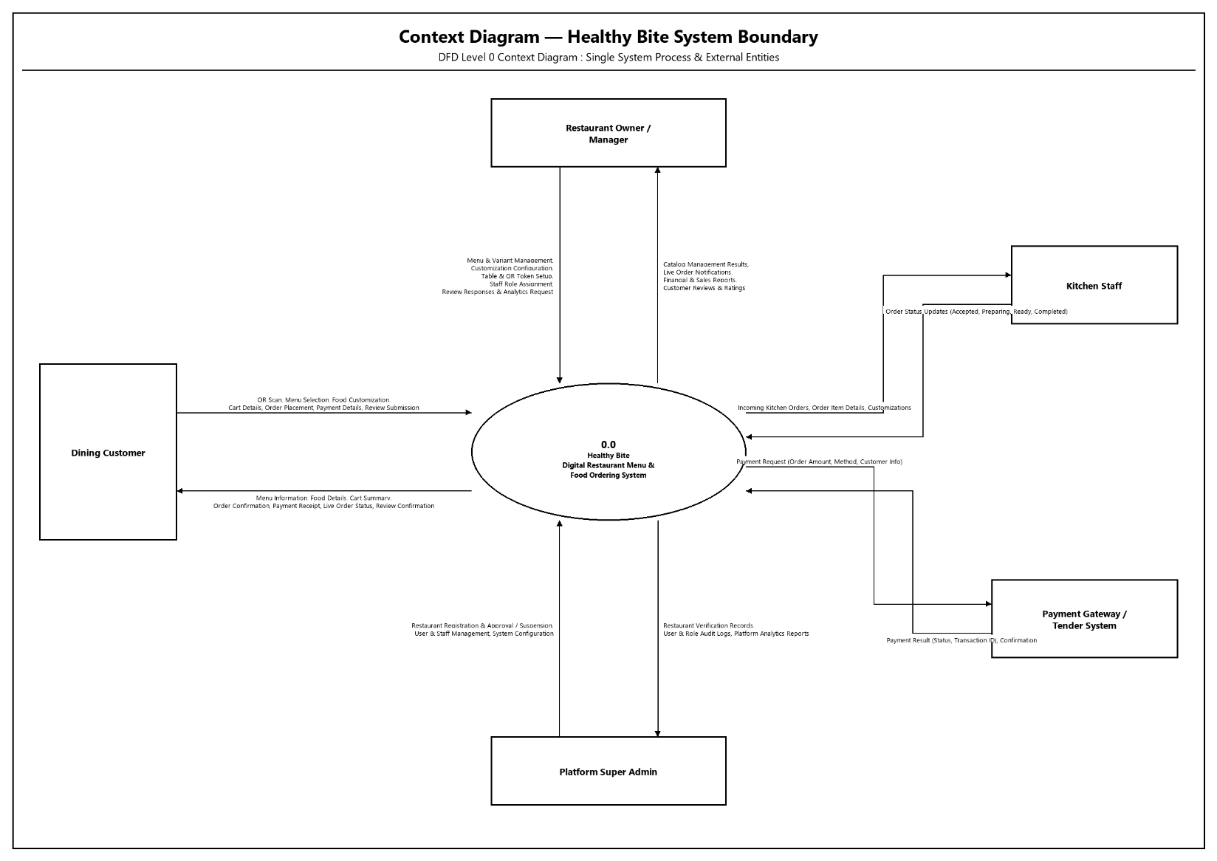
DFD – Context Diagram

Slide 31
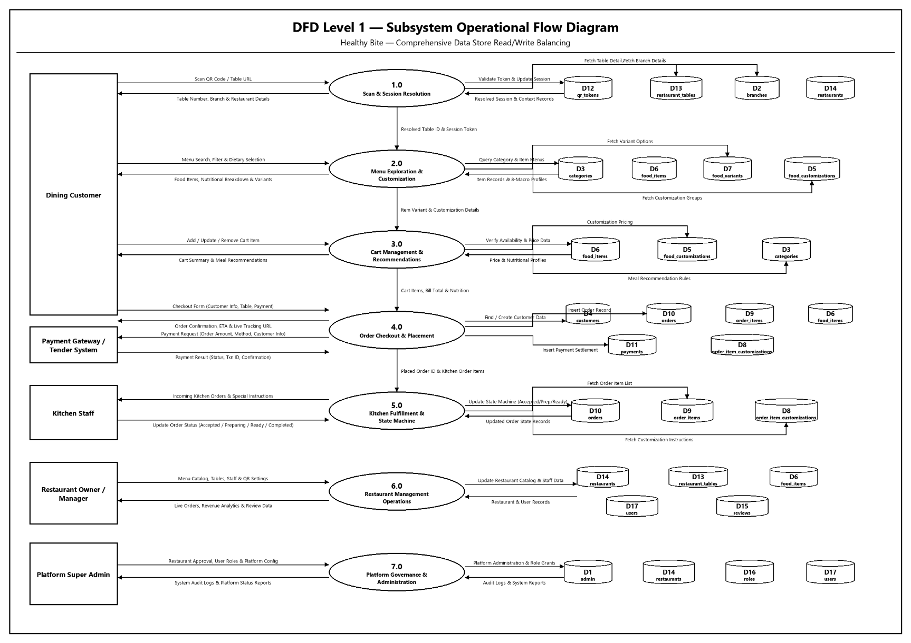
DFD – Level 1

Slide 32
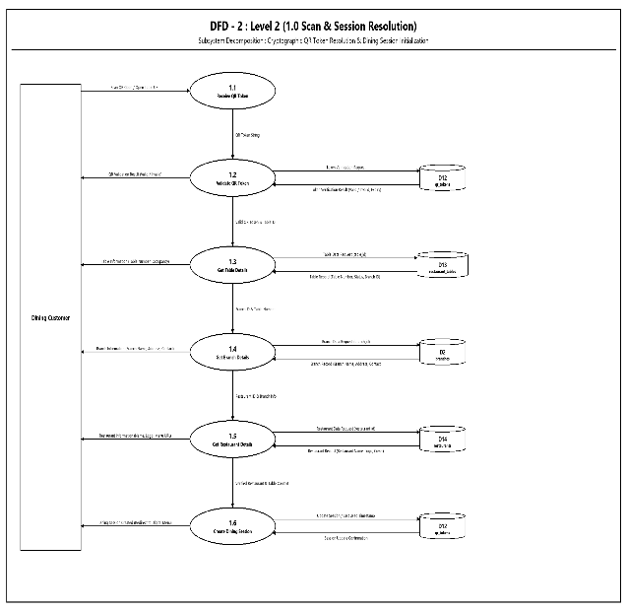
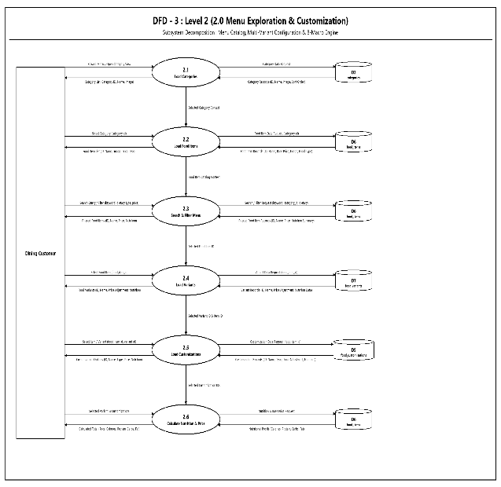
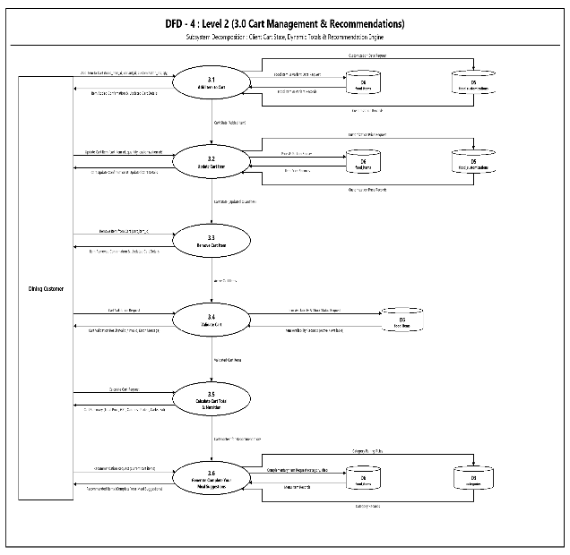
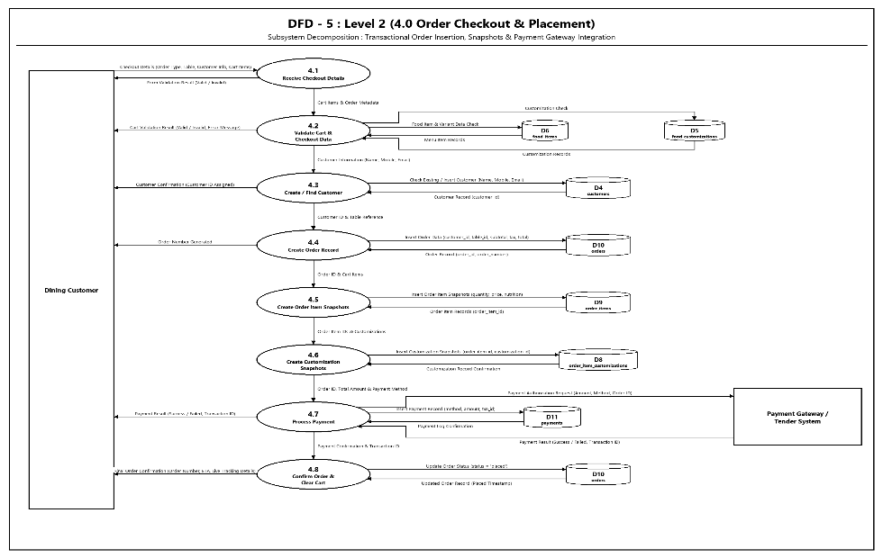
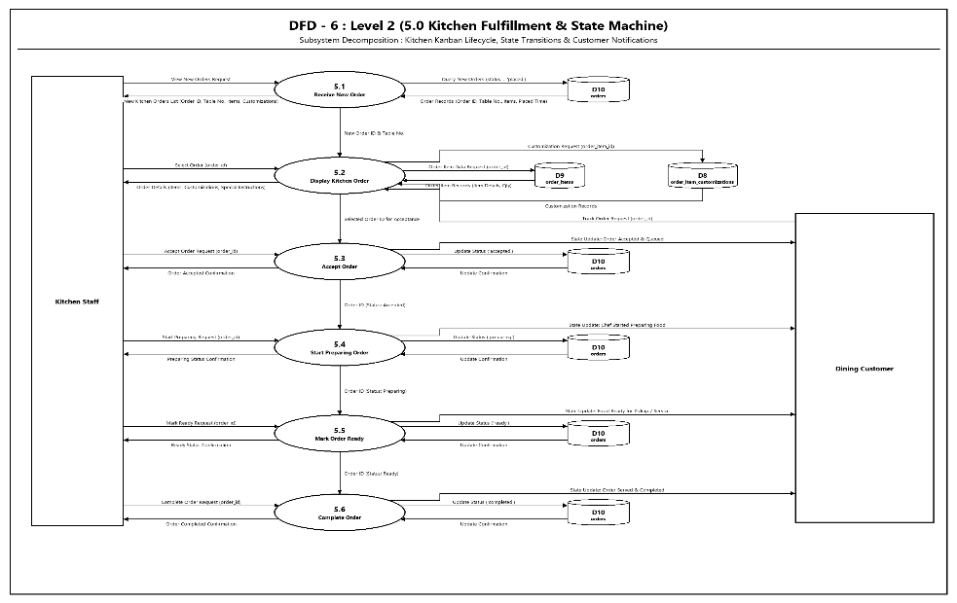
DFD – Level 2

Slide 33
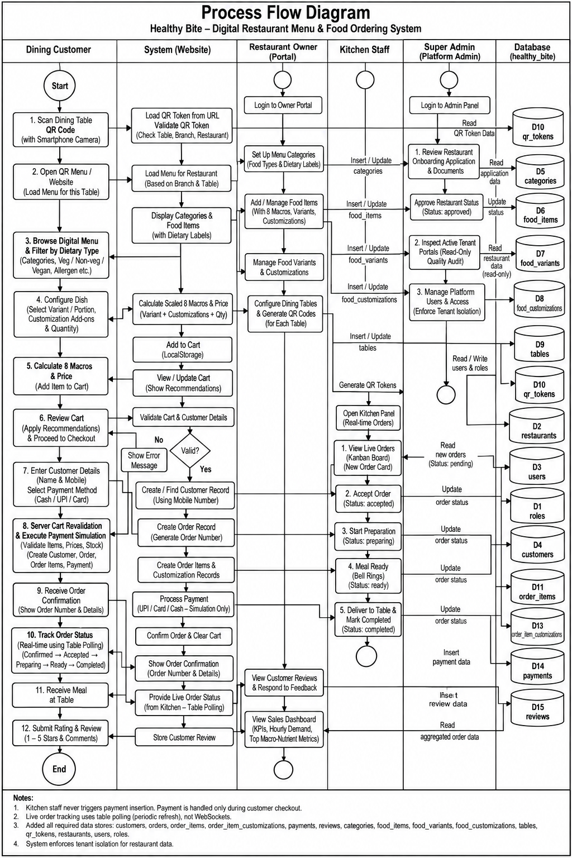
Process Flow Diagram

Slide 34
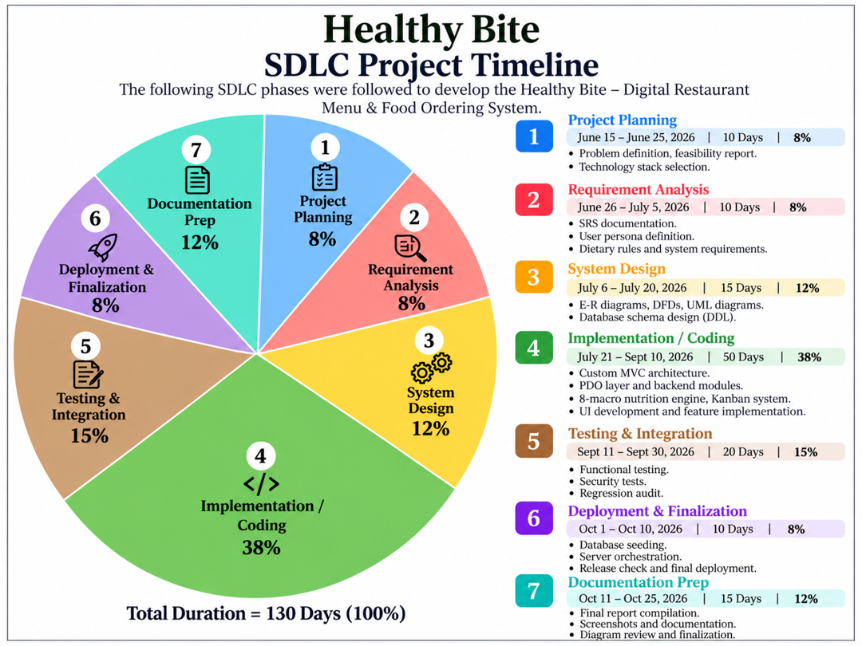
SDLC

Slide 35


