Slide 1


SMART INDIA HACKATHON 2024
TITLE PAGE
Problem Statement ID – SIH1515
Problem Statement Title - Smart and Effective Realtime Management of street parking
Theme -
PS Category - Software
Team ID -
Team Name – Bitwise Brigade

Slide 2
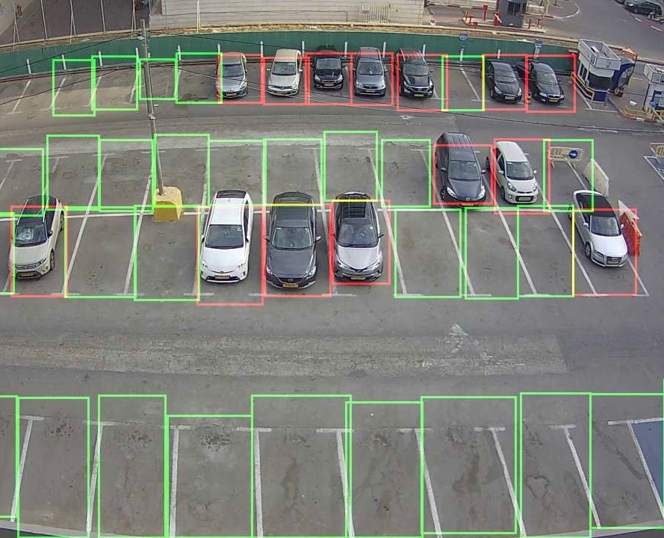
Vision-Based Parking Management
Your Team Name
Bitwise
Brigade
Dynamic Smart Parking System:
Computer Vision for real-time spot detection via camera feeds.
Machine Learning for vehicle tracking and occupancy management.
Dynamic Pricing adjusts rates based on real-time demand and trends.
Data Analytics provides insights on occupancy and revenue.
Mobile Integration for spot reservation and payment.
Unique Points:
Real-Time Parking Detection: Live monitoring of parking spots using Computer Vision to identify vacant and occupied spaces.
Dynamic Pricing: Machine Learning adjusts rates based on real-time demand and usage.
Data-Driven Insights: Analyzes parking usage and pricing trends for improved management.
Key Advantages:
Low Maintenance
Easy to deploy
Scalable
Minimal setup cost

Slide 3
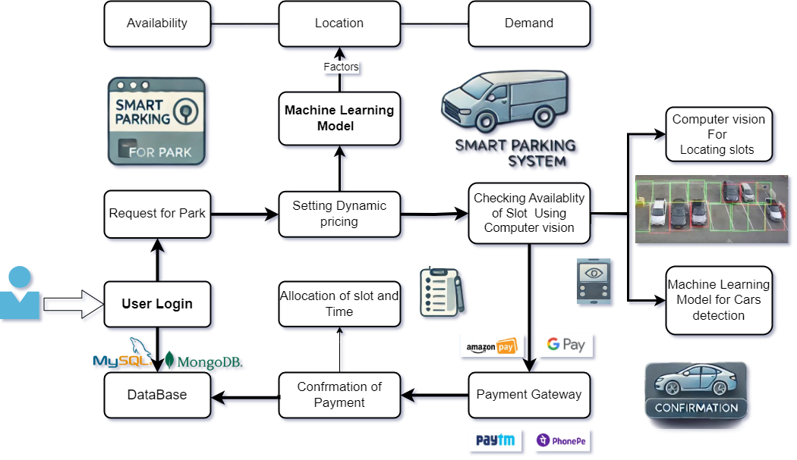
TECHNICAL APPROACH
Your Team Name
Bitwise
Brigade
Technology:
Backend:
Python
OpenCV
TensorFlow
Scikit-learn
PyTorch
YOLO
Pandas
Numpy
Frontend:
React/Next.JS
Database:
MongoDB

Slide 4
FEASIBILITY AND VIABILITY
Bitwise
Brigade
Analysis of the feasibility of the idea
Potential challenges and risks
Data Privacy:
Ensure compliance with GDPR and data protection laws.
Scalability:
Address cloud infrastructure limitations for real-time analytics.
Adoption:
Overcome user resistance through awareness
campaigns.
Technical Viability:
Computer Vision for real-time detection of available spaces using OpenCV.
Dynamic Pricing Models utilizing Machine Learning to adjust fees based on demand, time, and location.
Cross-platform App Development with React and Python/Next.js for seamless user experience.
Strategies for overcoming these challenges
Market Demand:
Rising vehicle numbers and urbanization create a pressing need for innovative solutions.
Aligns with smart city initiatives and sustainable development goals.
Financial Optimization:
Explore dynamic revenue-sharing models with municipal authorities.
AI Innovations:
Deploy AI-powered algorithms for precision detection and enhanced user interaction.

Slide 5
IMPACT AND BENEFITS
Your Team Name
Bitwise
Brigade
Potential impact on the target audience
Urban Commuters:
Reduced Search Time: Minimize time spent searching for parking with real-time availability updates.
Enhanced Convenience: Seamless reservation and payment through a user-friendly app.
City Administrators:
Optimized Resource Utilization: Efficient management of parking resources and reduced congestion.
Benefits of the solution (social, economic, environmental, etc.)
Social:
Improved Quality of Life: Less time wasted on parking leads to reduced stress and better overall urban experience.
Increased Accessibility: More equitable access to parking spaces across different city areas
Economic:
Revenue Growth: Enhanced revenue for city administration and local businesses through dynamic pricing.
Environmental:
Reduced Congestion: Lower traffic congestion decreases air pollution and carbon emissions.

