Slide 1
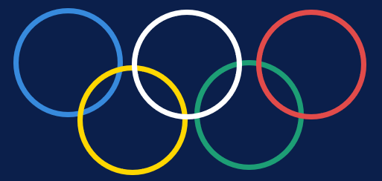
🏅 Olympics Data Analysis
Falak Jain (2507013047)
Gunjan Goyal (25070123048)
Hiranya Bedi (25070123054)
Jahnvi Shukla (25070123055)

Slide 2
INDEX
About the Dataset
India's Performance
01
05
05
Data sources, shape & key variables
India's Olympic journey vs global peers
Purpose of Analysis
Key Conclusions
02
06
02
06
Research objectives & analytical goals
Major findings from the analysis
Data Cleaning Steps
Policy Implications
03
07
How raw data was processed & validated
Actionable recommendations for stakeholders
Data Analysis & EDA
What the Analysis Says About India
04
08
Distributions, trends & statistical insights
Strategic insights & path forward

Slide 3
01 | About the Dataset
271,116
201
120
66
Athlete Records
Countries / NOCs
Years of History
Olympic Sports
Athlete Events Dataset
Country Economics Dataset
📄 athlete_events.csv
271,116 rows × 15 columns
Coverage: 1896 → 2016
Fields: Name, Sex, Age, Height, Weight
Team, NOC, Year, Season, Sport, Event, Medal
230 unique NOCs | 66 Sports | 2 Seasons
📄 country_economics.csv
201 rows × 4 columns
Fields: Country, Code, Population, GDP per Capita
12.4% missing GDP values
2.5% missing population values
8 territory entries (flagged with *)
Key Derived Variables: BMI, Won_Medal (0/1), GDP_Tier (Low/Mid/High), Log_Population, Medal_Rate

Slide 4
02 | Purpose of Analysis
🔍 Understand Performance Drivers
📊 Uncover Historical Patterns
🌍 Country-Level Benchmarking
Identify which economic, demographic & athlete-level factors correlate with Olympic medal success across nations.
Trace how Olympic participation, gender diversity and medal dominance evolved from 1896 to 2016.
Compare nations on medal efficiency (medals per athlete) to separate resource advantages from systemic sports development.
India-Specific Insights
📋 Policy-Relevant Outcomes
💡 Data Quality Demonstration
Understand India's Olympic underperformance relative to its population size and growing GDP — and identify gaps.
Generate actionable insights for policymakers, sports federations and corporate sponsors to improve athlete outcomes.
Showcase best practices in data cleaning, feature engineering and exploratory analysis on real-world messy datasets.

Slide 5
03 | Data Cleaning Steps
1
Territory Flagging & Strip
Detected 8 entries with asterisks (*) indicating territories. Created Is_Territory binary flag, then removed asterisks from country names.
2
Population Imputation
5 missing population values imputed using the overall dataset median (7,450,124) — preserving central tendency without distortion.
3
GDP Group-Median Imputation
25 missing GDP values filled using group-specific medians: $5,232 for countries, $42,328 for territories — accounting for structural differences.
4
Duplicate Removal
1,385 exact duplicate athlete rows removed from athlete_events.csv. Dataset reduced from 271,116 → 269,731 rows.
5
Medal NaN → 'No Medal'
All null Medal values replaced with 'No Medal' string — enabling category-level analysis including non-winners.
6
Numerical Imputation (Age/Height/Weight)
Median imputation: Age → 24, Height → 175cm, Weight → 70kg. IQR outlier detection flagged 11,059 age outliers (range: 10–97), retained for authenticity.
7
Feature Engineering
Created: BMI, Won_Medal (0/1), GDP_Tier (4 bins), Log_Population, Medal_Rate (medals/athletes) for richer analysis.

Slide 6
04 | Data Analysis — Steps & Approach
Descriptive Statistics
Distribution Analysis
Medal Breakdown
A
Computed mean, median, std for Age, Height, Weight, BMI by Season & Gender.
B
Histograms with mean/median lines for all physical attributes. BMI trimmed to 15–50.
C
Frequency counts and pie chart of Gold/Silver/Bronze distribution across all athletes.
Sports & Gender
Time-Series Analysis
Economics × Performance
D
Top 20 sports by entries; gender proportion stacked bar for top 15 sports.
E
Gender trends 1896–2016; medal dominance over time for top 6 nations; participation growth.
F
Merged athlete data with country GDP/Population. Bubble chart: GDP per capita vs total medals.

Slide 7
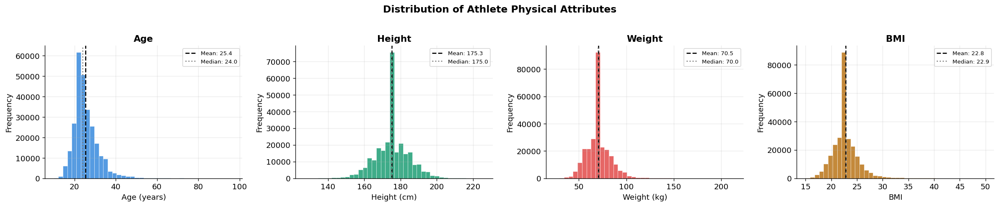
05 | Athlete Physical Attribute Distributions
Mean age ≈ 25.5 years; right-skewed due to veteran Olympians aged 60–97
Height: roughly normal at ~175cm mean; Weight: slight right skew (~70kg mean)
BMI peaks at 22–24 — typical healthy athletic range; outliers from heavy sports

Slide 8
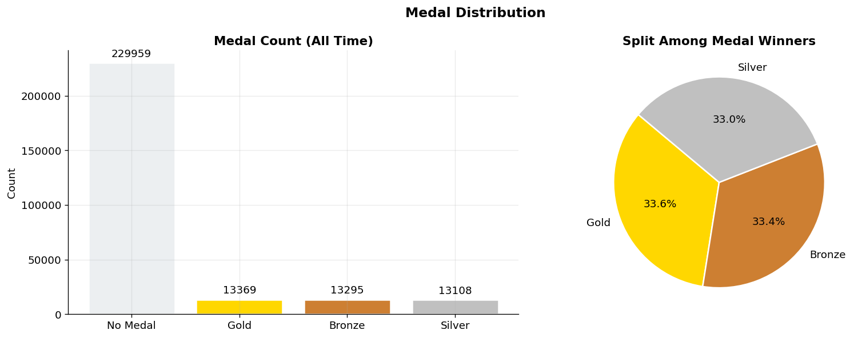
05 | Medal Distribution (All-Time)
Gold, Silver & Bronze are nearly equally distributed (~33% each) among medal winners
Vast majority of athlete-entries (>85%) receive no medal — reflecting high competition

Slide 9
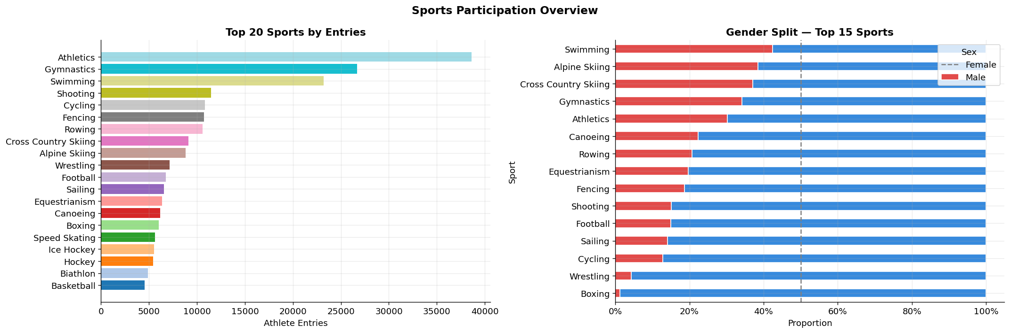
05 | Sports Participation & Gender Split
Athletics, Gymnastics & Swimming dominate total athlete entries by a large margin
Women's share in sports grew significantly post-1984 reforms

Slide 10
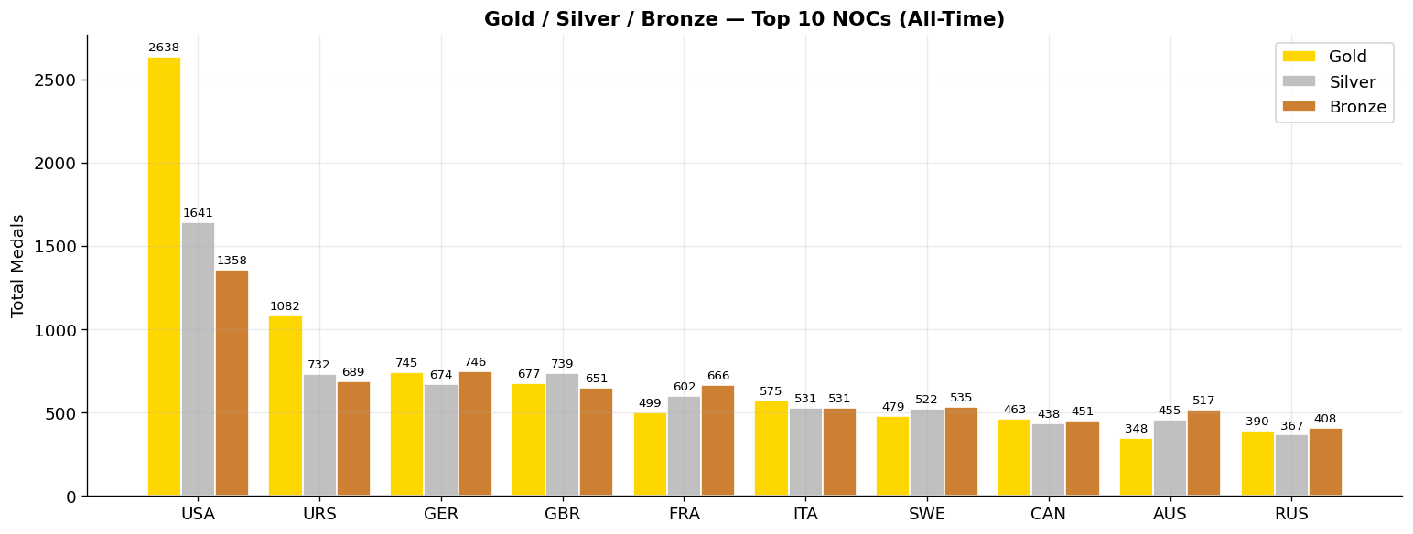
05 | Medal Breakdown: Top 10 Nations (All-Time)
USA leads all-time with the most Gold medals.
China (CHN) entered the top 10 only after 1984, showing rapid sports development
India (IND) does not appear in this top 10 — a major gap for a country of its population

Slide 11
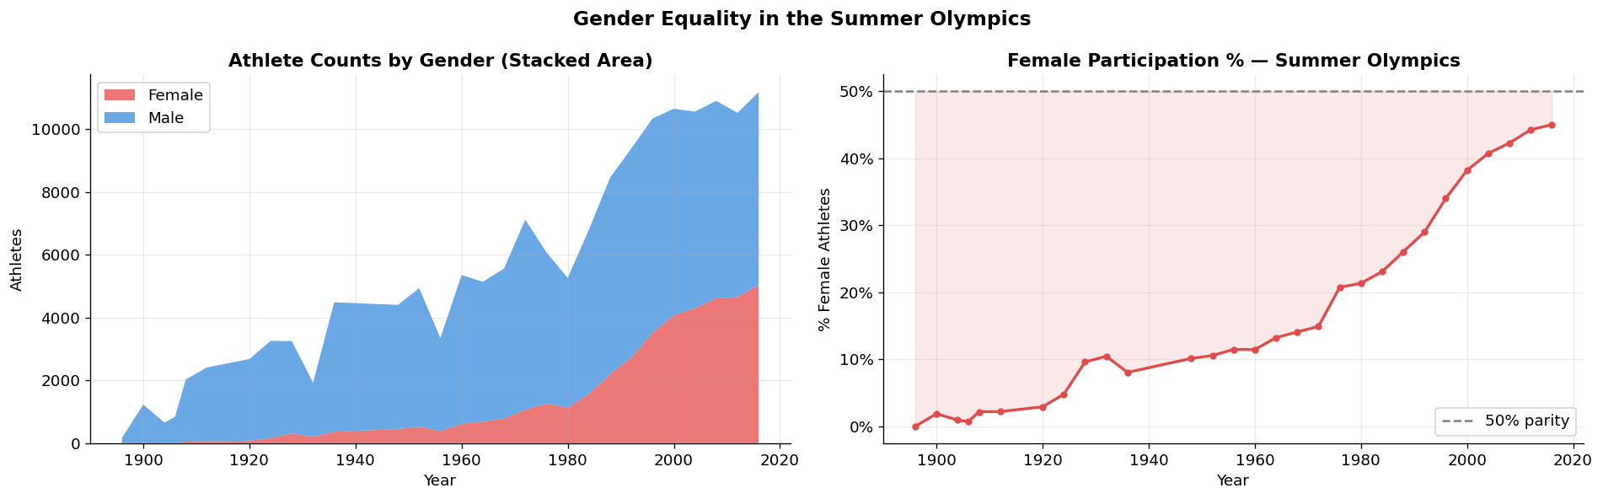
05 | Gender Equality in the Summer Olympics
Women were virtually absent until 1920s; IOC inclusion reforms accelerated from 1970s onward
Female athletes reached ~45% of total Summer Olympics participants by 2016.

Slide 12
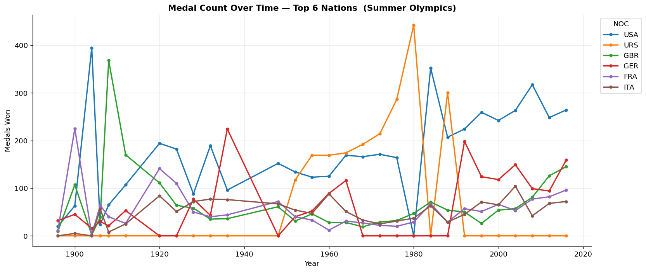
05 | Medal Dominance: Top 6 Nations
Post-1992: China's rapid rise in Summer medals reflects its state-led sports investment model
Dip in 1980 (USA boycott) & 1984 (Soviet boycott) visible in the trends

Slide 13
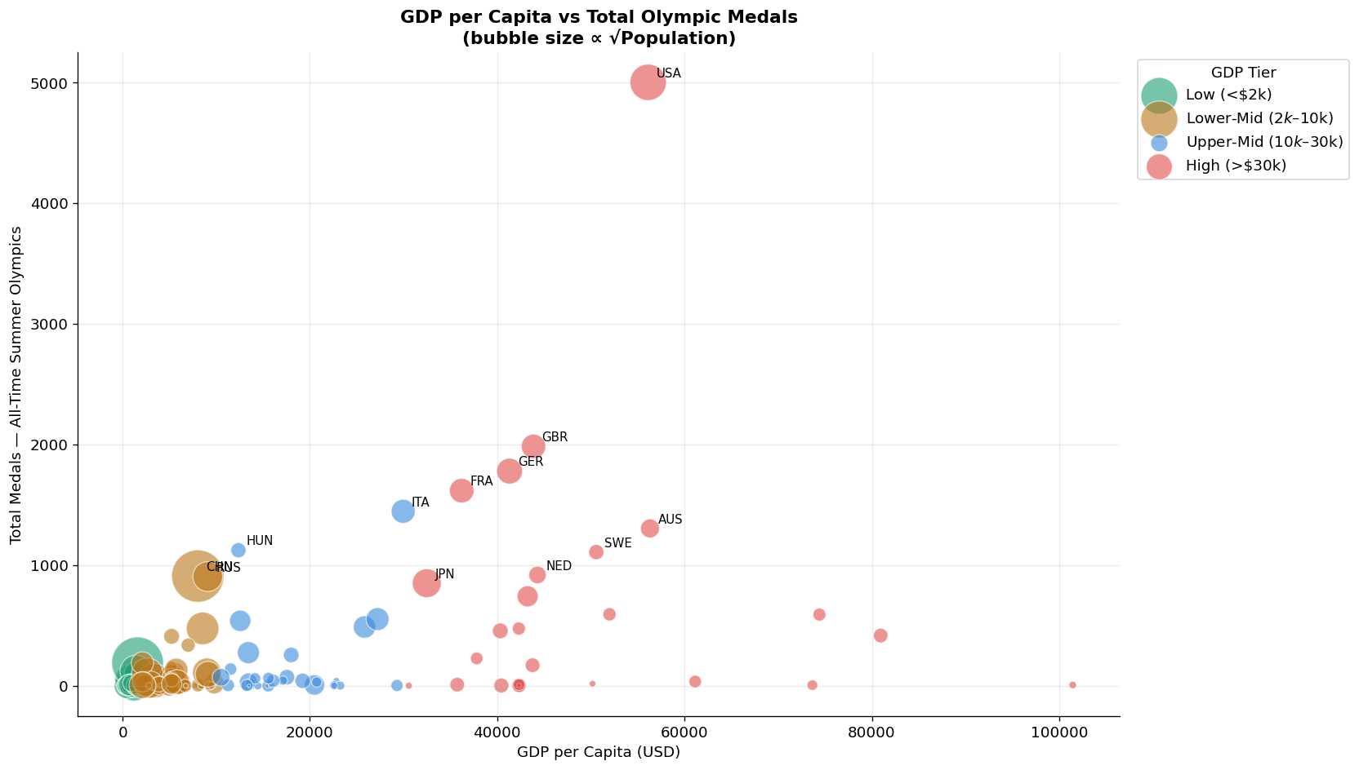
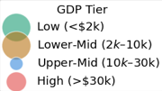
05 | Economics × Performance
Strong positive correlation between GDP/capita & medal count
USA: high GDP + huge population = top-right outlier
Small rich nations have high medal rate but modest totals
India: large bubble (population) but very low medals

Slide 14
06 | India's Olympic Performance vs Global Peers
Country | Total Medals | Gold Medals | Medal Rate | GDP/Capita
USA 🇺🇸 | 5,637 | 2,638 | 0.31 | $55,000+
China 🇨🇳 | 1,395 | 596 | 0.25 | $8,000+
Russia/URS 🇷🇺 | 3,947 | 1,122 | 0.28 | $12,000+
Australia 🇦🇺 | 1,344 | 503 | 0.29 | $50,000+
India 🇮🇳 | 35 | 10 | 0.006 | $2,000 (then)
Kenya 🇰🇪 | 107 | 34 | 0.18 | $1,400
Jamaica 🇯🇲 | 78 | 26 | 0.27 | $5,000
35
Total Medals
(1900–2016)
10
Gold Medals
(All-time)
0.006
Medal Rate
(medals/athlete)
⚠️ India's medal rate (0.006) is among the lowest globally — Kenya and Jamaica, with far smaller populations & lower GDPs, outperform India significantly.
#1.4B
Population
(World's largest)

Slide 15
06 | India — Sport-Wise Medal Breakdown
Field Hockey
Dominant (8 Golds)
25
Wrestling
3
Recent (KD Jadhav, Sushil, Bajrang)
Shooting
3
Recent (Manu Bhaker, Sarabjot Singh, Swapnil Kusale)
Boxing
1
Mary Kom — 2012
Athletics
1
Norman Pritchard — 1900
Badminton
1
Saina/Sindhu — 2012/16
⚠️ 71% of India's all-time medals come from a single sport — Field Hockey. Post-1980, India's hockey dominance collapsed, exposing deep structural dependence.

Slide 16
06 | What This Analysis Tells Us About India
Q: Is India's poor performance about poverty?
A: Partially. India's historical GDP/capita was low, but nations like Jamaica ($5K GDP) and Kenya ($1.4K GDP) vastly outperform India per capita. Economics alone cannot explain the gap.
Q: Is it a population problem (too many, too diverse)?
A: No — China has a comparable scale and leads the world. India's problem is lack of targeted talent identification and development pipelines, not population scale.
Q: Is it a sports culture issue?
A: Yes — cricket absorbs 80%+ of all corporate sponsorship, media attention and youth aspiration. Olympic sports operate in a funding vacuum with minimal public visibility.
Q: What does the medal rate reveal?
A: India's 0.006 medal rate (6 medals per 1,000 athletes) is among the world's worst. Nations with smaller delegations convert a far higher % of participants to medal winners.
Q: What is the structural root cause?
A: Post-1980 collapse of hockey dominance was never compensated by investment in other sports. No systematic state sports model (unlike China, Cuba or Kenya) exists in India.

Slide 17
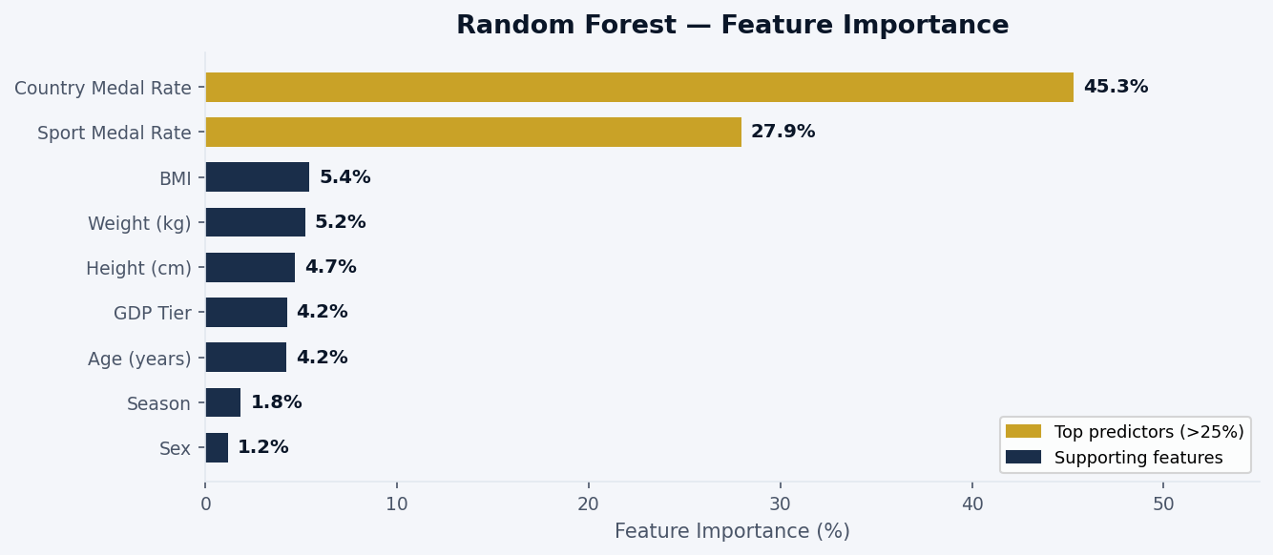
07 | Medal Prediction Model
Country Historical Medal Rate (45.3%) — strongest signal: elite nations consistently produce elite athletes
Sport Historical Medal Rate (27.9%) — sport selection is the second-biggest predictor of medal probability
Biometrics (BMI, Weight, Height, Age) each contribute ~4–5% — important but secondary to contextual factors

Slide 18
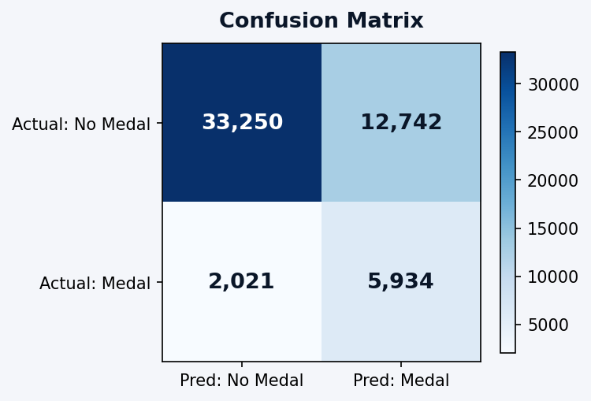
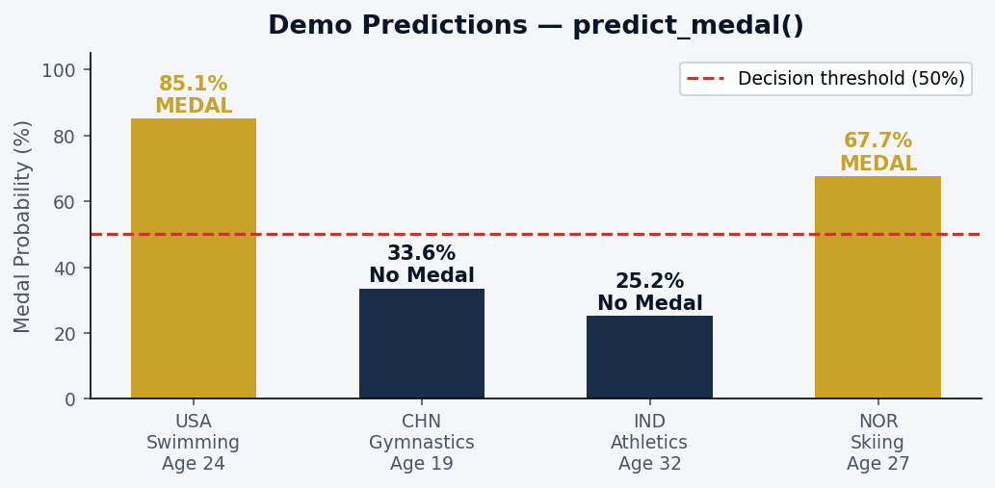
07 | Medal Prediction Model
✅ True Negatives: 33,250 Correctly predicted No Medal-72% of actual non-winners identified | ✅ True Positives: 5,934 Correctly predicted Medal — 74.6% of actual medal winners caught
⚠ False Positives: 12,742 Predicted Medal but got none | ⚠ False Negatives: 2,021 Missed winners — only 25.4% of winners slipped through

Slide 19
08 | Key Conclusions
💰 GDP Drives Medals
⚖️ Quality > Scale
👩 Gender Parity Progress
🏆 USA's Sustained Dominance
Strong positive correlation between GDP per capita and all-time medal count. Wealthy nations invest more in athlete development systems.
Small high-income nations (Scandinavia, Eastern Europe) show higher medal rates per athlete than large but lower-income countries.
Female participation rose from near-zero in 1896 to ~45% by 2016, driven by IOC policy reforms. Still ~5% short of parity.
The USA leads all-time Summer Olympic medals, sustained by private sports infrastructure, college athletics and diverse talent pipelines.
🇨🇳 China's Rapid Rise
🇮🇳 India's Chronic Gap
🏋️ Physical Profiles Matter
📉 Post-1980 Hockey Collapse
Post-1984 investment in targeted high-medal sports (diving, gymnastics, weightlifting) made China the #2 Summer power by 2008 Beijing.
Despite 1.4B population, India has won only 35 Olympics medals — 71% from hockey alone. Medal rate is among the world's lowest.
BMI and sport match significantly affect medal probability. Sports-specific training programs need physical profiling from youth level.
India's switch from natural grass to artificial turf in 1980 eliminated its key competitive advantage, causing a multi-decade medal drought.

Slide 20
09 | Policy Implications
 | Sports Budget Increase Raise sports ministry allocation to 0.5–1% of GDP. Benchmark: China spends ~$500M annually on elite athlete programs alone.
 | TOPS Expansion Scale up Target Olympic Podium Scheme (TOPS) from ~250 to 2,500 athletes. Include grassroots identification, not just established names.
 | Sport Diversification Reduce dependence on Hockey. Invest heavily in Shooting, Wrestling, Badminton, Athletics & Boxing where India shows emerging talent.
 | Gender Inclusion Mandate 40% female participation funding in all national sports bodies. India's female medal share is below even global developing-nation averages.
1
2
3
4

Slide 21
09 | Policy Implications
 | Physical Profiling Programs Institute nationwide BMI and physical attribute profiling at school level to identify and route children to sports aligned with their physique.
 | Corporate Sponsorship Incentives Offer CSR tax incentives for corporate sports sponsorship. Create public-private athlete academies on the Kenya / Jamaica community model.
 | Infrastructure Modernization Build sport-specific modern training centers in Tier 2/3 cities. India loses talent because athletes cannot afford to relocate to metro facilities.
5
6
7

Slide 22
Thank You
Key Takeaway: India punches far below its weight at the Olympics — a solvable problem with targeted investment, sport diversification & athlete-centric policy reform.

