Slide 1
Insurance Policy Lifecycle, Claims, Fraud & Risk Analytics Platform
Snowflake Capstone Project — Group 8
TEAM GROUP 8
Gunjan Rane
Simoni Das
Ayush Wankhede
Sai Bhavika
Sujitha C
Technologies Used: IDMC · AWS S3 · Snowflake · Snowpark Python · Streamlit

Slide 2
Business Problem Statement
PART 1 · PROJECT INTRODUCTION
Insurance data is spread across seven separate business processes:
Customer
registration
Product
selection
Policy
issuance
Premium
collection
Claim
registration
Claim
settlement
Fraud
investigation
Managed separately, they give no unified view of a policy’s complete lifecycle.
Disconnected data
Invalid source data
Duplicate records
Difficult to connect customer, policy and claim information.
Inconsistent or invalid values and mixed date formats.
Duplicates distort counts, amounts and KPIs.
Settlement reconciliation
Low fraud visibility
Inconsistent KPIs
Hard to reconcile approved claims with settlement amounts.
Limited visibility into fraud investigations and outcomes.
No consistent way to calculate business KPIs.

Slide 3
Project Objectives
PART 1 · PROJECT INTRODUCTION
Objective | Expected outcome | How we implemented it
Data Integration | Connect all seven insurance datasets | AWS S3 → IDMC mappings → Snowflake
Data Quality | Identify and handle invalid, duplicate and inconsistent records | IDMC Expression, Aggregator & Router; DQ status / reason
Medallion Architecture | Implement Bronze, Silver and Gold layers | BRONZE tables, SILVER validation, GOLD views
Insurance Analytics | Calculate policy, premium, claim and settlement KPIs | 4 Gold marts + KPI summary view
Fraud Risk Analytics | Classify fraud risk using Snowpark Python | Explainable Low / Medium / High score
Data Visualization | Present business insights through Streamlit | Role-based Streamlit dashboard
Also delivered
Incremental claims processing (IDMC listener + Stream & Task)
Role-based security (RBAC)
Data masking of customer contact & address
Audit and reconciliation

Slide 4
Dataset Overview – 7 CSV Files, 6,080 Records
PART 2 · DATASET UNDERSTANDING
Dataset | Records | Business purpose
Customers | 800 | Customer information
Insurance Products | 80 | Available insurance products
Policies | 1,500 | Issued insurance policies
Premium Payments | 1,400 | Premium payment transactions
Claims | 1,200 | Registered insurance claims
Claim Settlements | 700 | Claim settlement transactions
Fraud Cases | 400 | Fraud investigations
Total | 6,080
CUSTOMERS
INSURANCE_PRODUCTS
customer_id
product_id
POLICIES
policy_id
policy_id
PREMIUM_PAYMENTS
CLAIMS
claim_id
claim_id
CLAIM_SETTLEMENTS
FRAUD_CASES

Slide 5
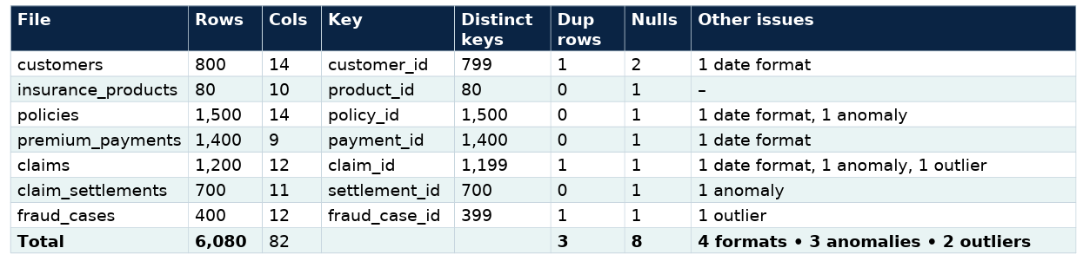
Data Profiling & Initial Quality Assessment
PART 2 · DATASET UNDERSTANDING
8
3
3
2
4
Null values
Duplicate records
Business anomalies
Outliers
Varied date formats
Missing mandatory or optional information
Multiple records with the same business key
Policy expiry < start · loss date < policy start · wrong net settlement
Claim of ₹25,000,000 · fraud score 145
Different source date / timestamp formats to standardise
Routing required by the specification
Correctable format → standardise & retain
Optional null → warning
Duplicate → duplicate route
Impossible sequence → reject
Extreme but possible → warning & retain

Slide 6
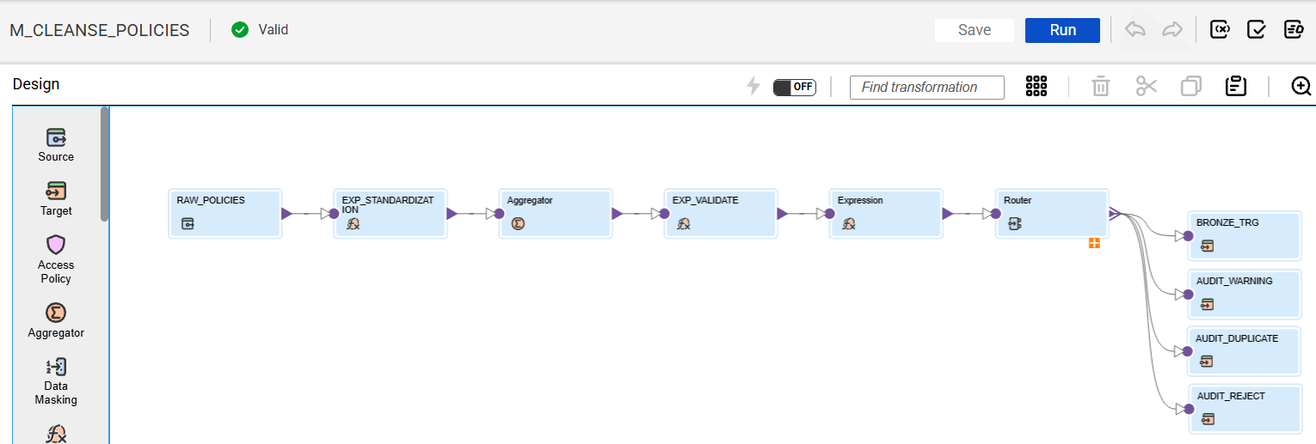
IDMC Mapping Design
PART 4 · IDMC IMPLEMENTATION
Source
AWS S3 CSV
Expression
Cleaning
Aggregator
Duplicate groups
Expression
DQ status
Router
Route records
Targets
Snowflake

Slide 7
Data Cleaning & Transformation Rules
PART 4 · IDMC IMPLEMENTATION
Dataset | Validation rule | Handling
Customers | Mandatory customer ID | Reject if missing
Policies | Expiry date must follow start date | Reject invalid sequence
Premium Payments | Payment amount must be positive | Reject invalid amount
Premium Payments | Standardise date format | Correct and retain
Claims | Validate claim amount | Reject or flag
Claim Settlements | Net = gross − deductible − recovery | Reject inconsistent values
Fraud Cases | Fraud score between 0 and 100 | Reject invalid score
Four types of handling
Correctable error
Standardise and retain
Business-rule violation
Reject or quarantine
Optional missing value
Warning
Extreme but valid value
Flag for review — never deleted automatically

Slide 8
Duplicate Detection, Error Handling & Reject Reasons
PART 4 · IDMC IMPLEMENTATION
IDMC ROUTER
Example output
Record ID | DQ status | Reject reason
PPY0000001 | VALID | —
PPY0000056 | REJECTED | Missing reference number
PPY0000141 | REJECTED | Payment date inconsistency
FRC000031 | REJECTED | Invalid fraud score
VALID
Pass all required DQ checks
ERROR
Fail mandatory validation rules
DUPLICATE
Duplicate on defined business key
DQ fields created
O_DQ_STATUS
VALID / REJECTED / DUPLICATE
O_DQ_REASON
Readable reason for every non-valid row
Every rejected row carries its reason → faster troubleshooting and full traceability.

Slide 9
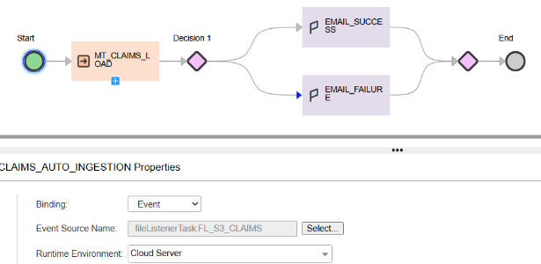
USP · EVENT-DRIVEN INGESTION
Implementation — Taskflow CLAIMS_AUTO_INGESTION
Configuration
Taskflow
CLAIMS_AUTO_INGESTION
Binding
Event
Event source
fileListenerTask:FL_S3_CLAIMS
Runtime environment
Cloud Server
Mapping task
MT_CLAIMS_LOAD
Notifications
EMAIL_SUCCESS · EMAIL_FAILURE
1
2
3
4
5
6
New claims file
File listener
Event trigger
Mapping task
Decision
Email alert
lands in the S3 claims folder
FL_S3_CLAIMS detects the arrival
starts the claims ingestion taskflow
MT_CLAIMS_LOAD cleanses & loads Bronze
success or failure path
EMAIL_SUCCESS / EMAIL_FAILURE
LTM | Internal

Slide 10
End-to-End Solution Architecture
PART 3 · SOLUTION ARCHITECTURE
SNOWFLAKE
Source systems
AWS S3
Informatica IDMC
Bronze
Silver
Gold
7 CSV datasets
Raw data storage
Original files kept
Profiling · cleansing
Standardisation
Duplicate detection
Validation · error routing
Source-aligned data
+ load metadata
Validated data
Relationships
Business rules
Dimensions
Facts
Analytical marts
Claims only: IDMC file listener on S3 → Bronze → Stream & Task → Silver (SCD2) → Gold
Snowpark
Fraud-risk scoring
Streamlit
Role-based dashboards

Slide 11
Why Medallion Architecture?
PART 3 · SOLUTION ARCHITECTURE
BRONZE
Preserve source-aligned data and ingestion metadata
Example: Raw premium payment records
Why we chose it
Separation of raw and transformed data
Easier troubleshooting
SILVER
Clean, deduplicate and validate relationships
Example: Validated premium payments
Data lineage
Reprocessing capability
GOLD
Create business-ready analytical datasets
Example: Premium collection summary
Better data quality
Reusable analytical datasets

Slide 12
Snowflake Environment Setup
PART 5 · SNOWFLAKE IMPLEMENTATION
Database: INSURANCEPOLICY_LIFECYCLE_DB
Setup covered
Database creation
Schemas per layer
Warehouse configuration
Connection / file formats for S3 loads
Target tables
Role configuration
Why an AUDIT schema?
Keeps rejected, duplicate and warning rows plus load counts separate from business data — nothing is lost and every load can be reconciled.
BRONZE
Source-aligned tables loaded by IDMC
AUDIT
Rejects, duplicates, warnings & reconciliation
SILVER
Validated, related data; claims SCD2
GOLD
Dimension, fact & mart views
SECURE_CONSUMPTION
11 role-specific secure views
Warehouse: IDMC_COMPUTE_WH — compute for IDMC loads and pipeline SQL

Slide 13
Bronze Layer Implementation
PART 5 · SNOWFLAKE IMPLEMENTATION
1
Source ingestion
2
File-format configuration
3
Bronze table structure
4
Metadata columns
5
Load validation
6
Error & duplicate records
Bronze table | Source file | Rows
BRONZE.CUSTOMERS | customers.csv | 800
BRONZE.INSURANCE_PRODUCTS | insurance_products.csv | 80
BRONZE.POLICIES | policies.csv | 1,500
BRONZE.PREMIUM_PAYMENTS | premium_payments.csv | 1,400
BRONZE.CLAIMS | claims.csv | 1,200
BRONZE.CLAIM_SETTLEMENTS | claim_settlements.csv | 700
BRONZE.FRAUD_CASES | fraud_cases.csv | 400
Metadata columns
SOURCE_FILE_NAME
→ Auditability
LOAD_TIMESTAMP
→ Reconciliation
BATCH_ID
→ Reruns
DQ_STATUS
→ Error tracking
DQ_REASON
→ Error tracking

Slide 14
Silver Layer Implementation
PART 5 · SNOWFLAKE IMPLEMENTATION
How Bronze becomes business-ready
Orphan-record validation
1
Datatype standardisation
2
Deduplication
0
orphan records
All seven datasets were checked across nine parent–child relationships.
3
Foreign-key validation
4
Business-rule validation
5
Joining related datasets
6
Consistent business keys
policies → customers · policies → products · payments → policies
claims → policies · claims → customers · settlements → claims
fraud → claims · fraud → policies · fraud → customers
Claims: automatic SCD Type 2
Stream on BRONZE.CLAIMS + scheduled Task
Changed claim → old version closed, new version inserted as current
Full history of status and amount changes kept
Not checkable: premium_schedule_id — its parent dataset is outside the seven-file scope.
Silver still runs referential checks on every load to catch future orphans.

Slide 15
PART 5 · SNOWFLAKE IMPLEMENTATION
Gold Layer — Dimensional Data Model
DIMENSIONS
ANALYTICAL MARTS
Customer
VW_DIM_CUSTOMER
Region · risk category
Contact masked
Product
VW_DIM_INSURANCE_PRODUCT
Insurance type · coverage
Sum-insured range
Policy
VW_DIM_POLICY
Status · sum insured
Risk band · dates
Date
VW_DIM_DATE
Day · month
Quarter · year
MART_POLICY_PORTFOLIO
Policy exposure and coverage
MART_CLAIMS_PERFORMANCE
Claim frequency and severity
Conformed dimensions — shared keys: customer · product · policy · date
FACTS
MART_SETTLEMENT_RECONCILIATION
Approved vs settled amounts
Premium Payment
VW_FACT_PREMIUM_PAYMENT
1 row per payment
payment_amount
payment_status
Claim
VW_FACT_CLAIM
1 row per claim
claim_amount
approved_amount · status
Claim Settlement
VW_FACT_CLAIM_SETTLEMENT
1 row per settlement
gross · deductible
recovery · net amount
Fraud Case
VW_FACT_FRAUD_CASE
1 row per investigation
fraud_score
outcome · duration
MART_FRAUD_RISK
Fraud investigations & risk classification
Why joins do not double-count
Each fact keeps one grain and joins only to dimensions (one row per key) — never fact-to-fact. Amounts are aggregated at their own grain before being combined in a mart.
Built as Gold views
4 dimensions · 4 facts · 4 marts — always current with Silver, and the source for the secure consumption views.
LTM | Internal

Slide 16
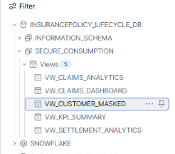
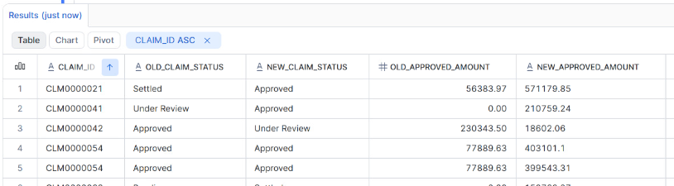
Incremental Processing, Security & Recovery
PART 7 · ADVANCED TECHNICAL REQUIREMENTS
A. Incremental claims processing
B. Security
New claims file → IDMC listener
Roles
INSURANCE_ANALYST_ROLE
CLAIMS_ANALYST_ROLE
FRAUD_MANAGER_ROLE
DATA_ENGINEER_ROLE
5 users · 4 roles
Controls
Role-based access control
Customer contact & address masked
11 secure views in SECURE_CONSUMPTION
Bronze restricted to engineering
Every role validated with USE ROLE
BRONZE.CLAIMS
Snowflake Stream
Snowflake Task
MERGE (SCD2) into Silver
Gold mart refresh

Slide 17
PART 7 · ADVANCED TECHNICAL REQUIREMENTS
Secure Access — RBAC, Users, Roles & Secure Views
USERADMIN
Creates 4 roles & 5 users
SECURITYADMIN
Grants roles to users; roles roll up to SYSADMIN
USAGE grants
IDMC_COMPUTE_WH · database · schemas
SELECT grants
Only on the role’s secure views
Masking — VW_CUSTOMER_MASKED
EMAIL
********@MASKED.COM
PHONE
XXXXXXXXXX
Access matrix secure views in SECURE_CONSUMPTION · layers
ADDRESS_LINE
ADDRESS MASKED
Role · users​ | Policy​ | Premium​ | Claims​ | Settle-​ ment​ | Fraud​ | Customer​ (masked)​ | Bronze​ Silver​ Audit​
INSURANCE_ANALYST_ROLE​ PROJECT_USER_1 · Insurance Analyst​ | ✓​ | ✓​ | ✕​ | ✕​ | ✕​ | ✓​ | ✕​
CLAIMS_ANALYST_ROLE​ PROJECT_USER_2 · Claims Analyst​ | ✕​ | ✕​ | ✓​ | ✓​ | ✕​ | ✓​ | ✕​
FRAUD_MANAGER_ROLE​ PROJECT_USER_3 · Fraud Manager​ | ✕​ | ✕​ | ✕​ | ✕​ | ✓​ | ✓​ | ✕​
DATA_ENGINEER_ROLE​ PROJECT_USER_4, _5 · Data Engineers​ | ✓​ | ✓​ | ✓​ | ✓​ | ✓​ | ✓​ | ✓​
Name, city, region & risk category stay visible for analysis.
Validation tests USE SECONDARY ROLES NONE
✓
Insurance analyst → VW_POLICY_ANALYTICS
allowed
✕
Insurance analyst → BRONZE.POLICIES
denied — not authorized
✕
Claims analyst → VW_FRAUD_ANALYTICS
denied — not authorized
✕
Fraud manager → BRONZE.FRAUD_CASES
denied — not authorized
✓
Data engineer → BRONZE & AUDIT error records
allowed
Design rule: analysts never touch tables — only SELECT on secure views (view SQL hidden). Engineers get Bronze, Silver & Audit incl. FUTURE TABLES. All 4 roles: USAGE on IDMC_COMPUTE_WH and the database.
All views report IS_SECURE = YES
verified
✓

Slide 18
Business KPIs — Definitions & Calculation
PART 6 · BUSINESS ANALYTICS
Area | KPI | Calculation | Source | Interpretation
Policy | Active policies / sum insured | COUNT, SUM(sum_insured) where status = 'Active' | FACT / DIM_POLICY | Current exposure
Premium | Premium collected | SUM(payment_amount) where payment_status = 'Paid' | FACT_PREMIUM_PAYMENT | Cash actually received
Claims | Claim frequency | Claims ÷ policies × 100 | FACT_CLAIM, DIM_POLICY | Claims per 100 policies
Claims | Average claim amount | AVG(claim_amount) | FACT_CLAIM | Claim severity
Claims | Approval ratio | Approved claims ÷ eligible (decided) claims × 100 | FACT_CLAIM | Share of claims approved
Settlement | Settlement turnaround | AVG(settlement_date − claim_registration_date) | FACT_CLAIM_SETTLEMENT | Days to settle
Settlement | Net settlement amount | SUM(net_settlement_amount) | FACT_CLAIM_SETTLEMENT | Total paid out
Settlement | Loss ratio proxy | Net settlement ÷ premium collected × 100 | Settlement + premium | Payout vs income
Fraud | Open investigations | COUNT where investigation not closed | FACT_FRAUD_CASE | Current workload
Fraud | Confirmed fraud rate | Confirmed fraud ÷ closed investigations × 100 | FACT_FRAUD_CASE | Fraud prevalence
Fraud | High-risk claims | COUNT where risk_category = 'HIGH' | Snowpark score | Priority review list

Slide 19
Snowpark Python — Fraud Risk Scoring
PART 6 · BUSINESS ANALYTICS
Inputs
Processing
Output
Why did this claim score HIGH?
Fraud score component + high
Claim amount component + high
Investigation component + medium
Total → category HIGH
Each component is stored, so any classification can be explained and reproduced.
Output read by the fraud manager through VW_CLAIM_RISK_SCORES.
Fraud score
Claim-related indicators (amount, timing)
Investigation information
Other approved business-risk metrics
Calculate component scores
Combine into a total score
Assign a risk category
LOW
MEDIUM
HIGH
Stored for every claim
Component scores
Total risk score
Risk category
Scoring timestamp

Slide 20
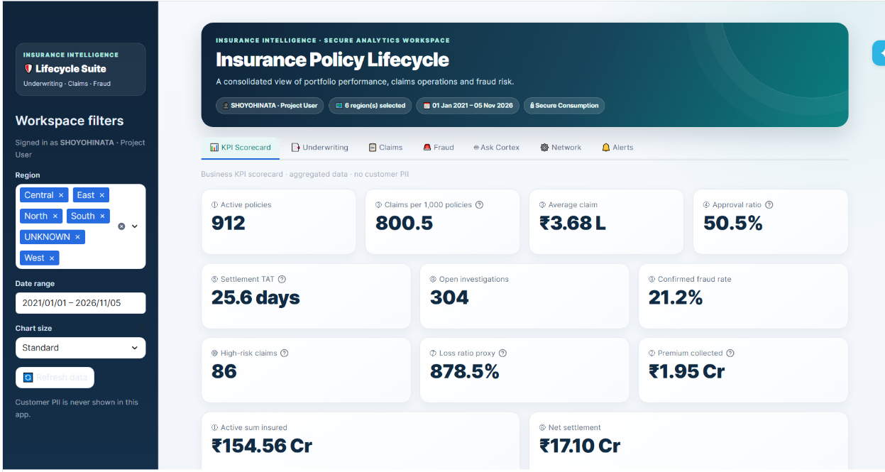
Streamlit Dashboard
PART 6 · BUSINESS ANALYTICS
1. Policy Overview
Active policies · total coverage
2. Premium Collection
Collected premiums · payment trends
3. Claims Performance
Claim count · approval ratio · average claim
4. Settlement Analytics
Net settlement · settlement turnaround
5. Fraud Risk
High-risk cases · open investigations · risk categories
Our USP — role-based dashboards
Each signed-in user sees only their role’s tabs — e.g. the fraud manager sees only Fraud analytics. Enforced by Snowflake grants on secure views.
6. Cortex & Analyst
AI data insights directly into your web apps

Slide 21
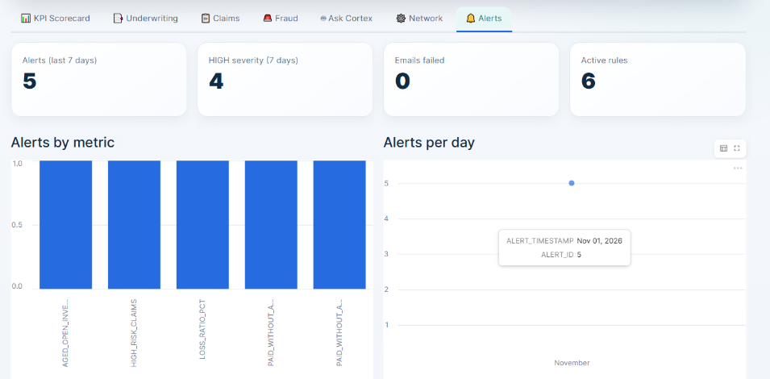
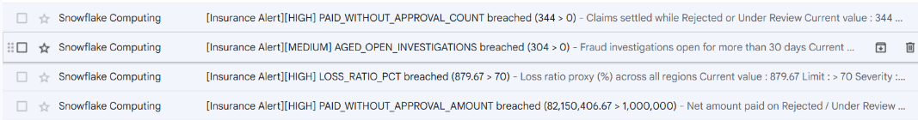
USP · PROACTIVE MONITORING
USP: Automated Fraud & Risk Alert Emails
Gold KPIs
Latest values from Gold views
6 alert rules
Metric · limit · severity
Breach check
Current value vs limit
Alert log
ALERT_ID · timestamp · severity
Email sent
[Insurance Alert][SEVERITY]
Alerts tab
Streamlit monitoring
Streamlit — Alerts tab
Alert emails received
HIGH
PAID_WITHOUT_APPROVAL_COUNT 344 > 0
Claims settled while Rejected / Under Review
HIGH
PAID_WITHOUT_APPROVAL_AMOUNT ₹82,150,406.67 > 1,000,000
Net paid on Rejected / Under Review claims
HIGH
LOSS_RATIO_PCT 879.67 > 70
Loss ratio proxy (%) across all regions
HIGH
HIGH_RISK_CLAIMS 86 > 20
Claims scored HIGH risk by Snowpark
MEDIUM
AGED_OPEN_INVESTIGATIONS 304 > 0
Fraud investigations open > 30 days

Slide 22
Testing, Challenges & Results
PART 8 · TESTING AND FINAL RESULTS
Test | Evidence to present
Source validation | All seven file counts
Data quality | Null, duplicate and anomaly reports
Mapping execution | IDMC successful job logs
Bronze validation | Snowflake row counts
Silver validation | Referential-integrity results
Gold validation | KPI reconciliation
Incremental processing | Initial, update and replay results
Security | Role and masking tests
Recovery | Successful restoration / rerun
Challenges encountered
1. Snowflake JDBC memory error
java.lang.OutOfMemoryError: Java heap space
2. DTM memory allocation failure
Failed to allocate memory. Out of virtual memory.
3. Duplicate-handling design
Aggregator finds duplicate groups but does not keep every occurrence

Slide 23

Project Outcomes, Limitations & Conclusion
PART 8 · TESTING AND FINAL RESULTS
Outcomes
An integrated insurance data platform
Governed Bronze, Silver and Gold datasets
Traceable data-quality processing
Validated insurance KPIs
Explainable fraud-risk classification
Secure, role-based analytical dashboards
Incremental processing and recovery capabilities
Limitations
Seven-source project scope
Premium Schedule parent dataset excluded
No advanced ML or production MLOps
Controlled capstone dataset, not a production insurance environment
Conclusion
IDMC and Snowflake integrate seven insurance processes into one governed platform. Snowpark adds explainable fraud risk and Streamlit gives a secure business view — with a focus on accuracy, traceability, security and recoverability.

Slide 24
DELIVERY TRACKING
Kanban Board: Day-wise
26 of 26 planned tasks are done.
SNOWFLAKE CAPSTONE · 5-DAY SPRINT · GROUP 8
26
Total tasks
26
Completed
100%
Progress
Insurance Policy Lifecycle Analytics – Kanban Board
Day 1
4 tasks
Day 2
6 tasks
Day 3
6 tasks
Day 4
6 tasks
Day 5
4 tasks
Discovery, profiling & design
IDMC cleansing & Bronze load
Silver, Gold & KPIs
Incremental, security & Snowpark
Dashboard, testing & presentation
PLAN
✓ Done
SETUP
✓ Done
SILVER
✓ Done
INCREMENTAL
✓ Done
ANALYTICS
✓ Done
Study project doc & define scope
Snowflake DB, schemas & WH
Silver typing & deduplication
IDMC file listener for claims
Role-based Streamlit dashboard
Scope, KPIs, acceptance criteria
INSURANCEPOLICY_LIFECYCLE_DB
Types, dates, business keys
S3 claims folder trigger
KPI, Underwriting, Claims, Fraud tabs
PROFILE
✓ Done
IDMC
✓ Done
SILVER
✓ Done
INCREMENTAL
✓ Done
QA & DOCS
✓ Done
Profile the 7 source datasets
S3 & Snowflake connections
Referential-integrity checks
Stream, Task & SCD2 into Silver
End-to-end testing & UAT
Nulls, duplicates, formats, keys
Secure Agent, connection tests
0 orphans across 9 relationships
New, updated, replay tests
Reconciliation, role & masking tests
PLAN
✓ Done
IDMC
✓ Done
GOLD
✓ Done
SECURITY
✓ Done
QA & DOCS
✓ Done
Design architecture & data model
Cleansing mappings – master data
Dimension views
Roles, users & grants
Runbook & documentation
Medallion, ER, fact grain
Customers, products, policies
VW_DIM_* (4)
5 users · 4 roles
Architecture, DQ, lineage
S3
✓ Done
IDMC
✓ Done
GOLD
✓ Done
SECURITY
✓ Done
QA & DOCS
✓ Done
Upload 7 CSV files to AWS S3
Cleansing mappings – transactions
Fact views
Masking & secure views
Final presentation & demo
Bucket + claims incremental folder
Payments, claims, settlements, fraud
VW_FACT_* (4)
11 views in SECURE_CONSUMPTION
SME walkthrough
IDMC
✓ Done
GOLD
✓ Done
ANALYTICS
✓ Done
DQ status & reject routing
Analytical marts
Snowpark fraud-risk scoring
O_DQ_STATUS / O_DQ_REASON → AUDIT
MART_* (4)
Low / Medium / High score
BRONZE
✓ Done
GOLD
✓ Done
SECURITY
✓ Done
Bronze load & reconciliation
KPI calculation & reconciliation
Recovery test
Row counts per file
10 business KPIs
Time Travel / clone, rerun
24

Slide 25
DELIVERY TRACKING
Burndown Chart: Day-wise
Tasks remaining against the 26 planned tasks — 0 remaining at sprint end.
SNOWFLAKE CAPSTONE · 5-DAY SPRINT · GROUP 8
26
Total tasks
26
Completed
0
Remaining
100%
Progress
5.2
Tasks / day
Insurance Policy Lifecycle – Burndown
DAY 1 4 tasks
done 4 · 22 left (ideal 20.8)
DAY 2 6 tasks
done 6 · 16 left (ideal 15.6)
DAY 3 6 tasks
done 6 · 10 left (ideal 10.4)
DAY 4 6 tasks
done 6 · 4 left (ideal 5.2)
DAY 5 4 tasks
done 4 · 0 left (ideal 0)
LTM | Internal
252

Slide 26
Thank you

