Slide 1
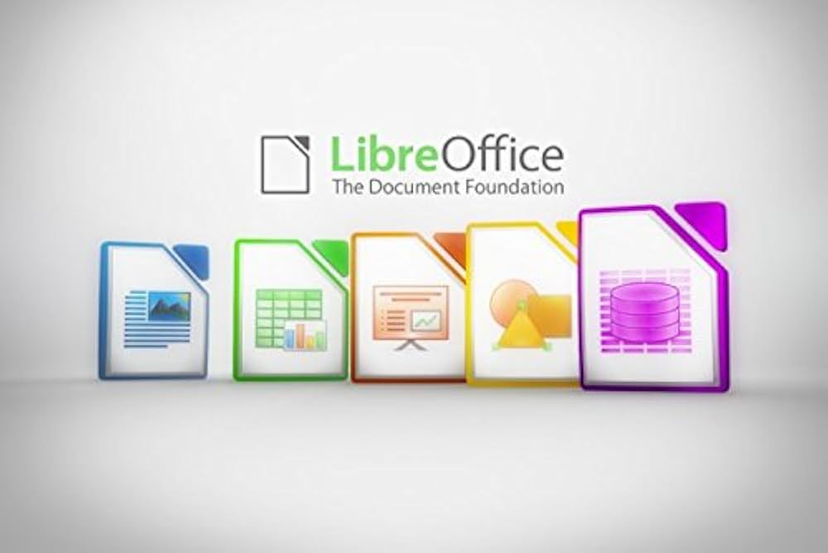
Welcome to LibreOffice Impress
A Free and Powerful Presentation Tool

Slide 2

Why Use Impress?
Free and Open-Source
Easy to use Interface
Supports Multimedia

Slide 3
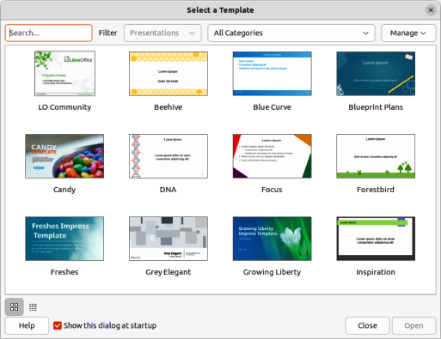
How to Get Started
Choose a template
Add texts and visuals
Apply Transitions

