Slide 1
Attention Models
An overview of the paper “Neural Machine Translation by Jointly Learning to Align and Translate”

Slide 2
Objective:
Machine translation is the process of converting the sentences from one language to the other.
It is the task for mapping a sequence to another sequence.
The conventional DNN although achieves very good performance for the labelled data cannot be used for sequence to sequence mapping.
Models proposed in the literature often belongs to the family of encoders- decoders where the input sequence is mapped to a fixed dimensional vector.
This fixed dimensional vector is used to generate the output translation.
The authors conjecture, that this fixed length vector is not useful in translating very long sequences.
Therefore, they propose to extend the above approach to search for parts of the input sequence that may be useful for predicting the target word.s

Slide 3
Shortcomings of DNN’s :
DNN’s can be used only if the input and output vectors can be encoded in fixed dimensionality vectors.
But Machine translation is a problem where the length of the input/output sequence is not known a-priori.
Every other input/output sample can be of a different length and hence cannot be encoded to fixed dimensions for DNN’s.
Therefore, DNN’s directly were not suitable for this problem.

Slide 4
Using RNN:
In paper “Sequence to Sequence Learning with Neural Networks” the authors suggest using RNN for solving the sequence to sequence mapping problem.
A RNN is a recurrent unit, it can effectively handle the unknown number of input units in the sequence.
However, the basic RNN architecture would require the number of input sequences to be equal to the number of output sequences which might not be the case in Machine Translation.
Therefore, an encoder- decoder architecture was proposed.
The encoder will read the input sequence one time-step at a time and convert it to a fixed dimensional vector.
The decoder will use this embedding to generate the output sequence.
LSTM’s were the obvious choice for the RNN blocks due to its capability of capturing the long range dependencies in the sequences.

Slide 5
Why LSTM’s ?
RNN’s suffer from the problem of Vanishing gradient problem.
Due to this, the basic RNN blocks are unable to capture the long range dependencies.
However, LSTM’s use the additional memory cells to solve this problem.

Slide 6
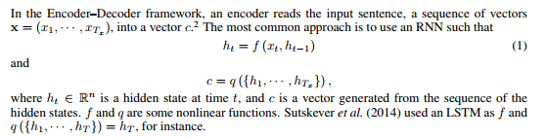
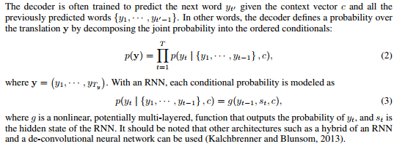
How this model does Machine Translation ?

Slide 7
Drawbacks of discussed model:
This approach is suitable for translation of only short input sequences.
When input sequences are too long, the embedding of the whole sentence is too much for the network to decode.

Slide 8
Attention Approach:
In this approach, a single embedding for the input sequence is not used to generate the output sequence.
Rather, multiple context vectors are generated for predicting the target word at each time-step.
The model searches for the most appropriate words in the input for predicting the target sequence for a particular time-step and generate context vectors prioritizing those words.
Also, the authors use bidirectional LSTM’s in the encoder to capture the dependencies in the input sequence both from the words preceding and succeeding.

Slide 9
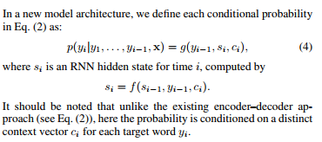
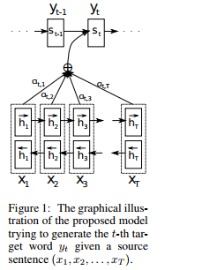

Architecture:

Slide 10
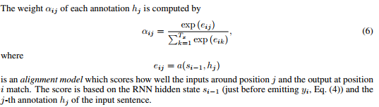
Calculation of Attention Weights:
The alignment model is a feed forward neural network which receives the previous state and the current annotation as input.
It generates the energy e_{ij} reflecting the importance of the annotation hj with respect to the previous hidden state si−1 in deciding the next state si and generating yi . Intuitively, this implements a mechanism of attention in the decoder.
This alignment model is trained with rest of the proposed system.

Slide 11
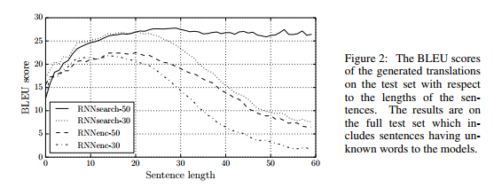
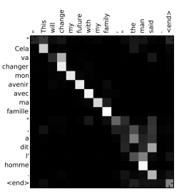
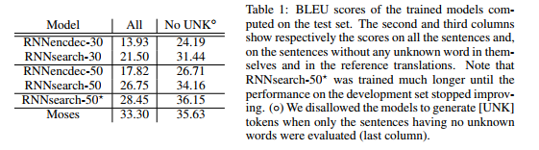
Results:

