Slide 1
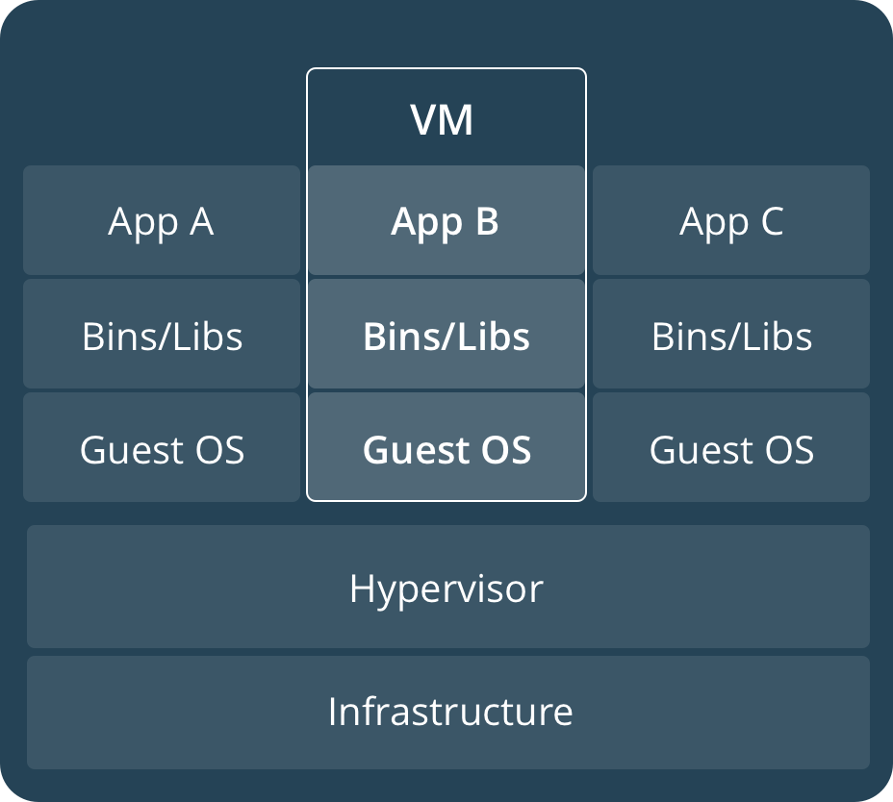
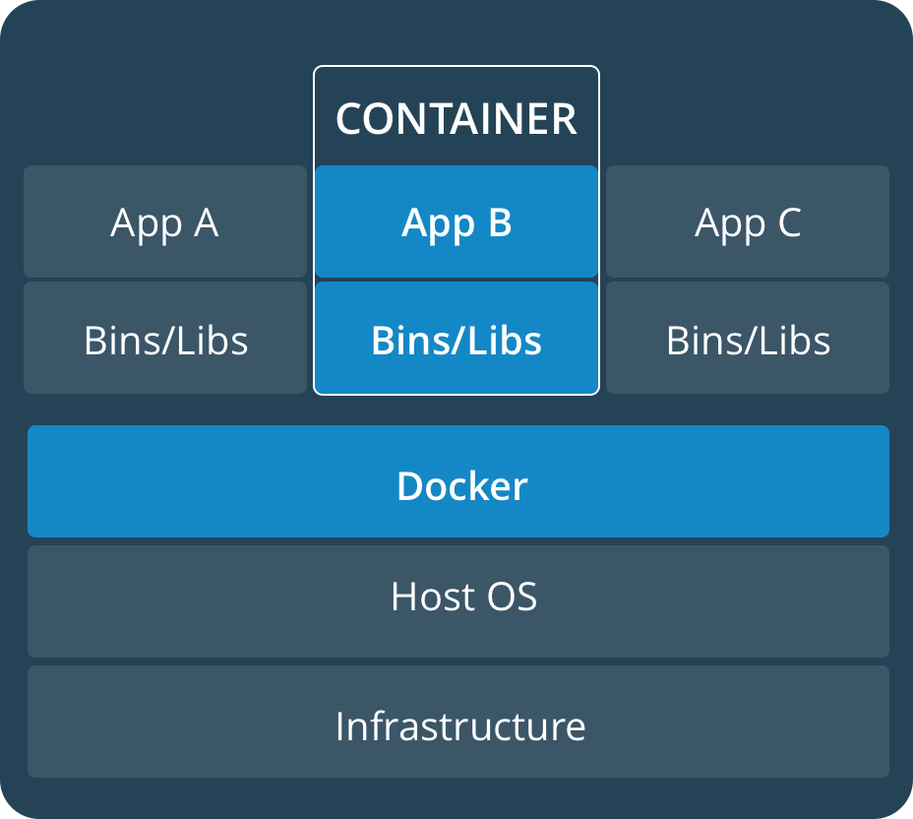

Slide 2
Namespace
Docker uses a technology called
namespaces to provide the isolated
workspace called the container.
When you run a container, Docker
creates a set of namespaces
for that container.

Slide 3
Linux Namespace
Namespace Constant Isolates
Cgroup CLONE_NEWCGROUP Cgroup root directory
IPC CLONE_NEWIPC System V IPC, POSIX message queues
Network CLONE_NEWNET Network devices, stacks, ports, etc.
Mount CLONE_NEWNS Mount points
PID CLONE_NEWPID Process IDs
User CLONE_NEWUSER User and group IDs
UTS CLONE_NEWUTS Hostname and NIS domain name

Slide 4
Clone System Call
int clone(int (*pfn)(void *), void *child_stack, int flags, void *arg, ...);

Slide 5
void main(int argc, char *argv[])
{
printf("Hello, World!\n");
void *pchild_stack = malloc(1024 * 1024);
if ( pchild_stack == NULL ) {
printf("ERROR: Unable to allocate memory.\n");
exit(EXIT_FAILURE);
}
int pid = clone(fn, pchild_stack + (1024 * 1024), CLONE_NEWIPC | CLONE_NEWNET | CLONE_NEWNS | CLONE_NEWPID | CLONE_NEWUSER | CLONE_NEWUTS | CLONE_NEWCGROUP, argv[1]);
if ( pid < 0 ) {
printf("ERROR: Unable to create the child process.\n");
exit(EXIT_FAILURE);
}
wait(NULL);
free(pchild_stack);
printf("INFO: Child process terminated.\n");
}

Slide 6
Setns System Call
The setns system call allows the calling process to join an
existing namespace. The namespace to join is specified via
a file descriptor that refers to one of the /proc/[pid]/ns files
described below.

Slide 7
Unshare System Call
The unshare system call moves the calling process to a new namespace.

Slide 8
Control groups
Docker Engine on Linux also relies on
another technology called cgroups.
Control groups allow Docker Engine to
share available hardware resources to
containers and optionally enforce limits
and constraints.

Slide 9
Linux cgroup
cpu
cpuacct
cpuset
memory
devices
freezer
net_cls
Guaranteed a minimum number of "CPU shares"
This provides accounting for CPU usage by groups of processes.
This cgroup can be used to bind the processes in a cgroup to a specified set of CPUs.
The memory controller supports reporting and limiting of process memory, kernel memory, and swap used by cgroups.
This supports controlling which processes may create devices as well as open them for reading or writing. The policies may be specified as whitelists and blacklists.
The freezer cgroup can suspend and resume all processes in a cgroup.
This places a classid, specified for the cgroup, on network packets created by a cgroup. These classids can then be used in firewall rules.

Slide 10
Linux cgroup
blkio
perf_event
net_prio
hugetlb
pids
rdma
The blkio cgroup controls and limits access to specified block devices by applying IO control in the form of throttling and upper limits against leaf nodes and intermediate nodes in the storage hierarchy.
This controller allows perf monitoring of the set of processes grouped in a cgroup.
This allows priorities to be specified, per network interface, for cgroups.
This supports limiting the use of huge pages by cgroups.
This controller permits limiting the number of process that may be created in a cgroup (and its descendants).
The RDMA controller permits limiting the use of RDMA/IB-specific resources per cgroup.

Slide 11
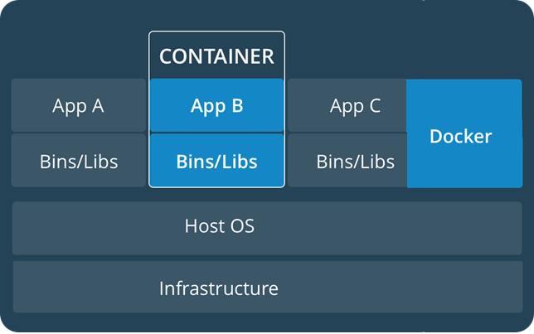

Slide 12


Slide 13

Q & A

