Slide 1
Smart Scan
College/University name: Bharat Institute of Technology Track chosen : Medical Team Name : Team Nova Team Leader Name : Gunjeet Singh Bawa

Slide 2
Objective
SmartScan objective is to make a self-contained system. Its aimed towards the users to know about their lung condition via web platform. The objective is to use machine learning to predict lung diseases in the person.

Slide 3
Problem description
Existing problem
Proposed solution
Patients with lung diseases have to rely on near-by doctors for their care.
Sometimes patients get wrongly diagnosed and want a second opinion.
Smart scan helps the patient to connect with many doctors and provides best care for the disease.
Smart scan runs a machine learning and provides the care according to result.

Slide 4
Comparison
Existing Approach
Proposed Approach
Existing approach involves going to the doctor, paying consultation fees, getting an X-ray done and then getting diagnosed for any disease
Proposed approach involves getting an X-ray done and uploading it on the Smart Scan servers and then consulting a doctor based on the results.

Slide 5
Tool and Programing Languages Used
Programming languages
Tool & Development Environment
HTML(Hyper Text Markup Language)
CSS(Cascading Style Sheet)
JavaScript
Flask
Python
Google Cloud Platform
Jupyter Notebook

Slide 6
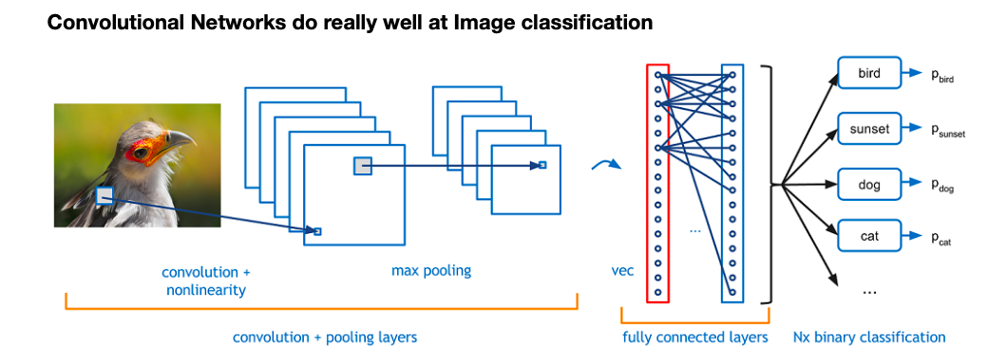
Implementation

Slide 7
New Future Features
In future we may a application and website of this.
User can direct consult to the doctors with paying little fees.
In future User can able to detect more diseases.

Slide 8
Conclusion
Smart Scan is a hassle-free online consultation web-application for lung patients.
It is better than the traditional approach of consulting near-by doctors for lung diseases.
Smart Scan is free to use.
Smart Scan compares the X-ray to thousands of other x-ray in it’s database and uses image classification.

Slide 9
Let us execute the project
Thanks for watching.

