Slide 1

FAKE NEWS
DETECTION using machine learning
Presentation by : amulya(23u51a6734)
Meenakshi(23u51a6751)
teja(23u51a6706)
Sai kiran(23u51a6739)

Slide 2

CONTENT
Objective
Introduction
Problem statement
Domain
System Architecture
Dataset
Technologies Used
Working Process
Frontend
Backend
Result

Slide 3

OBJECTIVE
To classify news as Fake or Real using Machine Learning
To reduce the spread of misinformation in society
Improve accuracy of classification
Detect fake and real news automatically
Provide quick and reliable results
This Photo by Unknown Author is licensed under CC BY-NC

Slide 4
INTRODUCTION
Fake news is intentionally created to mislead people
It spreads faster than real news due to social media sharing
Lack of awareness makes people believe fake information
Fake news can damage reputation and create social unrest
It is difficult for humans to verify large volumes of news
Traditional methods are not efficient for detection
Automation is required to handle large-scale data
Machine Learning models learn patterns from news data
NLP helps in understanding meaning and context of text
Early detection of fake news can prevent its spread
Fake news detection is an important research area today

Slide 5

PROBLEM STATEMENT
Rapid spread of fake news on social media
Difficult to verify authenticity manually
Causes misinformation and confusion
Large volume of news data
Need for automated fake news detection system
This Photo by Unknown Author is licensed under CC BY-NC

Slide 6
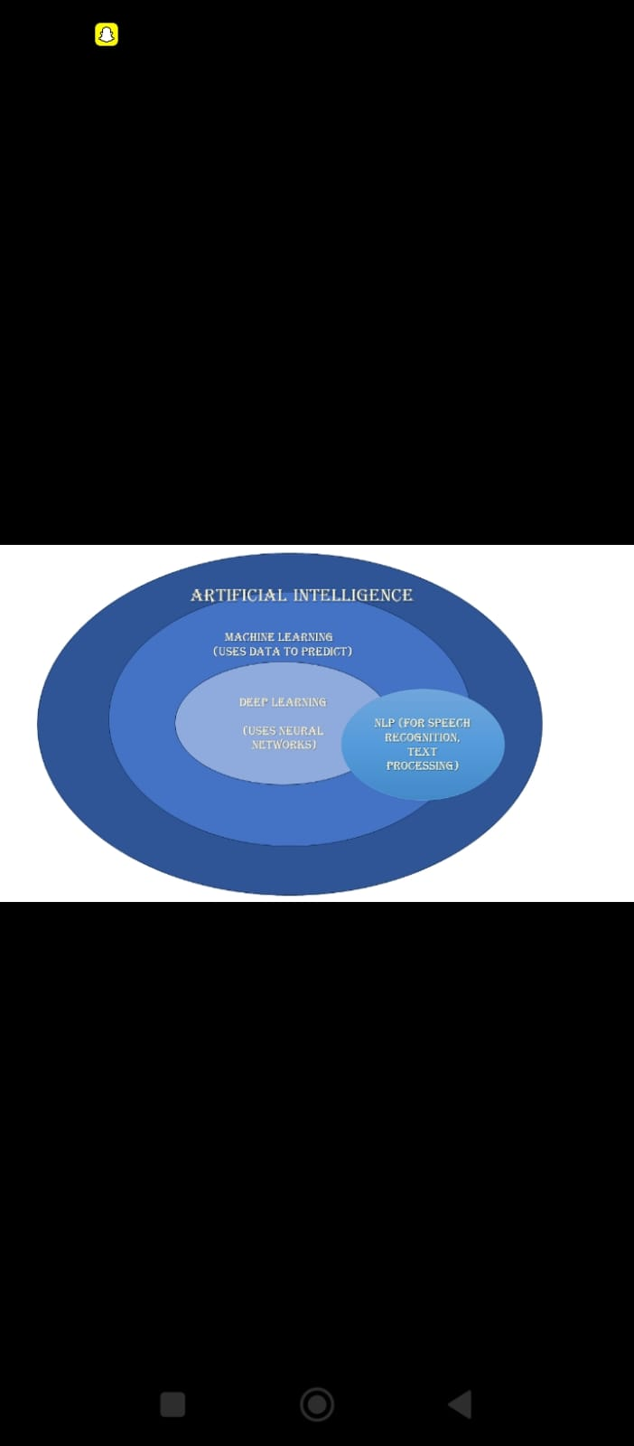
DOMAIN
This project belongs to the Artificial Intelligence(AI)domain
It mainly uses Machine Learning(ML) tecniques
It is also a part of Data Science for handling datasets
The system learns patterns from news data to make predictions
It classifies news as Real or Fake automatically

Slide 7
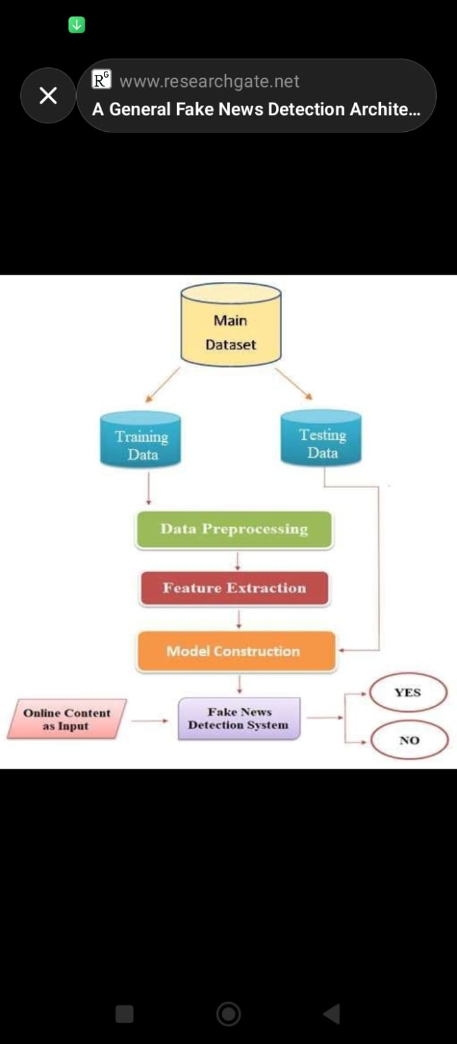
SYSTEM ARCHITECTURE
The system takes news text as input from the user
Input text is sent to the backend (Flask server)
Text is processed using preprocessing techniques
Data is converted into numerical form using TF-IDF / Tokenization
The processed data is given to the trained model
The model analyzes the text and predicts the result
Output is classified as Real News or Fake News
The result is displayed on the frontend (web page)

Slide 8
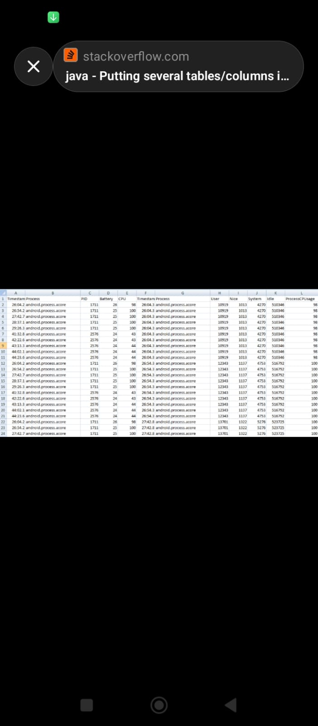
DATASET
Dataset is collected from Kaggle
It contains news articles used for training the model
The dataset includes text and label columns
Text column contains news content
Label column indicates:
0 → Fake News
1 → Real News
The dataset contains a large number of news samples
It is divided into training and testing data
Data is preprocessed before training

Slide 9

TECHNOLOGIES USED
PROGRAMMING LANGUAGE---python
LIBRARIES---Pandas , Scikit-learn , NumPy
FRONTEND---HTML ,CSS ,JavaScript
BACKEND---Flask

Slide 10
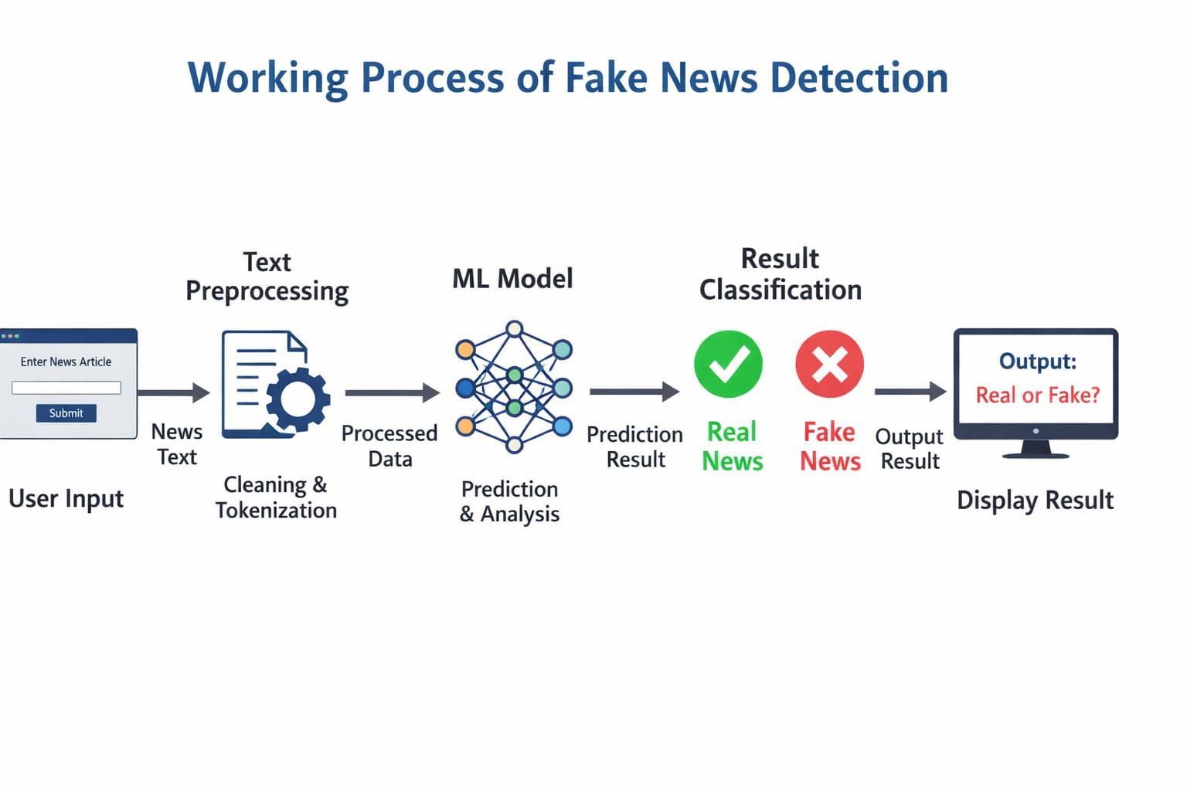
WORKING PROCESS

Slide 11
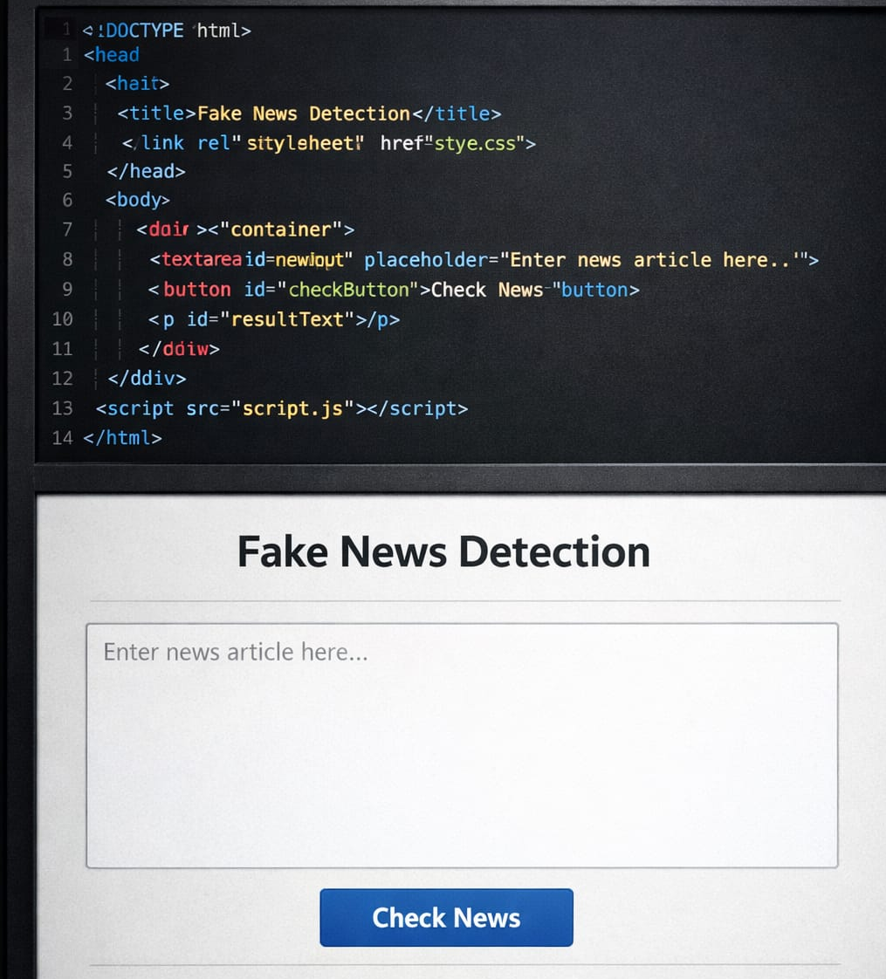
FRONTEND
Frontend is the user interface of the system
It is used to interact with the user
Developed using HTML and CSS
Provides a simple and user-friendly design
Allows user to enter news text
Sends input data to backend for processing
Displays the prediction result (Real/Fake)
Ensures smooth communication between user and system

Slide 12
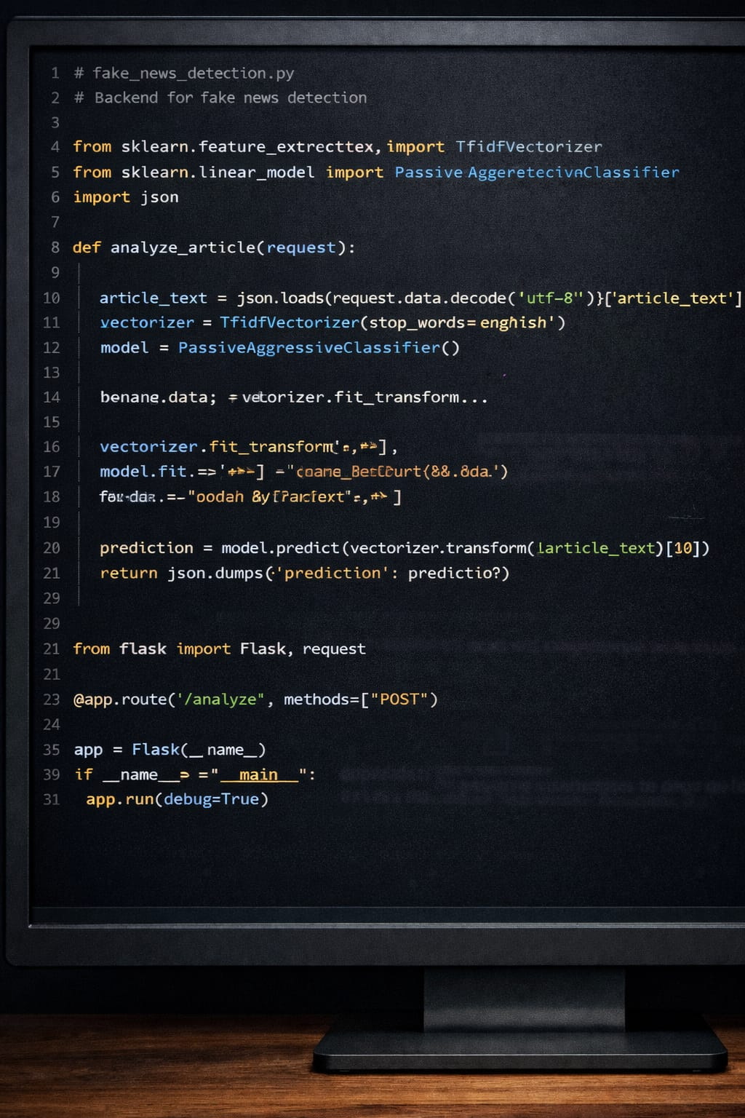
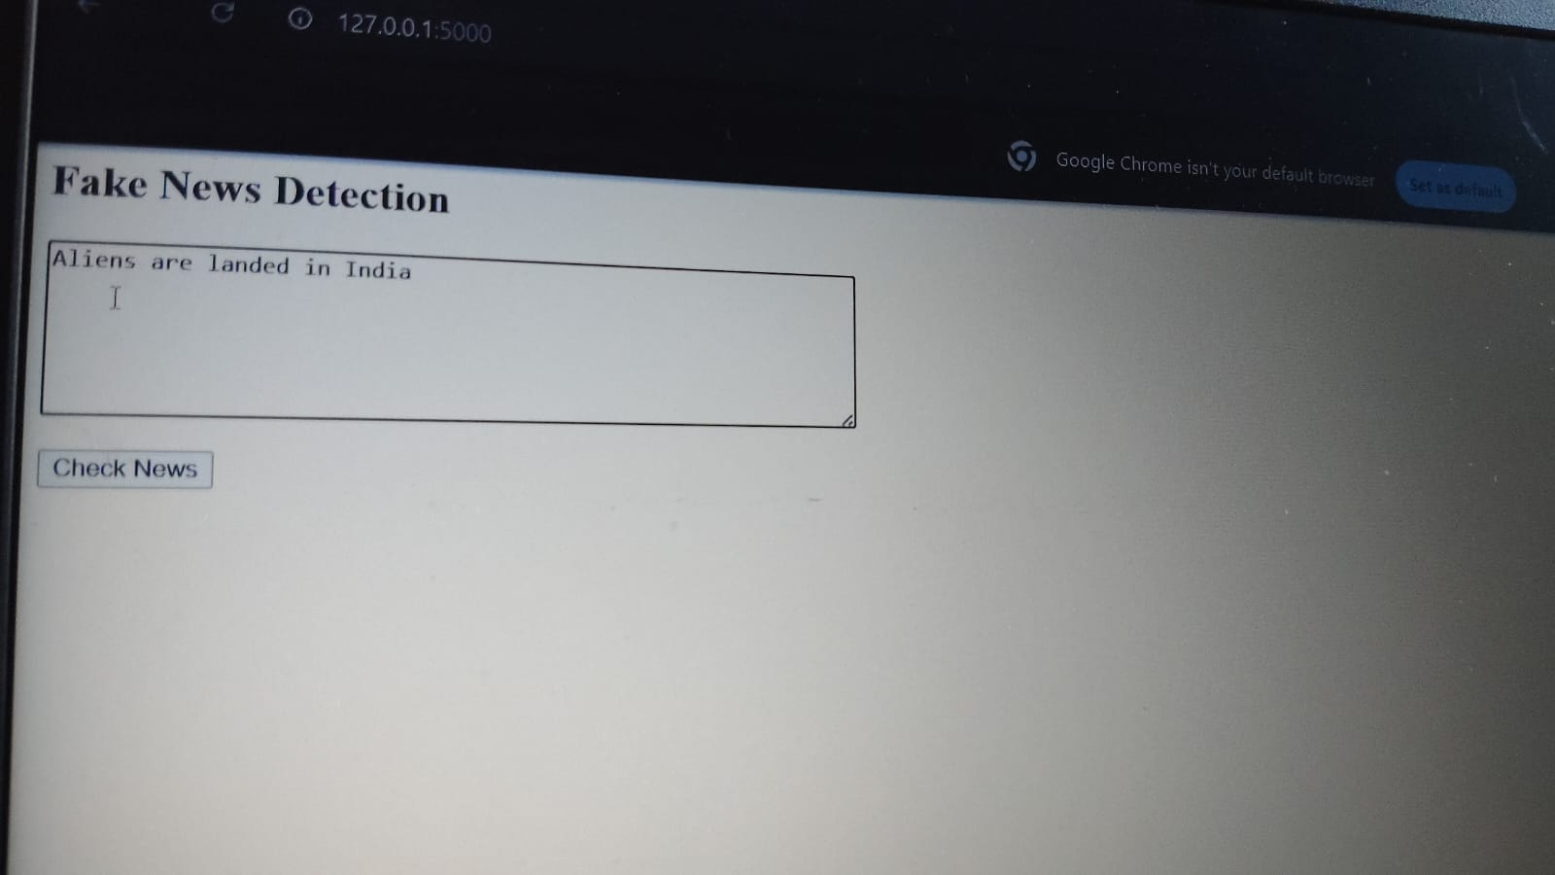
BACKEND
Backend is the core processing part of the system
It handles data processing and prediction logic
Developed using Python and Flask framework
Receives input from the frontend
Performs text preprocessing (cleaning, removing stopwords)
Converts text into numerical format using TF-IDF
Uses a trained Machine Learning model for prediction
Classifies news as Real or Fake
Sends the result back to the frontend

Slide 13
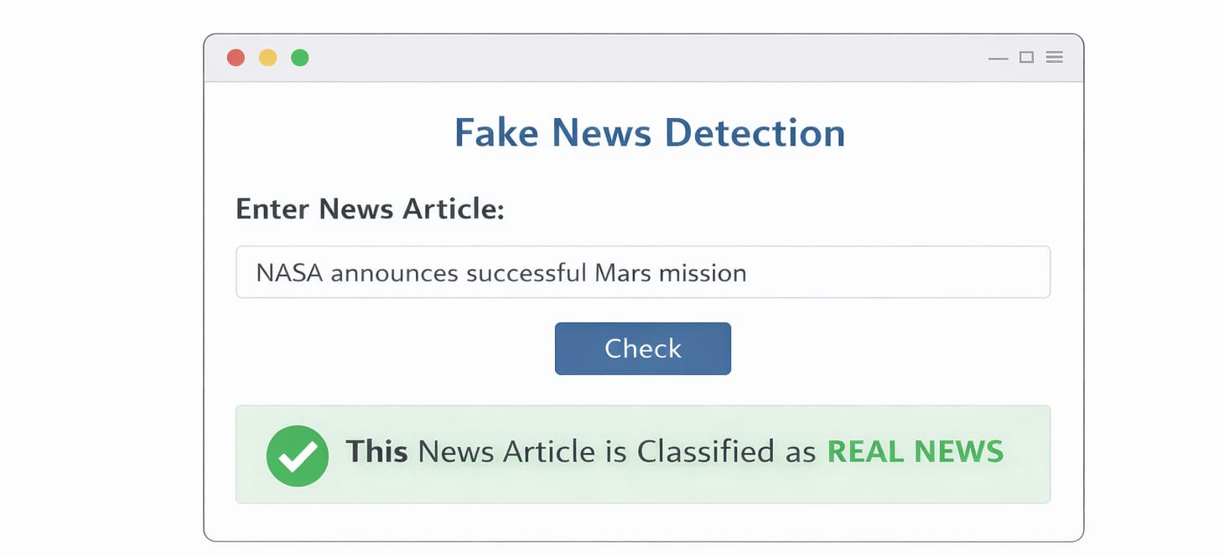
RESULT

Slide 14


