Slide 1
APEX MODEL UNITED NATION

Slide 2
what is United Nation
The United Nations (UN) is an international organization, made up of most independent countries in the world, whose stated aims are facilitating cooperation in International law, International security, Economic development, social progress, human rights, and achievement of world peace.
The UN was founded in 1945 after World War II to replace the League of Nations, to stop wars between countries, and to provide a platform for dialogue. It contains multiple subsidiary organizations to carry out its missions.

Slide 3

Offical logo of united nation

Slide 4
1.
What is Mun(model united nation)

Slide 5
Model United Nations is an academic simulation of the United Nations that aims to educate participants about civics, current events, and diplomacy. Students form teams, are assigned and research a country, take on roles as diplomats, investigate international issues, debate, and develop solutions to world problems.

Slide 6
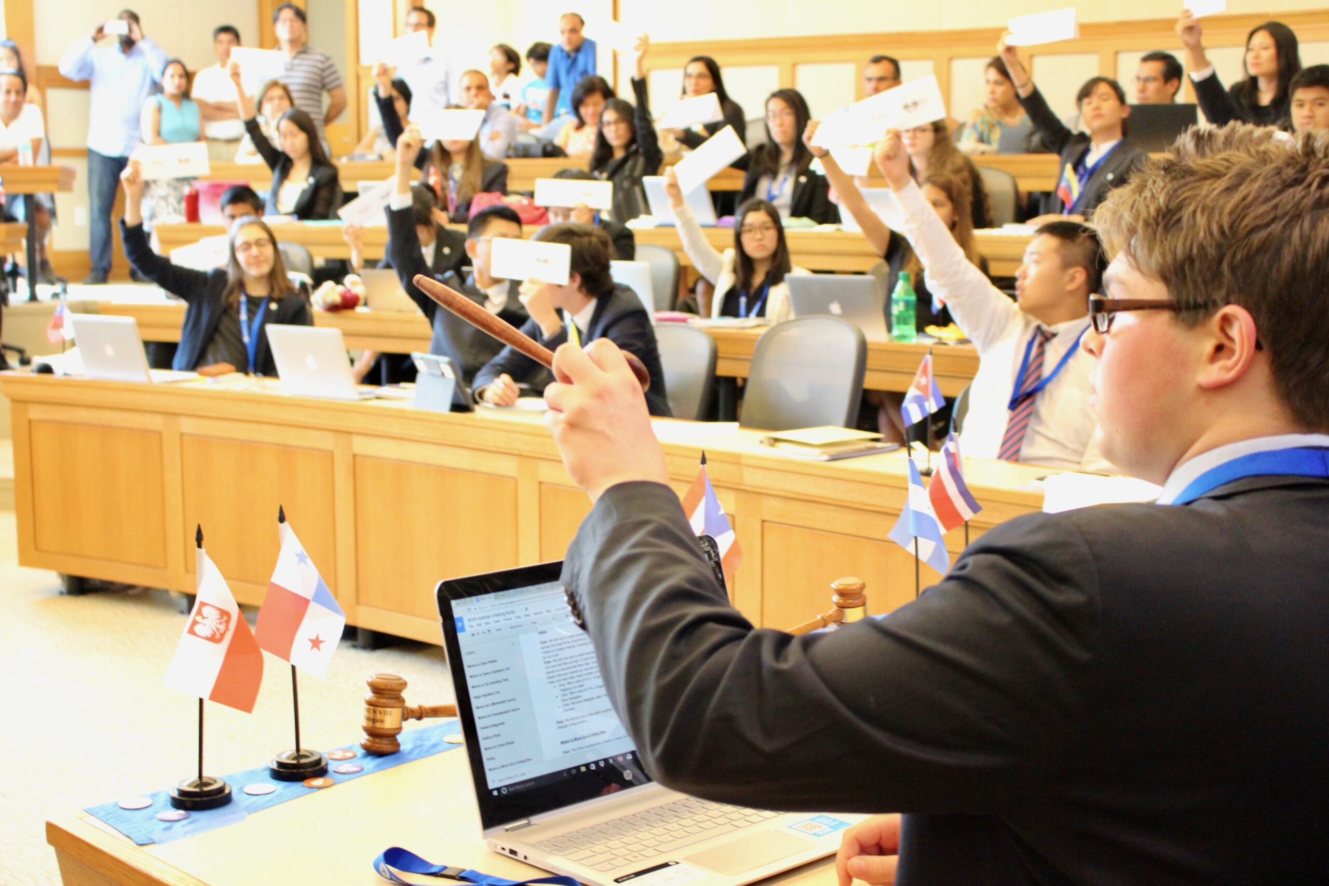
What does an MUN conference look like

Slide 7
Objective of MUN
The Aims of an MUN conference are to encourage debate and sharing of views between students from different schools and of different ethnicities. The Ultimate goal of an MUN Conference is to promote awareness of international relations and issues in young people, and to inspire global mindedness and an understanding to the problems of the world and how to combat them, whilst providing an atmosphere where students can progress in their personality, communication skills and open mindedness.

Slide 8
What is Position paper
In any MUN committee, there's a problem that you’re meant to solve - a Position Paper is an essay that presents your delegation's assessment of the situation and how to fix it.
A Position Paper is meant to accomplish two key goals:
1. Summarize the relevant aspects of your topic
2. Introduce your solutions
Your paper should highlight how the topic is relevant to your delegation, your proposed solutions and why they're best.

Slide 9
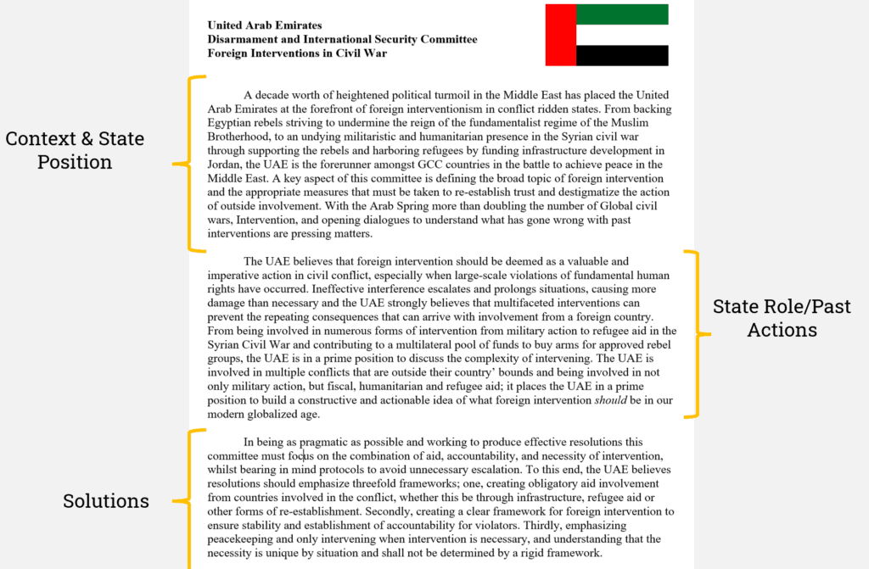
Position paper in mun

Slide 10
What happens in mun
Roll call
General Speakers List
Moderated Caucus
Unmoderated Caucus
Draft resolution
Voting on resolution

Slide 11
Roll call
Roll call voted upon in the United Nations. It includes votes of the General Assembly, five additional special sessions and selected committees. Announce each country's name and receive an answer of "Present or "Present and Voting

Slide 12
General Speaker list
A General Speakers' List (GSL) is the backbone of committee sessions. Speakers on the list, when granted permission by the chairperson, can express their views on the topic in discussion. The list will run throughout the committee sessions until it is exhausted or a motion to close the debate is passed.

Slide 13
Moderated caucus
In Model UN, we discuss topics with the aim of solving issues. Moderated caucuses give us a structured way of discussing solutions to the issue at hand:
- FOCUSED TOPIC; The topic for the moderated caucus is narrow and focused, making conversation more productive.
- TIME LIMITS; Each person is given a specific amount of time to speak, and the discussion has a set time limit.
- POTENTIAL TO EXTEND DISCUSSION; You can motion to extend the moderated caucus if you think more discussion should occur on the topic.

Slide 14
unmoderated caucus
Informal discussions without individual speaking time limits where you can meet with other delegates who may have ideas that align with yours and discuss possible solutions to the issues. As the conference progresses, you can use this time to write working papers and draft resolutions. Ex. Say you've just finished a series of mod caucuses that have sparked some ideas. You're hoping to now chat with other delegates to get the ball rolling on writing a working paper with potential solutions. You can propose an unmoderated caucus and get time to walk around the room, meet other delegates, form blocs with delegates who have a similar stance as you, and jot down thoughts together.

Slide 15
The RESOLUTION
The delegates:
-come together to write a resolution, which reflects each country's interests.
- vote on the resolution and the amendments (changes) -produce a final resolution, which most delegations agree on.

Slide 16
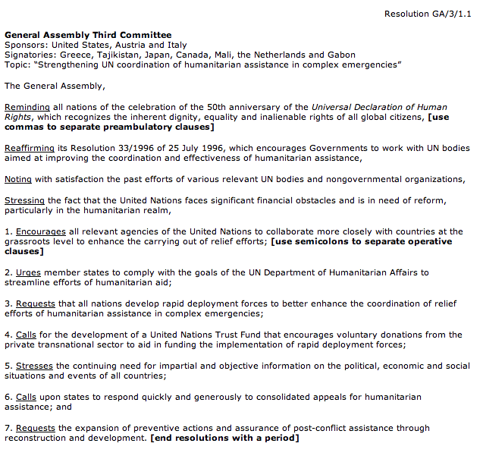

Slide 17
Points and motion
Motion/points | Debate Required/ Allowed? | Decision
Point of Order | Not Allowed | Chair
Motion to Reply (in written form) | Not Allowed | Chair
Point of Information | Not Allowed | Chair
Point of Inquiry | Not Allowed | Chair
Point of Personal Privilege | Not Allowed | Chair

Slide 18
Format of general speaker list
With the prior permission of dias the delegate of _________ would like to speak on the agenda ________ with the total time period __ and each delegate getting ___ minute of time period.
Format to raise any motion
The delegate of_______ would like to raise a motion to start _______ with the total time period _______ and each delegate getting ____ minute of time period.

Slide 19
THANKS!
Any questions?

