Slide 1

Voice-Based Early Detection of Parkinson’s Disease Using Machine Learning
A Non-Invasive Speech Analysis Framework for Early Screening
Presented by:
Goldi Kumari(2200429)
Guneet Kaur(2200430)
Gurkamalpreet Kaur(2200431)
Gurpreet Kaur(2200433)
Department of Computer Science & Engineering

Slide 2
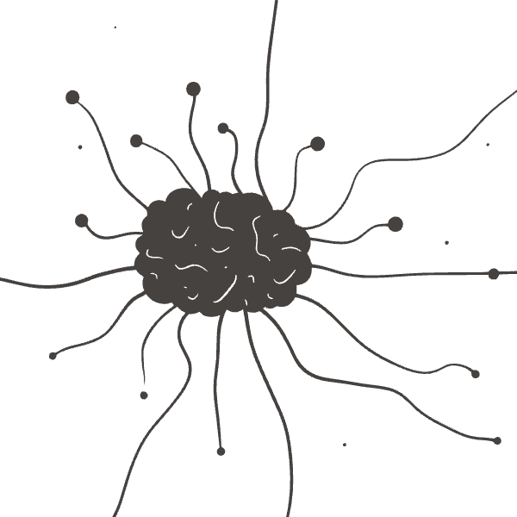
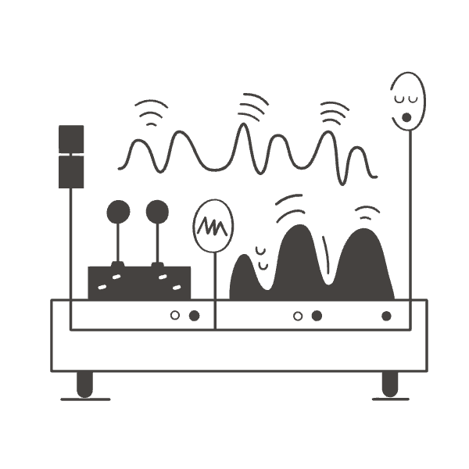
The Urgent Need for Early Detection in Parkinson's Disease
Parkinson's Disease (PD) is a progressive and irreversible neurodegenerative disorder that profoundly impacts quality of life. Current diagnostic methods often rely on the appearance of motor symptoms, which manifest only after significant neural damage has occurred, making early intervention challenging.
Early diagnosis is clinically difficult and existing methods are frequently invasive or costly, limiting their widespread application. This creates a critical gap in care, as delaying diagnosis can mean missing crucial windows for therapeutic interventions that could slow disease progression or manage symptoms more effectively.
Our motivation stems from the observation that speech impairment appears early in the disease course, often before motor symptoms. Speech analysis offers a unique opportunity: it is non-invasive, easy to record remotely, and cost-effective, paving the way for accessible early screening tools.

Slide 3






Project Objectives: Pioneering a Hybrid Feature-Based Framework
Deep Dive into PD & Speech
Extract Handcrafted Acoustic Features
Conduct an in-depth study of Parkinson’s Disease mechanisms and the specific characteristics of speech impairment associated with its onset and progression.
Develop and apply methods for extracting traditional, interpretable acoustic features from speech signals, capturing nuances related to PD.
Generate Deep Speech Embeddings
Comparative Analysis: ML vs. Deep Learning
Utilize state-of-the-art transformer models, specifically WavLM, to generate contextual and rich deep speech embeddings that capture complex vocal patterns.
Systematically compare the performance of classical machine learning algorithms against deep learning approaches for PD detection using speech data.
Propose Hybrid Feature Framework
Evaluate Early Screening Feasibility
Design and implement a novel hybrid framework that intelligently combines both handcrafted acoustic features and deep speech embeddings for enhanced diagnostic accuracy.
Assess the practical applicability and effectiveness of the proposed framework as a non-invasive tool for the early screening of Parkinson's Disease.

Slide 4

Leveraging Public Benchmarks: Our Dataset Foundation
Key Datasets Utilized:
Dataset Characteristics:
UCI Parkinson’s Dataset: A widely recognized dataset containing vocal measurements from individuals with and without PD.
Short .wav Recordings: Comprising brief audio samples, optimized for efficient processing and analysis.
Two Primary Classes:
Figshare Voice Dataset: Another valuable public resource providing diverse voice recordings for research purposes.
Recordings from confirmed Parkinson's Disease patients
Recordings from healthy controls for comparative analysis
These datasets are instrumental for academic and research validation due to their established presence and accessibility within the scientific community.
The binary classification nature of these datasets provides a clear target for our machine learning models, enabling robust evaluation of PD detection capabilities.

Slide 5
Unlocking Vocal Secrets: Speech Feature Extraction
Handcrafted Acoustic Features
Deep Speech Embeddings
These are traditional, expert-designed features that capture specific acoustic properties known to be affected by PD, offering interpretability.
Generated by powerful deep learning models, these features capture complex, high-level contextual information from raw audio, often surpassing the capacity of handcrafted features.
MFCC (Mel-Frequency Cepstral Coefficients): Represents the short-term power spectrum of a sound.
WavLM Transformer: A state-of-the-art self-supervised pre-trained model designed to learn rich representations from speech audio.
LPC (Linear Predictive Coding): Estimates formants, crucial for vowel production analysis.
Contextual Speech Embeddings: Unlike static features, WavLM embeddings capture dynamic acoustic patterns and semantic information, providing a more comprehensive representation of the speech signal.
Jitter & Shimmer: Measures of vocal pitch and amplitude perturbation, direct indicators of vocal cord instability.
LAR (Log Area Ratio): Reflects the vocal tract shape during speech production.
Prosodic Features: Analyze rhythm, stress, and intonation, which are often affected in dysarthria.

Slide 6
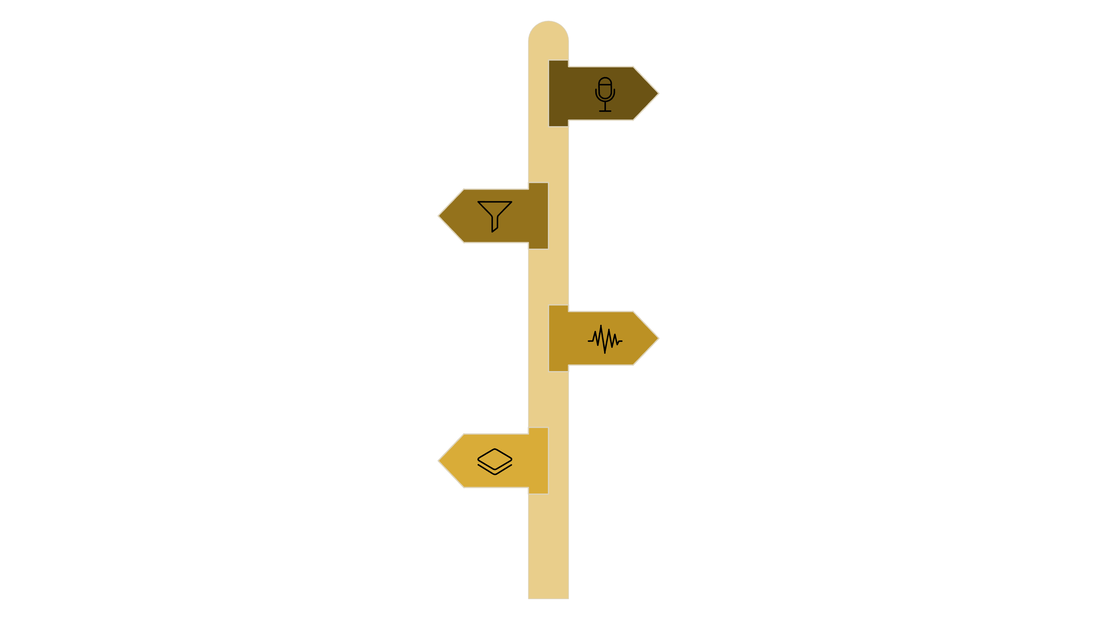




Our Diagnostic Pathway: Proposed Methodology
Speech Input
Recordings in .wav format from patient speech tasks.
Preprocessing
Noise reduction, normalization, and segmentation of recordings.
Feature Extraction
Handcrafted features and WavLM embeddings computed in parallel.
Feature Fusion
Combine handcrafted and embedding features into a single vector.
This flowchart illustrates our comprehensive approach to Parkinson's Disease detection. Raw speech input undergoes rigorous preprocessing, after which it branches into two distinct feature extraction pathways: traditional handcrafted features and advanced deep learning embeddings from WavLM. These features are then intelligently fused and subjected to dimensionality reduction via PCA before being fed into various Machine Learning models for final prediction. This integrated methodology aims to leverage the strengths of both classical and modern techniques for robust and accurate detection.

Slide 7




Intelligent Analysis: Machine Learning Models Employed
Random Forest
Support Vector Machine (SVM)
An ensemble learning method operating by constructing a multitude of decision trees. It excels in handling complex datasets and reducing overfitting, providing robust predictions.
A powerful supervised learning model used for classification and regression tasks. SVM works by finding an optimal hyperplane that best separates data points into different classes.
XGBoost
PCA for Dimensionality Reduction
An optimized distributed gradient boosting library designed for speed and performance. It's highly effective in various predictive modeling tasks due to its efficiency and flexibility.
Principal Component Analysis (PCA) is employed to transform high-dimensional data into a lower-dimensional representation while retaining most of its variance, mitigating the curse of dimensionality.
We conducted a thorough comparison of these models across three feature sets: exclusively handcrafted features, deep embeddings from WavLM, and a hybrid combination of both, to identify the most effective approach for PD detection.

Slide 8
Key Findings: Results and Observations
Diagnostic Relevance of Speech
Classical ML Effectiveness
WavLM's Role
Classical machine learning models like Random Forest and SVM proved effective in learning discriminative patterns from the extracted speech features, achieving commendable performance metrics.
While WavLM embeddings alone showed moderate performance, they captured intricate contextual information, suggesting their value as a component within a more comprehensive system.
Our analysis consistently demonstrated that speech features, both handcrafted and deep, hold significant diagnostic relevance for distinguishing between PD patients and healthy controls. This reinforces the potential of voice as a non-invasive biomarker.
Hybrid Feature Enhancement
PCA for Optimization
The integration of both handcrafted and deep features into a hybrid model significantly improved detection. This approach enhanced robustness, stability, and interpretability of the predictions.
Principal Component Analysis (PCA) successfully reduced feature dimensionality, which not only streamlined model training but also effectively mitigated the risk of overfitting, leading to more generalizable models.

Slide 9





Tangible Outcomes: Achievements & Deployment Potential
End-to-End ML Pipeline
Successfully constructed a complete machine learning pipeline, from data ingestion and feature extraction to model training and prediction, ready for operational use.
Validated Speech as Non-Invasive Biomarker
Empirically validated the efficacy of speech characteristics as a non-invasive biomarker for the early detection of Parkinson's Disease, supporting its clinical utility.
Comparative Model Analysis
Performed a rigorous comparison between classical machine learning and deep learning models, providing insights into their respective strengths and weaknesses in this application.
Proposed Hybrid Framework
Introduced and demonstrated the effectiveness of a novel hybrid feature-based framework, which combines the best of both traditional and deep learning approaches.
Streamlit-Based Prototype
Developed a functional and user-friendly prototype using Streamlit, showcasing the model's capabilities in a practical, interactive interface.

Slide 10



Charting the Future: Limitations, Future Work, and Conclusion
Current Limitations
Reliance on a relatively small dataset, potentially limiting generalizability.
Lack of clinical validation with real-world patient cohorts.
Challenges posed by class imbalance in existing datasets.
WavLM model was used without fine-tuning for this specific task.
Future Research Directions
Acquire and leverage larger, more diverse datasets.
Implement fine-tuning strategies for advanced speech transformers.
Conduct rigorous clinical trials to validate the system's efficacy in real-world settings.
Explore integration with mobile and wearable devices for continuous monitoring.
Concluding Thoughts
Speech analysis represents a strong and promising indicator for the early detection of Parkinson's Disease. Our hybrid machine learning approach significantly improves the reliability and robustness of this detection. It is crucial to emphasize that while this framework is highly suitable for early screening to identify at-risk individuals, it is not intended for definitive clinical diagnosis, which requires comprehensive medical evaluation. This work paves the way for accessible and timely intervention strategies.

