Slide 1

Magneti Marelli Enterprise Architect Document Generation System
23-may-2014
Guido Pennella
Senior Senior System/Software Architect
Magneti Marelli SPA

Slide 2
Agenda
Document Generation System Base Architecture
How the system generate documents
Document Generation System Operations
How to use the system, basic introduction
Developing your own plugins - repository & other SW stuff
How to extend the system

Slide 3
Document Generation System Base Architecture
How the documents are generated out of the system

Slide 4
Base Architecture – 1
Magneti Marelli Enterprise Architect Document Generation System is a Windows based application that can generate MS-WORD 2007 or later documents out of Enterprise Architect 8.x or later (or other sources) with DOCX based templates.
Is based on a plug-in architecture, that allows to be extended at will.
The SW per se is build in C#, using Visual Studio 2012 Express edition (i.e.: the free version of Visual Studio) and use freely redistributable XML SDK DLL from Microsoft© to build the documents.

Slide 5
Generating DOCX documents – 1
The core generation function is based on altChunk feature of the Open XML SDK from Microsoft©.
This feature allows to easy merge into a base document (hereafter referred as the template) other documents, mantaining the styles of the template.
So the document to be inserted can have different styles implementations (e.g.: NORMAL can be Arial in the template and Times New Roman in the document to merge, but in the resulting document will be Arial, as into the template).
For a tutorial on how this feature work, see the following link: http://blogs.msdn.com/b/ericwhite/archive/2008/10/27/how-to-use-altchunk-for-document-assembly.aspx

Slide 6
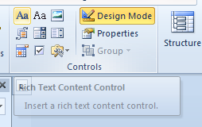
Generating DOCX documents – 2
In order to insert altChunk inside a DOCX, the user shall activate the DEVELOPER feature of MS-OFFICE 2007 (or later).
In the following URL is reported how to do this http://nikpatel.net/2010/04/11/add-content-controls-in-the-word-documents-for-the-open-xml-automation/
Once the DEVELOPER feature is activated, the use can insert into the template document the altChunk via RICH TEXT CONTENT CONTROLS present on the Ribbon.
Rich text content control on the ribbon

Slide 7
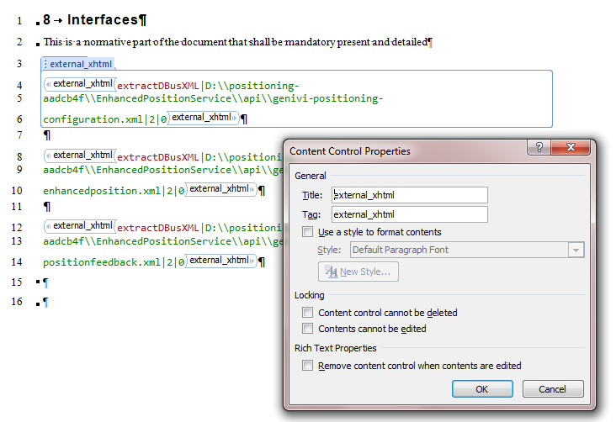
Generating DOCX documents – 3
Note that each control will have also properties, that can be accessed via the classic right click, ad will have a content, that will be turned to the model generation command with the title & tag of the control (see hereafter).

Slide 8
Generating DOCX documents – 4
The Document Generation System de facto will do the following steps:
Scan the Template document to identify the number of altChunks present
For each altChunk, identify the type (see hereafter) and if is necessary, call the proper DLL in order to generate the intermediate file in a temporary directory. Note that to the DLL will be passed the content of the control as a parameter set, together with a set of based parameters (see hereafter).
Take the intermediate file and inject it into the Template.
Thus, on the basis of the above description, is quite clear that we need to have a temporary directory to store the intermediate generation files.

Slide 9
Generating DOCX documents – details
String altChunkId = "AltChunkId" + id;
String filename = block.InnerText.ToString();
AlternativeFormatImportPart chunk = mainPart.AddAlternativeFormatImportPart(
AlternativeFormatImportPartType.WordprocessingML, altChunkId);
using (FileStream fileStream = System.IO.File.Open(filename, FileMode.Open)) chunk.FeedData(fileStream);
AltChunk altChunk = new AltChunk();
altChunk.Id = altChunkId;
OpenXmlElement parent = block.Parent;
parent.InsertAfter(altChunk, block);
block.Remove();
Sample C# code to manage altChunks into a DOCX file

Slide 10
Document Generation System Operations
How to use the system, basic introduction

Slide 11
Installation pre-requisite
The system needs the following:
Windows7 or later
.NET Framework 4.5
Microsoft Word 2007 or later
Enterprise Architect 8 or later (*)
Note that there are no real needs in terms of RAM and HARD DISK size, as the system is quite lightweight. Entry level PC with Windows7 will not have issues
(*) In theory the system can generate documents out of many sources (XML files, but also a generic XMI coming from another tool or a generic database), so EA is listed here only for some ready made plugins

Slide 12
Installation of the SW – 1
The sources of the system are provided with a Nullsoft Scriptable Install System (NSIS) script.
NSIS site: http://nsis.sourceforge.net/Main_Page
The script per se has been generated and managed via HM NIS EDIT: A Free NSIS Editor/IDE
HM NIS EDIT site: http://hmne.sourceforge.net/
In the GIT repository there will be a file, called SETUP.EXE that contains the latest and gratest compiled code, with the automated installation and disinstallation via NSIS.
Thus non developer users can easy download the SETUP.EXE file and install the SW on their PC without the need to manage the full development environment.

Slide 13
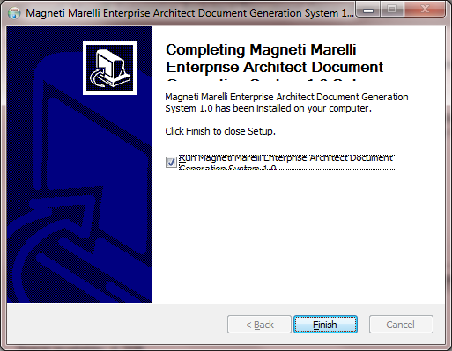
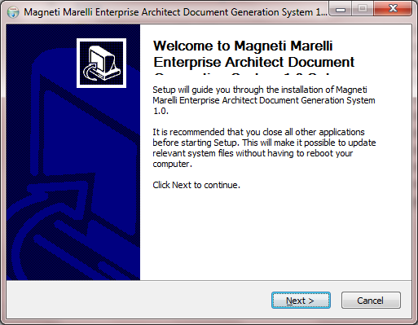
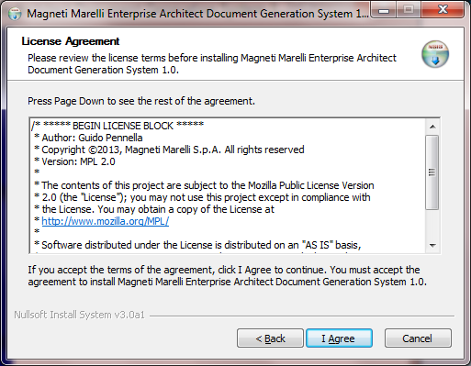
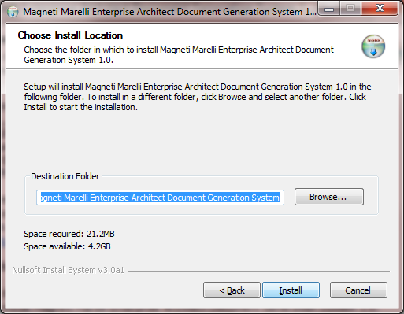
Installation of the SW – 1

Slide 14
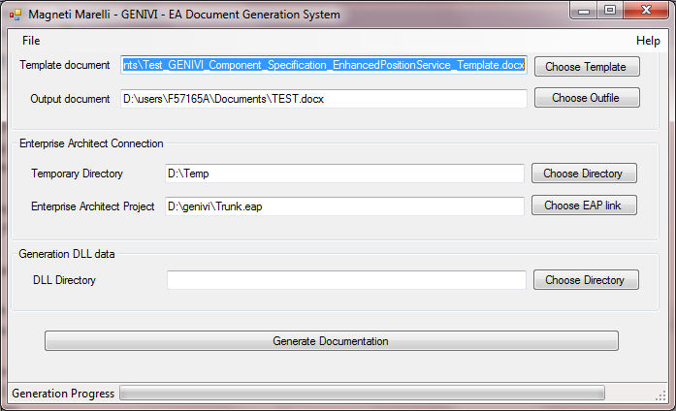
Running the Software – the main window
Menu not active
Menu not active

Slide 15

Running the SW – main window sections / 1
Document section
TEMPLATE DOCUMENT: this field shall contain the DOCX document template, with the full path. In order to choose an existing file, use the CHOOSE TEMPLATE button, that opens the classic Windows File Chooser.
OUTPUT DOCUMENT: this field shall contain the DOCX output document, that will be rewritten with the generation. In order to choose an existing file, use the CHOOSE TEMPLATE button, that opens the classic Windows File Chooser.

Slide 16
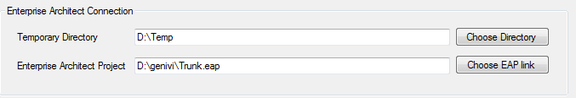
Running the SW – main window sections / 2
Enterprise Architect Connection
TEMPORARY DIRECTORY: this field shall contain the temporary directory where the tool will generate intermediate files to be injected into the template. The CHOOSE DIRECTORY button activate a classic Windows Directory Chooser dialog.
ENTEPRISE ARCHITCT PROJECT: this field shall contain the EAP file (even if EA is installed on a remote server the user can generate a EAP link file – see EA documentation) of the project we need to extract data. Via the CHOOSE EAP LINK the user can select the EAP file via a classic Windows File Chooser dialog

Slide 17

Running the SW – main window sections / 3
Generation DLL data
DLL DIRECTORY: if this field is left empty, the SW will look for the generation plugins DLL only into the installation directory. If contains a directory (chosen via the CHOOSE DIRECTORY dialog activated via the button on the side) the SW will load the DLL from that directory. So, if unsure, just leave it empty.

Slide 18
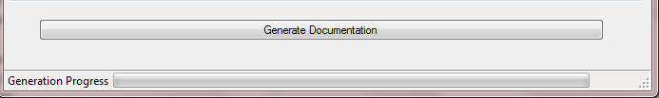
Running the SW – main window sections / 4
GENERATE DOCUMENTATION button: as the title suggest, this button activate the generation of the document, as described in the previous section.
GENERATION PROGRESS: simple progress bar, based on the number of controls found in the template.

Slide 19

Generation elements into the template
When the DEVELOPER feature has been activated, in order to place a generation element, just place the cursor where the element shall be placed and click on the RICH TEXT CONTENT CONTROL on the DEVELOPER ribbon.
This will insert an empty control at the cursor place, such as the one depicted hereafter
Generation elements are a mix of PROPERTIES of the above control and CONTENT of the control itself (CONTENT placed in «CLICK HERE TO ENTER TEXT»).

Slide 20
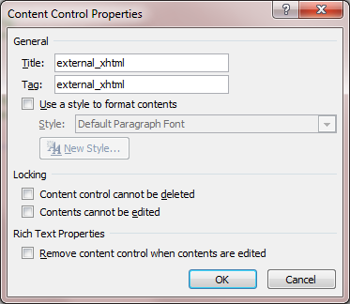
Title & TAG on the properties dialog
Note that the TITLE & TAG on the PROPERTIES of the control shall be equal and set on the basis of the generation plugins (see hereafter).
For the remaining part of the PROPERTIES, leave them empty, as in the example here aside.

Slide 21
Simple base generators: file injection – 1
The basic set of generators allows to insert existing files into the template.
Base files can be in RTF, DOCX and XHTML format.
Note: TITLE/TAG is CASE SENSITIVE (use always lowercase !)
Title/TAG value | Content value | Result
local | Full path of the DOCX file | Inject a DOCX file into the template
local_rtf | Full path of the RTF file | Inject a RTF file into the template
local_xhtml | Full path of the XHTML file | Inject a XHTML file into the template

Slide 22
Simple base generators: file injection – 2
These base generators are useful for inserting into the document common projects parts, such as
A general introduction of the project (or subproject) common to a set of documents.
A general licence for the document itself
Moreover, these can be useful to inject documents generated somehow by other means, such as part of a DOXYGEN documentation or other document generation systems.
Remember that the styles of the imported document will be translated into the styles of the template.
Note: these are hardcoded into the system, as such feature can be always necessary.

Slide 23
Plugin generators that create a XHTML intermediate file – 1
The first of the two advanced generators, based on a plugin architecure are those that generates a XHML intermediate file.
For these, the TITLE/TAG shall be set to external_xhml value.
The CONTENT section of the control shall have a set of | (pipe) separated values that represent the fields of the function, where:
The first field is the name of the function to be activated. This function shall be placed into a DLL whose name shall be eadgsPlugin_extract<function name>. E.g. the extractSingleReq function shall be placed into a eadgsPlugin_extractSingleReq.dll
The other fiels are parameters to this function, that will be passed to it (see into the customization section the real parameter set).

Slide 24

Plugin generators that create a XHTML intermediate file – 2
extractSingleReq Function
As the name suggest, this function allows to extract a single requirement out of the model.
This function has the following parameters:
The package in which the requirement has been placed. This is a path with the various packages separated by a dot, starting from the model root. So if the requirement is into the package PKG2 that is in turn into PGK1 and the latter is connected with the root, the parameter value shall be set to PKG1.PKG2.
The requirement alias. As into GENIVI model the requirement ID has been placed into the ALIAS field, the user shall specify the ID via this parameter.
Output format. This parameter is a flag (values 0 or 1) and allows to specify if the output shall be a table with 2 rows (in case 1 is chosen) or with only a single row (when 0 is chosen).

Slide 25

Plugin generators that create a XHTML intermediate file – 3
extractReqList Function
This function is similar to the previous one, except that extract all requirements in a package, recursively (option, see hereafter)
This function has the following parameters:
The package in which the requirement(s) has been placed. See the previous slide
Output format. Also for this see the previous slide
Recursive flag. This parameter indicates via true/false (1 or 0) if the extraction function shall perform a recursive extraction of the requirements with respect to the package tree

Slide 26
Plugin generators that create a XHTML intermediate file – 4
extractDBusXML Function
This function generate a documentation out of XML files that describe a DBus interface.
This function has the following parameters:
Full path of the xml file. Note that in Windows use \\ as the directory separator, as in the image hereafter.
Base header. This parameter indicates numerically the base title level to be generated by the engine (as the information will be placed under a «title» of the desided level).
Future parameter. This parameter currenlty does not have a meaning. Is just there for future updates.

Slide 27
Plugin generator that create a DOCX intermediate file – 1
The function of this plugin is similar to the previous ones: the difference relies in the fact that the plugin generate a MS WORD file as intermediate file.
Note that this plugin relies on MS WORD libraries, that are not shipped with the system (but the presence of MS WORD is in the pre-requisite …).

Slide 28

Plugin generator that create a DOCX intermediate file – 2
extractImageByName Function
This function extract a diagram from Enterprise Architect and inject it into the document.
It use a DOCX as intermediate file as it will also generate a caption of the image based on the title of the diagram or (if present) of the note on the diagram.
This function has the following parameters:
The package in which the diagram resides. See the previous slides
The name of the diagram

Slide 29
Developing your own plugins - repository & other SW stuff
How to extend the system by your own

Slide 30
Development Installation pre-requisite
The SW has been developed via the MS VISUAL STUDIO EXPRESS 2012 Desktop Edition (Version 11.x) with C#, but in theory, the user can build its own C# based DLL also with other versions of the Microsoft© IDE.
Nevertheless, the use of the same version is strongly suggested
The development environment shall be Windows7 or later
As the repository is under GENIVI GIT, a client such as TortoiseGIT is needed to perform checkin/checkout.

Slide 31


C# DLL Project characteristics – 1
The C# DLL project shall have the following main characteristics:
Name: the project (and the DLL) shall be named eadgsPlugin_extract<name>, as the engine load DLL on a name base.
References: the project shall use the eadgsPlugin_Utilies
eadgsLoadable class: the project shall have a class named
eadgsLoadable and inside it the user shall have a method called with the name of the function. This method shall have only a single input parameter that shall be a String and return a boolean. See the following slide for an example

Slide 32
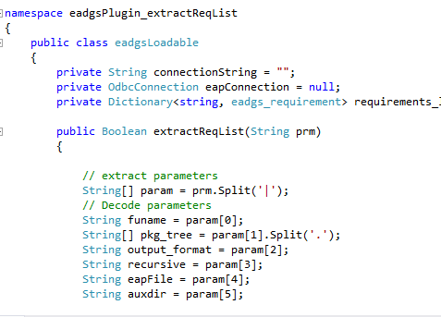
C# DLL Project characteristics – 2
Example: extractReqList plugin
Namespace with the same name of the project
Class called eadgsLoadable
A public boolean method called with the same name of the extraction function that take a String input. The String has the parameter separated via | character

Slide 33
Main method parameters
The main method acquire the parameters via a String that is a list of | separated values.
In order to acquire the real parameters the user shall use a SPLIT(‘|’) function applied to the string, so that turn the string to an array and then assign the array elements to internal variables.
De facto to the method is passed the content of the control, plus 2 parameters that comes from the GUI: the EAP file with full path and temporary directory path.
Thus the method is the entry point for the generation plugin

Slide 34
Main method task
On the basis of which we have seen, the main method shall build either a DOCX or an XHTML file into the temporary directory.
The name of the output file is based on the passed parameters with the following rule (code) for XHTML (same for DOCX …)
String filename = auxdir + "\\" + funame + ".xhtml";
Where:
AUXDIR: this is the last parameter passed to the method (see the example)
FUNAME: this is the first parameter passed to the method (see the example)

Slide 35
XHTML output string
In case of XHTML the classic approach should be to build an output string (see hereafter for some facilities) and dump it to the file with
System.IO.StreamWriter file = new System.IO.StreamWriter(filename);
file.Write(output_to_html);
file.Close();

Slide 36
eadgsPlugin_Utilies DLL
This DLL has some common utilies, listed hereafter for XHTML output:
String html_upper: this public access string contains the head part of XHTML file, up to the <body> element, to be used in the generation of XHTML files. Thus it shall be used in generating such intermediate file.
String html_lower: this is the counter part of the html_upper, as close the body of the XHTML and close the HTML tags itself.
acquirePackageID: this function allows to acquire the package ID of EA starting from the name in dot-separated format. It will return the package ID as a String.
acquirePackageListID: this function return the comma separated list of package ID in a String of the packages child of a main one.

Slide 37
acquirePackageID function parameters
Parameter | Type | Description
index | int | Index used to manage the recursive scan. When called from a DLL this parameter shall be set to 0
pkg_tree | String[] | Dot-separated package tree splitted into a String array (via previous Split('.') method applied to the String)
ret | String | String used to manage the comma separate list to be returned. When called from a DLL this parameter shall be set to «1» as a String
eapConnection | OdbcConnection | ODBC connection reference vs the EAP db

Slide 38
acquirePackageListID function parameters
Parameter | Type | Description
pkgID_list | String | String used for recursive scan. When called from the DLL use a string with the same value of the curPkgID parameter.
curPkgID | String | String that contain the topmost package ID, acquired usually by the acquirePackageID function
eapConnection | OdbcConnection | ODBC connection reference vs the EAP db

Slide 39
End of presentation

