Slide 1
CYBERSECURITY INTERNSHIP
WEEK 4 ASSIGNMENT REPORT Basic Network Setup and Initial Security Testing
Submitted by: Gunn Bhansali
Internship Domain: Cybersecurity

Slide 2
OBJECTIVE AND LAB SETUP:-
Configure a small virtual network using Vmware Workstation.
Use Kali Linux as the attacker machine
Use Ubuntu as the target machine
Connect both machines through a host-only network
Install and verify an Apache web server
Perform Nmap scanning and Wireshark traffic analysis

Slide 3
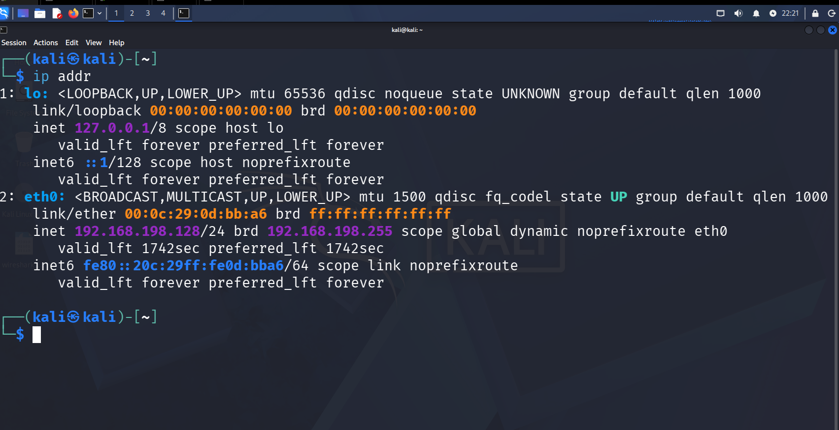
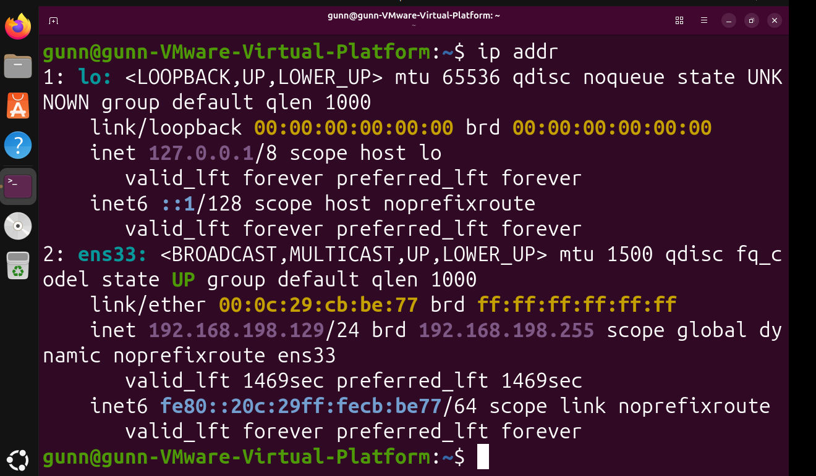
Kali Linux:192.168.198.128
Ubuntu Target: 192.168.198.129
Kali Linux Network configuration
Ubuntu Target Network configuration

Slide 4
Tools Used
VMware Workstation: Created and configured the virtual lab environment.
Kali Linux: Used as the attacker and scanning machine.
Ubuntu Linux: Used as the target machine.
Apache2: Provided the web service on the Ubuntu target.
Nmap: Used to scan open ports and identify running services.
Wireshark: Used to capture and analyze network traffic.

Slide 5
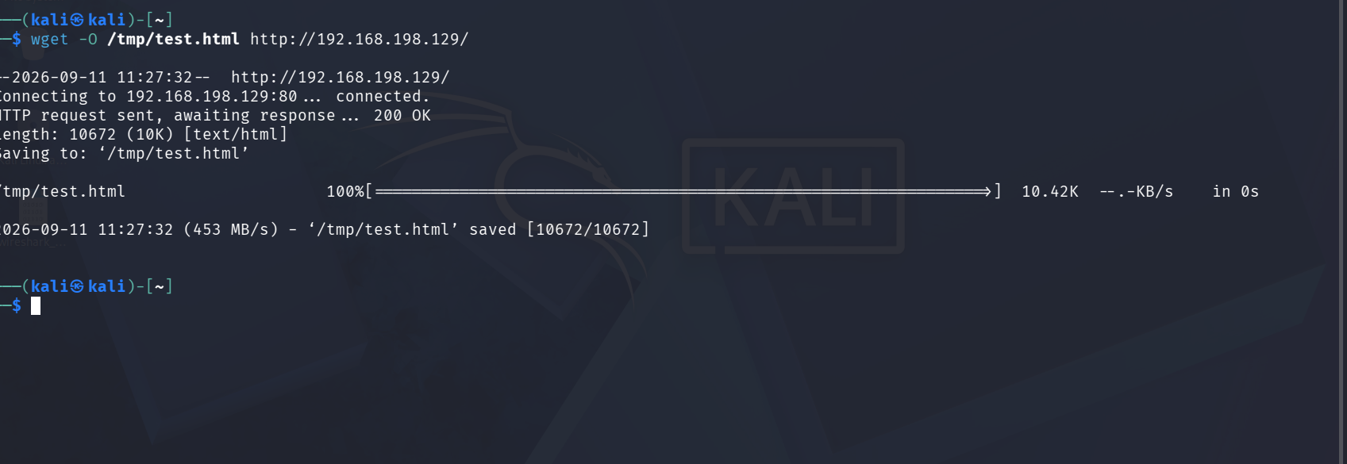
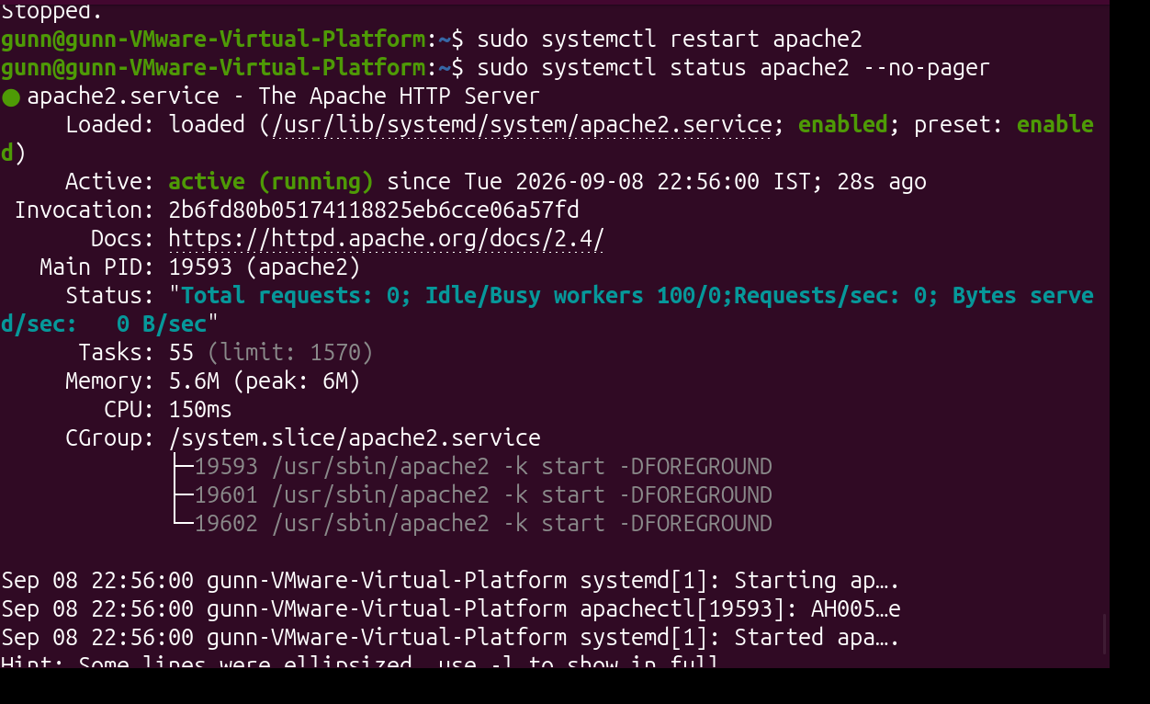
APACHE SERVICE VERIFICATION
Apache2 web server was installed and configured on the Ubuntu target machine. The service was verified to be active and running.
A successful HTTP connection from Kali Linux confirmed that the web server was accessible over the lab network.

Slide 6
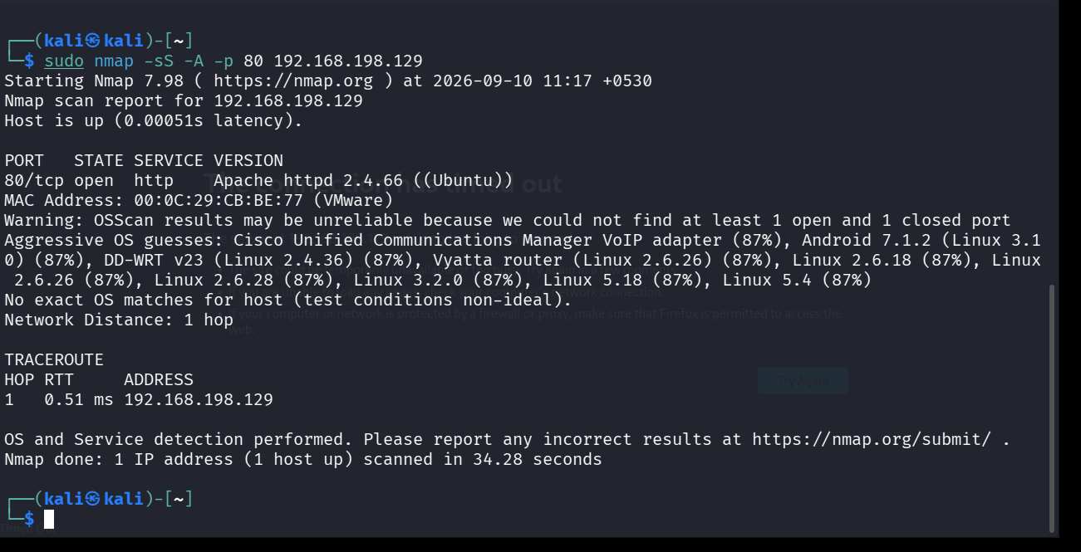
NETWORK SCANNING USING NMAP
Target IP: 192.168.198.129
Scan performed using Nmap service-version detection.
Port 80/tcp was found open.
The running service was identified as HTTP (Apache).
The scan results were saved for submission.

Slide 7
TRAFFIC ANALYSIS USING WIRESHARK
ICMP: Echo Request and Echo Reply packets were captured.
HTTP: HTTP GET request and 200 OK response were observed.
DNS: DNS query packets were captured and analyzed.
Wireshark was used to inspect the captured network traffic.

Slide 8
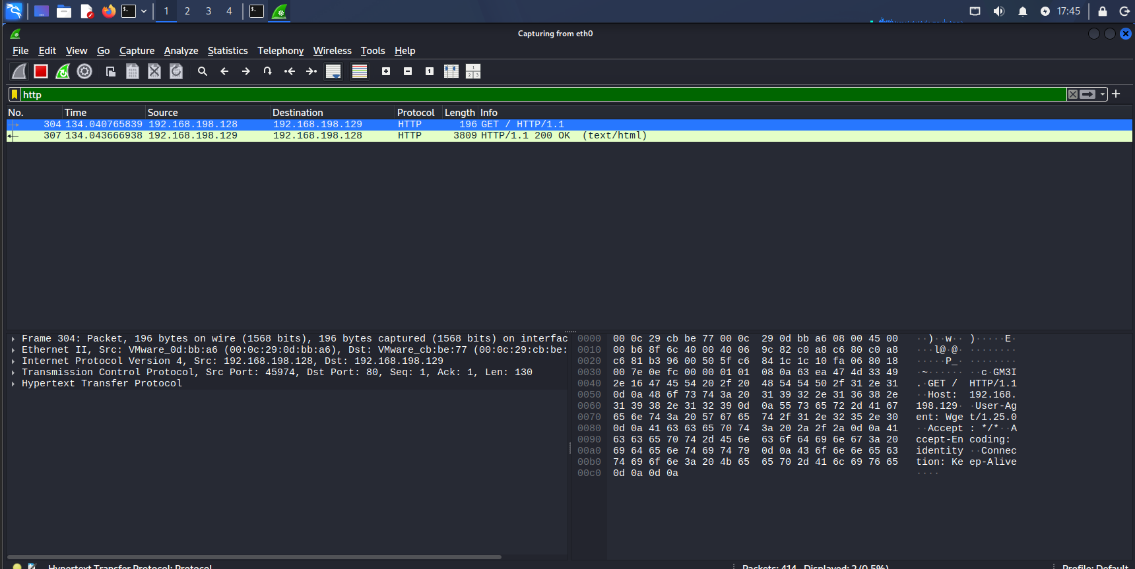
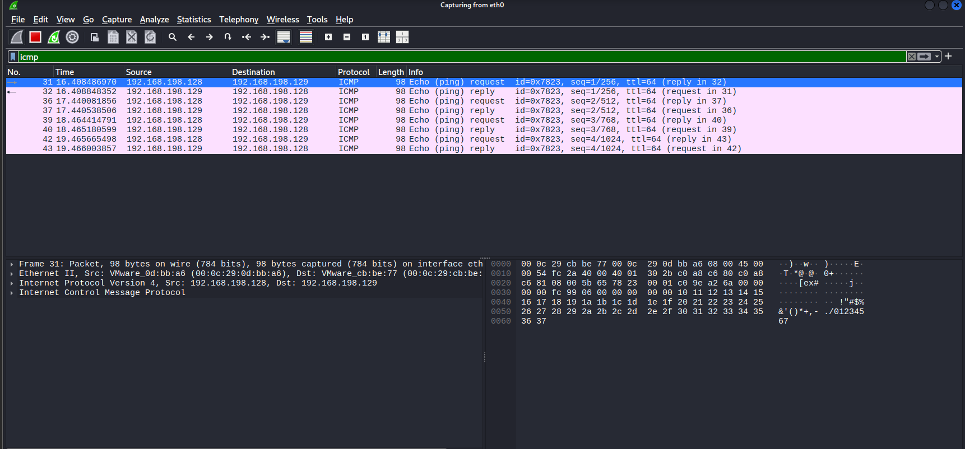
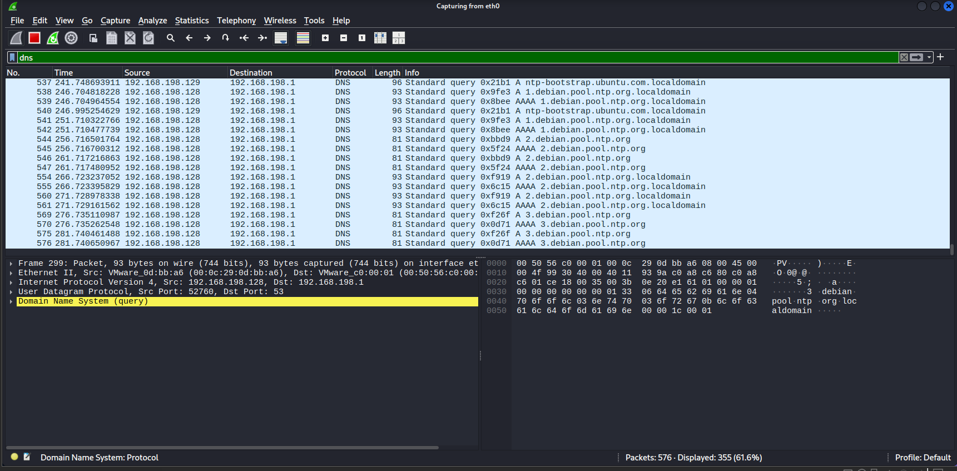
Icmp Traffic capture
Http Traffic capture
Dns Traffic capture

Slide 9
CONCLUSION AND LEARNING OUTCOMES
Successfully configured a basic virtual network using VMware Workstation.
Installed and verified the Apache web server on Ubuntu.
Performed network scanning using Nmap.
Identified open ports and running services on the target.
Captured and analyzed ICMP, HTTP, and DNS traffic using Wireshark.
Gained practical understanding of basic network security testing.

