Slide 1
Tecolutla Field, Contract Area 24 (Veracruz, Mexico)
Technical overview
Prepared for Kinjal - October 2026
Kevin Gunning, P.Eng.
Depths in m subsea (mSS) unless marked mMD; pressures at 2,300 mSS; USD. Sources for every figure are in the speaker notes and the data package.
Notes:
Purpose: a technical walk-through of the field, the 2018-19 programme and the remaining opportunity (TEC-12), with the data behind each statement. Every slide's notes list the questions we expect and the answers.

Slide 2
Tecolutla at a glance
Item | Value | Source
Setting | SE end of the Golden Lane (Faja de Oro) El Abra reef rim, Tampico-Misantla basin; ~60 km ESE of Poza Rica | PEMEX field summary; 2017 evaluation plan
Contract | CNH-R01-L03-A24/2016 licence (Round 1.3, Aug 2016); operator Tonalli Energía; 7.2 km² | contract; CNH
Reservoir | El Abra (Middle Cretaceous) reef-margin grainstone-packstone; top 2,294-2,310 mSS across the wells | well tops, GLJ YE2019 map
Field area / OOIP | 2.5-3.1 km²; 7.8 MMbbl (PEMEX/CNH booked), 11.2 MMbbl (IFR), P50 10.0 MMbbl (IFR 2018 pre-drill 26) | docs/07_volumetrics.md; TM-01 deck
Produced | 1.98 MMbbl to end-2022 (about 20-25 % of OOIP); peak 932 bbl/d (Mar 1972) | docs/04; PEMEX summary
Drive | Strong bottom-water aquifer: ~70 psi decline in 62 years | docs/05_pressure.md
Oil | 26.5-31 °API, 1.6-1.9 % S; GOR ~560-860 scf/bbl; sour gas (H2S 0.7-1.7 mol %) | lab analyses; CNH filings
Wells | 7 PEMEX wells 1956-73 (4 producers); TEC-10DES and TEC-11DES drilled 2018 | well files
Reserves | GLJ YE2025 for Kinjal (100 %): 348 / 903 / 1,383 kbbl, NPV10 BT 2.9 / 8.1 / 12.1 MM USD, none producing; PEMEX 1 Jan 2015: 1P 0.0, 2P 0.0, 3P 0.1 MMbbl | GLJ report 25269; CNH 2015 table
Status | Last production Jan 2023; TEC-10 and TEC-2 shut in, TEC-7 water disposal; TEC-12 approved in the 2022 transition programme, not drilled | GLJ YE2025; CNH filings
Tecolutla field, Contract Area 24 - technical overview, October 2026
2
Notes:
Q: How big is it really?
A: Small: 2.5-3.1 km², OOIP 7.8-11.2 MMbbl, ~2 MMbbl produced. Remaining recoverable 0.3-1.6 MMbbl, most likely ~0.9 MMbbl at the reef-rim trend recovery (docs/07_volumetrics.md).
Q: Who has interests?
A: Tonalli Energía operates the licence; IFR/Petro Frontera and Jaguar (from Aug 2022) are the partners. Confirm current equity before the meeting.

Slide 3
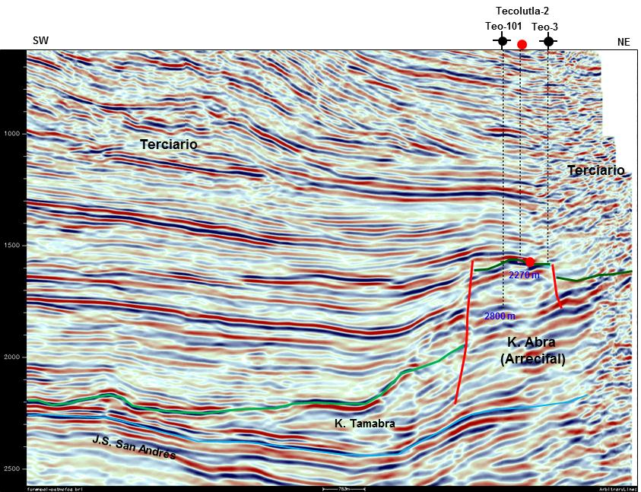
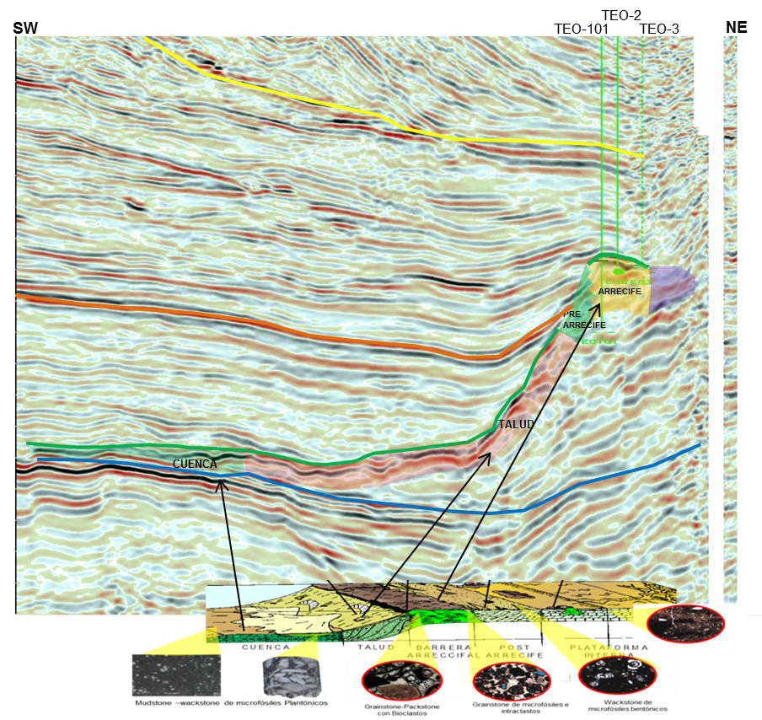
Regional setting: a small high on the Golden Lane reef rim
Golden Lane: an Early-Cretaceous carbonate atoll about 150 × 70 km and 1,200 m thick, rimming the Tuxpan platform; reef facies on the outer edge.
Tecolutla sits at the SE end of the onshore rim, between the Miguel Hidalgo block (NW) and Ignacio Allende (SE); same El Abra play as the giant Golden Lane fields, at a much smaller scale.
End-Albian exposure improved reservoir quality (karst, recrystallisation); Tertiary Tantoyuca rests directly on the El Abra over the crest (unconformity).
Left: PEMEX regional time section across the platform edge. Right: field section with the facies model (basin, slope, reef barrier, back-reef, inner platform).
Analogues: 45 El Abra fields in the CNH table; reef-rim median recovery 31 % (3P EUR); Tecolutla has 2.5 MMbbl/km² against a median 8.3.
Tecolutla field, Contract Area 24 - technical overview, October 2026
3
Notes:
Q: What is the seal and source?
A: No project document names them. Regionally the seal is the Tertiary shale over the unconformity (Tantoyuca/Chicontepec) and the source is Upper Jurassic. Cite as regional literature, not field data.
Q: Why is it so much poorer than the Golden Lane giants?
A: Lower porosity and net-to-gross in the recrystallised miliolid facies (2-11 % porosity, matrix 0.04-1.2 mD on core); it is a small culmination of 10-25 m relief. Volumes are set by porosity and N/G, not area (task 7).

Slide 4
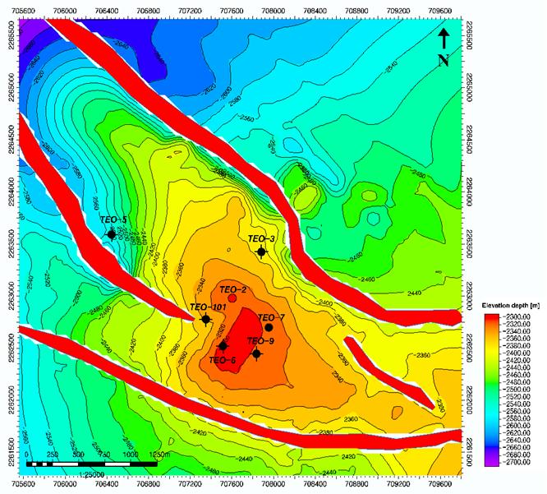
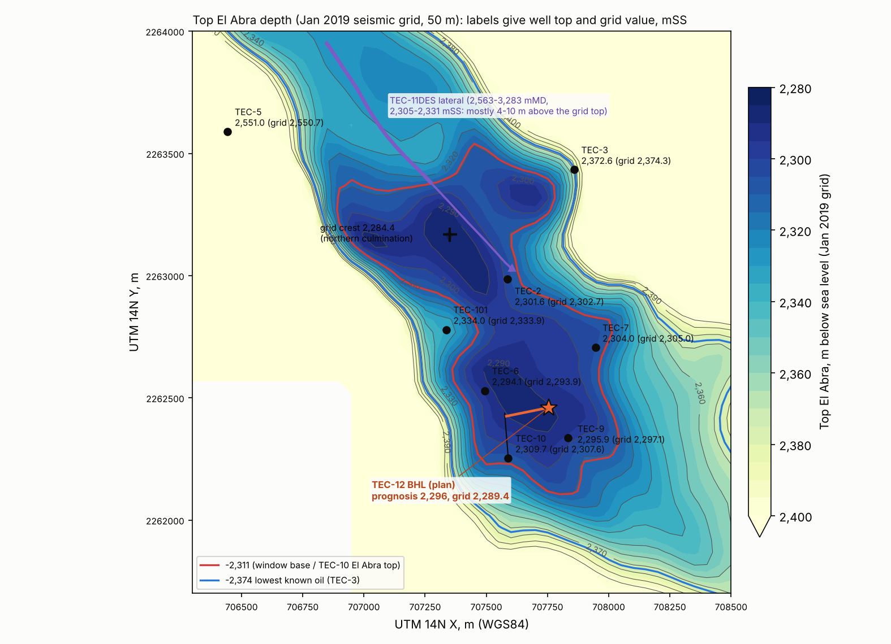
Structure and well locations
NW-SE elongated culmination on the reef rim; normal faults on both flanks parallel to the axis (PEMEX); no faults between TEC-6 and TEC-9 (Petrel Robertson).
Top El Abra (mSS): TEC-6 2,294; TEC-9 2,296; TEC-2 2,302; TEC-7 2,304; TEC-10 2,310 (2,313 on XRD); TEC-101 2,334; TEC-3 2,373.
Jan 2019 depth grid (right, 50 m nodes): ties all eight vertical-well tops within ±2 m; southern high ~2,286 at TEC-6/TEC-12; the -2,374 lowest-known-oil contour closes around the field. Its northern culmination (2,284) is not supported by the PEMEX PSTM (next slide).
Flank wells TEC-3 (NE), TEC-5 (NW) and TEC-101 found the El Abra low and wet; they define the edges.
TEC-12 bottom hole: on the southern high, 118 m from TEC-9; grid -2,289, PSTM-based -2,293, prognosis -2,296 mSS.
Tecolutla field, Contract Area 24 - technical overview, October 2026
4
Notes:
Q: How reliable is the depth map?
A: PEMEX 3D reprocessed by Earth Signal (PSTM, 2017-18) and DMI (PSDM, 2018), interpreted in Petrel and tied to MH-412. The Jan 2019 grid honours all eight vertical-well tops within 2.1 m (data/processed/seismic/el_abra_grid_ties.csv). The PSDM volume (710 MB) and the Petrel project are on the data room drive but have not been opened by us; the gathers, angle stacks and velocity models are not in the data room (G-55). TEC-10 came in a few metres low against prognosis.
Q: What about the northern culmination?
A: It is on the Jan 2019 grid at -2,284 mSS but the PEMEX PSTM puts it 20-40 ms (roughly 30-60 m) below TEC-12; it appears to follow the PSDM reflector, which does not track the El Abra top (G-75, G-79). Not a target until re-mapped.
Q: Where is the oil-water contact?
A: Not one flat number. Original FWL 2,380 mTVDss (2019 operator deck); PEMEX 1956 oil-salt-water ~2,373 and GLJ lowest known oil 2,374.2, both from the TEC-3 DST (980 m of 24 °API oil and 80 m of salt water); a possible current FWL ~2,316 (2019 deck); 'water at 2,350 m' (2017 plan); wet TEC-2 perforations at 2,331-2,345 mSS. Production history shows coning around producers (slide 9).

Slide 5
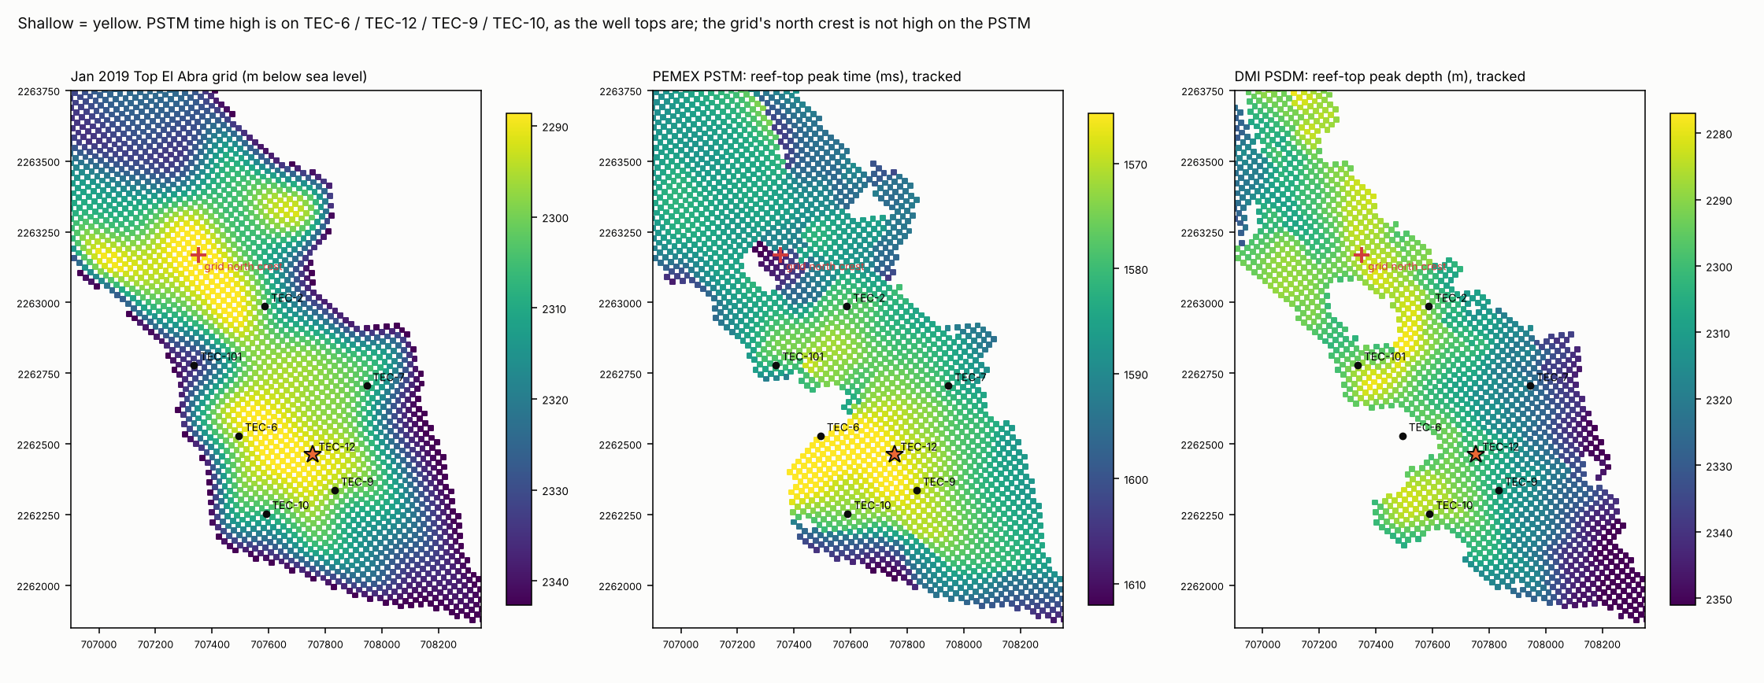
Seismic check: the PEMEX PSTM puts TEC-12 on top of the southern crest
PEMEX PSTM (2011-15 processing, read in full Oct 2026): reef-top time high on TEC-6 / TEC-12 / TEC-9 / TEC-10; TEC-12 earlier than every well except TEC-6; time correlates with the well tops (r = +0.69).
Depth at TEC-12: -2,293 mSS from the crestal wells' velocities (2,928-2,937 m/s; leave-one-out error +-2.5-2.7 m at TEC-6/9/10), between the grid (-2,289) and the prognosis (-2,296): 3 m above TEC-9, 17 m above TEC-10.
DMI PSDM (2018): visually sharper but its reef reflectors are highest in the west, opposite to the tops; it images the top of the carbonate package, not the El Abra top (a marl thickens off the crest). The grid's northern high is not supported by the PSTM.
Tecolutla field, Contract Area 24 - technical overview, October 2026
5
Notes:
Q: So which seismic do you trust?
A: For structure at the El Abra top, the PEMEX PSTM: it ties the wells and needs only a smooth well-velocity field. The PSDM is not wrong as data, but its strongest reflector is not the El Abra top (docs/20_seismic.md, G-79).
Q: Can the seismic tell you whether the window is reservoir?
A: No. Its dominant wavelength is ~67 m; whether El Abra starts at the top of the carbonate package (as at TEC-9) or ~20 m lower (as at TEC-10) is below resolution. That is what TEC-12's logs and test decide.
Q: What is still missing?
A: The Earth Signal PSTM, DMI gathers, angle stacks and velocity model (G-55). The volumes we read are the DMI PSDM stack and the PEMEX PSTM cuts.

Slide 6
Reservoir rock and fluids
Property | Value | Basis
Facies | Recrystallised miliolid grainstone to mudstone-wackestone, 91-100 % calcite; within the El Abra high GR marks porous facies (TEC-9, TEC-2). Overlying Tantoyuca is a silty marl (quartz ~31 %, clay ~9 %) | TEC-10 core, XRD on cuttings; logs; TEC-11 mud log
Porosity | 2-11 %; producing intervals 5-6 % | logs; TEC-10 core plugs 2.3 / 6.7 / 7.6 %
Permeability | Matrix 0.04-1.2 mD (core); 18 mD effective from the TEC-10 build-up | core; IHS 2018 PTA
Fractures | 0-7 open/mixed fractures per metre on the TEC-10 image log | Weatherford CMI 2,296-2,488 mMD
Initial pressure | 252 kg/cm² (24.7 MPa) at ~2,310 m, 1956 | PEMEX drilling report TEC-2
Temperature | ~98-99 °C at reservoir | log headers
Oil | 26.5-31 °API; 1.6-1.9 % S; dead oil 13.2 cP at 26 °C, 3.4 cP at 90 °C (TEC-9 2012); pour point -24 °C | SGS, Intertek, PEMEX lab, settlements
Gas | GOR 560 (1966-92), 762 (2018 test), 859 (2021) scf/bbl; H2S 0.66-1.75 mol %, CO2 ~11 % | lab gas analyses; CNH filings
Water | ~45,000-50,000 ppm (1956 tests); produced-water median 25,000-27,000 ppm (2009-15) | PEMEX tests and samples
Wax | Paraffin deposits in tubing (TEC-2, 2018); handled with periodic solvent clean-ups | Tonalli operations log
PVT | No laboratory PVT study exists; correlations and a PEMEX analogue only | G-31
Tecolutla field, Contract Area 24 - technical overview, October 2026
6
Notes:
Q: Is there a PVT?
A: No measured PVT (bubble point, Rs, Bo). A bottom-hole or recombined sample should be part of TEC-12. GLJ uses GOR 900 scf/bbl; measured 565-860; GLJ's own statistics give 1,265-8,162 (G-31).
Q: Matrix permeability is sub-millidarcy - how does it flow?
A: Through fractures and vugs. The TEC-10 build-up gives 18 mD effective; the image log shows up to 7 fractures/m. That is also why water moves fast along fractures and the wells cone.
Q: H2S handling?
A: Sour service: separator gas 0.7-1.7 mol % H2S. Gas is flared under the evaluation-period approval; H2S detection and SCBA are in the SASISOPA.

Slide 7
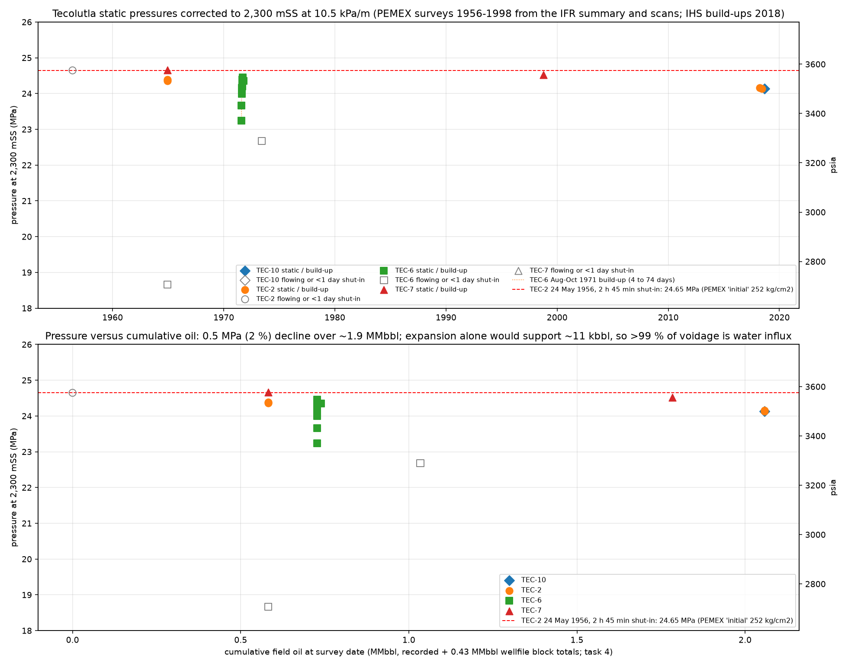
Drive mechanism: a strong bottom-water aquifer
Pressure barely moved. 24.65 MPa (1956) → 24.4-24.7 (1964) → 24.5 (1998) → 24.14-24.16 MPa (2018) at 2,300 mSS: about 0.5 MPa (70 psi) after ~1.9 MMbbl and 62 years.
Transients see it. Both 2018 build-ups needed a constant-pressure boundary to match late time: 195 m from TEC-10, 700 m from TEC-2.
Water behaviour. Every well watered out; PEMEX shut TEC-2 and TEC-7 in 1957-71 'for high salt-water content' and re-perforated higher.
Consequences. Voidage is replaced, so recovery is about sweep and water management, not pressure support. Rate per well is limited by coning, and water handling is the main operating cost.
Implication for new wells. Low drawdown, completion high in the column, and in-field water disposal.
Tecolutla field, Contract Area 24 - technical overview, October 2026
7
Notes:
Q: How confident is the pressure data?
A: 18 PEMEX survey forms were OCR'd and checked against IFR's transcription (15 of 16 agree to the last digit), plus the 2018 Tonalli gradient and two IHS build-ups. All corrected to 2,300 mSS at 10.5 kPa/m (docs/05_pressure.md).
Q: Could it be a gas cap and not an aquifer?
A: No: pressure maintenance with rising water cut in every well is aquifer behaviour. There was a small gas cap at the crest in 1956 (TEC-2 top test, GOR ~6,500 scf/bbl), which is a separate point for TEC-12 (slide 18).

Slide 8
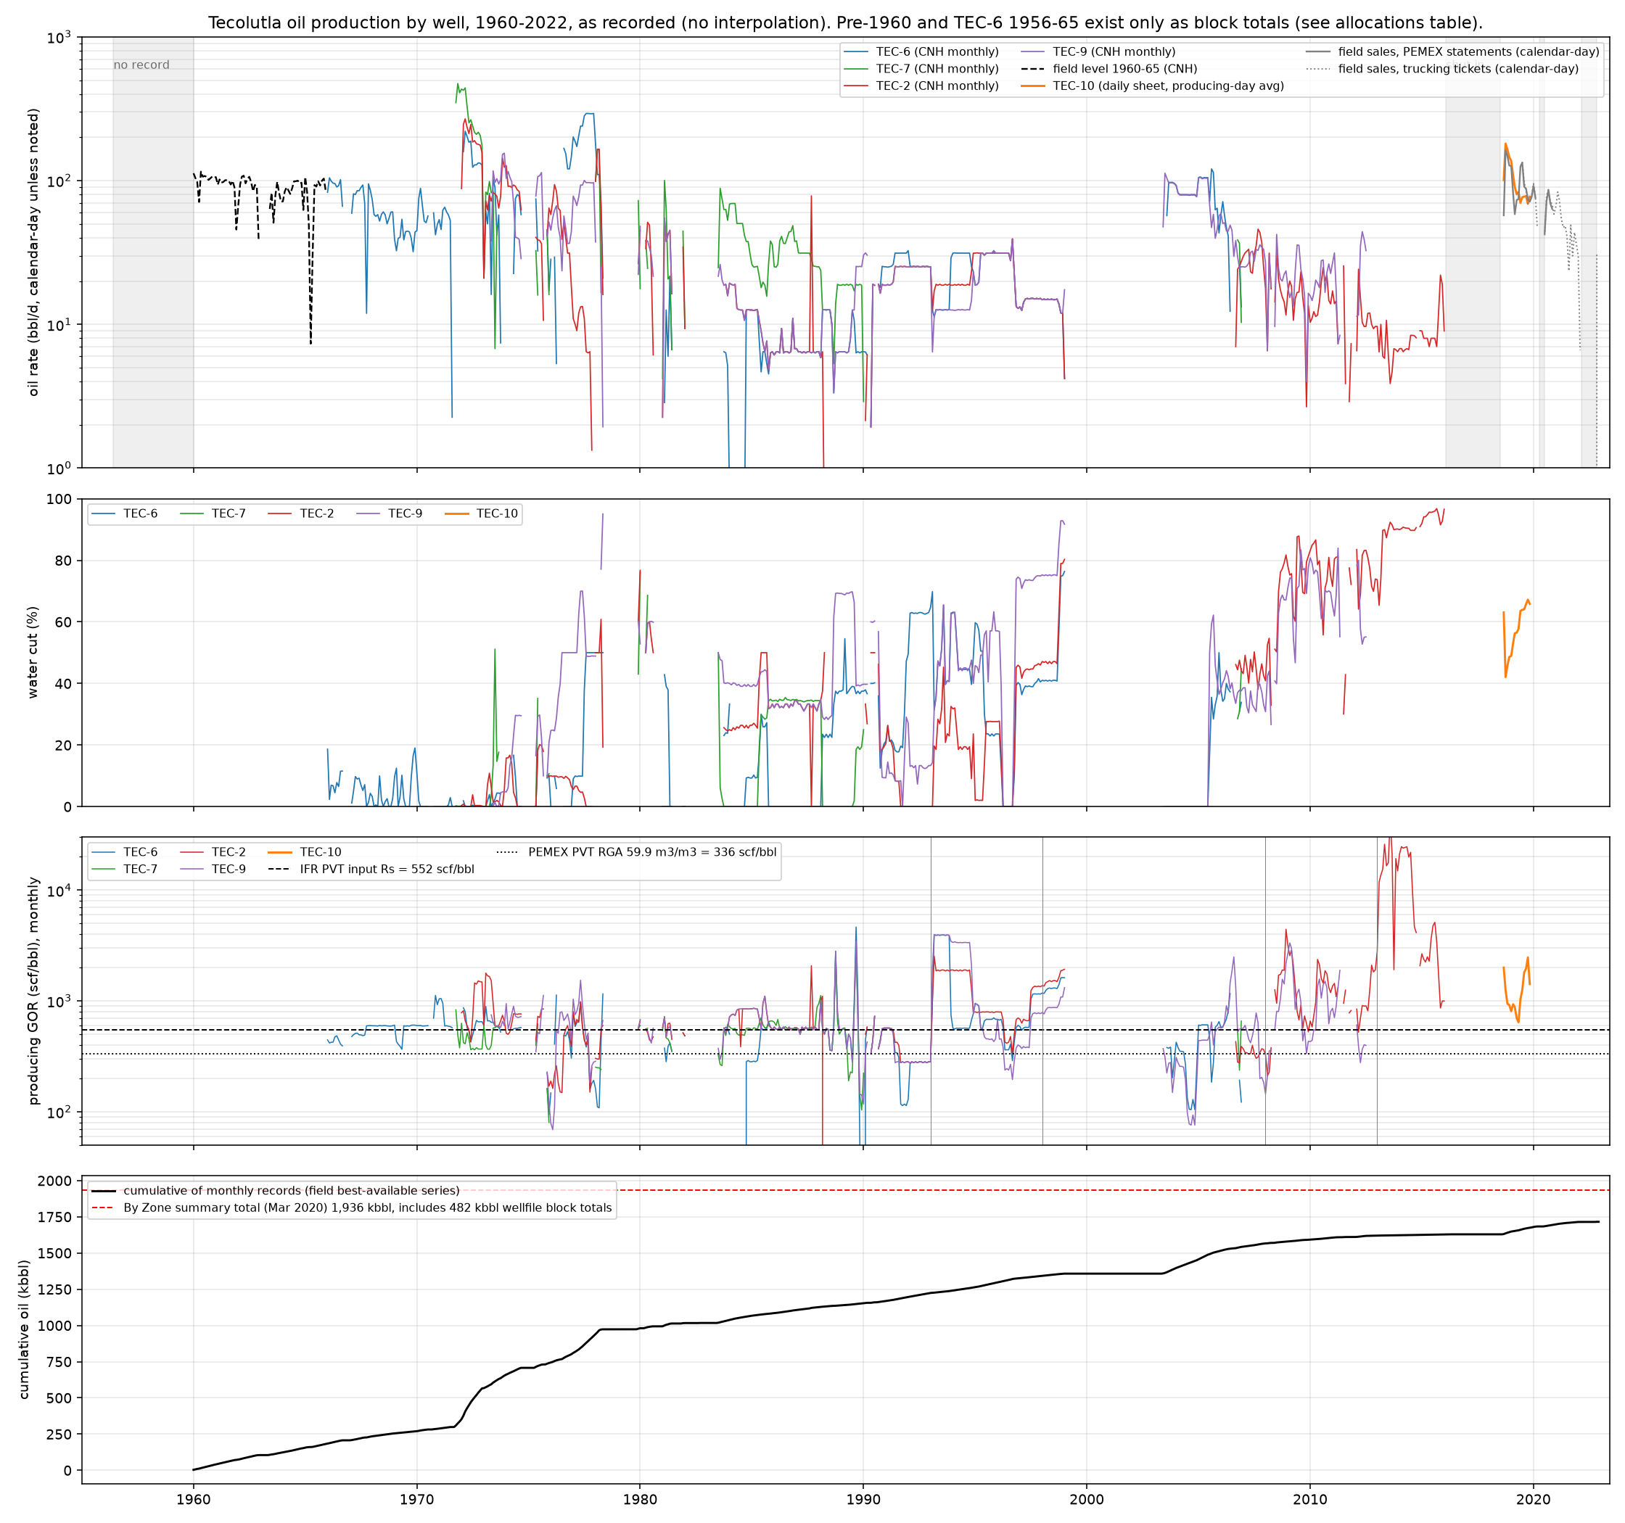
Production history: 1956-2022
1956-1965: four wells flow from the El Abra; TEC-2 and TEC-7 shut in for salt water from 1957, TEC-6 carries the field.
1971-72 workovers re-perforate TEC-2 and TEC-7 higher; field peak 932 bbl/d in March 1972; TEC-9 drilled 1973.
1973-2012: decline with rising water cut; intermittent operation; TEC-9's second life 2003-2012 (a 2012 solvent-acid job took it from 10 to 102 bopd).
2016: PEMEX hands over; 1.9 MMbbl produced; field shut in Feb 2016 - mid 2018.
2018-2022: Tonalli/IFR programme. TEC-10 75.8 kbbl to Dec 2021 (first full month 181 bbl/d); TEC-2 10.0 kbbl since 2018; PEMEX-measured sales 63 kbbl Sep 2018 - Nov 2020.
GOR stable at 400-800 scf/bbl through 1966-92 (cumulative 565); no sign of a gas-cap blow-down.
Tecolutla field, Contract Area 24 - technical overview, October 2026
8
Notes:
Q: Why the gaps in the record?
A: They are reported zero-production months. The original CNH CD tables carry 781 explicit zero rows that fill all 66 gap runs; an intermediate copy had dropped them (G-34 closed). The PEMEX well files give the reasons, e.g. TEC-2/TEC-7 shut in for salt water 1957-71.
Q: What is the Tonalli-era per-well split after 2019?
A: Field sales 2020-22 are commingled tickets (~90 % TEC-10 by the 2021 CNH filing). Per-well CNH formats exist only for Nov 2022 in our package (G-32).

Slide 9
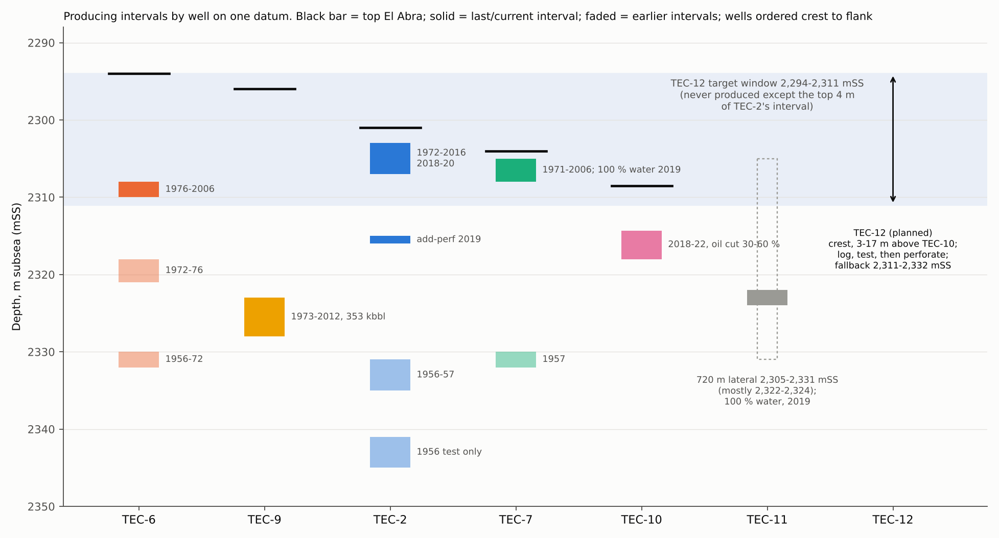
How the field was produced: each well chased the water upward
TEC-6, TEC-2 and TEC-7 each moved 10-25 m up the column as the bottom water arrived (faded bars = earlier intervals).
TEC-9 is the exception: 353 kbbl from one interval 27-32 m below its top El Abra, never re-perforated.
The water did not rise as a flat plane: TEC-10 (2018) found an oil-bearing interval at 2,314-2,318 mSS, 7-11 m below the last TEC-2/TEC-7 intervals, and produced it at 30-60 % oil cut.
Water advances by coning and along fractures around each producer, which leaves oil between and above the old wells.
Under-exploited top of the zone: the crest wells left the top of the El Abra unperforated, 14 m at TEC-6 (2,294-2,308 mSS) and 27 m at TEC-9 (2,296-2,323 mSS). Nothing has produced from 2,294-2,303 mSS anywhere in the field.
Tecolutla field, Contract Area 24 - technical overview, October 2026
9
Notes:
Q: Is the 'oil deeper than last produced' claim fair given TEC-9?
A: Yes against TEC-2 and TEC-7, which were last producing from 2,303-2,308 mSS. TEC-9 produced deeper (2,323-2,328) until 2012. The point is that the oil column is still there between the old producers, not that oil is deeper than anything produced.
Q: TEC-7 tested 100 % water at 2,305-2,308 in 2019 - doesn't that say the top is wet?
A: Tonalli suspected bad cement or a leaking plug giving access to the lower perforations (Sep 2022 review). TEC-2, 1-7 m below its top, still makes oil at 72-90 % water cut. Both are flank-side of the crest.
Q: Sources?
A: docs/09_log_panel.md §3 (one datum); perforations CSV; PEMEX expedientes; Tonalli operations log; GLJ/XS top picks.

Slide 10
IFR/Tonalli programme 2018-2019: what was done and what it showed
Well | Work | Result | What it told us
TEC-10DES (Apr-May 2018) | New J-shape well from a new pad; modern logs (incl. image log), core at 2,352 m, three zones tested | Zone A no inflow; zone B weak water inflow. Zone C 2,314-2,318 mSS: 182 bbl/d oil at 39 % WC, ~880 psi FTP; 75.8 kbbl to Dec 2021 | Oil column intact below the last PEMEX intervals; flowing well
TEC-2 (2018, 2019) | Wellhead repair, clean-out (paraffin); 2019 add-perf 2,315-2,316 mSS and plug over wet deep perfs | 2018: 50 bbl/d oil at 90 % WC; 2019: 47 bbl/d at 75 % WC, ~250 psi; 10.0 kbbl since 2018 | Old wells can be restored; water shut-off pays
TEC-7 (Jun-Aug 2019) | Workover, acid; tested 2,305-2,308 mSS | 182 bbl/d water, no oil | Converted to produced-water disposal (triplex pump, ASEA-authorised)
TEC-11DES (Nov-Dec 2018) | 720 m open-hole horizontal from the TEC-2 pad, aimed at the top of the zone for low drawdown | Lateral at 2,305-2,331 mSS in tight mudstone; open hole lost; five liner perfs 2,643.5-2,745.5 mMD, 286 bbl/d water | Execution failure; the concept is untested (slide 13)
Facilities (2019) | TEC-10 to TEC-2 flowline; separator purchased; in-field disposal | One battery; water trucking ended Aug 2019 | Field opex down by about two-thirds (slide 14)
Tecolutla field, Contract Area 24 - technical overview, October 2026
10
Notes:
Q: Why didn't TEC-10's deeper zones flow?
A: Zone A (2,433-2,442 mMD) gave no inflow after acid; the 2018 injectivity test needed 2,120 psi. Zone B (2,394.5-2,413.5 mMD) gave weak water inflow: 16.9 m³ back against 19.6 m³ injected, inconclusive. Both isolated below a bridge plug at 2,382 m. Zone C had 140 ppm H2S.
Q: What did the programme cost?
A: Drilling to rig release: TEC-10 USD 2.04 MM against a 2.92 MM AFE; TEC-11 USD 3.03 MM against 2.25 MM. All-in tax pools: TEC-10 2.96 MM, TEC-11 3.51 MM (4.40 MM in the cost summary; ~0.96 MM of Workstrings invoices of unknown status, G-64), TEC-2 0.86 MM, TEC-7 0.17 MM.
Q: Sources
A: Activities performed in Tecolutla.xlsx (Tonalli operations log); Tecolutla Discussion with Jaguar, 1 Sep 2022; TEC-10/TEC-11 cost trackers.

Slide 11
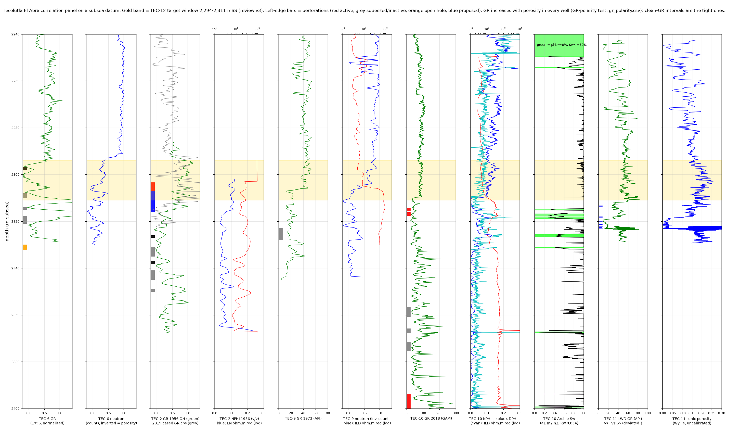
TEC-10DES: confirming the oil column between the old producers
J-shape well from a new pad beside TEC-6, 193 m step-out to the south; top El Abra 2,310 mSS (log), 2,313 mSS on cuttings XRD: TEC-10 is 14-20 m lower than the crest.
Modern suite: triple-combo, dipole sonic, Weatherford CMI image log; 10 m core at 2,352 mMD (grainstone, 2-8 % porosity, Dean-Stark oil 14-59 % PV).
Perforated 2,349.5-2,353 mMD (2,314-2,318 mSS) at the resistivity break (4-5 → 15-50 ohm·m), acidised, flowed.
Test: 182 bbl/d oil, 118 bbl/d water, 146 Mcf/d, ~880 psi flowing (Jul 2018); IHS build-up: k 18 mD, skin +5, aquifer boundary at 195 m.
Production: 181 bbl/d first full month; qi 152 bbl/d, b ≈ 0.5 decline; 75.8 kbbl to Dec 2021, last rate 34 bbl/d at 86 % WC; flowing throughout, kept on with solvent clean-ups.
Above the perforations, 2,294-2,311 mSS is Tantoyuca marl on XRD (quartz 31 %, clay 9 %); IFR's evaluation finds no pay above 2,314 mSS. TEC-10 therefore did not sample the crestal El Abra window that TEC-12 targets.
Tecolutla field, Contract Area 24 - technical overview, October 2026
11
Notes:
Q: Why only 3.5 m perforated?
A: Tonalli perforated the high-resistivity interval directly below the El Abra top; the low-resistivity zone above is the Tantoyuca (XRD, RockWise 2018), not reservoir. IFR's TEC-10 evaluation gives 5.8 m TVD net pay, all at 2,314-2,332 mSS (third-party, parameters unknown).
Q: What was the decline?
A: Hyperbolic fit qi 152 bbl/d, Di 0.79/yr, b ≈ 0.49 on 15 months of daily data plus 2020-22 sales (docs/06_forecast.md).
Q: Why is it shut in?
A: Shut in Feb 2022 (rate and cash), restarted Nov 2022 on TEC-10 alone; last production Jan 2023. GLJ cites an environmental permit; the CNH filings give July 2022 (G-65). GLJ carries it as PDNP with a 15 k$ paraffin workover.
Q: Was 131 bbl/d at 49 % in Sep 2018?
A: No: that rate falls on 19-21 Jan 2019 in the daily data; Sep 2018 averaged 101 bbl/d at 63 % during clean-up (G-78).

Slide 12
Restoring old wells and running the field
TEC-2 restart. 2018 clean-out found paraffin in the tubing; 7-day test 50 bbl/d oil at 90 % WC. 2019: add-perf at 2,315-2,316 mSS (operations log), permanent plug at 2,322.5 mMD to shut off wet deeper perforations; 69-day test 47 bbl/d at 75 % WC.
TEC-2 operating practice. Produced in cycles: on until the water cut climbs, shut in to let the cone subside, then back on; last reported 18 bbl/d oil at 72 % WC (Sep 2020).
TEC-7 disposal. Tested 100 % water in 2019; converted to produced-water injection by triplex pump from 7 Aug 2019 under ASEA authorisation 1712/2019. Indicative injectivity 0.5-1 bbl/min at under 450 psi on the 2019 job.
TEC-10 flowing. Natural flow from 880 psi (2018) declining; no artificial lift needed to date.
Solvent clean-ups. Aromatic solvent jobs (2-3 m³ APSOL-AP) to remove wax from tubing and the near-wellbore: six jobs in 2019, four on TEC-10 and two on TEC-2, repeated as needed; oil cut and rate recover for a period after each job.
Water handling. TEC-10 production flows to the TEC-2 battery (2 in, 504 m line); separation, tankage, crude trucked to PEMEX; water to TEC-7.
Tecolutla field, Contract Area 24 - technical overview, October 2026
12
Notes:
Q: What is APSOL-AP?
A: Química Apollo's aromatic organic system (Kevin: confirm the composition, usually xylene-based, before calling it xylene).
Q: Is there evidence the solvent jobs work?
A: Operating experience: rate and oil cut recovered after jobs. The daily data for 2019 are in the TEC-10 daily file (data/processed/tecolutla_tec10_daily.csv) if a before/after plot is requested.
Q: Is the TEC-2 cycling documented?
A: The 2018-2020 tests and rates are documented; the on/off schedule is operating practice, not a separate dataset. Per-well volumes after Nov 2019 are commingled (G-32).
Q: How much water can TEC-7 take?
A: No long-term injection log is in our package (G-57). The 2019 stimulation job pumped 0.5-1 bbl/min at 250-440 psi surface pressure; the 2020-21 ASEA compliance reports confirm continuous injection.

Slide 13
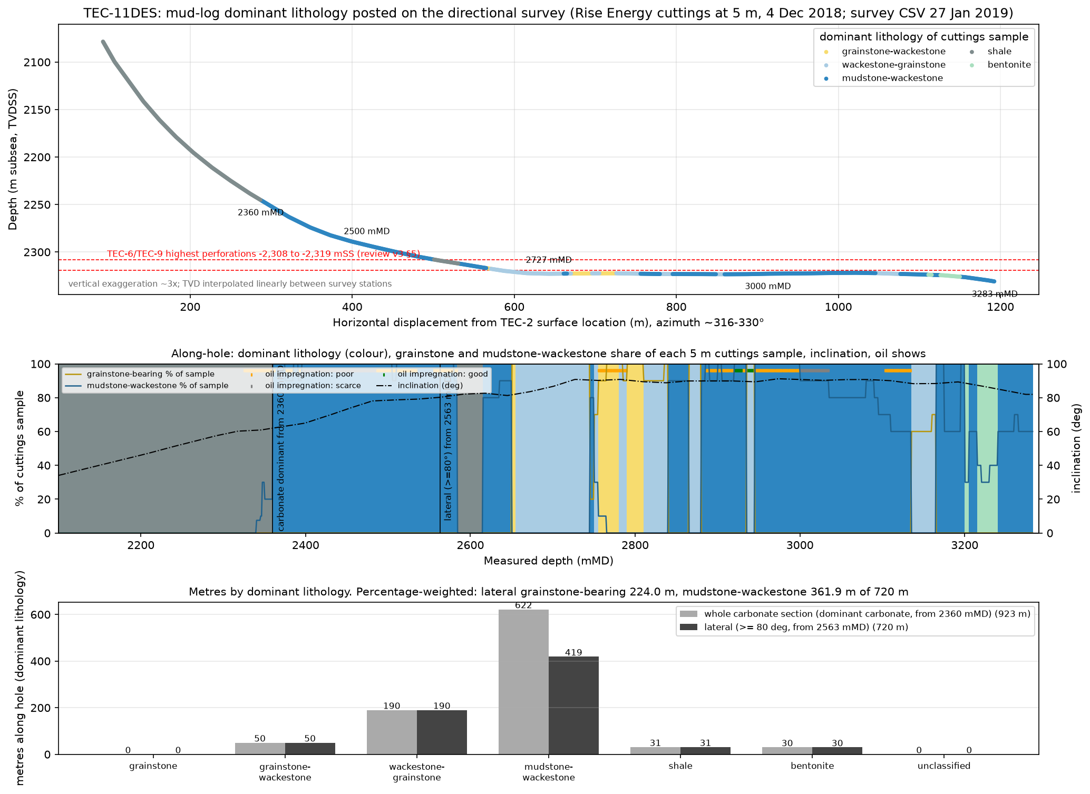
TEC-11DES horizontal: the concept and why the well did not test it
Concept. A 720 m open-hole lateral in the top of the El Abra from the TEC-2 pad: low drawdown along a long contact to delay water coning.
What was drilled. Azimuth 316-331° to cut fractures predicted from TEC-10; lateral at 2,305-2,331 mSS (mostly 2,322-2,324) down the north-west plunge, 4-12 m below the TEC-6/TEC-9 high, through 923 m of mostly mudstone-wackestone; on the Jan 2019 grid mostly 4-10 m above the mapped El Abra top.
Execution problems. Navigation below plan, no pilot hole and no logs while drilling, hole collapse in the lateral, failed tie-back and liner cement job, fish; the open-hole section could not be re-entered.
Final state and test. 4.5 in liner 1,869-2,863 mMD, fish at 2,866-2,872, open hole to 3,283; acid bullheaded without isolation; five perforations 2,643.5-2,745.5 mMD flowed 286 bbl/d water, no oil; Tantoyuca recompletion trace 17 °API oil; composite plug at 2,400 m (Aug 2019).
Lessons applied to TEC-12. A conventional deviated well to the crest, a full open-hole log suite before completion, perforations chosen on the logs, and no unisolated acid near the water. The operator's own 2019 summary: 'faults and fractures connect aquifer to oil column'.
Tecolutla field, Contract Area 24 - technical overview, October 2026
13
Notes:
Q: Does TEC-11 condemn the top-of-zone idea?
A: No. The lateral sat 4-12 m below the crest in tight mudstone facies on the north-west plunge, the open hole was never tested, and the water came through liner perforations after an unisolated acid job. Its El Abra pick is itself disputed: 2,611.8 mMD in the tops table vs carbonate from 2,360 mMD on the mud log (G-75). The recorded sonic over the lateral reads ~73 us/ft, like the Tantoyuca marl at TEC-10 (71) rather than El Abra (52-57), and the grid puts the lateral 4-10 m above the El Abra top: it may never have entered the reservoir.
Q: What did it cost?
A: USD 3.03 MM to rig release against a 2.25 MM AFE.
Q: Source
A: docs/03_tec11_facies.md; Rise Energy mud log; Tonalli operations log; Sep 2022 Jaguar review.

Slide 14
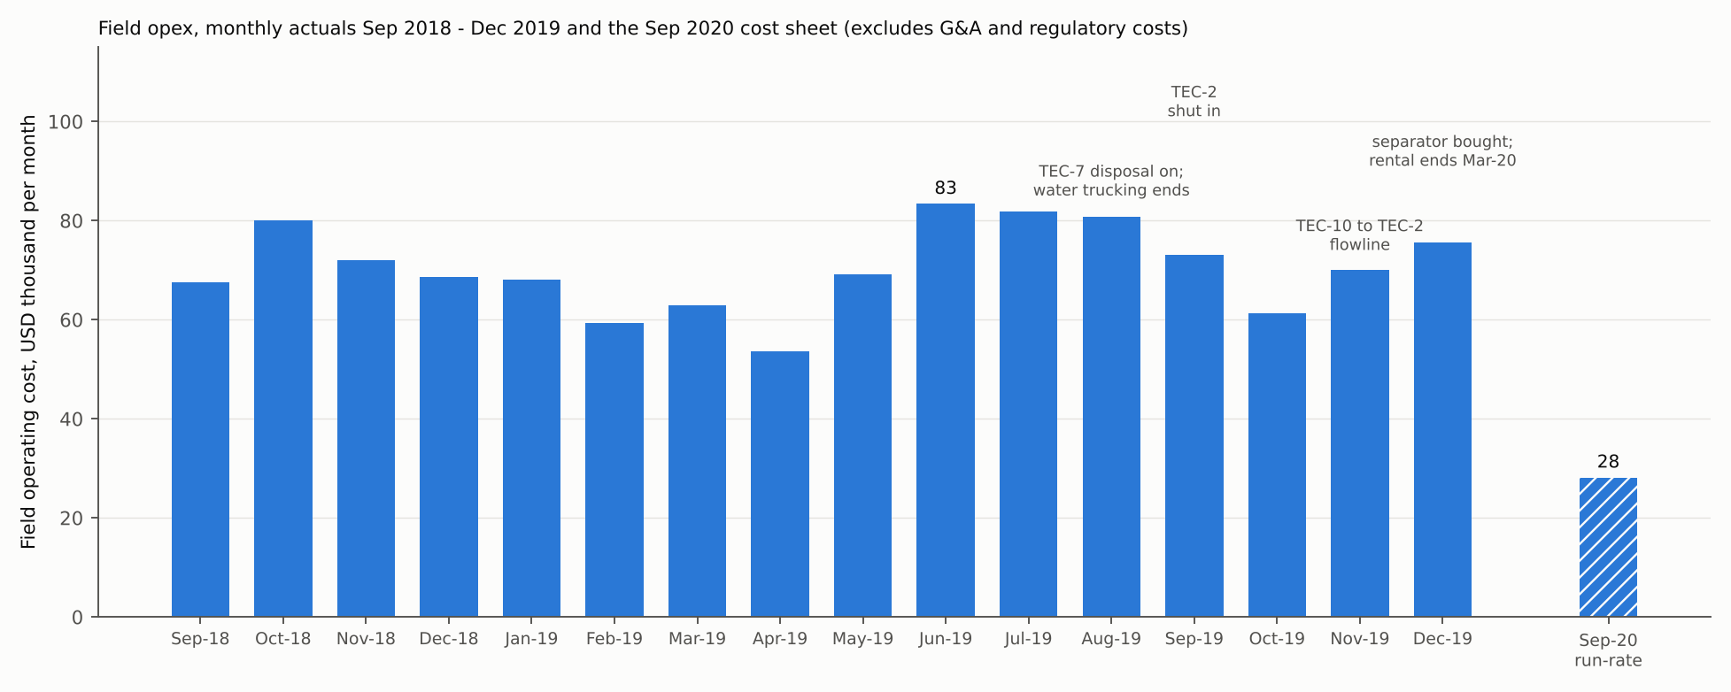
Operations and opex: logistics brought field costs down by two-thirds
2019, two wells on test: USD 54-83 k/month field opex (839 k for the year, 25.6 USD/bbl), with a rented separator (MXN 216 k/month) and water trucked out.
Changes: TEC-7 disposal (Aug 2019, water trucking ends); TEC-10 to TEC-2 flowline and one battery (Nov 2019); separator bought, rental ended Mar 2020; TEC-2 shut in when uneconomic.
Sep 2020 run-rate: about USD 28 k/month: crew MXN 280 k, vacuum truck 108 k, diesel 60 k, frac tank 32 k, consumables and lab; roughly 13-16 USD/bbl at 2020 volumes.
Actuals 2020-21: USD 24-25 k/month Jul-Nov 2020 and 29 k/month in 2021 (17.7 and 19.9 USD/bbl). 2018-23 field revenue 4.48 MM, royalties and fees 1.87 MM, opex 2.61 MM: field netback about zero before G&A and capital. 2023 care and maintenance ~52 k/month.
Tecolutla field, Contract Area 24 - technical overview, October 2026
14
Notes:
Q: Are these audited numbers?
A: 2018-19 are monthly management actuals; Sep 2020 is a cost sheet; 2020-23 are the field lease operating statements, which match the PEMEX settlements (exact for 2020-21, within 0.6 % for 2022). Annual field opex 291 k / 839 k / 336 k / 349 k / 168 k / 627 k USD for 2018-23 (acc_findings.md).
Q: Why did 2023 cost 627 k with almost no production?
A: No breakdown in the data room (G-70); likely environmental compliance and standby crew. 2024-25 holding opex was 289 k and 248 k USD with no sales. Ask Tonalli.
Q: What is the all-in cost?
A: Field opex excludes G&A (USD 674 k in 2019; corporate administration USD 39 k/month in the 2022 CNH report) and area charges (USD 1.1-1.4 k/month in 2018-22; about 5.2 k/month as paid in 2024-25, G-60).
Q: What opex does the TEC-12 case assume?
A: 7.25 USD/bbl oil + 3.25 USD/bbl water + 2,500 USD/well/month + 10 k battery + 1.5 k disposal per month (2023 model terms), consistent with the 2020 run-rate.

Slide 15
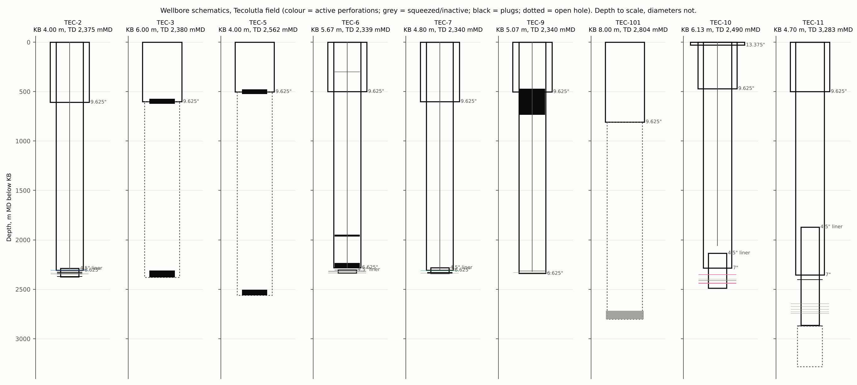
Wellbores: all nine wells documented
PEMEX wells: 9 5/8 in surface casing at 500-610 m (807 m at TEC-101), 6 5/8 in production casing to ~2,300 m, 4 1/2 in liners across the El Abra (TEC-2, TEC-6, TEC-7); TEC-3, TEC-5, TEC-101 plugged.
TEC-10: 7 in L-80 to 2,285 mMD cemented to surface; 4 1/2 in L-80 liner 2,133-2,489 mMD; perforations 2,349.5-2,353 mMD.
TEC-11: 7 in to 2,354 mMD; 4 1/2 in liner 1,869-2,863 mMD, fish 2,866-2,872, open hole to 3,283; composite plug at 2,400 mMD.
Integrity: TEC-2 and TEC-7 accepted in 2017 without integrity tests. TEC-6 (beside the TEC-12 pad) abandoned 2007 with its 6 5/8 in casing parted at 352 m; TEC-9 breached at ~70 m (repaired) and 530-833 m, plugged 4 Jan 2013.
Abandonment reserve USD 411 k (four wells + line, separator, pit); trust balance MXN 6.94 MM (2024-25).
Full casing table with a source on every row: data/processed/wells/casing_strings.csv.
Tecolutla field, Contract Area 24 - technical overview, October 2026
15
Notes:
Q: Where do the TEC-2/TEC-3 casing data come from?
A: PEMEX 1956 weekly drilling reports and the 2017 CNH clause-3.3 well-integrity forms (G-54 closed).
Q: Liabilities?
A: TEC-6 casing parted at 352 m with gas at surface before its 2007 abandonment (anti-collision and shallow-integrity check for TEC-12, G-63); TEC-9 wellhead (flagged as a hazard); TEC-11 composite plug only; the four-well abandonment reserve.
Q: What changed in the casing register?
A: TEC-3 surface shoe is 601.7 m (not 501.35, which is TEC-5's); TEC-6 and TEC-9 now show their PEMEX abandonment states; TEC-11 its final state (database review, docs/19).

Slide 16
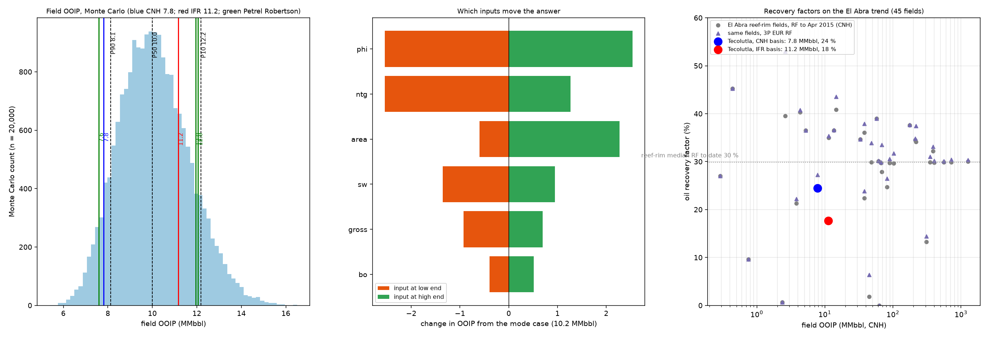
Volumes: in place, produced and remaining
OOIP. 7.8 MMbbl PEMEX/CNH booked; 11.2 MMbbl IFR (modern-log petrophysics); probabilistic P90/P50/P10 8.1 / 10.0 / 12.2 MMbbl. IFR's 2018 pre-drill figure was 26 MMbbl.
Produced. 1.98 MMbbl to end-2022 (1.72 monthly record + PEMEX wellfile allocations): 18-25 % of OOIP.
Analogue recovery. 45 El Abra fields: reef-rim 3P EUR recovery P90/median/P10 12 / 31 / 40 %; best 53 %.
Remaining recoverable. 0.3-1.6 MMbbl; most likely ~0.9 MMbbl at trend-average recovery.
Where it is. Between and above the old producers on the crest, where the aquifer has coned rather than swept (slide 9).
Booked. PEMEX 1 Jan 2015: 1P 0.0, 2P 0.0, 3P 0.1 MMbbl. GLJ YE2025 for Kinjal: 348 / 903 / 1,383 kbbl, none producing; TEC-12 EUR 250 / 399 / 578 kbbl.
The lever is petrophysics. Porosity and net-to-gross, not area, drive the 4 MMbbl OOIP uncertainty; TEC-12's logs measure it directly.
Tecolutla field, Contract Area 24 - technical overview, October 2026
16
Notes:
Q: Why such a range in OOIP?
A: Same area; the difference is net pay and porosity (old PEMEX logs vs 2018 modern logs). Petrel Robertson's model gives either depending on which logs are used.
Q: Reserves status?
A: GLJ YE2025 (report 25269, for Kinjal Gas, 100 %): 348 / 903 / 1,383 kbbl, NPV10 BT 2.87 / 8.11 / 12.11 MM USD on the Jan-2026 deck; TEC-12 in Jul 2028 at 1.9 MM. GLJ volumes have moved by 1-2 % a year since YE2022 and its TEC-12 type well has not changed since YE2019. YE2019 had no proved undeveloped after TEC-11; TEC-12 became proved at YE2020 as a directional well.
Q: GLJ says 400 kbbl for TEC-12 and you say 218 - why?
A: Our base is calibrated on TEC-10's own decline. GLJ still carries TEC-10 at 300 kbbl 2P against 77 kbbl produced to end-2022.

Slide 17
TEC-12: the remaining opportunity is the unswept top of the El Abra on the crest
Well | Top El Abra mSS | Highest perforation mSS | Unperforated top | Result
TEC-6 (crest) | 2,294 | 2,308 | 14 m | 507 kbbl recorded + 388 kbbl allocated; 3 intervals stepping up
TEC-9 (crest) | 2,296 | 2,323 | 27 m (top 8 m porous; cemented by PEMEX, never perforated) | 353 kbbl from one interval
TEC-2 | 2,300-2,302 | 2,303 | 1-3 m | 320 kbbl 1972-2016; 10 kbbl 2018-20
TEC-7 | 2,304 | 2,305 | 1 m | 267 kbbl; 100 % water 2019
TEC-10 (2018) | 2,310 (2,313 XRD) | 2,314 | 1-4 m | oil at 30-60 % cut, 75.8 kbbl
TEC-12 (planned) | 2,296 prog.; 2,289 grid; 2,293 PSTM | to be chosen on logs | target: top ~8 m of El Abra | crest, 118 m from TEC-9, 175 m from TEC-10
Every well that produced from near its top El Abra (TEC-2, TEC-7) did so 6-10 m lower on structure than the crest.
On the crest, the top 14-27 m of the El Abra was left unperforated by PEMEX: it is the highest, least-drained part of the field. At TEC-9 its top 8 m has SPHI ~15 % and ILD ~8 ohm·m; the 6 m below is tight.
TEC-12 targets it from the TEC-10 pad: S-shape well, target El Abra at -2,296 mSS, TD 2,360 mMD (-2,333 mSS), 7 in casing to TD, AFE USD 2.04 MM (1.57 MM at Nov 2020 prices, PPI-indexed).
Fallback: the 2,311-2,332 mSS interval that produced in every well.
Tecolutla field, Contract Area 24 - technical overview, October 2026
17
Notes:
Q: Why is TEC-12 better than re-perforating TEC-6 or TEC-9?
A: TEC-6 is plugged (bridge plug at 2,297 mSS, 2006) and TEC-9's wellhead is in poor condition; neither has modern logs. A new well gives modern logs, a sample and a clean completion at the crest.
Q: How big is the attic?
A: Not separately mapped. On the Jan 2019 grid the area above -2,303 mSS on the southern high is small; GLJ books TEC-12 at 250 / 399 / 578 kbbl EUR from the whole column at the crest. Treat the attic as upside, the produced interval as the base.
Q: Source
A: docs/09_log_panel.md §3; GLJ YE2019 top picks; TEC-12 drilling programme (Prog12 p.7-8, 27); docs/08_afe.md.

Slide 18
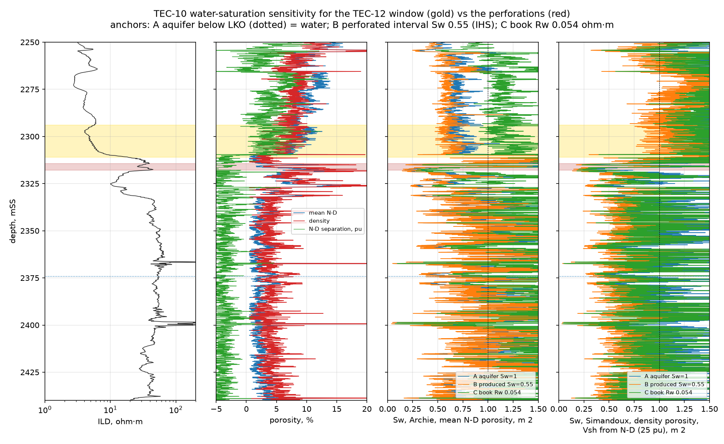
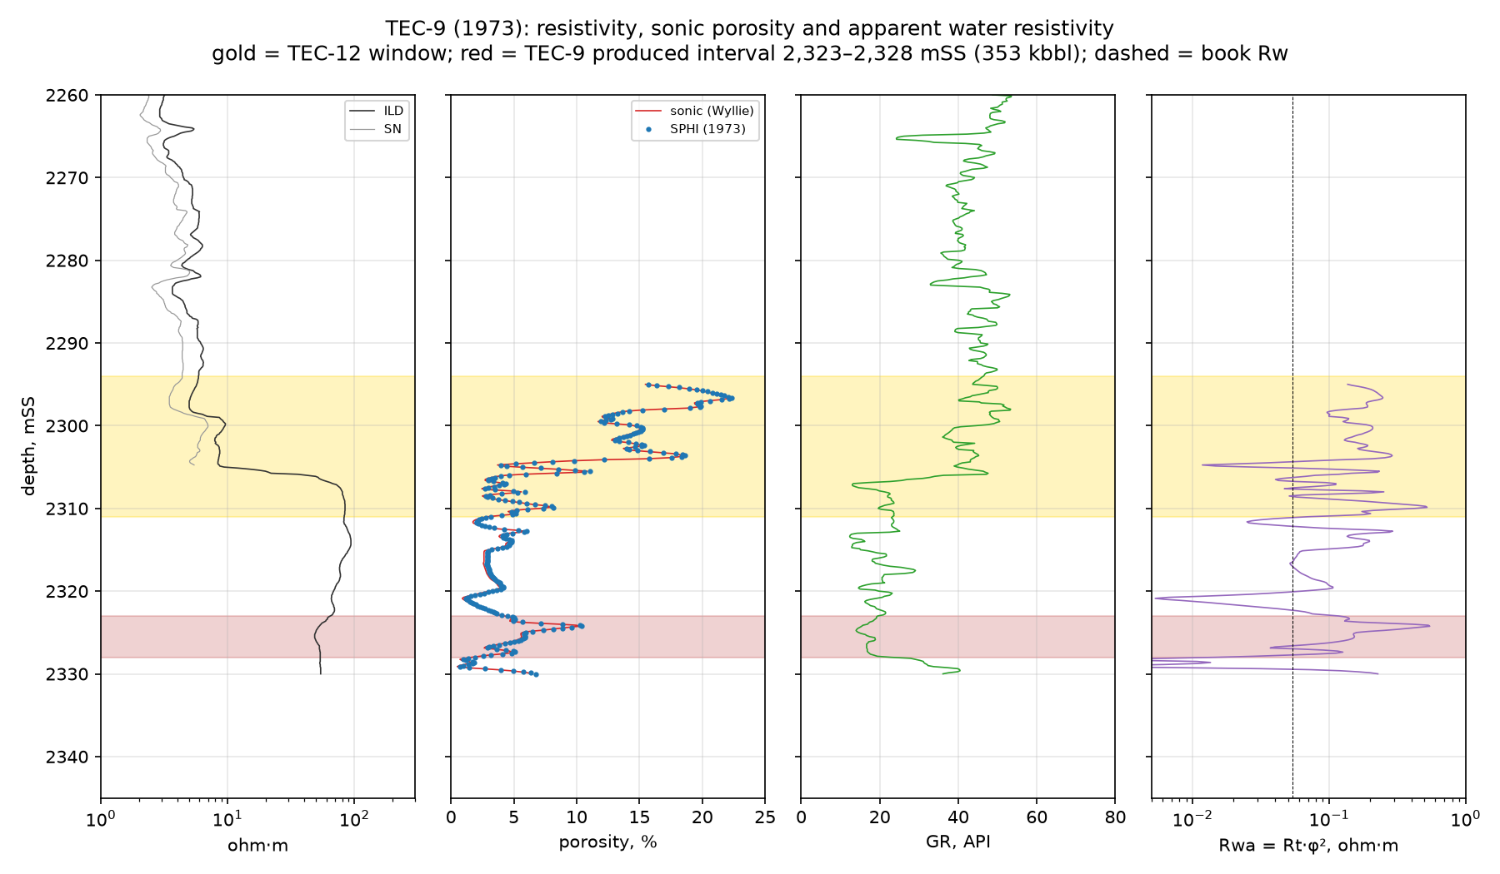
TEC-12: what the offset logs say, and how the well is designed to answer it
TEC-9 (118 m away, 1973 logs), the only well with El Abra at window depth: top 8 m (2,296-2,304 mSS) porous, SPHI ~15 %, ILD ~8 ohm·m, Sw at parity with the interval that made 353 kbbl; the next 6 m tight (SPHI 5 %).
TEC-10 and TEC-101: the same depths are Tantoyuca marl above a deeper El Abra (XRD at TEC-10: quartz 31 %, clay 9 %); low resistivity there is lithology. IFR's TEC-10 evaluation: no pay above 2,314 mSS.
Risks: the top unit may be thin or argillaceous; operator's 2019 view that the FWL may have risen to ~2,316 mTVDss with a transition zone above; a small crestal gas cap in 1956 (TEC-2 GOR ~6,500 scf/bbl).
Plan: triple-combo with PE, resistivity and image log, formation pressures and a fluid sample across 2,290-2,335 mSS; perforate on the data; low drawdown; solvent clean-ups as needed.
Decision rule: perforate the window if logs show El Abra with low clay and hydrocarbon; otherwise complete in the 2,311-2,332 mSS producing interval.
Tecolutla field, Contract Area 24 - technical overview, October 2026
18
Notes:
Q: Your own logs at TEC-10 say the upper zone is wet. Why drill for it?
A: At TEC-10 the window depths are entirely Tantoyuca on the cuttings XRD (El Abra from 2,348 mMD, -2,312.9 mSS), so they say nothing about the El Abra at the crest. TEC-101 shows the same low-resistivity signature above its El Abra top at -2,334. At TEC-9 and at the TEC-12 location the El Abra top is ~2,290-2,296 mSS; TEC-9's top 8 m is porous and at parity with its 353-kbbl producer, and PEMEX cemented it without perforating. TEC-12 settles it with modern logs and a sample before any perforation.
Q: Is there any direct evidence the top El Abra unit holds oil?
A: Yes, in original conditions: PEMEX's 1957 E-log analysis of TEC-7 gives Sw 0.13 and porosity 0.17 over the top 7 m of El Abra (about -2,305 to -2,312 mSS), before that interval was produced (1971-2006). At TEC-9 the same top unit has sonic porosity ~15 %. Current saturation at the crest is what TEC-12 measures.
Q: Isn't the window a transition zone?
A: Possibly: Tonalli's July 2019 deck offered that as one reading (FWL risen from 2,380 to ~2,316 mTVDss), the other being water up fractures. That is why TEC-12 carries pressures and a sample, and why the fallback is the 2,311-2,332 mSS interval.
Q: What if the sonic porosity at TEC-9 is overstated by shale?
A: With a 20 % shale correction the window's Sw is 1.1-1.3 times the producer's; with 40 %, 1.5-1.6 times. That is why the plan includes PE and density-neutron to measure clay, and a pressure/sample test.
Q: Is the crest gas?
A: There was gas at the top of TEC-2 in 1956 (open-hole test 2,303-2,318 mSS: 41 m³/d oil, 47,702 m³/d gas) and PEMEX marked a gas-oil level at ~2,315 mSS in 1971. Field GOR stayed 400-1,100 scf/bbl through decades of crestal production, so any remaining cap is small. Logs (neutron-density crossover) and the fluid sample will show it.
Q: Sources
A: docs/09_log_panel.md §4; docs/14_sw_sensitivity.md §2, §5; TEC-10 masterlog; PEMEX TEC-2 drilling reports (1956) and 1971 schematic; G-47.

Slide 19
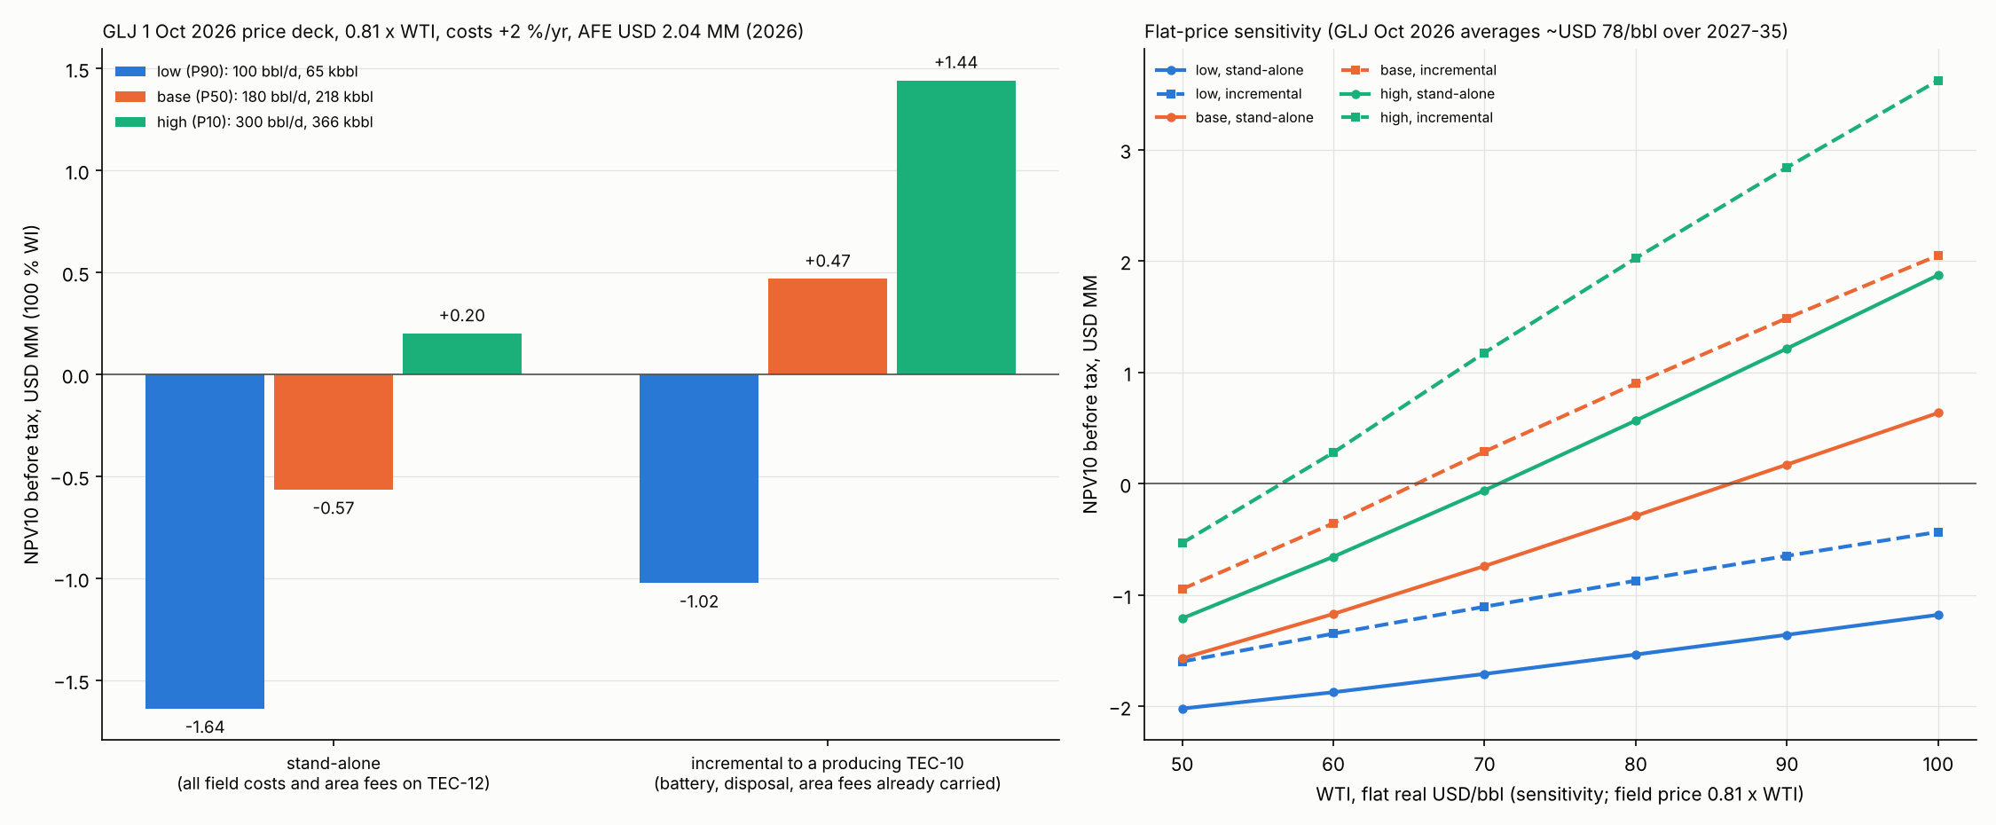
TEC-12: forecast and economics
Well: S-shape from the TEC-10 pad, ~13 days drilling; AFE USD 2.04 MM (drill, complete, equip; Nov 2020 estimate indexed on the US drilling PPI).
Forecast range: first-month rate 100-221 bbl/d across the studies; repository base 50 / 133 / 178 kbbl at 1 / 5 / 10 years, EUR 218 kbbl; GLJ YE2025 EUR 250 / 399 / 578 kbbl.
Price: GLJ 1 Oct 2026 forecast, WTI 81 (2027), 75, 73, then rising 2 %/yr; costs +2 %/yr; realisation 0.81 × WTI (PEMEX settlements 2020-22).
Incremental to a producing TEC-10 (battery, disposal and area fees already carried): NPV10 +0.47 MM before tax, +0.11 MM after tax; payout 27 months; IRR 29 %; high profile +1.44, low -1.02.
Stand-alone: -0.57 MM before tax (high +0.20), carrying the area charges as paid in 2024-25 (USD 5.2 k/month). Flat-WTI break-evens ~66 incremental, ~86 stand-alone.
Upside: high profile positive from WTI ~57 incremental; a successful window completion would also re-rate the crest for a follow-up well (TEC-13).
Basis: contract fiscal terms (31.22 % bid royalty + basic royalty, 30 % tax), unchanged by the 2025 reform (LSH transitorio Décimo). GLJ's TEC-12 1P entity is 2.08 MM: the difference is mostly cost basis (next slide).
Tecolutla field, Contract Area 24 - technical overview, October 2026
19
Notes:
Q: Why is the base EUR lower than GLJ's?
A: The repository base uses TEC-10's own decline (b ≈ 0.5); GLJ's 1P type well (qi 200, Di 36.6 %, b 0.5) gives ~250 kbbl. GLJ is the booked number; ours is a conservative check (docs/06_forecast.md).
Q: Downside case?
A: Low profile (65 kbbl EUR) is negative at every price tested (-1.02 MM incremental on GLJ); that is the case where the window adds nothing and the produced interval underperforms.
Q: Why GLJ Oct 2026?
A: Current independent deck, the basis Kinjal's planned reserve report is likely to use. It averages ~USD 78/bbl WTI over 2027-35. Flat-price sensitivity is on the chart.
Q: What about after-tax?
A: Base incremental +0.11 MM after tax; the 30 % tax with 25 % declining-balance depreciation takes ~0.36 MM.
Q: Source
A: docs/10_econ_rebuild.md; data/processed/econ_rebuild/; docs/08_afe.md.

Slide 20
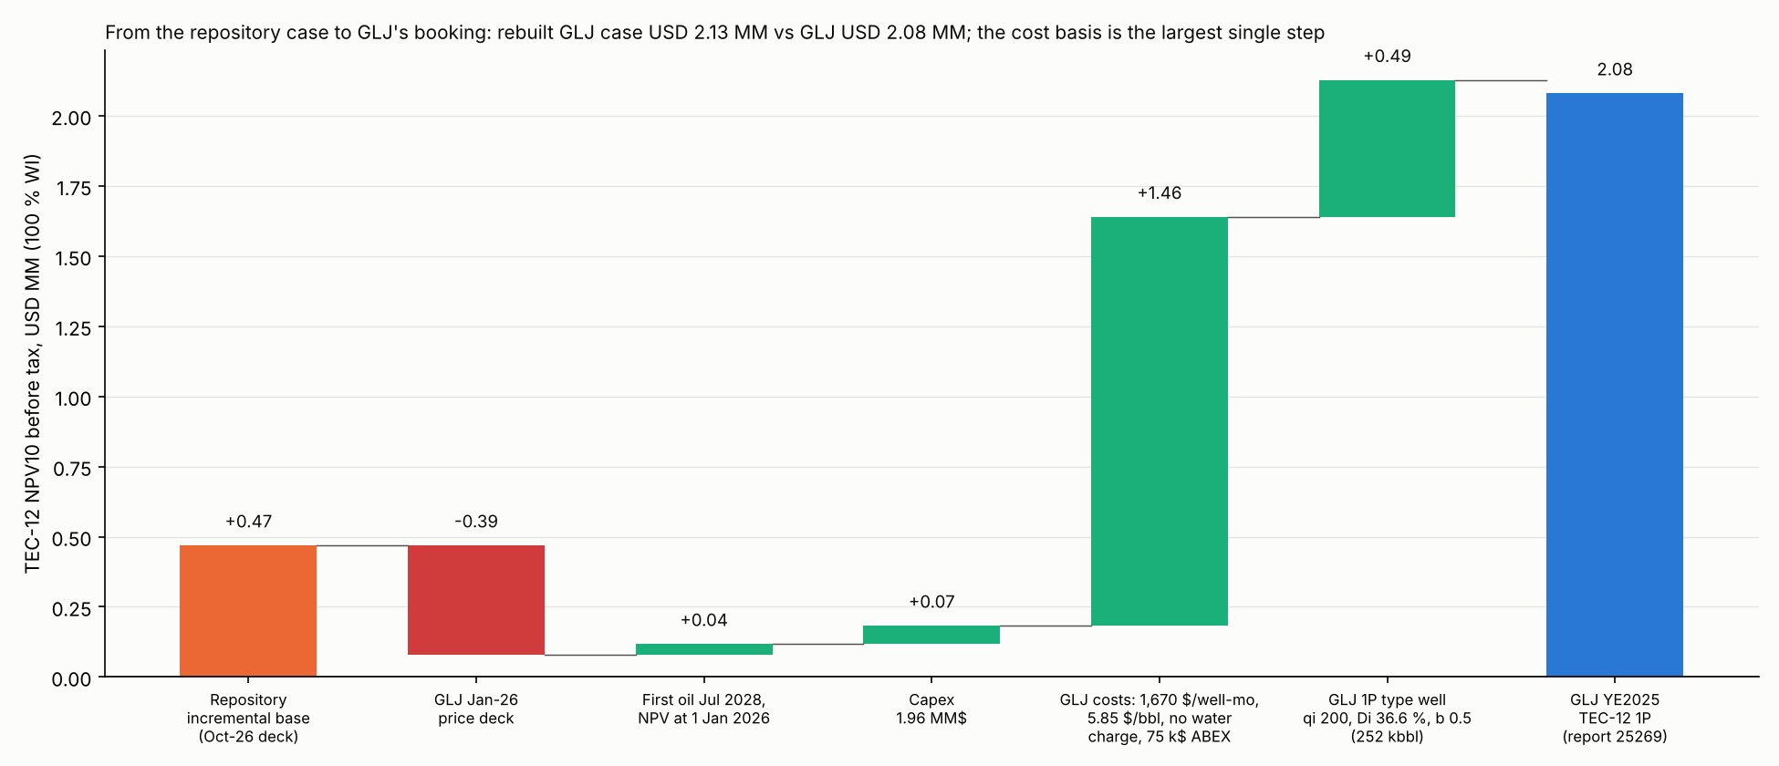
TEC-12 economics against GLJ's booking: the gap is cost basis, not volume
GLJ YE2025 for Kinjal: TEC-12 1P entity NPV10 BT USD 2.08 MM (Jan-2026 deck, first oil Jul 2028, capex 1.96 MM).
Rebuilt step by step from our case: deck -0.39, timing +0.04, capex +0.07, costs +1.46, type well +0.49, giving 2.13 MM (within 2 % of GLJ).
The big step: GLJ carries 1,670 $/well-month and 5.85 $/bbl with no water-handling charge; we carry 2,500 $/well-month, 7.25 $/bbl oil and 3.25 $/bbl water at 40-85 % water cut, in line with the 2020-21 actuals.
Tecolutla field, Contract Area 24 - technical overview, October 2026
20
Notes:
Q: Which case is right?
A: Both are internally consistent. GLJ's is the booked case; ours charges water handling explicitly, which TEC-10's water cuts make material. Kinjal's planned post-closing report can choose; the bridge shows exactly what moves the answer (data/processed/econ_rebuild/bridge.csv).
Q: How did you get GLJ's type well?
A: From GLJ's stated qi 200 bbl/d, Di 36.6 %, b 0.5, reading Di as an effective annual decline: that gives 252 kbbl over 30 years against GLJ's 1P EUR of 250. The reading is ours.

Slide 21
Commercial and regulatory position
Offtake: crude sold to PEMEX at CAB Poza Rica under a 2018 sales contract (amended 2019); formula price realised at 0.81 × WTI (2020-22 volume-weighted); quality 28-31 °API, 1.5-1.9 % S; fixed tariffs 2.7-3.3 USD/bbl.
Fiscal: licence contract with 31.22 % bid royalty plus basic royalty, exploration/extraction fee on 7.2 km², 30 % income tax.
Regulatory: evaluation period and transition programme (approved 18 Jul 2022, includes TEC-12); Development Plan to be submitted. CNH's functions passed to the CNE in 2025; pre-reform contracts keep their terms (to be confirmed by counsel).
Environmental: ASEA impact authorisation (2017, extended to Oct 2023) and TEC-7 injection authorisation (2019); gas flared under the evaluation approval; SEMARNAT and CNH arrears settled in 2024.
Contract: term to 25 Aug 2041 plus two conditional 5-year extensions; guarantee USD 1.76 MM; minimum 4,600 work units (4,978 offered); change of control needs CNH consent (cl. 23.2).
Abandonment: reserve USD 411 k; trust MXN 6.94 MM.
Tecolutla field, Contract Area 24 - technical overview, October 2026
21
Notes:
Q: What happens to the contract under the 2025 reform?
A: Secondary sources (GT Law, Holland & Knight) say pre-existing contracts keep their terms; the CNE now regulates; CNH suspended evaluation periods and transition programmes in Feb 2025 while contractors kept executing approved plans. Counsel to confirm against the DOF text (G-49).
Q: Payment risk?
A: PEMEX pays through the NAFIN factoring portal; 2019 saw invoice-loading delays. Settlements 2020-22 reconcile within 1-4 % of the tickets (docs/15_pemex_settlements.md).
Q: Gas?
A: Flared under the evaluation-period approval; volumes ~0.1-0.2 MMcf/d sour gas. The 2017 plan justified flaring at GOR 337 scf/bbl against 742-859 measured, under a 98 % utilisation norm (G-67); a gas solution may be required in the Development Plan.
Q: Why are the wells shut in?
A: GLJ YE2025: early 2023, environmental permit. CNH filings: from July 2022. IFR representation letters say all permits are in place. Counsel to reconcile before closing (G-65).
Q: Area charges?
A: As paid 2024-25: FMP quota MXN 29,829/month plus IEEH USD 42.8 k/yr, about USD 5.2 k/month; the IEEH amount looks like the extraction-phase rate, to confirm (G-60).

Slide 22
Data available and open technical items
Data package: reconciled production database 1956-2022; 21 pressure surveys on one datum; casing and completion table for all wells; TEC-10 logs, core and image log; TEC-9 and older logs; well tests and PTA; volumetrics; economics; PEMEX settlements; CNH filings.
Located, to be opened natively: PSDM volume (710 MB), Petrel project, two legacy PSTM SEG-Y (1.07 GB each); nine large LAS files; IFR Nov 2023 deck.
Not in the data room: Earth Signal and DMI gathers, angle stacks and velocity models; TEC-7 injection records; 2023 opex breakdown; TEC-6 2007 abandonment report; the Feb 2019 TEC-2 perforating ticket.
Open technical items: no laboratory PVT; no core electrical properties (m, n) or recent water analysis; per-well split of 2020-22 sales; TEC-11 and TEC-2 El Abra picks disputed.
What TEC-12 resolves: upper-El-Abra saturation and clay content, current contact and any gas cap at the crest, PVT, and the petrophysics behind the 4 MMbbl OOIP range.
Tecolutla field, Contract Area 24 - technical overview, October 2026
22
Notes:
Kevin: docs/19_database_review.md summarises the file-by-file review; docs/gaps.md lists each item with its status. Items not to lead with but to answer if asked: TEC-9 Tonalli testing (no record; the PEMEX 2012 job is documented), solvent product composition, TEC-11 Workstrings invoices (G-64), shut-in cause (G-65), CNH consent to the change of control (G-66).

Slide 23
Backup

Slide 24
Backup: well tests 1956-2019
Well | Date | Interval | Oil | Water / WC | Gas / GOR | FTP / notes
TEC-3 | Feb-Mar 1956 | DST 2,376.8-2,380.8 mKB | 980 m oil in pipe | 80 m salt water | gassy; 24 °API | SIP 230 kg/cm²; lowest known oil
TEC-2 | May 1956 | 2,307.4-2,321.7 mMD open hole | 41 m³/d | 1.5-9 % | 47,702 m³/d; 1,163 m³/m³ | 174 kg/cm²; gas at the top
TEC-2 | Jun 1956 | 2,345-2,349 mMD | 56 m³/d | 6-13 % | 4,320 m³/d; 77 m³/m³ | squeezed later
TEC-2 | Jun 1956 | 2,335-2,339 mMD | 72 m³/d | 5-9 % | 6,900 m³/d; 96 m³/m³ | placed on production
TEC-6 | Oct 1956 | 2,336-2,338 mMD | 77 m³/d | 3.4 % | - | 8 mm choke
TEC-7 | Jan 1957 | 2,335-2,337 mMD | 352 bbl/d | - | - | initial test
TEC-9 | May 1973 | 2,328-2,333 mMD | 91.6 m³/d | - | - | initial
TEC-9 | 2012 | after solvent + 15 % HCl | 10 → 101.6 bbl/d net | 10 % | - | 710 psi casing; then 33-46 bbl/d
TEC-2 | May 2018 | 2,307.4-2,311 + deep | 50 bbl/d | 454 bbl/d (90 %) | 220 Mcf/d | ~500 psi; 7 days
TEC-10 | Jul 2018 | 2,349.5-2,353 mMD | 182 bbl/d | 118 bbl/d (39 %) | 146 Mcf/d | ~880 psi
TEC-10 | Jan 2019 | same | 131 bbl/d | 125 bbl/d (49 %) | 100 Mcf/d | ~520 psi
TEC-2 | May-Sep 2019 | after plug + add-perf | 47 bbl/d | 141 bbl/d (75 %) | 69 Mcf/d | ~250 psi; 69 days
TEC-7 | Jun 2019 | 2,310-2,313 mMD | 0 | 182 bbl/d (100 %) | 0 | ~230 psi; converted to disposal
TEC-11 | May-Jul 2019 | liner perfs 2,643.5-2,745.5 mMD | 0 | 286 bbl/d (100 %) | 0 | ~200 psi
Tecolutla field, Contract Area 24 - technical overview, October 2026
24
Notes:
Sources: PEMEX TEC-2 weekly drilling reports 1956 (1oHDmwaM); TEC-6 informe final; PEMEX summary tables; Tonalli operations log; Sep 2022 Jaguar review; IHS PTA reports.

Slide 25
Backup: pressure surveys at 2,300 mSS
Date | Well | Type | Pressure MPa | Note
1956-05-24 | TEC-2 | static (2 h 45 min) | 24.65 | new well; 252 kg/cm²
1964-12-05/08 | TEC-2 | static (75-78 d) | 24.36-24.39
1964-12-08 | TEC-7 | static (95 d) | 24.66
1971-08 to 10 | TEC-6 | 74-day build-up | 23.24 → 24.35 | 11 runs; 12 Aug reading under check (G-73)
1998-10-06 | TEC-7 | static | 24.52 | 252.2 kg/cm²
2018-03-27 | TEC-2 | static after 2+ years shut in | 24.16 | extrapolated 54 m
2018-05-30 | TEC-2 | build-up p* | 24.14 | IHS; constant-pressure boundary 700 m
2018 | TEC-10 | build-up | 24.14 (gauge 2,316 mSS) | k 18 mD, skin +5; boundary 195 m
Tecolutla field, Contract Area 24 - technical overview, October 2026
25
Notes:
docs/05_pressure.md; data/processed/pressure/tecolutla_pressures.csv.

