Slide 1
Stage Report
VE490 INDOOR LOCALIZATION
Tianyu Wang
Oct 19th , 2018

Slide 2

Contents
Contents
Paper Reading
Reproduction
2

Slide 3
Enlightment
Fundamental Limits of RSS Fingerprinting based Indoor Localization
2015 IEEE Conference on Computer Communications (INFOCOM)
3

Slide 4
Paper [1]
Flash-Loc: Flashing Mobile Phones for Accurate Indoor Localization
IEEE INFOCOM 2016 - The 35th Annual IEEE International Conference on Computer Communications
4

Slide 5
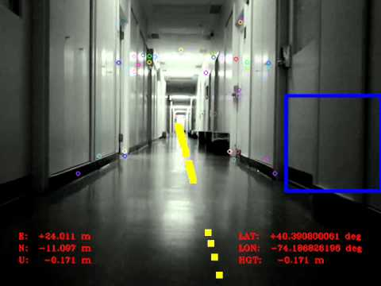
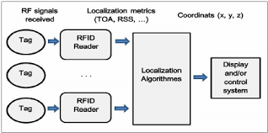
Existing Approaches
RF-based indoor localization
Unsatisfactory due to multipath, environmental change, human body interference, etc.
Vision-based indoor localization
Object recognition unreliable in changing environments and crowded areas.
5

Slide 6
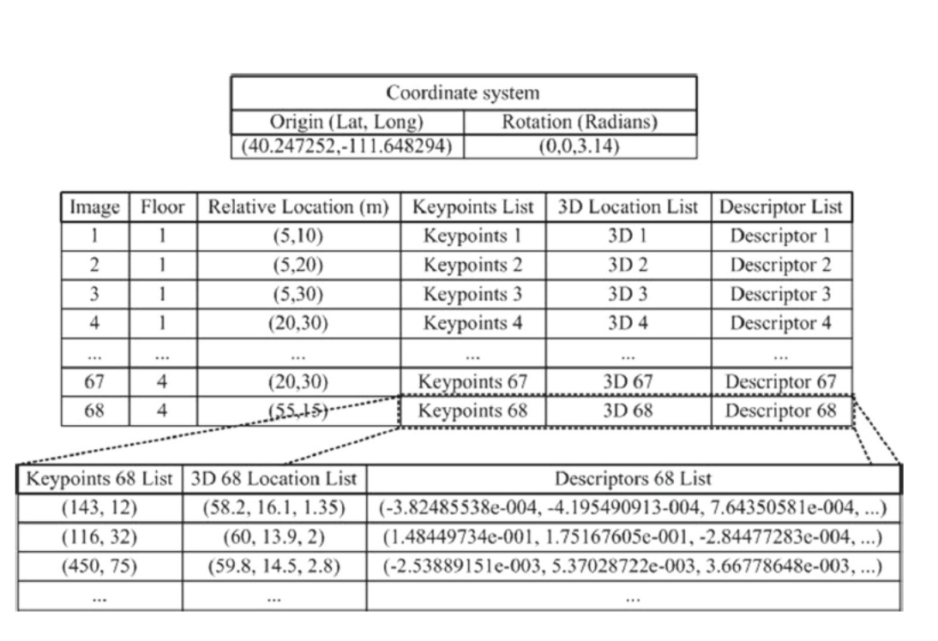
Vision-Based Approaches
Topological Retrieval
The main idea is to classify an input image into one or more place class candidates, which have been designed and determined in the database building stage. When topological retrieval is finished, metric retrieval can also be carried out within the selected class to determine a refined localization result.
Metric Retrieval
Get more detailed relative position
Matching in the database
6

Slide 7
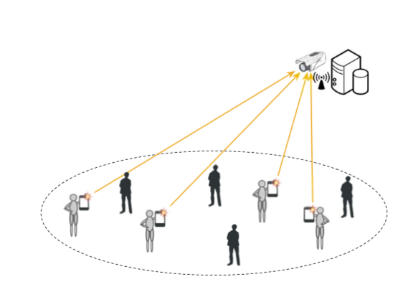
Overview
Human’s mobile phone generates a sequence of flashes.
Each sequence embeds carefully designed codes that uniquely represent a human.
Flashes with abrupt brightness are clear visual indicators of users in the view of surveillance cameras in order to avoid unreliable human recognition.
Camera then localize users by computing locations of visual flash points.
7

Slide 8
Three Key Mechanisms
To avoid irritating long-lasting flashes:
Deal with multiple users
Deal with false flashes
Deal with missed or incorrect flash detections caused by environmental noise
Three mechanisms are introduced:
Adaptive-length flash coding
Pulse width modulation (PWM) based flash generation
Image subtraction based flash localization
8

Slide 9
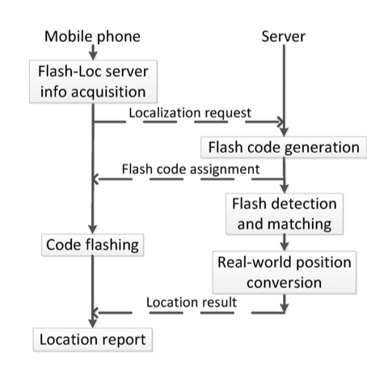
Workflow
User communicates with the server via a mobile application.
Server manages cameras, knows each camera’s position, orientation and FoV (Field of View).
9

Slide 10
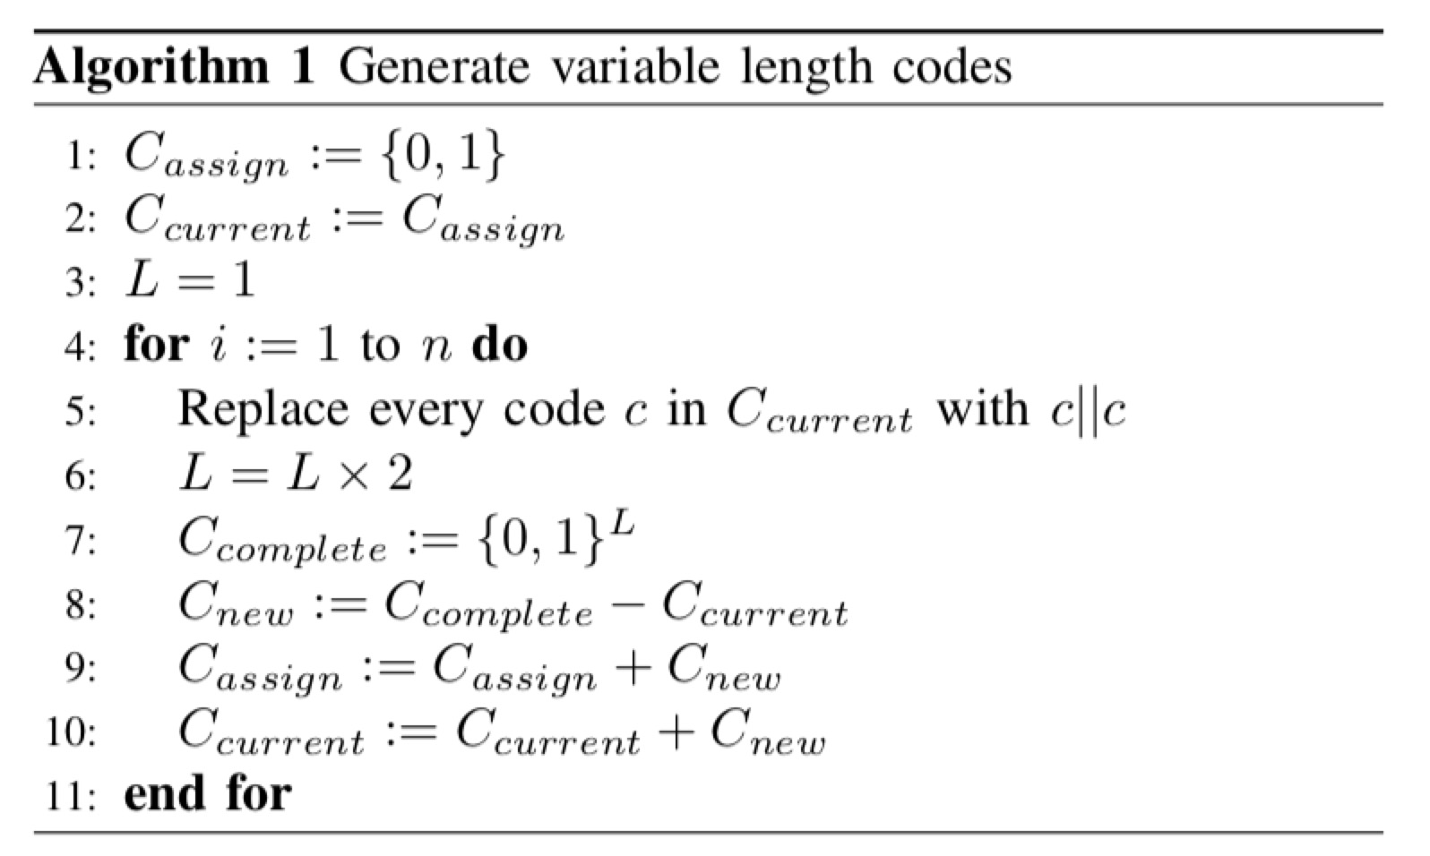
Flash Coding
Variable-Length Codes
Example: Codes 0 and 1 are assigned to the first two users. When the third user arrives, the code length is doubled to 2 and a new code 01 is assigned to the third user while the previous codes 0 and 1 transition to 00 and 11, respectively. The first two users still think their codes are 0 and 1, but the server uses 00 and 11, respectively, to localize them.
When users finish localization, their codes are released. Any incoming user is assigned the shortest available code and the server uses the maximum length of all assigned codes for decoding.
10

Slide 11
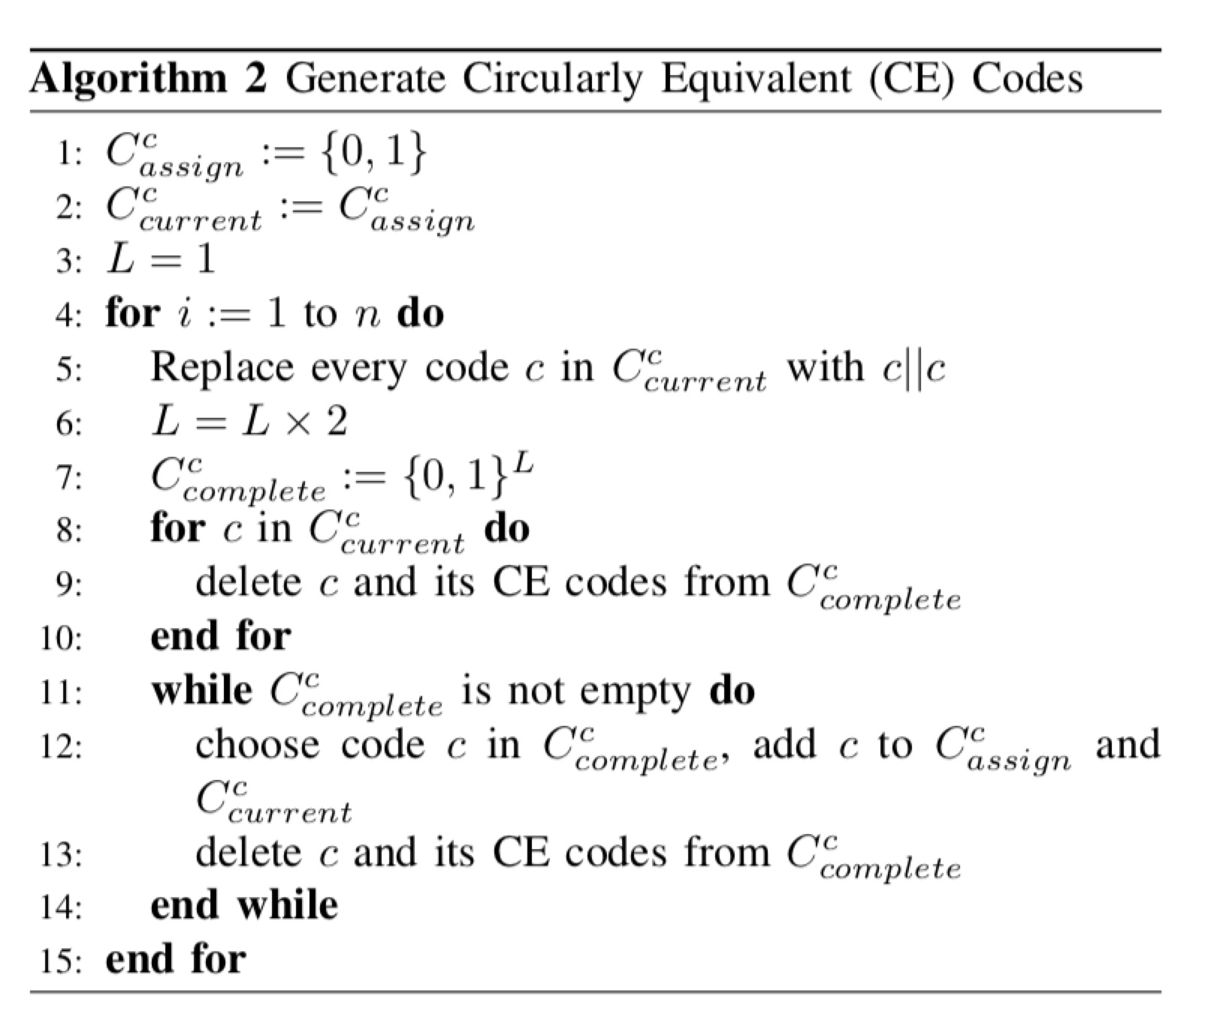
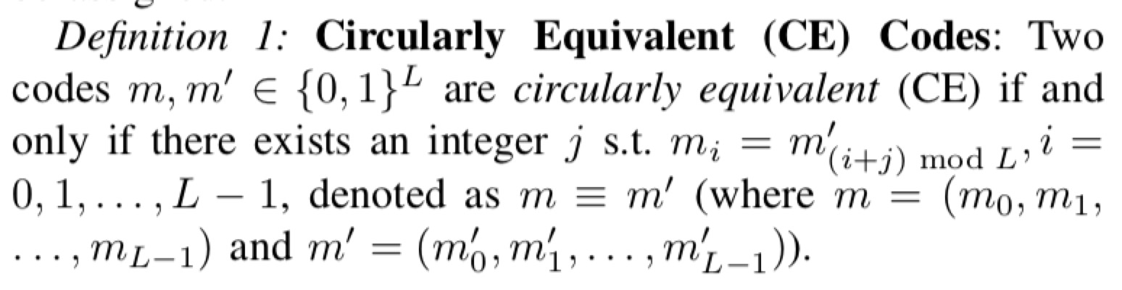
Flash Coding
2. Circularly Equivalent Codes
If one bit is missing and the server fails to notice this, all of the following repetitions will be decoded to some “rotation” of the original code.
11

Slide 12
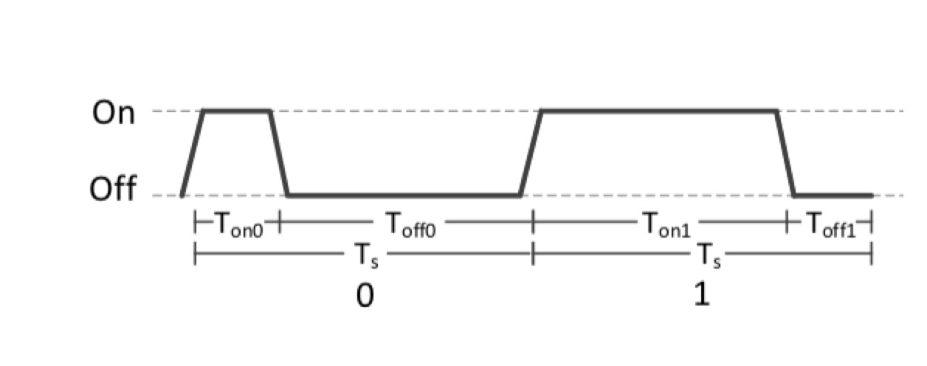
Flash Generation
Flash Mode Selection
Two adjacent flash on-off switches
Fixed length of time for each bit
Difference between 0 and 1 is the proportion of “on” time
FPWM helps estimate the number of missed detected bits
12

Slide 13
Flash Generation
Flash Parameter Determination
Every symbol starts with a rising edge and ends before another rising edge.
The difference between T_on0 and T_on1 is used to distinguish 0 and 1.
If the time t between two detected rising edges exceeds 2T_s, there are approximately t/T_s – 1 missed symbols.
Video frame -> sample point; [1:3]
T_on0 = T_off1 = T_f; T_off0 = T_on1 = 2T_f
13

Slide 14
Flash Localization
Flash Detection
Detect abrupt brightness changes in consecutive video frames.
Flash between two consecutive switch-on is extracted as one symbol.
RGB video images converted to grayscale.
Subtract two consecutive grayscale images and perform contour detection
Flash detection works well even 30m away at a ~43^circ as claimed.
14

Slide 15
Flash Localization
Flash Positioning
Camera Calibration for fixed camera state, grab intrinsic and extrinsic parameters.
Find the flash’s pixel location and project back to real world.
One Single Camera
Height Known
Two Cameras
No External Information
15

Slide 16
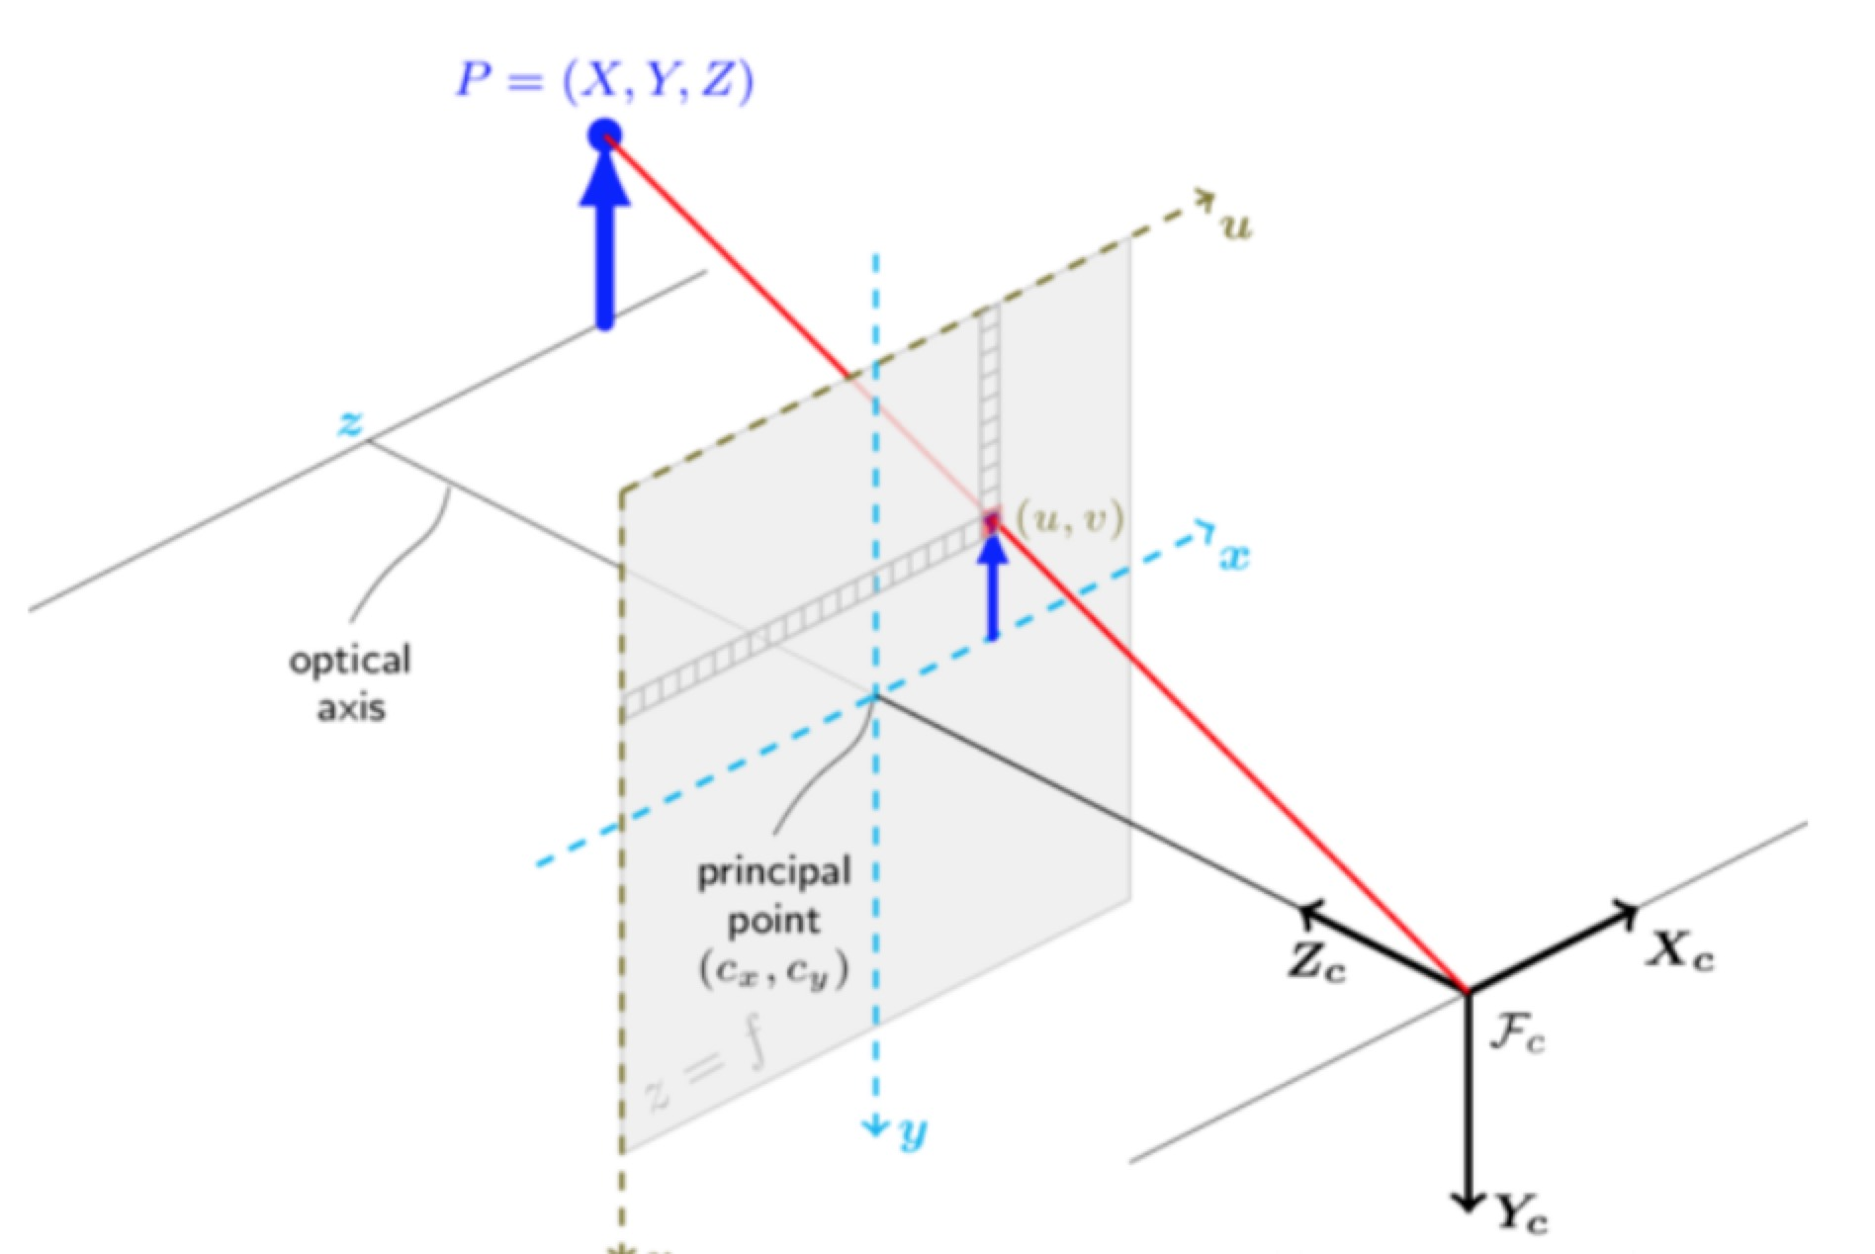
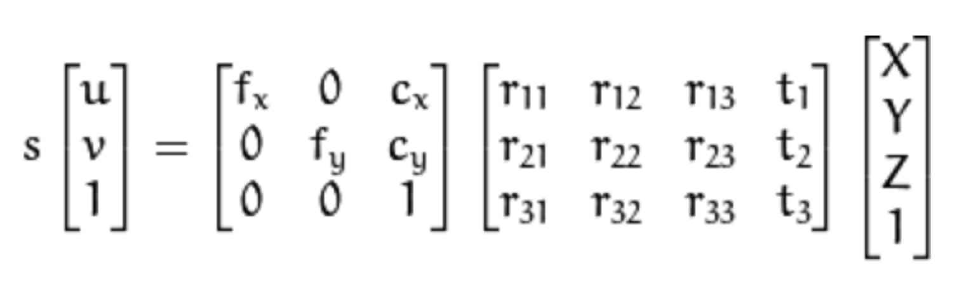
Flash Localization
16

Slide 17
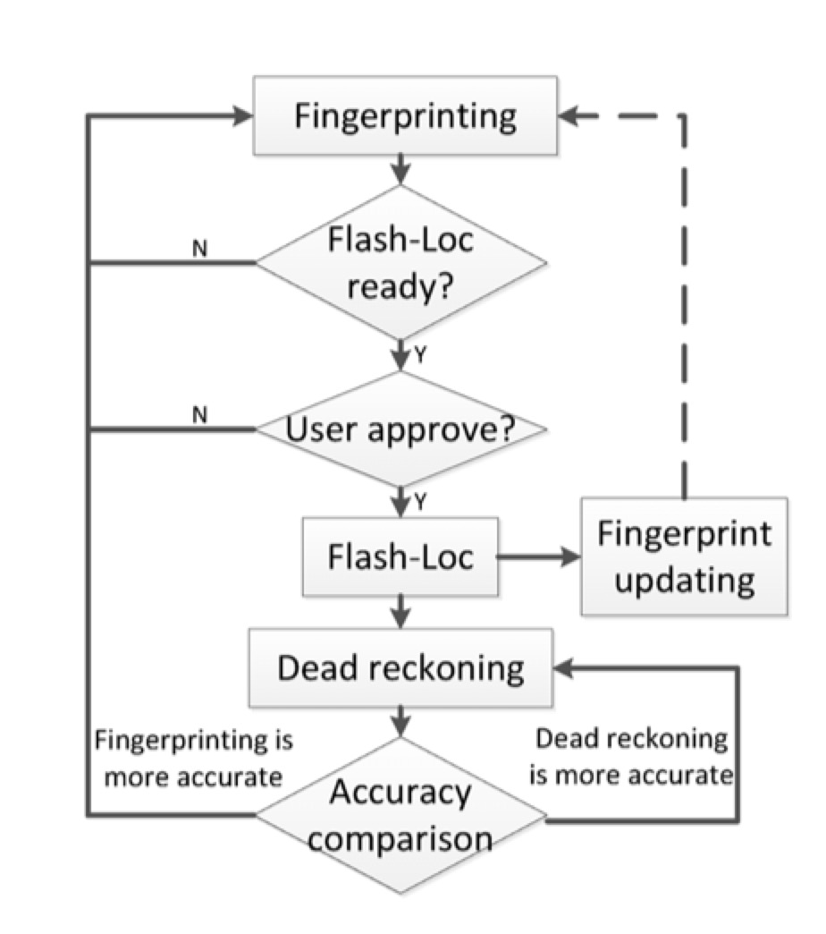
Adaptivity
Coarse -> Refinement
“Checkpoint”
Update the fingerprinting map
Reduce the interaction with user to save time
17

Slide 18
Devices
User Side:
Flash Module
Fingerprinting Module
Dead reckoning Module
Server Side:
Commodity Cameras (D-Link DCS-930L set to 15 fps)
OpenCV
Raspiberry ?
Nexus S mobile phones running Android 2.3+
18

Slide 19
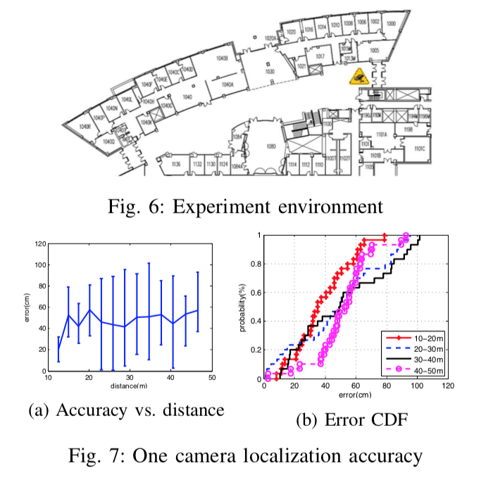
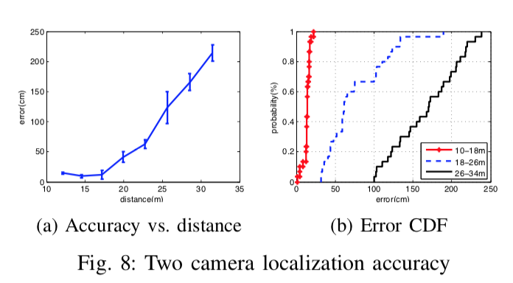
Outcome
19

Slide 20
Pros & Cons
Innovations
Very accurate outcome and very robust to distance away.
Less influence from multipath effect, NLOS condition, etc. , as occurred in the case of electromagnetic wave.
Flexibility and compatibility with fingerprinting methods
More to explore
Now device-dependent and sometimes not user-friendly
User have to deliberately control flashing (active localization)
Camera coverage
Vulnerable to irrelevant objects’ movement and environmental changes
More compatibility with other methods
20

