Slide 1
Stage Report
VE490 INDOOR LOCALIZATION
Tianyu Wang
Oct 28th , 2018

Slide 2

Contents
Contents
Paper Reading
Reproduction
2

Slide 3
Paper List
NaviLight: Indoor Localization and Navigation Under Arbitrary Lights
Zenghua Zhao∗, Jiankun Wang∗, Xingya Zhao†, Chunyi Peng†, Qian Guo∗ and Bin Wu∗ ∗Tianjin Key Laboratory of Advanced Networking (TANK) School of Computer Science and Technology, Tianjin University,Tianjin, China †Department of Computer Science and Engineering, The Ohio State University,Columbus, Ohio, USA
INFOCOM 2017
DSOD: Learning Deeply Supervised Object Detectors from Scratch
Zhiqiang Shen∗1, Zhuang Liu∗2, Jianguo Li3, Yu-Gang Jiang1, Yurong Chen3, Xiangyang Xue1 1Fudan University, 2Tsinghua University, 3Intel Labs China ICCV 2017
Temporal Action Detection with Structured Segment Networks
Yue Zhao1, Yuanjun Xiong1, Limin Wang2, Zhirong Wu1, Xiaoou Tang1, and Dahua Lin1
1Department of Information Engineering, The Chinese University of Hong Kong 2Computer Vision Laboratory, ETH Zurich, Switzerland
ICCV 2017
Camera Calibration from Periodic Motion of a Pedestrian
Shiyao Huang, Xianghua Ying*, Jiangpeng Rong, Zeyu Shang and Hongbin Zha
Key Laboratory of Machine Perception (Ministry of Education)
School of Electronic Engineering and Computer Science, Center for Information Science
Peking University, Beijing 100871, P.R. China
CVPR 2016
3

Slide 4
Paper [1]
NaviLight: Indoor Localization and Navigation Under Arbitrary Lights
IEEE INFOCOM 2017
4

Slide 5
Rationale
State-of-the-art techniques using LIGHT require customized hardware, and mainly work with one single light source.
Discriminative light fingerprinting
5

Slide 6
Key Issues
Light intensity is much more coarse-grained and ambiguous over space as compared with the electronic counterpart.
Unlike WiFi-based systems, there is no any communication between sources/lamps and targets/users.
Quick match between the user movements and pre-collected light intensity field (LIF) fingerprints.
6

Slide 7
Approaches
In-depth study on the properties of light intensity; a vector of multiple light intensity instead of single intensity value.
A coarse-grained indoor localization among all subareas before another fine-grained localization is carried out for each subarea.
Curve-matching problem turns into a time-sequence matching one.
7

Slide 8
Feasibility Study
To investigate whether light intensity is stable and discriminative enough to act as a suitable location signature:
Light Primer
Spatial Discrimination
Other Factors
8

Slide 9
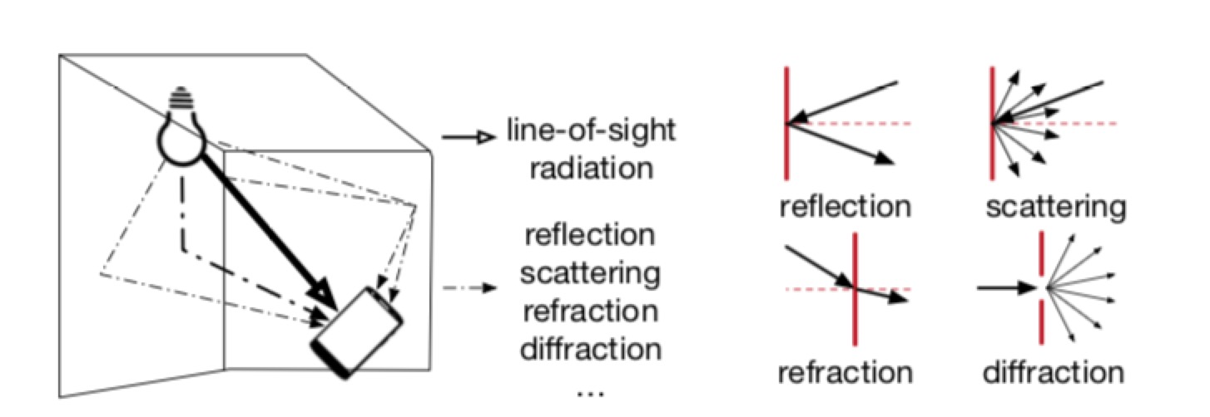
Light Primer
Light intensity produced by even a single source may not be uniformly distributed due to the impact of the surroundings.
Sufficiently Discriminative
9

Slide 10
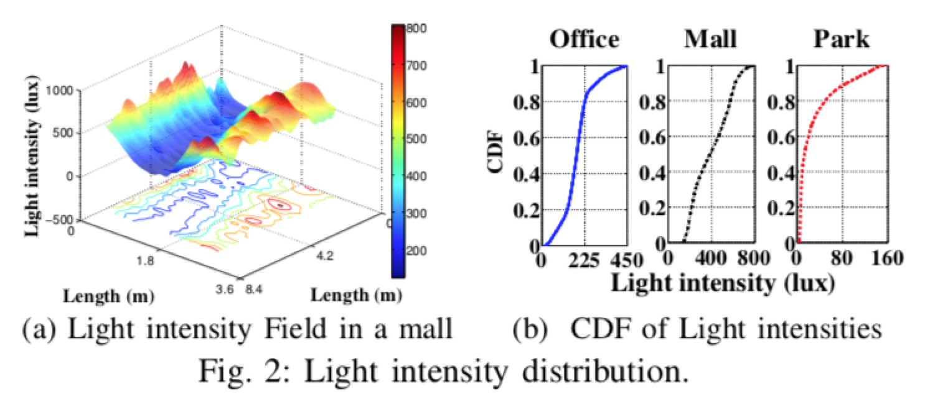
Spatial Discrimination
Location dependent fading effect
Light intensity varies over space
Less regular than anticipated ( an ideal circle )
Diversity more significant in the mall and office
10

Slide 11
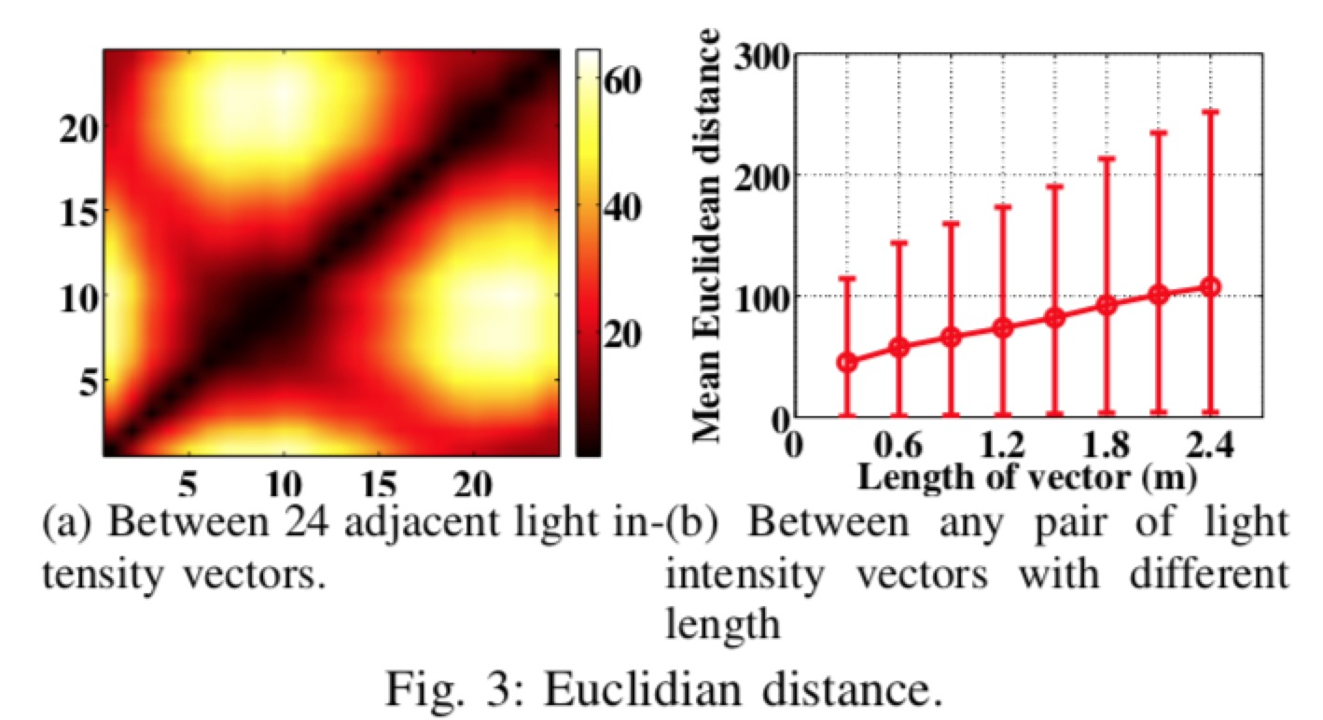
Spatial Discrimination
Spatial discrimination of light intensity vectors
A vector of light intensity values each of whose entry denotes a light intensity value of a spot on the walking trace
Euclidian distance to denote discrimination
11

Slide 12
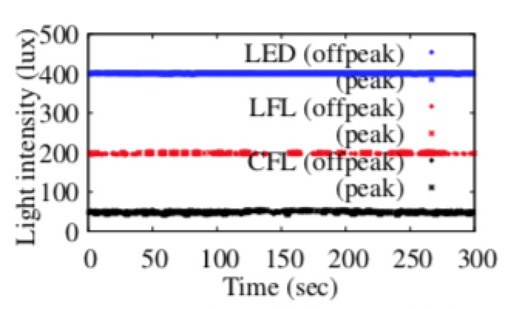
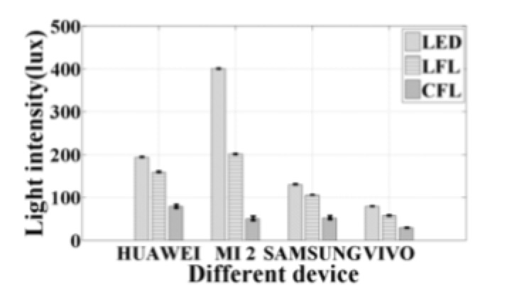
Other Factors
Temporal stability
Device diversity and stability
12

Slide 13
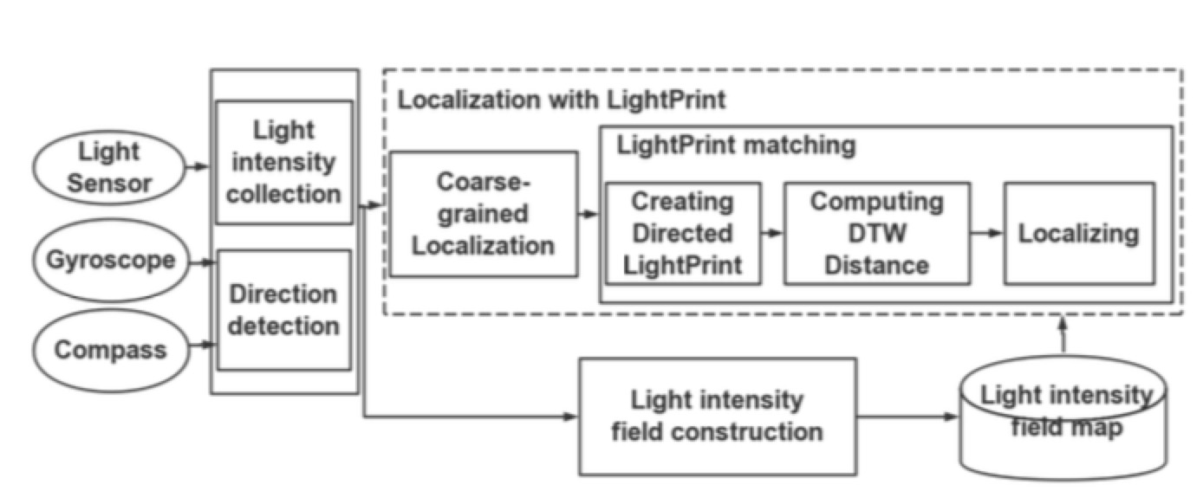
Architecture
Coarse-grained localization via KNN
LightPrint matching
13

Slide 14
Coarse-Grained Localization
The LIF map of a building floor can be divided into multiple smaller subareas according to their physical forms and sizes.
Use KNN classifier to match the measurement with the current LIF map.
May be erroneous (would discuss later)
14

Slide 15
Creating Directed LightPrints
Directed LightPrints
Breaking a LightPrint vector into multiple smaller-size vectors with one direction for each (denoting the instantaneous walking direction of the user at a corresponding point on the walk trace.
Gyroscope
Complementary Filter
Detect direction changes
Compass
15

Slide 16
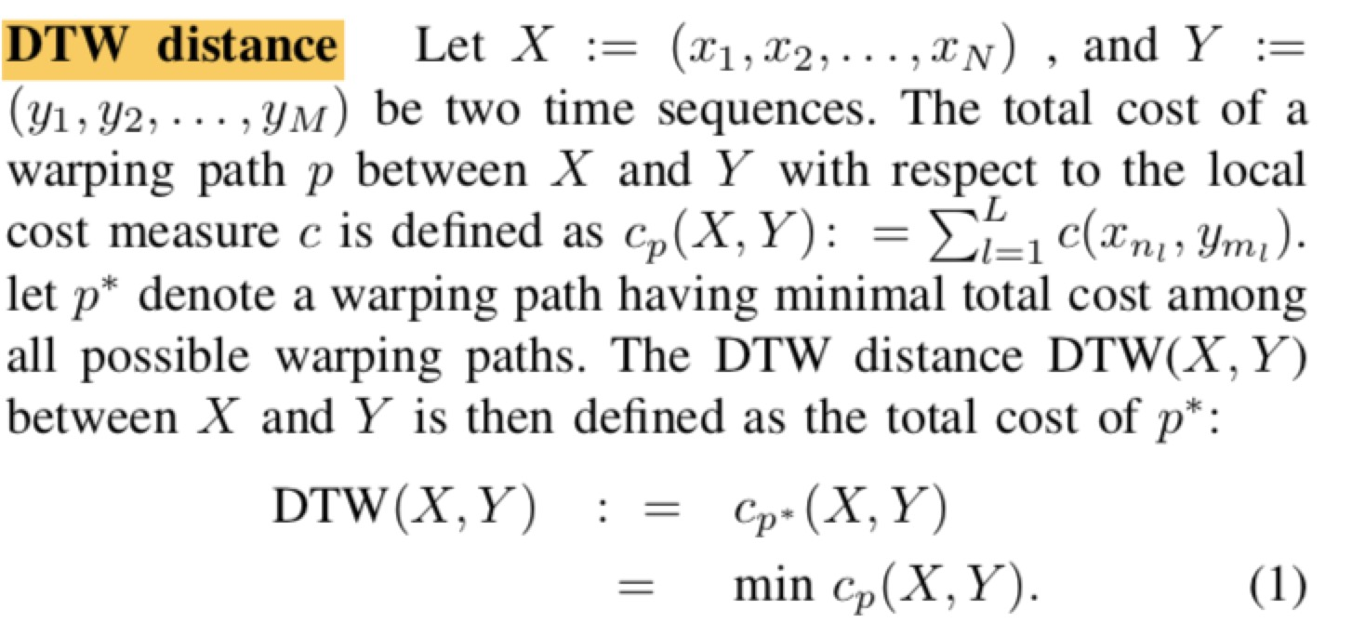
Computing DTW Distances
Dynamic Time Warping
To align and measure the similarity between two time sequences with different speeds.
16

Slide 17
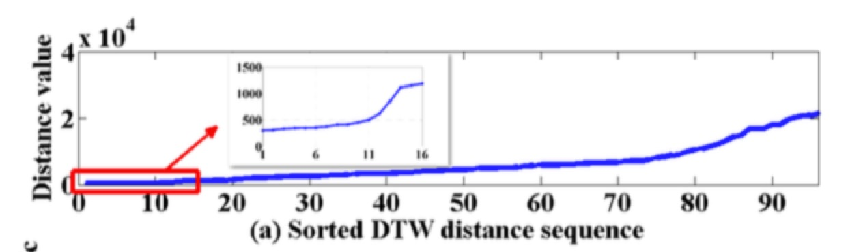
Localization Based on DTW
A few light intensity segments that have similar minimum DTW distances.
Cluster the top K light intensity segments with similar minimum DTW distances.
A cluster with the smallest average DTW distance is taken as the most similar one to the LightPrint.
17

Slide 18
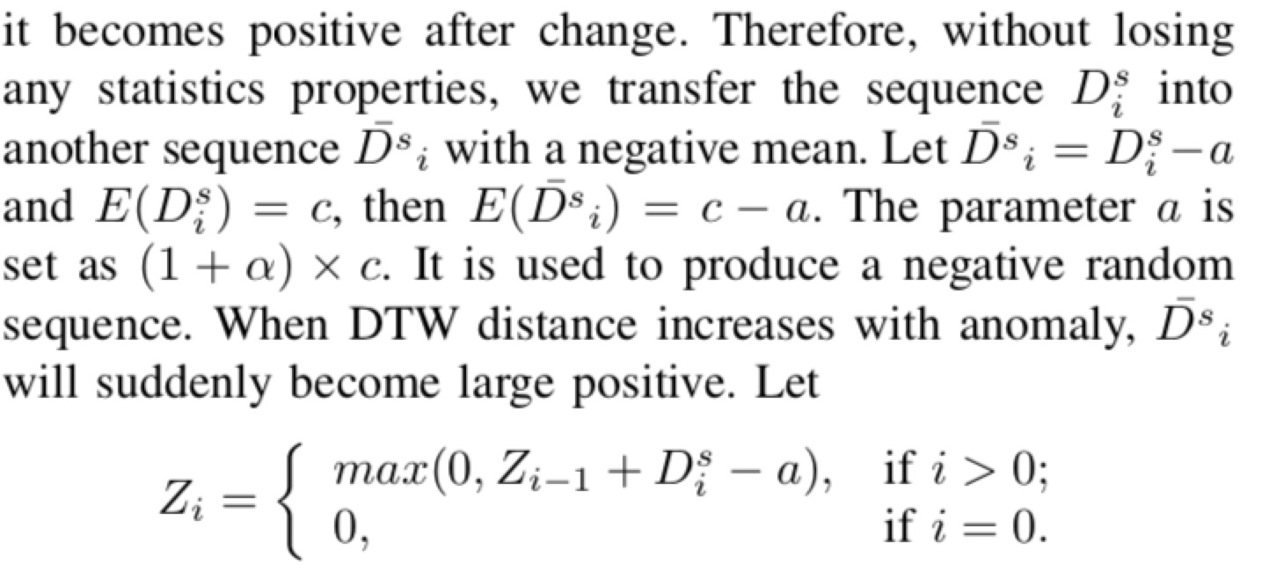
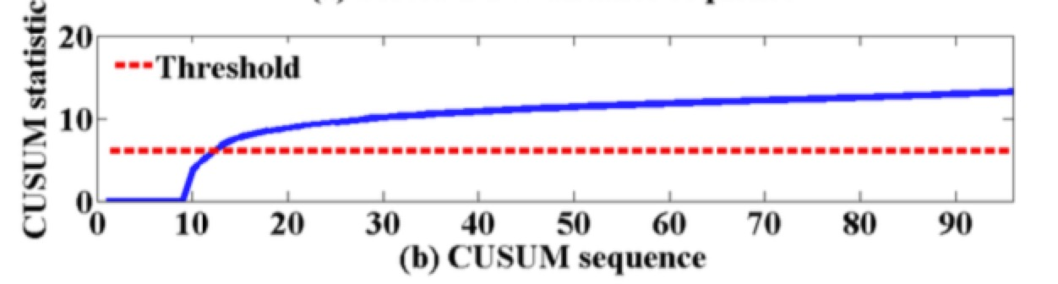
CUSUM
CUSUM
To adaptively determine the value of K
18

Slide 19
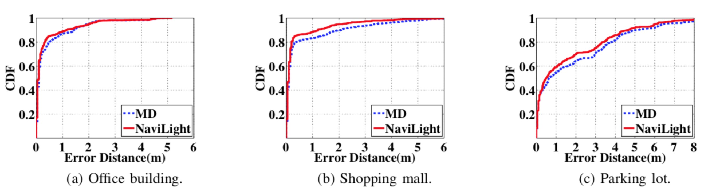
Outcome
19

Slide 20
Pros & Cons
Innovations
Leverage information from unmodified luminaries.
Less user interaction compared to FlashLoc.
Distance does not matter;
More to explore
Still requires the user to actively cooperate with the system
Vulnerable to sunlight (change the light fingerprinting significantly)
Assist in Camera-related computer vision methods (coarse localization)
20

