Slide 1
Enhancing Therapeutic Interventions Through Technology
DSCI 4810- Artificial Intelligence
Gunn Madan

Slide 2
Table of contents
01
02
03
04
05
06
Introduction
Data Exploration
Fuzzy Risk
Model Evaluation
Streamlit
Conclusion

Slide 3
Problem Statement
Current assessments for health risks rely heavily on subjective surveys and are often delayed, missing early intervention opportunities.
Wearable devices (e.g., Fitbit watch) provide continuous, objective physiological data such as sleep, heart rate, and activity patterns.
This project explores how machine learning and fuzzy logic can transform raw sensor data into early personalized health risk predictions.

Slide 4
Motivation
Early risk detection using wearable data can lead to proactive interventions before health deterioration occurs.
Fuzzy logic enables modeling of uncertainty in health indicators, moving beyond rigid classifications.
Machine learning models and an interactive application can deliver personalized, real-time feedback to empower users.

Slide 5
Dataset Overview
Source
Features
Records Collected
Fitbit wearable device data (public health dataset)
Data Source: Kaggle
30-90 days of daily sleep, activity, and heart rate data per user
Sleep metrics
Physical activity metrics
Cardiovascular metrics

Slide 6
Data Preparation
Merged seven Fitbit datasets, including daily activity, intensities, steps, sleep records, and second-by-second heart rate measurements.
Standardized all date columns to a consistent daily format (YYYY-MM-DD) for accurate merging
Aggregated second-level heart rate data into daily average heart rates to match the granularity of daily activity and sleep metrics.
Engineered features:
Calculated Sleep Efficiency
Created Fuzzy Risk Scores using fuzzy logic
Labeled users into Risk Categories: Low, Medium, High Risk.

Slide 7
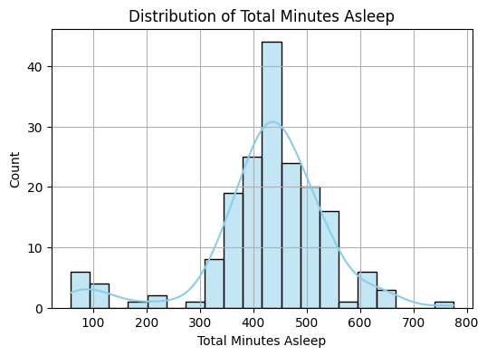
Exploring Key Features
Most users sleep between 5-8 hours per night.
A noticeable portion sleeps below recommended thresholds (under 6 hours).

Slide 8
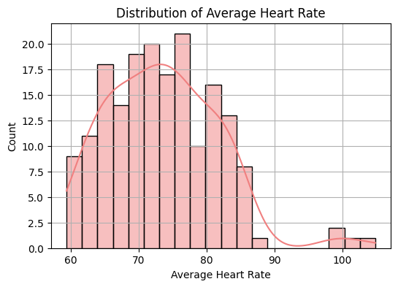
Exploring Key Features
Majority of users have heat rates between 60-85 bpm.
Some users show elevated resting heart rates (above 90 bpm), indicating possible stress or health risks.
Notes:
"Health indicators like sleep duration and heart rate aren't simply healthy or unhealthy — they exist along a spectrum. This justified using fuzzy logic instead of rigid thresholds in our modeling."

Slide 9
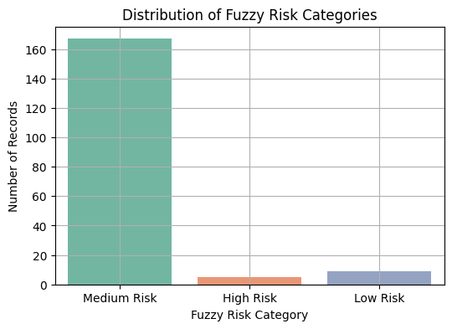
Fuzzy Risk Categories
Population Bias: The Fitbit dataset mainly represents generally healthy, active users, not clinical patients.
Most users showed mild to moderate risk factors, but had not yet deteriorated into critical conditions.
The fuzzy logic thresholds were intentionally designed to flag only severe multi-factor risks as High Risk, making the label rare but meaningful.

Slide 10
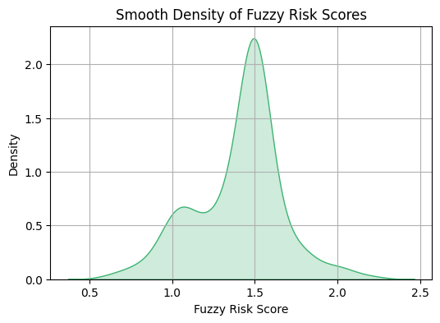
Fuzzy Risk Scoring
Traditional hard thresholds oversimplify real health risks
Modeled risk as a continuous score; Assigned users to Low, Medium, or High Risk based on fuzzy membership scores.
Outcome: captured gradual transitions between risk categories; reflected real-world uncertainty more accurately than binary classification.
Notes:
Traditional hard thresholds (e.g., "heart rate > 90 bpm = unhealthy")

Slide 11
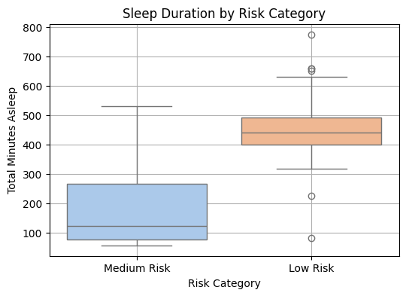
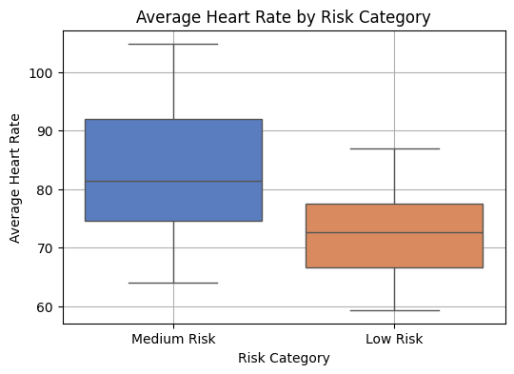
Feature Distributions by Risk Category
Notes:
Traditional hard thresholds (e.g., "heart rate > 90 bpm = unhealthy")

Slide 12
ML Models Overview
Logistic Regression
SVM
Used as a baseline to establish basic classification performance on wearable health data.
Tested for its strength in separating classes when users have subtle, overlapping health risks.
Random Forest
XGBoost
Used to handle feature variability and prevent overfitting with ensemble averaging.
Deployed to achieve highest predictive performance, especially on a dataset with mild class imbalance (few High Risk Users)

Slide 13
Data Collection Techniques
Model | Accuracy | Macro F1 Score | Notes
Logistic Regression | 98.19% | 0.94 | Extremely strong performance
Random Forest | 98.19% | 0.94 | Same as LR; good robustness
SVM | 90.91% | 0.48 | Only predicted low risk well; failed on medium risk
XGBoost | 98.13% | 0.94 | Strong overall; imbalance smoothly

Slide 14
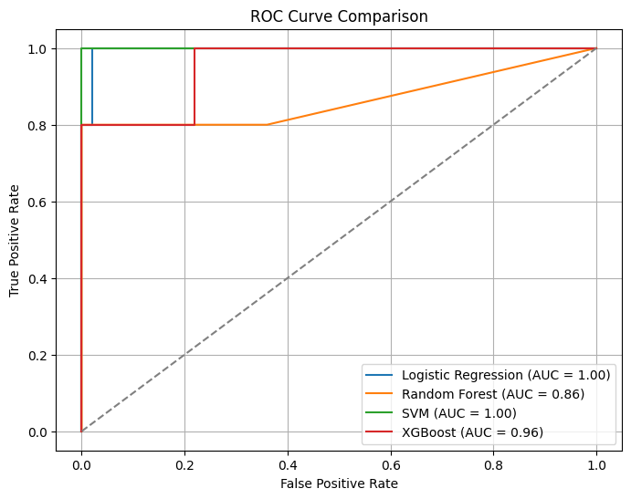
ROC Curve Comparison
All ML models tested achieved near-perfect ROC curves indicating excellent true positive rates across thresholds.
SVM underperformed in distinguishing Medium Risk users, resulting in a lower AUC.
XGBoost exhibited the best overall curve, suggesting strong model robustness and ability to handle mild class imbalance.
Notes:
Traditional hard thresholds (e.g., "heart rate > 90 bpm = unhealthy")

Slide 15
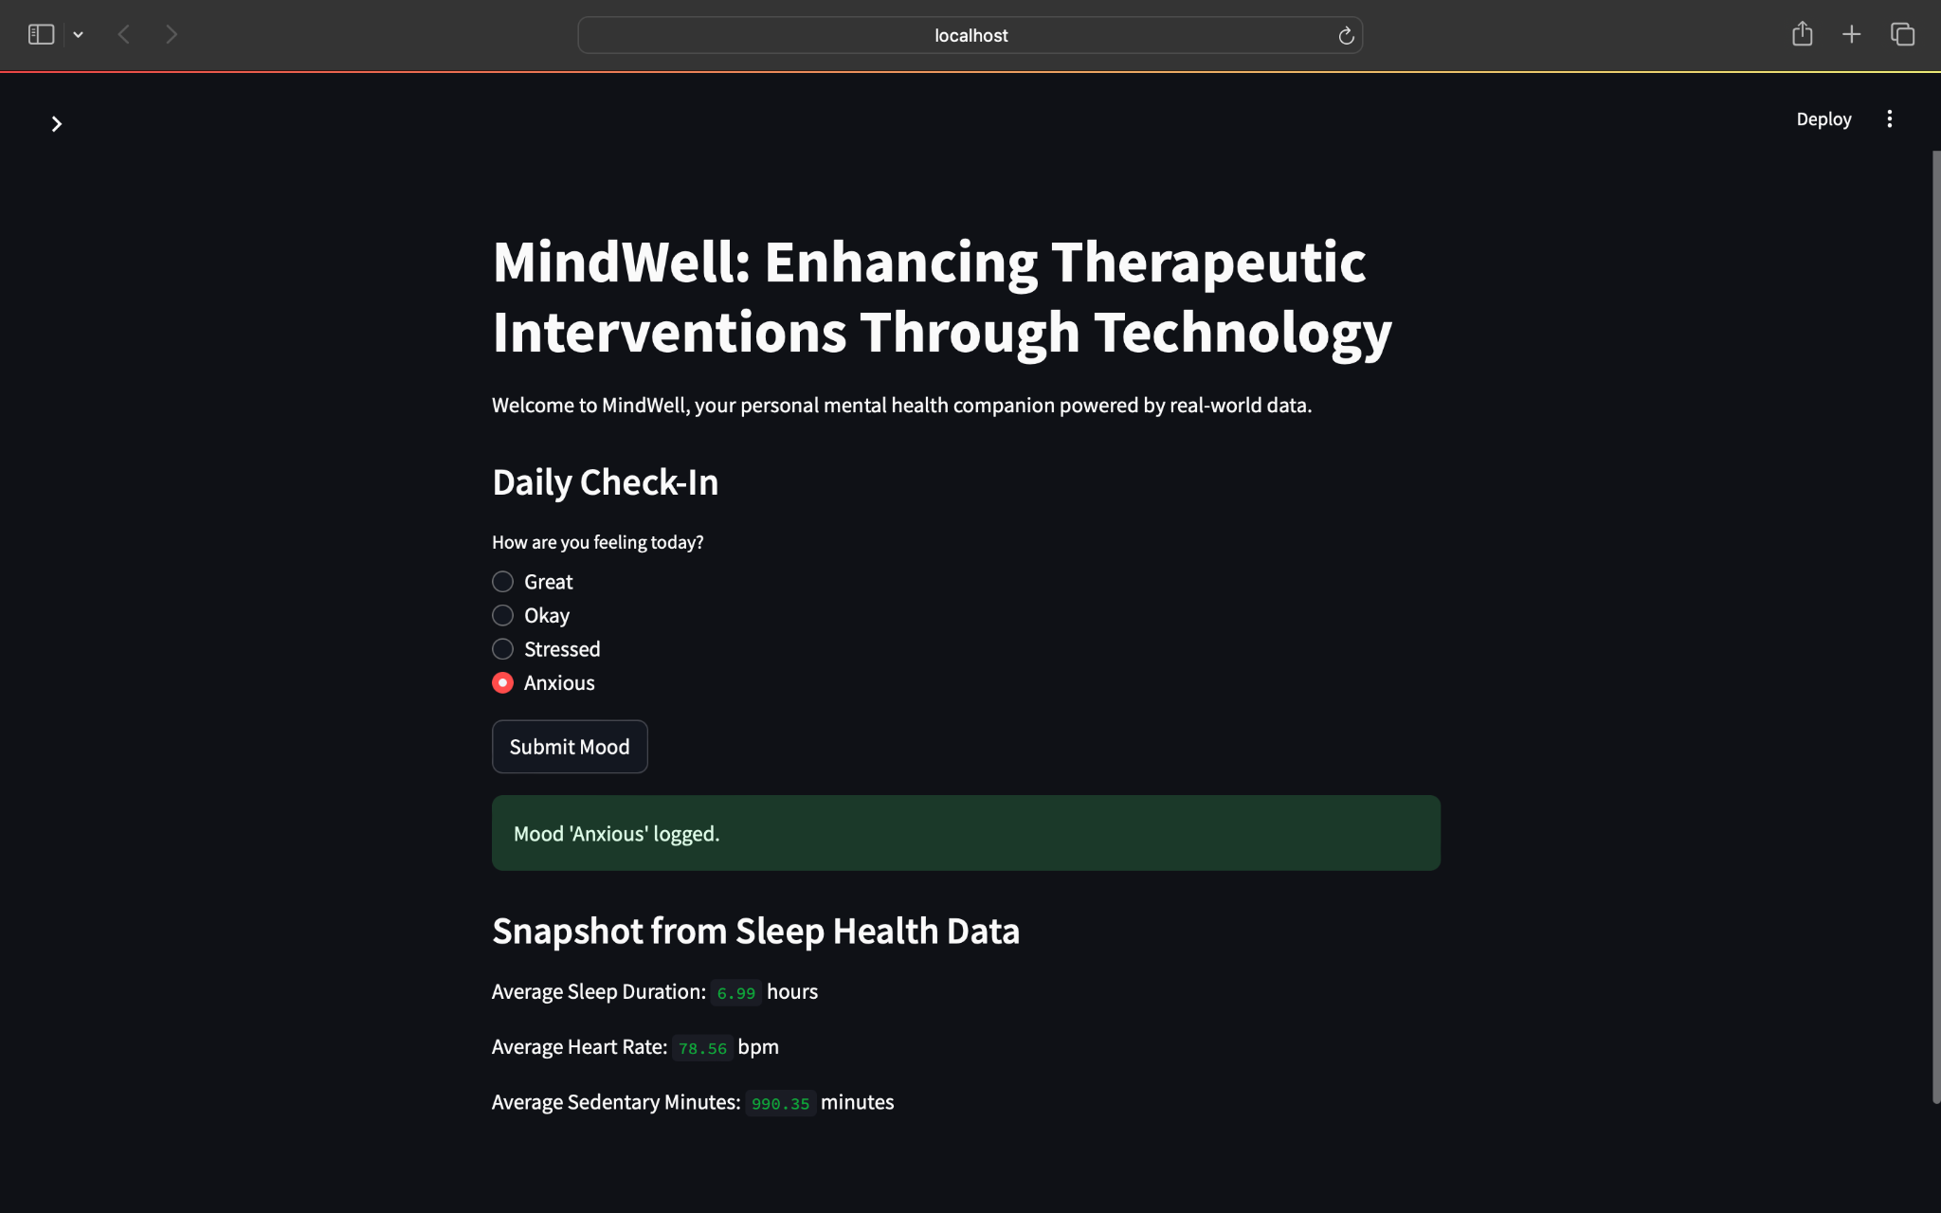
Streamlit App Overview

Slide 16
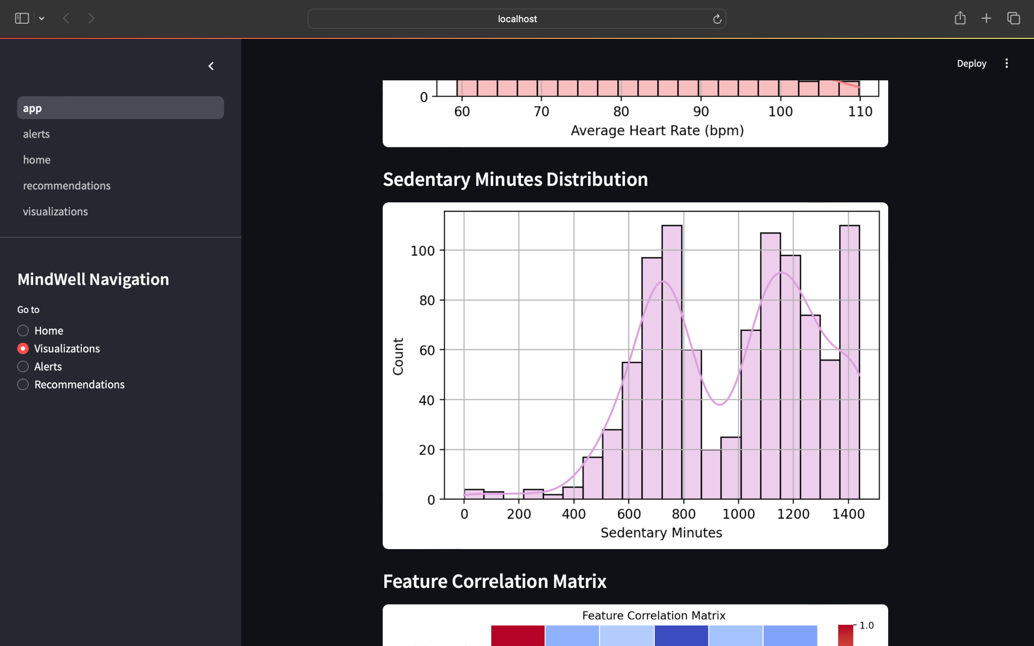

Slide 17
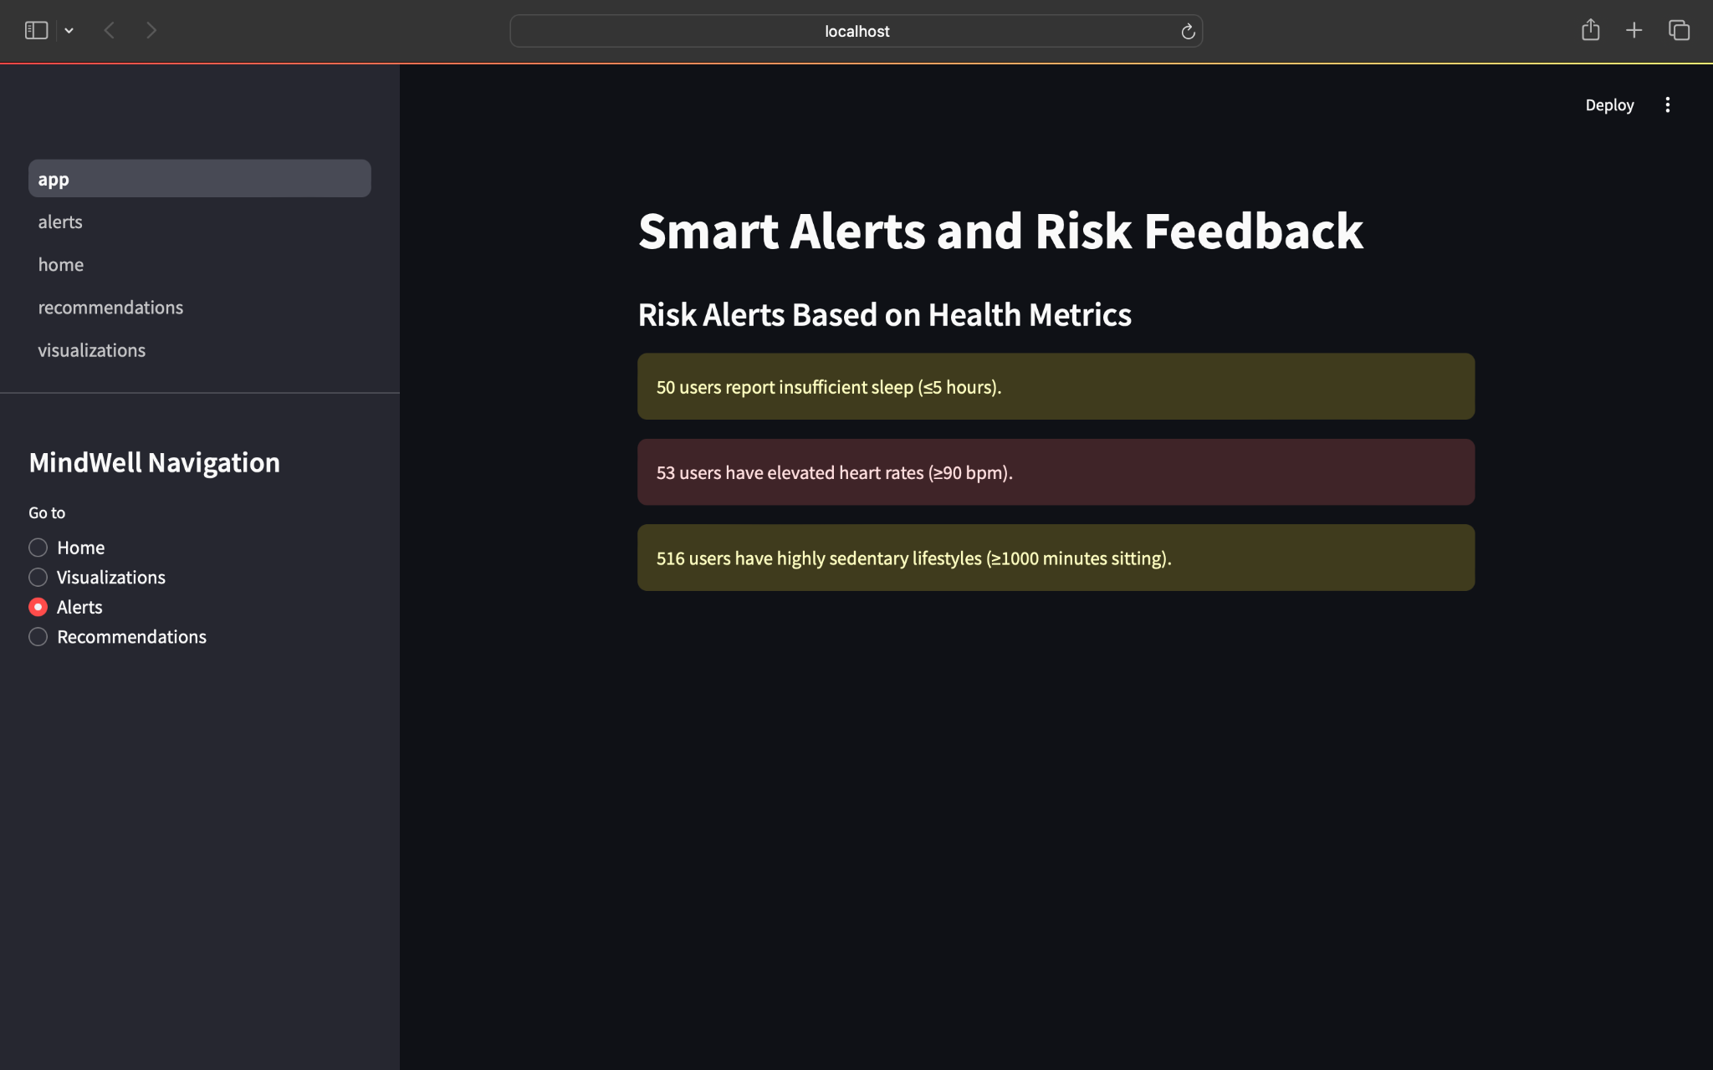

Slide 18
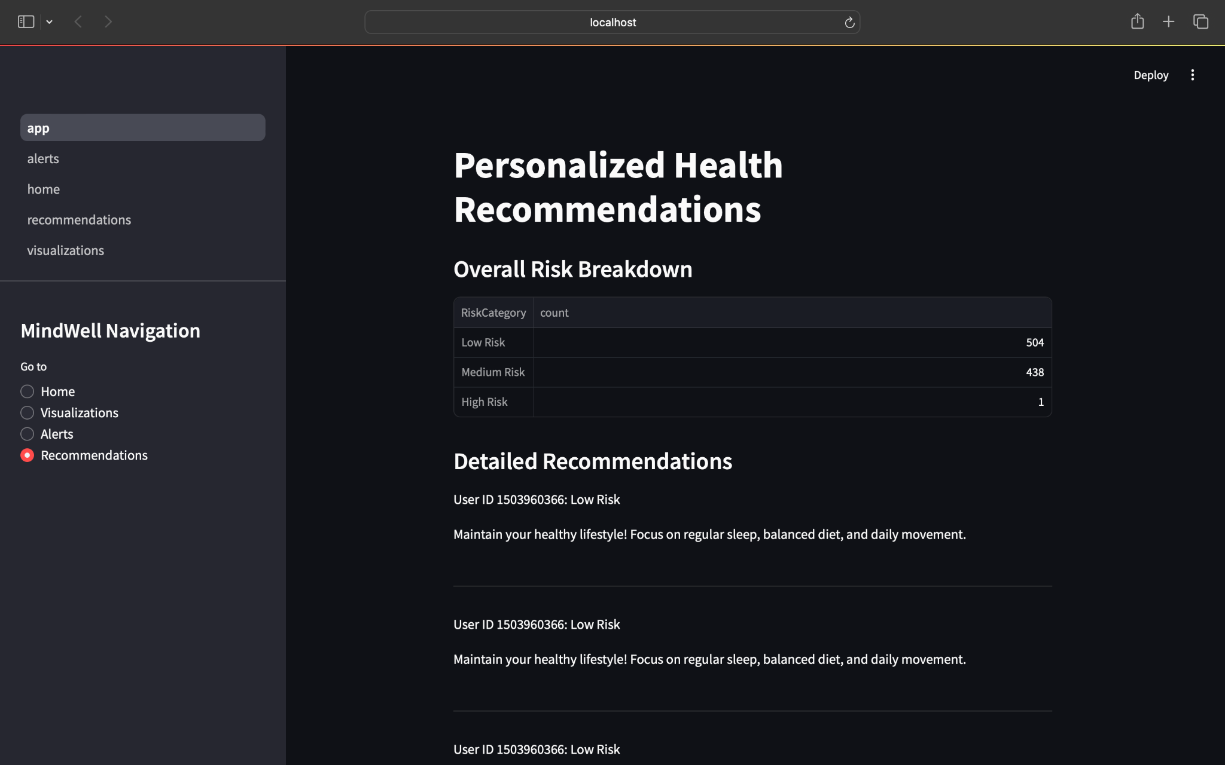

Slide 19
Improvements and Findings
In real-world wearable datasets, severe (High Risk) cases are rare, reflecting that most users exhibit mild to moderate risks — supporting the need for sensitive, uncertainty-aware modeling like fuzzy logic.
Expand dataset with longitudinal tracking and a more diverse user population to enhance model generalizability.
Integrate additional physiological signals such as stress scores, oxygen saturation, and continuous heart rate variability for deeper risk modeling.
Notes:
Traditional hard thresholds (e.g., "heart rate > 90 bpm = unhealthy")

Slide 20
Conclusion
MindWell demonstrates how wearable health data, fuzzy logic, and machine learning can be integrated to enable early detection of health risks.
By modeling real-world uncertainty and delivering personalized feedback through an interactive system, this research advances the potential for proactive, user-centered healthcare interventions.
This work highlights the need for intelligent, flexible AI systems to bridge the gap between raw physiological data and actionable early health insights.
Notes:
Traditional hard thresholds (e.g., "heart rate > 90 bpm = unhealthy")

Slide 21
Thanks!
Resources/Appendix:
GitHub Repository (Source Code) + README
Project Proposal
Final Project Report (IEEE)
Please keep this slide for attribution

