Slide 1




计算机系统
选题五
计科1907第二组
印

Slide 2
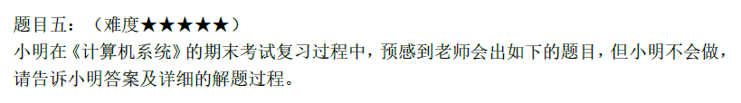
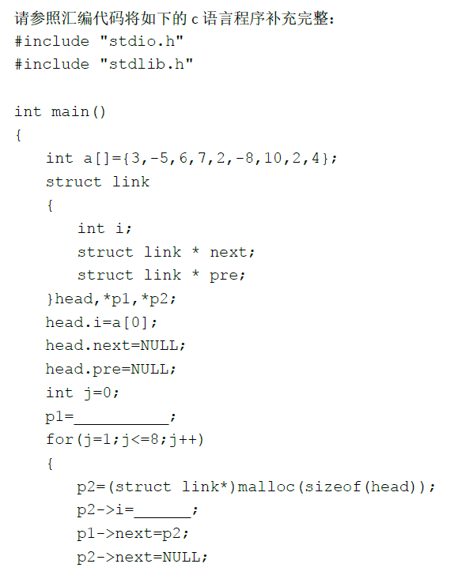
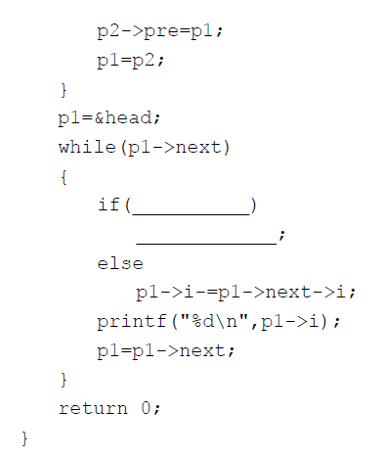
题目

Slide 3
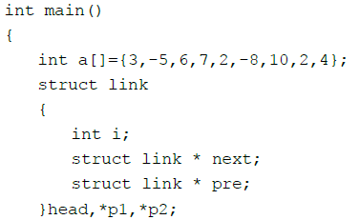

main
main:
pushl %ebp //调用者ebp入栈
movl %esp, %ebp //esp、ebp拉平
andl $-16, %esp //-16的16进制补码表示为0xfffffff0,将esp置为16的倍数
subl $80, %esp //esp下移80个字 节，main函数栈帧开辟完毕
movl $3, 20(%esp) //a[0]=3
movl $-5, 24(%esp) //a[1]=-5
movl $6, 28(%esp) //a[2]=6
movl $7, 32(%esp) //a[3]=7
movl $2, 36(%esp) //a[4]=2
movl $-8, 40(%esp) //a[5]=-8
movl $10, 44(%esp) //a[6]=10
movl $2, 48(%esp) //a[7]=2
movl $4, 52(%esp) //a[8]=4
函数栈帧开辟
36int数组+12head+4*2 p1p2
+4int j+20传递参数
放入a数组

Slide 4
 | 栈 | 地址
 |  | esp+76
 |  | esp+72
 |  | esp+68
 |  | esp+64
 |  | esp+60
 |  | esp+56
 |  | esp+52
 |  | esp+48
 |  | esp+44
 |  | esp+40
 |  | esp+36
 |  | esp+32
 |  | esp+28
 |  | esp+24
 |  | esp+20
 |  | esp+16
 |  | esp+12
 |  | esp+8
 |  | esp+4
 |  | esp+0
main帧的开辟
a[8] | 4 | esp+52
a[7] | 2 | esp+48
a[6] | 10 | esp+44
a[5] | -8 | esp+40
a[4] | 2 | esp+36
a[3] | 7 | esp+32
a[2] | 6 | esp+28
a[1] | -5 | esp+24
a[0] | 3 | esp+20

Slide 5
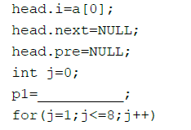
movl 20(%esp), %eax //eax=3
movl %eax, 56(%esp) //esp+56是head结构体变量的首地址，head.i=3
movl $0, 60(%esp) //head.next=0
movl $0, 64(%esp) //head.pre=0
movl $0, 72(%esp) //j=0
leal 56(%esp), %eax //eax=esp+56,即head首地址
movl %eax, 68(%esp) //esp+68是p1的地址，该内存单元的值为head首地址
movl $1, 72(%esp) //j=1
jmp .L2 //无条件跳转至.L2
main
head.i = a[0];
head.next = NULL;
head.pre = NULL;
int j = 0;
p1 = &head;
进入for (j = 1; j <= 8; j++)

Slide 6
 | 栈 | 地址
 |  | esp+76
 |  | esp+72
 |  | esp+68
 |  | esp+64
 |  | esp+60
 |  | esp+56
 |  | esp+52
 |  | esp+48
 |  | esp+44
 |  | esp+40
 |  | esp+36
 |  | esp+32
 |  | esp+28
 |  | esp+24
 |  | esp+20
 |  | esp+16
 |  | esp+12
 |  | esp+8
 |  | esp+4
 |  | esp+0
main帧的开辟
j | 0 | esp+72
p1 | esp+56 | esp+68
head.pre | 0 | esp+64
head.next | 0 | esp+60
head.i | 3 | esp+56
a[8] | 4 | esp+52
a[7] | 2 | esp+48
a[6] | 10 | esp+44
a[5] | -8 | esp+40
a[4] | 2 | esp+36
a[3] | 7 | esp+32
a[2] | 6 | esp+28
a[1] | -5 | esp+24
a[0] | 3 | esp+20

Slide 7


for循环判别条件
.L2: //for循环判别条件
cmpl $8, 72(%esp) //比较j和8的大小关系
jle .L3 //如果j<=8,跳转至.L3处，否则顺序执行下一条指令
leal 56(%esp), %eax //eax=head首地址
movl %eax, 68(%esp) //p1=&head
jmp .L4 //无条件跳转至.L4

Slide 8

for循环体
.L3: //for循环体
movl $12, (%esp) //12作为malloc函数参数传递
call malloc //调用malloc函数
movl %eax, 76(%esp) //函数返回值p2存入76(%esp)
movl 72(%esp), %eax //eax=j
movl 20(%esp,%eax,4), %eax //eax=a[j]
movl %eax, %edx //edx=a[j]
imull 72(%esp), %edx //edx=j*a[j]
movl 76(%esp), %eax //eax=p2
movl %edx, (%eax) //p2->i=j*a[j]

Slide 9



for循环体
movl 68(%esp), %eax //eax=p1
movl 76(%esp), %edx //edx=p2
movl %edx, 4(%eax) //p1->next=p2
movl 76(%esp), %eax //eax=p2
movl $0, 4(%eax) //p2->next=0
movl 76(%esp), %eax //eax=p2
movl 68(%esp), %edx //edx=p1
movl %edx, 8(%eax) //p2->pre=p1
movl 76(%esp), %eax //eax=p2
movl %eax, 68(%esp) //p1=p2
addl $1, 72(%esp) //j=j+1

Slide 10

 |  | ebp
 |  | esp+76
j | 0 | esp+72
p1 | esp+56 | esp+68
head.pre | 0 | esp+64
head.next | 0 | esp+60
head.i | 3 | esp+56
a[8] | 4 | esp+52
a[7] | 2 | esp+48
a[6] | 10 | esp+44
a[5] | -8 | esp+40
a[4] | 2 | esp+36
a[3] | 7 | esp+32
a[2] | 6 | esp+28
a[1] | -5 | esp+24
a[0] | 3 | esp+20
 |  | esp+16
 |  | esp+12
 |  | esp+8
 |  | esp+4
 |  | esp+0
p2 | 0x80843400 | esp+76
for循环
j | 1 | esp+72
p1 | 0x80843400 | esp+68
 | 堆 | 起始地址
 |  | 0x8084347C
 | 0x80843460 | 0x80843478
 | 0 | 0x80843474
 | 8*4=32 | 0x80843470
 | … | …
 |  | 0x8084342C
 | 0x80843410 | 0x80843428
 | 0x80843430 | 0x80843424
 | 3*7=21 | 0x80843420
 |  | 0x8084341C
 | 0x80843400 | 0x80843418
 | 0x80843420 | 0x80843414
 | 2*6=12 | 0x80843410
 |  | 0x8084340C
 | esp+56 | 0x80843408
 | 0x80843410 | 0x80843404
 | 1*（-5）=-5 | 0x80843400
head.next | 0x80843400 | esp+60
 | 堆 | 起始地址
 |  | 0x80843420
 |  | 0x8084341C
 |  | 0x80843418
 |  | 0x80843414
 |  | 0x80843410
 |  | 0x80843410
 |  | 0x8084340C
p2->pre |  | 0x80843408
p2->next |  | 0x80843404
p2->i |  | 0x80843400
p2->pre | esp+56 | 0x80843408
p2->next | 0 | 0x80843404
p2->i | -5 | 0x80843400
参数传递 | 12 | esp+0

Slide 11


while循环判别条件
.L4: //while循环判别条件
movl 68(%esp), %eax //eax=p1=head首地址
movl 4(%eax), %eax //eax=head.next=p1->next
testl %eax, %eax //p1->next&p1->next
jne .L7 //如果p1->next不为0，跳转至.L7,否则，顺序执行下一条指令
movl $0, %eax //eax=0
leave //leave=movl %ebp,%esp+popl %ebp 依次是将esp、ebp拉平，将调用者ebp弹出给ebp
ret //ret=popl %eip 将返回地址弹给eip，栈帧恢复到调用者，从call指令的下一条指令继续执行

Slide 12
while循环体中分支判断
.L7: //while循环体中分支判断
movl 68(%esp), %eax //eax=p1=&head
movl (%eax), %edx //edx=head.i=p1->i
movl 68(%esp), %eax //eax=p1=&head
movl 4(%eax), %eax //eax=head.next=p1->next
movl (%eax), %eax //eax=p1->next->i
leal (%edx,%eax), %ecx //ecx=p1->i+p1->next->i
movl 68(%esp), %eax //eax=p1=&head
movl (%eax), %edx //edx=head.i=p1->i
movl 68(%esp), %eax //eax=p1=&head
movl 4(%eax), %eax //eax=head.next=p1->next
movl (%eax), %eax //eax=p1->next->i
imull %edx, %eax //eax=p1->i*p1->next->i
movl %eax, %edx //edx=p1->i*p1->next->i
shrl $31, %edx //将edx逻辑右移31位，正数得0，负数得1
addl %edx, %eax //eax=p1->i*p1->next->i+0(正数)或eax=p1->i*p1->next->i+1(负数)
sarl %eax //eax算数右移一位，以上三步实际上实现了eax=(p1->i*p1->next->i)/2
cmpl %eax, %ecx //比较ecx和eax的大小关系

Slide 13
while循环体中分支判断
jle .L5 //如果ecx<=eax,跳转至.L5,否则顺序执行下一条指令
movl 68(%esp), %eax //eax=p1=&head
movl (%eax), %edx //edx=head.i=p1->i
movl 68(%esp), %eax //eax=p1=&head
movl 4(%eax), %eax //eax=head.next=p1->next
movl (%eax), %eax //eax=p1->next->i
addl %eax, %edx //edx=p1->i+p1->next->i
movl 68(%esp), %eax //eax=p1=&head
movl %edx, (%eax) //p1->i=p1->i+p1->next->i
jmp .L6 //无条件跳转至.L6

Slide 14
注意：68(%esp)=p1
else分支
.L5: //else分支
movl 68(%esp), %eax //eax=p1=&head
movl (%eax), %edx //edx=head.i=p1->i
movl 68(%esp), %eax //eax=p1=&head
movl 4(%eax), %eax //eax=head.next=p1->next
movl (%eax), %eax //eax=(p1->next)->i
subl %eax, %edx //edx=(p1->i)-((p1->next)->i)
movl 68(%esp), %eax //eax=p1=&head
movl %edx, (%eax) //p1->i=(p1->i)-((p1->next)->i)
对应的c++代码
while (p1->next)
{
if (p1->i + p1->next->i > (p1->i * p1->next->i) / 2)
p1->i += p1->next->i;
else
p1->i -= p1->next->i;
printf("%d\n", p1->i);
p1 = p1->next;
}

Slide 15
.L6
C代码：
printf("%d\n", p1->i);
p1 = p1->next;
汇编代码：
……//进行if判断
jle L5 //if判断为假则跳转到L5
…… //if判断为真则执行
jmp .L6 //无条件跳转至.L6
.L5: //else分支
…… //else的具体语句
.L6: //while循环体后半段，if条件句执行完毕之后的printf语句
movl 68(%esp), %eax
movl (%eax), %edx
movl $.LC0, %eax
movl %edx, 4(%esp)
movl %eax, (%esp)
call printf
movl 68(%esp), %eax
movl 4(%eax), %eax
movl %eax, 68(%esp)
.L4: //循环条件判断
……
可以看到L6中有printf调用，就能判断出是在执行输出语句。之后就是更新p1为下一个结点。然后进入下一次循环的条件判断。
如果从整体汇编代码来看，可以发现在jle L5之前是进行if条件的判断，如果判断为假就跳转到L5，通过对L5的分析可以发现L5是在执行else分支的语句。之后就进入到L6了，而在C代码中else执行完之后就是执行printf和更新p1，这也是证据之一；如果if判断为真就直接顺序执行，然后jmp L6，在C代码中也一样是if判断为真并且执行完毕之后就进行printf和更新p1了，这是证据之二。

Slide 16
.L6的功能
$.LC0
.L6: /*while循环体后半段，if条件句执行完 毕之后的printf语句*/
movl 68(%esp), %eax //eax=p1
movl (%eax), %edx //edx=p1->i
movl $.LC0, %eax //将.LC0内容送给eax,可能是%d\n
movl %edx, 4(%esp) //edx作为printf函数的第二个参数
movl %eax, (%esp) //eax作为printf函数的第一个参数
call printf //调用printf函数，并且输出”p1->i\n”
movl 68(%esp), %eax //eax=p1=&head
movl 4(%eax), %eax //eax=head.next=p1->next
movl %eax, 68(%esp) //p1=p1->next

Slide 17
 |  | ebp
 |  | esp+76
j | 0 | esp+72
p1 | esp+56 | esp+68
head.pre | 0 | esp+64
head.next | 0 | esp+60
head.i | 3 | esp+56
a[8] | 4 | esp+52
a[7] | 2 | esp+48
a[6] | 10 | esp+44
a[5] | -8 | esp+40
a[4] | 2 | esp+36
a[3] | 7 | esp+32
a[2] | 6 | esp+28
a[1] | -5 | esp+24
a[0] | 3 | esp+20
 |  | esp+16
 |  | esp+12
 |  | esp+8
 |  | esp+4
 |  | esp+0
p2 | 0x80843480 | esp+76
while循环
j | 8 | esp+72
p1 | 0x80843480 | esp+68
p1 | esp+56 | esp+68
 | 堆 | 起始地址
 |  | 0x8084347C
 | 0x80843460 | 0x80843478
 | 0 | 0x80843474
 | 8*4=32 | 0x80843470
 | … | …
 |  | 0x8084342C
 | 0x80843410 | 0x80843428
 | 0x80843430 | 0x80843424
 | 3*7=21 | 0x80843420
 |  | 0x8084341C
 | 0x80843400 | 0x80843418
 | 0x80843420 | 0x80843414
 | 2*6=12 | 0x80843410
 |  | 0x8084340C
 | esp+56 | 0x80843408
 | 0x80843410 | 0x80843404
 | 1*（-5）=-5 | 0x80843400
head.next | 0x80843400 | esp+60
head.i | -2 | esp+56
 | 32 | 0x80843470
 | 13 | 0x80843420
 | -9 | 0x80843410
 | 7 | 0x80843400
参数传递 | 12 | esp+0

Slide 18
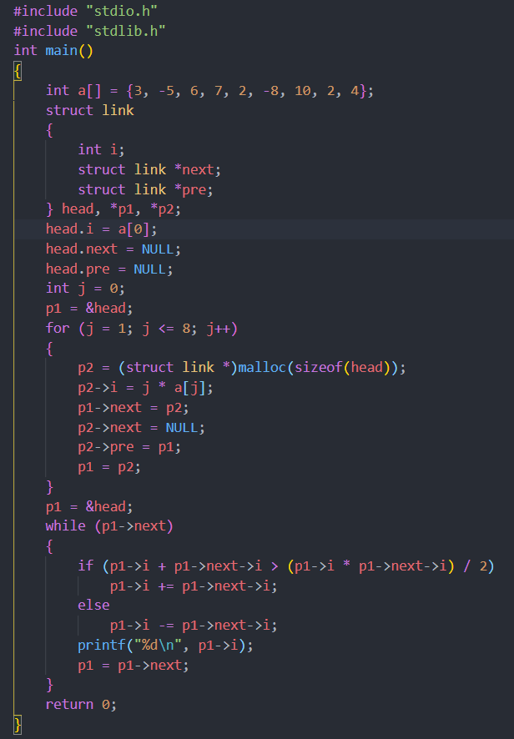

完整C代码
及运行结果

Slide 19


印

