Slide 1
Backbone with Socket.IO
Nate Hunzaker
Frontend Developer,
Smashing Boxes

Slide 2

Backbone.js
A lightweight framework designed to turn spaghetti Javascript into well formed, logical code.
Spaghetti.js
(Not Backbone.js)

Slide 3
Structure : MVCR
Model
Container
View
Router

Slide 4







Why ?

Slide 5
It Fights Entropy
Fewer incentives to produce jQuery Chains from hell:
$(“#father”).fadeOut()
.filter(“#child”)
.fadeIn(500)
.siblings(“#brother”)
.animate({ width: “+=24” }, 500, function(){
// Do something
})
.end()
.find(“#mother”)
.fadeIn().
.text(“Hey Ma, look at my jQuery Skills!”);

Slide 6
TwitterMap Example

Slide 7
It’s Easy to Extend
var CustomModel = Backbone.Model.extend({
defaults: {
name: ‘Unknown’,
title: ‘Mr.’
}
combined: function() {
return this.get(‘title’) + this.get(‘name’);
}
});
var people = new CustomModel({
name: ‘Nate Hunzaker’,
});
alert(people.combine()) //=> “Mr. Nate Hunzaker”

Slide 8
Backbone.Server Example

Slide 9


It Plays Nice with Ruby (Rack)
Backbone == ERB Tempaltes == Rails/Sinatra/etc…
Same templates on the front end and backend is for the win

Slide 10
Backbone Blog Example

Slide 11
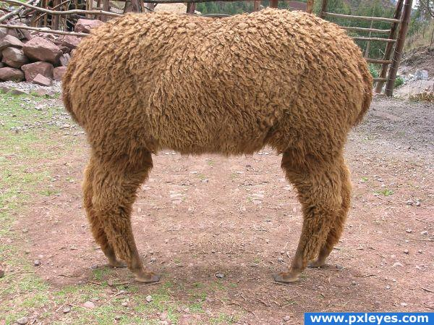
Better Methods
Less pull, more push

Slide 12
Socket.IO
Adds broad support for Websockets, allowing for high speed communication between clients and servers.
Excellent Browser support.

Slide 13
NowJS
Less painful Socket.IO.
Creates a global “now” object which acts as a way point.

Slide 14
PokemonJS

Slide 15
// NowJS
var nowjs = require('now'),
everyone = nowjs.initialize(app);
nowjs.on('connect', function () {
everyone.now.addSprite(this.now.name);
});
nowjs.on('disconnect', function() {
everyone.now.removeSprite(this.now.name);
});
everyone.now.distCoords = function(name, dir, loc){
everyone.now.receiveCoords(name, direction, location);
};

Slide 16
Pulling it together (Patchwork Example)

