Slide 1



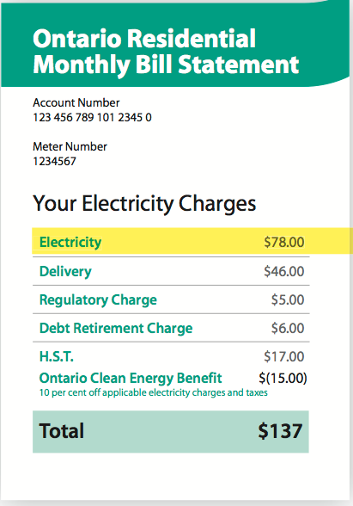


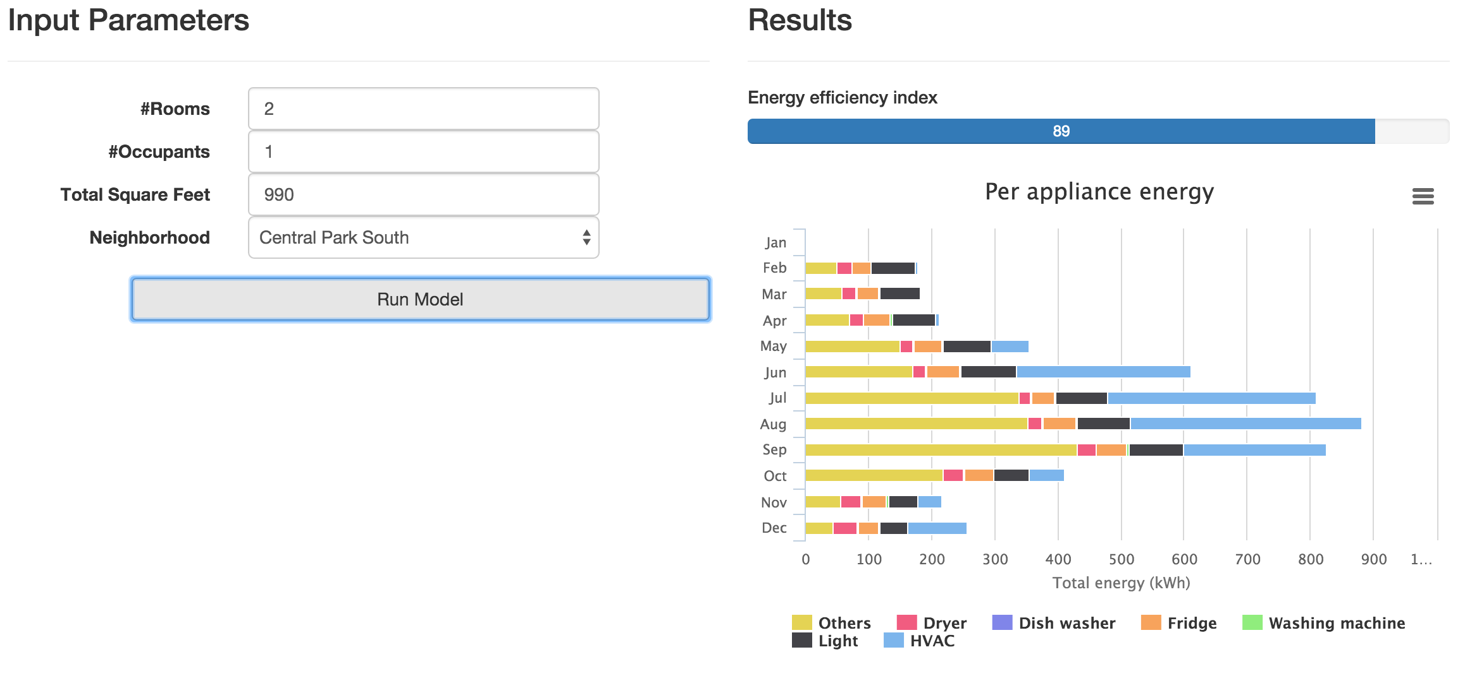

Matrix Factorisation for Scalable Energy Breakdown
Nipun Batra, Hongning Wang, Amarjeet Singh, Kamin Whitehouse
IIIT Delhi, University of Virginia
Goal
Approach
Results
To create an energy breakdown for million homes. Can save up to 15% on energy bills.
Our approach can produce an energy breakdown without installing new hardware in every home
Our approach can be more accurate than alternatives, with lower cost. Thus, more scalable.
Key insight: Much of the variation in energy data across buildings occurs along a relatively small number of dimensions
Alternative approaches
Existing solutions require hardware in every home, so cost scales linearly with the number of homes.
Step 1: Add easy to collect monthly bills in the matrix. Historical bills add more value.
Step 1I: Submeter small #homes (train) to create matrix X
1. Appliance submetering
Monthly bill
 | $ 80 | $ 10 | $ 40
 | $ 70 | $ 60 | $ 10
 | $ 20 | $ 30 | $ 80
… | … | … | …
 | $ 30 | $ 40 | $ 50
Appliance
sensor
 | $ 40 | $ 10 | $ 40 | $ 500
 | $ 70 | $ 60 | $ 10 | $ 400
 | ? | ? | ? | $ 300
… | … | … | … | …
 | ? | ? | ? | $ 500
Web application
Train
Our web application can potentially provide energy breakdown to 60 million homes
Test
1I. Source separation
Step III: Perform non-negative matrix factorisation. X~AB. Include static information, such as area of homes, to guide factorisation.
Signal
separation
$20
$80
$15
Smart
meter
Step IV: Predict energy breakdown from factors.

