Slide 1
Classification and Prediction
What is classification? What is prediction?
Issues regarding classification and prediction
Classification by decision tree induction
Bayesian classification
Rule-based classification
Support vector machines
Associative classification
Lazy learners (or learning from your neighbors)
Ensemble methods
Model selection
Summary

Slide 2
Classification vs. Prediction
Classification
predicts categorical class labels (discrete or nominal)
classifies data (constructs a model) based on the training set and the values (class labels) in a classifying attribute and uses it in uses it in classifying new data
Prediction
models continuous-valued functions, i.e., predicts unknown or missing values
Typical applications
Credit approval
Target marketing
Medical diagnosis
Fraud detection

Slide 3
Classification: A Two-Step Process
Model construction: describing a set of predetermined classes
Each tuple/sample is assumed to belong to a predefined class, as determined by the class label attribute
The set of tuples used for model construction is training set
The model is represented as classification rules, decision trees, or mathematical formulae
Model usage: for classifying future or unknown objects
Estimate accuracy of the model
The known label of test sample is compared with the classified result from the model
Accuracy rate is the percentage of test set samples that are correctly classified by the model
Test set is independent of training set, otherwise over-fitting will occur
If the accuracy is acceptable, use the model to classify data tuples whose class labels are not known

Slide 4
Model Construction
Classification
method
Training
Data
Classifier
(Model)
IF rank = ‘professor’
OR years > 6
THEN tenured = ‘yes’

Slide 5
Prediction
Classifier
Testing
Data
Unseen Data
(Jeff, Professor, 4)
Tenured?

Slide 6
Machine Learning Paradigms
Supervised learning (classification)
The training data (observations, measurements, etc.) are accompanied by labels indicating the class of the observations
Unsupervised learning (clustering)
The class labels of training data is unknown
Given a set of measurements, observations, etc. with the aim of establishing the existence of classes or clusters in the data
Reinforcement learning
how the methods take actions in an environment to maximize the cumulative reward

Slide 7
Evaluating Classification Methods
Accuracy
classifier accuracy: predicting class label
predictor accuracy: guessing value of predicted attributes
Speed
time to construct the model (training time)
time to use the model (classification/prediction time)
Robustness: handling noise and missing values
Scalability: efficiency in disk-resident databases
Interpretability
understanding and insight provided by the model
Other measures, e.g., goodness of rules, such as decision tree size or compactness of classification rules

Slide 8
Decision Tree

Slide 9
Decision Tree Induction: Training Dataset
Notes:
30% Japanese college students use cellular phones to write reports or theses

Slide 10
A Decision Tree for “buy”
age?
<=30
31..40
>40
student?
yes
credit rating?
no
yes
excellent
fair
no
yes
no
yes

Slide 11
Algorithm for Decision Tree Induction
Basic algorithm (a greedy algorithm)
Tree is constructed in a top-down recursive divide-and-conquer manner
At start, all the training examples are at the root
Attributes are categorical (if continuous-valued, they are discretized in advance)
Examples are partitioned recursively based on selected attributes
Test attributes are selected on the basis of a heuristic or statistical measure (e.g., information gain)
Conditions for stopping partitioning
All samples for a given node belong to the same class
There are no remaining attributes for further partitioning – majority voting is employed for classifying the leaf
There are no samples left

Slide 12
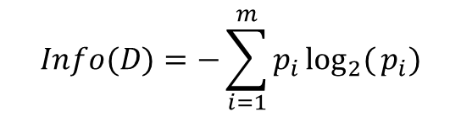
Attribute Selection Measure: Information Gain (ID3/C4.5)
Select the attribute with the highest information gain
Let p_{i} be the probability that an arbitrary tuple in D belongs to class C_{i}, estimated by |C_{i, D}|/|D|
Expected information (entropy) needed to classify a tuple in D:
Information needed (after using A to split D into v partitions) to classify D:
Information gained by branching on attribute A
這是整個資料集中要分類一筆資料所需要的平均資訊量，熵越高表示不確定性越高。
$$Info(D)=−\sum_{i=1}^{m}{p_{i}}\log_{2}{(}p_{i})$$
把資料根據屬性 A 分成 v 組（例如根據天氣分成「晴、陰、雨」三組），再加總各組的熵（加權平均）。
也就是切分前的不確定性減去切分後的不確定性。值越大，表示屬性 A 的分類效果越好。

Slide 13

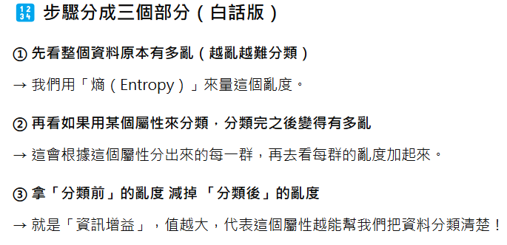
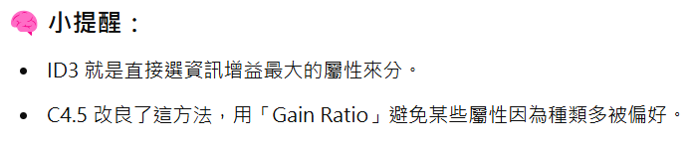

Slide 14
Attribute Selection: Information Gain
Class P: buy = “yes”
Class N: buy = “no”
means “age <=30” has 5 out of 14 samples, with 2 yes’es and 3 no’s. Hence
Similarly,

Slide 15
A Decision Tree for “buy”
age?
<=30
31..40
>40
student?
yes
credit rating?
no
yes
excellent
fair
no
yes
no
yes

Slide 16
Computing Information-Gain for Continuous-Value Attributes
Let attribute A be a continuous-valued attribute
Must determine the best split point for A
Sort the value A in increasing order
Typically, the midpoint between each pair of adjacent values is considered as a possible split point
(a_{i}+a_{i+1})/2 is the midpoint between the values of a_{i} and a_{i+1}
The point with the minimum expected information requirement for A is selected as the split-point for A
Split:
D1 is the set of tuples in D satisfying A ≤ split-point, and D2 is the set of tuples in D satisfying A > split-point

Slide 17
Gain Ratio for Attribute Selection (C4.5)
Information gain measure is biased towards attributes with a large number of values
C4.5 (a successor of ID3) uses gain ratio to overcome the problem (normalization to information gain)
GainRatio(A) = Gain(A)/SplitInfo_{A}(D) GainRatio(age) = 0.246/1.577 = 0.156
The attribute with the maximum gain ratio is selected as the splitting attribute
$$SplitInfo_{A}(D)=−\frac{5}{14}×\log_{2}{(}\frac{5}{14})−\frac{4}{14}×\log_{2}{(}\frac{4}{14})−\frac{5}{14}×\log_{2}{(}\frac{5}{14})=1.577$$

Slide 18
Gini index (CART, IBM IntelligentMiner)
If a data set D contains examples from n classes, gini index, gini(D) is defined as
where p_{j} is the relative frequency of class j in D
If a data set D is split on A into two subsets D₁ and D₂, the gini index gini(D) is defined as
Reduction in impurity:
The attribute provides the smallest gini_{split}(D) (or the largest reduction in impurity) is chosen to split the node (need to enumerate all the possible splitting points for each attribute)

Slide 19
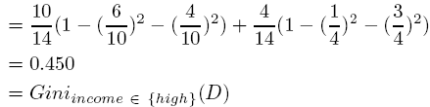
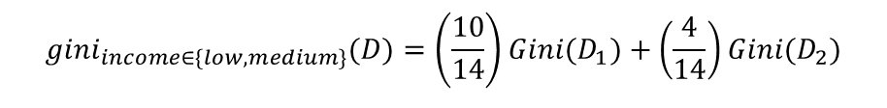
Gini index (CART, IBM IntelligentMiner)
Ex. D has 9 tuples in buy = “yes” and 5 in “no”
Suppose the attribute income partitions D into 10 in D₁: {low, medium} and 4 in D₂ : {High}
but gini_{{medium,high}} is 0.336 and thus the best since it is the lowest
All attributes are assumed continuous-valued
May need other tools, e.g., clustering, to get the possible split values
Can be modified for categorical attributes
$$gini_{income∈\{low,medium\}}(D)=\left(\frac{10}{14}\right)Gini(D_{1})+\left(\frac{4}{14}\right)Gini(D_{2})$$
 | Low | Medium | High
Buy | 1 | 5 | 3
Not buy | 3 | 1 | 1

Slide 20
Attribute Selection Measures
The three measures, in general, return good results but
Information gain:
biased towards multivalued attributes
Gain ratio:
tends to prefer unbalanced splits in which one partition is much smaller than the others
Gini index:
biased towards multivalued attributes
has difficulty when # of classes is large
tends to favor tests that result in equal-sized partitions and purity in both partitions

Slide 21
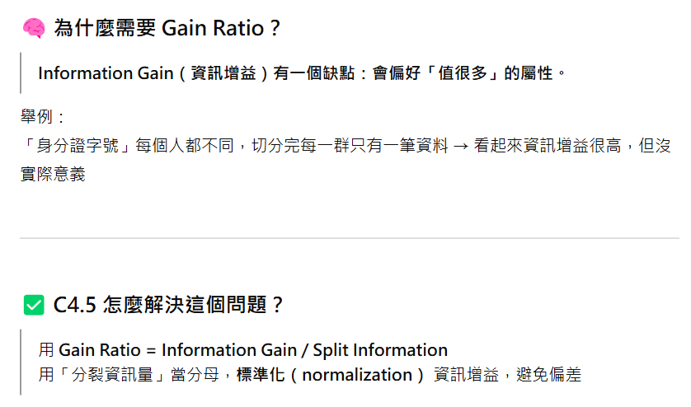
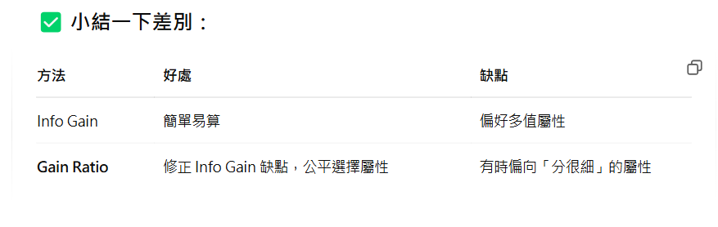

Slide 22
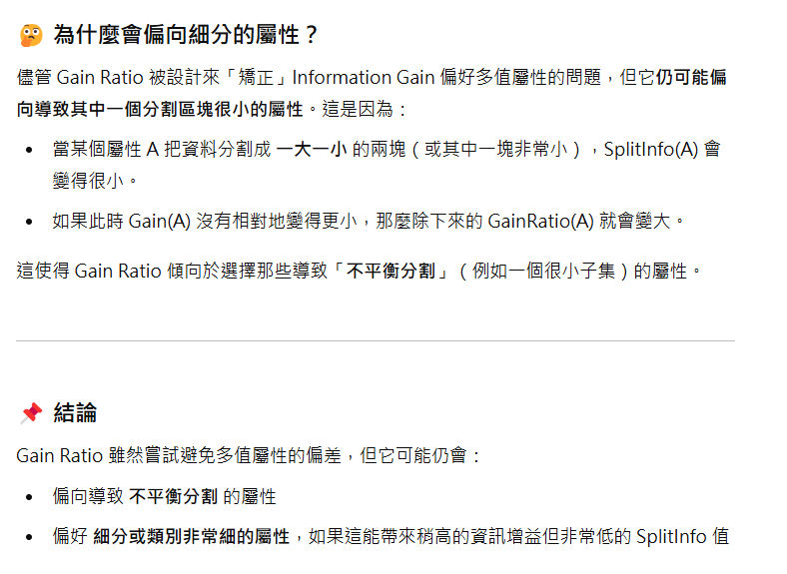

Slide 23
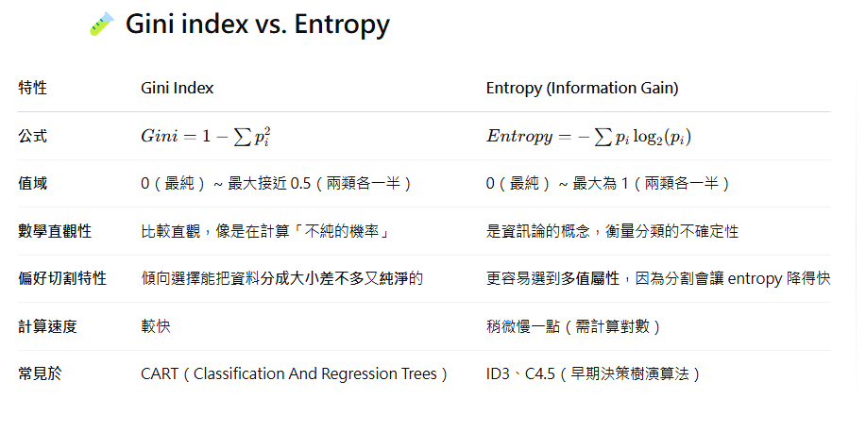

Slide 24
Overfitting and Tree Pruning
Overfitting: An induced tree may overfit the training data
Too many branches, some may reflect anomalies due to noise or outliers
Poor accuracy for unseen samples
Two approaches to avoid overfitting
Prepruning: Halt tree construction early—do not split a node if this would result in the goodness measure falling below a threshold
Difficult to choose an appropriate threshold
Postpruning: Remove branches from a “fully grown” tree—get a sequence of progressively pruned trees
Use a set of data different from the training data to decide which is the “best pruned tree”

Slide 25
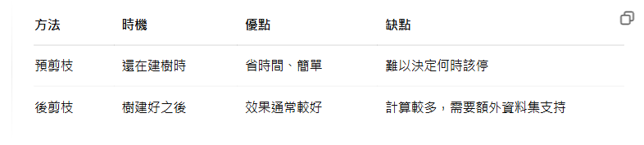

Slide 26
Enhancements to Basic Decision Tree Induction
Allow for continuous-valued attributes
Dynamically define new discrete-valued attributes that partition the continuous attribute value into a discrete set of intervals
Handle missing attribute values
Assign the most common value of the attribute
Assign probability to each of the possible values
Attribute construction
Create new attributes based on existing ones that are sparsely represented
This reduces fragmentation, repetition, and replication

Slide 27
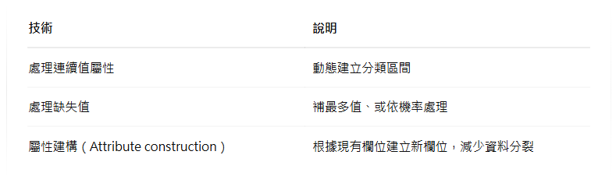

Slide 28
Classification in Large Databases
Classification—a classical problem extensively studied by statisticians and machine learning researchers
Scalability: Classifying data sets with millions of examples and hundreds of attributes with reasonable speed
Why decision tree induction in data mining?
relatively faster learning speed (than other classification methods)
convertible to simple and easy to understand classification rules
can use SQL queries for accessing databases
comparable classification accuracy with other methods

Slide 29
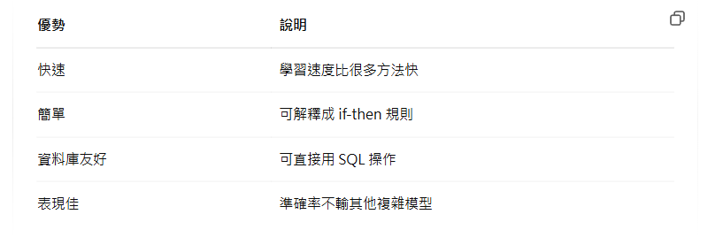

Slide 30
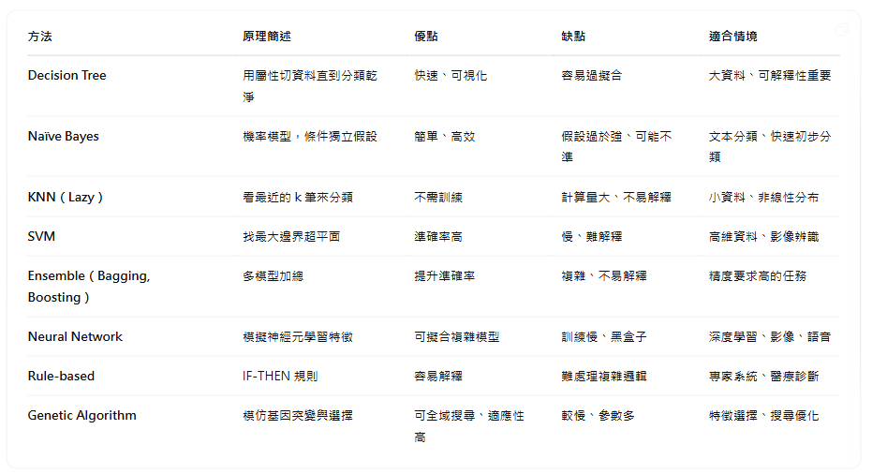

Slide 31
Bayesian Classification

Slide 32
Bayesian Classification: Why?
A statistical classifier: performs probabilistic prediction, i.e., predicts class membership probabilities
Foundation: Based on Bayes’ Theorem.
Performance: A simple Bayesian classifier, naïve Bayesian classifier, has comparable performance with decision tree and selected neural network classifiers
Incremental: Each training example can incrementally increase/decrease the probability that a hypothesis is correct — prior knowledge can be combined with observed data
Standard: Even when Bayesian methods are computationally intractable, they can provide a standard of optimal decision making against which other methods can be measured

Slide 33
Bayesian Theorem: Basics
已知這筆資料的特徵 X，這筆資料屬於類別 H 的機率是多少
Let X be a data sample (evidence): class label is unknown
Let H be a hypothesis that X belongs to class C_{i}, i=1, 2, …, k
Classification is to determine P(H|X), the probability that the hypothesis holds given the observed data sample X
P(H) (prior probability), the initial probability
E.g., X will buy computer, regardless of age, income, …
P(X): probability that sample data is observed
P(X|H) (posteriori probability), the probability of observing the sample X, given that the hypothesis holds
E.g., Given that X will buy computer, the prob. that X is a student with age <=30, medium income, and credit_rating=Fair
X = (age <=30, Income = medium, Student = yes, Credit_rating = fair)

Slide 34
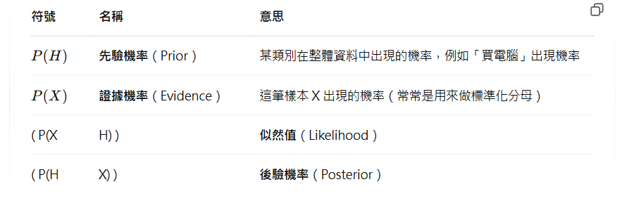

Slide 35
Bayesian Theorem
Given training data X, posteriori probability of a hypothesis H, P(H|X), follows the Bayes theorem
Informally, this can be written as
posteriori = likelihood x prior/evidence
Predicts X belongs to C_{i} iff the probability P(C_{i}|X) is the highest among all the k classes
Practical difficulty: require initial knowledge of many probabilities, significant computational cost
條件機率
先驗機率
, H=C₁, C₂, …, C_{k}
後驗機率
Notes:
[temperature, wind, play] (C,W,Y; H,W, Y; H,W, N; H,S,N; C,S,N) What about (H,W)?

Slide 36
Towards Naïve Bayesian Classifier
Let D be a training set of tuples and their associated class labels, and each tuple is represented by an n-D attribute vector X = (x₁, x₂, …, x_{n})
Suppose there are k classes C₁, C₂, …, C_{k}.
Classification is to derive the maximum posteriori, i.e., the maximal P(C_{i}|X)
This can be derived from Bayes’ theorem
Since P(X) is constant for all classes, only
needs to be maximized
P(C₁|X)=P(X|C₁)P(C₁)
P(C₂|X)=P(X|C₂)P(C₂)
.
.
.
P(C_{k}|X)=P(X|C_{k})P(C_{k})
= 0.1
= 0.25
= 0.15

Slide 37
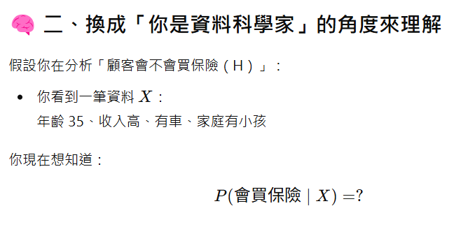
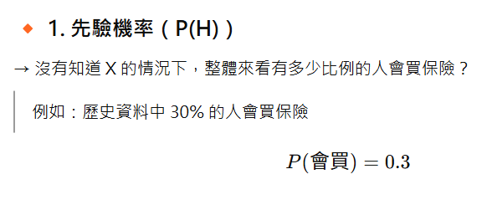
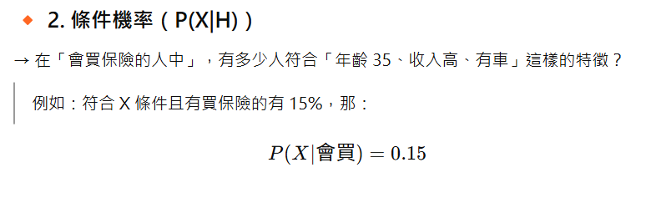
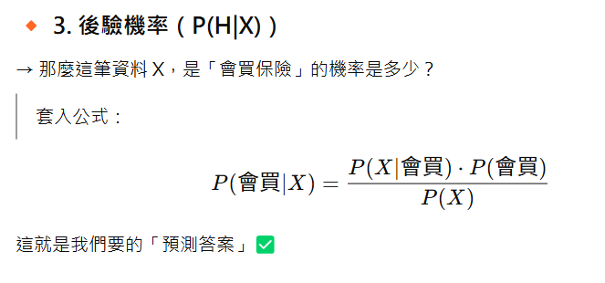

Slide 38
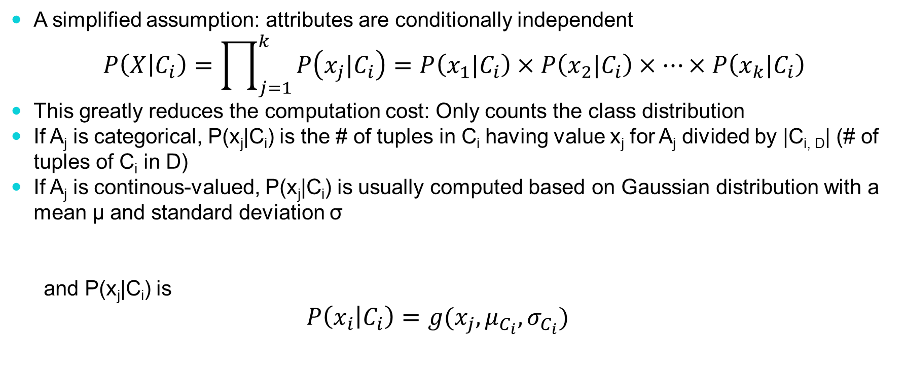
Derivation of Naïve Bayes Classifier
A simplified assumption: attributes are conditionally independent
$$P\left(X | C_{i}\right)=\prod_{j=1}^{k}{P\left(x_{j}|C_{i}\right)=P\left(x_{1}|C_{i}\right)×P\left(x_{2}|C_{i}\right)×…×P\left(x_{k}|C_{i}\right)}$$
This greatly reduces the computation cost: Only counts the class distribution
If A_{j} is categorical, P(x_{j}|C_{i}) is the # of tuples in C_{i} having value x_{j} for A_{j} divided by |C_{i, D}| (# of tuples of C_{i} in D)
If A_{j} is continous-valued, P(x_{j}|C_{i}) is usually computed based on Gaussian distribution with a mean μ and standard deviation σ
and P(x_{j}|C_{i}) is
$$P\left(x_{i} | C_{i}\right)=g(x_{j},μ_{C_{i}},σ_{C_{i}})$$
X = (age <=30, Income = medium, Student = yes, Credit_rating = Fair)
P(X|Ci)=P(age <=30|Ci)P(Income = medium|Ci)P(Student = yes|Ci)P(Credit_rating = Fair|Ci)

Slide 39
Naïve Bayesian Classifier: Training Dataset
Class:
C₁:buy = ‘yes’
C₂:buy = ‘no’
Data sample
X = (age <=30,
Income = medium,
Student = yes,
Credit_rating = Fair)

Slide 40
An Example
P(C_{i}):P(buy = “yes”) = 9/14 = 0.643
P(buy = “no”) = 5/14= 0.357
Compute P(x_{i}|C_{i}) for each class
P(age = “<=30” | buy = “yes”) = 2/9 = 0.222
P(income = “medium” | buy = “yes”) =4/9=0.444
P(student = “yes” | buy = “yes) = 6/9 = 0.667
P(credit_rating = “fair” | buy = “yes”) =6/9=0.667
P(age = “<= 30” | buy = “no”) = 3/5 = 0.6
P(income = “medium” | buy = “no”) = 2/5 = 0.4
P(student = “yes” | buy = “no”) = 1/5 = 0.2
P(credit_rating = “fair” | buy = “no”) = 2/5 = 0.4
X = (age <= 30 , income = medium, student = yes, credit_rating = fair)
P(X|C_{i}) : P(X|buy = “yes”) = 0.222 x 0.444 x 0.667 x 0.667 = 0.044
P(X|buy = “no”) = 0.6 x 0.4 x 0.2 x 0.4 = 0.019
P(X|C_{i})*P(C_{i}) : P(X|buy = “yes”) * P(buy = “yes”) = 0.028
P(X|buy = “no”) * P(buy = “no”) = 0.007
Therefore, X belongs to class (“buys_computer = yes”)
Notes:
X=(age>40, income=high) buy or not?

Slide 41
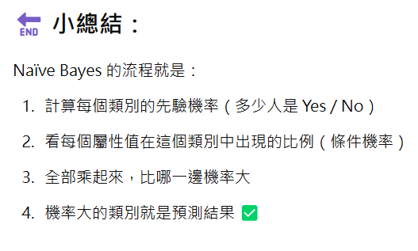

Slide 42
Avoiding the 0-Probability Problem
Naïve Bayesian prediction requires each conditional prob. be non-zero. Otherwise, the predicted prob. will be zero
Suppose a dataset with 1000 tuples, income=low (0), income= medium (990), and income = high (10),
Use Laplacian correction (or Laplacian estimator)
Adding 1 to each case
Prob(income = low) = 1/1003
Prob(income = medium) = 991/1003
Prob(income = high) = 11/1003
The “corrected” prob. estimates are close to their “uncorrected” counterparts

Slide 43
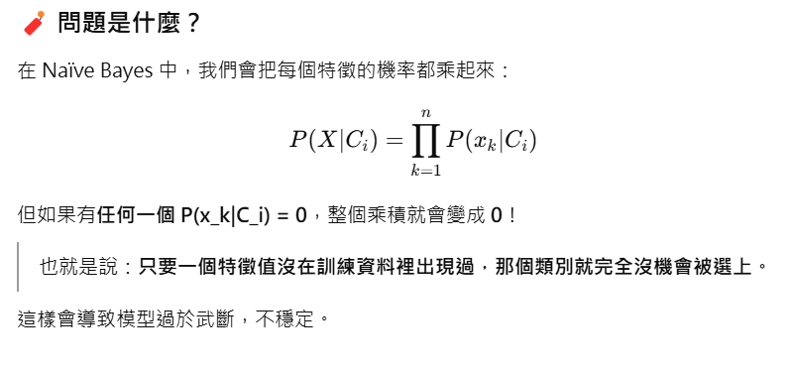

Slide 44
Naïve Bayesian Classifier: Comments
Advantages
Easy to implement
Good results obtained in most of the cases
Disadvantages
Assumption: class conditional independence, therefore loss of accuracy
Practically, dependencies exist among variables
E.g., hospitals: patients:
Profile: age, family history, etc.
Symptoms: fever, cough etc.
Disease: lung cancer, diabetes, etc.
Dependencies among these cannot be modeled by Naïve Bayesian Classifier
How to deal with these dependencies?
Bayesian Belief Networks

Slide 45
Bayesian Belief Networks
Bayesian belief network allows a subset of the variables conditionally independent
A graphical model of causal relationships
Represents dependency among the variables
Gives a specification of joint probability distribution
Nodes: random variables
Links: dependency
U and V are the parents of Z, and V is the parent of P
No dependency between Z and P
Has no loops or cycles
U
V
Z
P
P(X|C_{i}) =P(W)P(Z)P(P)P(U)P(V)
W
P(X|C_{i})=P(W|P,Z)P(Z|U,V)P(P|V)P(U)P(V)

Slide 46
An Example
Family
History
Smoker
The conditional probability table (CPT) for variable LungCancer:
(FH, S)
(FH, ~S)
(~FH, S)
(~FH, ~S)
LC
0.8
0.5
0.7
0.1
LungCancer
Emphysema
~LC
0.2
0.5
0.3
0.9
CPT shows the conditional probability for each possible combination of its parents
PositiveXRay
Dyspnea
Derivation of the probability of a particular combination of values of X, from CPT:
Bayesian Belief Networks
Notes:
Emphysema: 肺氣腫 Dyspnea:呼吸困難

Slide 47
Rule-Based Classification

Slide 48
Using IF-THEN Rules for Classification
Represent the knowledge in the form of IF-THEN rules
R: IF age = youth AND student = yes THEN buy = yes
Rule antecedent/precondition vs. rule consequent
Assessment of a rule: coverage and accuracy
n_{covers} = # of tuples covered by R
n_{correct} = # of tuples correctly classified by R
coverage(R) = n_{covers} /|D| /* D: training data set */
accuracy(R) = n_{correct} / n_{covers}
If more than one rule is triggered, need conflict resolution
Size ordering: assign the highest priority to the triggering rules that has the “toughest” requirement (i.e., with the most attribute test)
Class-based ordering: decreasing order of prevalence or misclassification cost per class
Rule-based ordering (decision list): rules are organized into one long priority list, according to some measure of rule quality or by experts

Slide 49
Rule Extraction from a Decision Tree
Rules are easier to understand than large trees
One rule is created for each path from the root to a leaf
Each attribute-value pair along a path forms a conjunction: the leaf holds the class prediction
Rules are mutually exclusive and exhaustive
age?
<=30
31..40
>40
student?
yes
credit rating?
no
yes
excellent
fair
no
yes
no
yes
Example:
IF age = young AND student = no THEN buy = no
IF age = young AND student = yes THEN buy = yes
IF age = mid-age THEN buy = yes
IF age = old AND credit_rating = excellent THEN buy = yes
IF age = young AND credit_rating = fair THEN buy = no

Slide 50
Support Vector Machine

Slide 51
Support Vector Machine (SVM)
A classification method for both linear and nonlinear data
It uses a nonlinear mapping to transform the original training data into a higher dimension
With the new dimension, it searches for the linear optimal separating hyperplane (i.e., “decision boundary”)
With an appropriate nonlinear mapping to a sufficiently high dimension, data from two classes can always be separated by a hyperplane
SVM finds this hyperplane using support vectors (“essential” training tuples) and margins (defined by the support vectors)

Slide 52
SVM—History and Applications
Vapnik and colleagues (1992)—groundwork from Vapnik & Chervonenkis’ statistical learning theory in 1960s
Features: training can be slow but accuracy is high owing to their ability to model complex nonlinear decision boundaries (margin maximization)
Used both for classification and prediction
Applications:
handwritten digit recognition, object recognition, speaker identification, benchmarking time-series prediction tests

Slide 53
Support Vector Machine
Find a linear hyperplane (decision boundary) that will separate the data

Slide 54
Support Vector Machine
One Possible Solution

Slide 55
Support Vector Machine
Another possible solution

Slide 56
Support Vector Machine
Other possible solutions

Slide 57
Support Vector Machine
Which one is better? B1 or B2?
How do you define better?

Slide 58

Support Vector Machine
Find hyperplane maximizes the margin => B1 is better than B2

Slide 59
Support Vector Machine
Support vectors

Slide 60
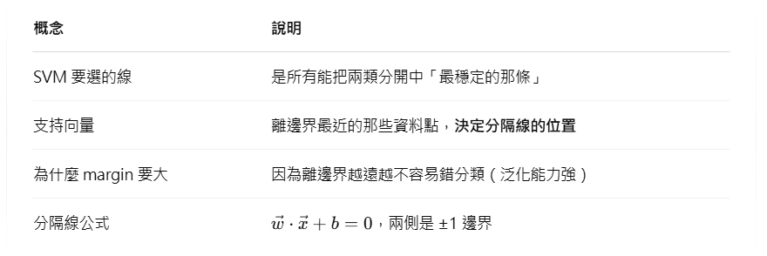

Slide 61
Support Vector Machine
We want to maximize:
Which is equivalent to minimizing:
But subjected to the following constraints:
This is a constrained optimization problem
Numerical approaches to solve it (e.g., quadratic programming)

Slide 62
SVM—Linearly Separable
A separating hyperplane can be written as
W ● X + b = 0
where W={w₁, w₂, …, w_{n}} is a weight vector and b a scalar (bias)
For 2-D it can be written as
w₀ + w₁ x₁ + w₂ x₂ = 0
The hyperplane defining the sides of the margin:
H₁: w₀ + w₁ x₁ + w₂ x₂ ≥ 1 for y_{i} = +1, and
H₂: w₀ + w₁ x₁ + w₂ x₂ ≤ – 1 for y_{i} = –1
Any training tuples that fall on hyperplanes H₁ or H₂ (i.e., the sides defining the margin) are support vectors
This becomes a constrained (convex) quadratic optimization problem: Quadratic objective function and linear constraints → Quadratic Programming (QP) → Lagrangian multipliers

Slide 63
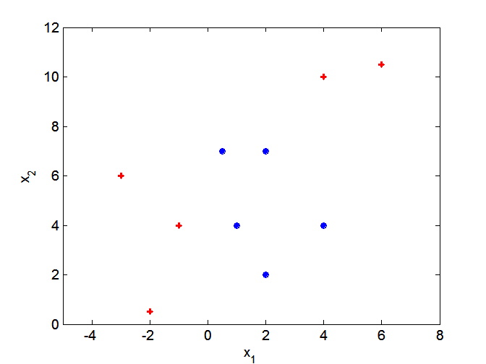
Nonlinear Support Vector Machine
What if decision boundary is not linear?

Slide 64
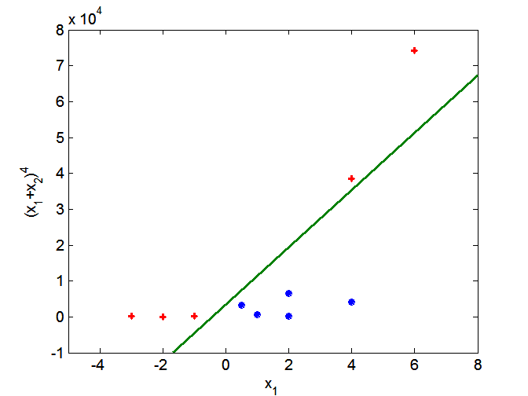
Nonlinear Support Vector Machine
Transform data into higher dimensional space

Slide 65
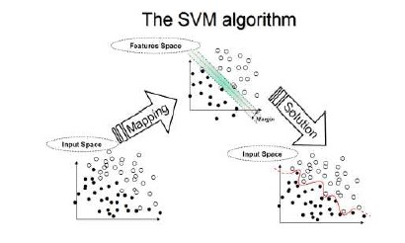
SVM

Slide 66
Kernel Functions
To make the data linearly separable we could:
Project the data from the input space to a new space called “feature space”
This feature space having more dimensions than the input space we could separate the data THERE…

Slide 67
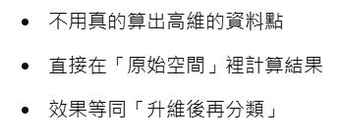
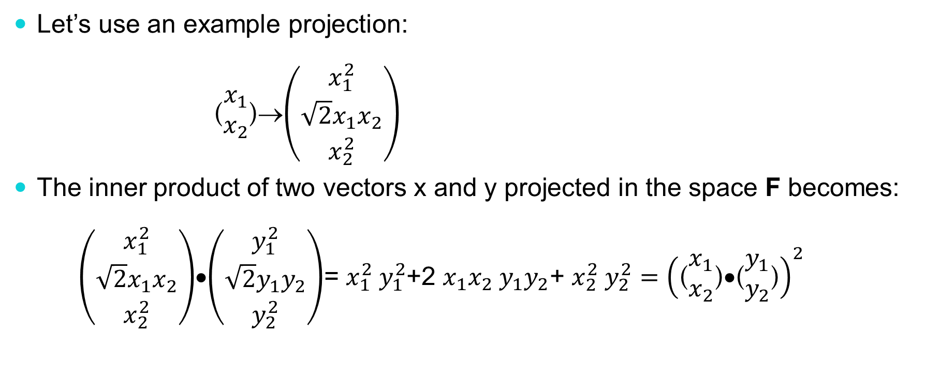
Kernel Functions
Let’s use an example projection:
($\begin{matrix}x_{1} \\ x_{2}\end{matrix}$)→$\left(\begin{matrix}x_{1}^{2} \\ \sqrt{2}x_{1}x_{2} \\ x_{2}^{2}\end{matrix}\right)$
The inner product of two vectors x and y projected in the space F becomes:
$\left(\begin{matrix}x_{1}^{2} \\ \sqrt{2}x_{1}x_{2} \\ x_{2}^{2}\end{matrix}\right)$•$\left(\begin{matrix}y_{1}^{2} \\ \sqrt{2}y_{1}y_{2} \\ y_{2}^{2}\end{matrix}\right)$= $x_{1}^{2}$ $y_{1}^{2}$+2 $x_{1}x_{2}$ $y_{1}y_{2}$+ $x_{2}^{2}$ $y_{2}^{2}={\left(\text{(}\begin{matrix}x_{1} \\ x_{2}\end{matrix}\text{)}\text{•}\text{(}\begin{matrix}y_{1} \\ y_{2}\end{matrix}\text{)}\right)}^{2}$

Slide 68
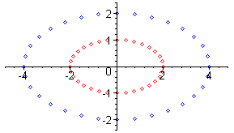
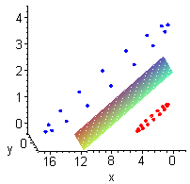
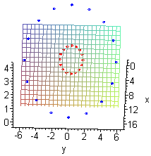
Kernel Functions
Here is a training set in the input space I and the same training in the feature space F. We go from a 2D space to a 3D space.
The training set is not linearly separable in the input space.
The training set is linearly separable in the feature space. This is called the “Kernel Trick”.

Slide 69
Kernel function details
The first kernel shown is called the polynomial kernel:
Where n is its order (in our example n=2) and b is called the lower order term (in our example b=0).
Why do we need a lower order term?
Because the origin of the input space matches the origin of the feature space induced by the polynomial kernel.
It serves as an offset or a shift for the origin of the feature space from the input space origin.

Slide 70
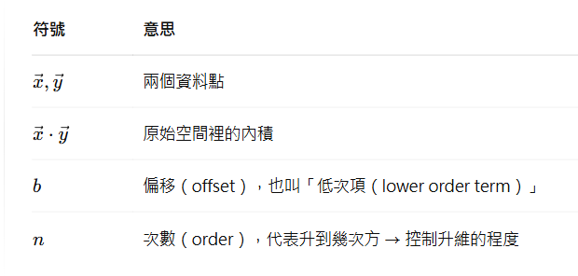
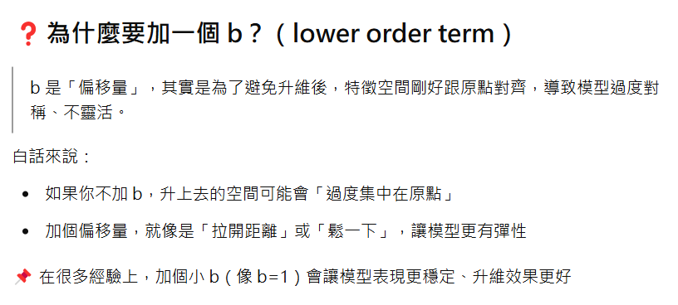

Slide 71
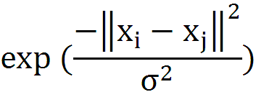
Kernel Function
Linear SVM K(x_{i},x_{j})=x_{i}‧x_{j}
Polynomial SVM K(x_{i},x_{j})=(x_{i}‧x_{j} +b)^{q}
RBF kernel K(x_{i},x_{j})=
MLP kernel K(x_{i},x_{j})=tanh(x_{i}‧x_{j} +Θ)

Slide 72
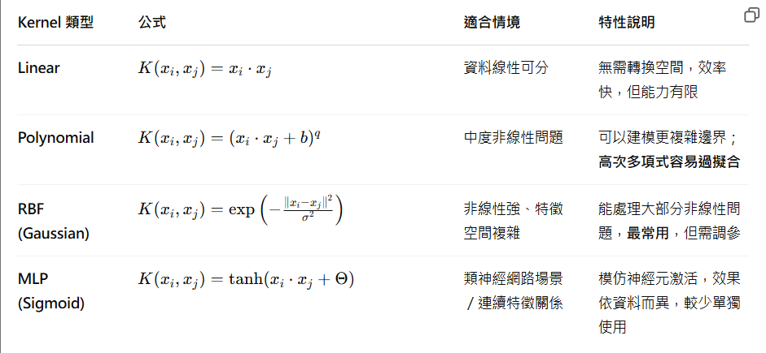

Slide 73


Slide 74
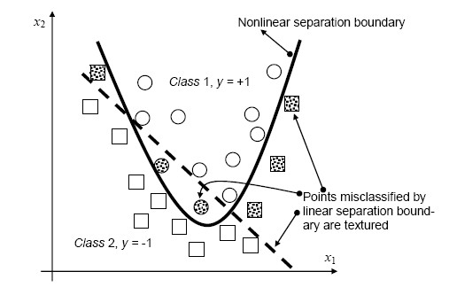
Polynomial kernel

Slide 75
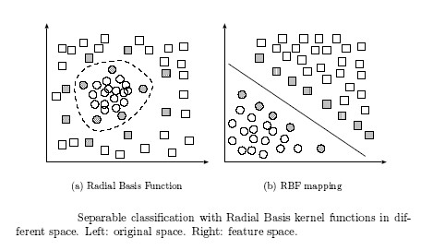
RBF kernel

Slide 76
Kernel function details
The most popular kernel function (most powerful) is the Gaussian RBF kernel:
K(x_{i},x_{j})=
Powerful kernel as its effect is to create a small classification “hyperball” around an instance. This kernel doesn’t have a projection formula since its dimension is infinite (you can create as many “balls” as you want).
Where σ is a measure of the radius of the “hyperball” around an instance.
You want this ball to be big enough so “hyperballs” connect with each other (pattern recognition) but not too big to overlap the other class.

Slide 77
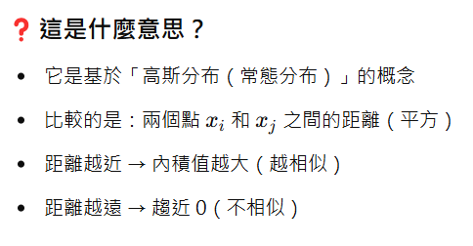
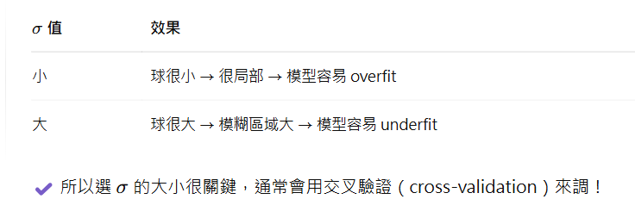
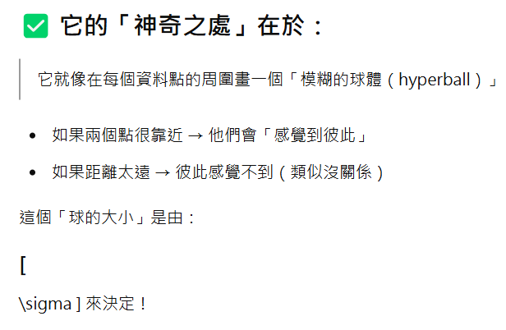

Slide 78
Kernel function details
Gaussian RBF overfits badly
The “Christmas Tree” effect.
If you select “σ” too small for the distance between your examples, you will create small balls around all your instances.
You will get a 100% accuracy on your training set, wonderful!
But only your examples are classified (balls are too small).

Slide 79
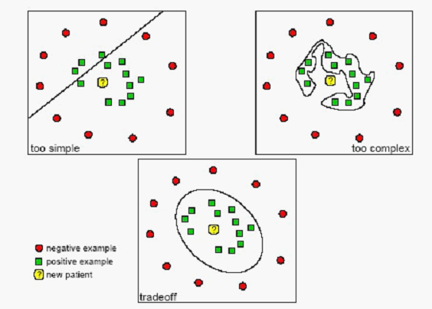
Underfitting and overfitting

Slide 80
Support Vector Machines
What if the problem is not linearly separable?

Slide 81
Support Vector Machines
What if the problem is not linearly separable?
Introduce slack variables
Need to minimize:
Subject to:

Slide 82
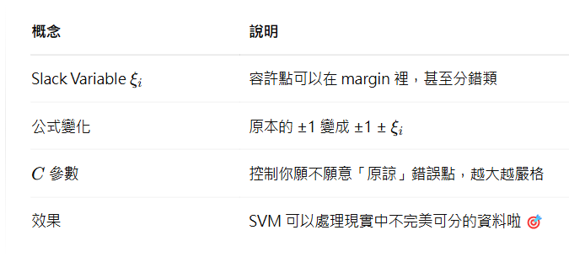
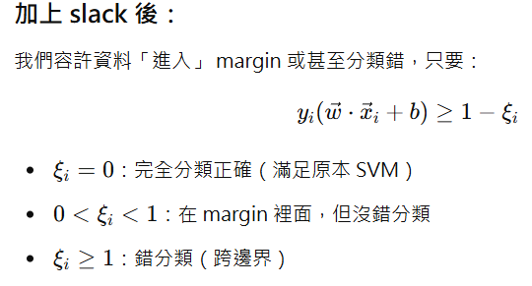

Slide 83
Multiple classes
One-against-Rest (One-vs-All, OvA, OvR)
Construct a classifier for each class
Class imbalance
One-against-One (One-vs-One, OvO)
Construct a classifier for each pair of classes

Slide 84
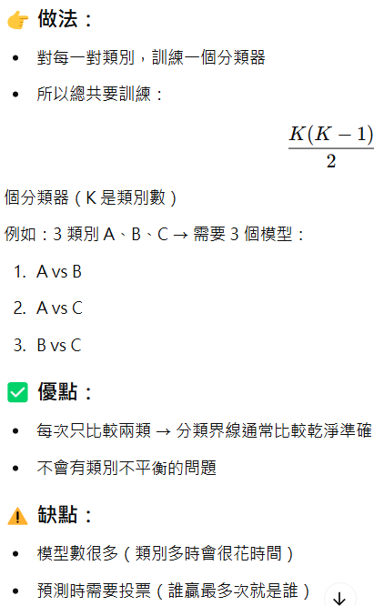
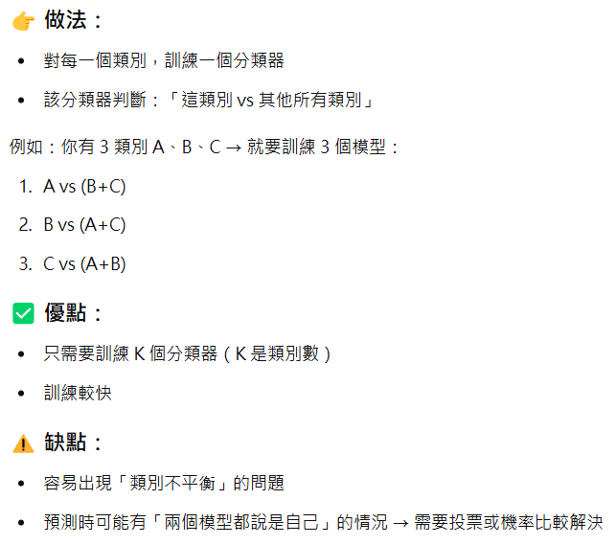

Slide 85
Lazy vs. Eager Learning
Lazy vs. eager learning
Lazy learning (e.g., instance-based learning): Simply store training data (or only minor processing) and wait until it is given a test tuple
Eager learning (the above discussed methods): Given a set of training set, construct a classification model before receiving new (e.g., test) data to classify
Lazy: less time in training but more time in predicting
Accuracy
Lazy method effectively uses a richer hypothesis space since it uses many local linear functions to form its implicit global approximation to the target function
Eager: must commit to a single hypothesis that covers the entire instance space

Slide 86
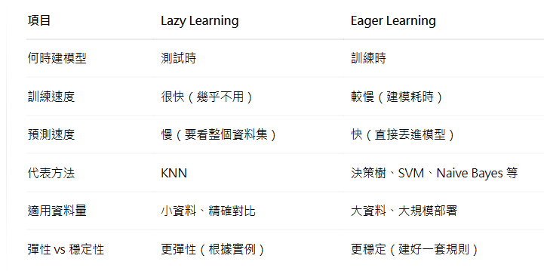

Slide 87
Lazy Learner: Instance-Based Methods
Instance-based learning:
Store training examples and delay the processing (“lazy evaluation”) until a new instance must be classified
Typical approaches
k-nearest neighbor approach
Instances represented as points in a Euclidean space.
Locally weighted regression
Constructs local approximation
Case-based reasoning
Uses symbolic representations and knowledge-based inference

Slide 88
The k-Nearest Neighbor Algorithm
All instances correspond to points in the n-D space
The nearest neighbor are defined in terms of Euclidean distance, dist(X₁, X₂)
Target function could be discrete- or real- valued
For discrete-valued, k-NN returns the most common value among the k training examples nearest to x_{q}
Vonoroi diagram: the decision surface induced by 1-NN for a typical set of training examples
_
.
_
_
.
+
_
.
+
.
.
_
x_{q}
+
_
.
+

Slide 89
Discussion on the k-NN Algorithm
k-NN for real-valued prediction for a given unknown tuple
Returns the mean values of the k nearest neighbors
Distance-weighted nearest neighbor algorithm
Weight the contribution of each of the k neighbors according to their distance to the query x_{q}
Give greater weight to closer neighbors
Robust to noisy data by averaging k-nearest neighbors
Curse of dimensionality: distance between neighbors could be dominated by irrelevant attributes
To overcome it, axes stretch or elimination of the least relevant attributes

Slide 90
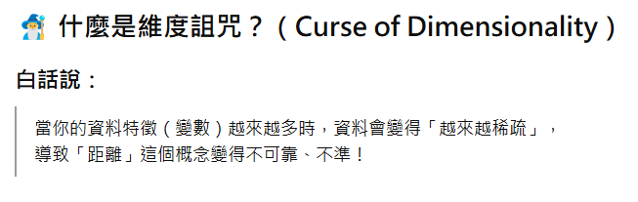

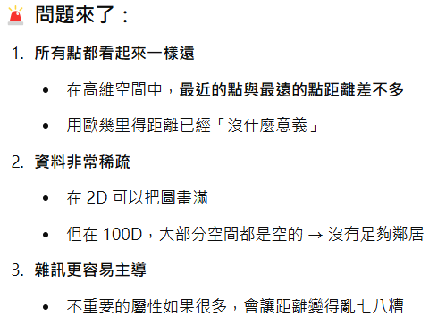
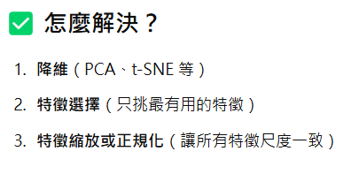

Slide 91
Genetic Algorithm

Slide 92
Genetic Algorithm
GA: based on an analogy to biological evolution
Each rule (solution or chromosome) is represented by a string of bits
An initial population is created consisting of randomly generated rules
Based on the notion of survival of the fittest, a new population is formed to consist of the fittest rules and their offsprings
The fitness of a rule is represented by its classification accuracy on a set of training examples

Slide 93
Genetic Algorithm
Reproduction
Produce new generations of improved solutions by selecting higher fitness ratings
Crossover
Choose a random position on the string and exchange the segments of both strings
Mutation
Change a 1 to 0 or a 0 to 1

Slide 94
Feature Seletion
The selected features are represented as 101010
Step 1: Randomly select four chromosomes
(A) 110100 (score=0.2)
(B) 111101 (score=0.2)
(C) 011011 (score=0.8)
(D) 101100 (score=0.6)

Slide 95
Feature Seletion (Cont.)
Step 2: Delete (A) and (B) for having low scores, and call (C) and (D) parents
Step 3:Mate the parents “genes” through crossover
(C) 01:1011 (score=0.8)
(D) 10:1100 (score=0.6)
(E) 011100 (score=0.6)
(F) 101011 (score=0.9)

Slide 96
Feature Seletion (Cont.)
Step 4: Now copy the original (C) and (F)
Step 5:Mate the parents
(C) 011011 (score=0.8)
(F) 101011 (score=0.9)
(G) 011010 (score=0.9)
(H) 101111 (score=0.7)
Step 6:Select (F) and (G). Now duplicate and crossover

Slide 97
Feature Seletion (Cont.)
(F) 101:011 (score=0.9)
(G) 011:010 (score=0.9)
(I) 101010 (score=1)
(J) 011011 (score=0.85)
Reach the solution after 10 guesses.

Slide 98
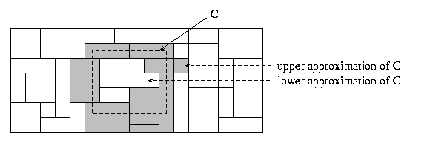
Rough Set Approach
Rough sets are used to approximately or “roughly” define equivalent classes
A rough set for a given class C is approximated by two sets: a lower approximation (certain to be in C) and an upper approximation (cannot be described as not belonging to C)
Finding the minimal subsets (reducts) of attributes for feature reduction is NP-hard but a discernibility matrix (which stores the differences between attribute values for each pair of data tuples) is used to reduce the computation intensity

Slide 99
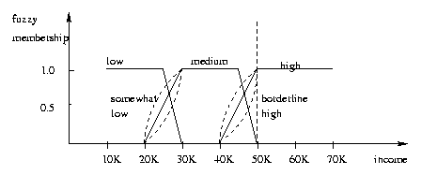
Fuzzy Set Approaches
Fuzzy logic uses truth values between 0.0 and 1.0 to represent the degree of membership (such as using fuzzy membership graph)
Attribute values are converted to fuzzy values
e.g., income is mapped into the discrete categories {low, medium, high} with fuzzy values calculated
For a given new sample, more than one fuzzy value may apply
Each applicable rule contributes a vote for membership in the categories
Typically, the truth values for each predicted category are summed, and these sums are combined

Slide 100

Classifier Measures
 | Positive | Negative
Positive | True positive | False negative
Negative | False positive | True negative
classes | buy_computer = yes | buy_computer = no | total | recognition(%)
buy_computer = yes | 6954 | 46 | 7000 | 99.34
buy_computer = no | 412 | 2588 | 3000 | 86.27
total | 7366 | 2634 | 10000 | 95.42
Accuracy of a classifier M, acc(M): percentage of test set tuples that are correctly classified by the model M
Error rate (misclassification rate) of M = 1 – acc(M)
Given m classes, CM_{i,j}, an entry in a confusion matrix, indicates # of tuples in class i that are labeled by the classifier as class j
Alternative accuracy measures (e.g., for cancer diagnosis)
sensitivity (recall) = t-pos/pos /* true positive recognition rate */
specificity = t-neg/neg /* true negative recognition rate */
precision = t-pos/(t-pos + f-pos)
accuracy = sensitivity * pos/(pos + neg) + specificity * neg/(pos + neg)
F1-measure= $\frac{2PR}{P+R}$

Slide 101
ROC Curves
The area under the ROC (Receiver Operating Characteristics) curve is a measure of the accuracy of the model
Shows the trade-off between the true positive rate and the false positive rate
Rank the test tuples in decreasing order: the one that is most likely to belong to the positive class appears at the top of the list
The closer to the diagonal line (i.e., the closer the area is to 0.5), the less accurate is the model

Slide 102
Evaluating the Accuracy of a Classifier or Predictor (I)
Holdout method
Given data is randomly partitioned into two independent sets
Training set (e.g., 2/3) for model construction
Test set (e.g., 1/3) for accuracy estimation
Random sampling: a variation of holdout
Repeat holdout k times, accuracy = avg. of the accuracies obtained
Cross-validation (k-fold, where k = 10 is most popular)
Randomly partition the data into k mutually exclusive subsets, each approximately equal size
At i-th iteration, use D_{i} as test set and others as training set
Leave-one-out: k folds where k = # of tuples, for small sized data

Slide 103
Ensemble Methods

Slide 104

Ensemble Methods: Increasing the Accuracy
Ensemble methods
Use a combination of models to increase accuracy
Combine a series of T learned models, C₁, C₂, …, C_{T}, with the aim of creating an improved model M*
Popular ensemble methods
Bagging: averaging the prediction over a collection of classifiers
Boosting: weighted vote with a collection of classifiers
Ensemble: combining a set of heterogeneous classifiers

Slide 105


Slide 106
Bagging: Boostrap Aggregation
Analogy: Diagnosis based on majority votes, e.g. Random Forest
Training
Given a set D of d tuples, at each iteration i, a training set D_{i} of d tuples is sampled with replacement from D (i.e., boostrap)
A classifier model C_{i} is learned for each training set D_{i}
Classification: classify an unknown sample X
Each classifier C_{i} returns its class prediction
The bagged classifier C* counts the votes and assigns the class with the most votes to X
Prediction: can be applied to the prediction of continuous values by taking the average value of each prediction for a given test tuple
Accuracy
Often significant better than a single classifier derived from D
For noisy data: not considerably worse, more robust
Improve accuracy in prediction

Slide 107
Boosting
Analogy: Consult several doctors, based on a combination of weighted diagnoses—weight assigned based on the previous diagnosis accuracy
How boosting works?
Weights are assigned to each training tuple
A series of k classifiers is iteratively learned
After a classifier C_{i} is learned, the weights are updated to allow the subsequent classifier, C_{i+1}, to pay more attention to the training tuples that were misclassified by C_{i}
The final C* combines the votes of each individual classifier, where the weight of each classifier's vote is a function of its accuracy
The boosting algorithm can be extended for the prediction of continuous values
Comparing with bagging: boosting tends to achieve greater accuracy, but it also risks overfitting the model to misclassified data

Slide 108


Slide 109
Boosting (Schapire 1989)
Consider creating three component classifiers for a two-class problem through boosting.
Randomly select n₁ < n samples from D without replacement to obtain D₁
Train weak learner C₁
Select n₂ < n samples from D with half of the samples misclassified by C₁ to obtain D₂
Train weak learner C₂
Select all remaining samples from D
that C₁ and C₂ disagree on
Train weak learner C₃
Final classifier is vote of weak learners
D
D3
D1
D2
-
+
+
-
Notes:
The goal of boosting is to improve the accuracy of any given learning algorithm.
Consider creating three component classifiers for a two-category problem through boosting.
First, ……, call this set D1. Based on D1, train the first classifier, C1.
Now, we seek a second training set D2, half of the patterns in D2 should be correctly classified by C1, half incorrectly classified by C1.
Next, we seek a third data set D3,

Slide 110

Adaboost
Instead of resampling, uses training set re-weighting
Each training sample uses a weight to determine the probability of being selected for a training set.
AdaBoost is an algorithm for constructing a “strong” classifier as a linear combination of “simple” “weak” classifier
Final classification based on weighted vote of weak classifiers

Slide 111



Slide 112

Adaboost Terminology
h_{t}(x) : “weak” or basis classifier (Classifier = Learner = Hypothesis)
“strong” or final classifier
Weak Classifier: < 50% error over any distribution
Strong Classifier: thresholded linear combination of weak classifier outputs

Slide 113



Discrete Adaboost Algorithm
$$e^{α_{t}}=e^{\frac{1}{2}ln\frac{1−ε_{t}}{ε_{t}}}=\sqrt{\frac{1−ε_{t}}{ε_{t}}}$$
$$e^{{−α}_{t}}=e^{−\frac{1}{2}ln\frac{1−ε_{t}}{ε_{t}}}=\sqrt{\frac{ε_{t}}{{1−ε}_{t}}}$$
Notes:
In the first round, the first two are misclassified in the dataset with 10 records. In the second round, the second one is misclassified.
D(i) is weight for each training sample, which determines the probability of being selected for a training set for an individual component classifier.
(Epislon is the sum of the weights of those misclassified samples.)
Specifically, we initialize the weights across the training set to be uniform.
On each iteration t, we find a classifier h(x) that minimizes the error with respect to the distribution.
Next we increase weights of training examples misclassified by h(x), and decrease weights of the examples correctly classified by h(x)
The new distribution is used to train the next classifier, and the process is iterated.

Slide 114





X y_{i} w_{i}
h₁(x_{i})
w_{i}
h₂(x_{i})
w_{i}
x₁
x₂
x₃
x₄
x₅
x₆
x₇
x₈
x₉
x₁₀
+1
+1
+1
-1
+1
-1
-1
+1
+1
+1
0.1
0.1
0.1
0.1
0.1
0.1
0.1
0.1
0.1
0.1
-1
-1
+1
-1
+1
-1
-1
+1
+1
+1
0.2
0.2
0.05
0.05
0.05
0.05
0.05
0.05
0.05
0.05
$$\frac{1}{4}$$
$$\frac{1}{4}$$
$$\frac{1}{16}$$
$$\frac{1}{16}$$
$$\frac{1}{16}$$
$$\frac{1}{16}$$
$$\frac{1}{16}$$
$$\frac{1}{16}$$
$$\frac{1}{16}$$
$$\frac{1}{16}$$
+1
+1
-1
+1
-1
+1
-1
+1
+1
+1
$$\frac{1}{4\sqrt{3}}$$
$$\frac{1}{4\sqrt{3}}$$
$$\frac{\sqrt{3}}{16}$$
$$\frac{\sqrt{3}}{16}$$
$$\frac{\sqrt{3}}{16}$$
$$\frac{\sqrt{3}}{16}$$
$$\frac{1}{16\sqrt{3}}$$
$$\frac{1}{16\sqrt{3}}$$
$$\frac{1}{16\sqrt{3}}$$
$$\frac{1}{16\sqrt{3}}$$
$$\frac{1}{6}$$
$$\frac{1}{6}$$
$$\frac{1}{8}$$
$$\frac{1}{8}$$
$$\frac{1}{8}$$
$$\frac{1}{8}$$
$$\frac{1}{24}$$
$$\frac{1}{24}$$
$$\frac{1}{24}$$
$$\frac{1}{24}$$
$ε_{2}$= $\frac{1}{4}$,$\sqrt{\frac{1−ε_{2}}{ε_{2}}}=\sqrt{\frac{\frac{3}{4}}{\frac{1}{4}}}=\sqrt{3}$
$$α_{2}=\ln\left(\sqrt{3}\right), \sqrt{\frac{ε_{2}}{1−ε_{2}}}=\frac{1}{\sqrt{3}}$$
$ε_{1}$=0.2, $\sqrt{\frac{1−ε_{1}}{ε_{1}}}=\sqrt{\frac{1−0.2}{0.2}}=\sqrt{4}$=2
$$α_{1}=\text{ln}\text{(2)}, \sqrt{\frac{ε_{1}}{1−ε_{1}}}=\frac{1}{2}$$

Slide 115


Reweighting
y * h(x) = 1
y * h(x) = -1

Slide 116

Reweighting
In this way, AdaBoost “focused on” the informative or “difficult” examples.

Slide 117

Reweighting
In this way, AdaBoost “focused on” the informative or “difficult” examples.

Slide 118



Slide 119



Classifications (colors) and
Weights (size) after 1 iteration
Of AdaBoost
20 iterations
3 iterations
Notes:
Note after 1 iteration the step classes of a single decision tree.

Slide 120

An example: horizontal and vertical half-planes

Slide 121


$α_{1}=ln⁡(\sqrt{\frac{1−ε_{1}}{ε_{1}}})$ $=\ln\left(\sqrt{\frac{1−0.3}{0.3}}\right)=0.42$
$$\sqrt{\frac{1−0.3}{0.3}}≈1.5$$
$\frac{\frac{0.1}{1.5}}{\frac{0.1}{1.5}∗7+0.1∗1.5∗3}$ $≈0.07$ $\frac{0.1∗1.5}{\frac{0.1}{1.5}∗7+0.1∗1.5∗3}$ $≈0.16$

Slide 122

$α_{2}=ln⁡(\sqrt{\frac{1−ε_{2}}{ε_{2}}})$ $=\ln\left(\sqrt{\frac{1−0.21}{0.21}}\right)=0.65$

Slide 123

$α_{3}=ln⁡(\sqrt{\frac{1−ε_{3}}{ε_{3}}})$ $=\ln\left(\sqrt{\frac{1−0.14}{0.14}}\right)=0.92$

Slide 125
Pros and cons of AdaBoost
Advantages
Very simple to implement
Does feature selection resulting in relatively simple classifier
Fairly good generalization
Disadvantages
Suboptimal solution
Sensitive to noisy data and outliers
Notes:
Sensitive to noisy data and outliers
Be wary if using noisy/unlabeled data

Slide 126


Tree Boosting Method
Trees are built sequentially such that each subsequent tree aims to reduce the errors of the previous tree.
Given a dataset {x_{i},y_{i}}, a tree ensemble model uses K additive functions to predict the output.
Loss function, where Ω(f) is a regularization term
Notes:
T: the number of leaves in the tree
Fk: an independent tree structure
w: leaf weights. Unlike decision trees, each regression tree contains a continuous score on each of the leaf, we use
Wi: score on i-th leaf.
omega penalizes the complexity of the model (i.e., the regression tree functions)

Slide 127

Tree Boosting Example

Slide 128
XGBoosting
XGBoost (eXtreme Gradient Boosting) has been lauded as the holy grail of machine learning hackathons and competitions.
Gradient boosting is an approach where new models are created that predict the errors of prior models and then added together to make the final prediction. It is called gradient boosting because it uses a gradient descent algorithm to minimize the loss when adding new models.
Execution speed: XGBoost is fast. Really fast when compared to other implementations of gradient boosting. But newly introduced LightGBM is faster than XGBoosting.

Slide 129



XGBoosting (Cont.)
Loss function
Ignore the constant term
Notes:
Subsititue f(xi) with wi, omega with T and w

Slide 130

XGBoosting (Cont.)
Estimated loss function
A greedy algorithm that starts from a single leaf and iteratively adds branches to the tree is used instead.
Notes:
Subsititue f(xi) with wi, omega with T and w

Slide 131


Slide 132
Features of XGBoost
Regularization: XGBoost has an option to penalize complex models through both L1 and L2 regularization. Regularization helps in preventing overfitting.
Handling sparse data: XGBoost incorporates a sparsity-aware split finding algorithm to handle different types of sparsity patterns in the data.
Weighted quantile sketch: Most existing tree based algorithms can find the split points when the data points are of equal weights (using quantile sketch algorithm). However, they are not equipped to handle weighted data. XGBoost has a distributed weighted quantile sketch algorithm to effectively handle weighted data

Slide 133
Features of XGBoost (Cont.)
Block structure for parallel learning: Data is sorted and stored in in-memory units called blocks. Unlike other algorithms, this enables the data layout to be reused by subsequent iterations, instead of computing it again. This feature also serves useful for steps like split finding and column sub-sampling
Cache awareness: This is done by allocating internal buffers in each thread, where the gradient statistics can be stored.
Out-of-core computing: This feature optimizes the available disk space and maximizes its usage when handling huge datasets that do not fit into memory

