Slide 1
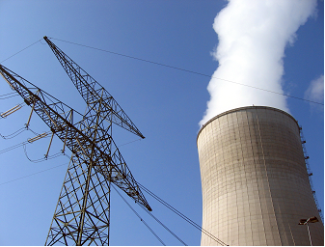

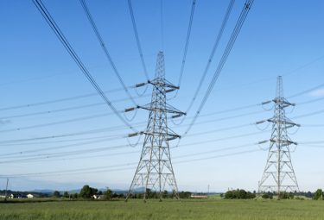
Energiewirtschaft - Elektrizitätswirtschaft
Lecture – 16.4.2018
Energy Sector Modeling
Technische Universität Berlin, Fachgebiet Wirtschafts- und Infrastrukturpolitik (WIP)
Prof. Christian von Hirschhausen, Jens Weibezahn, Richard Weinhold
Notes:
1

Slide 2
Agenda - Lecture 5
Physical Grid Constraints - Overview
Physical Flows – General description
Physical Flows – Mathematical description
Modeling – DC Load Flow implementation
Exercise – Revision and Data-handling

Slide 3
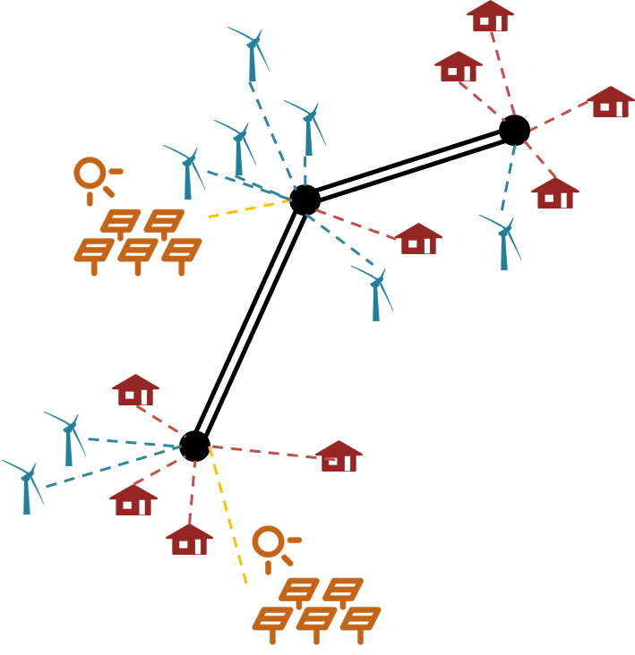
Physical Flow - Introduction
Commercial vs. Physical Flows:
Assumption: Market is cleared
What are the resulting line flows?
Flows according to the laws of physics
Topology taken into account

Slide 4
Physical Grid Constraints - Electricity Markets
Uniform
Pricing
Single price for all nodes
Market dispatch for entire network
Only supply and demand goes into the optimization
No transmission network included (“copper plate”)
Congested lines no constraint for the market
Congestions are dealt in an ex-post analysis→ redispatch
Zonal Pricing
Multiple Zones
Separation of market in several zones with nodes
Only Exchange constraints between zones
Zones according to congested lines (if possible)
Feasible solution if all congestions in between zones, redispatch otherwise
Example: Nordpool market, Essentially EU
Locational
Marginal
Pricing
Nodal markets
Every nodes is its own market
Full transmission network is part of the market clearing
Congestions are part of the overall electricity price
Better market dispatch as higher utilization of available transmission capacity
Example: PJM market

Slide 5
Physical Flow - Introduction
Commercial vs. Physical Flows:
Assumption: Market is cleared
What are the resulting line flows?
Flows according to the laws of physics
Topology taken into account
Economic Topics:
How do we clear the market with line flows in mind?
Load Flow Constraints
Adjust the market result to account for line capacities?
Redispatch
Take Outages into account
N-1 Criterion
Technical Topics:
Ensure secure operation based on the actual grid parameters
Balance reactive power demand

Slide 6
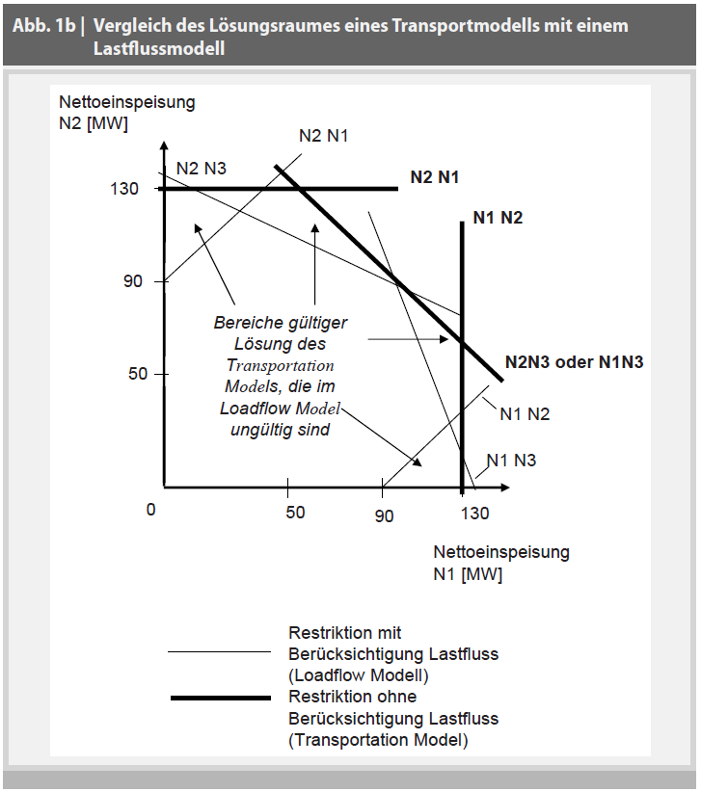
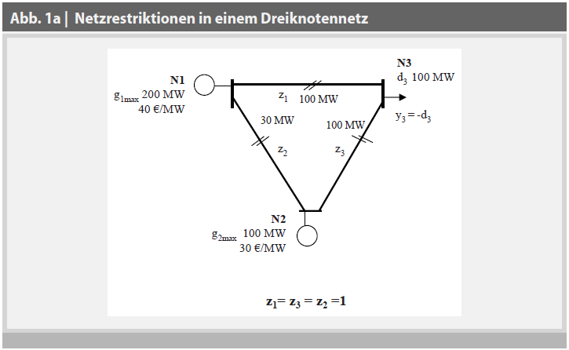
General Derivation: Load Flow
Transport versus Load Flow Model:
Flows are inverse proportional to “line resistance”
Source: Eßer et al. (2009).

Slide 7
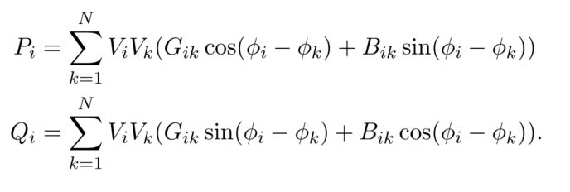
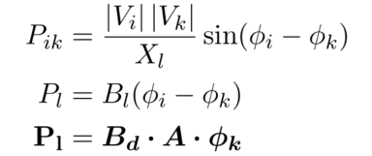
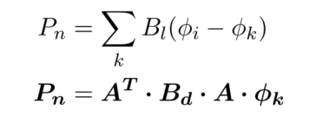
Physical Flows – Mathematical description
Fundamental Power Flow Equations:
S = P + jQ Apparent Power = Active Power + Reactive Power
Z = R + jX Impedance = Resistance + Reactance
Y = G + jB Admittance = Conductance + Susceptance
To simplify the non-linear equations we make the following assumptions:
Neglecting reactive power flows
Neglecting active power losses. We assume that R << jX, thus the impedances are given as Z ≈ jX and Y ≈ jB
Voltage angles are small (small angle approximation)
The voltage profile is flat, meaning that the voltage amplitude is equal for all nodes
A: Incidence Matrix (Topology)
Bl: Susceptance of Line l
Bd: lxl Matrix with line susceptance on the diagonal

Slide 8


Physical Flows – Mathematical description
DC Load Flow Assumptions:
Neglecting reactive power flows
Neglecting active power losses. We assume that R << jX, thus the impedances are given as Z ≈ jX and Y ≈ jB
Voltage angles are small (small angle approximation)
The voltage profile is flat, meaning that the voltage amplitude is equal for all nodes
These assumptions result in the PTDF (Power Transfer Distribution Matrix)
Also known as Node-Line Sensitivity Matrix -> Essentially Pl / Pn
With
A: Incidence Matrix (Topology)
Bl: Susceptance of Line l
Bd: lxl Matrix with line susceptance on the diagonal

Slide 9

Deriving the PTDF:
Building the PTDF Matrix from:
Network topology (Incidence Matrix)
Line Susceptance ( approx. 1/ Line Impedance)
Problem: The equation for nodal balance is linearly dependent and is therefore singular and has no inverse
Solution: Define reference (or Slack) Node
This node is removed from the power flow equations
and sorted back in with the value zero.
Therefore the PTDF matrix gives all node to line sensitivities under the restriction that the slack node will balance all other grid injections.
Define Slack Node
Define Line Susceptance Vector
Calculate Line Susceptance Matrix
Calculate Node Susceptance Matrix
Remove Row/Column of slack-index
Invert and sort slack back in with value 0
PTDF = Calculate Line Susceptance Matrix * “inverse” Node Susceptance Matrix

Slide 10
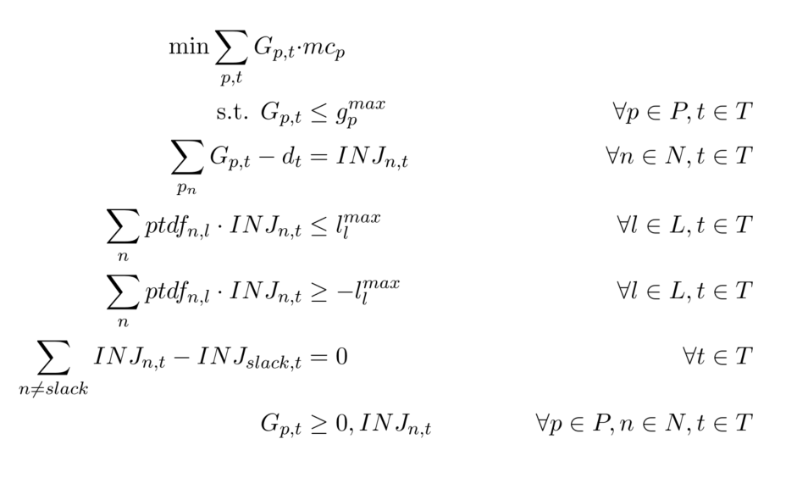
DC Load Flow in a Dispatch Model
DCLF Mode:
Cost Minimization
Nodal Energy Balance that sets the nodal INJ
Flow on line = vector product of ptdf row and inj
Upper and lower limits
Slack balances all injections

Slide 11
Objective: Welfare Maximization
Price
Social welfare
Demand curve
p_{n}(d)
Marginal costs of total production
merit order
c_{n}(g)
Consumer surplus
p_{n}^{opt}
Producer surplus
d_{n}^{opt}
Demand; Supply
$$\max_{G,Q,Δ}{\int_{0}^{Q}{p\left(Q\right)QdQ}−\int_{0}^{G}{mc\left(G\right)dG=\sum_{dem}{\left(a+0.5b⋅Q_{dem}\right)Q_{dem} −\sum_{supply}{(a+0.5b⋅Q_{sup})Q_{sup}}}}}$$
Notes:
Social Welfare = Consumers Willignes to pay – costs of generation

Slide 12
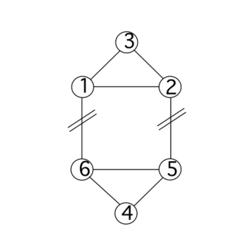
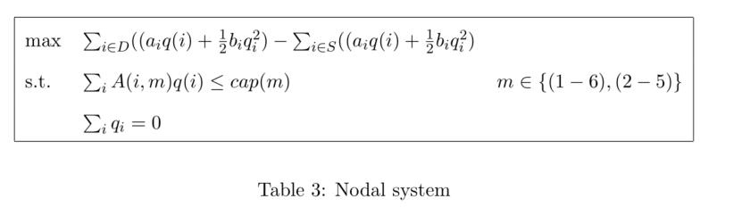
Ehrenmann, Smeers: The Model
Welfare Maximization:
Overall Variable Q
for demand
And supply
Underlying Grid
Constraints for lines 1-6 and 2-5
Different Constraints
regarding market zones,
Market prices
line capacities

Slide 13
Overview/outlook:
Load Flow Calculation based on a cleared market
Active power: commodity
Reactive Power: Ancillary service
Load Flow in the Market Clearing
Physical Flows as constraint in the model
Homework 3: Ehremann, Smeers as example of how different implementations yields different

